Slide 1
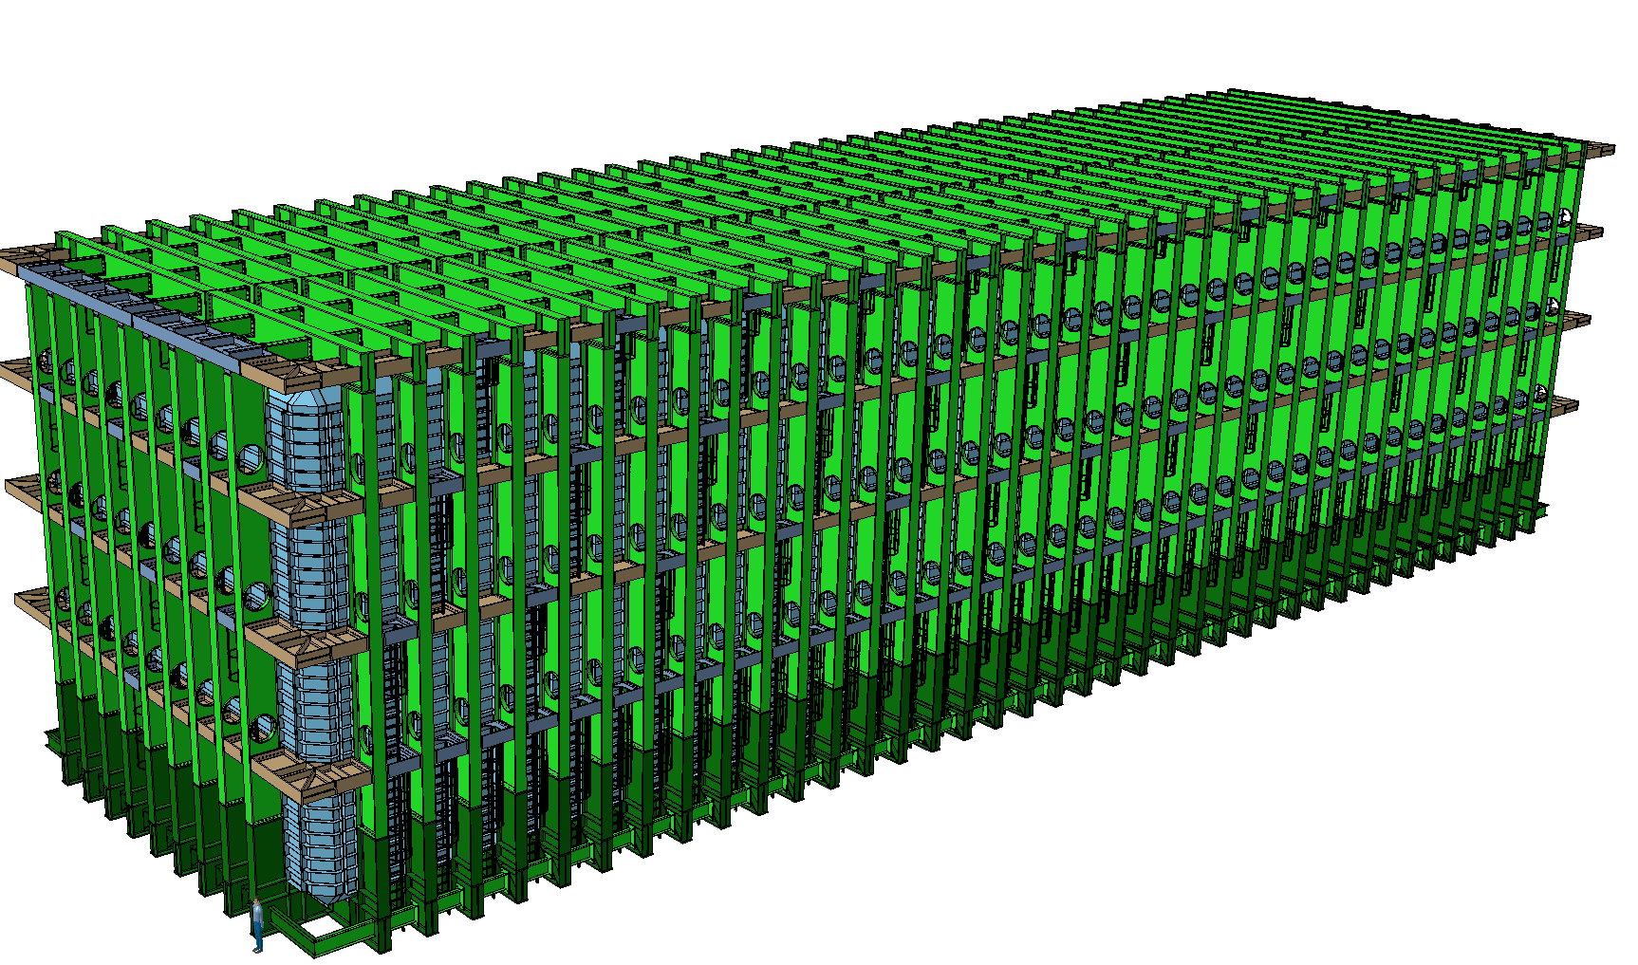


LBNF – Cold Box Interfaces & Requirements
Dimitar MLADENOV & The entire CERN Team
FS Integration/Installation Planning
Kartause Ittingen, 02-04 January 2020

Slide 2
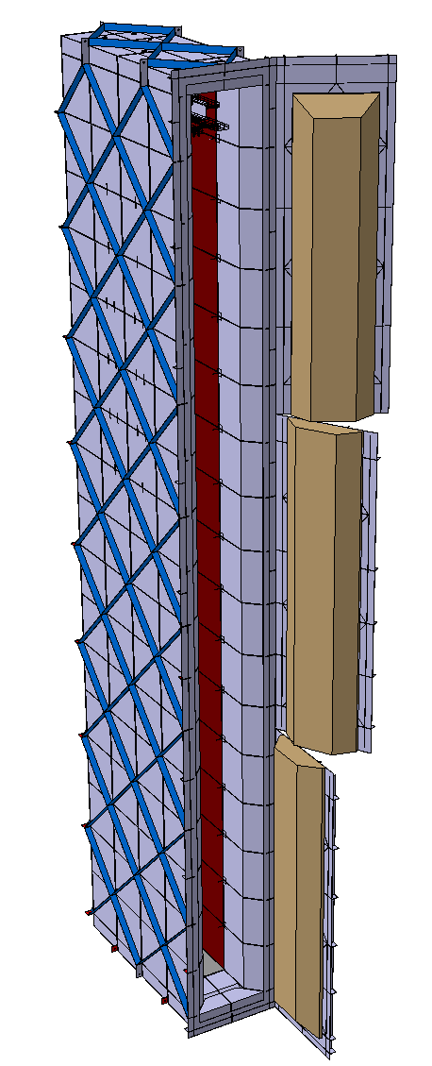
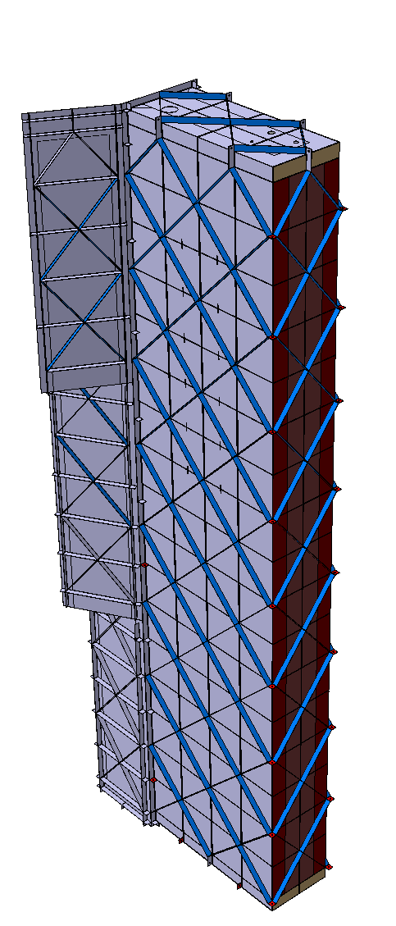
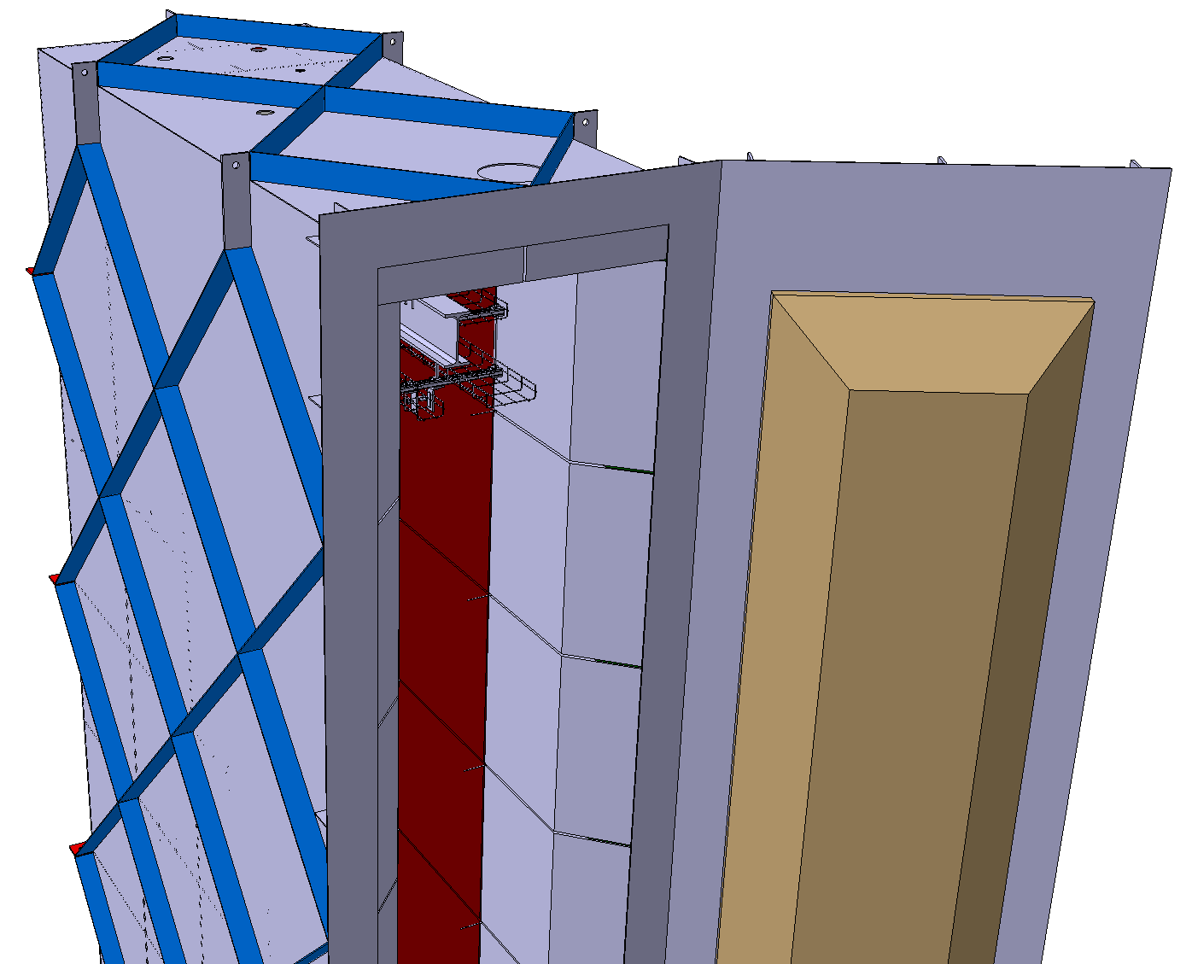
Current Design
External Dimensions
14.0m x 3.2m x 1.3m (H x L x W)
Thickness of the insulation
3x100mm
Internal Dimensions
13.4m x 2.6m x 0.7m (H x L x W)
Physical dimensions
11 T of Stainless Steel
+ insulation + membrane + services + …

Slide 3
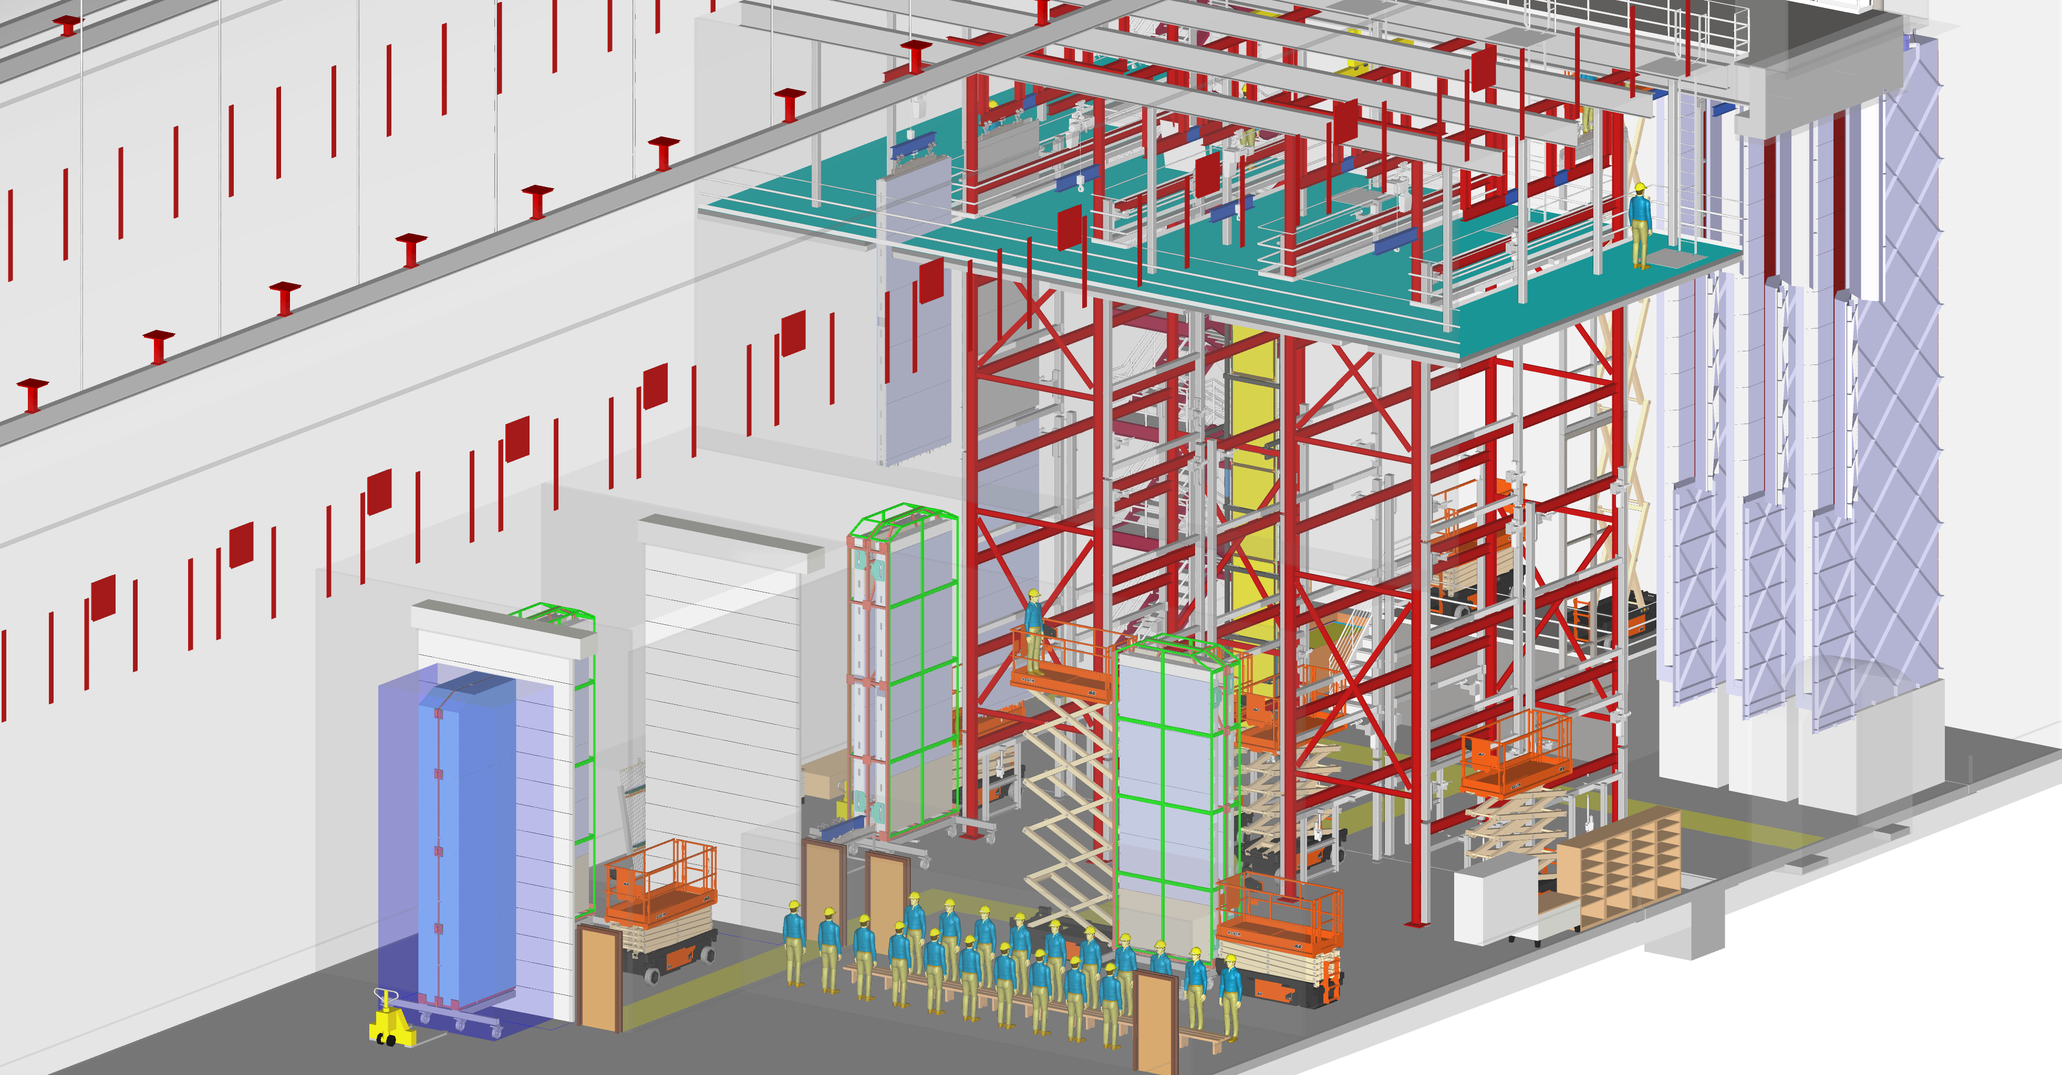
Current cavern layout

Slide 4
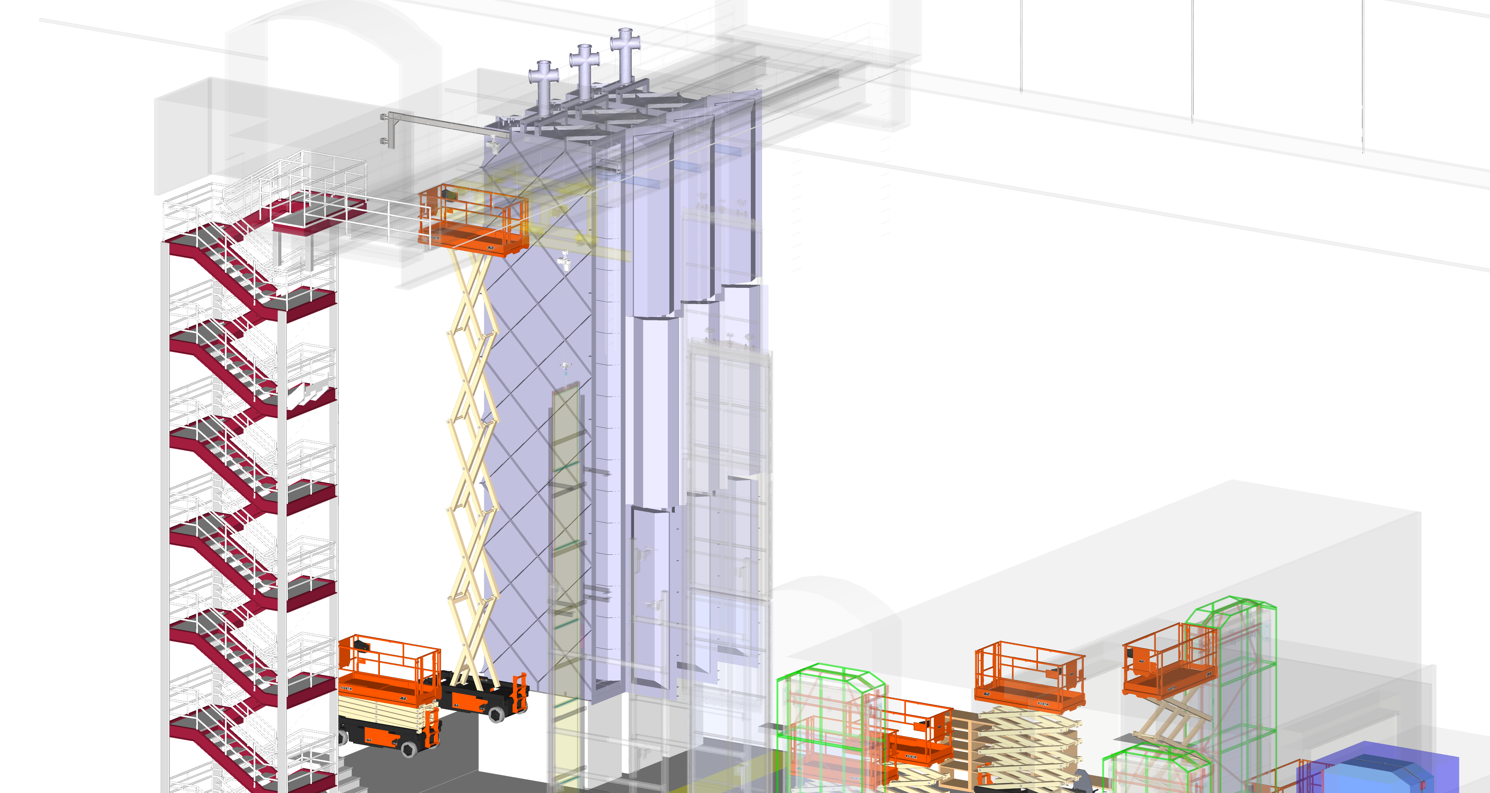
Current cavern layout

Slide 5
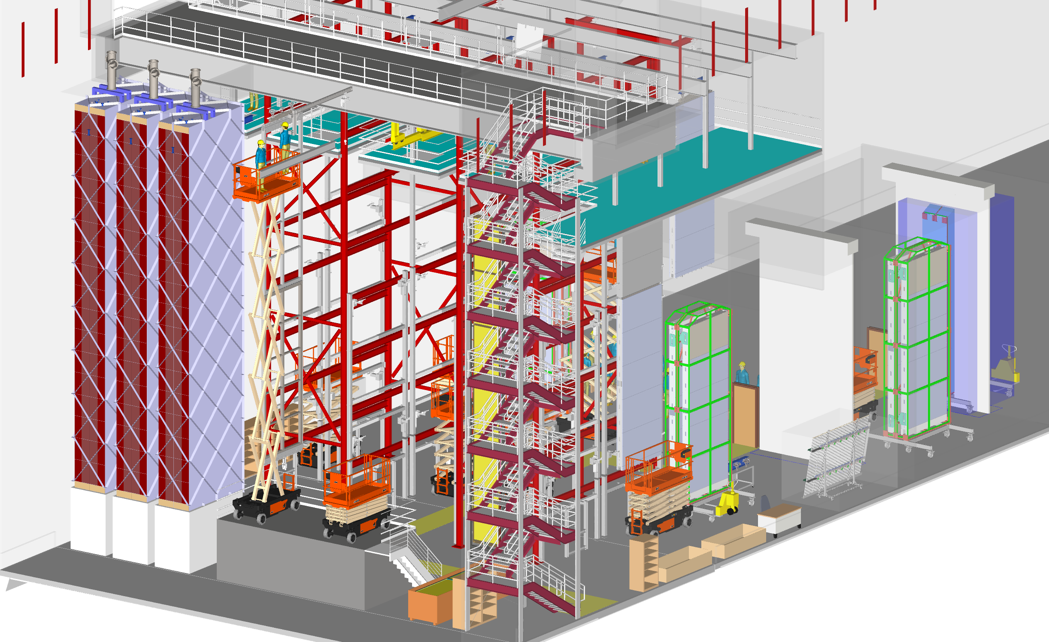
Current cavern layout

Slide 6
Future Work
Agree on:
- the internal dimensions
- cryo interfaces
- clean room interfaces
Improve:
- the door, for easier opening and closing
- the door sealing, i.e. add additional seal
- the “membrane”

