Slide 1
DUNE Electrical Infrastructure
Terri Shaw
FS Integration/Installation Planning
1-4 February 2020

Slide 2
Outline
DUNE AC power distribution design and distribution
  Detector Racks
  DAQ Room
Requested information being gathered from Consortia
  Cables, racks, equip, power, detector safety

Slide 3
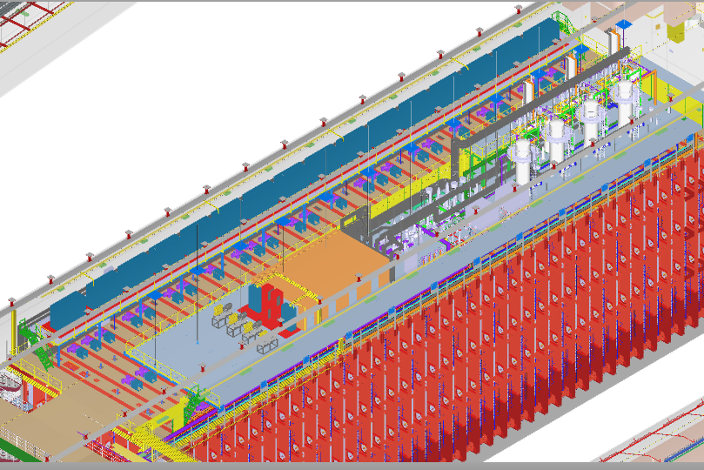
Detector Racks on Mezzanine
DAQ Barrack Area
Small on detector
Racks

Slide 4
AC Distribution to ~76 Detector Racks (42U 36” deep)
Single line electrical drawing “LBNF_Level_4850_SLED-Sheet_1-Rev_3.pdf” exists in EDMS 2169065
Power will be distributed to Detector Racks which reside on Detector Mezzanine.
~76 Racks will be available and will be provided a 120V/30Amp service.
Racks will be air-cooled.
Requests for special high power racks should be submitted for review. Cooling design should be described.
No AC distribution is planned for the top of the cryostat.
Detector Racks will have pre-installed a rack protection system, ground cable, network switch, cooling fans, air filters and power distribution units (PDUs)

Slide 5
Small On-Detector Racks
75 small (~15U) on detector racks located near each APA feedthrough
Primarily will house PD Readout
  Qty (2) 1-2U DAPHNE readout units
  3U Light Monitoring units
  ~2U for Fiber Patch panels
No AC power
Air-cooled

Slide 6
AC Distribution of Power for DAQ
DAQ infrastructure requirements documented in EDMS 2233290.
Working document - Single line electrical drawing “DUNE_DAQ_Room_UPS_schematic.pdf” exists in EDMS 2169065.
Delivers 100KW per detector.
Includes preliminary design for UPS 5 minute backup.

Slide 7
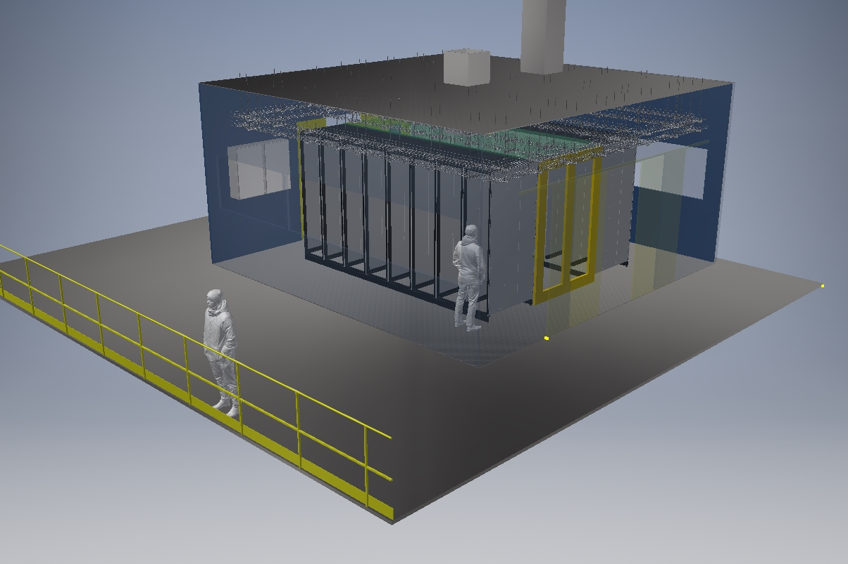
Tim Durkin - UKRI STFC

Slide 8
DUNE Cables, equipment, power and equipment safety
All Consortia Technical Leads have been asked to fill out spreadsheets to allow collection of information on
  Cables
  Equipment and power
  Detector Safety System/Hardware Interlocks
Completed/working version of the spreadsheets should be placed in EDMS 205264.
This information will
  Allow work on rack assignments and rack builds
  Enable understanding of cable routes and lengths
  Refine power envelopes

Slide 9
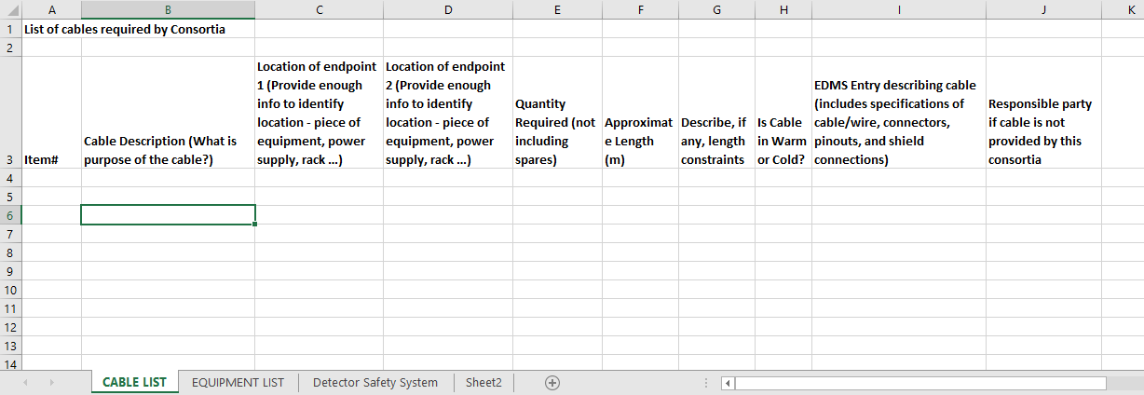
Cable Query

Slide 10
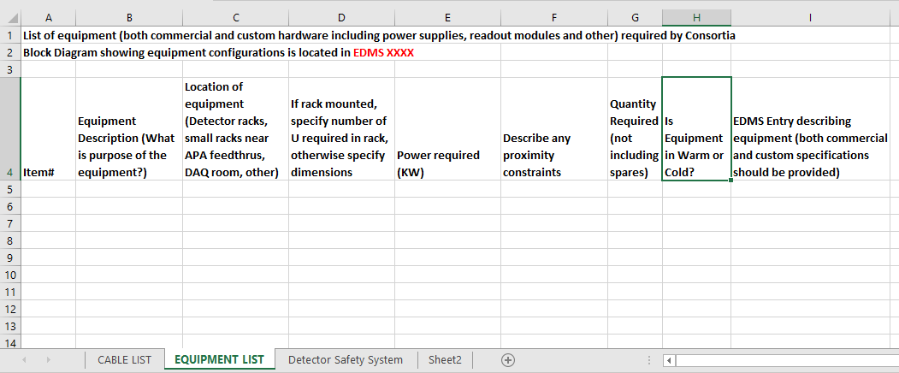
Equipment Query

Slide 11
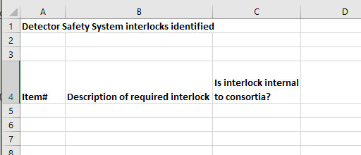
Detector Safety System

Slide 12
Consortia electrical equipment installation
All Consortia team members will need to coordinate work with SURF Installation team.
Work expected to be limited to installing modules; no work with exposed energized conductors.
Safety group will specify training requirements.
Electrical Technicians will install power supplies and technicians will install long cable runs.

Slide 13
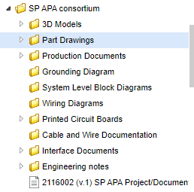
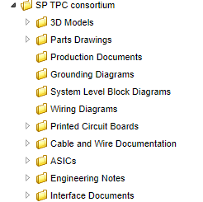
Consortia need to use EDMS for documentation
Folder Structure can be tailored to specific consortia
If you need help, let us know.
Examples:

