Slide 1
LIU-PS Planning report

Slide 2
New demineralized water circuit
  News since last meeting:
    A bit of delay on the mechanical works in B355 and B255
    Connection between gallery 3 and TT2 + outer side of the ring completed
    Connection between gallery 5 and the outer side of the ring completed
    Connection between gallery 7 and the outer side of the ring started this Monday
    Connection between gallery 1 and B.355 (last part) will be performed in January 2020
    The new cooling system will be available end of February 2020 to allow starting the ISTs of some systems in March 2020
    More information will be given by Serge

Slide 3
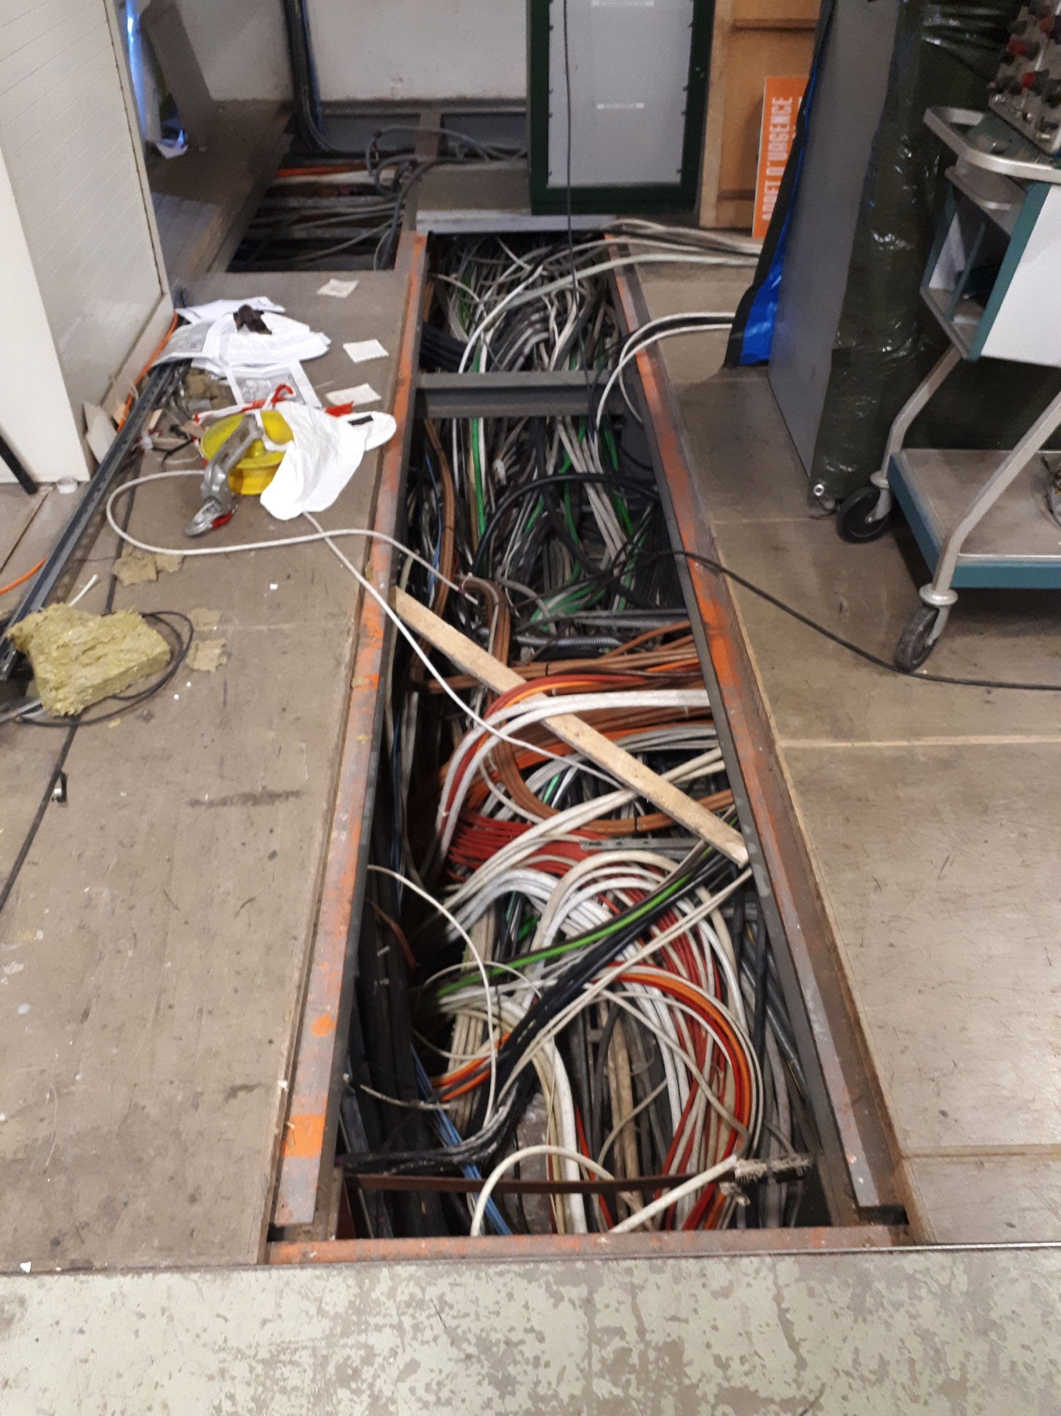
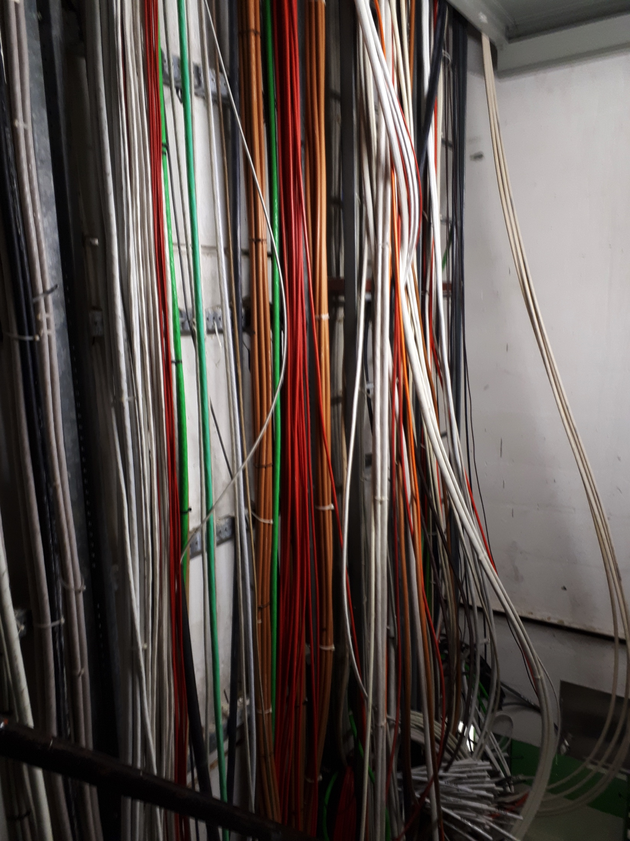
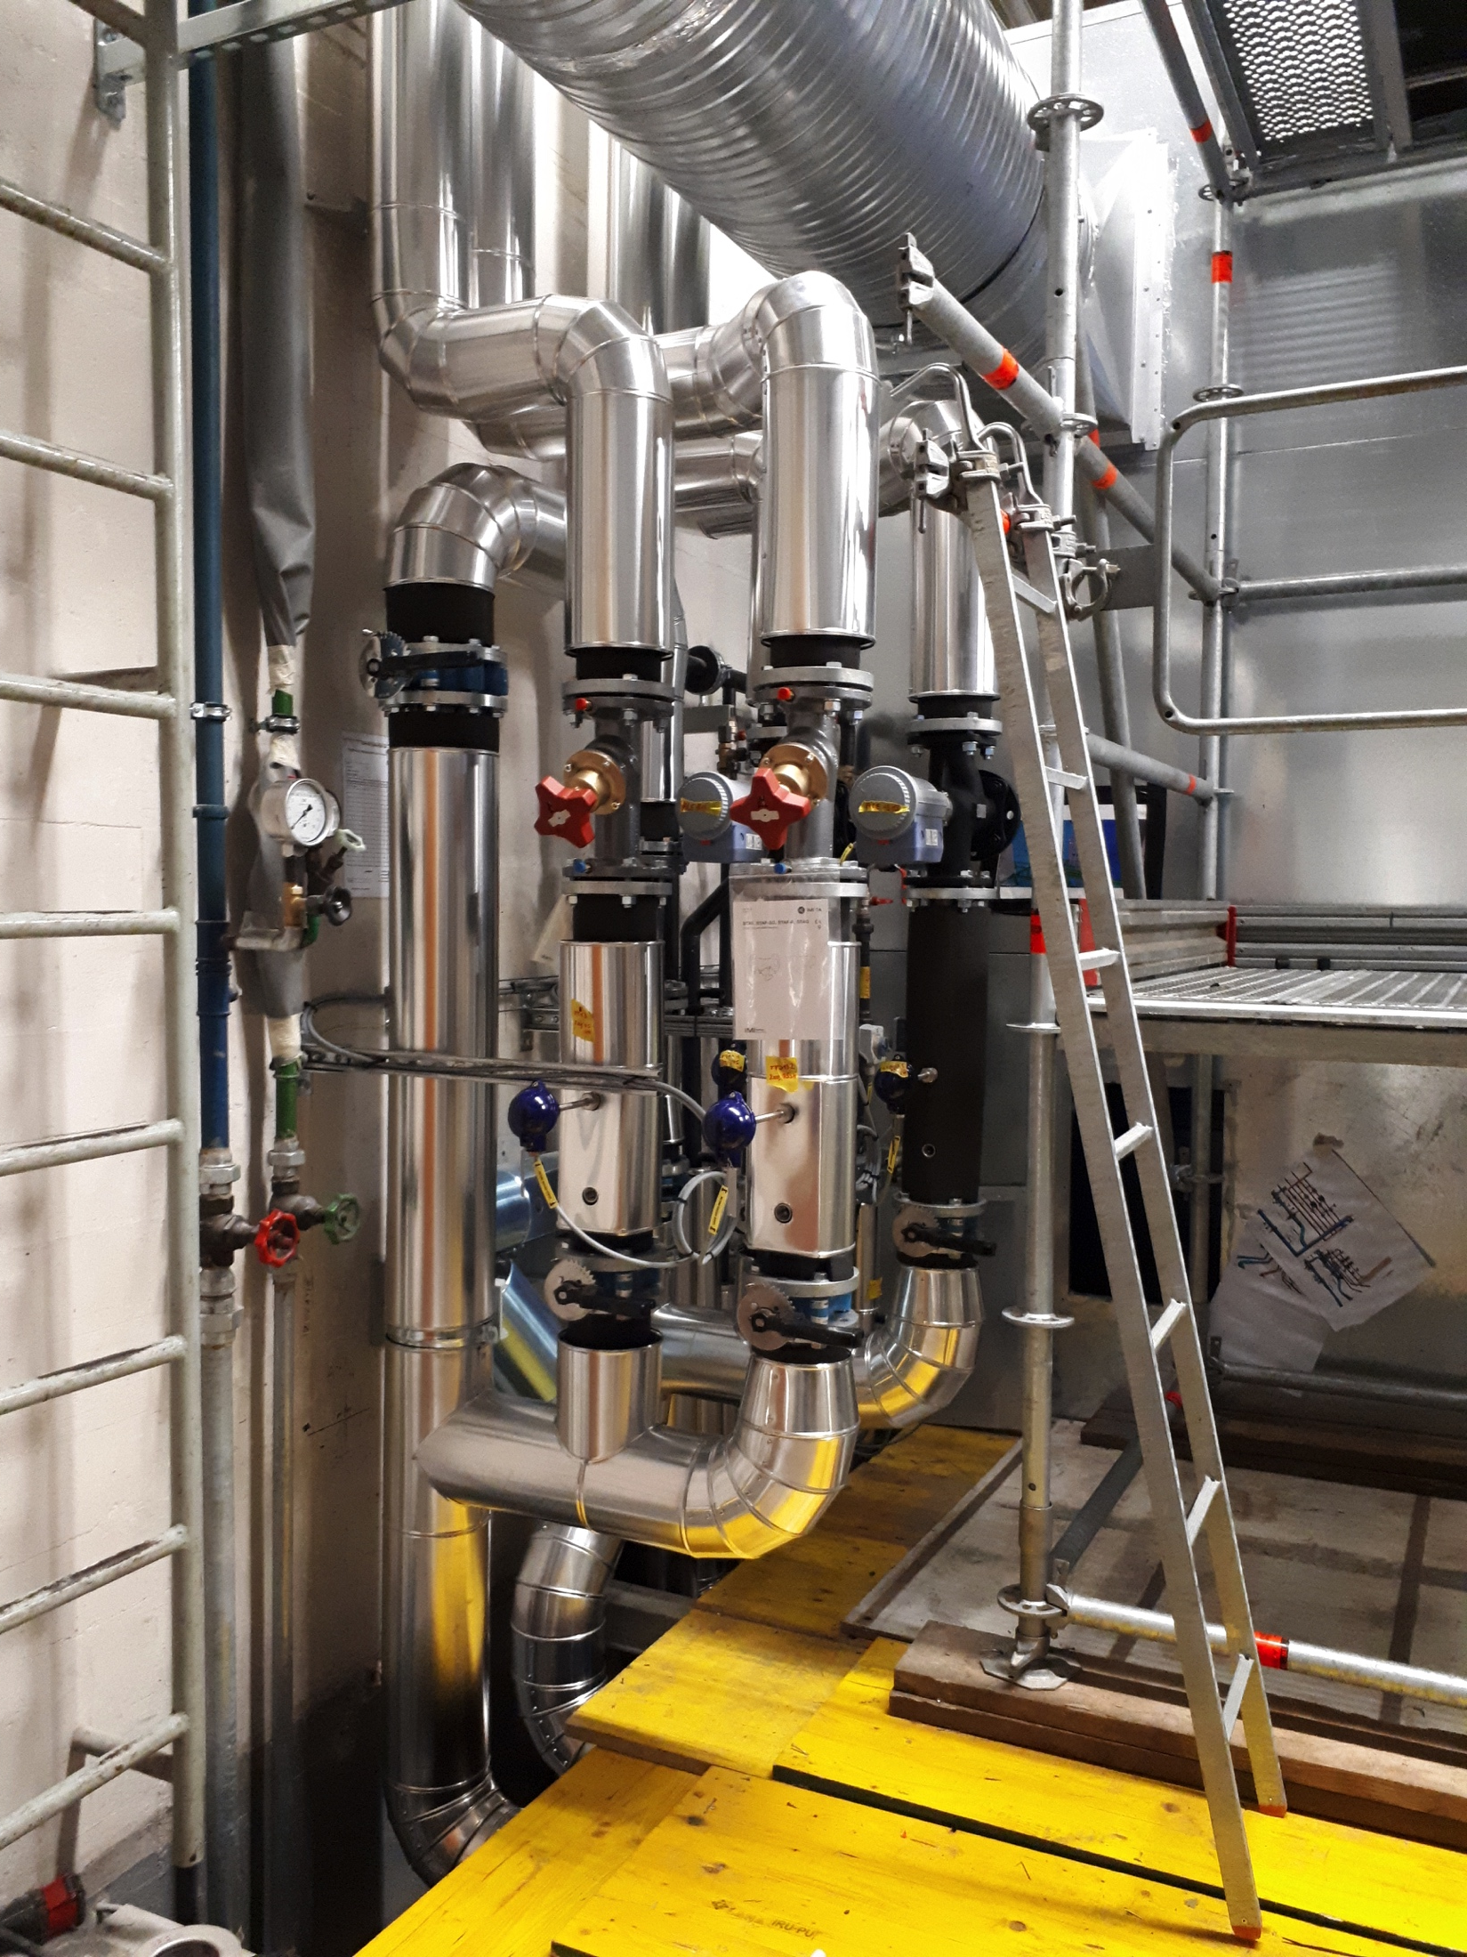
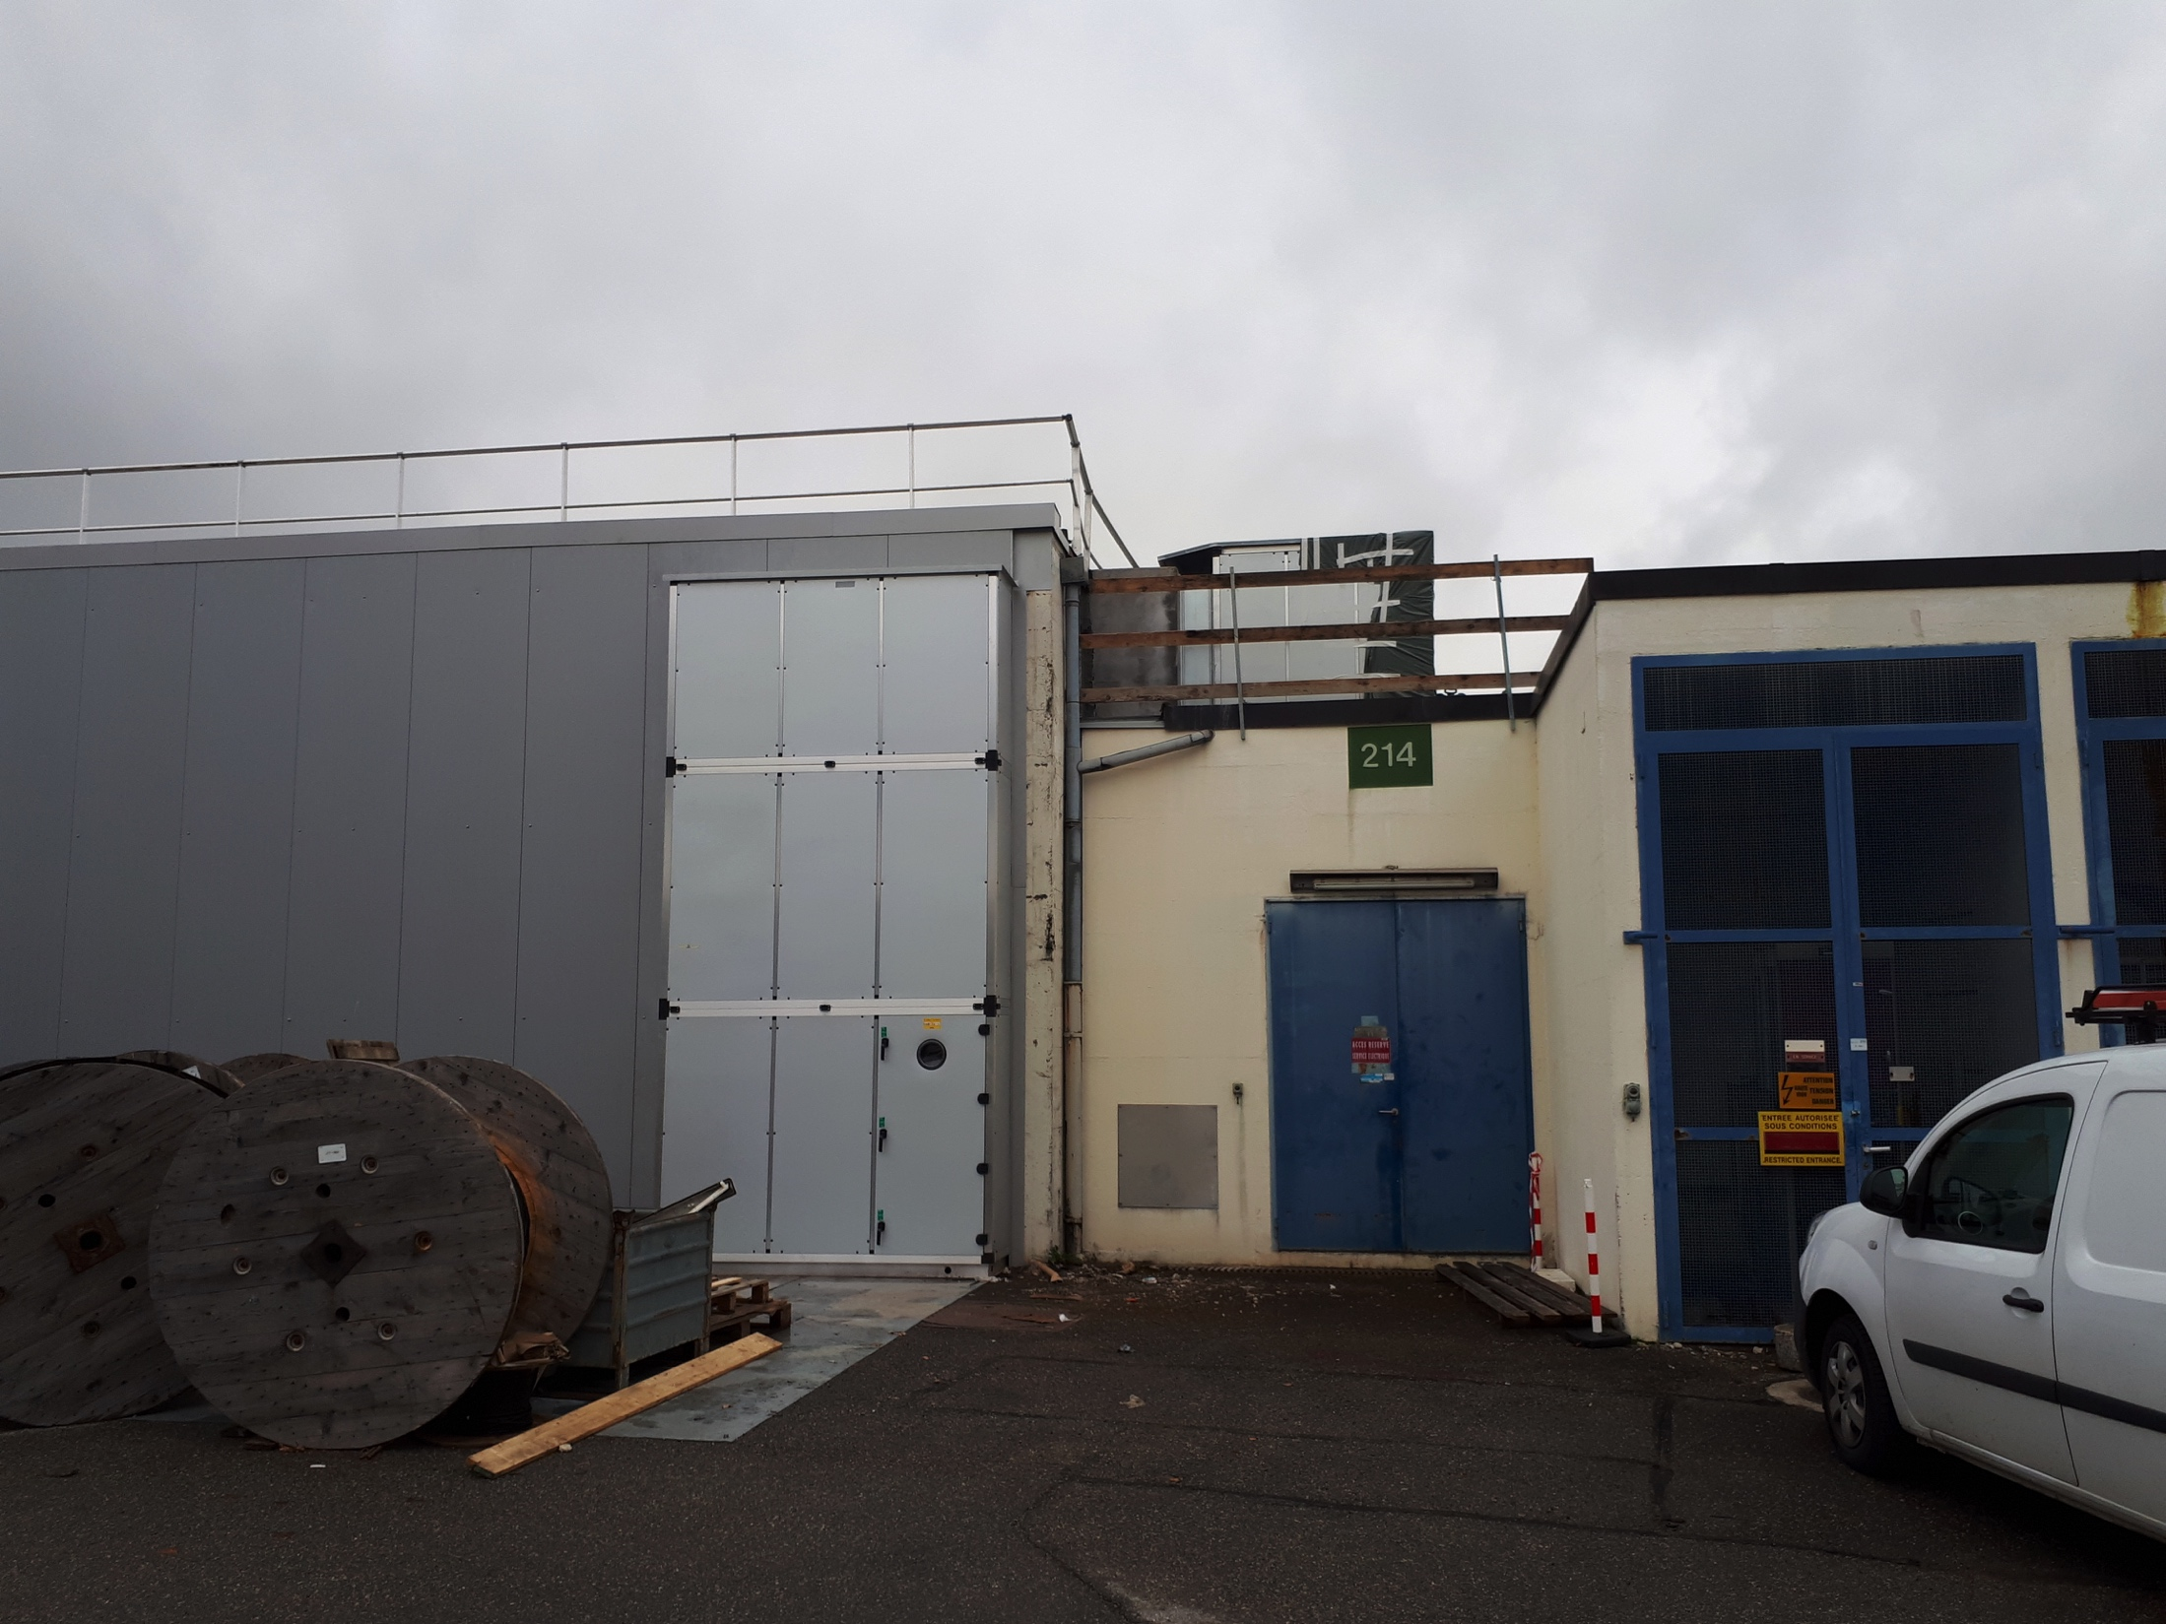
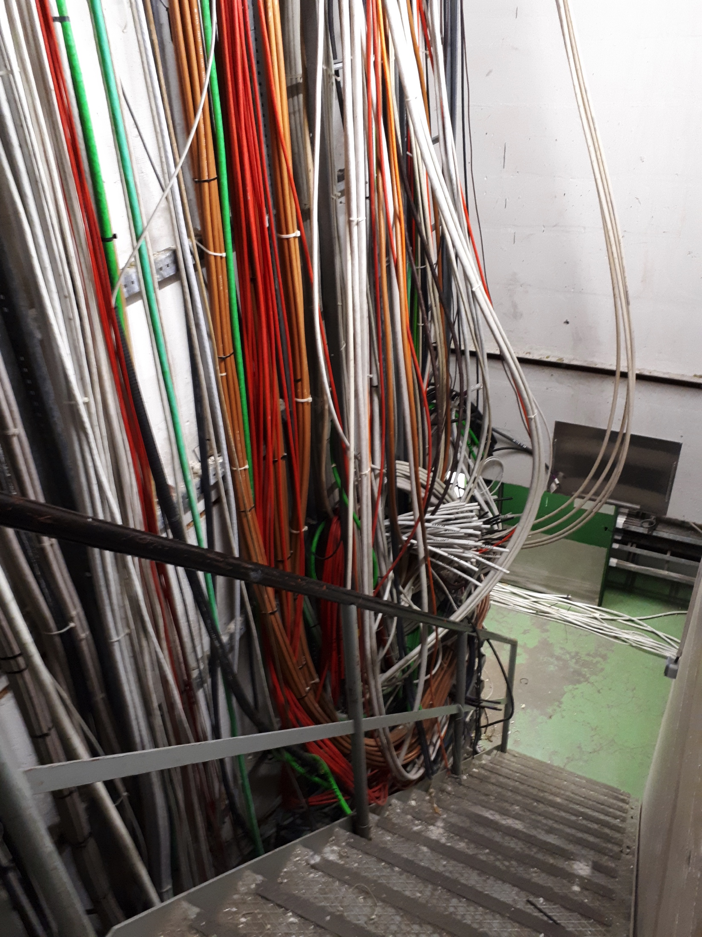
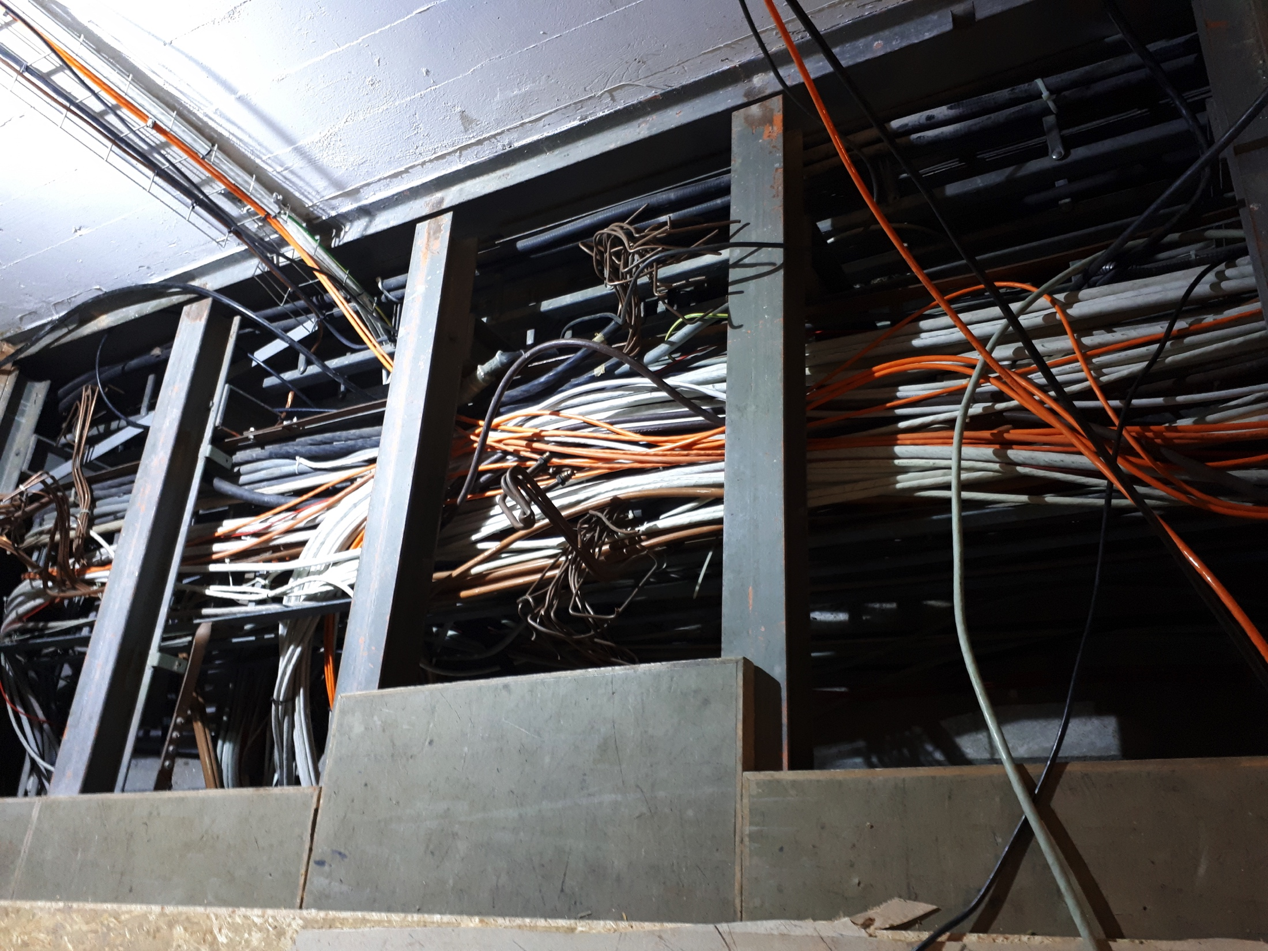
B.269
Integration issue with one TE-EPC rack
Connection between the transformers and the switchboard is ongoing
First cabling campaign is finished, second campaign started with a de-cabling on the shaft part and is now starting the cabling
CV station works progressing well

Slide 4
Main Units renovation (cons.)
43/43
  already renovated
1/43
  kept in B.150 (MU27) for the LINAC4 connection
36/43
  already re-installed and re-aligned in the machine
7/43
  Kept out for the moment waiting the asbestos works to be completed or the PS SWY to be opened
  Note:
  Some straight section have still to be re-installed and some MUs reconnected

Slide 5
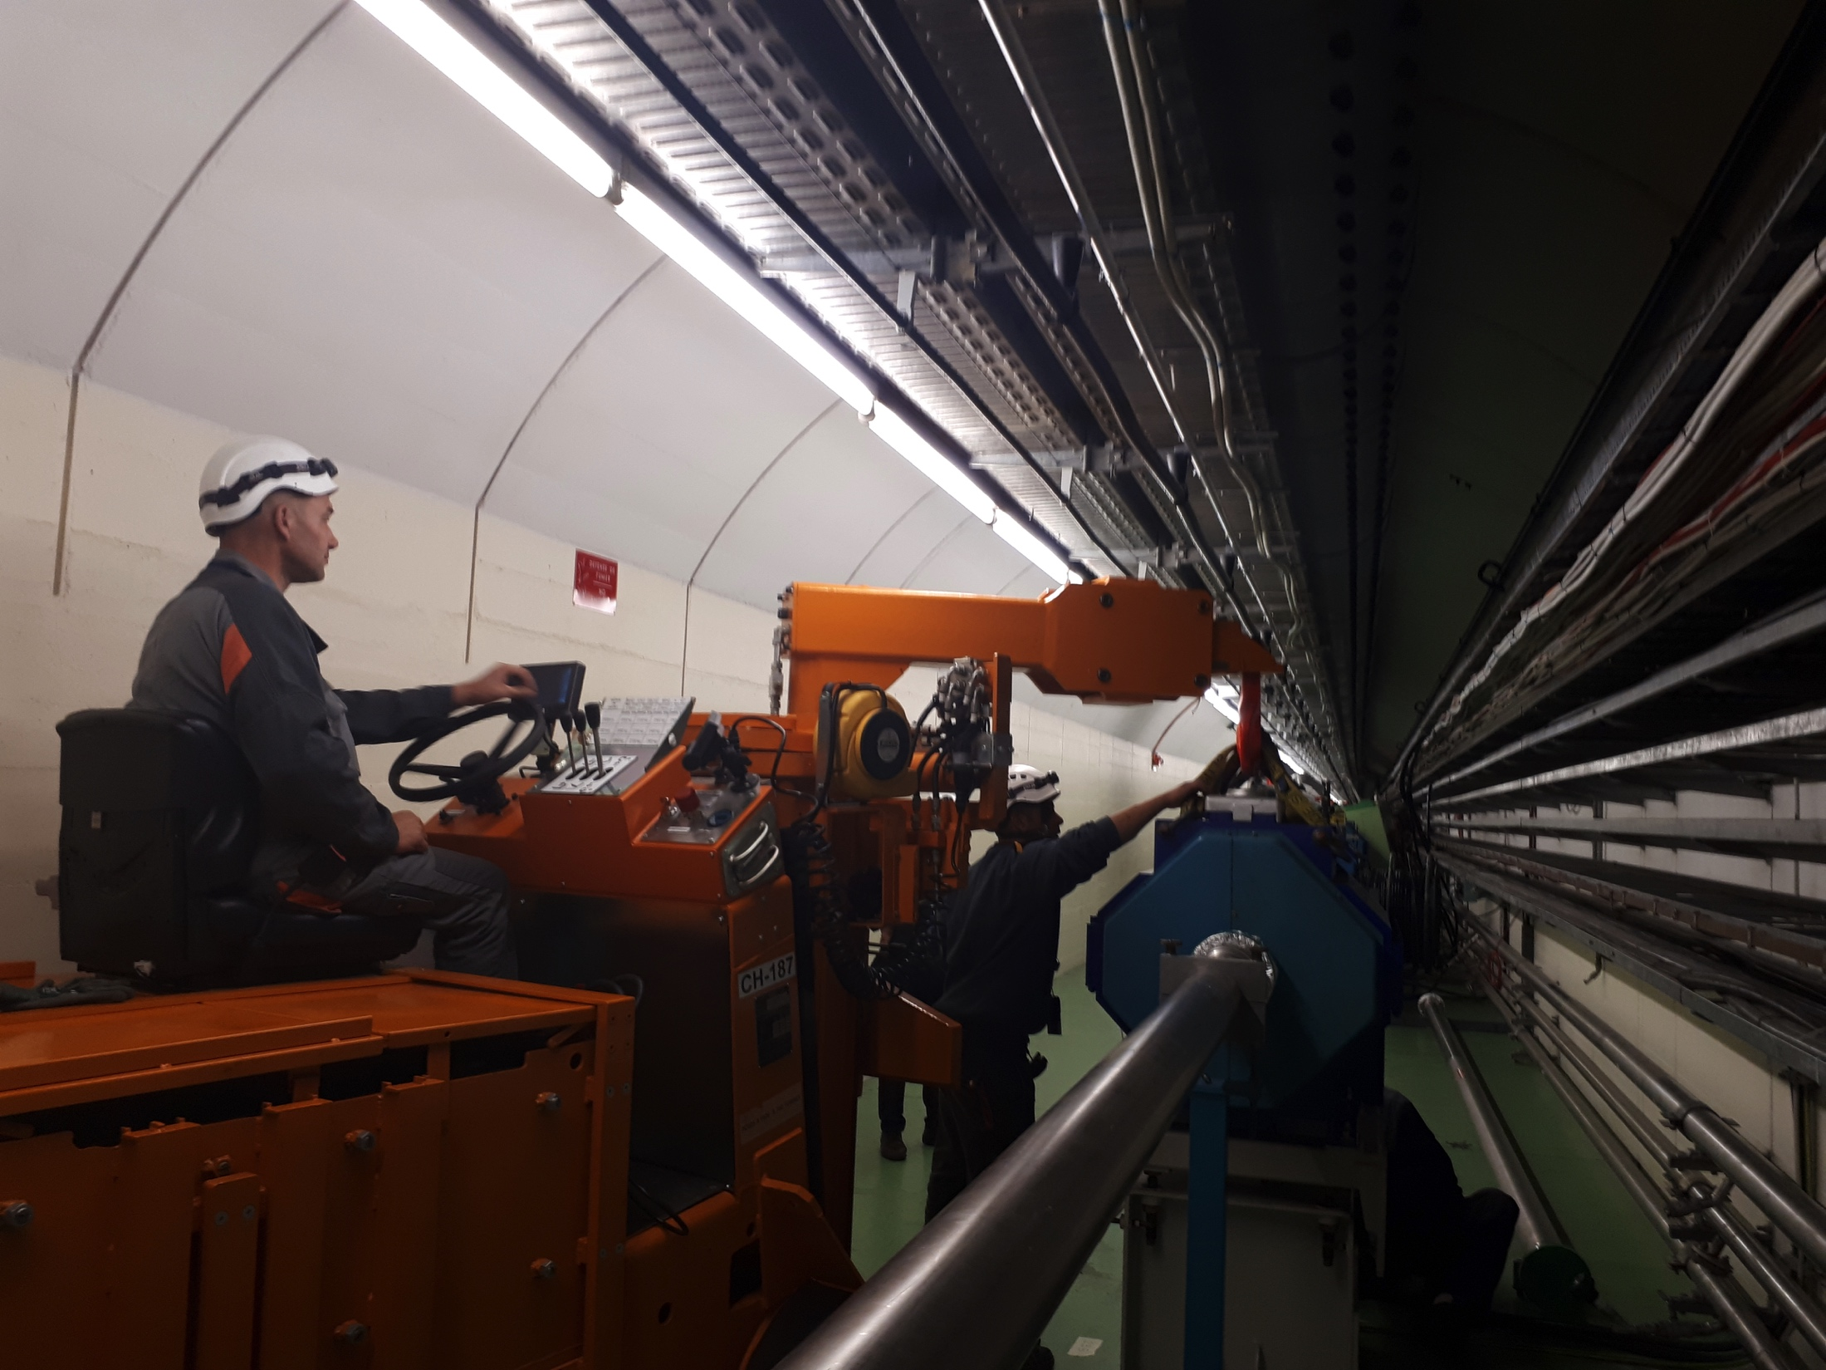
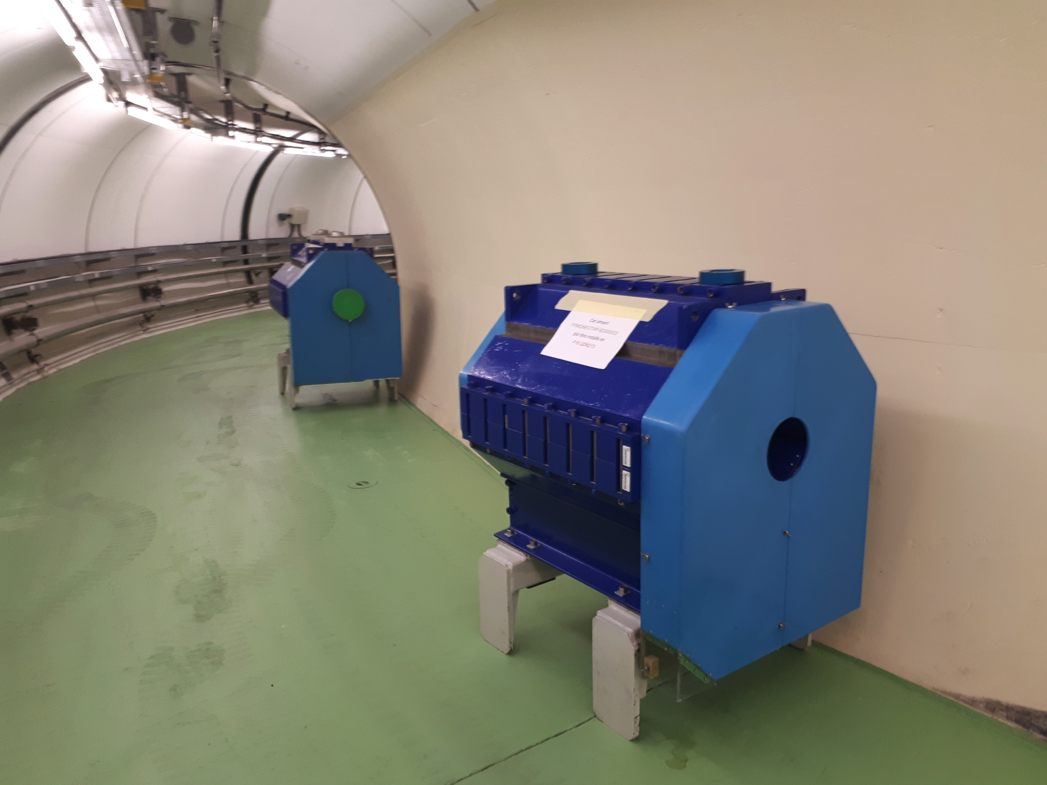
TT2 quads renovation (cons.)
Two batches of 5 quads have been already “chamber replaced”, re-installed and re-aligned (F16.QFN205, F16.QDN213, F16.QDN217, F16.QFN225, F16.QFN235, F16.QFN245, F16.QFN255, F16.QFN265, F16.QFN275, F16.QFN285)
Third batch has been “chamber replaced”, re-installed and alignment is ongoing (F16.QDN207, F16.QFN315, F16.QFN325, F16.QFN345, F16.QFN365, F16.QFN375)
QFN275

Slide 6
Ring
Asbestos cleaning is progressing well and will be finished in advanced with respect to the planning
General services renovation in the ring is progressing well
Some cabling campaigns have been re-organized due to the asbestos, but are progressing well
Some issues on the surface buildings following LV services renovation (B365, B355)

Slide 7
Question?

