Slide 1
LIU – PS&TT2 Status report CV

Slide 2
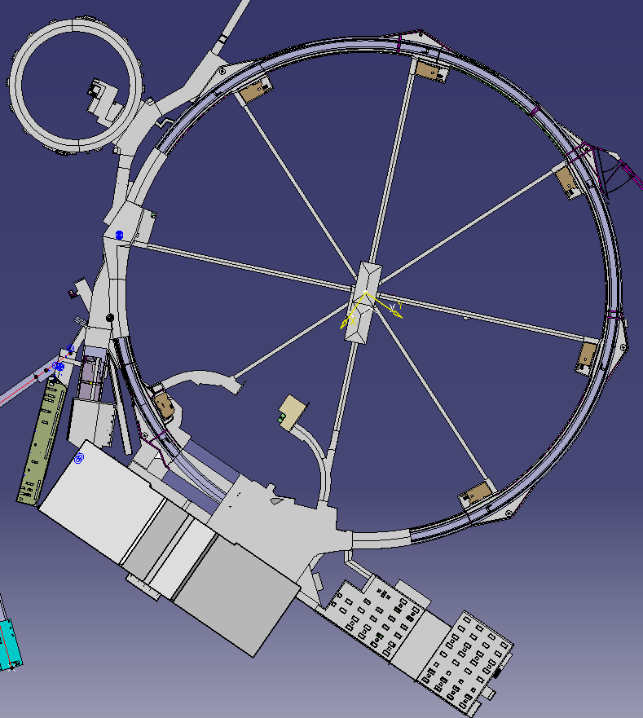
Replacement of pipes inside the PS tunnel
Done
Ongoing

Slide 3
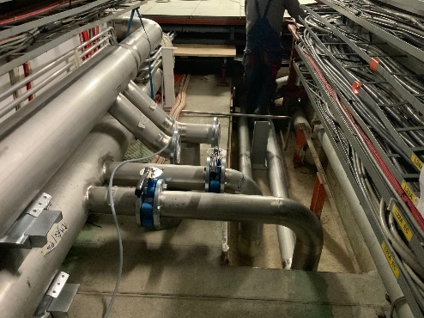
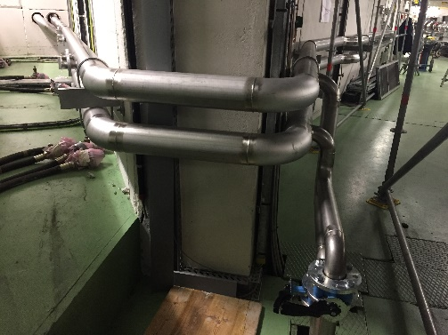
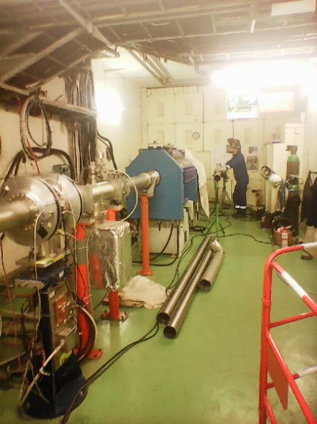
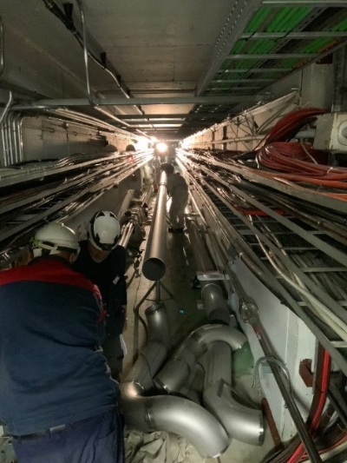
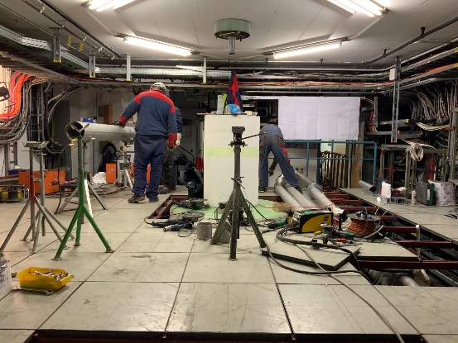
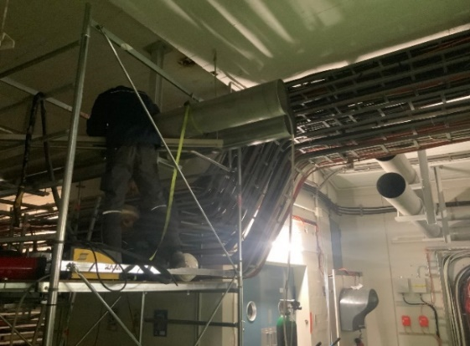
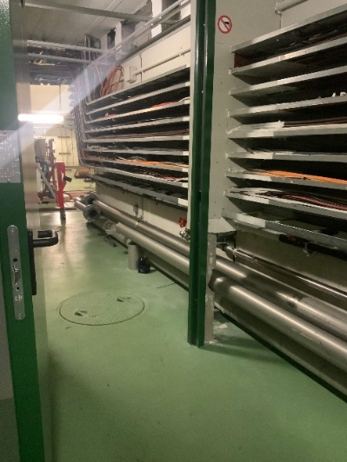
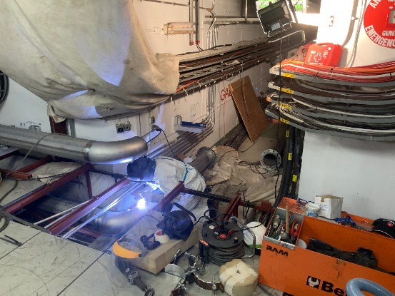
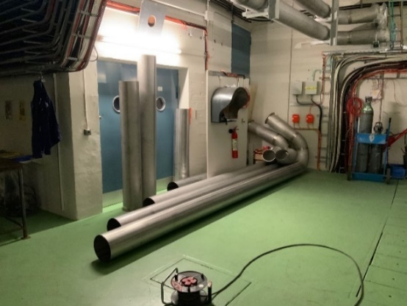
Works inside the PS tunnel

Slide 4
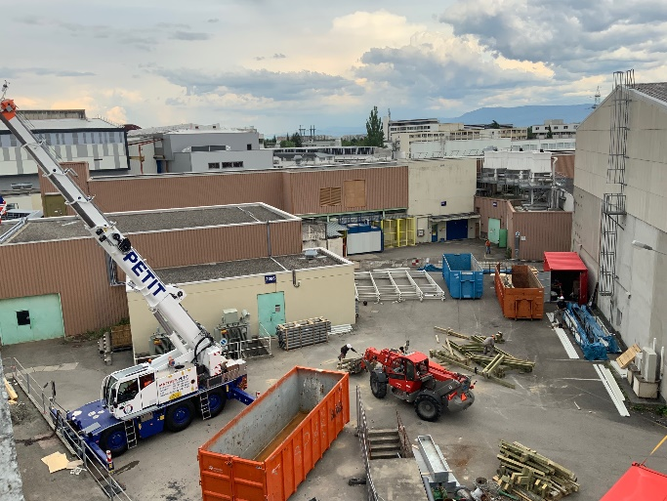
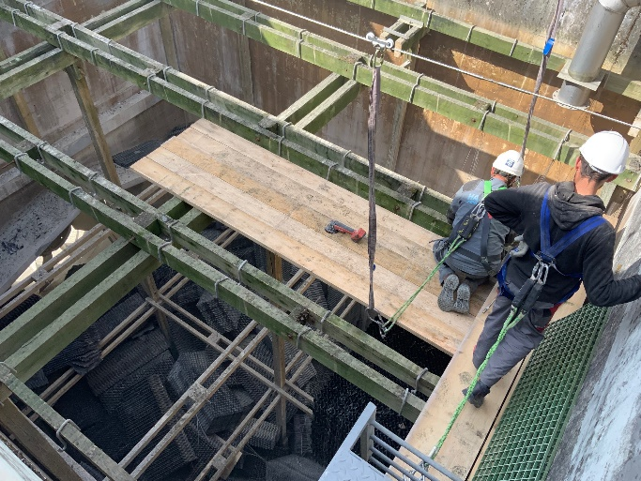
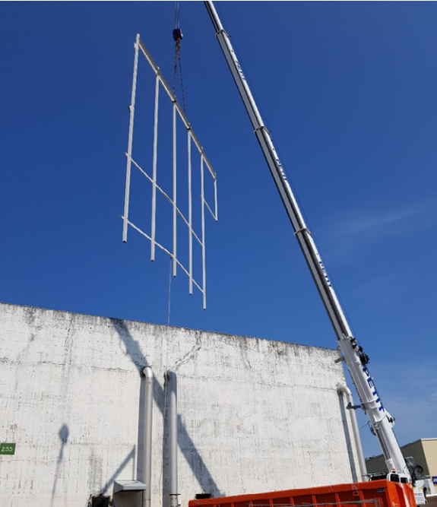
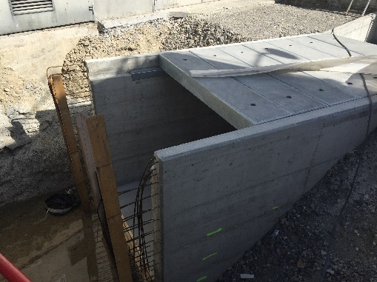
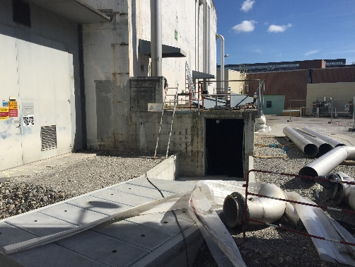
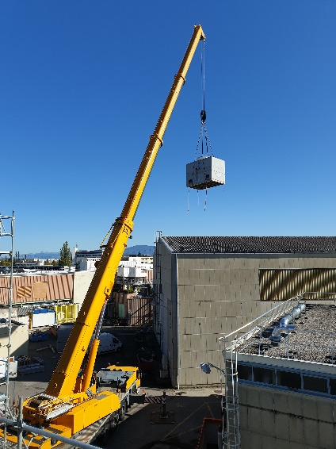
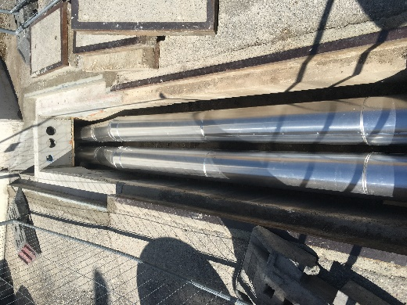
Works outside the PS tunnel

Slide 5
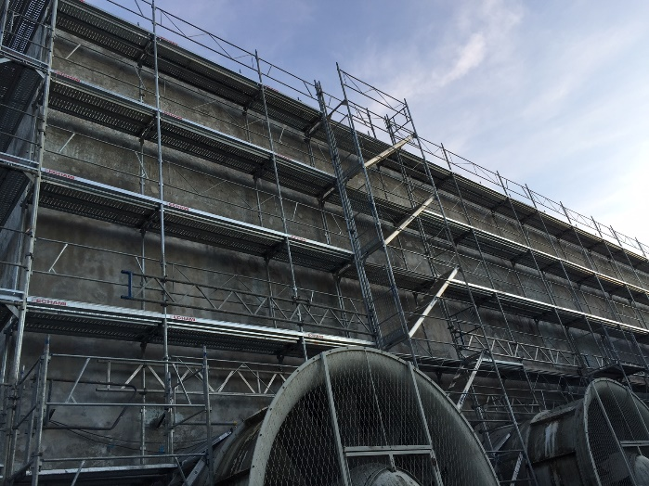
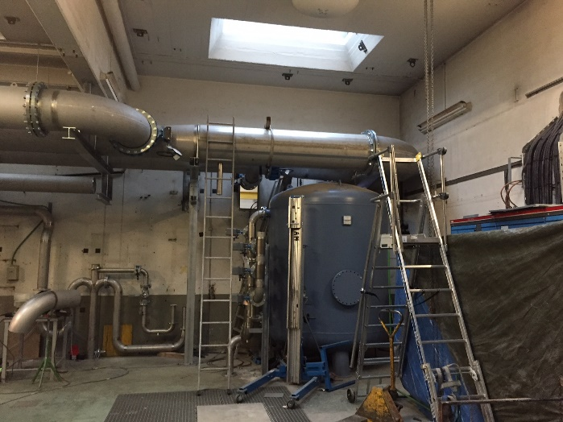
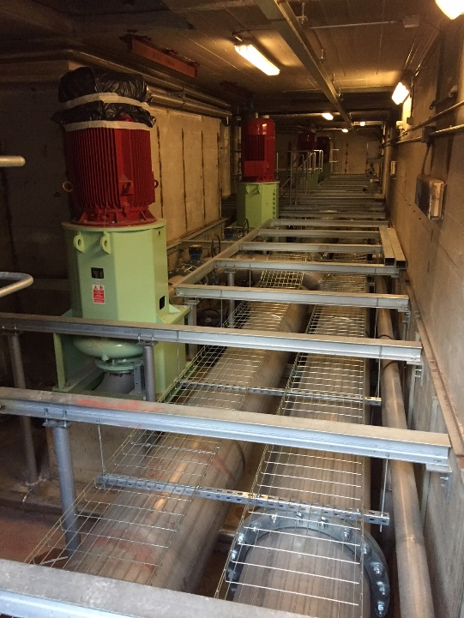
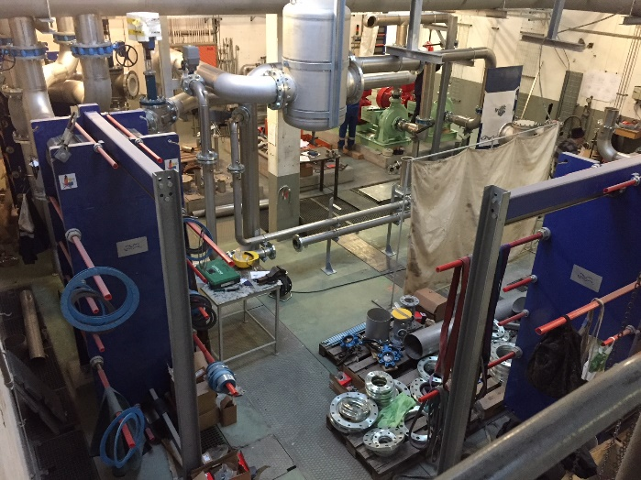
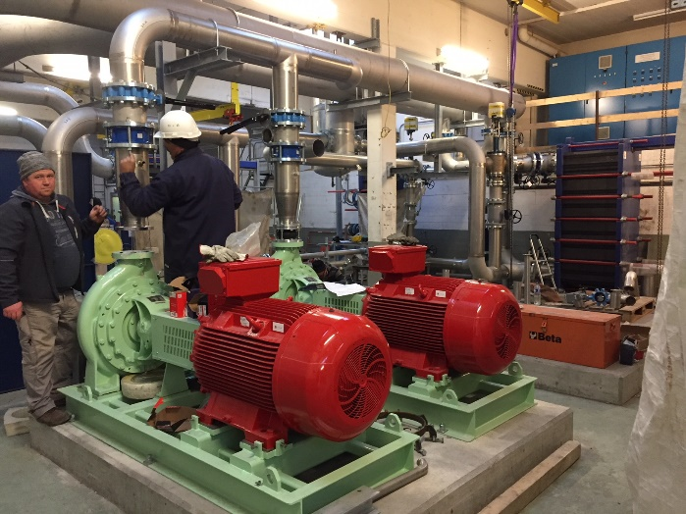
Works outside the PS tunnel

Slide 6
Status
  PS & TT2 cooling :
  All the work inside the PS tunnel is finished except :
      The connection of the ring to the gallery 7 – on going.
      Cables to draw to supply the septa pump
  Replacement of packing and distribution of the cooling towers is finished.
  Mechanical part of the cooling plant in the bldg. 255 is finished. Metallic structure is finished.
  Installation of the mechanical part in the bldg. 355 is ongoing.
  Installation of the electrical part in bldg. 255 and 355 is ongoing.

Slide 7
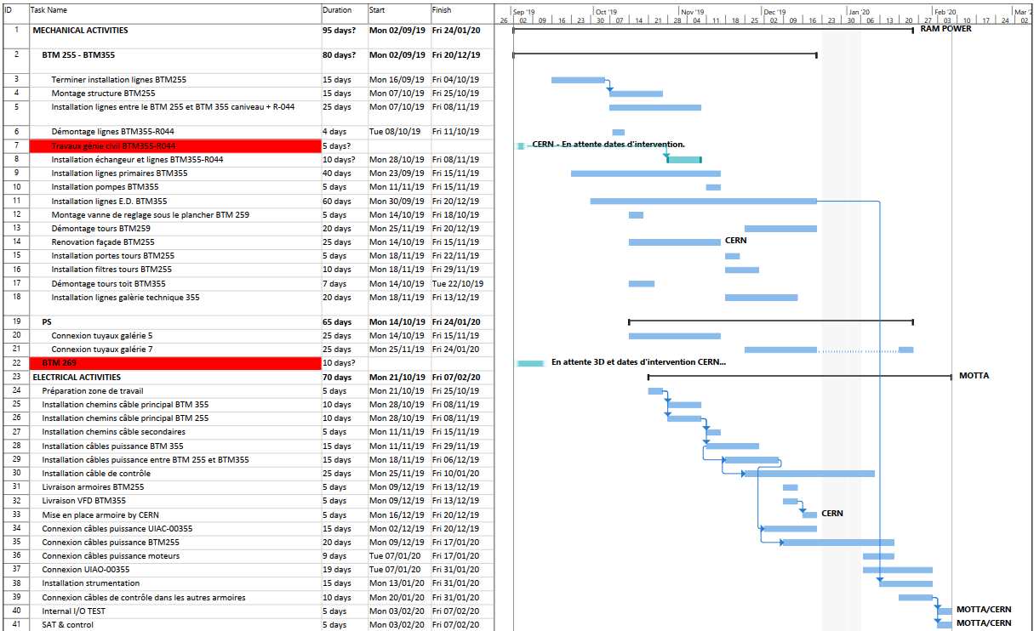
Schedule

Slide 8
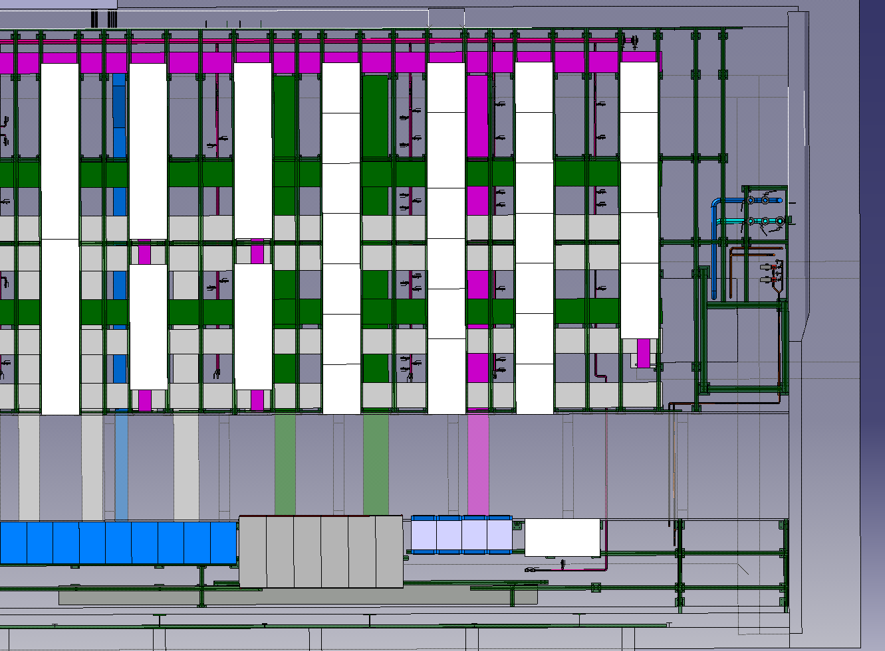
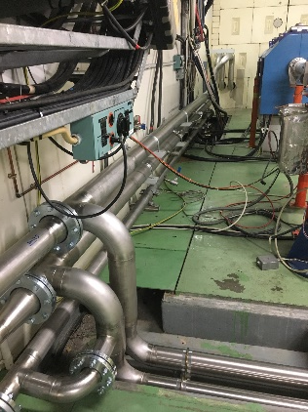
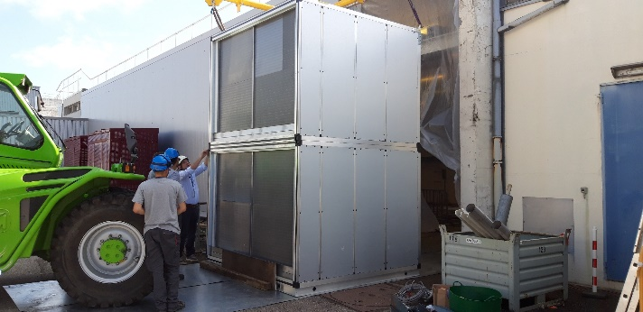
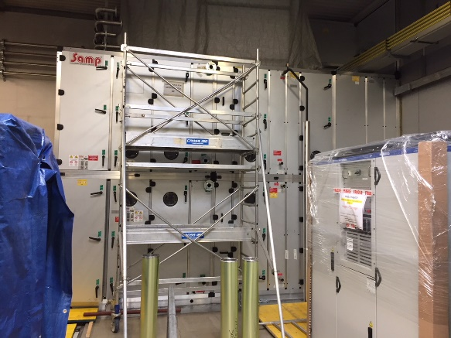
Injectors – Projects
Bldg. 269: new cooling and ventilation
Cooling :
Works finished except for :
  The connection between the TT2 and the distribution inside the bldg. 269 → Planned the 25th of November (asbestos).
  Connections (flexible hoses) to the 35 power converters planned in 2020
  Xray and pressure test: planned in December.
Ventilation :
Air handling units in place.
Distribution of chilled and superheated water done.
Insulation Done.
Electrical and control part ongoing (50%).
Commissioning end of November

