Slide 1
LHCb Upgrade
…….from the point-of-view of electronics
On behalf of the LHCb collaboration
Many thanks to all my colleagues who provided material

Slide 2
Outline
Reminder of Electronics Architecture
Review of status
& some interesting high(low)lights
Conclusions

Slide 3
Upgrade philosophy
Remove existing L0 hardware trigger (1 MHz)
Read out all detector data from all BXs @ 40 MHz
Triggering is 100% in software running in PC farm
  New electronics & DAQ
Upgrade installation now in LS2
Ready for data-taking in 2021

Slide 4
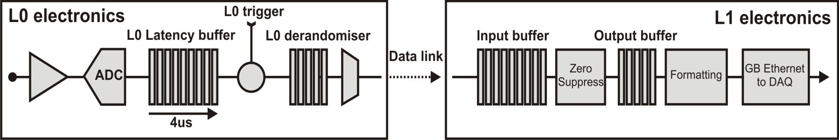
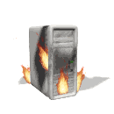
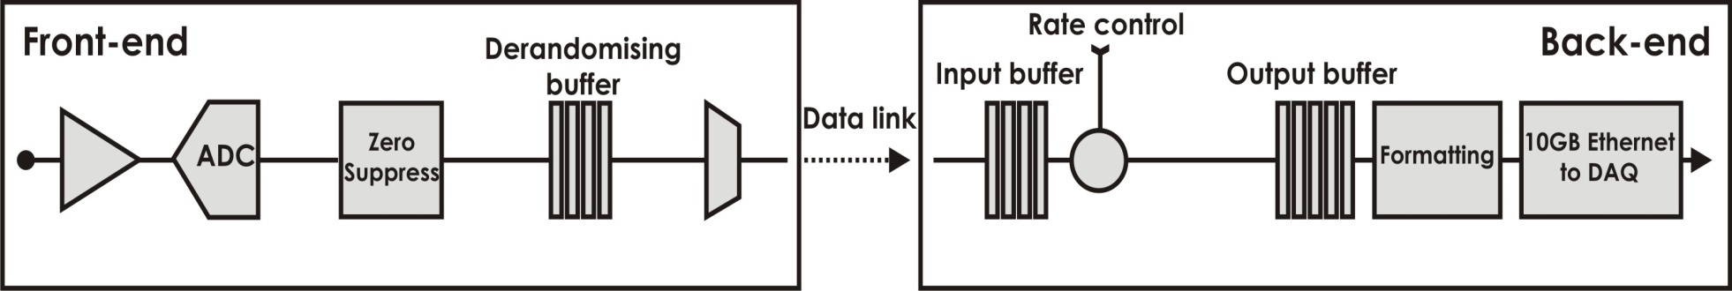
Upgrade architecture
No ‘front-end’ trigger, Event rate to DAQ nominally 40 MHz
Old
Readout Supervisor
L0 Hardware Trigger
HLT
1MHz
event
rate
Upgrade
Readout Supervisor
event-building-farm
Rate-control
PCIe
PC server
40MHz
event
rate
HLT++
Ken Wyllie, CERN

Slide 5
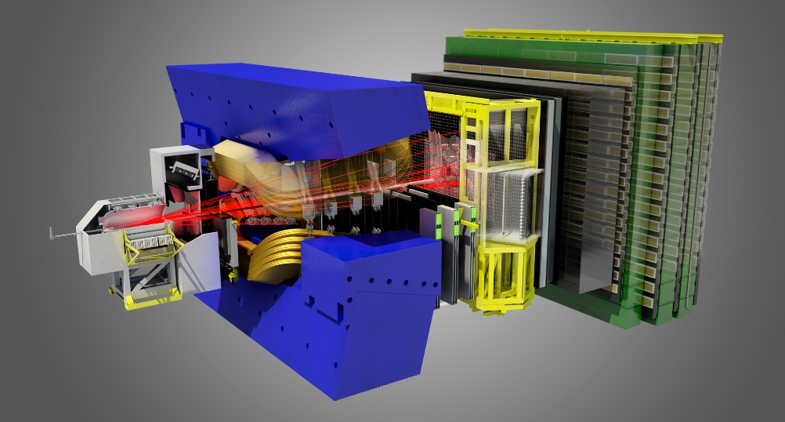
LHCb after 2021
Upstream Tracker
Si strips
Downstream Tracker
Sci-Fibres
Muon
MWPC
VeLo
Si pixels
RICH
MAPMTs
Calo
PMTs

Slide 6
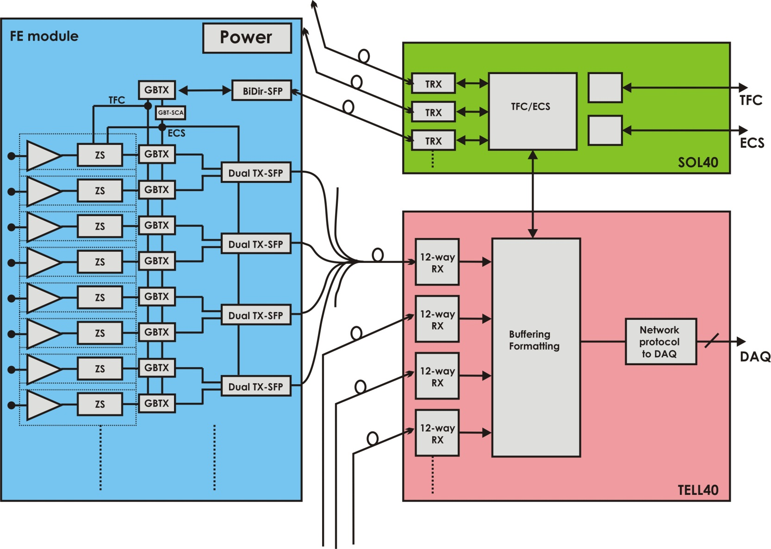
Generic Blocks
Common Electronics

Slide 7
Review of electronics status
(non-exhaustive)

Slide 8

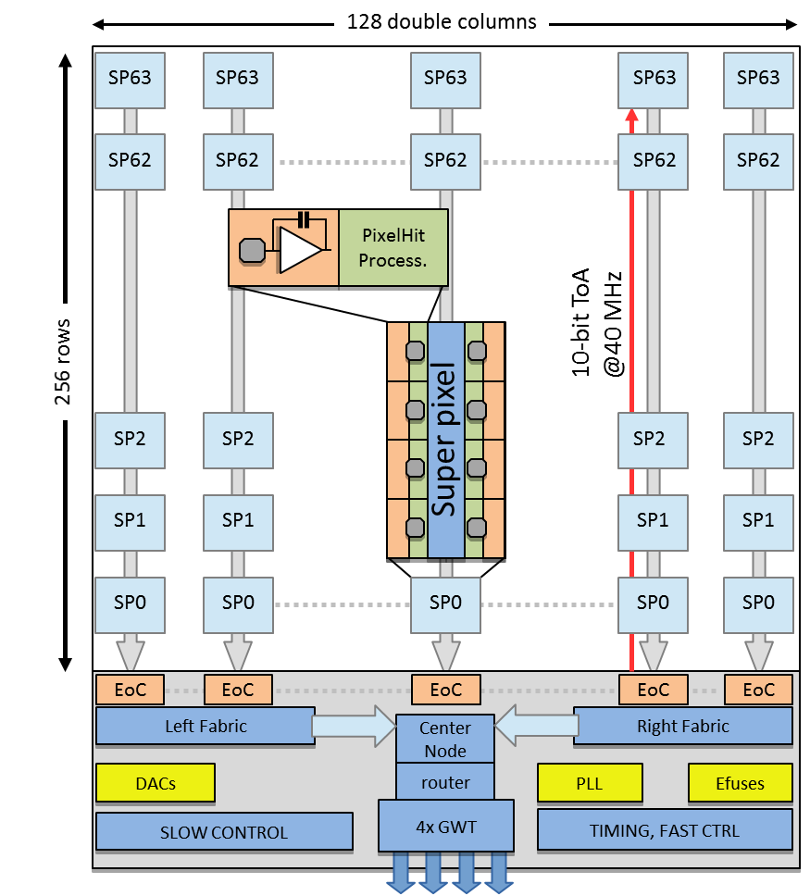
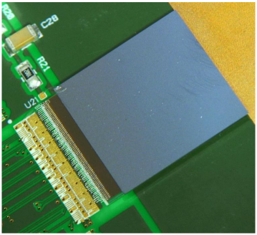
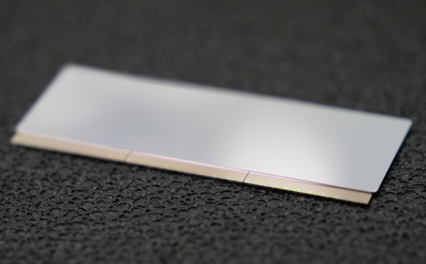
VeLo (Si pixels)
VeloPix readout chip
Big challenge: high data rate
4 x 5.12 Gbps

Slide 9
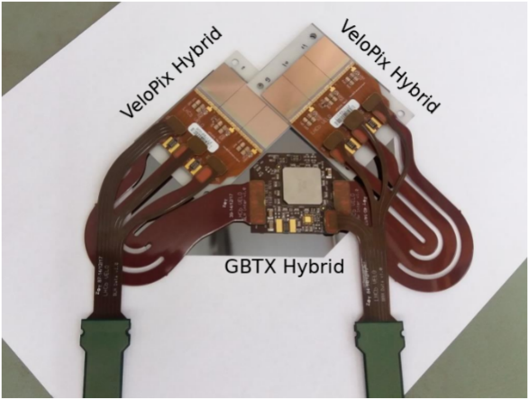
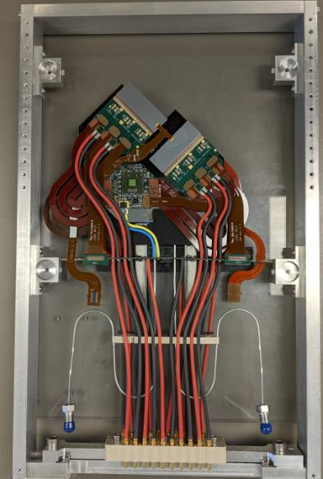
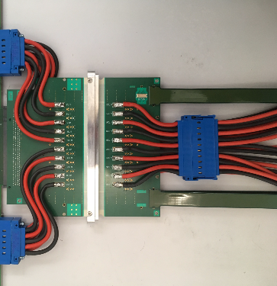
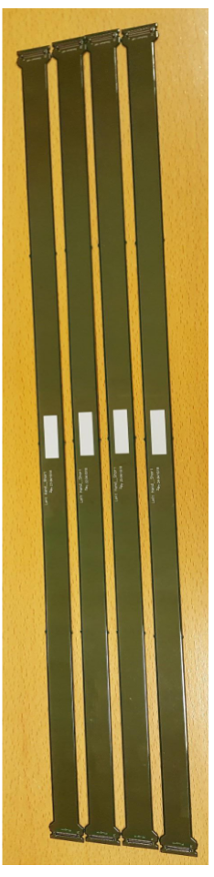
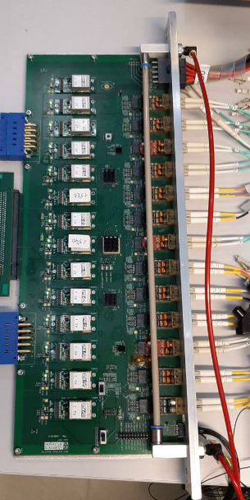
Modules & readout chain
data
Testing at -30 degC:
GBTX cannot lock to incoming data.
OK after optimising PLL settings
60cm
Wall of vacuum tank

Slide 10
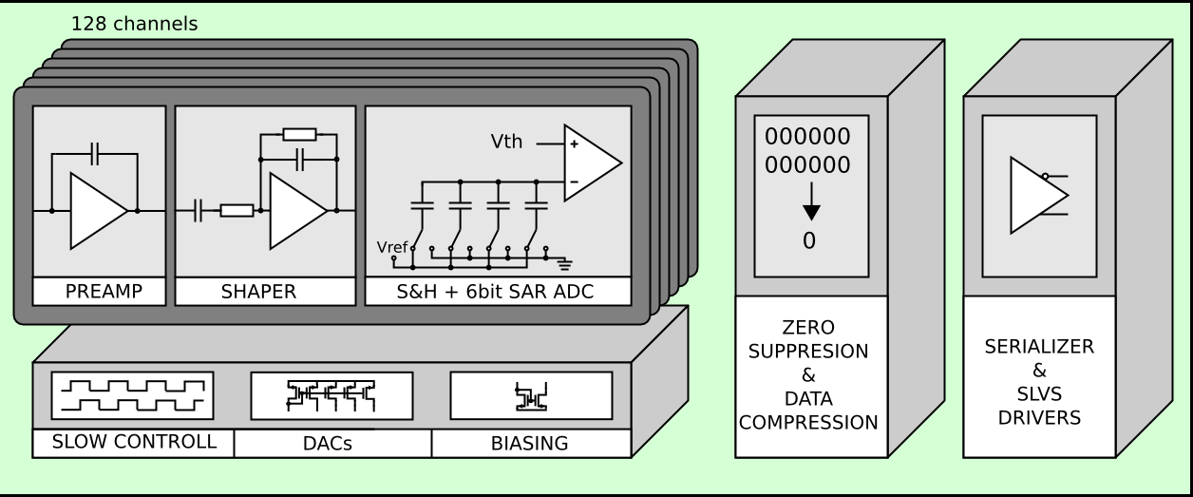
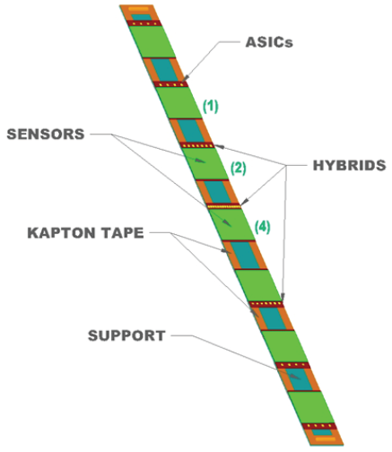
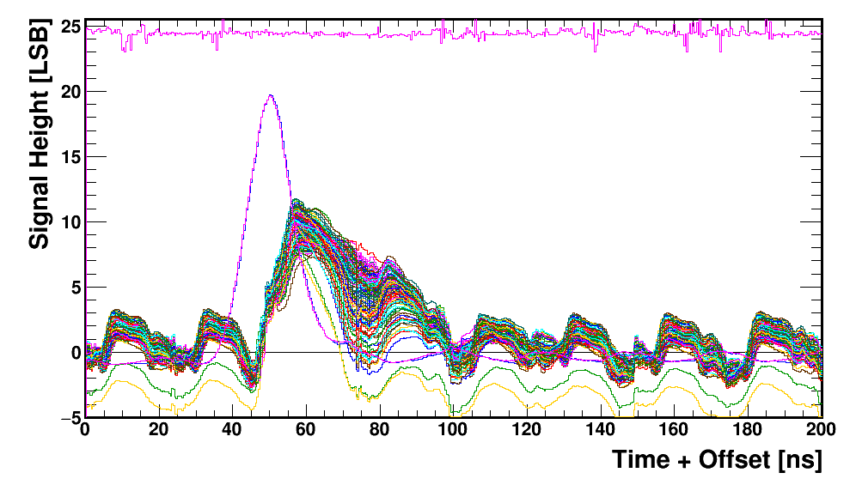
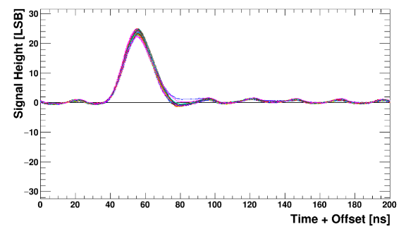
Upstream Tracker (Si strips)
SALT chip in 130nm CMOS
4 planes of 16 staves
1.3m
Flex cable
SALT issues:
Parasitic effects => noise injected from ADC&digital into FE
New version: improved PSRR of FE
reduced current fluctuations
reorganisation of power domains
New version

Slide 11
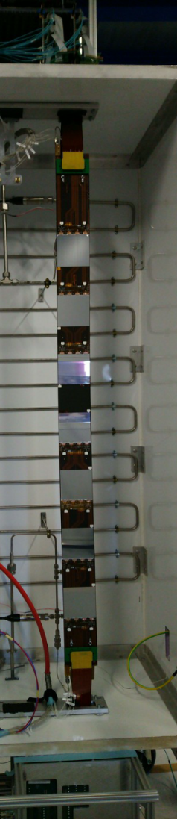
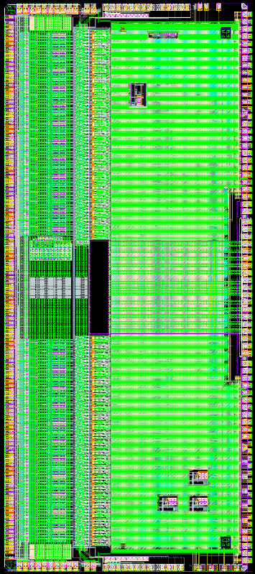
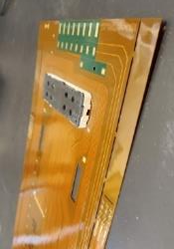
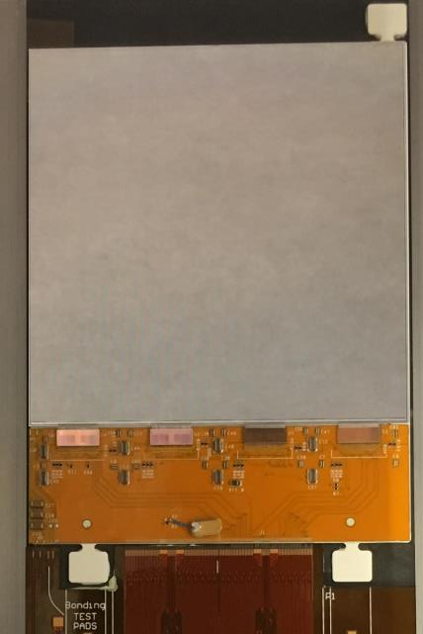
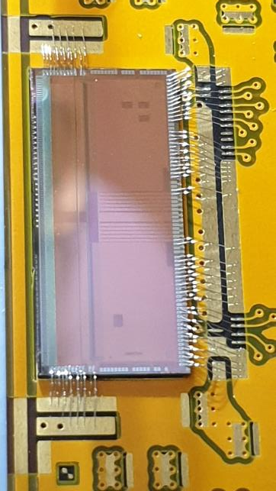

Production hybrids, modules & flexes
Flex cable
> 24 inches!
Tricky to manufacture in industry
SALT
Hybrid + Si sensor
SALT on hybrid

Slide 12
Discovery of SEU sensitivity
Previous version of chip:
No SEUs observed in configuration registers during proton testing
New design
No logic changes but re-synthesised
SEUs (low rate) observed in config regs during proton testing
Found a design weakness, sensitive to gate-level implementation
Luckily….. Can be mitigated by specific configuration & scrubbing
=> Radiation testing is mandatory

Slide 13
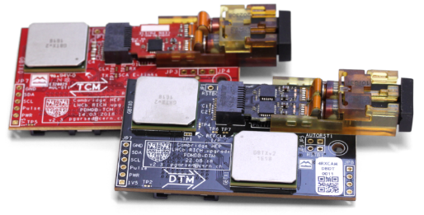
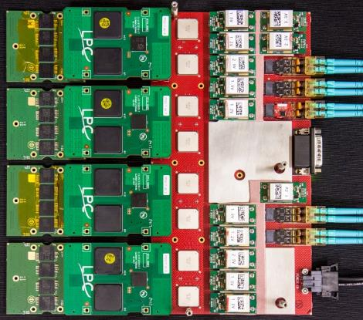
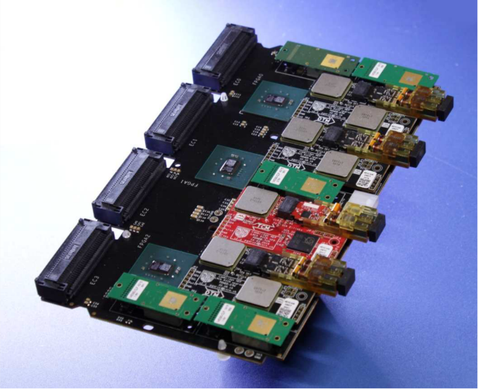
Commercial FPGAs on detector
(Mild radiation)
RICH (~200 krad): Kintex7 SRAM FPGA
CHARM irradiation tests vital
Mezzanine approach to safeguard special components
SciFi (~8krad): IGLOO2 flash FPGA
CHARM irradiation tests vital
Config rad-hard as expected
But lose programmability quite early
(~ 2krad)

Slide 14
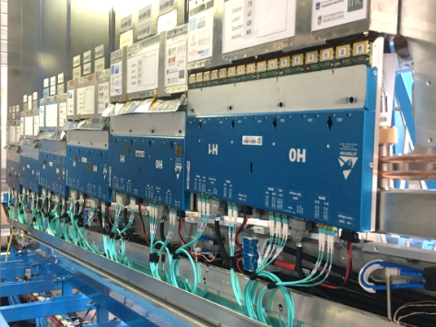
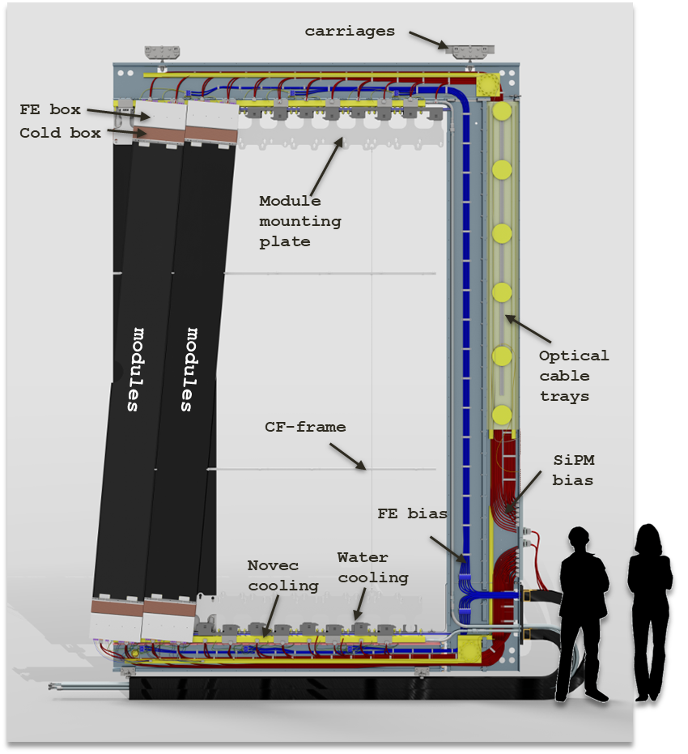
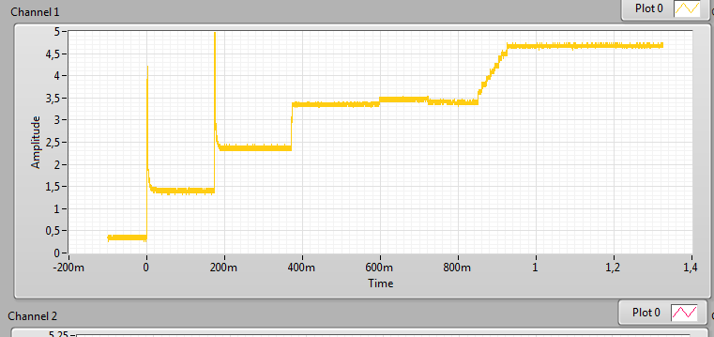
SciFi system integration
Modules finished production
Now facing (& resolving!) system issues
Inrush current & voltage glitches when configuration
Loss of control link in neighbour modules
Lose module configuration
OK after optimising GBTX PLL settings!
Current during module powering
1 channel = 4 modules

Slide 15
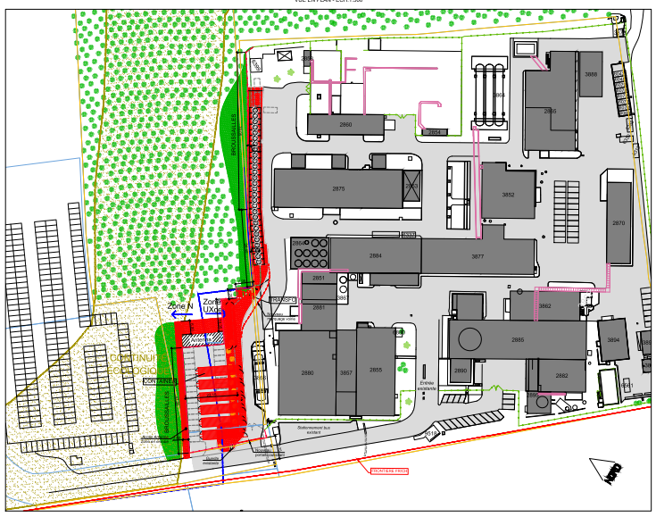
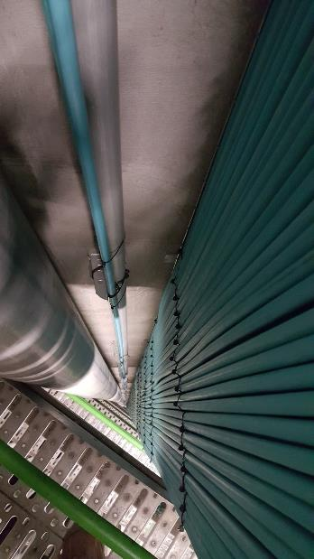
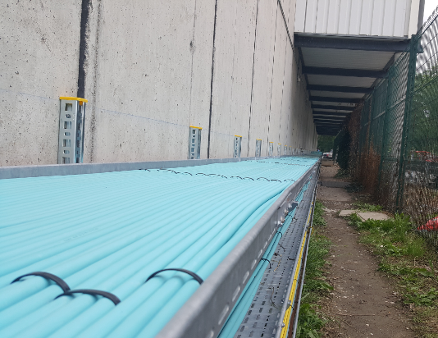


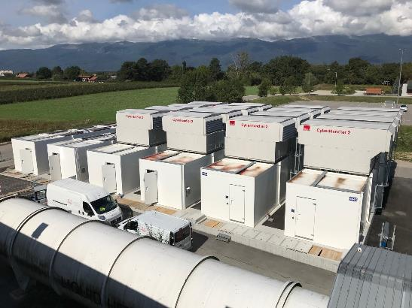
Swallowing the data
Farm of PC servers in data-centres on surface
350m optical fibres bringing data up from cavern

Slide 16
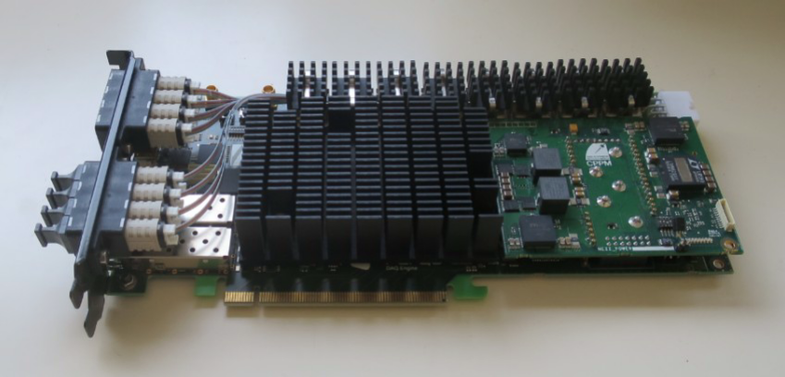
Digesting the data with PCIe40

Slide 17
Digesting the data with PCIe40
Common module for data readout & controls
Challenges:
new & complex FPGA
power & cooling
firmware
Production complete
Different firmware recipes
Common framework
+
custom blocks per sub-system
HUGE TASK !!!!
Continuous integration essential

Slide 18
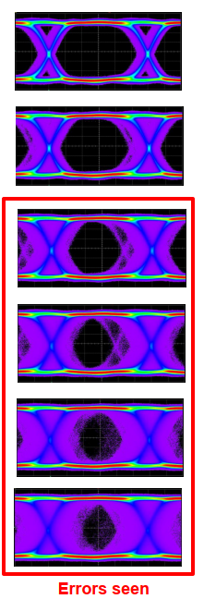
Link errors vs resource useage
Some nervous moments when PCIe40 was starting production
Ref: seminar by J-P. Cachemiche, https://indico.cern.ch/event/788032/
Intense investigation
Coupling between power planes? (more prototyping)
Inadequate decoupling? (peaks in ripple noise spectrum)
Increasing resources used
Power plane resonance?
PLL phase noise?
Choice of PLL?
Finally identified in firmware:
Ref clk routed to core before PLL, & was noisy
[Was required to allow older tools to converge]

Slide 19
Lessons (re-)learned
Enormous benefits from ‘Common Developments’
Complex components requiring skilled personnel to design, test & procure
Early R&D funding was vital
Custom ASICs
These defined the timescales <= availability of skilled personnel
Complex, demanding rigorous verification
Radiation testing essential (always surprises)
System prototyping is essential
Discovering dirty details in last 12 months (eg low temp, power-supply glitches)
Procurement procedures are lengthy & tricky
Relationships with suppliers must be nurtured (& follow industrial standards!)
Quality assurance ! (many examples of poor quality)
FPGAs are very powerful & very complex
Power & signal integrity are critical
Can only be handled by well-trained personnel

Slide 20
Conclusions
Sub-detectors implementing a global architecture
All modules in production, some already integrated
Infrastructure almost ready
On target for end of LS2………
Proposals now for next upgrades in LS3/LS4

Slide 21



Slide 22
Back-ups

Slide 23
Motivation for upgrade
At L = 2(+) x 10³² cm⁻²s⁻¹,
beyond 5 fb⁻¹, statistics don’t improve much
Big statistical improvement if:
  increase L to 2 x 10³³, AND
  improve efficiency of trigger algorithms
BUT ..... with current L0 trigger:
rate & latency limited by electronics
(1 MHz, 4 μs) => saturation

Slide 24
BUT…. efficient trigger decisions require:
  long latencies (>> 4 μs)
  computational power
  data from many (all) sub-detectors
  (momentum, impact parameter .....)
      Trigger in software
Use data from every bunch crossing
Upgrade electronics + DAQ for LS2

Slide 25
Architectural choices
Data compression on front-end to minimize links:
~ 15,000 links (4.8 Gbit/s)
Flexibility:
4 of 6 sub-detectors will use FPGAs in front-ends
TFC
TFC
Combine slow & fast controls (ECS & TFC) in duplex links
On detector
4.8 Gb/s
Off detector
ECS
ECS
4.8 Gb/s
Simplex data links
4.8 Gb/s
Off detector
Data
Data
Backend is PCIe form factor in event-building farm

Slide 26
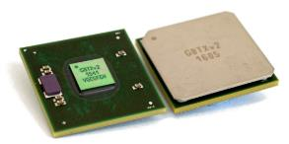
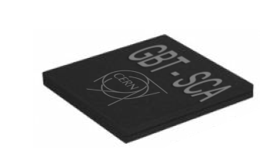
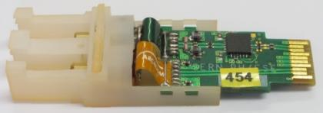
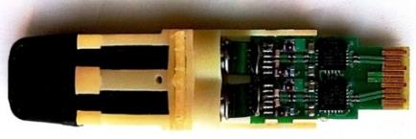
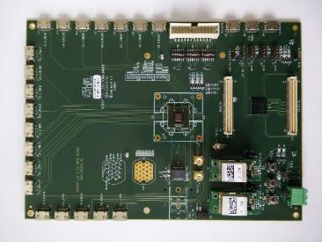
Common front-end components
GBTX
GBT-SCA
VTRX (incl GBTIA + GBLD)
VTTX (incl GBLD)
FEASTMP
VLDB
A huge thank you to the teams for the many man-years of development and the never-ending requests for support !!!!
The LHCb upgrade would not be possible without this effort

Slide 27
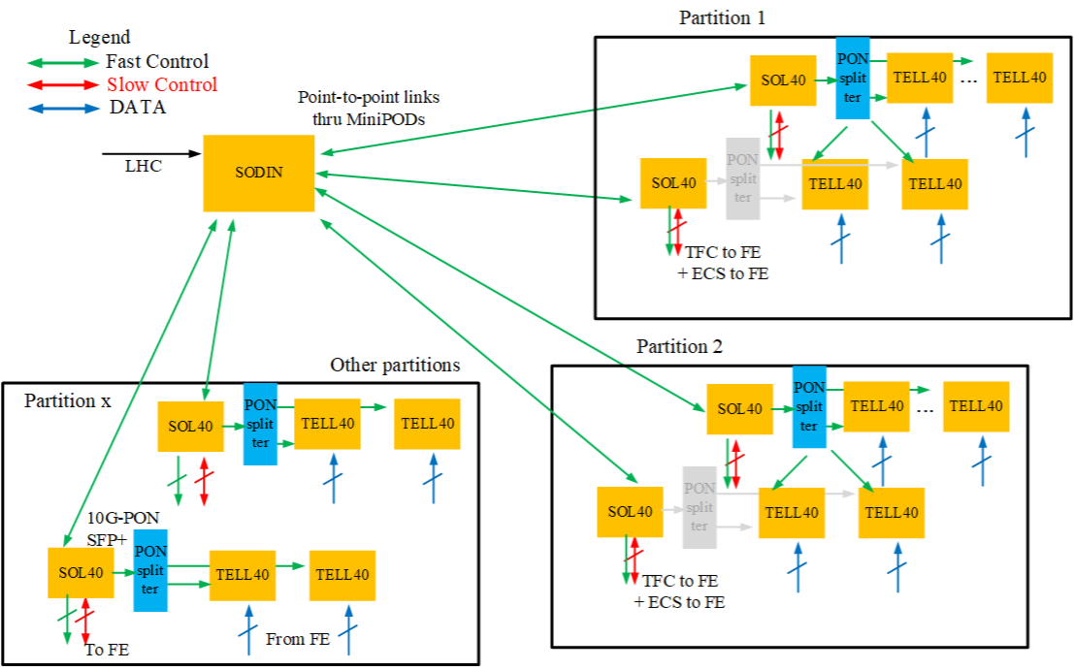
Fast & slow controls with PCIe40

Slide 28
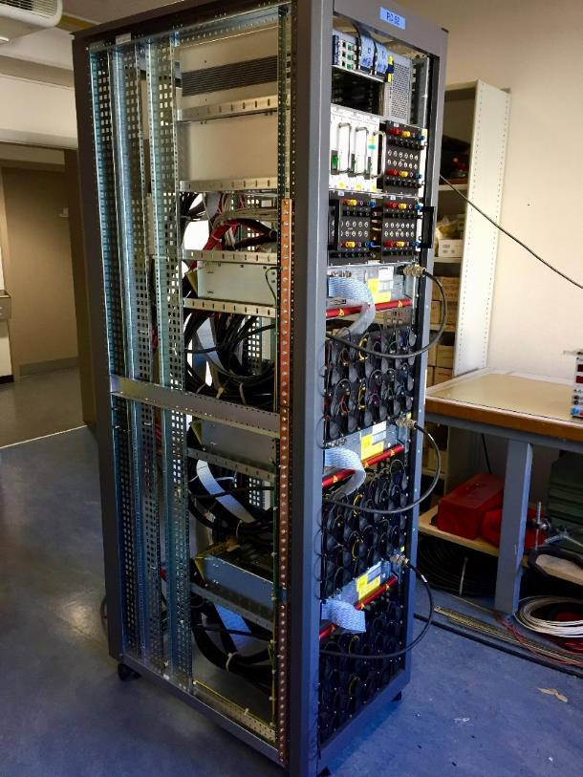
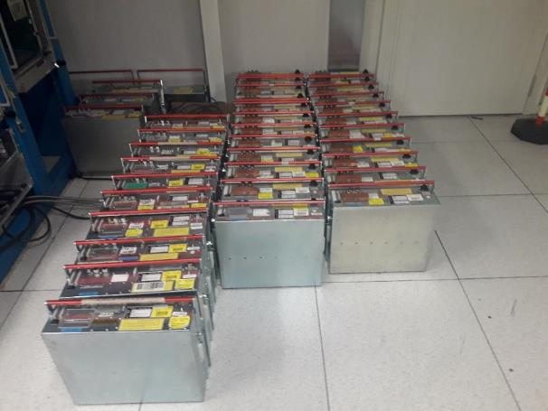
Infrastructure
Re-use as much as possible
Keep power supply infrastructure
Maintenance & modifications
Most of Cu cables
Thanks for the ongoing support & maintenance & purchasing contracts for power supplies

