Slide 2
CERN power converters
Controlled with FGC3
Jean-Paul Burnet

Slide 3
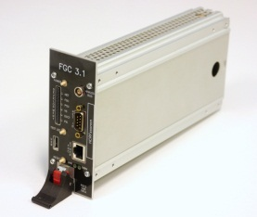
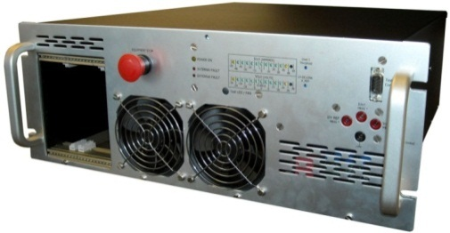
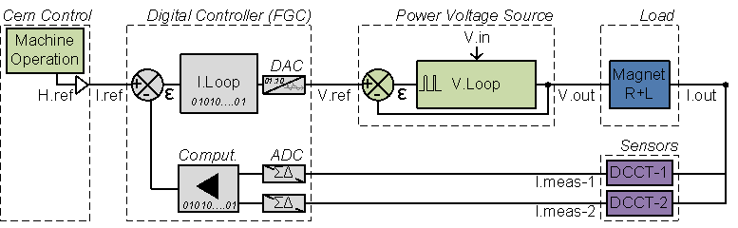
Magnet power converters
TE-EPC developed many power converters to be operated at CERN.
Each converters is controlled with an FGC (Function Generator and Controller) which receives the current reference and performs the digital current control.
FGC

Slide 4
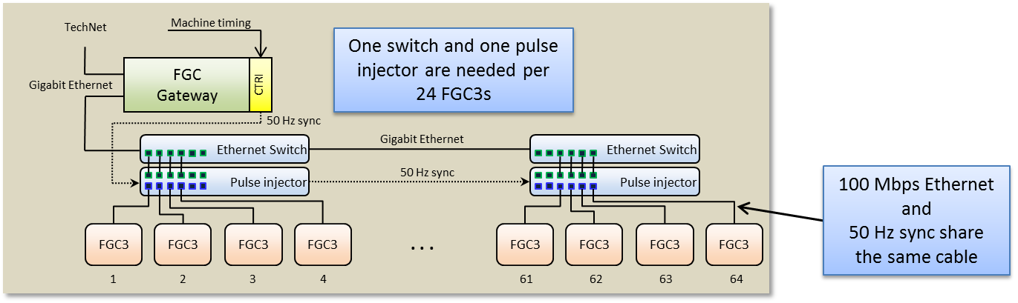
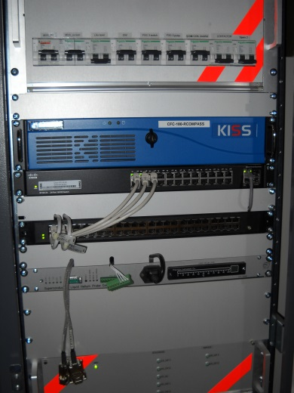
Power converters control
Each converters is controlled by an FGC (Function Generator and Controller) which communicates with a gateway through a dedicated ETHERNET bus.
This gateway makes the interface with the control room through the general control infrastructure.
CERN has a special control infrastructure, very powerful but very complex.
CERN control infrastructure is unique, while Light sources developed common control platforms like EPICS or TANGO.
Gateway

Slide 5
List of power converters controlled by FGC3
Follow link below:
CANCUN ±50A/±30V or ±20A/±75V
RF25KV 8A/25kV
APOLO ±450A/±450V
COMET ±250A/±120V
SATURN ±800A/±700V or ±1600A/±350V
MIDIDISCAP ±50A/±600V/5ms
Commercial Power Supplies Controlled With FGC3: as an example : 700A/14V
Following slides, LINAC4 power converters controlled by FGC3

Slide 6
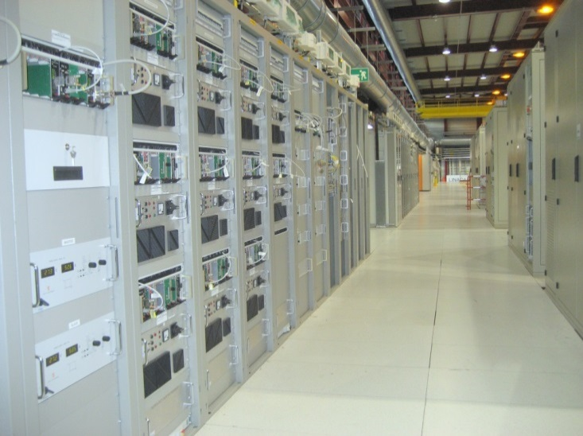
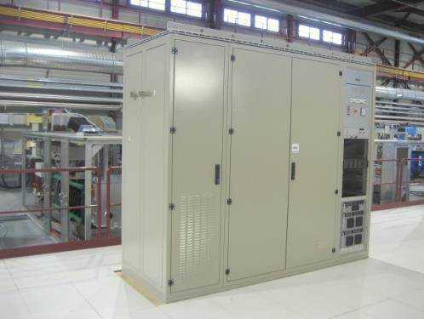
List of power converters for LINAC4
FGC3 started with LINAC4 (2008)
All power converters of LINAC4 are controlled with FGC3
COMMERCIAL (DELTA)
MAXIDISCAP
MODULATOR

Slide 7
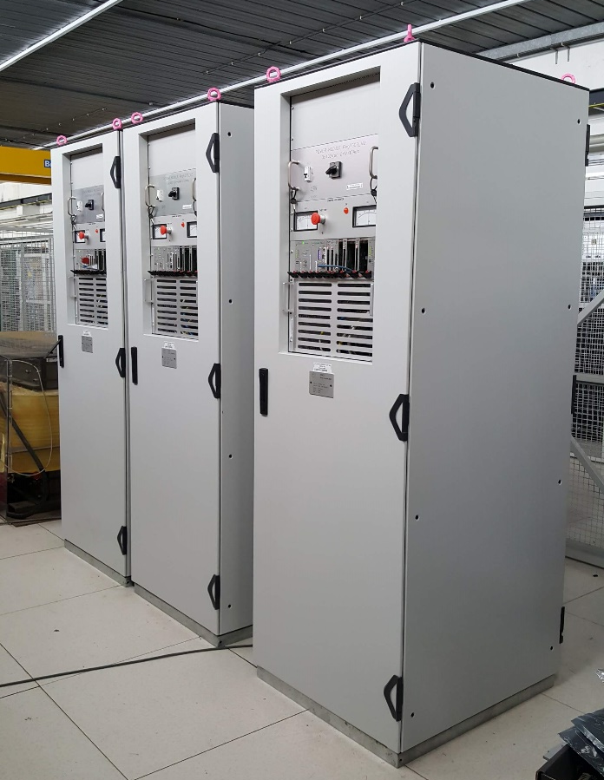
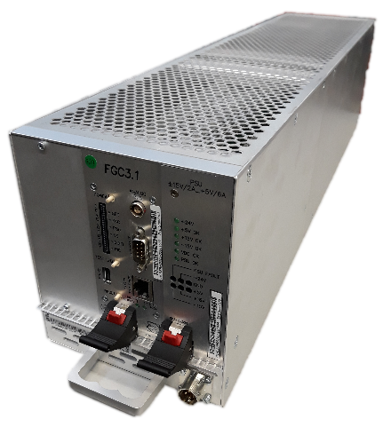
FGC is everywhere at CERN
All type of power converters is controlled with an FGC.
Many ways to integrate it!
Interface case, FGC3 only.
Full integrated control electronics is REGFGC3.
COMET ±250A / ± 120V
CUTE (±12,5A / ±15V)
Full REGFGC3
FGC3 only

Slide 8
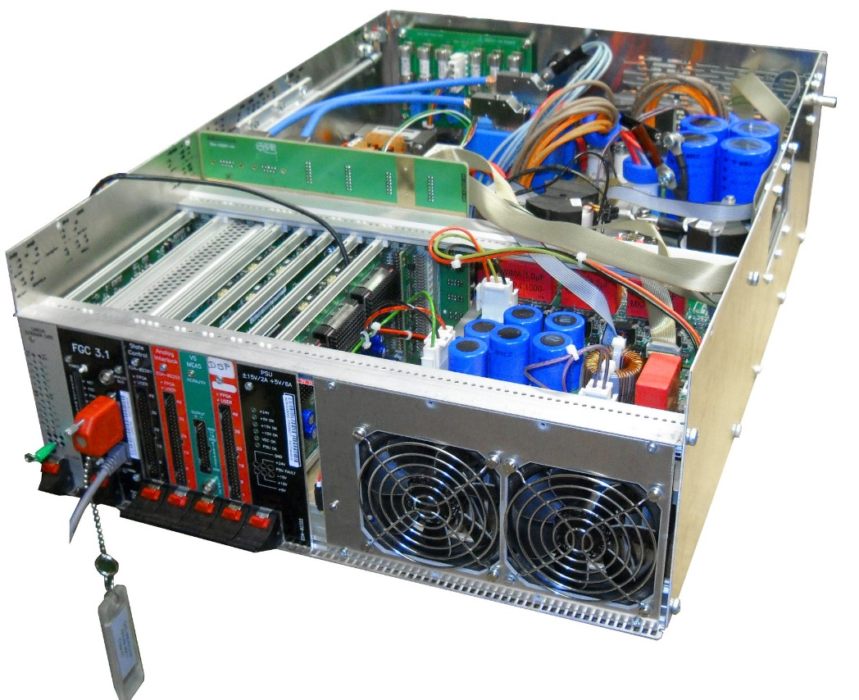
CANCUN
4-quadrant power converters
±50A / ±30V
±20A / ±75V
±5A / ±100V
300 produced for LIU, ELENA, …

Slide 9
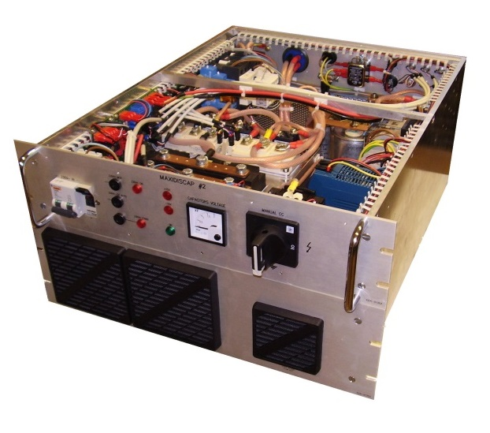
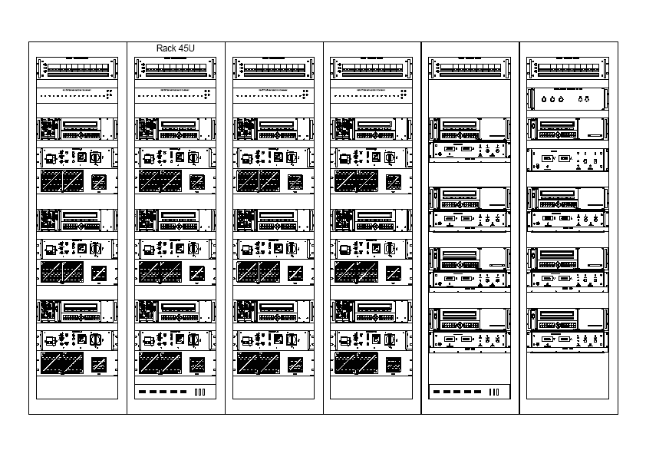
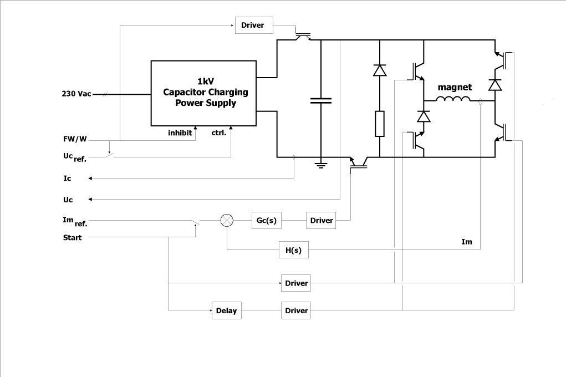
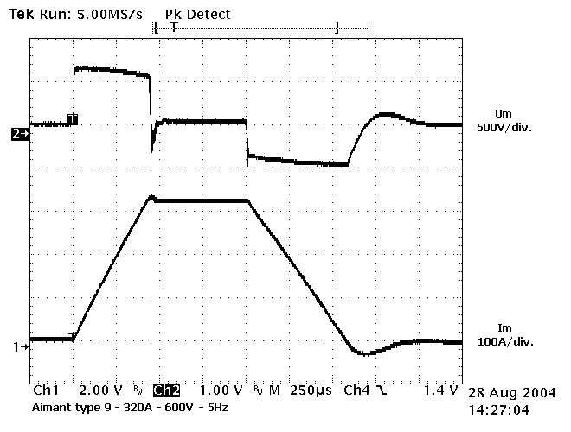
MAXIDISCAP
3 units per rack
1 kV, 200A;
pulsed 2 Hz;
flat-top duration: 1.2ms
flat-top precision: ~500 ppm
Power crate 19”, 6U
voltage
500V
current
300A
1 ms

Slide 10
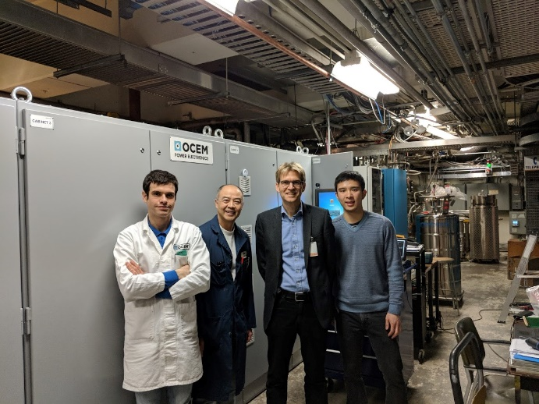
Technology transfer, first agreement
OCEM got a contract for a 20kA / 70V power converter for TRIUMF.
FCG control was part of their offer (2ppm stability) with EPICS framework.
The specification was challenging in term of current stability, and thanks to FGC control and CERN expertise, TRIUMF was confident to place the contract with OCEM.
The power converter was successfully commissioned in 2018!

Slide 11
Second agreement
ESRF wanted to get a MEGADISCAP for their new injection septum.
CERN proposed to delivered 2 MEGADISCAP (technology transfer agreement).
Standard CERN product, however, CERN isn’t a vendor.
The power converter was delivered in October 2019!

Slide 12
Third agreement
SOLEIL wants to get an uniform control system for their power converters.
They identified FGC as a potential controller for their future machine (1700 power converters in 2025).
First step, upgrade of 13 converters in 2020.
Training session done.
Integration of FGC in their control environment for tests, done.
Study of FGC3 and RegFGC3 integration, to be completed.

Slide 13
Summary
FGC controller is part of the CERN KT portfolio.
FGC gateway in TANGO/EPICS version are in good progress.
CERN is looking for industrial partners to ease diffusion.
All lab requests are studied and need appropriated solutions.

