Slide 1
Booster
Main Power Supplies
Roberto Petrocelli
13th November, 2019

Slide 2
The ALBA Synchrotron
ALBA is the Spanish synchrotron light source. It is a complex of electron accelerators to produce synchrotron light, which allows visualization and analysis of matter and its properties at atomic and molecular levels.
ALBA is in operation since May 2012 and has seven beamlines which are able to perform experiments in different scientific fields: physics, chemistry, life sciences, materials science, cultural heritage, biology, nanotechnology,... Two new beamlines were initiated in 2014 to be devoted to infrared microspectroscopy and photoemission with angular resolution in 2017 and 2019, respectively. In 2016, a new microfocus beamline for macromolecular crystallography has been started with the aim of having the first users in 2020.
This scientific infrastructure produces 5.700 hours of beamtime per year and is available for the academic and the industrial sector to give service to more than 1.000 researchers every year.

Slide 3
OVERVIEW OF ALBA
SYNCHROTRON ACCELERATORS
Booster
(inner)
Booster-to-SR
Transfer line
Storage Ring
Linac-to-Booster
Transfer line

Slide 4
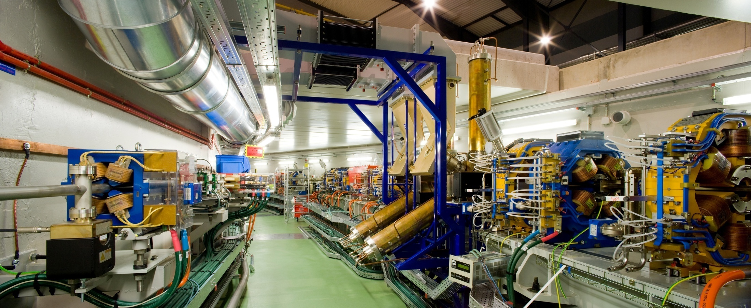

Slide 5
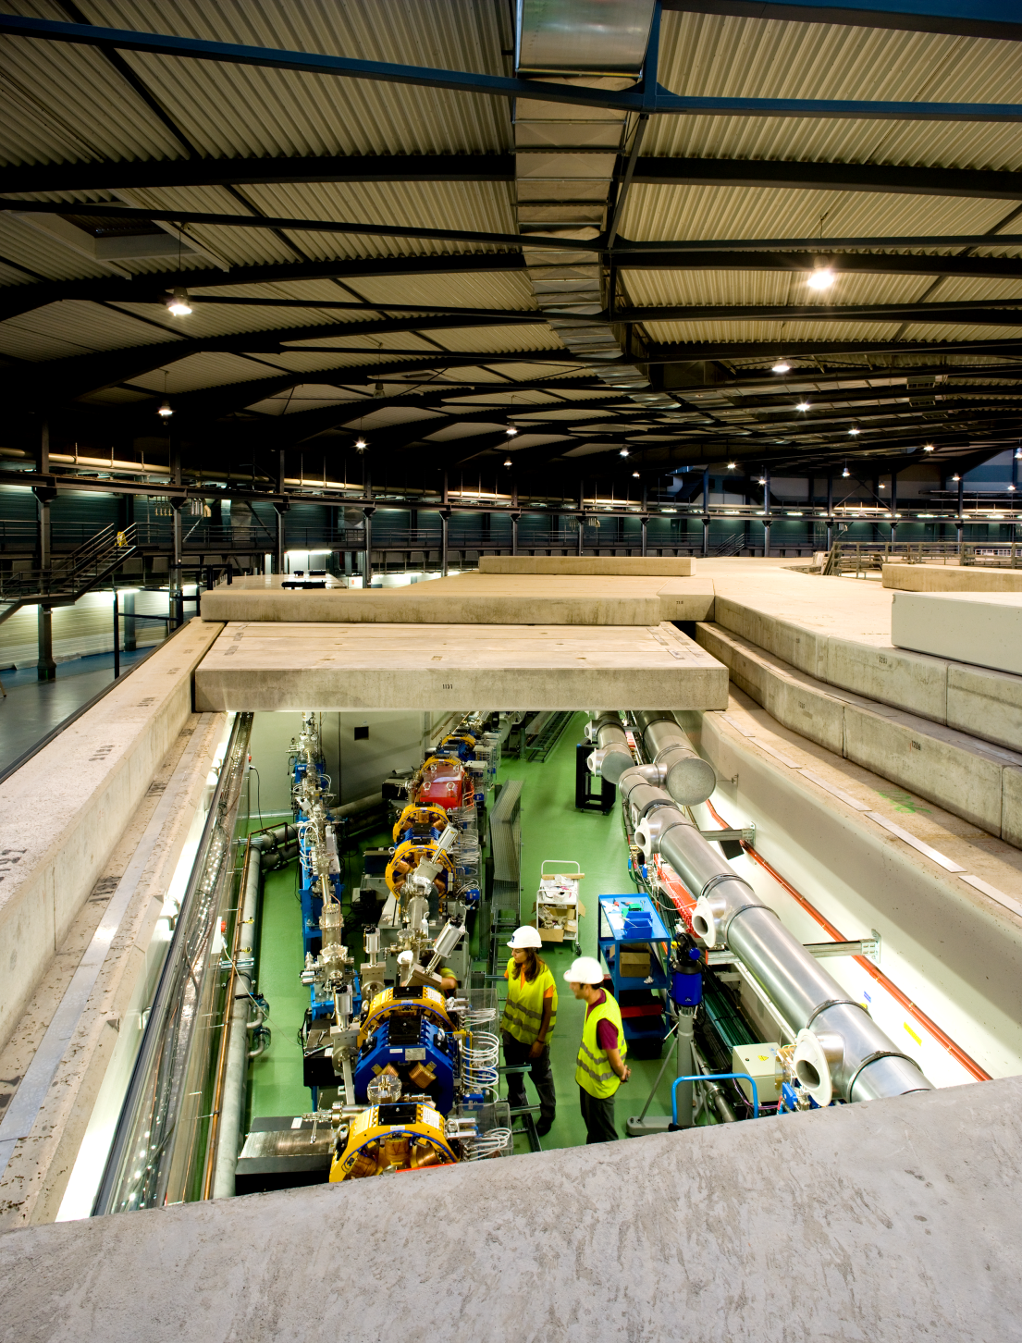

Slide 6
Distribution of Power Supplies in the Service Area
BO-MAINS
BT
SR-MAINS
LT

Slide 7
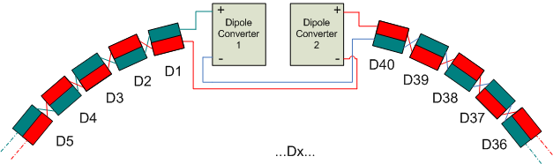
Magnet Families
Type of PC | Bend | QS180 | QS340 | QC340
Nr of PCs | 2 | 2 | 1 | 1
Load R [mOhm] | 710 | 440 | 610 | 2360
Load L [mH] | 200 | 27.2 | 48 | 216
Irated peak [A] | ±750 | ±180 | ±180 | ±180
Vrated peak [V] | ±1000 | ±120 | ±200 | ±750
Resolution [ppm] | 5 | 5 | 5 | 5
Stability 100s 8h [ppm] | ±15 | ±15 | ±15 | ±15
Reproducibility [ppm] | ±50 | ±50 | ±50 | ±50
Power Converters for ALBA Booster

Slide 8
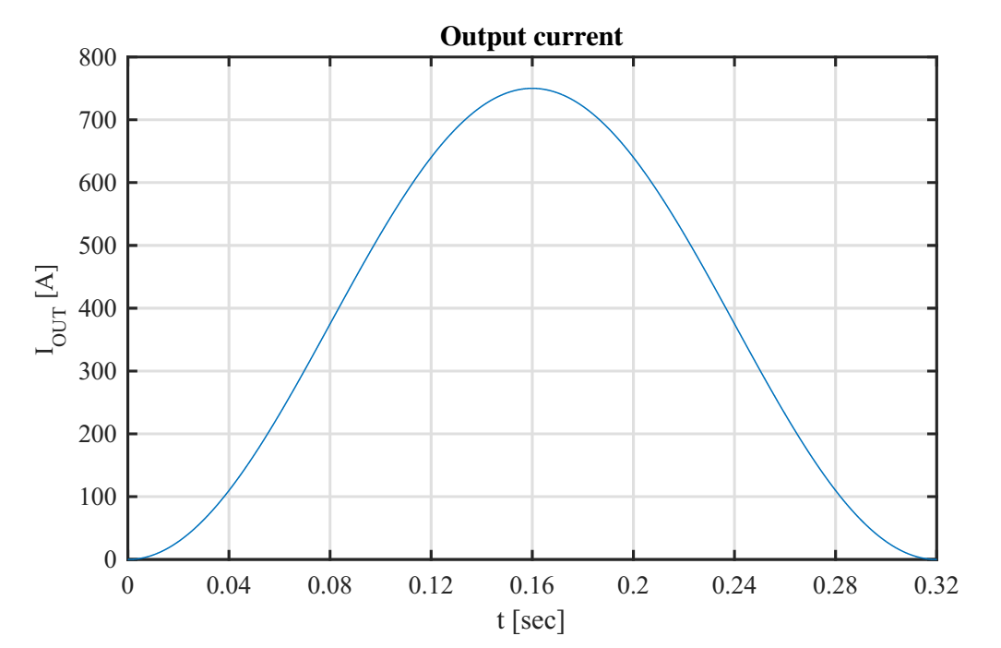
Booster Bending Output Current

Slide 9
Today’s Booster Bending Power Supply

Slide 10
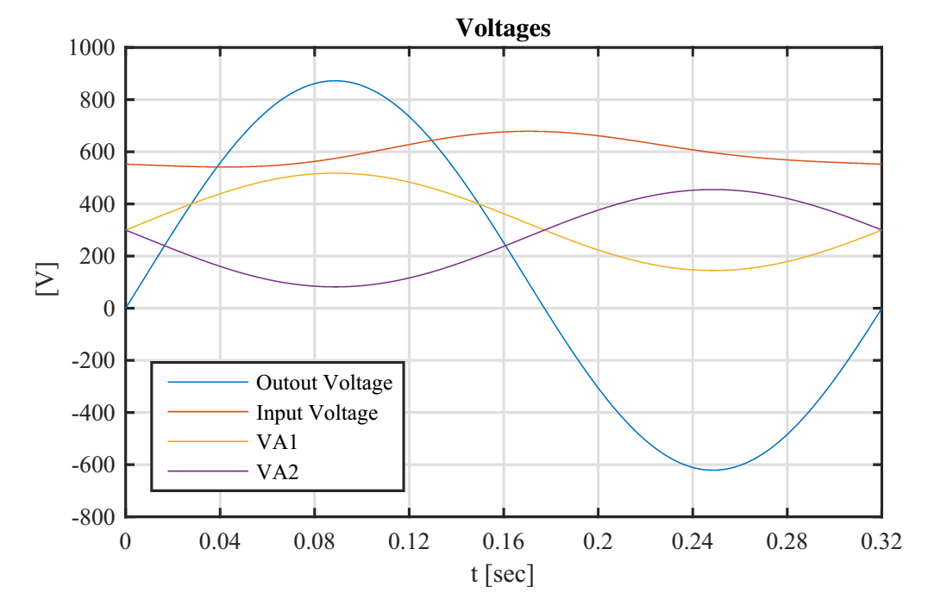
Booster Bending Output Voltages

Slide 11
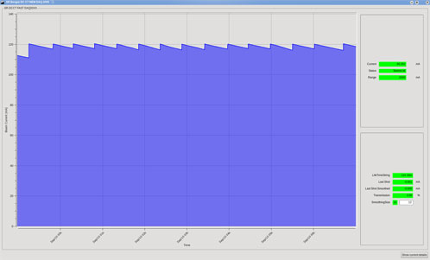
Booster Top-up Mode Operation
Injection into Storage Ring every 20 minutes
https://www.albasynchrotron.es/en/accelerators/operations
TOP-UP OPERATION AT ALBA SYNCHROTRON LIGHT SOURCE
Idle 1170sec | ramping 30 sec | Idle 1170sec | ramping 30 sec | Idle 1170sec

Slide 12
Synchronization with other Components of the Accelerators
A timing system produce trigger signals for the different components of the acelerators
  ALBA TIMING SYSTEM - A KNOWN ARCHITECTURE WITH FAST INTERLOCK SYSTEM UPGRADE
Trigger signal could a TTL electric signal or fiber optic.
This signal triggers the output current waveform
Setpoints for the output current waveform are pre loaded into the power supply control.

Slide 13
Why New Power Supplies ?
Two Main Problems
  Very low lifetime of 2Q modules under the stress of top-up operation.
  Power and thermal cycling.
  Large difficulties to make failure diagnostics when the control/regulation boards are involve.
Booster Power supplies has been identified as the highest risk for the long term operation of the facility

Slide 14
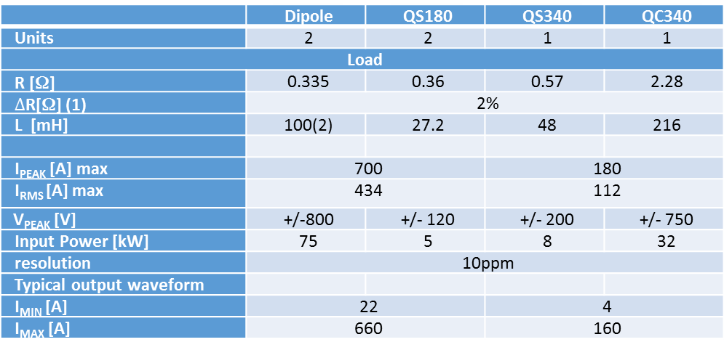
Summary
 | Dipole | QS180 | QS340 | QC340
Units | 2 | 2 | 1 | 1
Load
R [Ω] | 0.335 | 0.36 | 0.57 | 2.28
$∆$R[Ω] (1) | 2%
L [mH] | 100(2) | 27.2 | 48 | 216
I_{PEAK} [A] max | 700 |  | 180
I_{RMS} [A] max | 434 |  | 112
V_{PEAK} [V] | +/-800 | +/- 120 | +/- 200 | +/- 750
Input Power [kW] | 75 | 5 | 8 | 32
resolution | 10ppm
Typical output waveform
I_{MIN} [A] | 22 |  | 4
I_{MAX} [A] | 660 |  | 160

Slide 15
Operation conditions
Mains
Line voltage [V] | 400 +/- 10%
Frequency [Hz] | 50
Short circuit capacity | < 40MVA
Cooling water
Water conductivity uS/cm | 0.2
Inlet temperature [ºC] | 23 +/- 1
Max temperature variation [ºC] | 17
Inlet pressure [bar] | 10
Outlet pressure [bar] | 4

Slide 16
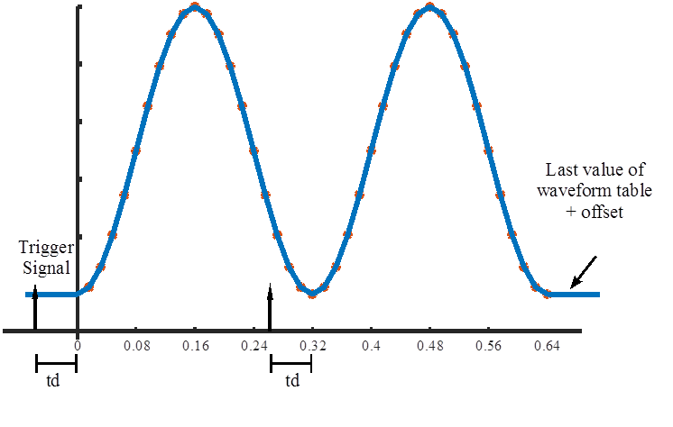

Slide 17
8.33 ppm FS
Relative error E_{REL} [ppm] | 125
I_{ERR(Low)} (3) | I_{MIN} E_{REL} or 2.75 mA | I_{MIN} E_{REL} or 0.5 mA
I_{ERR(Hi)} (3) | I_{MAX} E_{REL} or 2.75 mA | I_{MAX} E_{REL} or 0.5 mA

Slide 18

Tracking Error:
The tracking error is defined as follow:
$$\left|\frac{I_{OUTPUT}(t)−I_{REF}(t−t_{d})}{I_{REF}(t−t_{d})} \right| ≤ E_{TCK}$$
Where:
  I_{OUTPUT}(t) = output current of a power supply
  I_{REF}(t) = input reference values downloaded into the power supply
  t_{d} = delay time
Tracking error E_{TCK} [ppm] | 1000

Slide 19
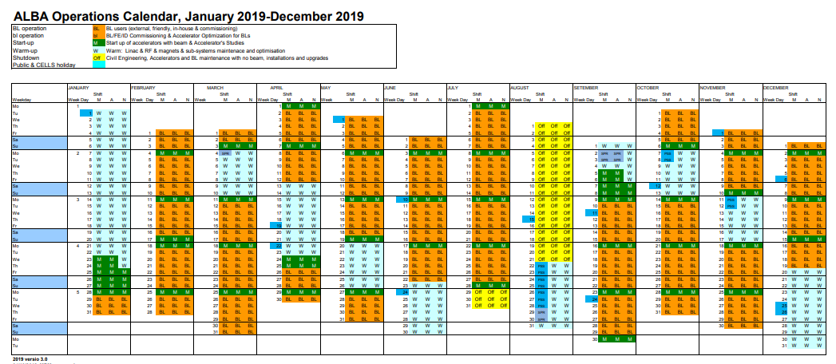
ALBA Calendar

