Slide 1
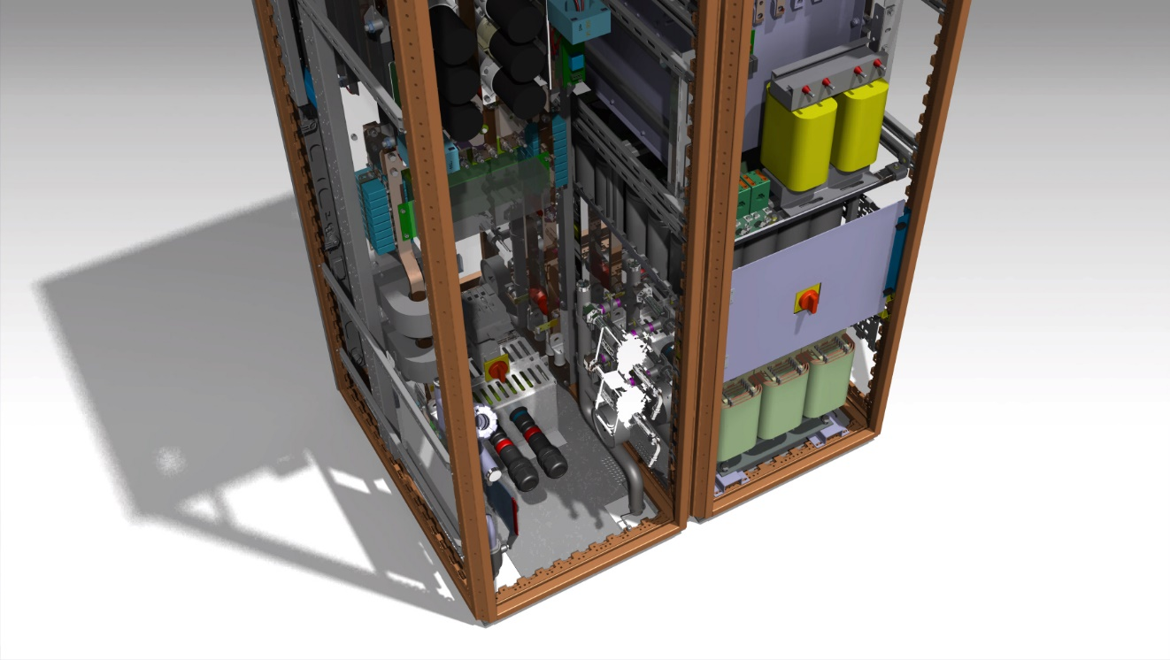

SIRIUS converter family
CERN-TE-EPC
13 June 2017

Slide 2
Overview
Introduction to Sirius Family
  Target applications
  Choosing the right model
Design industrialisation
  Production file
  Testing aids
ALBA pre-study
  Bending magnets
  Quadrupole magnets
  Budget allocation

Slide 3

Introduction to Sirius
Magnet type | Total (1.2sec) | Recoverable | Thermal loss (1.2sec)
Quadrupole (26Gev) | 11kJ | 6kJ | 5kJ
Small Dipole (26Gev) | 31.5kJ | 25kJ | 6.5kJ
Large Dipole (26Gev) | 101kJ | 82kJ | 19kJ
Annual cost of electricity of each 1kJ of losses:
(Non-recoverable/consumed every 1.2seconds)
242 CHF*
Sirius is primarily suitable for:
Cycling applications with considerable amounts of recoverable energy
RMS loss minimisation and magnet field conditioning (with FGC3)
Long life and fast cycling
* Assuming cost of electricity of 0.045 CHF/kWh. 1kJ of energy over a 1.2sec cycle corresponds to 1kJ/1.2sec=0.83kW of average power. Assuming this 1.2sec (PS) cycle repeats for 24hours over 270 working days the total energy required from the power network (for each 1kJ) is 5378kWh/annum. If this energy is not recovered in capacitor banks after every magnet cycle it is returned to the power network and is not remunerated by the provider.

Slide 4
Power Converter for Transfer lines
Energy recovery bank 30-90kJ
Standardised converter brick
SIRIUS S
SIRIUS 2P
SIRIUS 4P
SIRIUS S 30kJ
SIRIUS S 60kJ
SIRIUS S 90kJ
SIRIUS 2P 60kJ
SIRIUS 2P 120kJ
SIRIUS 2P 180kJ
SIRIUS 4P 120kJ
SIRIUS 4P 240kJ
SIRIUS 4P 360kJ
Extra cabinet for energy storage: SIRIUS 4P+ 600kJ

Slide 5
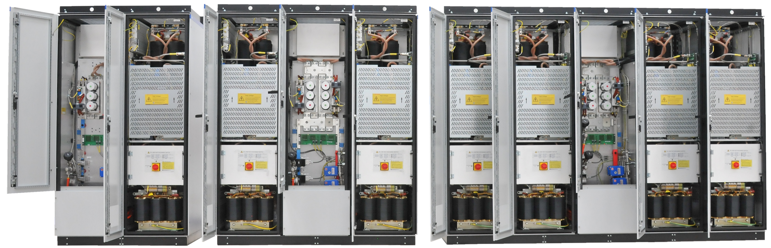
Power Converter for Transfer lines
SIRIUS S
SIRIUS 2P
SIRIUS 4P
SIRIUS S 30kJ
SIRIUS S 60kJ
SIRIUS S 90kJ
SIRIUS 2P 60kJ
SIRIUS 2P 120kJ
SIRIUS 2P 180kJ
SIRIUS 4P 120kJ
SIRIUS 4P 240kJ
SIRIUS 4P 360kJ
Extra cabinet for energy storage: SIRIUS 4P+ 600kJ

Slide 6
Power Converter for Transfer Lines
V_{magnet,peak}
SIRIUS 2S
I_{magnet,rms}: 200A
P_{magnet,rms}: 30kW
E_{magnet,max}: 56kJ
113kJ
SIRIUS 2P2S
I_{magnet,rms}: 400A
P_{magnet,rms}: 60kW
E_{magnet,max}: 113kJ
900V
56kJ
SIRIUS 4P*
I_{magnet,rms}: 800A
P_{magnet,rms}: 60kW
E_{magnet,max}: 200kJ
200kJ
450V
28kJ
56kJ
113kJ
SIRIUS S
I_{magnet,rms}: 200A
P_{magnet,rms}: 15kW
E_{magnet,max}: 28kJ
SIRIUS 2P
I_{magnet,rms}: 400A
P_{magnet,rms}: 30kW
E_{magnet,max}: 56kJ
SIRIUS 4P
I_{magnet,rms}: 800A
P_{magnet,rms}: 60kW
E_{magnet,max}: 113kJ
450A
900A
1800A
I_{magnet,peak}
NOTE! Sirius a Fast Pulsed converter range exists too!

Slide 7
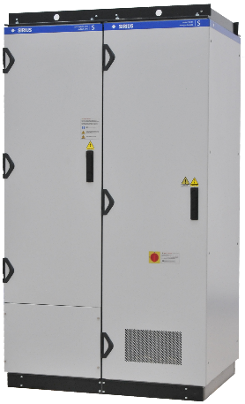
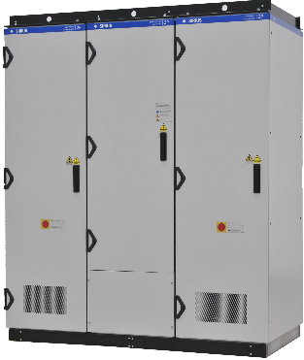
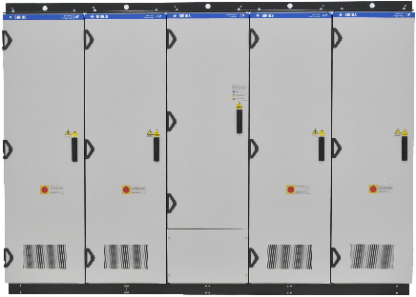
Choosing the right model
Sirius S
Sirius 2P
Sirius 4P
Output power
limited by the front-end Boost stage power rating
15kW
30kW
60kW
Recoverable magnet energy is limited by the built-in capacitive storage¹ (0 to 7 banks per power brick²)
77kJ
144kJ
288kJ
Output RMS current is limited by the output H-bridge stage ratings and lifetime³ considerations
200A
400A
800A
450A peak
900A peak
1800A peak
¹ moderate dc-link discharge depth of 300V
² capacitor banks 4 to 7 require additional rack
³ assuming 200million cycles with 1.2second period
Complete specification: http://section-mpc.web.cern.ch/content/converters/sirius/general

Slide 8
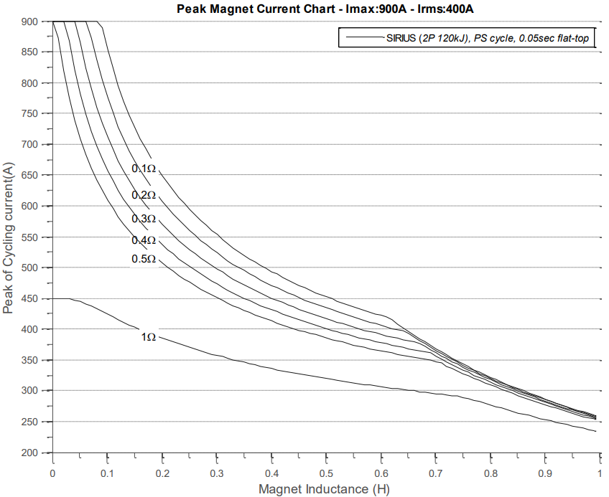



Choosing the right model
High RMS losses
Energy storage limited
Not
OK
OK
Voltage ratings
not enough
Selection curves:https://edms.cern.ch/document/1540790/1

Slide 9
Design Industrialisation

Slide 10
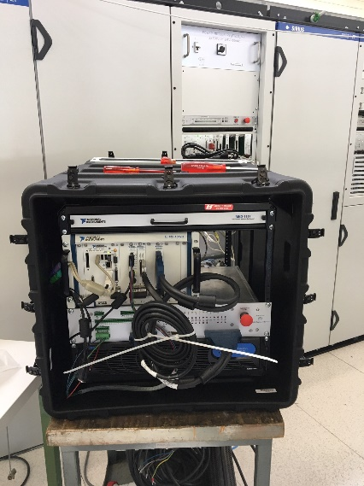
Design industrialisation
The main principles:
  Standardise solution across different projects
    Produce in large scale -> lower prices
  Create a complete production file
    No development effort for supplier -> wide range of bidders
  Cern supply of critical components (to maintain the know-how)
    DCCTs, power stacks where made by specialist companies -> reduce risks
  Use off-the-shelf parts where possible
    Energy storing capacitors
    Metal cabinets
    All switchgear
Test tools made for industry and troubleshooting

Slide 11
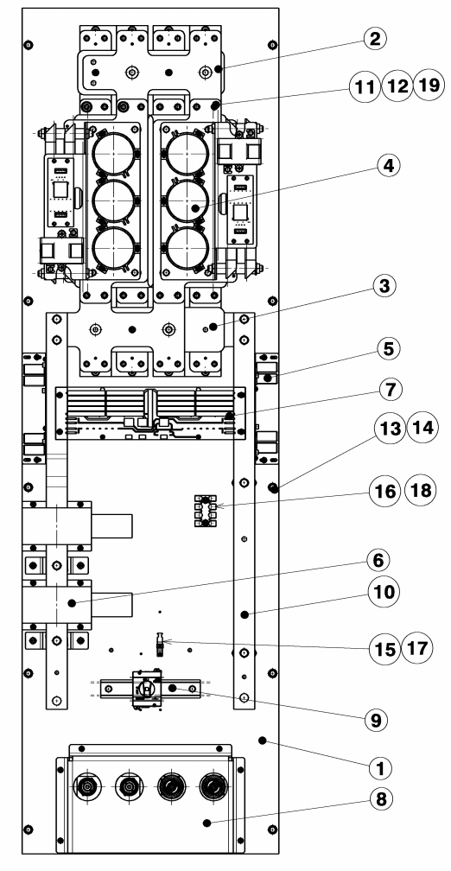
Production file
Production file contents:
Electronic Schematics (1 per model)
Mechanical drawings (~130 drawings)
Bill of materials (electromechanical)
List of cables
Suppliers list (suggestions)
Items specified/tendered for by CERN:
magnetic materials
power stack
DCCT
RegFGC3 chassis and cards

Slide 12
The ALBA pre-study

Slide 13
User requirements

Slide 14
Bending magnets
Quantity | Value |  | Unit | notes
APPLICATION DERIVED PARAMETERS
L_{MAGNET} | 0.1 | 0.1 | H
R_{MAGNET} | 0.355 | 0.355 | 0.355 | Includes 20mOhm cabling
I_{MAGNET,sat} | ? | ? | A
Imin | 20 | 20 | A
Imax | 700 | 700 | A | Converter rating: 900A
Vmax | 500 | 500 | V | Converter rating :900V
Energy to recover | 25 | 25 | kJ | 1 cap bank per brick
Rise time (Tr) | 0.19 | 0.19 | Sec
Fall time (Tf) | 0.11 | 0.11 | Sec
Flat-top duration (Tft) | 0.01 | 0.01 | Sec
Period time | 0.32 | 0.32 | Sec
Current RMS 4s | 410 | 410 | A | See note 1
Current RMS 40s | 39 | 39 | A
Current DC max | 400 | 400 | A | See note 2
Power Peak | 350 | 350 | kW
Power 4s | 59.7 | 59.7 | kW | Converter rating: 60kW
Operating time | 5700 | 5700 | h/annum
Cycles | 17100 | 17100 | Cyc/annum | See note 3
Cycles in lifetime | 342000 | 342000 | Cycles | In 20 years
CONVERTER PARAMETERS
Solution | 2x SIRIUS 2P2S Input: 3ph, 400V, 125A, cosφ:0.93, THD:30% Output: 900V_{PK},900A_{PK}, 400A_{RMS}, 60kW_{RMS,} E_{Recoverable}:132kJ)
Simplified (trapezoid) cycle
Fast ramping with 500V

Slide 15
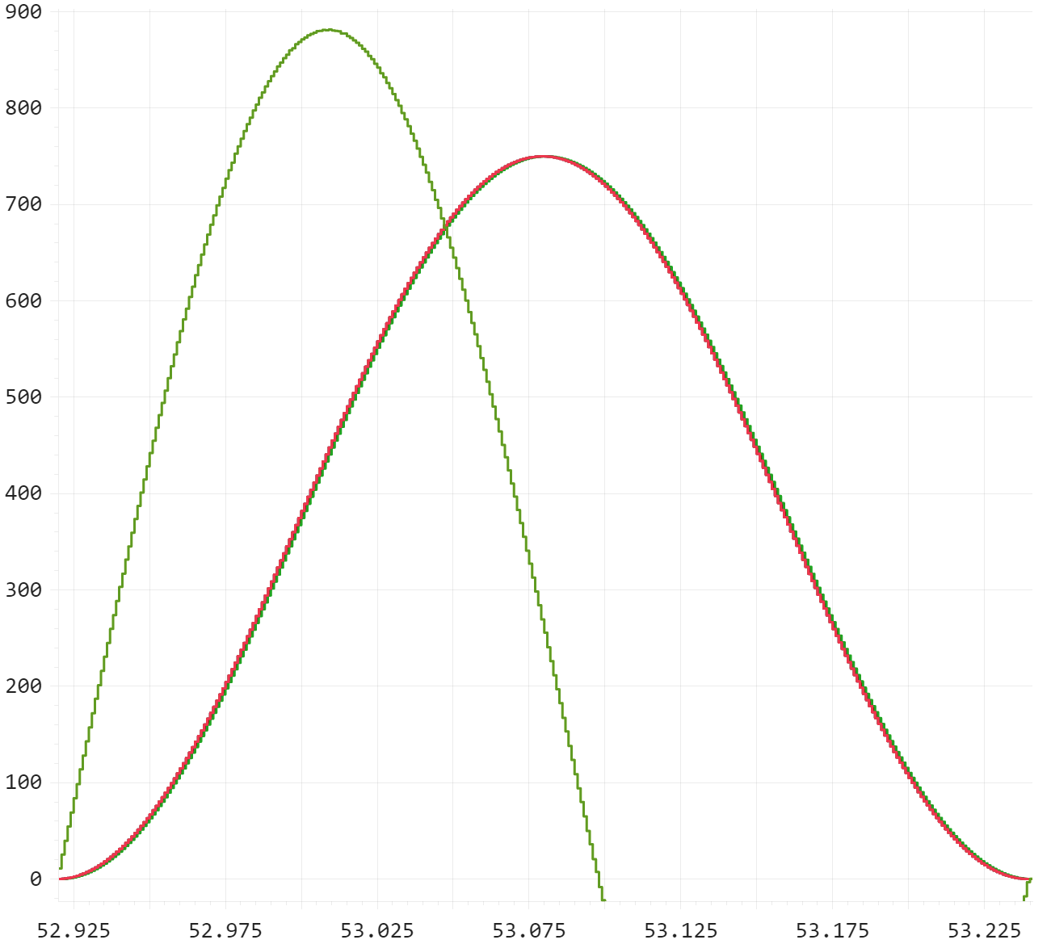
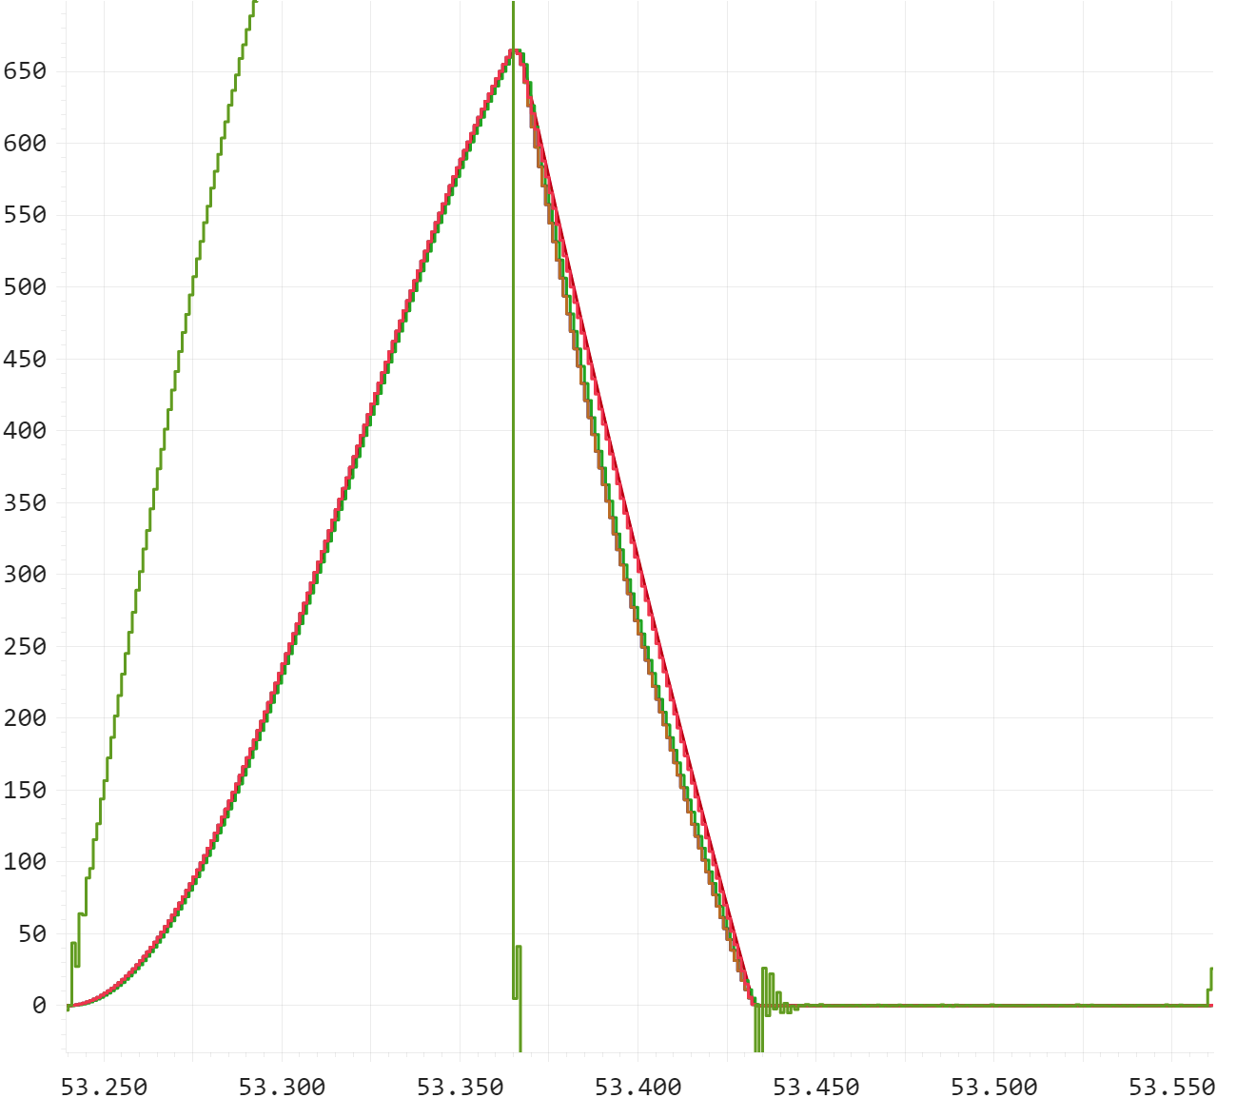
Bending magnets
Extraction instance
Sinusoidal cycle
Irms=459A
P=74.8kW (over 0.320s)
Semi-sinusoidal cycle
Irms =282A
P=52.6kW (over 0.320s)

Slide 16
Booster Quadrupole magnets
Quantity | Value |  | Unit |  | notes
APPLICATION DERIVED PARAMETERS
L_{MAGNET} | 0.0272 | 0.0272 | H | H | 8 magnets in series | 8 magnets in series
R_{MAGNET} | 0.44 | 0.44 | Ohm | Ohm | *discrepancy with spec | *discrepancy with spec
I_{MAGNET,sat} | ? | ? | A | A
Imin | 0 | 0 | A | A
Imax | 180 | 180 | A | A | Converter rating: 450A | Converter rating: 450A
Vmax | 81 | 81 | V | V | Converter rating: 450V | Converter rating: 450V
Energy to recover | 0.4 | 0.4 | kJ | kJ
Rise time (Tr) | 0.24 | 0.24 | Sec | Sec
Fall time (Tf) | 0.04 | 0.04 | Sec | Sec
Flat-top duration (Tft) | 0.01 | 0.01 | Sec | Sec
Period time | 0.32 | 0.32 | Sec | Sec
Current RMS 4s | 102 | 102 | A | A | Converter rating: 200A | Converter rating: 200A
Current RMS 40s | 10 | 10 | A | A
Current DC max | 185 | 185 | A | A | Converter rating: 200A | Converter rating: 200A
Power Peak | 14.6 | 14.6 | kW | kW
Power 4s | 4.6 | 4.6 | kW | kW
Operating time | 5700 | 5700 | H | H
Cycles | 17100 | 17100 | Cycles/annum | Cycles/annum
Cycles in lifetime | 342000 | 342000 | Cycles | Cycles | In 20 years | In 20 years
CONVERTER PARAMETERS
Solution | SIRIUS S Input: 3ph, 400V, 32A, cosφ:0.93, THD:30% Output: 450V_{PK},450A_{PK}, 200A_{RMS}, 15kW_{RMS,} E_{Recoverable}:33kJ)

Slide 17
Booster QS340
Quantity | Value | Unit | notes
APPLICATION DERIVED PARAMETERS
L_{MAGNET} | 0.048 | H | 8 magnets in series
R_{MAGNET} | 0.61 | Ohm | *discrepancy with spec
I_{MAGNET,sat} | ? | A
Imin | 0 | A
Imax | 180 | A | Converter rating: 450A
Vmax | 115 | V | Converter rating: 450V
Energy to recover | 0.8 | kJ
Rise time (Tr) | 0.24 | Sec
Fall time (Tf) | 0.05 | Sec
Flat-top duration (Tft) | 0.01 | Sec
Period time | 0.32 | Sec
Current RMS 4s | 105 | A | Converter rating: 200A
Current RMS 40s | 10 | A
Current DC max | 157 | A | Converter rating: 200A
Power Peak | 20.7 | kW
Power 4s | 6.7 | kW
Operating time | 5700 | H
Cycles | 17100 | Cycles/annum
Cycles in lifetime | 342000 | Cycles | In 20 years
CONVERTER PARAMETERS
Solution | SIRIUS S Input: 3ph, 400V, 32A, cosφ:0.93, THD:30% Output: 450V_{PK},450A_{PK}, 200A_{RMS}, 15kW_{RMS,} E_{Recoverable}:33kJ)

Slide 18
Booster QC340
Quantity | Value | Unit | notes
APPLICATION DERIVED PARAMETERS
L_{MAGNET} | 0.216 | H | 8 magnets in series
R_{MAGNET} | 2.36 | Ohm | *discrepancy with spec
I_{MAGNET,sat} | ? | A
Imin | 0 | A
Imax | 180 | A | Converter rating: 450A
Vmax | 460 | V | Converter rating: 450V
Energy to recover | 3.5 | kJ
Rise time (Tr) | 0.24 | Sec
Fall time (Tf) | 0.06 | Sec
Flat-top duration (Tft) | 0.01 | Sec
Period time | 0.32 | Sec
Current RMS 4s | 105 | A | Converter rating: 200A
Current RMS 40s | 10 | A | -
Current DC max | 113 | A | Converter rating: 200A
Power Peak | 82.8 | kW
Power 4s | 25.9 | kW
Operating time | 5700 | H
Cycles | 17100 | Cycles/annum
Cycles in lifetime | 342000 | Cycles | In 20 years
CONVERTER PARAMETERS
Solution | SIRIUS 2S Input: 3ph, 400V, 63A, cosφ:0.93, THD:30% Output: 900V_{PK},450A_{PK}, 200A_{RMS}, 30kW_{RMS,} E_{Recoverable}:66kJ)

Slide 19
Budget allocation
The bending circuits are expected to cost approximately 55% of the overall budget.

Slide 20
Annex

Slide 21
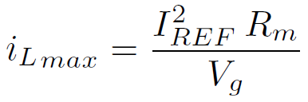
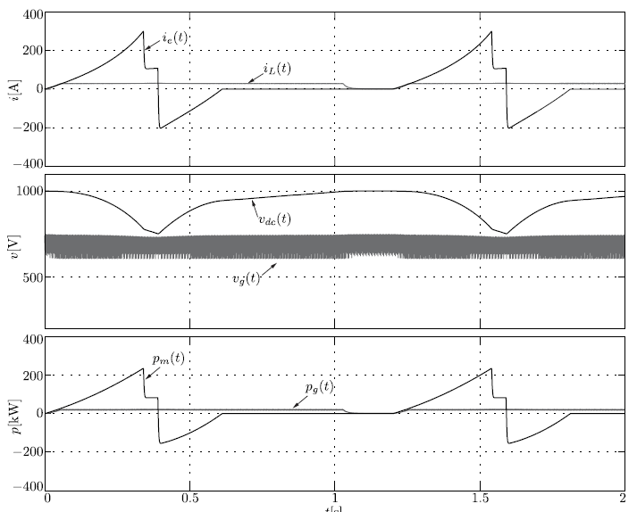
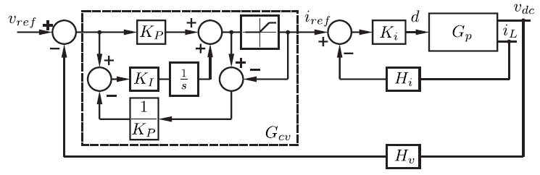
Limited grid power strategy
Energy supply
Energy recovery
Dc-link recharge

Slide 22
Grid disturbances
Nominal grid
Grid overvoltage
(0.4s – 0.5s)
Grid disconnection
(0.40s – 0.45s)

Slide 23
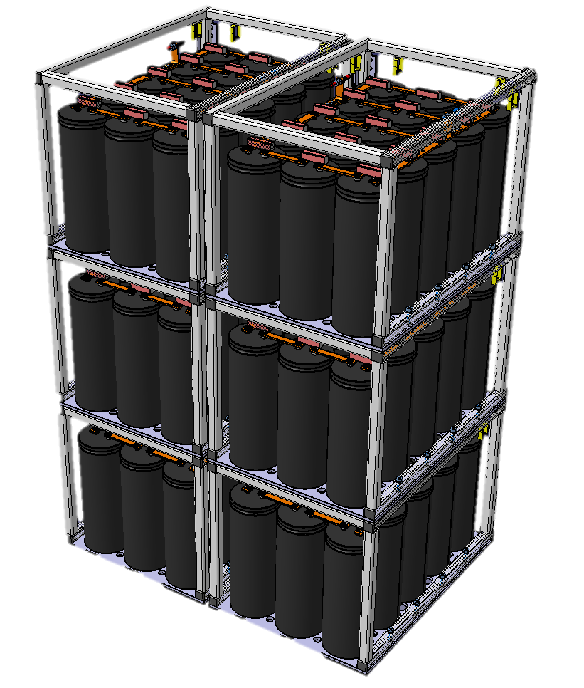
Energy storage module
Energy/capacitor
  Theoretical at 400V → 2320J
  Actual (tol.-15%) →1972J
  Operating at 300V → 1660J
  Usable 300V to 200V→ 616J
Energy/module (15 caps)
  Theoretical → 34800J
  Usable →9243J
Maximum 3 modules per brick
Customisation to increase total energy to 1MJ

Slide 24
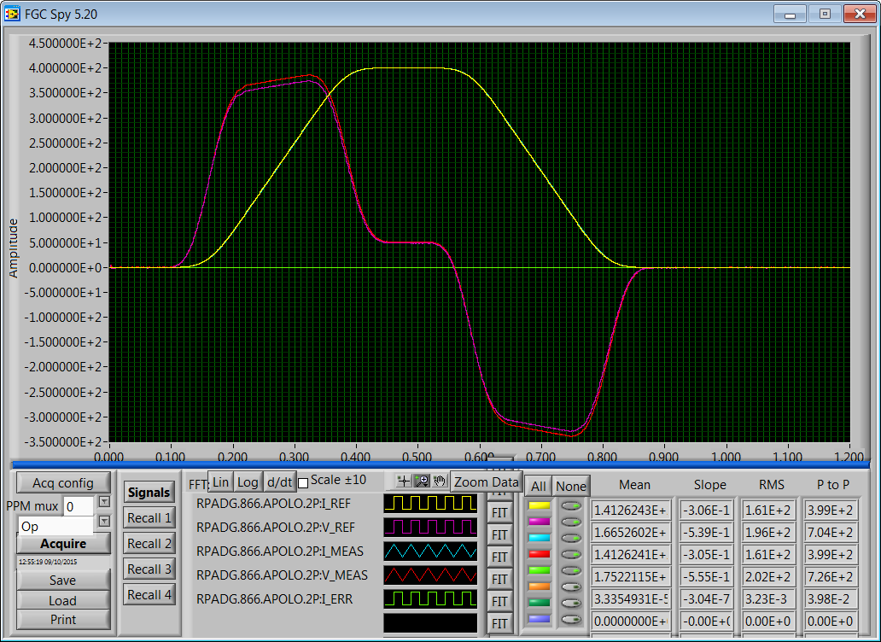
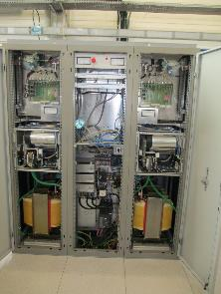
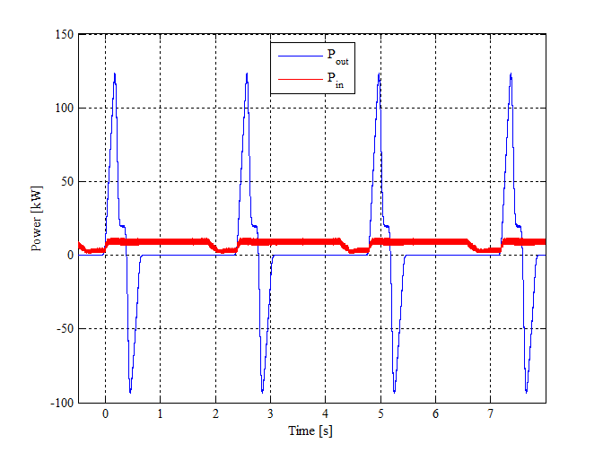
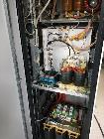
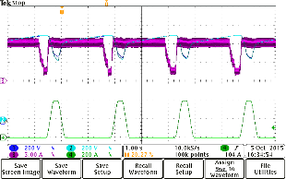
SIRIUS proof-of-concept
I_{magnet}
125kWpk
U_{out}
U_{DCA}
U_{DCB}
10kWpk
I_{boost}
I_{magnet}
https://edms.cern.ch/document/1506381/1

Slide 25
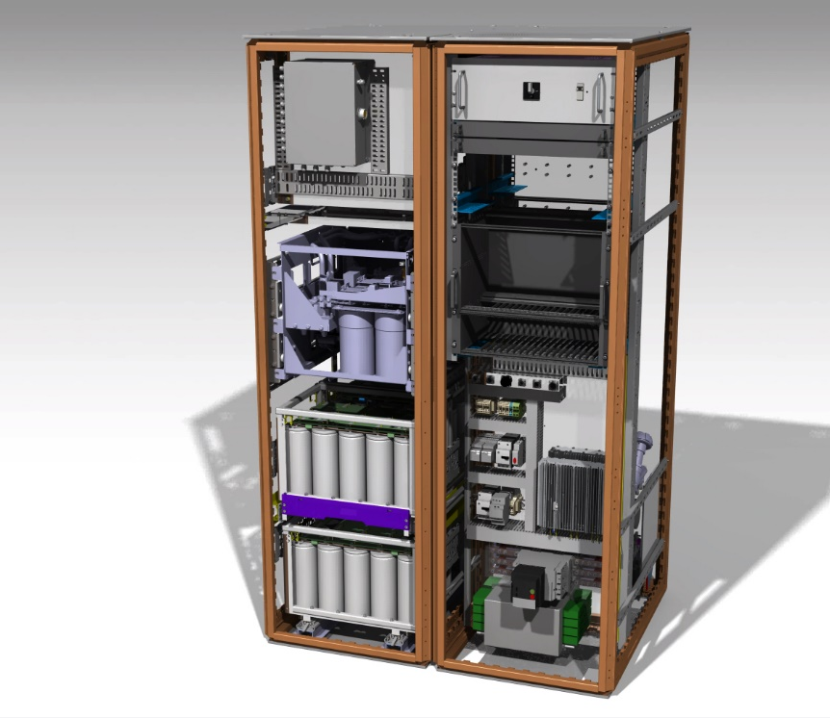
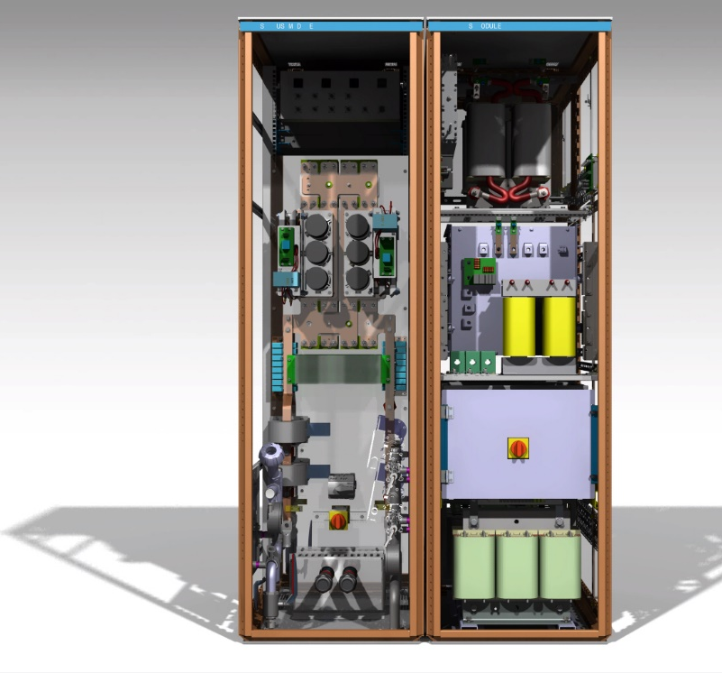
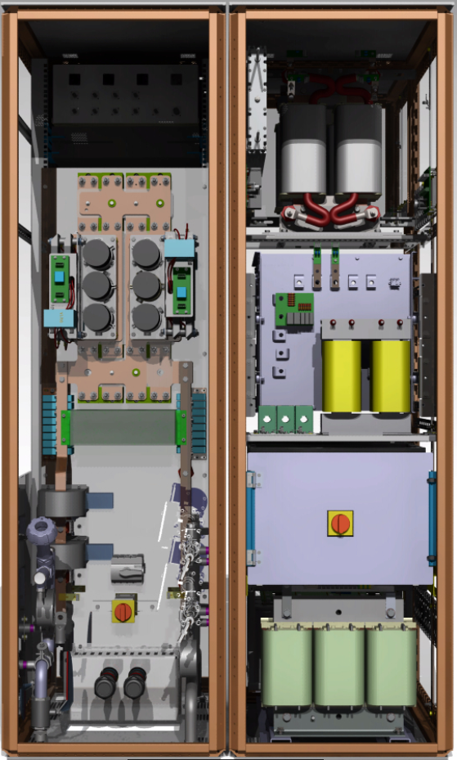
The SIRIUS converter

