Slide 1

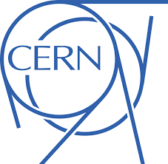
Accelerating Innovation
Aurélie Pezous CERN Knowledge Transfer | Section Business Development
Notes:
Greetings, blabla. I want to show you how CERN – the largest physics laboratory in the world, famous for its fundamental research – is bridging the gap between science and business. Because at CERN, we don’t just accelerate particles. We accelerate innovation.

Slide 2

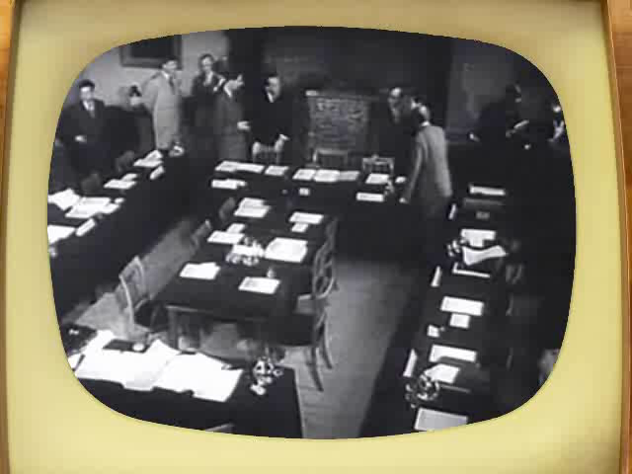
Council meeting in Amsterdam when the CERN convention was signed (1953).
Notes:
Ask the audience what they think «CERN» acronym stands for before showing the answer.
After WW II, fundamental research in Europe was not leading anymore.
Many scientists were flying away to the United States.
In order to stop this movement, eminent scientists gathered in meetings to setup a structure to continue fundamental research in physics in Europe.
They were gathered as a «Council» which means there were just holding meetings and they did not (yet) had a lab or led experiments.
The images are from Amsterdam meeting in 1953 when the CERN convention was signed.

Slide 3

Notes:
Here’s a map to give you an idea of just how big it actually is. As you see, it crosses the border between France and Switzerland four times.
Welcome to CERN! The European Organization for Nuclear Research, located on the Franco-Swiss border, by the foot of the Jura mountains. It is the world’s largest physics laboratory, and inside it, physicists and engineers are probing the fundamental structure of the universe. I’ll come back to how we do that in practice

Slide 4
Mission of CERN?
Notes:
Summed up, CERN technology is being used in a variety of different areas in everyday life. But how do the technologies find their way from CERN to society?

Slide 5
Research
Seeking and finding answers to questions about the universe
Technology
Advancing the frontiers of technology
Collaborating
Bringing nations together through science
Education
Training the scientists of tomorrow

Slide 6
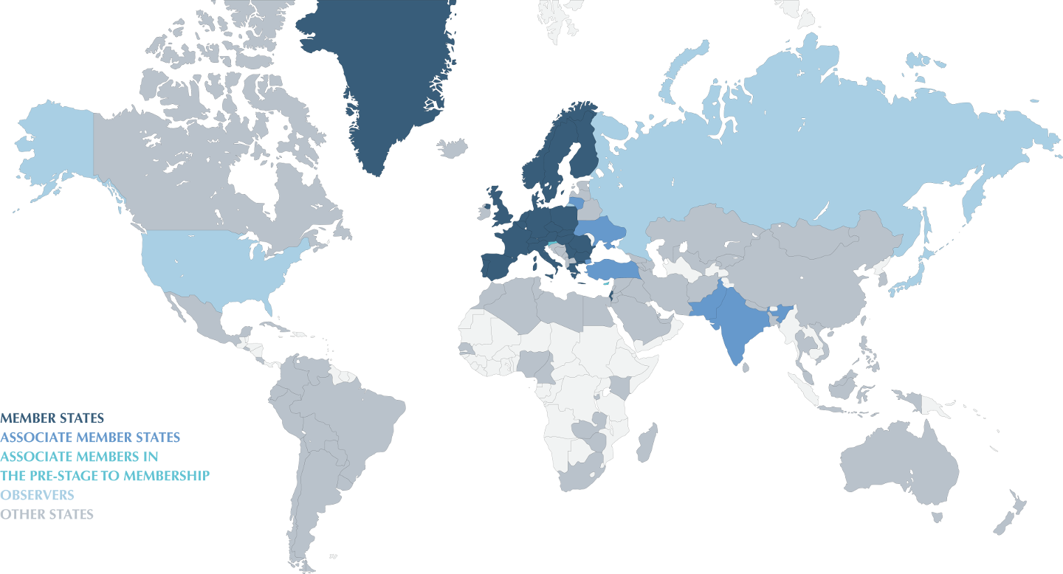
Conseil Européen pour la Recherche Nucléaire
World’s largest Particle Physics Laboratory (1954)
Personnel
2500 Staff
730 Fellows & Associates
200 Students
11000 Users from
500 Universities
2000 External
companies
Yearly Budget
~1100 MCHF
(~ 1000 MEUR)
Experiments
financed
externally
23 Member States
Austria, Belgium, Bulgaria, Check Republic, Denmark, Finland, France, Germany, Greece, Italia, Israel, Hungary, Holland, Norway, Poland, Portugal, Romania, Serbia, Slovakia, Spain, Sweden, Switzerland, UK.
6 Observers
EU, Japan, JINR, Russia, UNESCO, USA
8 Associate Member States
Croatia, Cyprus, India, Lithuania, Pakistan, Slovenia
Turkey, Ukraine
Notes:
CERN has a co-operation agreement with Korea

Slide 7
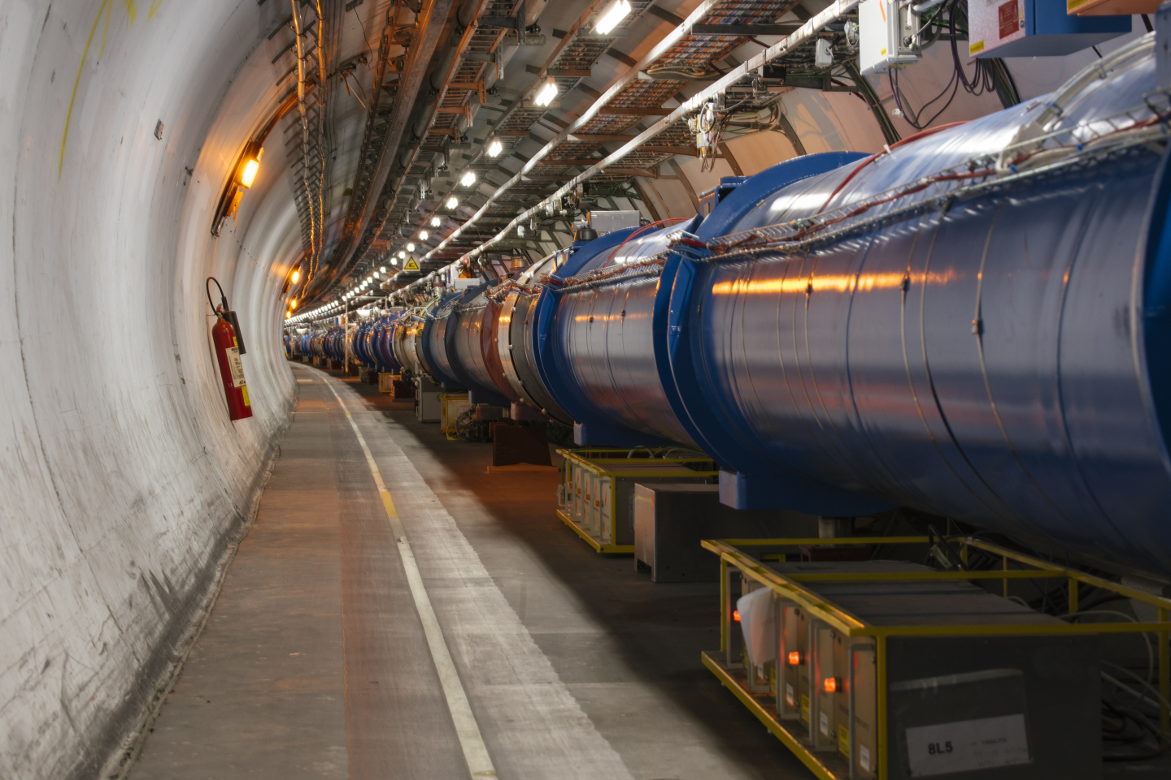
The Large Hadron Collider (LHC)
Notes:
You have probably heard of the crown jewel of the accelerator complex, the large hadron collider. With its 27 kilometres in circumference it is the largest machine in the world, and inside it, particles travel almost at the speed of light, in temperatures lower than in the outer space.

Slide 8
Why Knowledge Transfer?
Notes:
Summed up, CERN technology is being used in a variety of different areas in everyday life. But how do the technologies find their way from CERN to society?

Slide 9
The mission of CERN’s Knowledge Transfer Group is to maximise the impact of CERN technology and know-how in society, in particular thru industry in the member states.
Notes:
20 years ago the Organization decided to formalise and increase its knowledge transfer by establishing the Knowledge Transfer group. The mission of the group is to maximise the impact of CERN technology and know-how in society and industry.

Slide 10
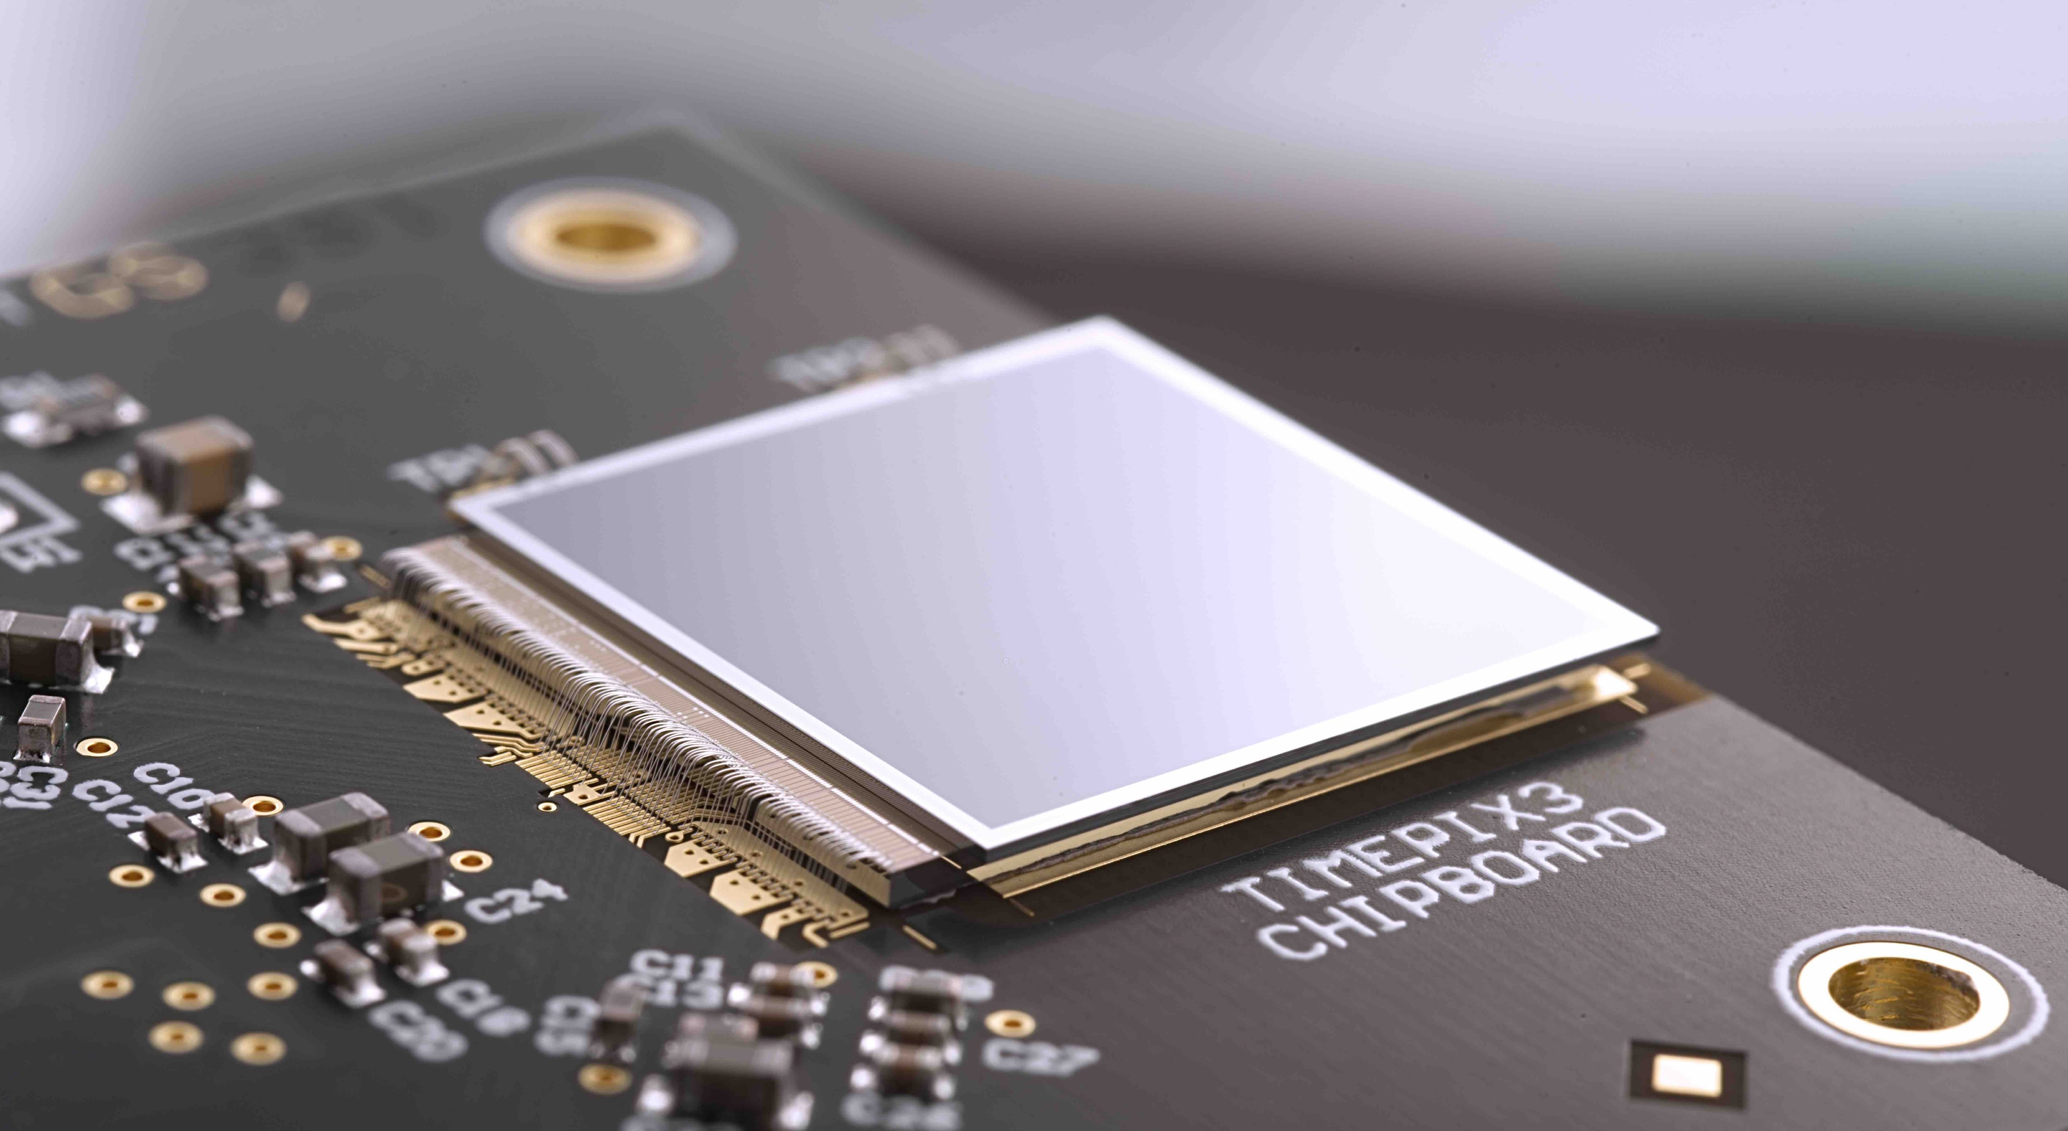
Accelerating Innovation
Notes:
Innovation can happen organically, in the sense that new ideas and technologies eventually diffuse into new products or market needs. Actively investing in innovation can accelerate the process. CERN invests in many activities to make this happen, as illustrated in the infographic below. The CERN Knowledge Transfer group provides advice, support, training, networks and infrastructure to ease the transfer of CERN’s know-how to industry and eventually society. These activities are all fundamentally based on CERN’s Open Innovation strategy, and reach out to CERN personnel, industry, entrepreneurs and research collaborators. This section describes how these activities support the innovation process.

Slide 11
From CERN Technologies …
… to Society
Notes:
CERN’s mission extends beyond science: it also aims to advance the frontiers of technology, to train the next generation of scientists and to bring nations together. The transfer of CERN technologies and know-how to society – grouped under the concept of Knowledge Transfer – is an integral part of each of these activities.

Slide 12
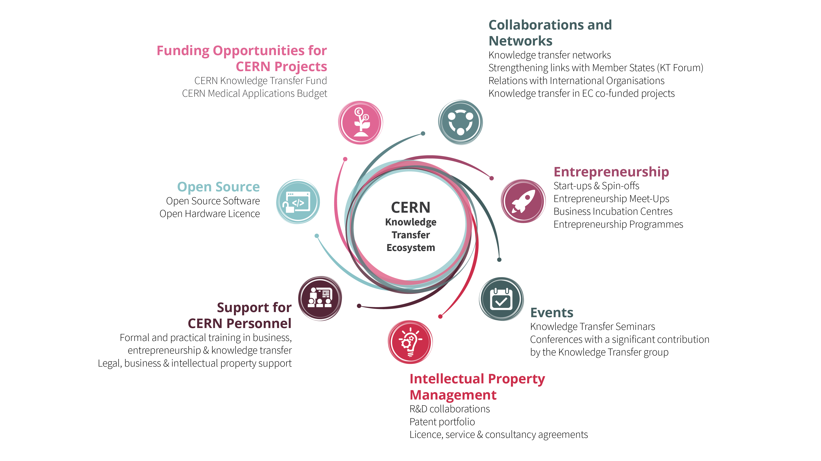
Notes:
CERN’s Knowledge Transfer group provides a wide variety of activities and services to ease the transfer of the Organisation’s technology and know-how.

Slide 13
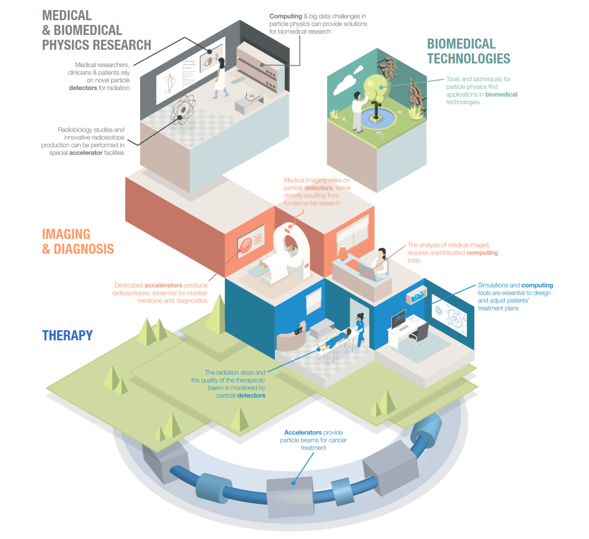
Medical & Biomedical Technologies
Notes:
There’s always been a tight link between high-energy physics and the medical and biomedical field. That’s because they’re both dependent on accelerators, detectors and computing. For instance, accelerators provide particle beams for cancer treatment. Particle detectors monitors the radiation dose and the quality of the therapeutic beam. And analysing medical images requires sophisticated computing tools.

Slide 14
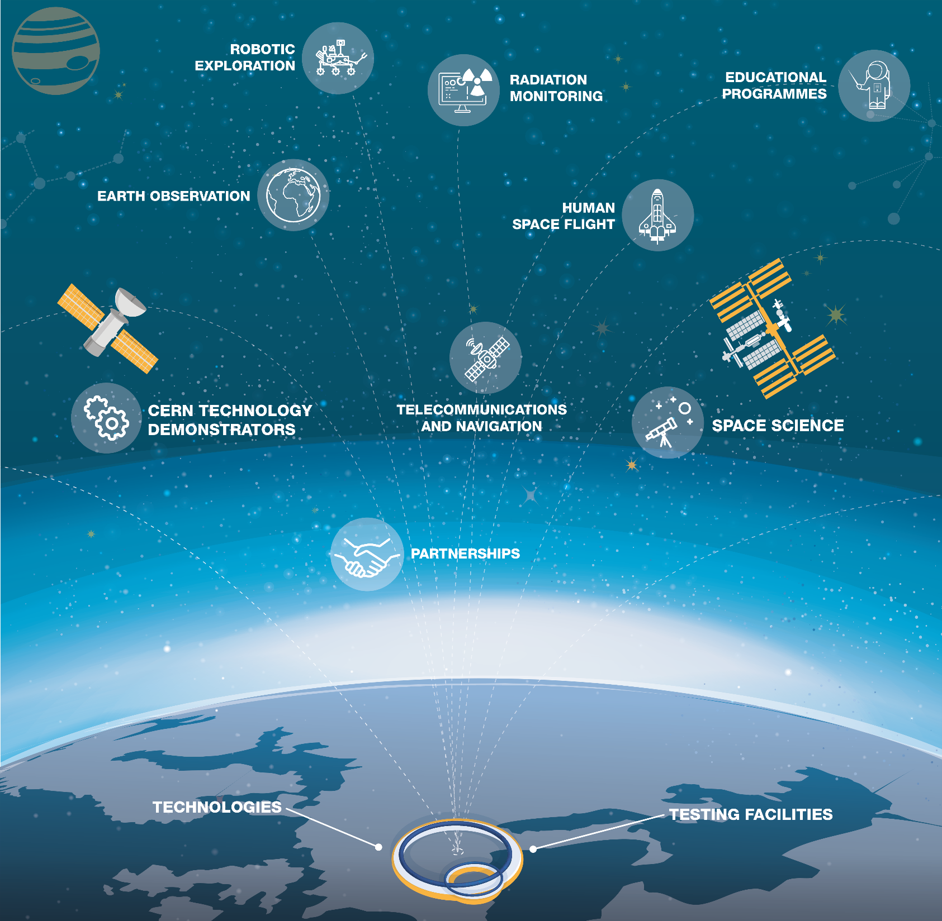
Aerospace Applications
Notes:
CERN technologies are not bound to planet Earth. For example, CERN technology is used for astronaut dosimetry on the International Space Station and for magnetic shield studies in space. We also host and provide computing support to UNOSAT, the United Nations Operational Satellite Applications Programme.

Slide 15
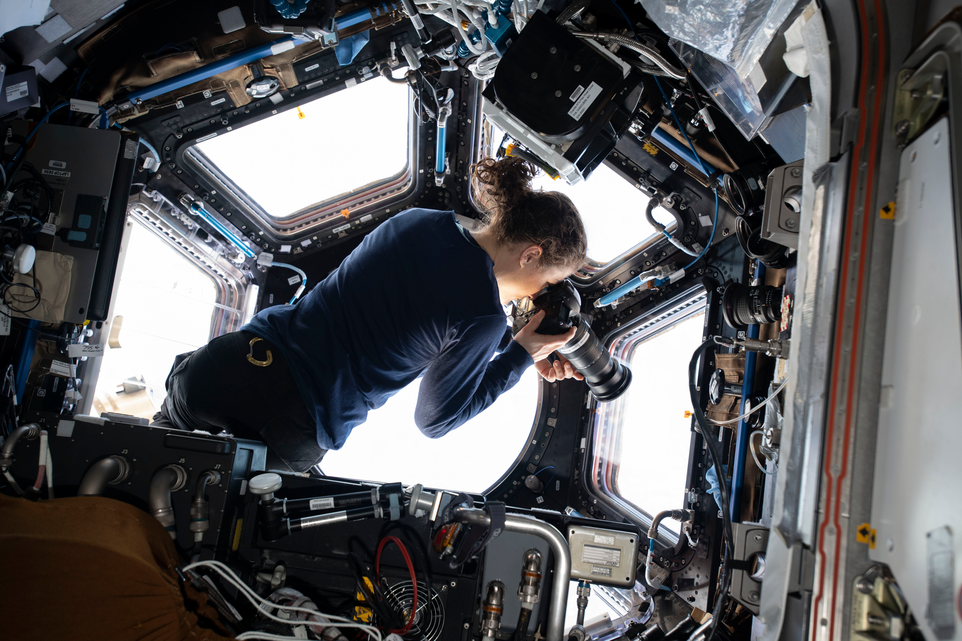
CERN tech used for monitoring radiation levels in space missions (courtesy of NASA ISS)

Slide 16
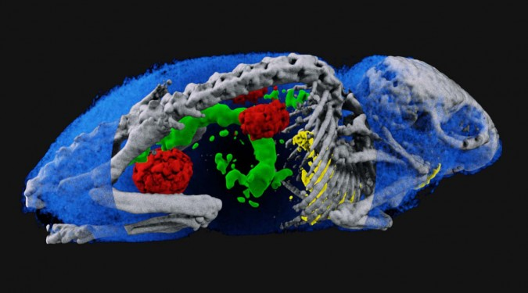
Spectral imaging - Medipix chip

Slide 17
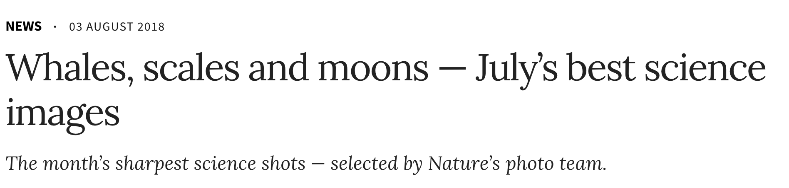


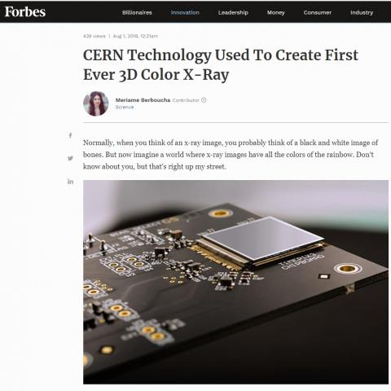
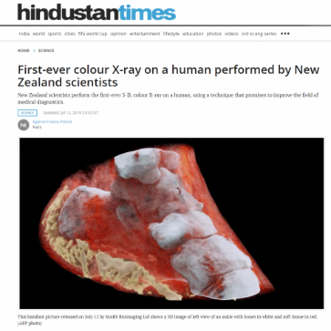
July’s best science images

Slide 18
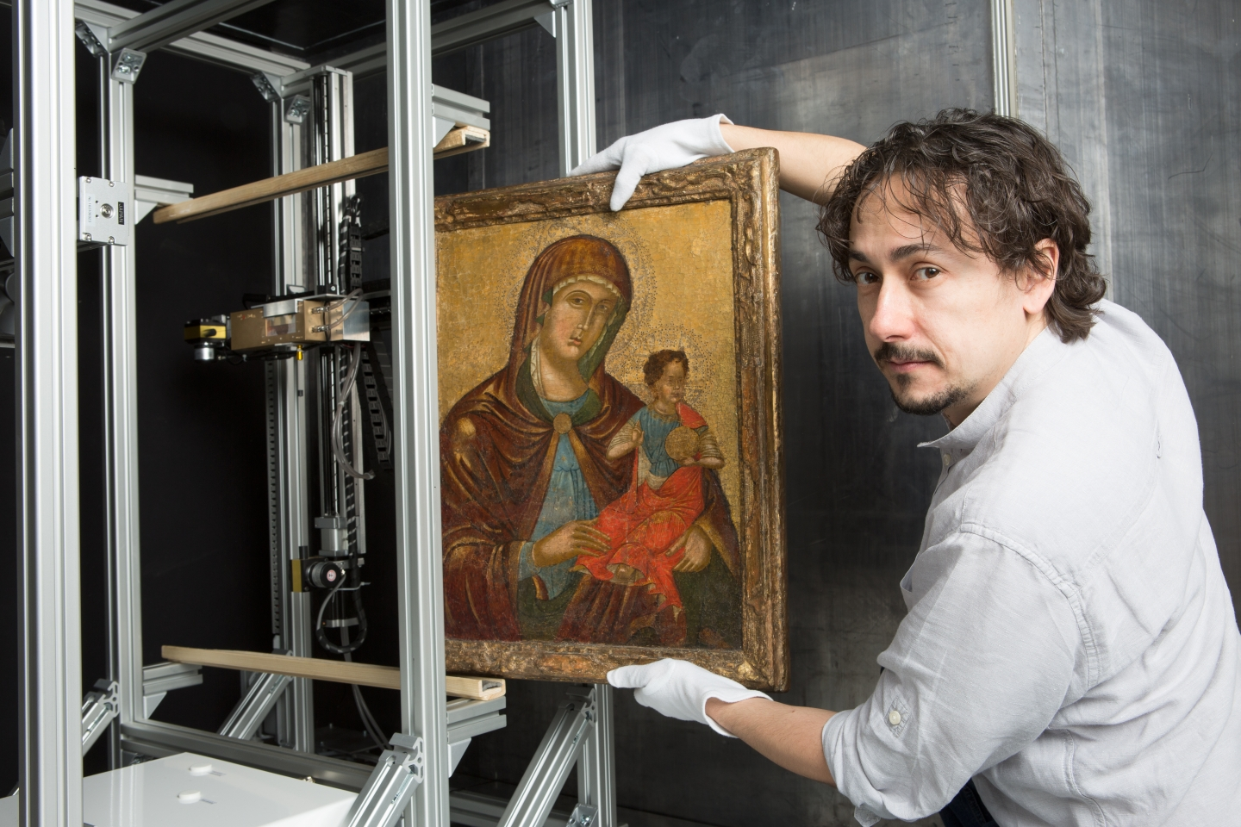
X-ray eyes for cultural heritage – Medipix chip
Notes:
#EuropeForCulture = because 2018 is the European Year for Cultural Heritage.
At CERN, the Medipix collaborations have been developing pixel detector readout chips since the 1990s, enabling high-resolution, high-contrast, noise-free images – making them unique for imaging applications. Medipix2, Medipix3, Timepix and Timepix3 are state-of-the-art particle imaging and detection readout chips. Now they are being used to bring about a revolutionary improvement in the field of art authentication and restoration. A new start-up company based in Prague, InsightArt s.r.o., has adopted the technology to perform spectral X-ray scans of paintings.
Note: Cultural Heritage is defined as: “Cultural heritage takes many forms: from the tangible legacy of monuments, artwork and books, to digital resources, either newly created or used to ensure cultural preservation. The concept also includes intangible (such as language and oral traditions) and natural elements (such as flora and fauna). This heritage may seem remotely connected to CERN's technological advances, yet the opposite is true: in 2018, several projects related to art restoration and digital preservation are using CERN technology.”

Slide 19
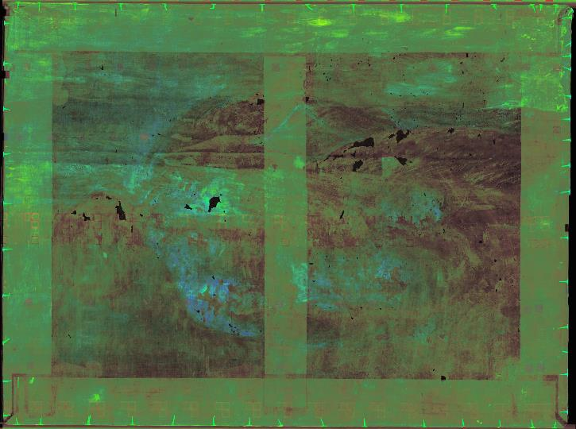
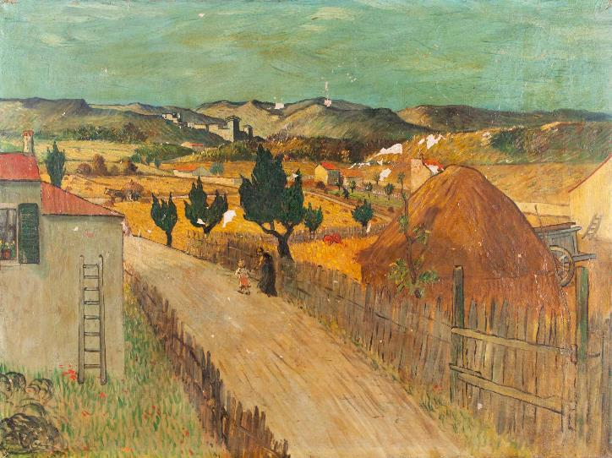

X-ray eyes for cultural heritage Medipix chip

Slide 20
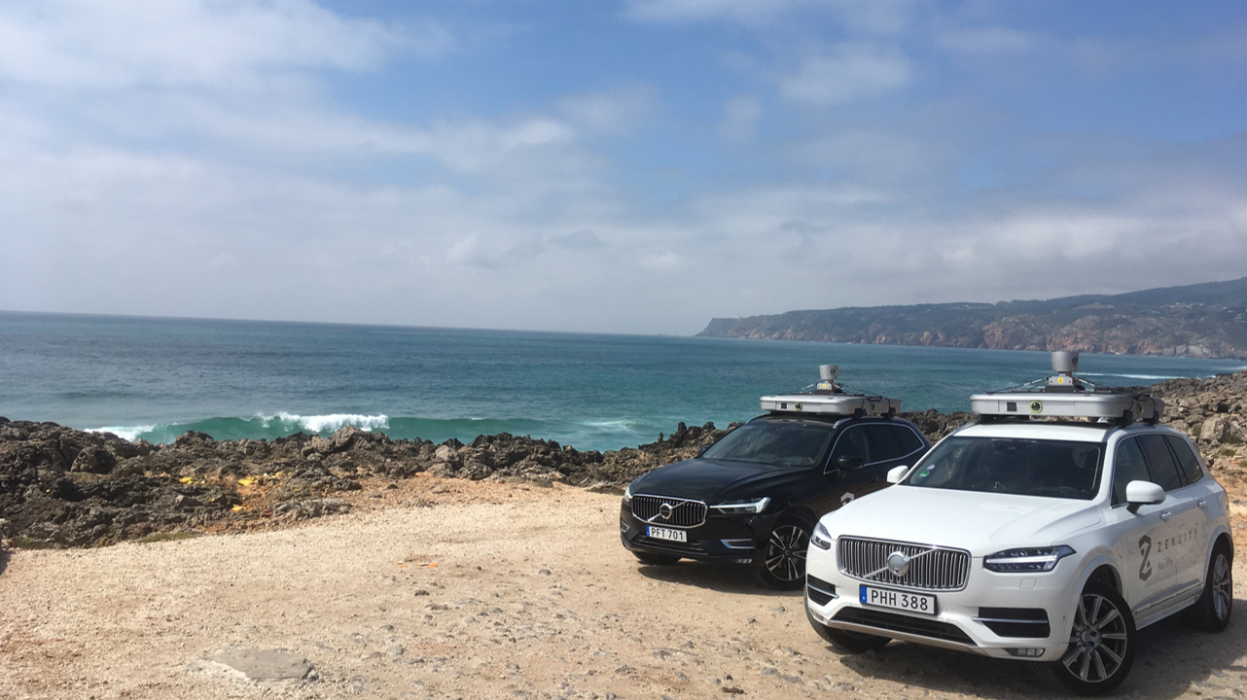
Zenuity (Volvo Cars / Veoneer) teams up with CERN on fast machine learning using FPGAs .

Slide 21
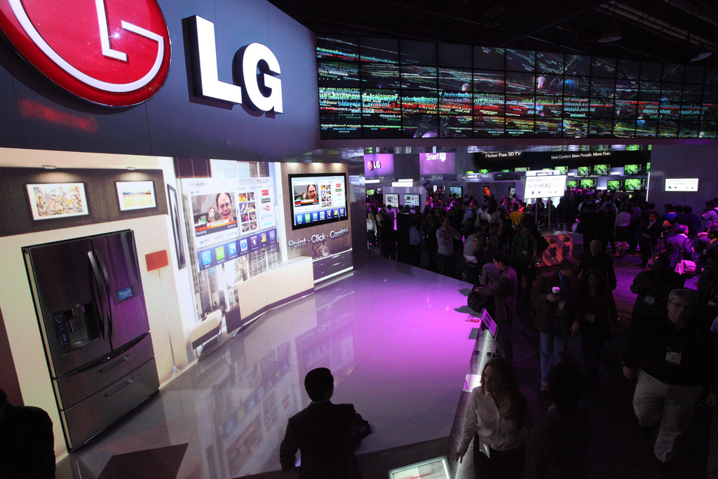
CERN’s Controls middleware software for worldwide factory automation at LG.

Slide 22

Using CERN ROOT for helping detect fraud in commodity stock market transactions

Slide 23
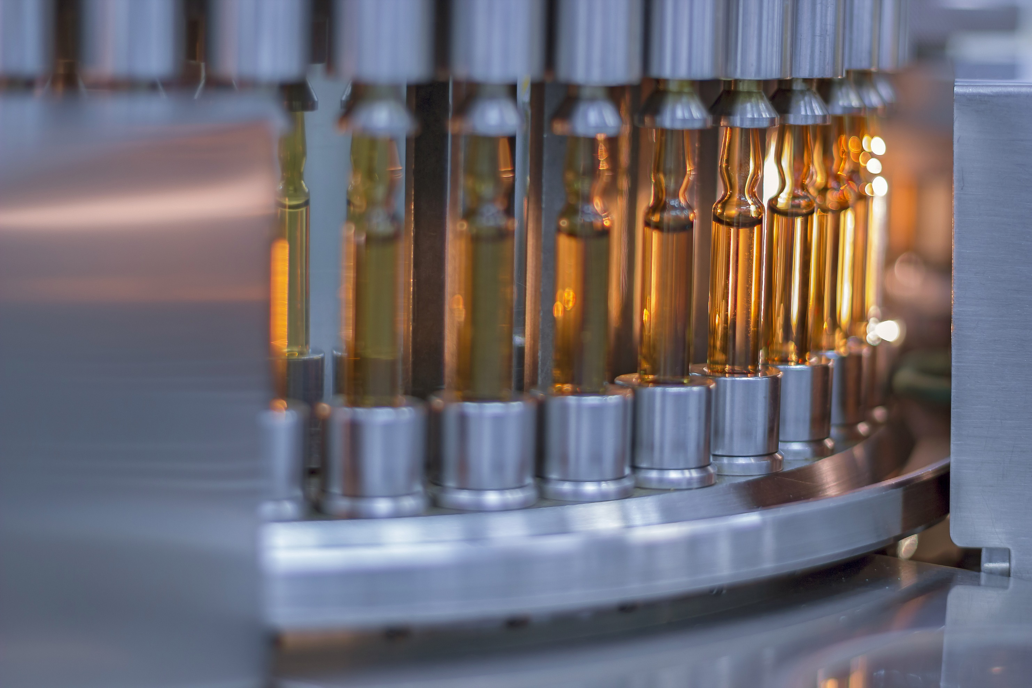
Machine learning to improve vaccine production at Sanofi.
Notes:
Example 1 - Medtech
CERN experts train Sanofi in machine learning - potential application in their vaccine production
Training was in 2017

Slide 24
How?
Notes:
Summed up, CERN technology is being used in a variety of different areas in everyday life. But how do the technologies find their way from CERN to society?

Slide 25
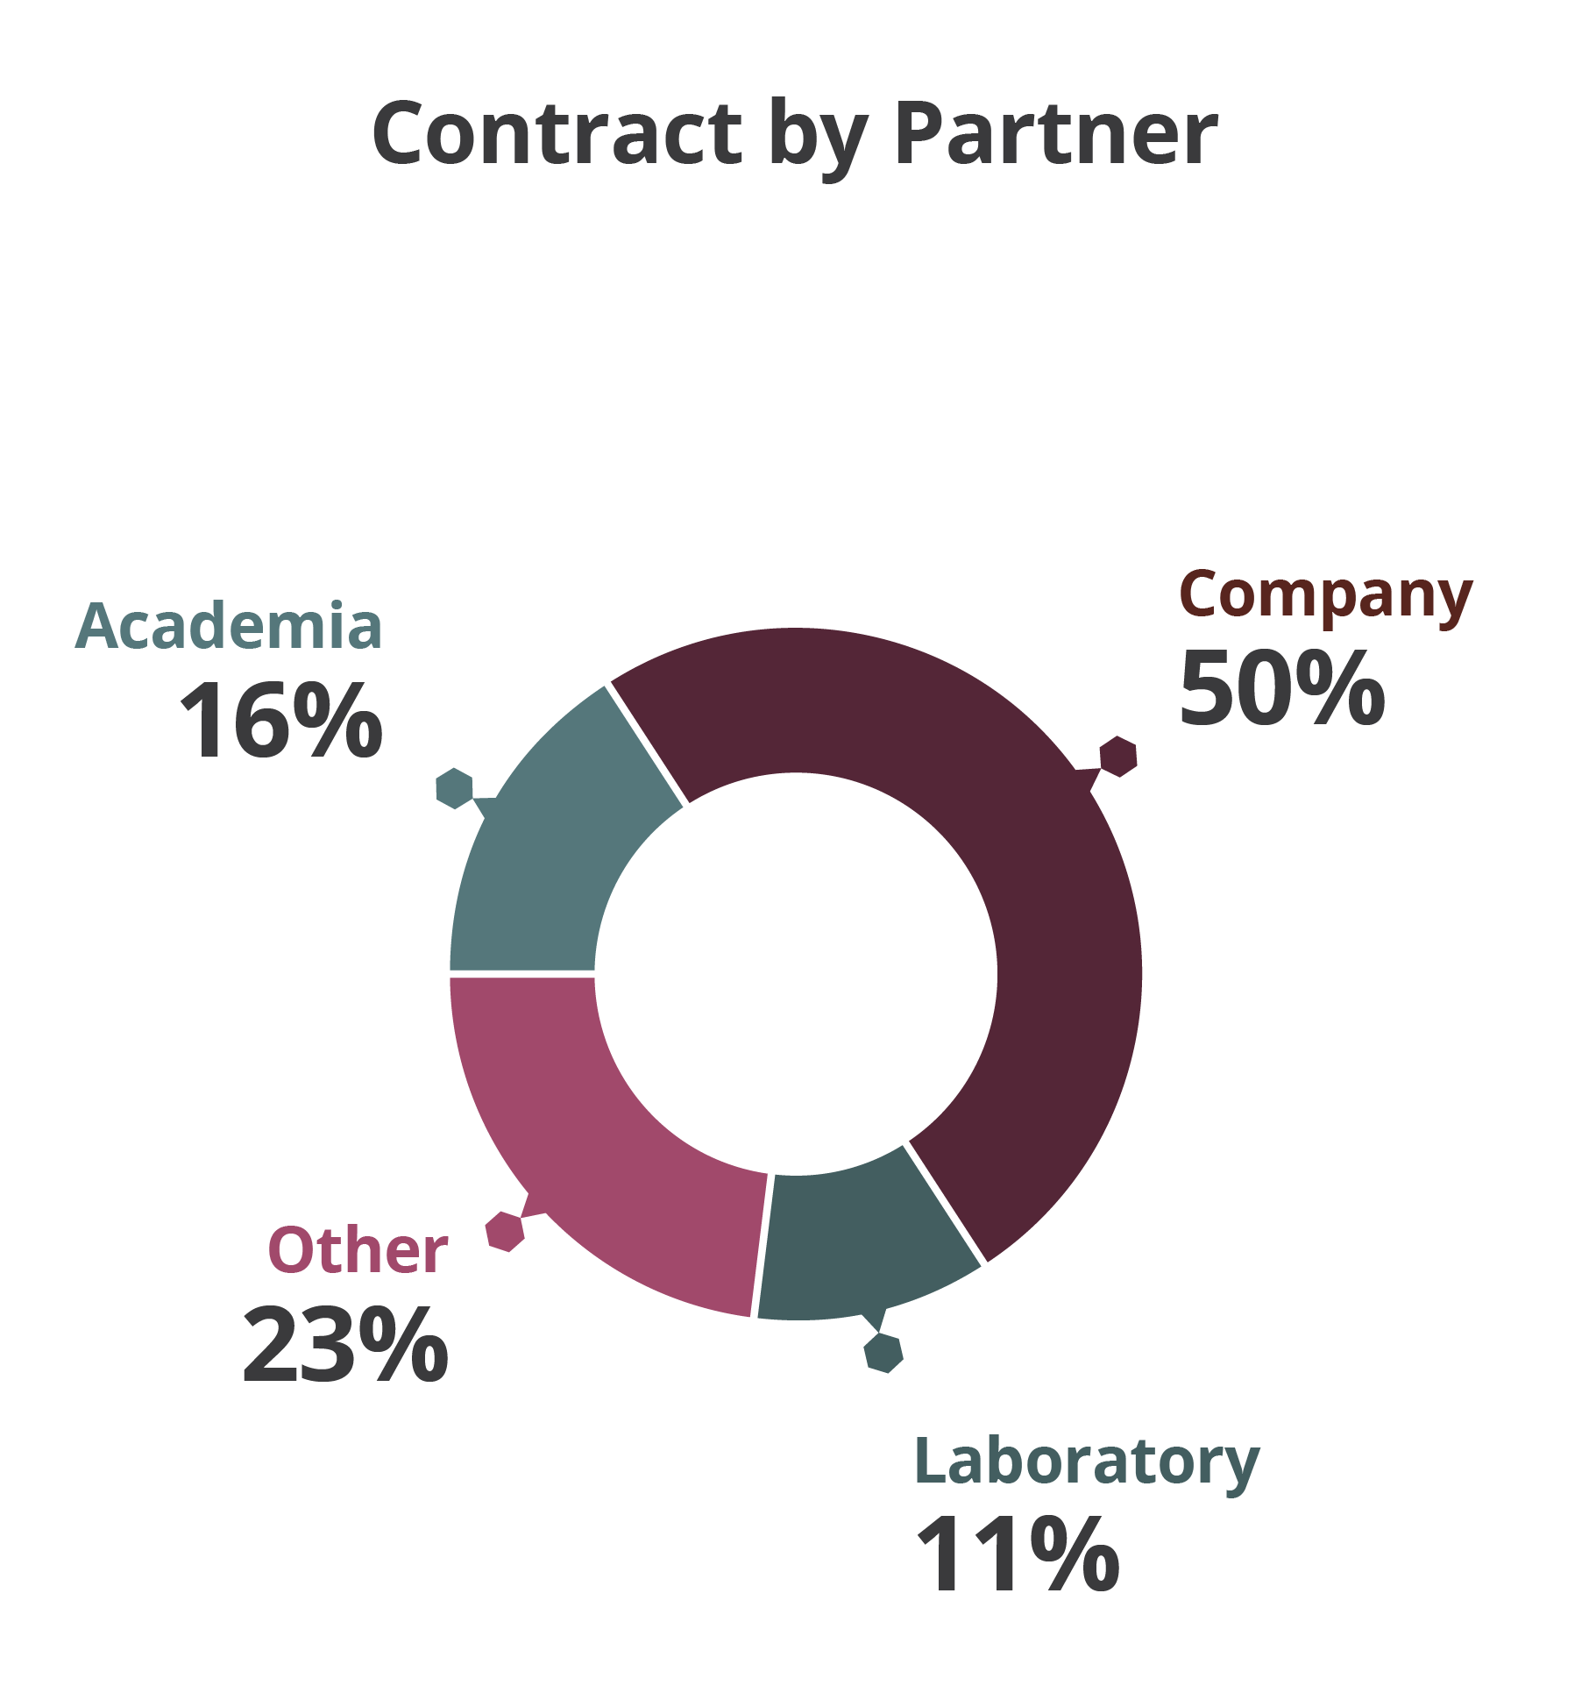
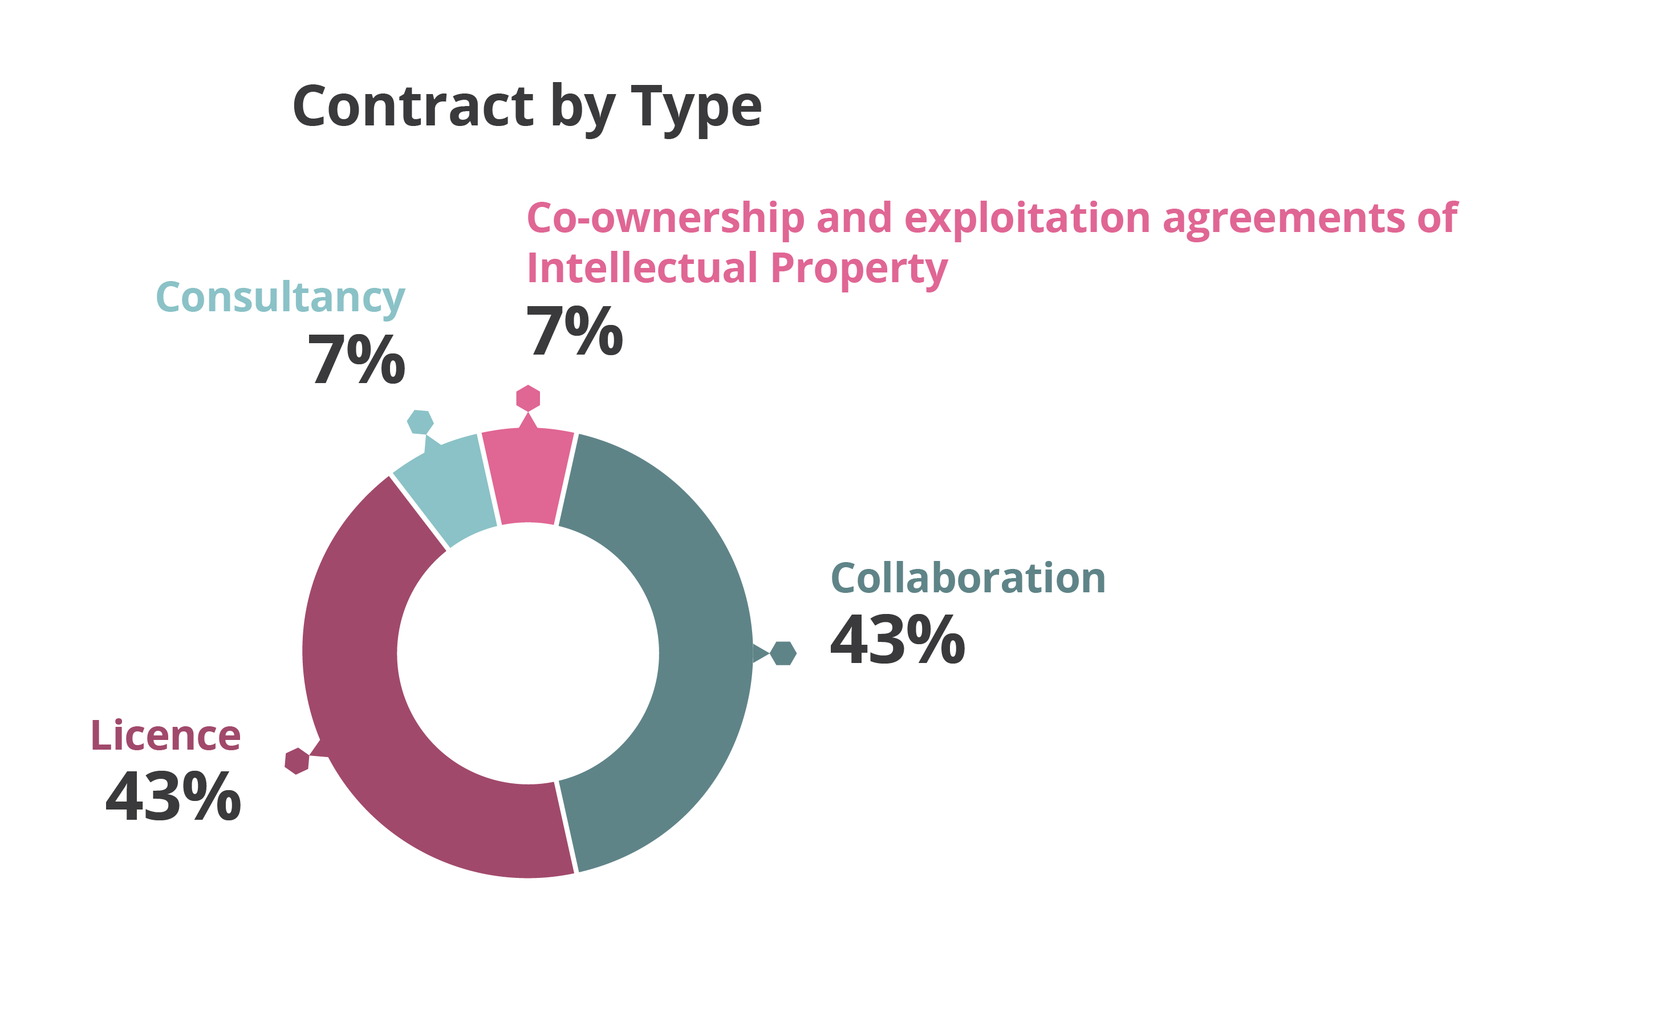
44 KT Contracts in 2018

Slide 26
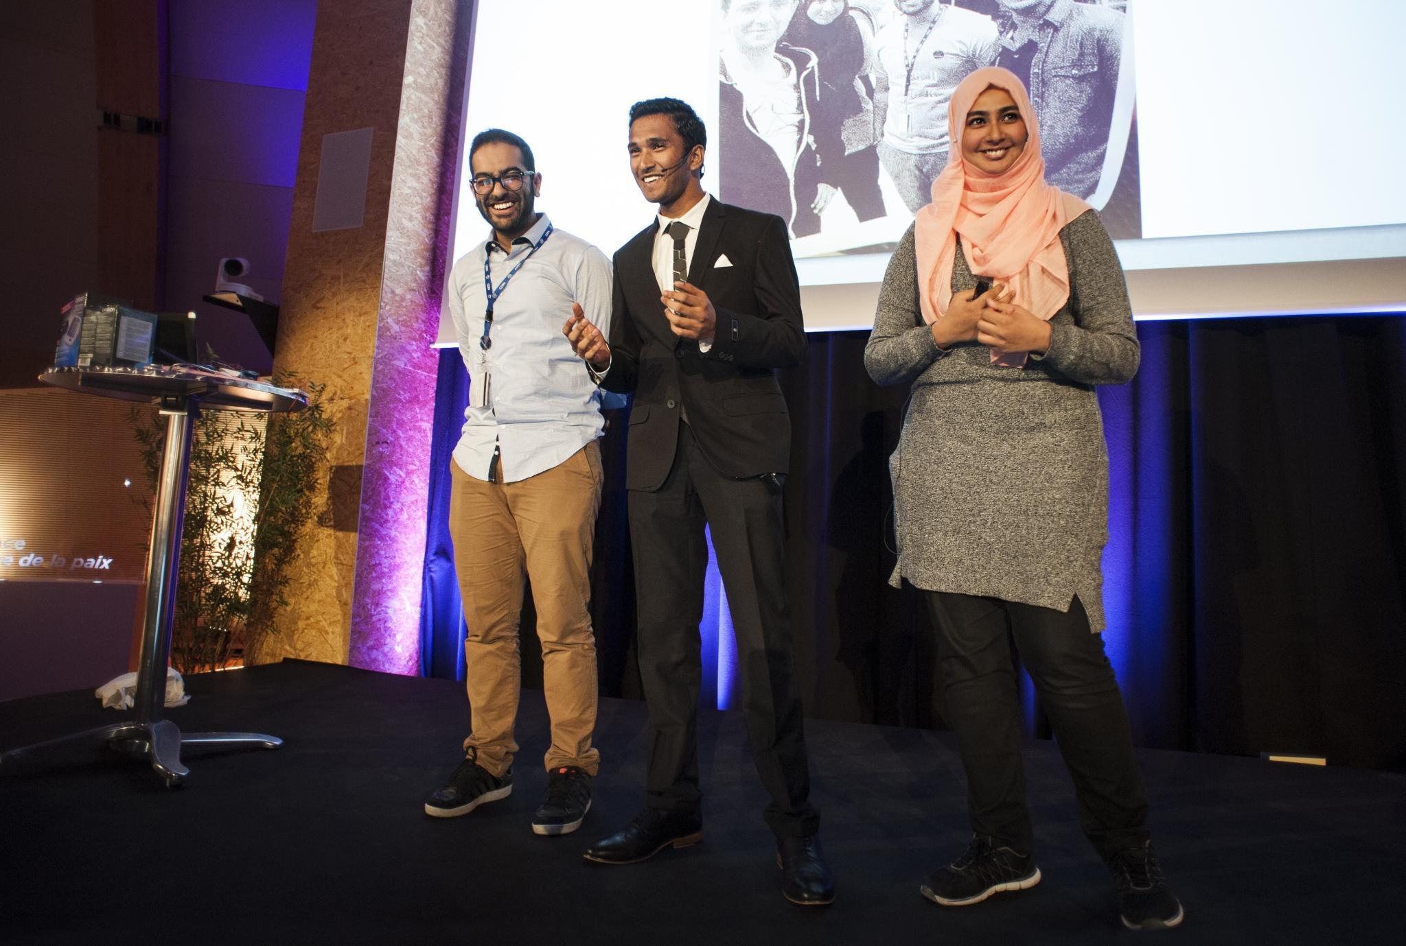
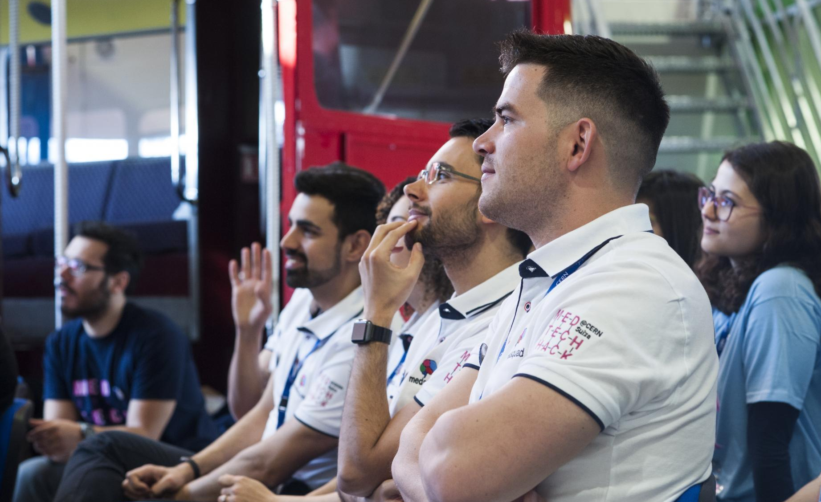
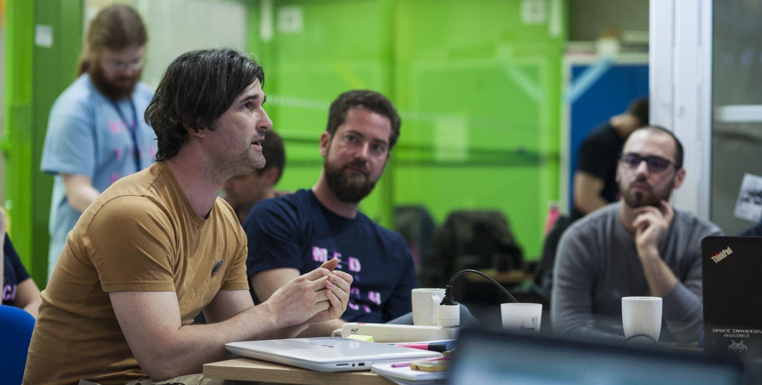
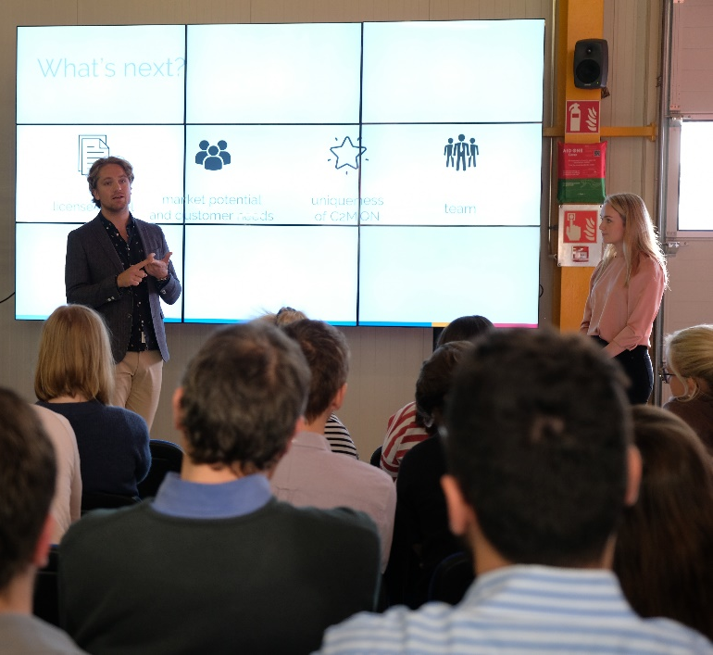
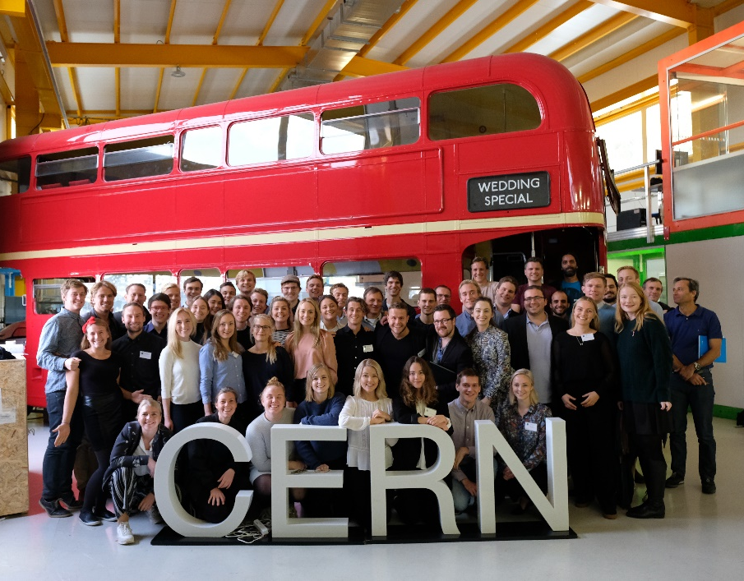
Building a culture of entrepreneurship

Slide 27
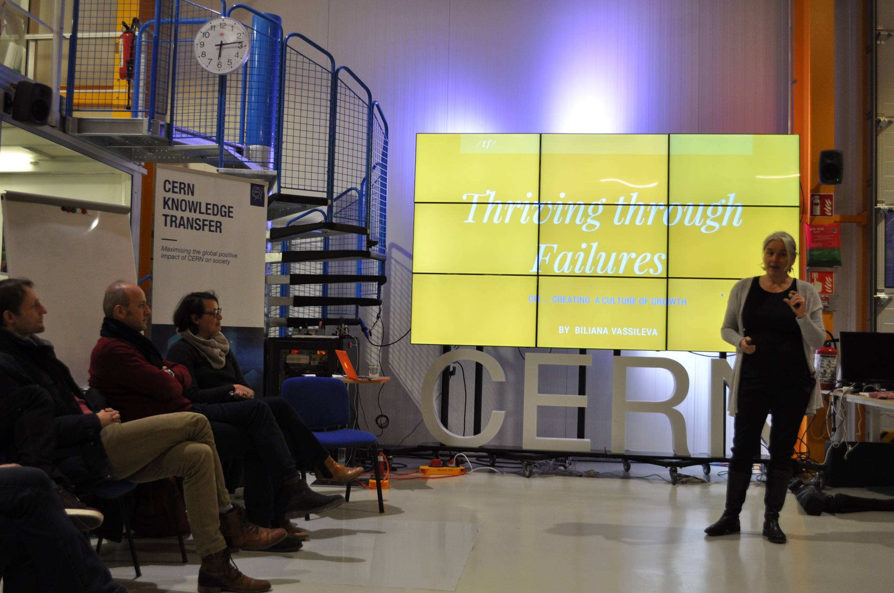
Entrepreneurship Meet-Ups
http://cern.ch/go/Bnc7

Slide 28
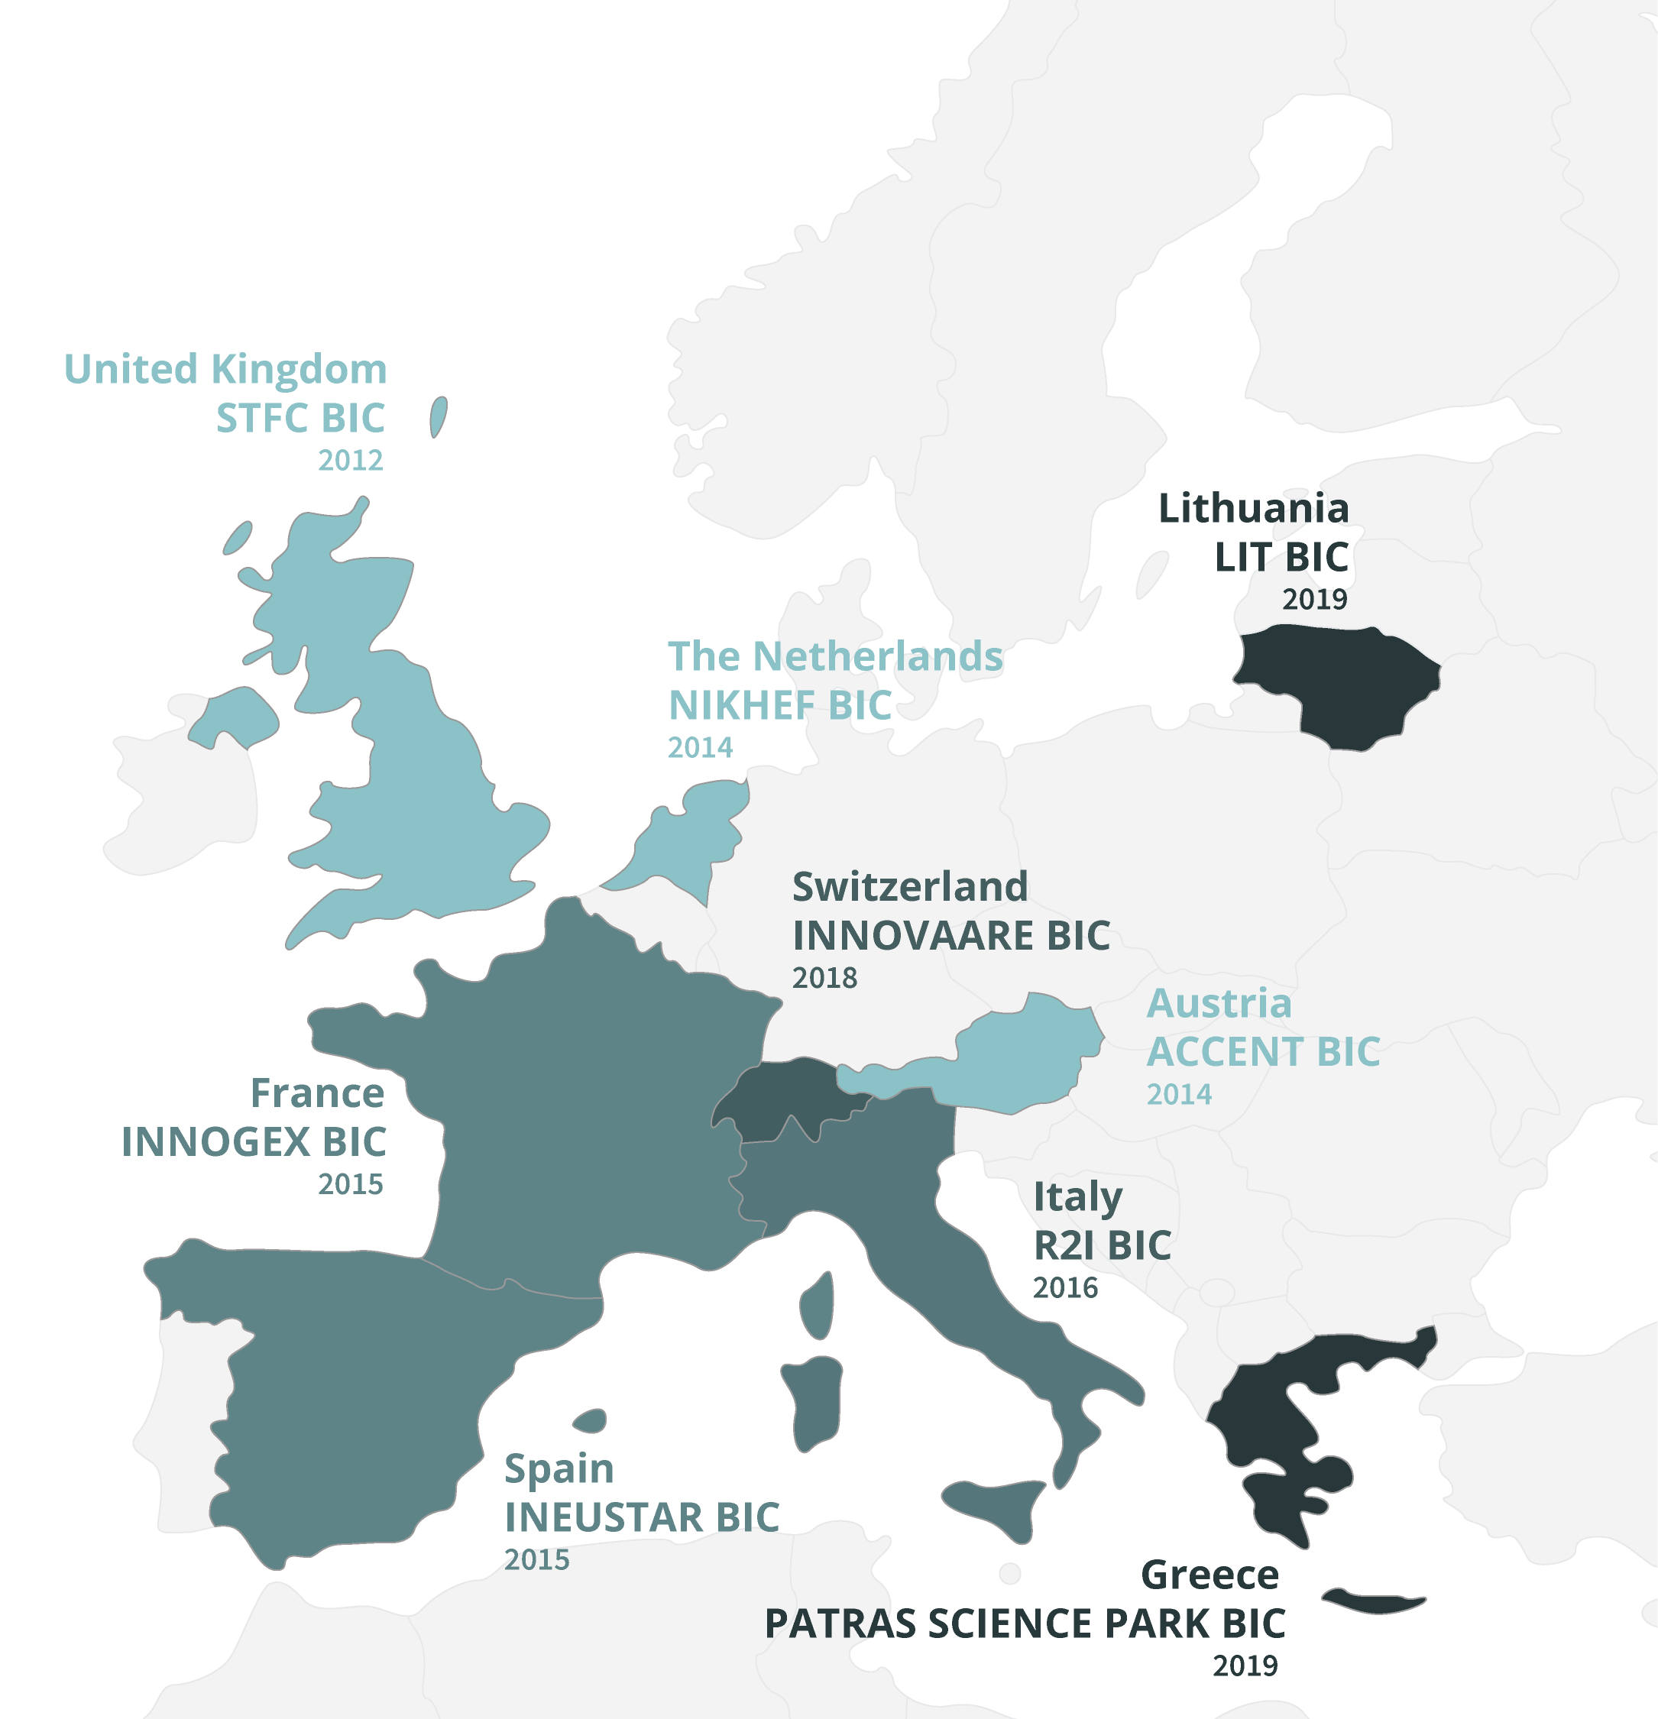
9 Established Business Incubation Centres in the Member States

Slide 29
Examples of industry collaborations?
Notes:
Summed up, CERN technology is being used in a variety of different areas in everyday life. But how do the technologies find their way from CERN to society?

Slide 30


Advise / 2ND Opinion / Tech Challenge from CERN Expert team
Collaborative R&D / Co-development agreements on specific topic of mutual interest
Challenge Based Innovation program with CERN Experts and/or universities to address specific issue

Slide 31
Using CERN labs / openlab for prototyping, benchmarking and testing of equipment
Licensing of CERN technology for commercial use / Support or training on using Open Source Hardware / Software
Facilitation of Knowledge Exchange by sponsoring PhD / Allocation of company resource at CERN / Use of Alumni Network

Slide 32
What we hear from industry
Improved our Innovation Capability
Helped us see where technology is going and what is around the curve
Great challenge for our technology and R&D roadmaps and strategies
Provided Fast Learning of Technology
Various licensing options and great training on tech available for (open) license
We learned technology from CERN that also has helped us in other applications
Endorsed our Brand
CERN Brand endorsement increased buyer confidence
Discovered new opportunities for joint R&D and on-site knowledge exchange
Great benchmarking facilities helped to quickly identify design issues
CERN helped to address some of our biggest challenges with a fresh view
Strong international reputation far beyond just science community
Using CERN technology has helped us get funding for scaling up
CERN associated with latest cutting edge technology helped position us better
In contact with a great talent pool of technical experts and engineers

Slide 33






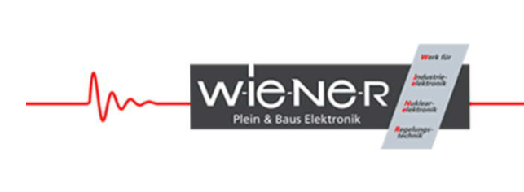


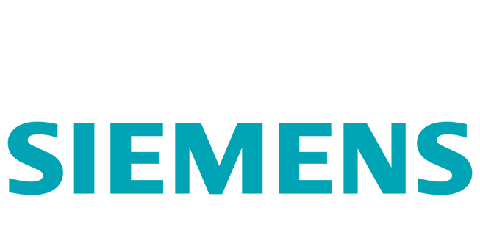
…is licensing software from CERN to enhance the safety in complex cooling systems
…is testing electronic components at CERN to assure space missions reliability
…Intel teams up with CERN openlab on the Modern Code Developer Challenge to team up with the best coders in the world
…is licensing machine learning software developed at CERN for improving vaccine production
…is using CERN readout chips to improve material analysis for applications in food, pharma, oil and nanomaterials
…is using CERN middleware to for enhanced factory automation across their plants
…is using CERN software for machine-to-machine communication
…is using CERN detectors to help advance art restauration and authentication
…is using technology derived from one of the big experiments in CERN for advanced headlights in cars
…is part of the CERN openlab to work together on advancing Automation and Control technology

Slide 34
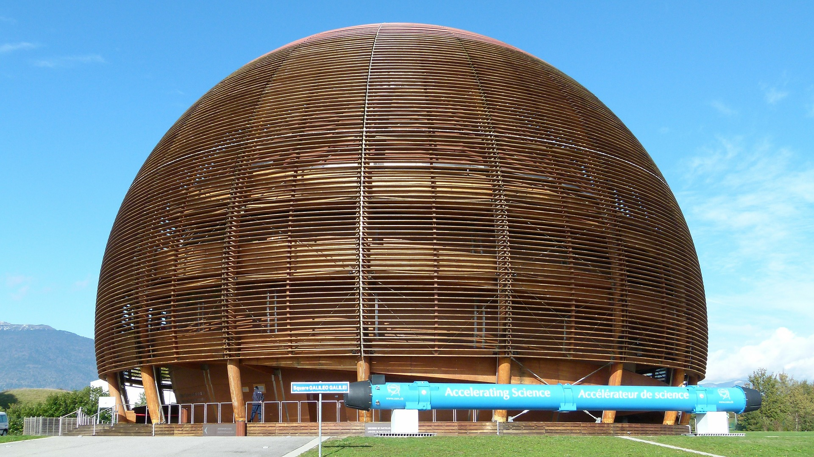
Thank you!

