Slide 1
Proton Radius @ M2
Communications
13.11.2019
Roadmap as communicated in August (1.8.2019)
COMPASS++/AMBER Proposal drafting group:
  July 10: final list of detailed update plans ready (i.e.: which sections of the proposal will be updated by whom and how)
  August 14: first versions of specific updates ready for discussion
  September 4: final versions of specific updates ready for insertion into proposal
  September 18: updated proposal ready for reading by collaboration
  hand in an update of the Proposal to SPSC (latest end of September)
decide by „end of July“ on the target region geometry
Proposal update 30.9. (and 13.10.)
SPSC considers proposals for test beam times in 2021, decisions may be expected from the January 2020 meeting

Slide 2
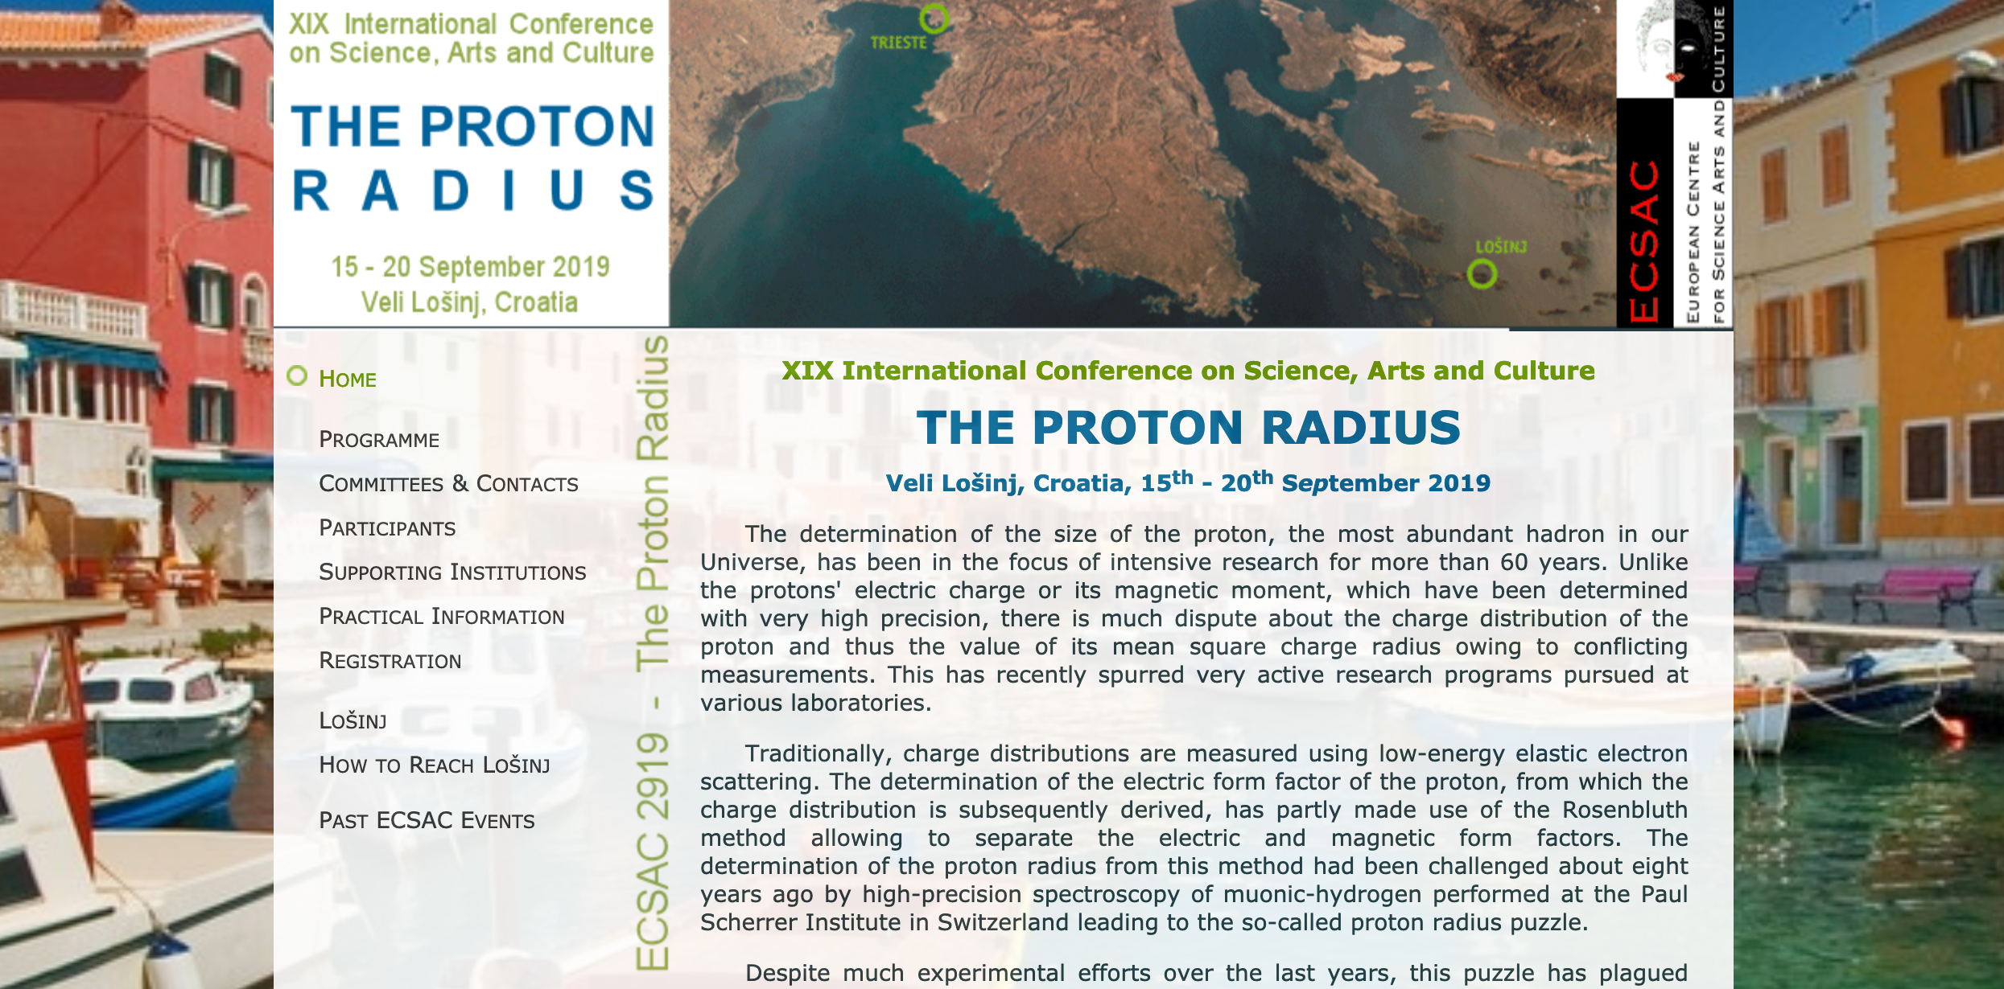
Losinj Conference
Jan Bernauer The proton radius puzzle ten years later
Alexander Golossanov The MUSE experiment at PSI
Ulrich Müller Proton form factors with elastic electron scattering at MAMI
Franziska Hagelstein Proton-Polarizability Eﬀects in Muonic Hydrogen & A Lower Bound on the Proton Radius
Stephan Paul Muon-p experiment with COMPASS: Principle and Setup
Andrea Vacchi The FAMU experiment at RIKEN-RAL to measure the muonic hydrogen ground state
Yimin Wang/J.B. Proton form factor measurement using electron proton scattering with the gas jet target at A1
Katsuhiko Ishida Proton Zemach radius from hyperfine splitting: Principle and Method
Sohtaro Kanda Proton Zemach radius: Preparation Status
Douglas Higinbotham Extracting the proton charge and magnetic radius using dispersively improved chiral effective field theory
Franco Zanini An interlude on Cultural Heritage: Elettra
Miha Mihovilovič The Initial state radiation experiment and beyond
Emiliano Mocchiutti Transfer rate from muonic hydrogen to oxygen with FAMU
Cecilia Pizzolotto Characterization FAMU Experiment
Jose Suarez-Vargas Cr+4: MOPA laser system for a high resolution MIR spectroscopy
Christian Dreisbach Muon-p experiment with COMPASS: Monte Carlo simulation
Thomas Pöschl Fitting procedure
Dominik Steffen Lessons on small-angle and low Q2 from Primakoff scattering
Jan Friedrich Muon-p experiment with COMPASS: Systematics and NLO
Luigi Moretti Design of a multipass optical cavity for the FAMU experiment
Lyubomir I. Stoyche DFG-based mid-IR laser system for the FAMU experiment
Martin Hoffmann Muon-p experiment with COMPASS: Results of the 2018 test
Haiyan Gao The PRad experiment at JLab
Vladimir Pascalutsa Two photon exchange in (muonic-)hydrogen and lepton scattering
Gianrossano Giannini An interlude on Cultural Heritage: Muons for non-destructive analysis
Round table discussion: extraction of the proton radius from scattering data
Katsuhiko Ishida The g-2 experiment at J-PARC

Slide 3
Muon-proton elastic scattering
MUSE versus COMPASS++
very similar in terms of determining G_{E}² + τ G_{M}²
very different systematic effects: apparative and (e.g.) rad.corr. (?)
to be further worked out for SPSC reply

Slide 4
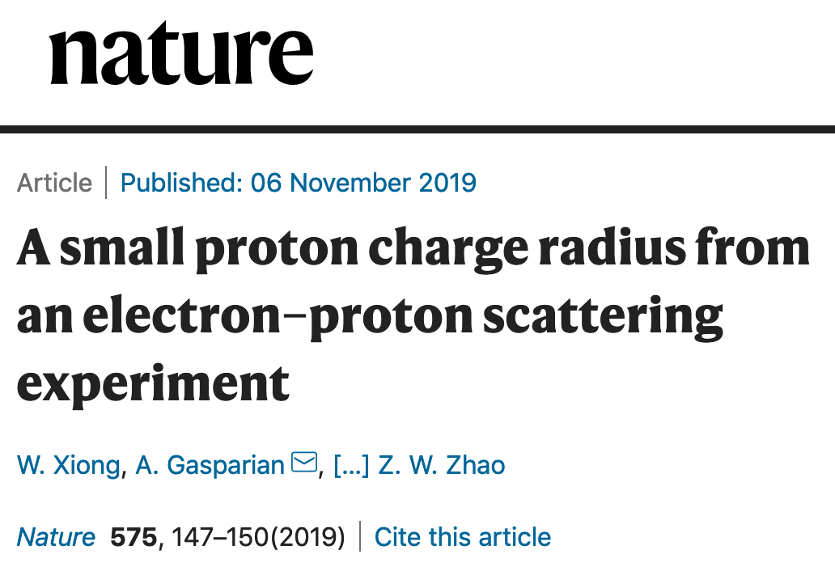
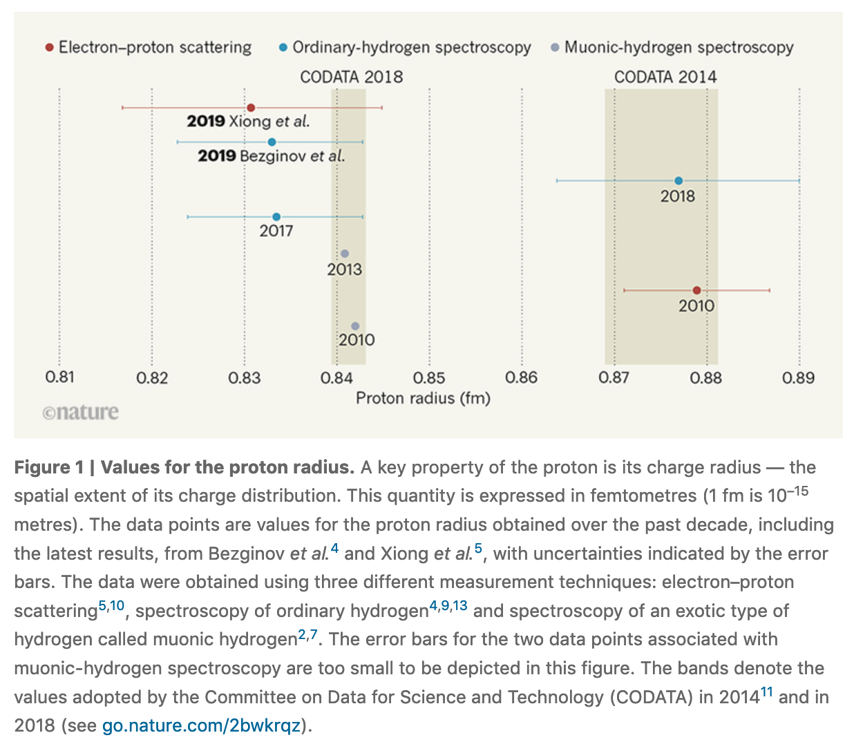
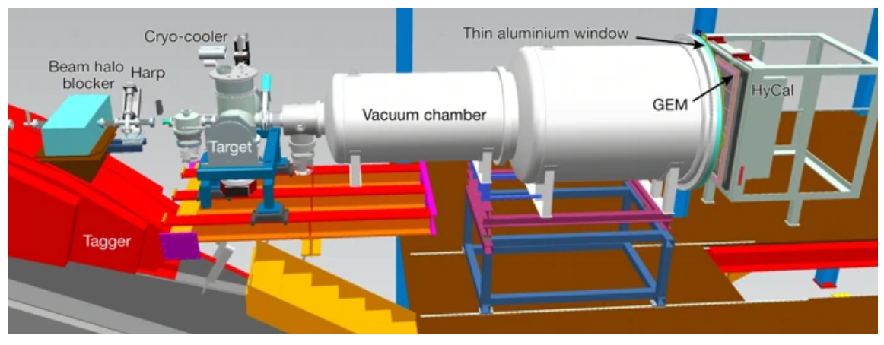
Electron-proton elastic scattering
Several initiatives planned and ongoing at MAMI / MAGIX
PRad at Jefferson Lab: Nature article published last week
not much details on size of corrections
(dominant) systematics likely to be (heavily?) underestimated

Slide 5
