Slide 1
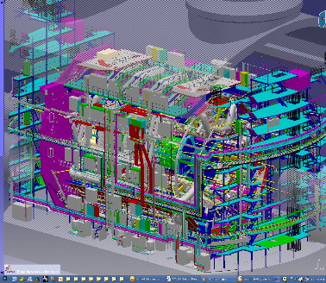
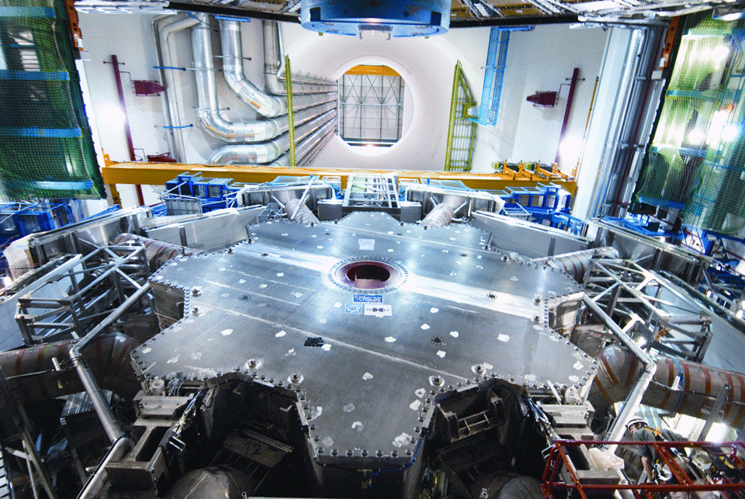

Inspired by Physics - How to Design a Flying Jumbo Jet
- in Just One Hour
CBI-ER, December 17, 2019, Markus Nordberg
Development & Innovation Unit (CERN)

Slide 2
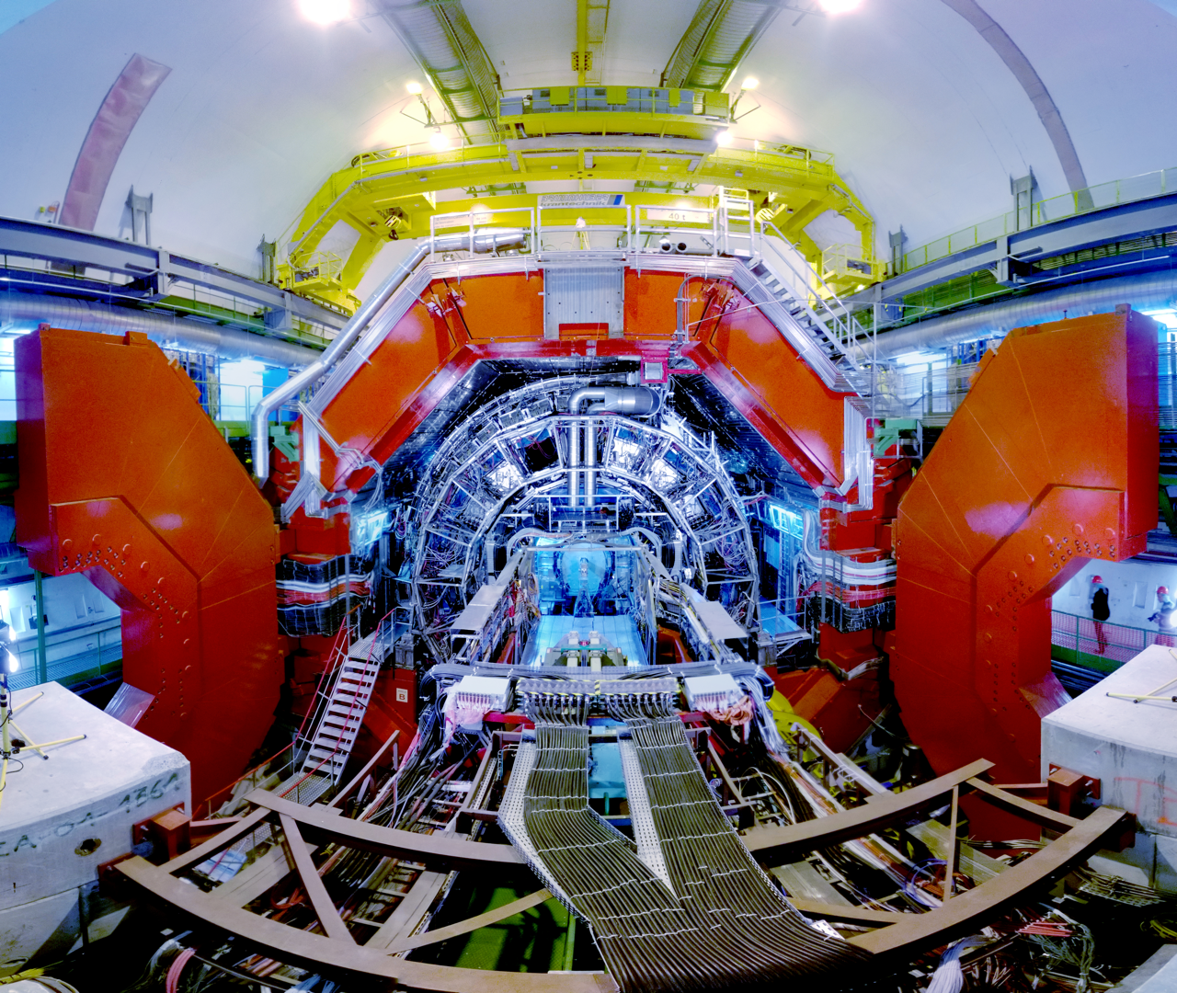

Slide 3
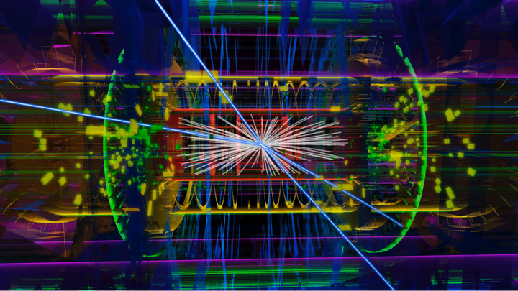

Slide 4
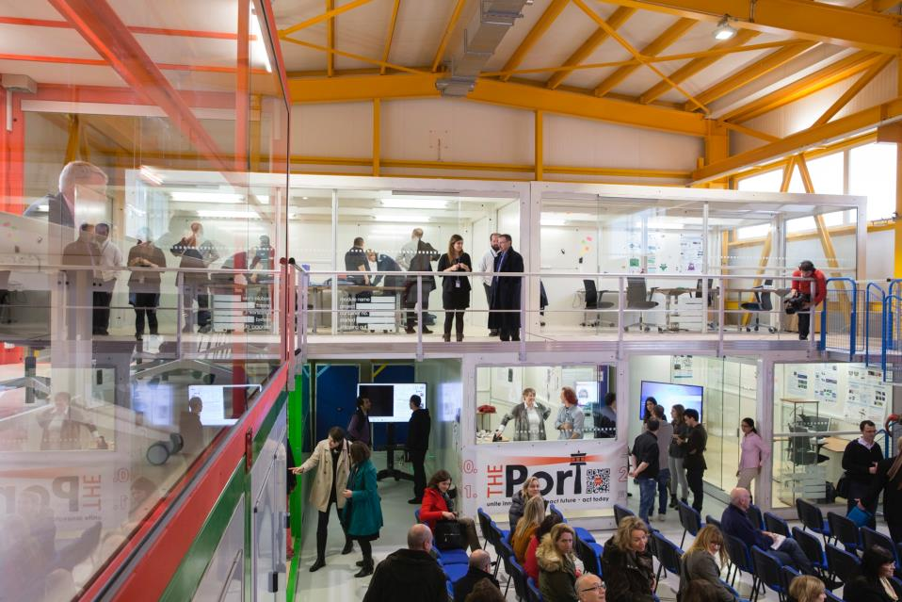
WHY ARE WE DOING THIS?
Like the experiments at CERN, the aerodynamic design of aircraft are also much determined by the laws of physics
We wish to give an example of physics-driven experimentation process, requiring cross-disciplinary collaboration
Here, we wish to bring in business management, engineering and design, but driven by physics (i.e. special case)
They all contribute, even if the driver here is aerodynamics
Prototyping is a good way to start to learn about the design process (even if incremental)
If we are able to design a stupid jumbo, well, then we can ….
… better judge what looks disruptive rather than just incremental
Physics driven Design Thinking is Fun

Slide 5
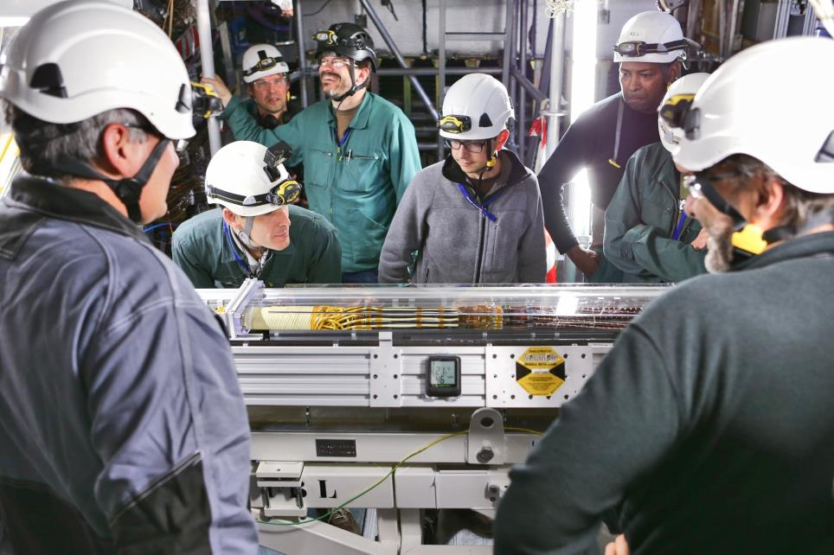
PLEASE REMEMBER THAT …
… Modern aircraft designers are not taught like this
  (The difference between this intro and designing real airliners is only about 10 000 hours … But make no mistake, our jumbo will fly)
… Modern aircrafts are not designed by MSc-level students
… You will not be a certified aircraft designer after this course
… Folks at CERN can’t do anything
  (Alas - but they do know how far the laws of physics will take you)

Slide 6
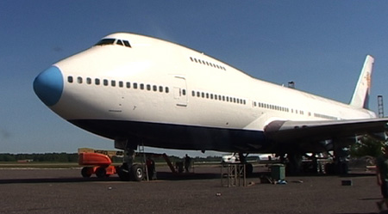
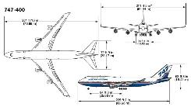
LET US START

Slide 7
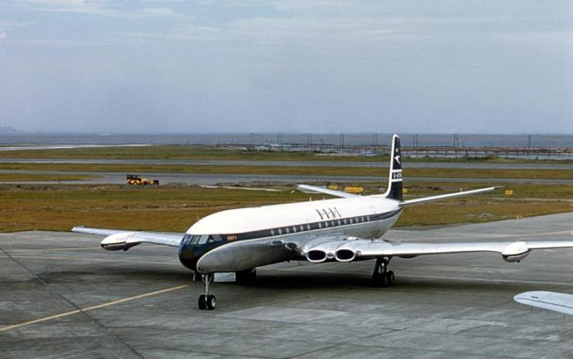
WHO DESIGNED THIS?

Slide 8
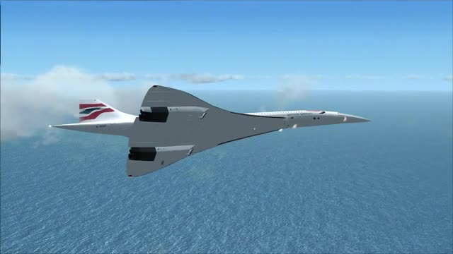
OR THIS?

Slide 9
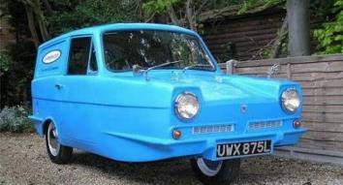
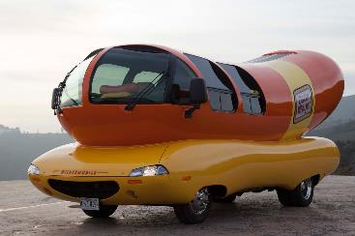
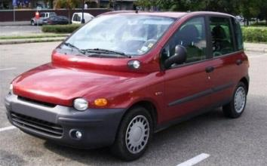
USUALLY GROUP DESIGNING COMES UP WITH THINGS LIKE THESE

Slide 10
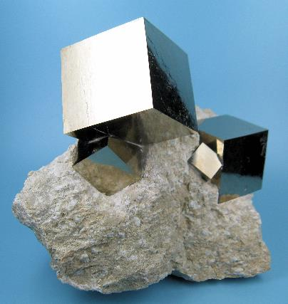
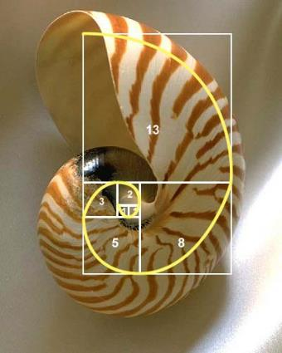
NATURE SEEMS TO KNOW ITS SHAPES WELL

Slide 11
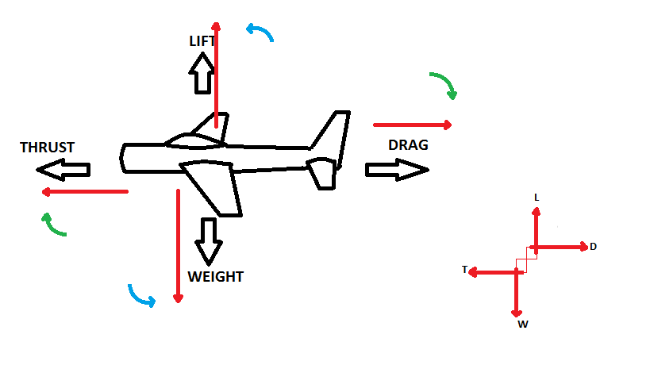
ALL YOU NEED TODAY TO KNOW ABOUT THE THEORY
Finesse F = L/D
Aspect Ratio Ar = b²/S
b
S
Shape (F)
Performance (engines)
codecogs

Slide 12
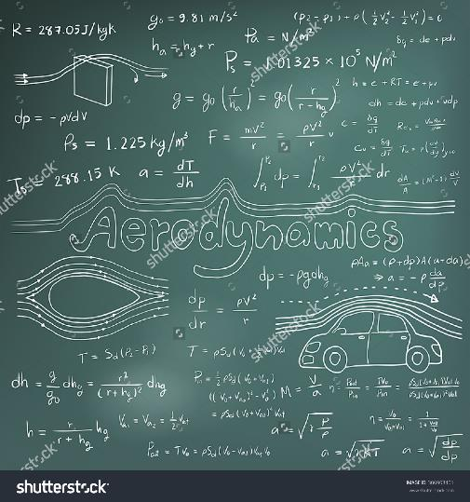
F = ma
or, assuming air ~ fluid
W/S ~ 0.3 x σ x v²
Where:
W = weight of the object (N)
S = wing area (m²)
σ = density of air; 1.1 kg/m³ at sea level, 0.4 kg/m³ at 10 km altitude
v = (constant) cruising speed (m/s)
So at low altitudes
W/S ~ 0.4 x v²

Slide 13
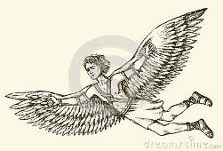
How fast did Daedalus fly?
W/S ~ 0.4 x v²
(at low altitudes)
W = weight of the object (750N)
S = wing area (2 m²)
v = cruising speed (m/s) ~ 30 m/s = 110 km/h

Slide 14
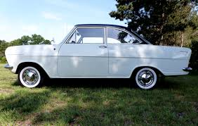
Did my Uncle Alport’s Opel Really Fly?
W/S ~ 0.4 x v²
(at low altitudes)
W = weight of the object (8500N)
S = wing area (7 m²)
v = cruising speed (m/s) ~ 55 m/s = 200 km/h

Slide 15
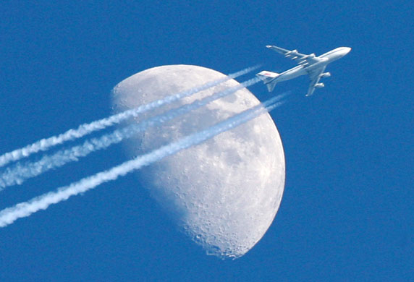
WHAT DOES OUR JUMBO NEED TO DO?
Transport a lot of cargo (originally)
Fly non-stop long distances (Europe-US)
Be fuel-efficient (i.e. good aerodynamics, good Ar and F)
Take off and land in existing (big) airports
Return back to home base the same day
Fast turnaround time (cargo handling, aircraft servicing)
+ Other criteria (not relevant for us today)

Slide 16
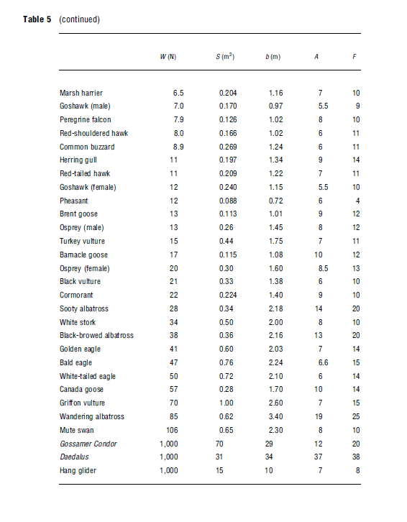
Let us Start with the Aerodynamics
Looking for inspiration from:
heavy migrating birds
high Aspect Ratio (Ar) and Finesse (F)
H. Tennekes (2009)
H. Tennekes (2009)

Slide 17
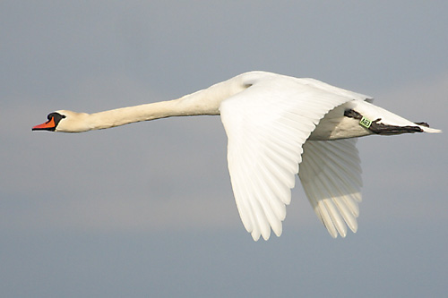

Slide 18
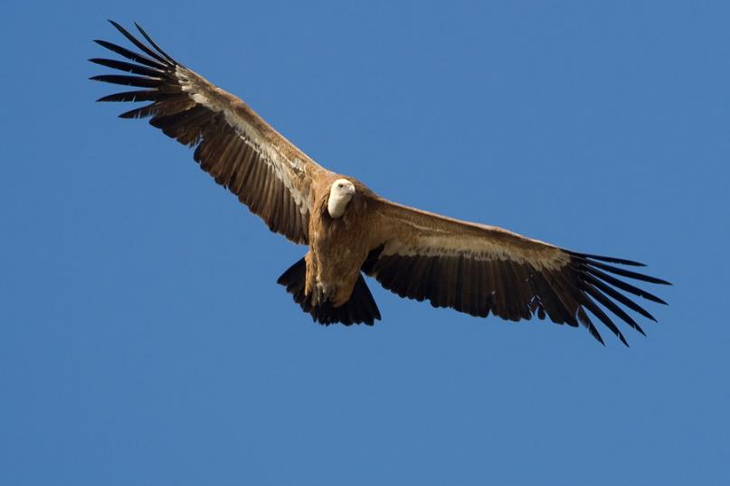

Slide 19
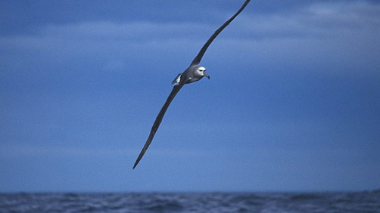

Slide 20
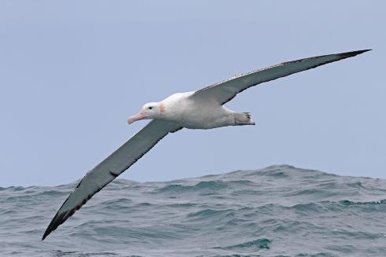

Slide 21
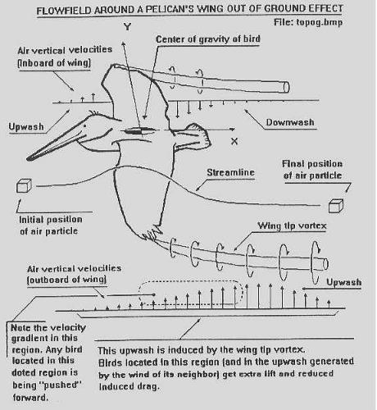
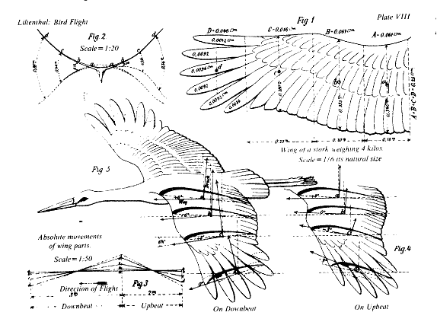
INITIAL INPUT PARAMETERS (ROUGH GUESS)
We assume 6h service + 3h turnaround + 15h flying time per day (ie. 2 x 7.5 h)
Distance Frankfurt – New York is ~ 6300 km + small margin (say, 200 km) => v < 870 km/h
W/S ~ 0.3 x σ x v² < 7000 N/m²
Ar = b²/S, large airport taxiways are max. 80 m wide (max b!)
An average albatross Ar ~ 19 => S ~ 340 m² => W ~ 2600 kN (260 tn)

Slide 22
DESIGN CYCLE
Range
R
Wing load
W/S
Thrust & Weight
T, W
Cruising (C) speed
v
Aspect Ratio
Ar -> b -> S
Engine fuel consumption
fc (SFC)

Slide 23
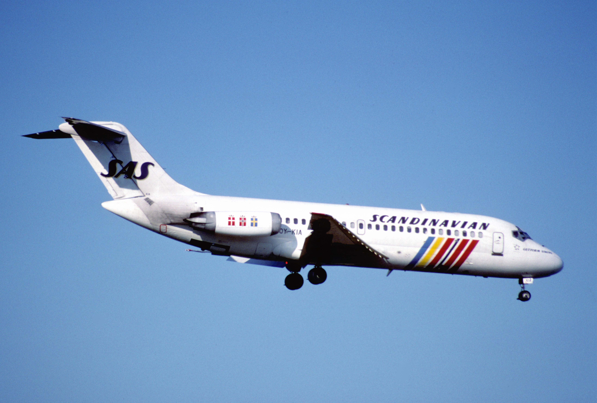
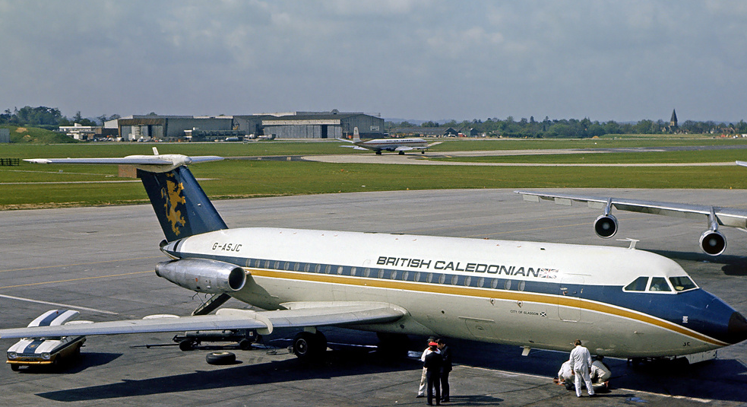
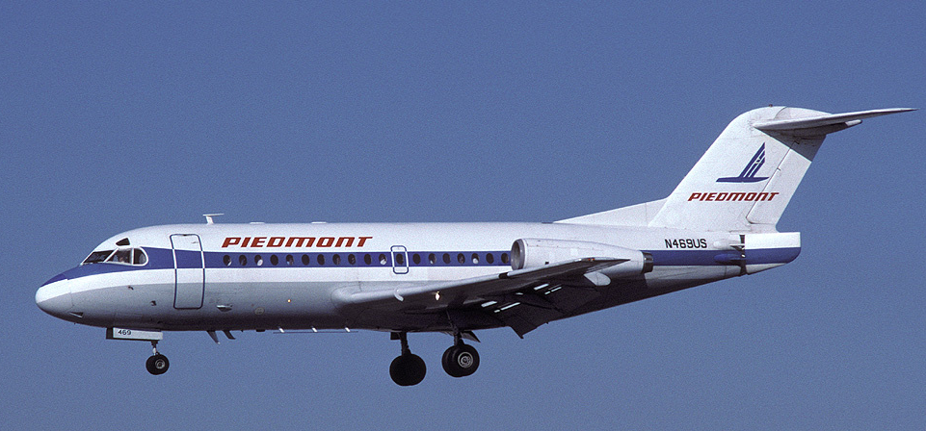
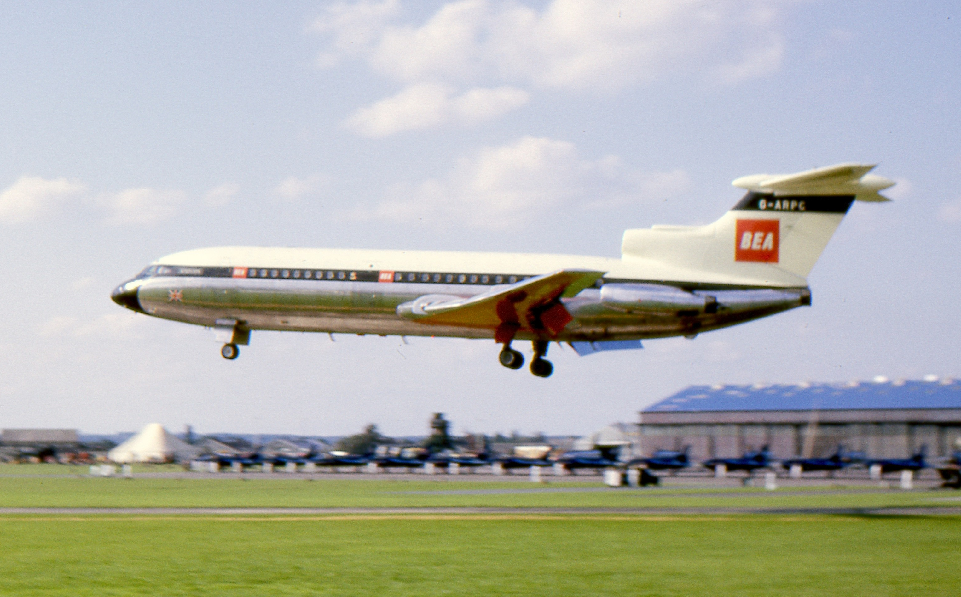
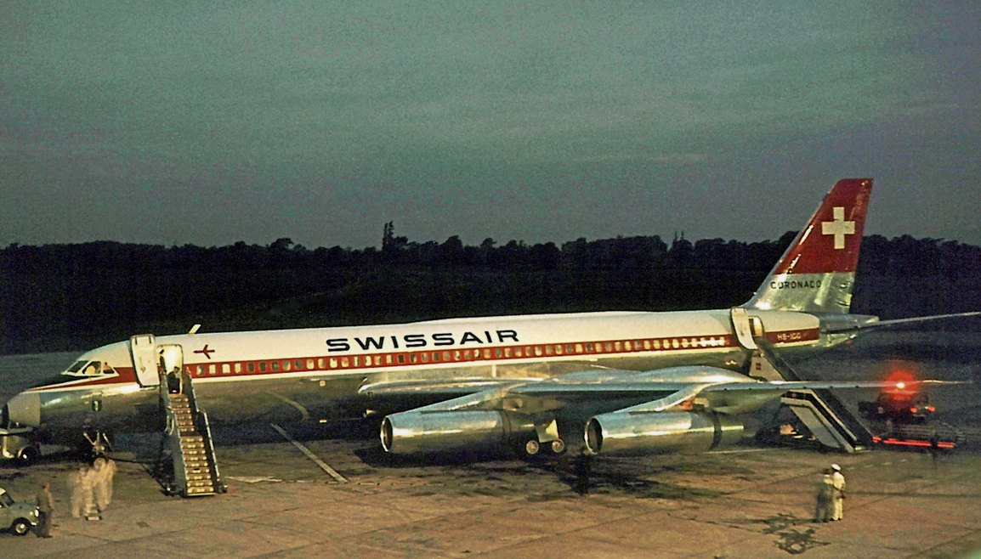
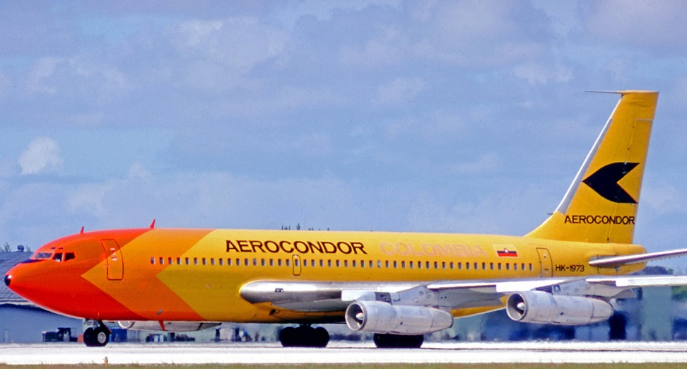
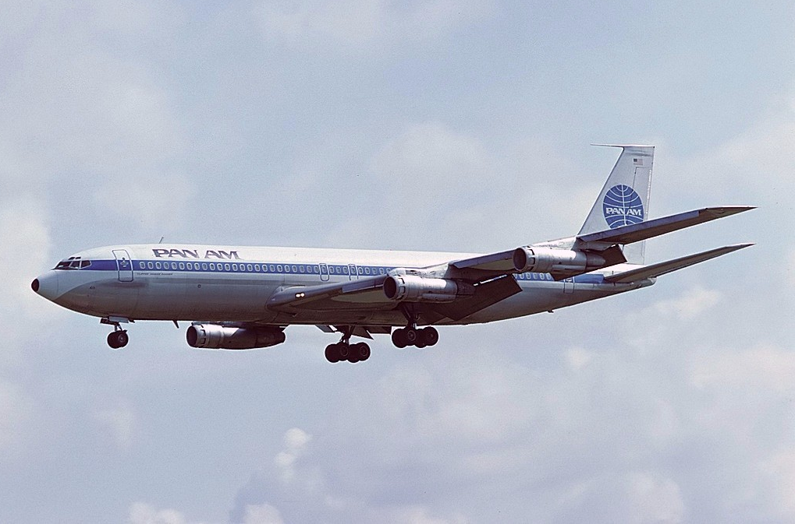
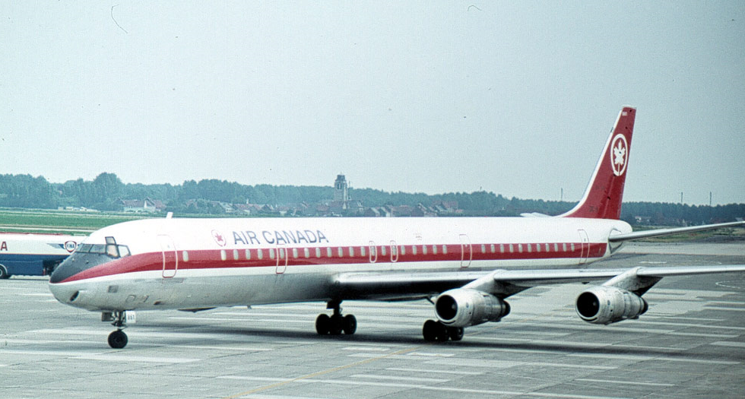
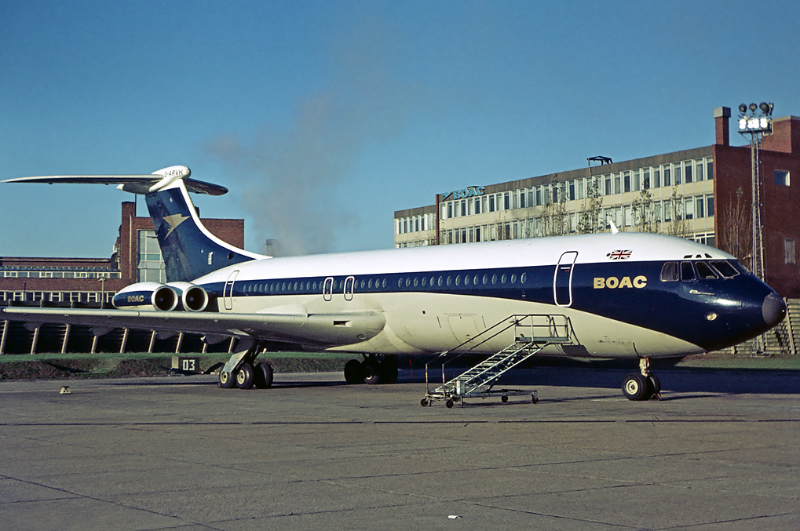
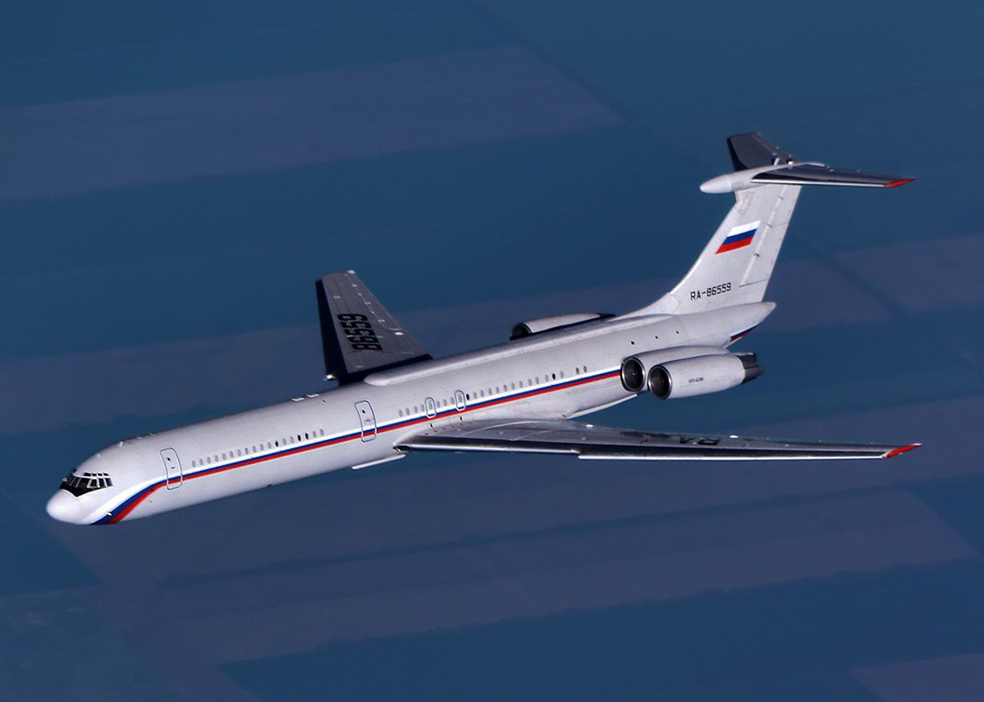
PERFORMANCE OF CIVIL AIRCRAFTS IN 1960s
Wikipedia

Slide 24
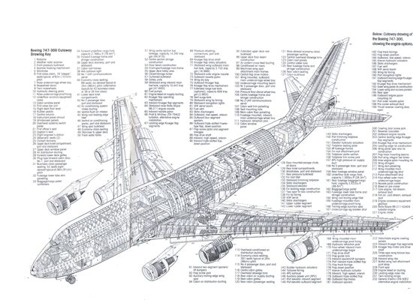
OUTPUT JUMBO PARAMETERS (1st CYCLE)
Let us optimize on Cargo
For the time being, let us not worry about minor details such as the landing gear, stabilizers, engine nacelles, or the length and diameter of the fuselage, landing speed or minimum runway distances etc …

Slide 25
OK NOW YOU GO & IMPROVE (2nd CYCLE)

Slide 26
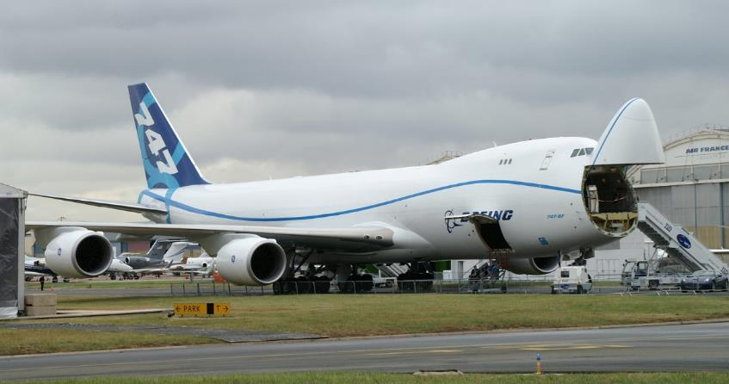
SO THERE WE ARE …

Slide 27
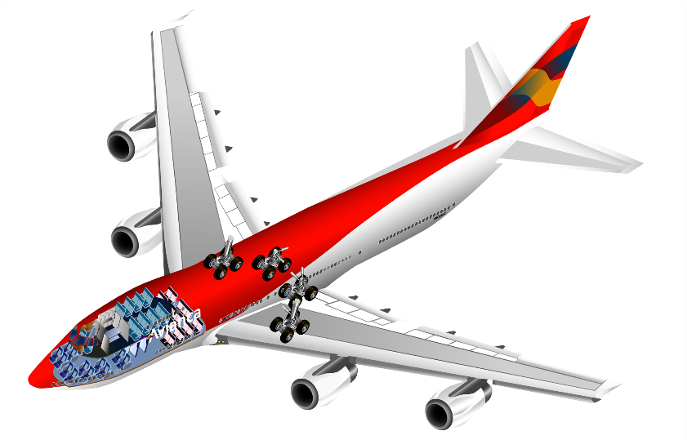
WHAT DO WE TAKE AWAY FROM ALL OF THIS?
Apart perhaps its engine performance, the jumbo (design) is basically incremental
Socio-economic needs drive such large aircraft designs
Less than five engineering parameters determine the aerodynamic design of a large aircraft – but of course there is plenty more to design (interior, cockpit, services etc.)
Performance of large birds does not seem to fall under the spell of neoclassical economics and business thinking -> Not much help in optimizing aircraft design?

Slide 28


THANK YOU
Questions? Comments?
Contact information:
Email: markus.nordberg@cern.ch
Skype: phone-markus

Slide 29
ASSIGNMENT

Slide 30
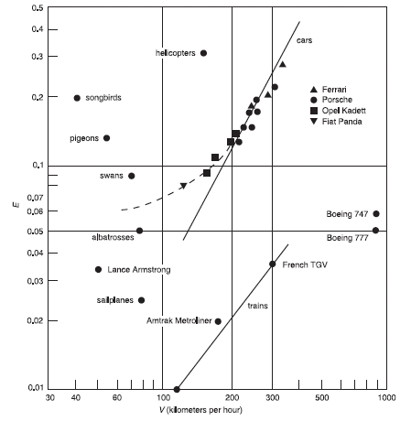
Finesse
Please design a passenger aircraft that fulfills the following needs:
Highly economical to fly (F higher than 20)
Cruising speed less than current large jets (but above TGV)
Can land and take off from existing airports or fields
Integral element of a new, compelling business model
Its appearance is perceived as unique or distinctive in the market
10
20
40
H. Tennekes (2009)

Slide 31
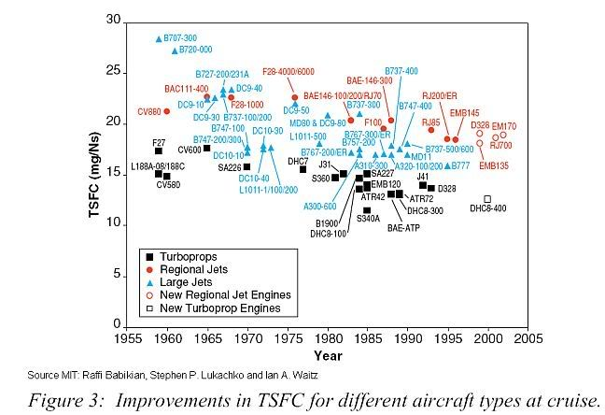
EVOLUTION OF JET ENGINE (FUEL CONSUMPTION)
To obtain fuel consumption in tn/h,
= (TSFC x Thrust (kN) x 3600)/100’000
List of engines
https://en.wikipedia.org/wiki/List_of_aircraft_engines
PPRuNe Forum

Slide 32
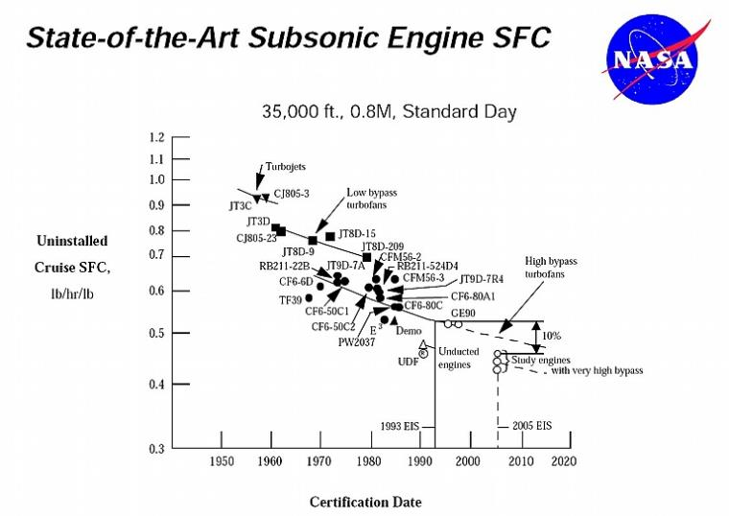
To obtain fuel consumption in mg/Ns, multiply by 28

Slide 33
DESIGN CYCLE
Range
R
Wing load
W/S
Thrust & Weight
T ~ W/3.5
Finesse
~ 6 x √Ar
-> S
Cruising (C) speed
v
Engine fuel consumption
fc (SFC)

Slide 34
DESIGN PARAMETERS OF MODERN CIVIL JETS
Wikipedia

Slide 35
LET US START (EXERCISE)

Slide 36
BE INSPIRED BY NATURE AND PHYSICS…

Slide 37
… BUT LET’s NOT GET TOO CARRIED AWAY

Slide 38
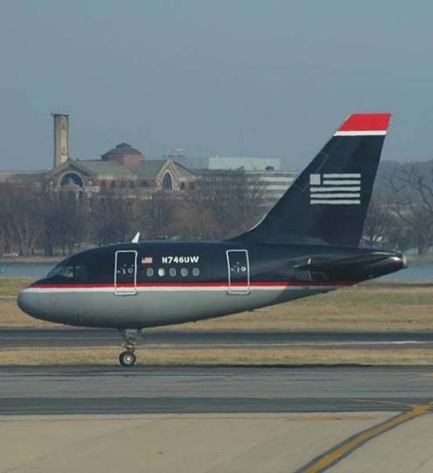

Slide 39
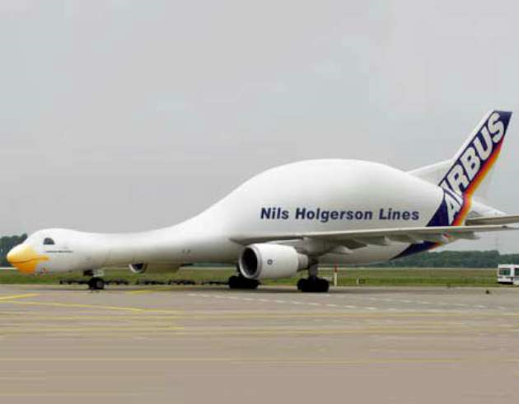

Slide 40
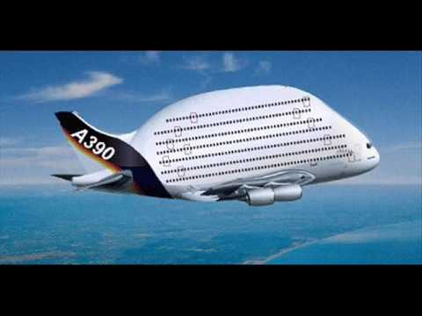

Slide 41
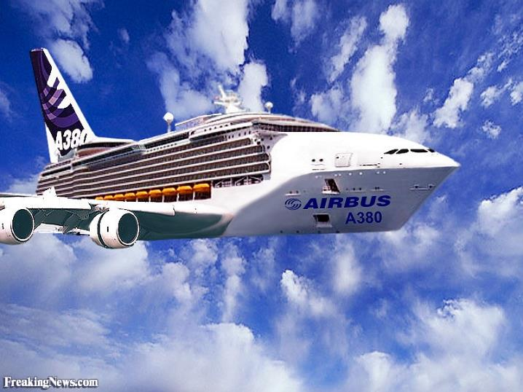

Slide 42
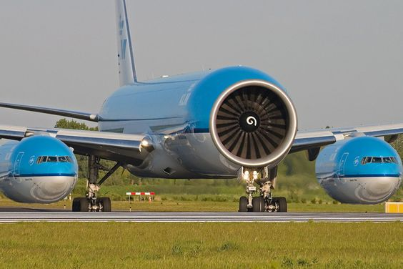

Slide 43
