Slide 1
LS2 planning meeting
A.Tauro

Slide 2
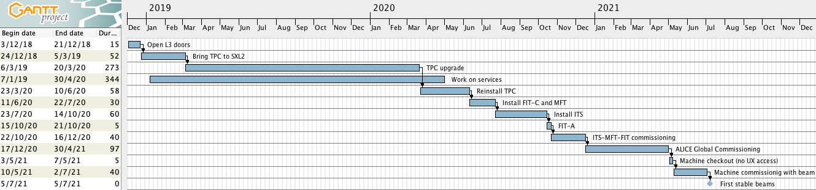
LS2 master plan (v35)

Slide 3
Key dates
Activity | v35
Move TPC to SX2 | 23 Mar 2020
Install TPC (parking position) | 24 Mar – 20 Apr
Install cage and central beampipe | 21 Apr – 12 May
Move TPC to IP | 13 – 15 May
Install Miniframe | 8 – 9 Jun
FIT-C & MFT installation and checks | 11 Jun – 22 Jul
ITS installation and checks | 23 Jul – 14 Oct
FDD-C installation | First half Aug*
FDD-A installation | 1-10 Sep
FIT-A installation | 15 – 21 Oct
ITS & MFT commissioning time | 8w
ALICE global commissioning time | 20w
End of LS2 – stop UX25 access | 1 May 2021
Start commissioning with beam – ALICE in super-safe | 10 May 2021
* we need to redo tightness UX-RB26 before w35 (start cool down S23)

Slide 4
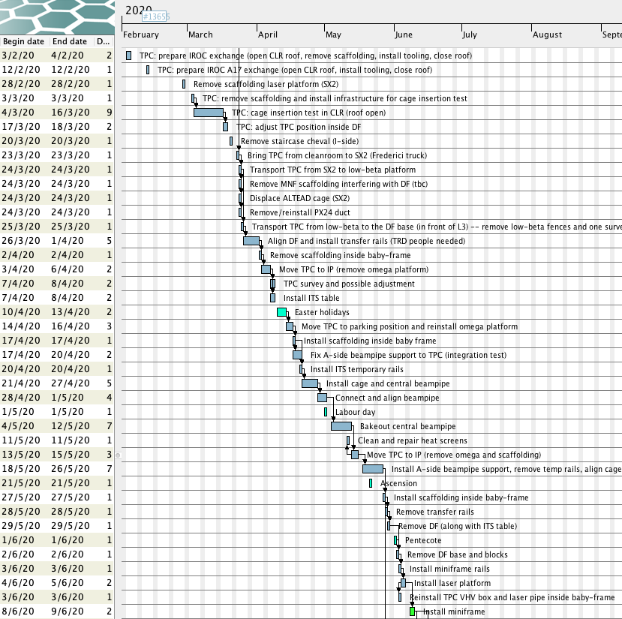
TPC & miniframe reinstallation sequence
Jan 5th – Mar 20th – complete TPC, cage insertion test in SXL2 cleanroom, prepare for TPC transportation, TOF and HMPID activities in the cavern
Mar 23rd – transportation TPC to SX2
Mar 24th – Apr 20th – reinstall TPC
TPC moved to IP, adjusted and put back to parking position
Apr 21st – May 12th – install cage and central beampipe
May 13th – 15th – move TPC to IP – start connection TPC to services
May 18th – Jun 5th – prepare miniframe installation
Jun 8th – 9th – reinstall miniframe

Slide 5
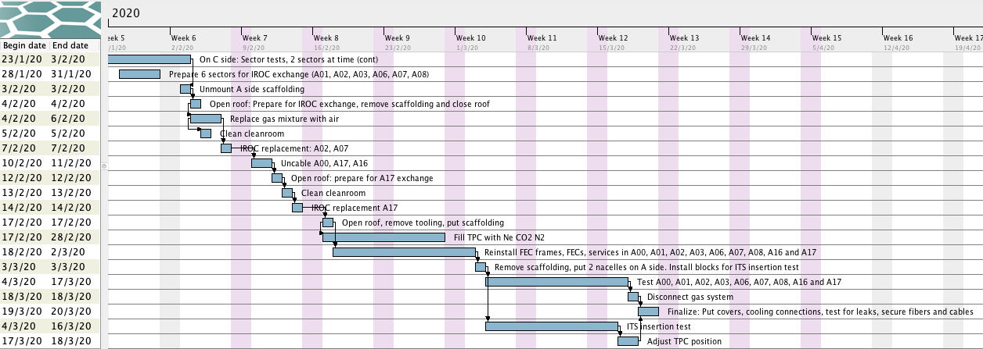
TPC upgrade sequence
TPC schedule v42

Slide 6
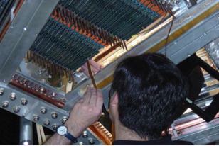
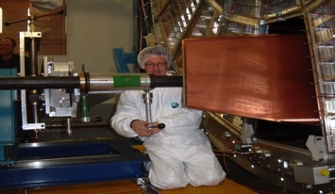
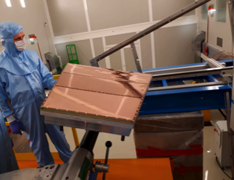
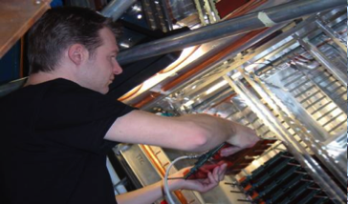
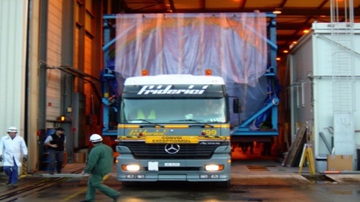
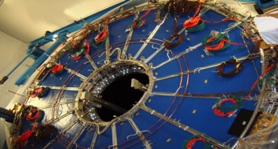
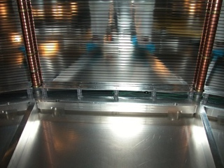
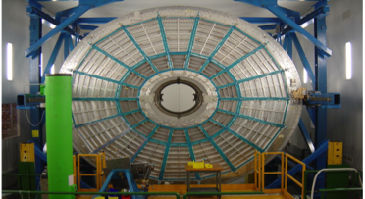

TPC upgrade sequence
Done
Done
Done
Done
Remove Services and FEE (outside cleanroom)
Uninstall MWPC ROC
Install GEM ROC
Install new FEC + test
Ready for transportation to SX2
Done
Done
Done
Ongoing
TPC in cleanroom.
Cleaning & irradiation tests
FC HV infrastructure
modification
Survey, shimming, sealing
Pre-commissioning with cosmic, Laser, pulser, Xray
7 Mar
11 Apr
25 Apr (A)
5 Aug (C)
13 May (A)
16 Aug (C)
14 Jun (A)
25 Aug (C)
5 Jul (A)
16 Sep (C)
14 Oct (A)
31 Oct (C)
25 Nov (A)
3 Feb (C)
20 Mar 2020
TPC schedule v42

Slide 7
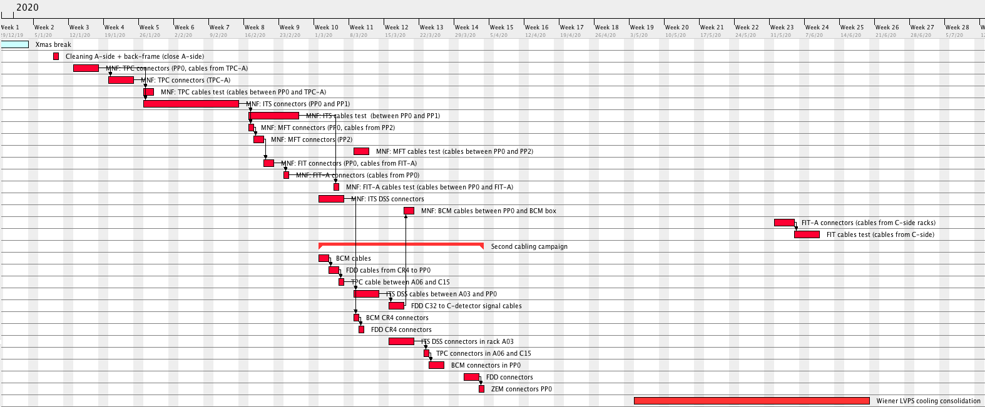
Copper cables (EN-EA)

Slide 8
Copper cables (EN-EA)
Progress pulling: 96%
Progress connectors: 59%
Progress test: 47%

Slide 9
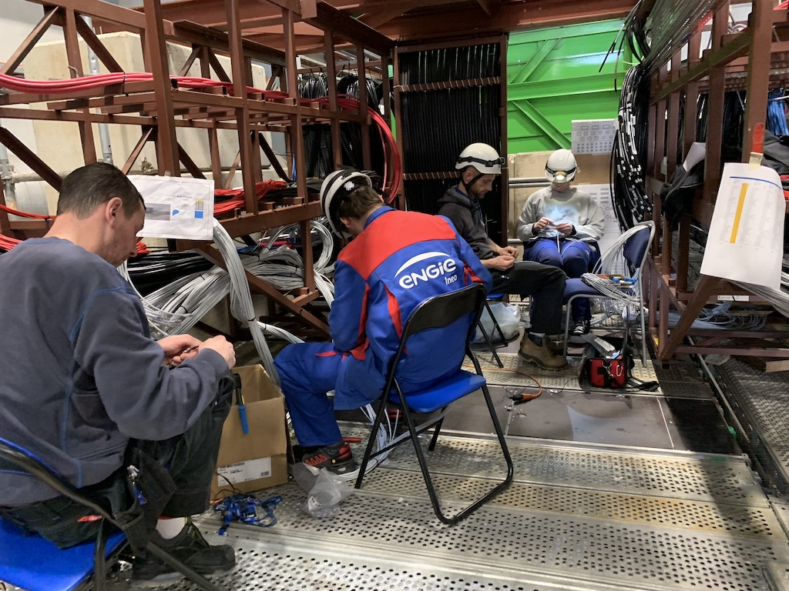
Copper cables (EN-EA)

Slide 10
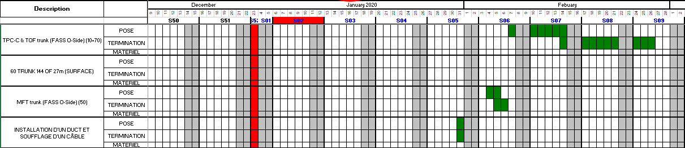
Optical fibers (EN-EL)

Slide 11
Optical fibers (EN-EL)
Completed
To be completed
Completed on miniframe,
to be pulled to A19 in June
Overall progress: ~ 75% pulled
Completion by March (miniframe in June)

Slide 12
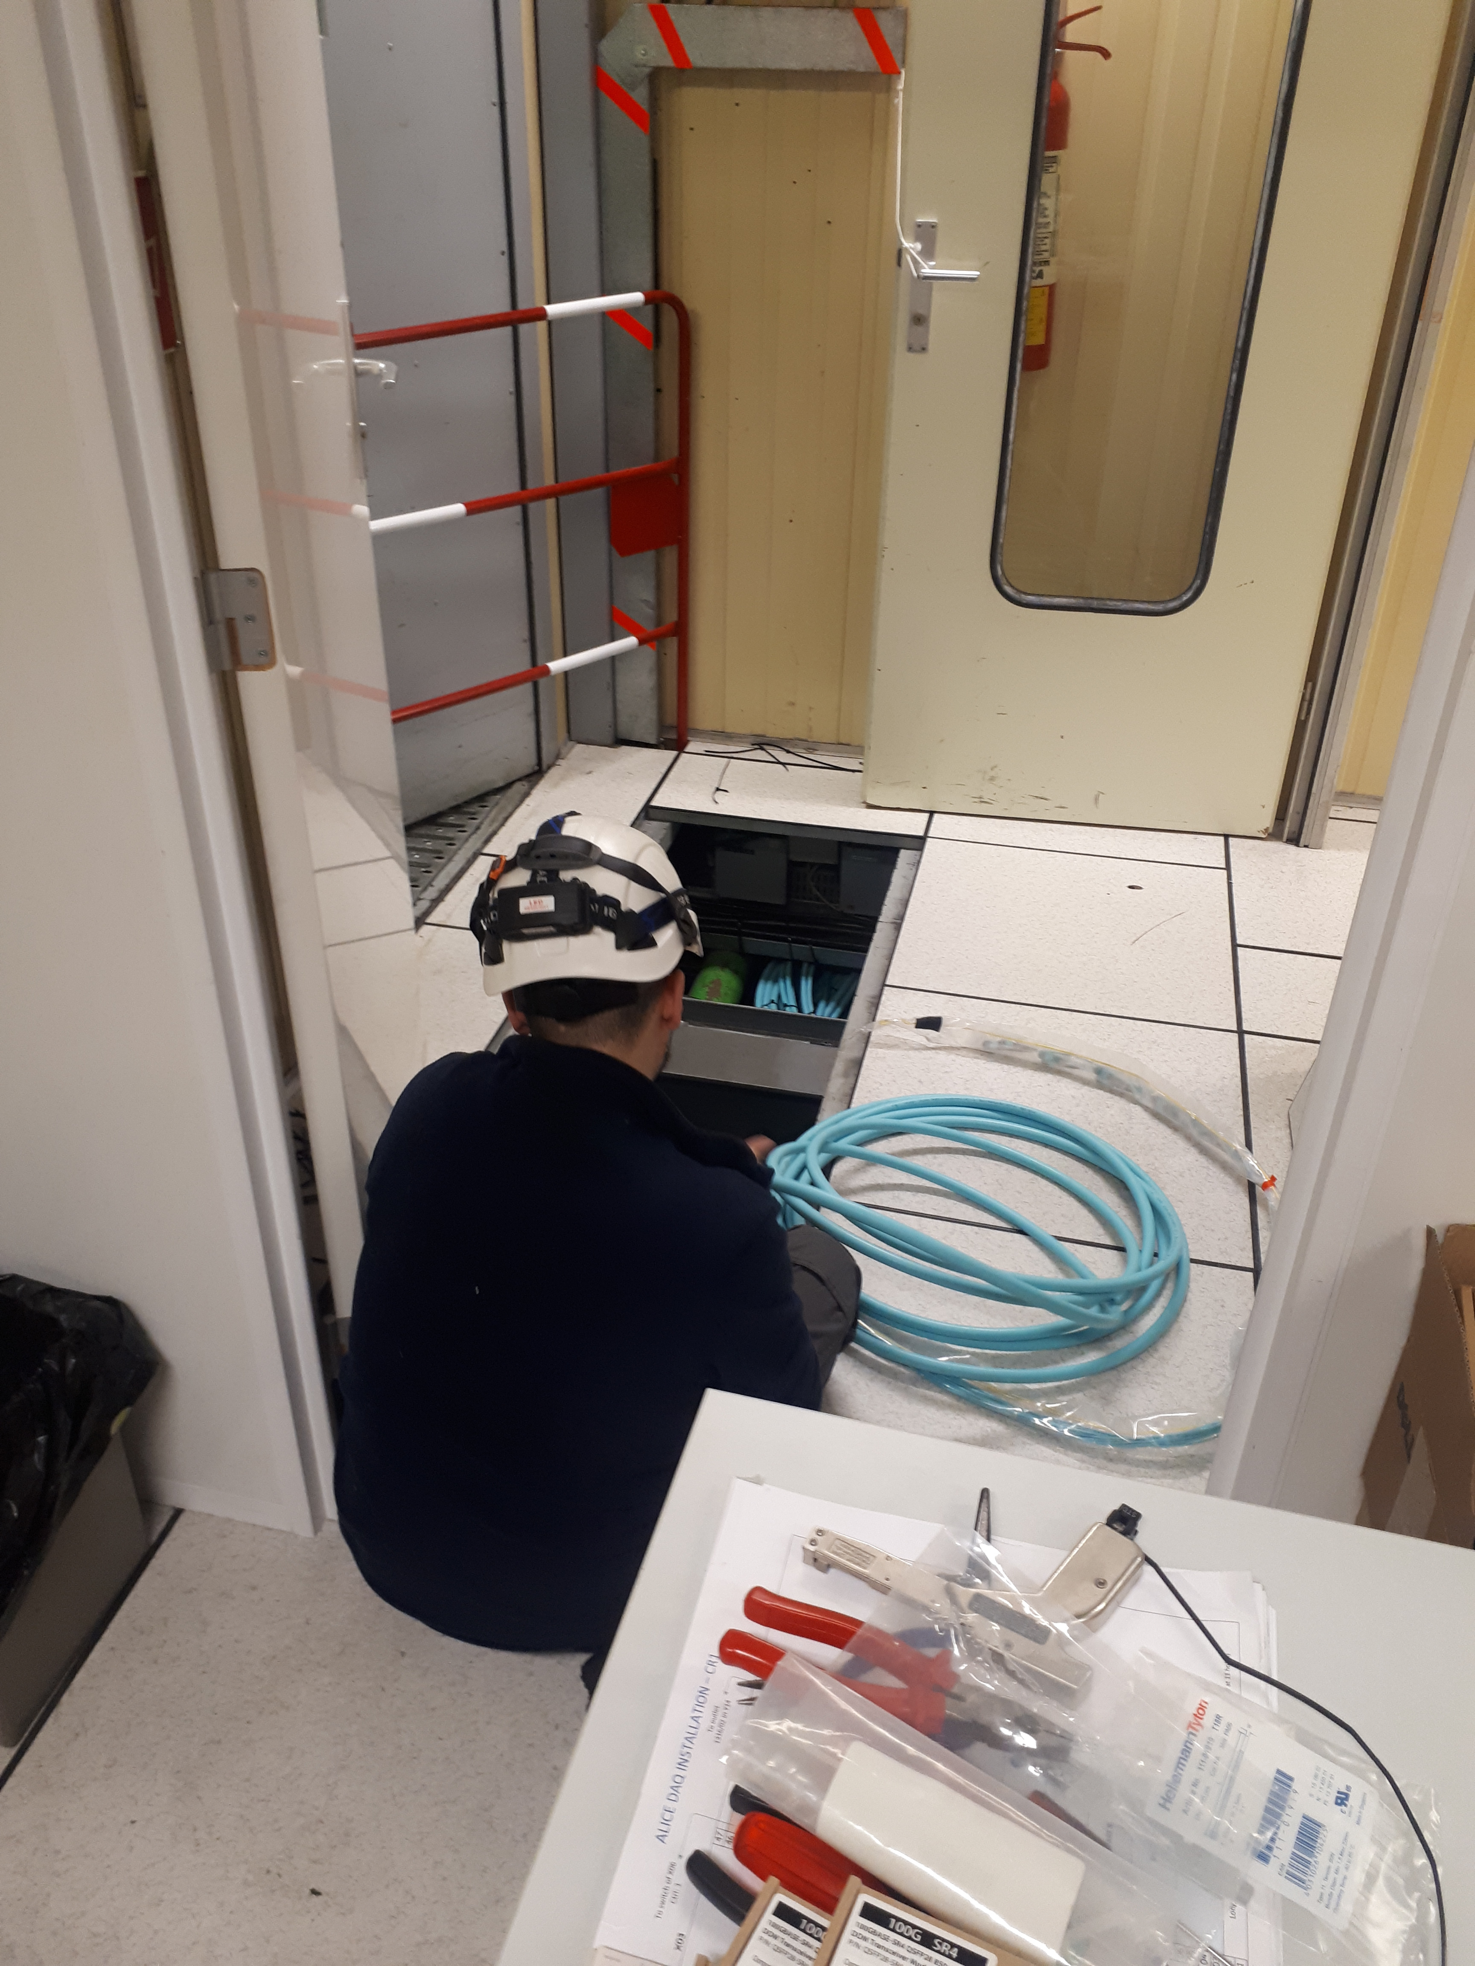
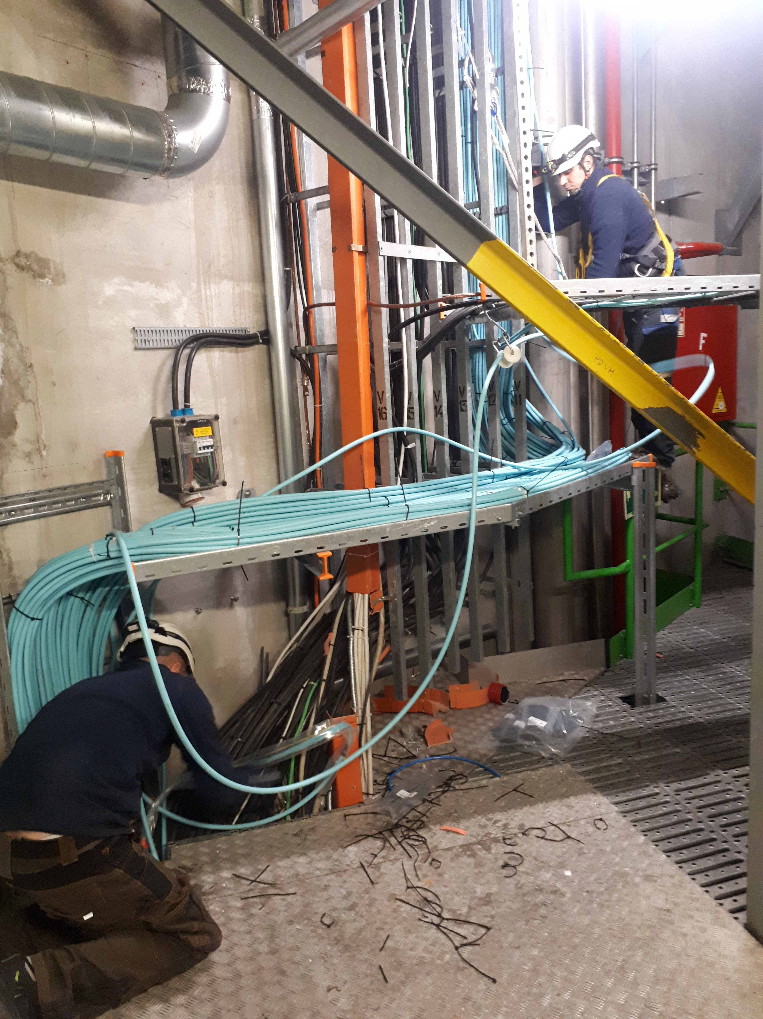
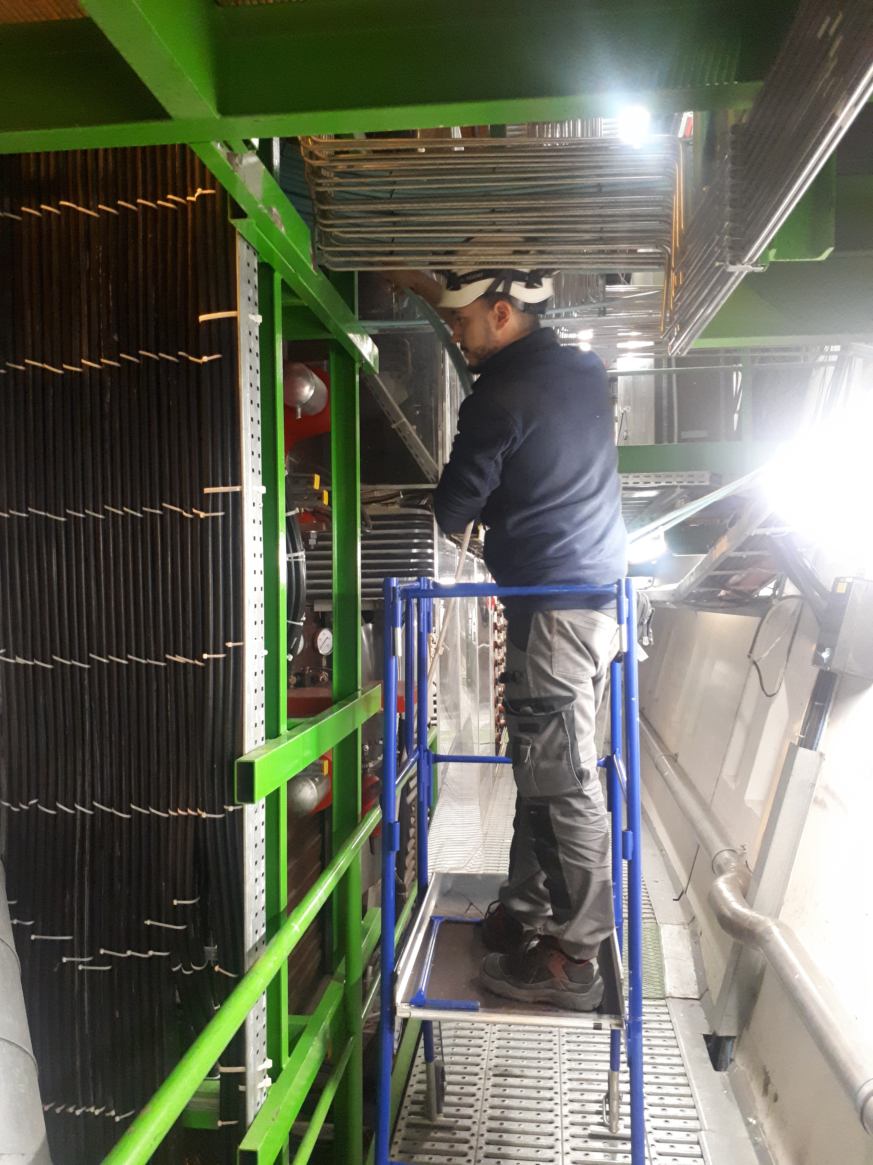
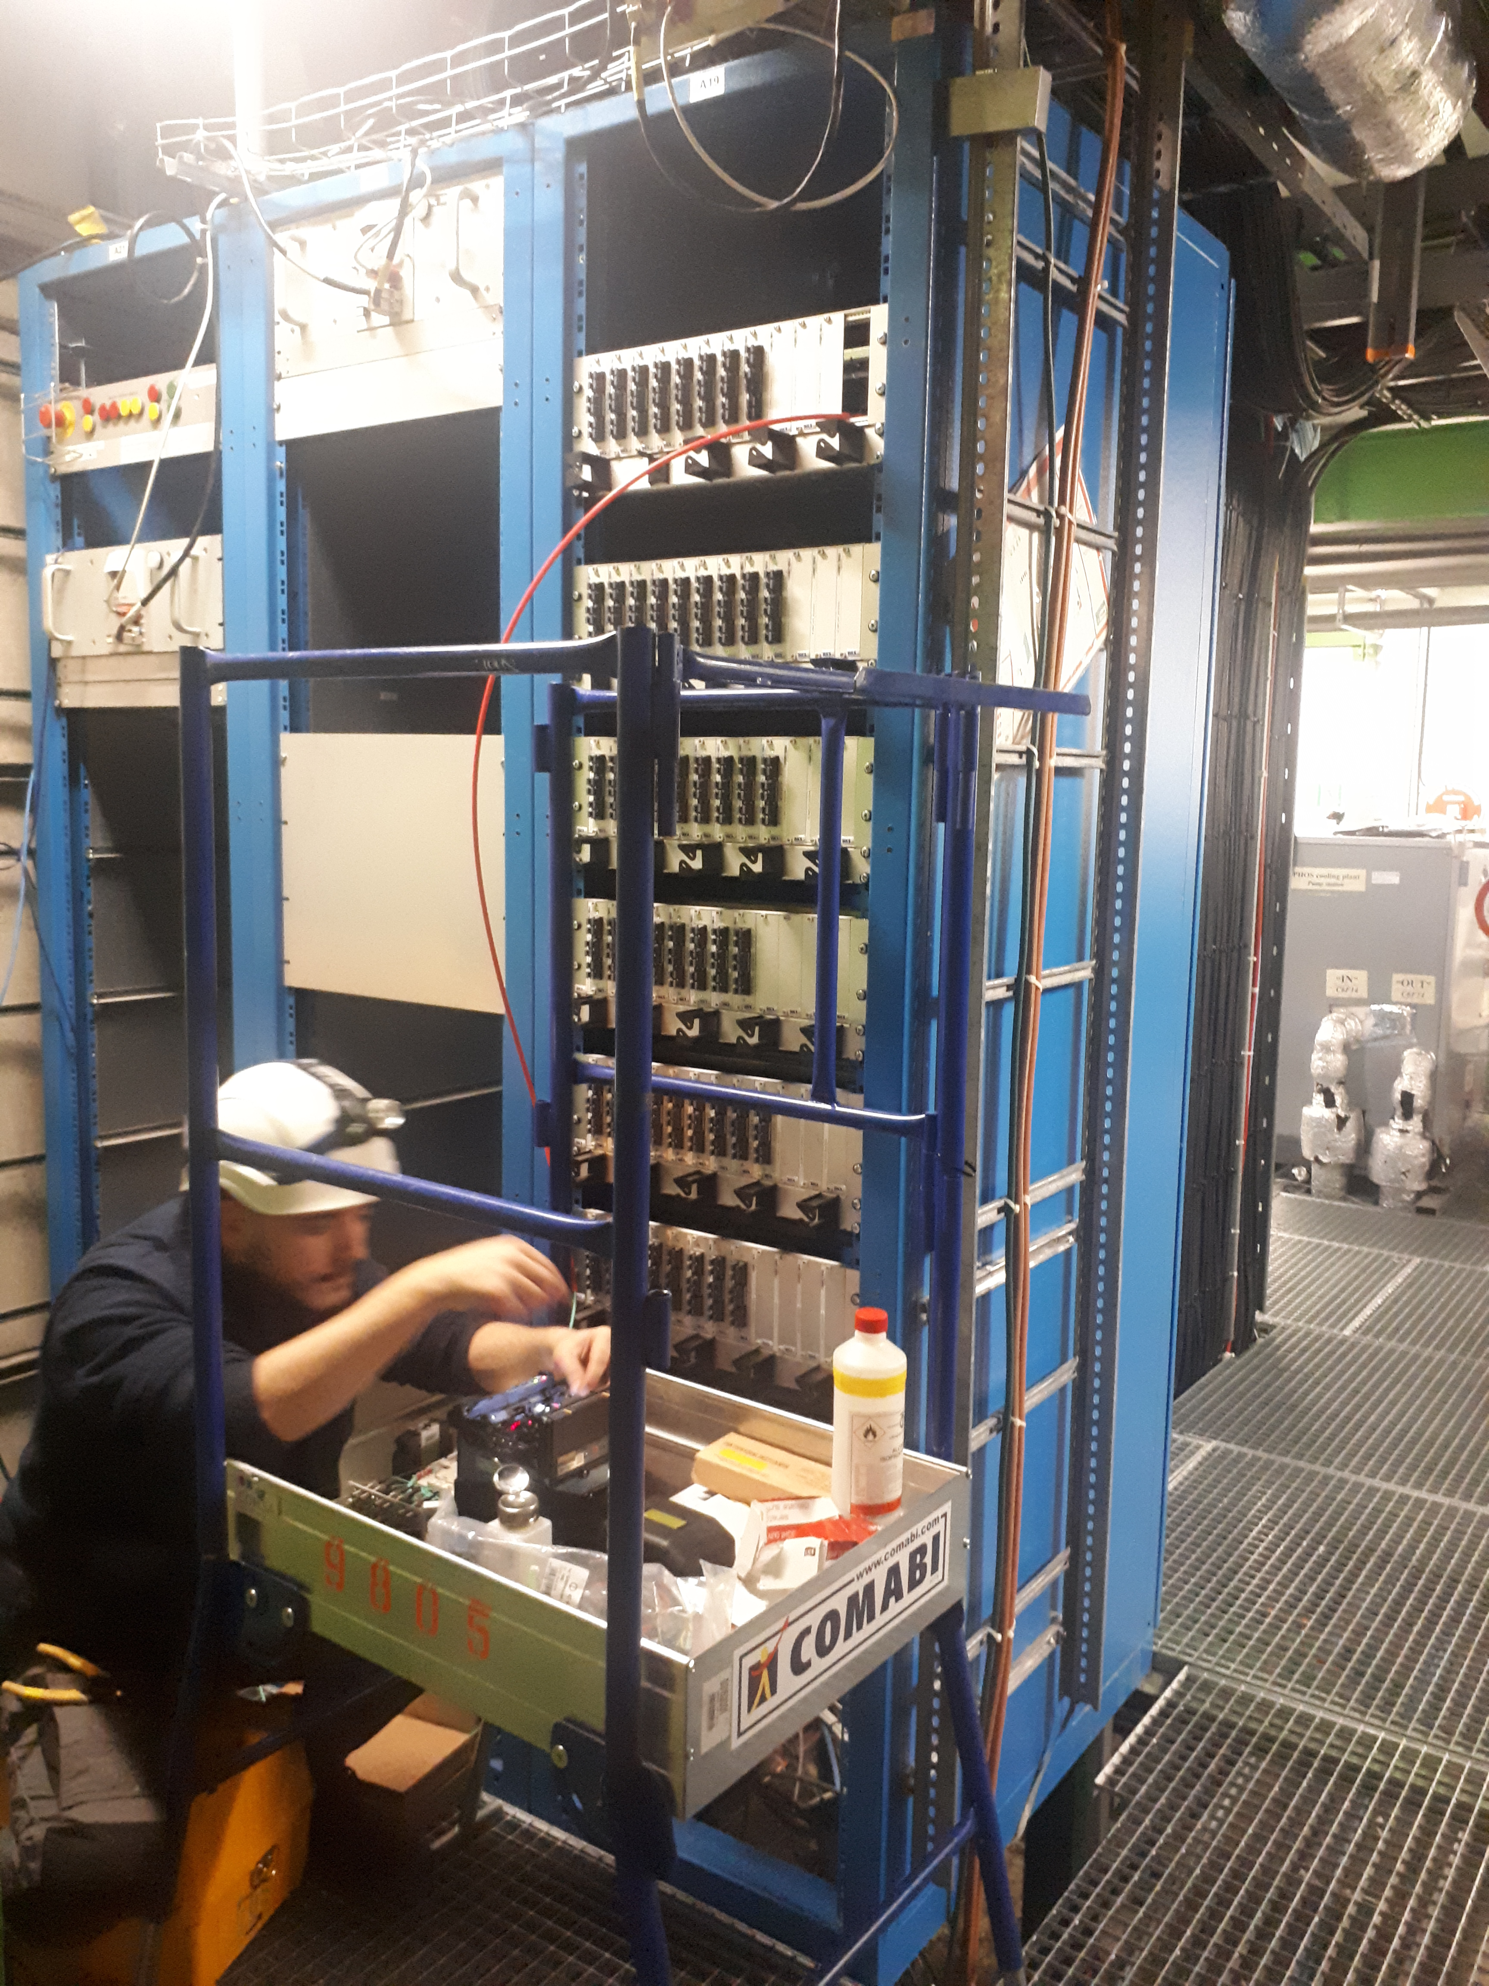
Optical fibers (EN-EL)

Slide 13
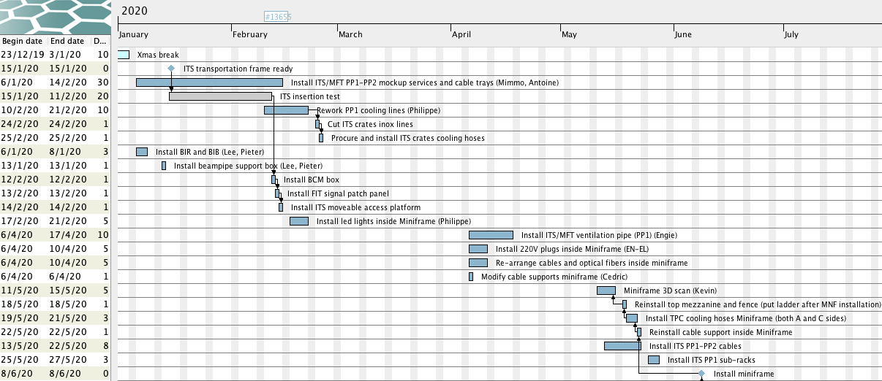
Miniframe schedule
16 weeks to reinstallation

Slide 14
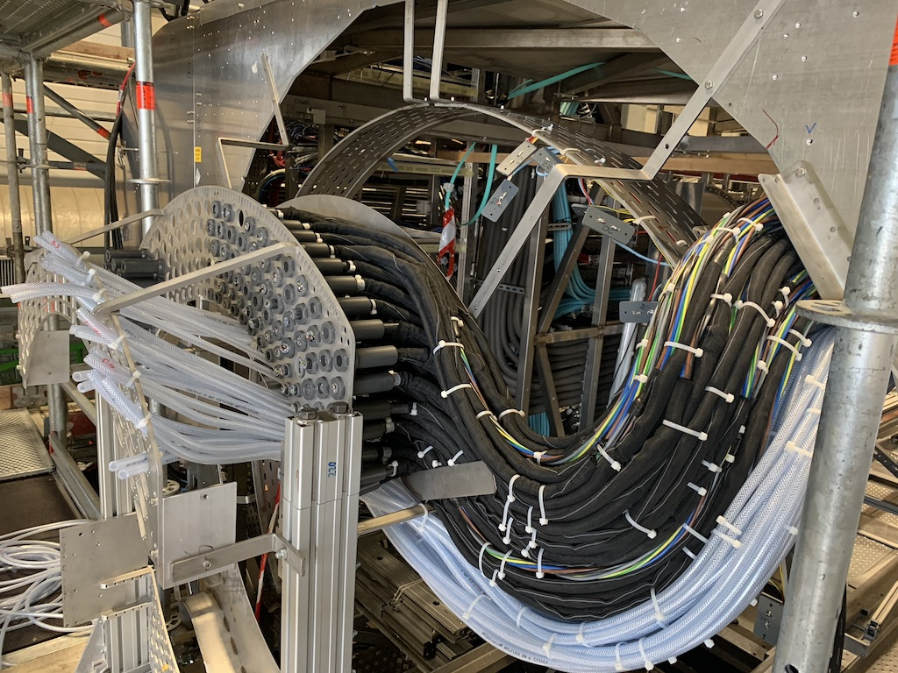
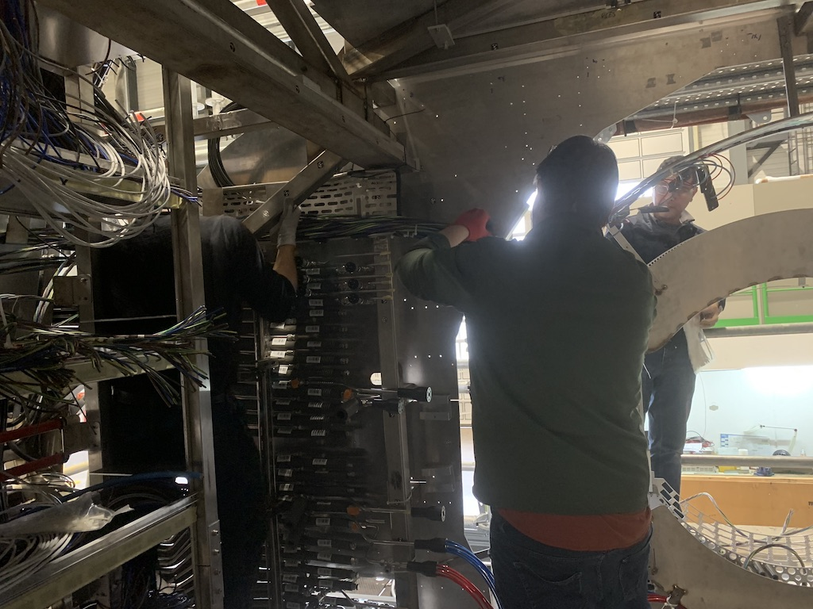
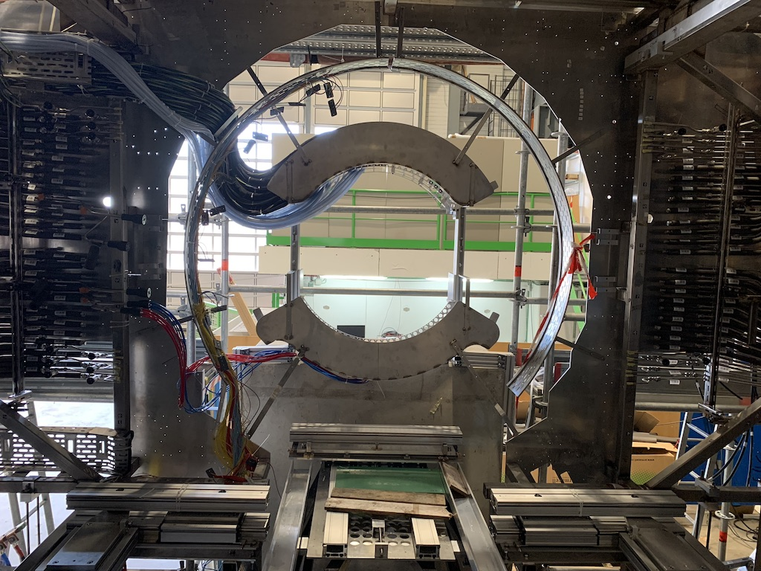
ITS mockup cables
PP1-PP2

Slide 15
EN-EL interventions
18kV, 3.3kV and LV network maintenance: 20-24 Jan 2020 – Done
AUG on Monday 27 January 2020 – Done
Auto transfer test: 27-29 Apr 2020
Test secours (10 min at 6:00 AM): 26 May 2020

Slide 16
Racks status
Racks currently powered on:
  HMPID: I01, I02
  PHOS-CPV: A16, A17
  CTP: C24, C25, C26, C27 (CTP) (and VME crates on)
  MCH: C08, C10, C37, C39
  TOF: O03, O04, O05, O30, O31, O32, I03, I04, I05, I30, I31, I32
  TRD: O06, O08, O26-29, I06, I08, I26-29, C16-19, C29
  Dcal, EMcal: A14, O12
Detectors can be powered, compatible with current activities inside L3

Slide 17
CR3 status
(A.Augustinus)
February
  (10.02 – 21.02) Modify water circuit (add TA valves) – kept DCS up and running – DONE (valves in CR4 are also installed)
  Extension of main network starpoint outside CR2 (preparation)
  Arrival of new racks end of February (t.b.c.)
March
  (02.03 – 20.03) Installation of new racks, water connections
  (from 23.03) Installation of network fibres (between CR1,starpoint and CR3), electricity
  Arrival of new servers end of March
April
  Installation of the servers in the new racks
  Installation of network infrastructure (some network interruptions to be foreseen, details to be defined with IT-CS)
May-June-July
  Migration from old servers to new servers (first central systems, then detector systems)
July-August
  Removal of old servers and last old racks

Slide 18
EN-CV interventions
Big maintenance:
  SF: from Nov 2019 to mid Jan 2020. NO impact on ALICE as both magnets will be OFF – done
  UW: stop UX mixed water for 2 days in week 41/2019 (October) – Tue 8 and Wed 9 Oct – done
  SU: various small perturbations + 1 day stop all cooling UX + 1 day stop all cooling SXL2 in week 16/2020 (April)
Small maintenance:
  UW: from mid Aug 2020 to mid Sep 2020. Stop mixed water UX for 1 day in week 37/2020 (September).
  SF+SU: weeks 45-47/2020: cleaning towers (stop SF 1 week) + 1 day stop all cooling UX.
Renovation transformer UIAC220 in w10/2020 → transparent but need to reduce mixed-water consumption
Stop demineralized water from 17 to 20 December 2019
Ventilation:
  SG2 (2019): w7/2019
  SG2 (2020): Tue-Wed - w3/2020
  Gas extraction: w8/2019
  UX25 cavern: w2/2020
  MCH and MTG: Mon-Thu - w3/2020
  L3: need to replace extractor → 2 days stop → will cut flammable gases (maybe in week 17)
  ITS: → will be done before end June
Raw water:
  Test after Apr 2019. Short interruption (1 day), can be used tap water during the test.

Slide 19
Other tests foreseen in 2020-21
2020:
LASS functional test: no access to UX25 on Monday 3 Aug 2020 whole day (weekend 8-9 Aug as contingency)
LASS global verification of entire LHC: 1 day no access to UX25 (date tbc)
BIW test: no access underground on 5 and 6 Oct 2020 from 18:00 to 00:00
2021:
DSO test: no access to UX25 on 8 and 9 Mar 2021 (tbc)
LHC sector test (beam through ALICE): no access to UX25 from 26 to 29 March 2021

Slide 20
Day-by-day sequence w7
ALICE technicians
Institutes
Transport
Scaffolding
EN-EA
Other CERN groups
Pakistani team
EN-EL
Rampower

Slide 21
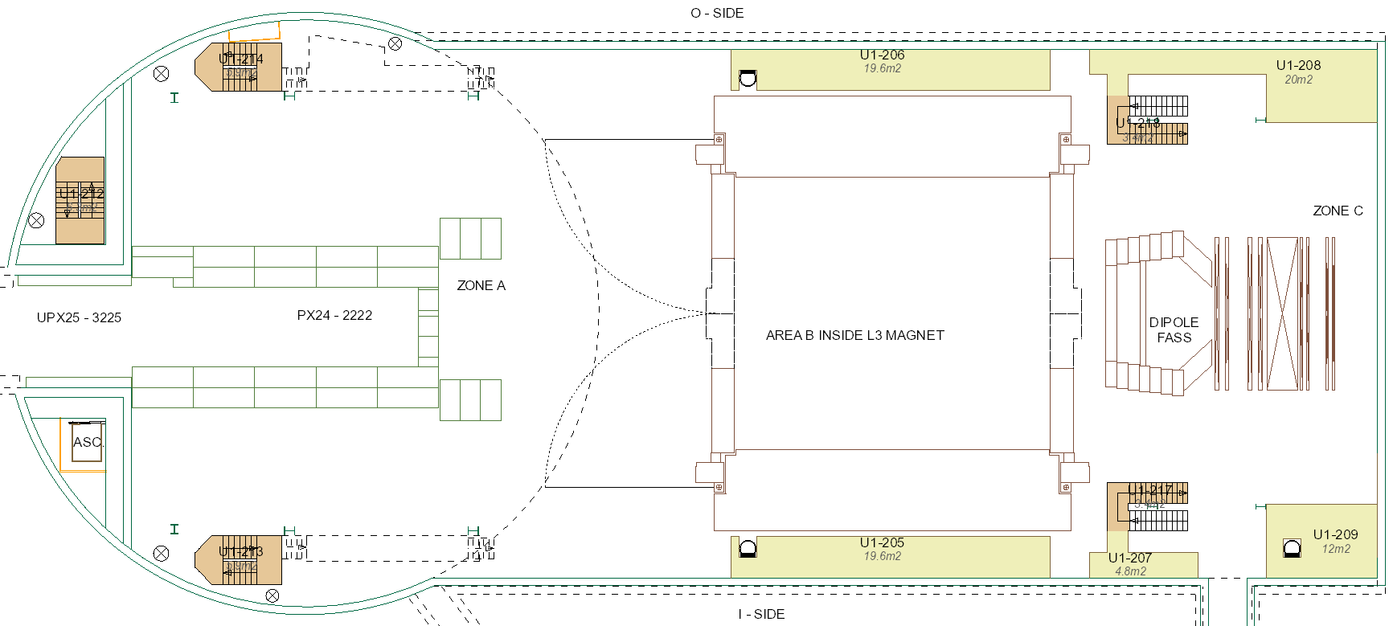
UX25 activities w7 – Mon 10 Feb 2020
Install TA valves CR3-4 – whole week (Bruno, Philippe)
TPC/TOF trunks
Weld MID gas pipes
TOF load transfer (SM7-8-9-10)
PHOS cooling maintenance
TPC/TOF trunks
ST7 cabling
Remove HMPID scaffolding (AM)

Slide 22
UX25 activities w7 – Tue 11 Feb 2020
Cleaning cavern (Topnet): 13:00 to 15:00
TPC/TOF trunks
Weld MID gas pipes
TOF load transfer (SM7-8-9-10)
PHOS cooling maintenance
TPC/TOF trunks
ST7 cabling

Slide 23
UX25 activities w7 – Wed 12 Feb 2020
EN-CV: maintenance cavern ventilation (extraction: UAIE-231 and UAIE-232)
TPC/TOF trunks
Weld MID gas pipes
Remove cables
PHOS cooling maintenance
TPC/TOF trunks
ST7 cabling
Move objects to I-side
Replace L3 flowmeter o-rings

Slide 24
UX25 activities w7 – Thu 13 Feb 2020
TPC/TOF trunks
PHOS cooling maintenance
TPC/TOF trunks
ST7 cabling
Replace L3 flowmeter o-rings

Slide 25
UX25 activities w7 – Fri 14 Feb 2020
TPC/TOF trunks
PHOS cooling maintenance
TPC/TOF trunks
ST7 cabling

Slide 26
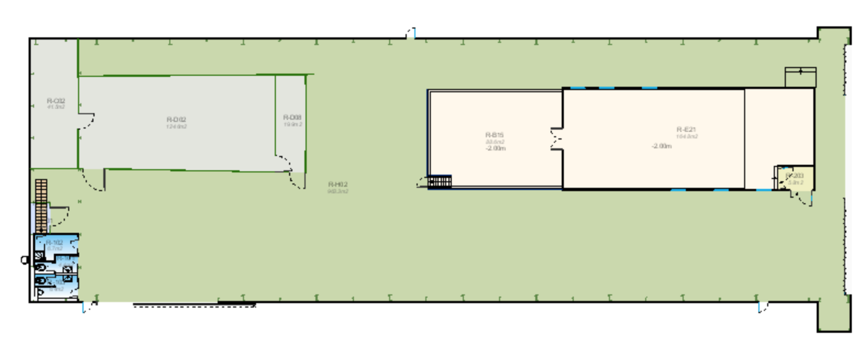
SXL2 activities w7 – Mon 10 Feb 2020
Uncable A00, A17 and A16
A-side
C-side

Slide 27
SXL2 activities w7 – Tue 11 Feb 2020
Uncable A00, A17 and A16
A-side
C-side

Slide 28
SXL2 activities w7 – Wed 12 Feb 2020
Uncable A00, A17 and A16
A-side
C-side

Slide 29
SXL2 activities w7 – Thu 13 Feb 2020
Cleaning (Dosim)
A-side
C-side

Slide 30
SXL2 activities w7 – Fri 14 Feb 2020
TPC: switch off cleanroom ventilation (PM)
A17 replacem.
A-side
C-side

Slide 31
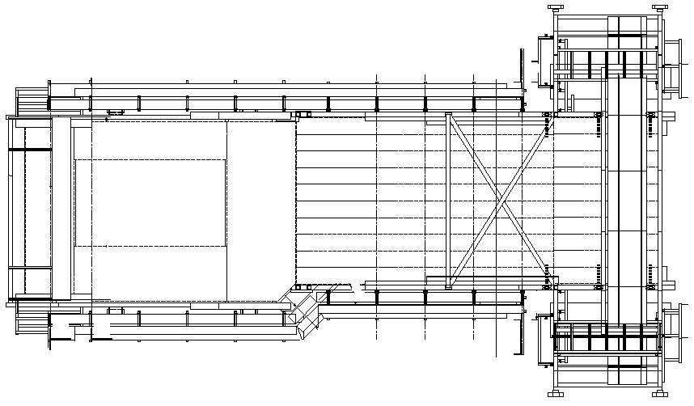
Miniframe activities w7 – Mon 10 Feb 2020
Produce and install steps to protect FO boxes; finish ITS rack supports; build ITS access trap and FIT patch panel (Cedric)
ITS connectors
ITS PP1-PP2 mockup cables (Antoine, Mimmo),
PP1 cooling (Philippe)
Install MFT PP1 PT and filters, cut ITS PP1 cooling pipes and put plate (Philippe)

Slide 32
Miniframe activities w7 – Tue 11 Feb 2020
ITS connectors
ITS PP1-PP2 mockup cables (Antoine, Mimmo),
PP1 cooling (Philippe)

Slide 33
Miniframe activities w7 – Wed 12 Feb 2020
ITS connectors
ITS PP1-PP2 mockup cables (Antoine, Mimmo),
PP1 cooling (Philippe)

Slide 34
Miniframe activities w7 – Thu 13 Feb 2020
ITS connectors
ITS PP1-PP2 mockup cables (Antoine, Mimmo),
PP1 cooling (Philippe)

Slide 35
Miniframe activities w7 – Fri 14 Feb 2020
ITS connectors
ITS PP1-PP2 mockup cables (Antoine, Mimmo),
PP1 cooling (Philippe)

Slide 36
Day-by-day sequence w8
ALICE technicians
Institutes
Transport
Scaffolding
EN-EA
Other CERN groups
Pakistani team
EN-EL
Rampower

Slide 37
UX25 activities w8 – Mon 17 Feb 2020
Delivery at P2 of 9 wooden boxes (60x70x75, ~45kg each)
TPC
trunks
PHOS cooling maintenance
Measurement TRD fibers
TPC trunks

Slide 38
UX25 activities w8 – Tue 18 Feb 2020
Cleaning cavern (Topnet): 13:00 to 15:00
TPC
trunks
PHOS cooling maintenance
Clean under false floor
Measurement TRD fibers
TPC trunks

Slide 39
UX25 activities w8 – Wed 19 Feb 2020
Load test FIT transportation box
TPC
trunks
PHOS cooling maintenance
TPC trunks

Slide 40
UX25 activities w8 – Thu 20 Feb 2020
Cavern lift maintenance: no access to UX25 from 6:00 AM to 8:00 AM
TPC
trunks
PHOS cooling maintenance
TPC trunks

Slide 41
UX25 activities w8 – Fri 21 Feb 2020
TPC
trunks
PHOS cooling maintenance
TPC trunks

Slide 42
SXL2 activities w8 – Mon 17 Feb 2020
TPC: start replacing gas mixture with Ne-CO2-N2
Remove tooling (AM)
Scaffolding (PM)
A-side
C-side
TPC, ALTEAD & P2tech: open roof, remove tooling, close roof

Slide 43
SXL2 activities w8 – Tue 18 Feb 2020
FEC install.
Preparation cage insert. test
A-side
C-side

Slide 44
SXL2 activities w8 – Wed 19 Feb 2020
TPC survey from C-side (preparation cage insertion test)
Reinstall shaft DCal rotator and re-assemble it
FEC install.
Preparation cage insert. test
A-side
C-side

Slide 45
SXL2 activities w8 – Thu 20 Feb 2020
FEC install.
Preparation cage insert. test
A-side
C-side

Slide 46
SXL2 activities w8 – Fri 21 Feb 2020
FEC install.
Preparation cage insert. test
A-side
C-side

Slide 47
Miniframe activities w8 – Mon 17 Feb 2020
Produce and install steps to protect FO boxes; finish ITS rack supports; build ITS access trap and FIT patch panel (Cedric)
Install scaffolding I-side
Install BCM box
ITS connectors
PP1 cooling (Philippe)

Slide 48
Miniframe activities w8 – Tue 18 Feb 2020
ITS connectors
ITS connectors
PP1 cooling (Philippe)

Slide 49
Miniframe activities w8 – Wed 19 Feb 2020
ITS connectors
ITS connectors
PP1 cooling (Philippe)

Slide 50
Miniframe activities w8 – Thu 20 Feb 2020
ITS connectors
ITS connectors
PP1 cooling (Philippe)

Slide 51
Miniframe activities w8 – Fri 21 Feb 2020
ITS connectors
ITS connectors
PP1 cooling (Philippe)

Slide 52
Day-by-day sequence w9
ALICE technicians
Institutes
Transport
Scaffolding
EN-EA
Other CERN groups
Pakistani team
EN-EL
Rampower

Slide 53
UX25 activities w9 – Mon 24 Feb 2020
MCH: X-ray tests ST1 quadrants in SX2 RP bunker (whole week)
TPC
trunks
PHOS cooling maintenance
TPC trunks
Re-route ITS/MFT cooling pipes

Slide 54
UX25 activities w9 – Tue 25 Feb 2020
Cleaning cavern (Topnet): 13:00 to 15:00
TPC
trunks
PHOS cooling maintenance
TPC trunks
Re-route ITS/MFT cooling pipes

Slide 55
UX25 activities w9 – Wed 26 Feb 2020
TPC
trunks
PHOS cooling maintenance
TPC trunks
Re-route ITS/MFT cooling pipes

Slide 56
UX25 activities w9 – Thu 27 Feb 2020
TPC
trunks
PHOS cooling maintenance
TPC trunks
Re-route ITS/MFT cooling pipes

Slide 57
UX25 activities w9 – Fri 28 Feb 2020
Remove scaffolding laser platform in SX2 (Ouvaroff)
TPC
trunks
PHOS cooling maintenance
TPC trunks
Re-route ITS/MFT cooling pipes

Slide 58
SXL2 activities w9 – Mon 24 Feb 2020
FEC install.
Preparation cage insert. test
A-side
C-side

Slide 59
SXL2 activities w9 – Tue 25 Feb 2020
FEC install.
Preparation cage insert. test
A-side
C-side

Slide 60
SXL2 activities w9 – Wed 26 Feb 2020
FEC install.
Preparation cage insert. test
A-side
C-side

Slide 61
SXL2 activities w9 – Thu 27 Feb 2020
FEC install.
Preparation cage insert. test
A-side
C-side

Slide 62
SXL2 activities w9 – Fri 28 Feb 2020
FEC install.
Preparation cage insert. test
A-side
C-side

Slide 63
Miniframe activities w9 – Mon 24 Feb 2020
ITS connectors
ITS connectors
PP1 cooling (Philippe)
Install scaffolding O-side

Slide 64
Miniframe activities w9 – Tue 25 Feb 2020
ITS connectors
Install lights (Philippe)
PP1 cooling (Philippe)
ITS connectors

Slide 65
Miniframe activities w9 – Wed 26 Feb 2020
ITS connectors
PP1 cooling (Philippe)
ITS connectors

Slide 66
Miniframe activities w9 – Thu 27 Feb 2020
ITS connectors
PP1 cooling (Philippe)
ITS connectors

Slide 67
Miniframe activities w9 – Fri 28 Feb 2020
ITS connectors
PP1 cooling (Philippe)
ITS connectors

