Slide 1
LS2 planning meeting
A.Tauro

Slide 2
COVID-19 news
  Access to CERN: an access (white) list is still enforced presently. The access list will be replaced on 18 or 19 October by a blocking list (containing: retirees and anyone over 70, club members, Family Members, Colleagues in quarantine, confirmed/suspected cases). Exceptions will be possible through a standard EDH Access Request. Badging when entering the sites remains mandatory, allowing a monitoring of the number of people at CERN. Badging when leaving is abandoned.
Case declaration: members of CERN personnel who have either tested positive for COVID-19 or are suspected cases (i.e. having possible COVID-19 symptoms but are untested or tested negative) are requested to inform the Medical Service (Tel: + 41 22 766 7777 or medical.service@cern.ch) urgently. The same applies if any household members show symptoms associated with COVID-19.
Close contacts shall not come on the CERN site for 10 days from their identification as a close contact. Contact tracing is done for 4 days prior to the onset of the symptoms (>15’ at less than 2m without mask).
Travel to CERN: access to CERN sites is not allowed for 14 days after arrival from a country/area that features on at least one of the lists (Switzerland or France) of high risk countries and areas for COVID-19 infection → latest information here
  The Swiss list now includes a number of French regions, however, the region of Auvergne - Rhone-Alpes (which includes the departments of Ain and Haute Savoie) is not on the list and colleagues living in this area can therefore come to CERN. Switzerland is not on the French list.
For any question please refer to Covid19.helpline@cern.ch or ALICE-covid19-coordination@cern.ch.

Slide 3
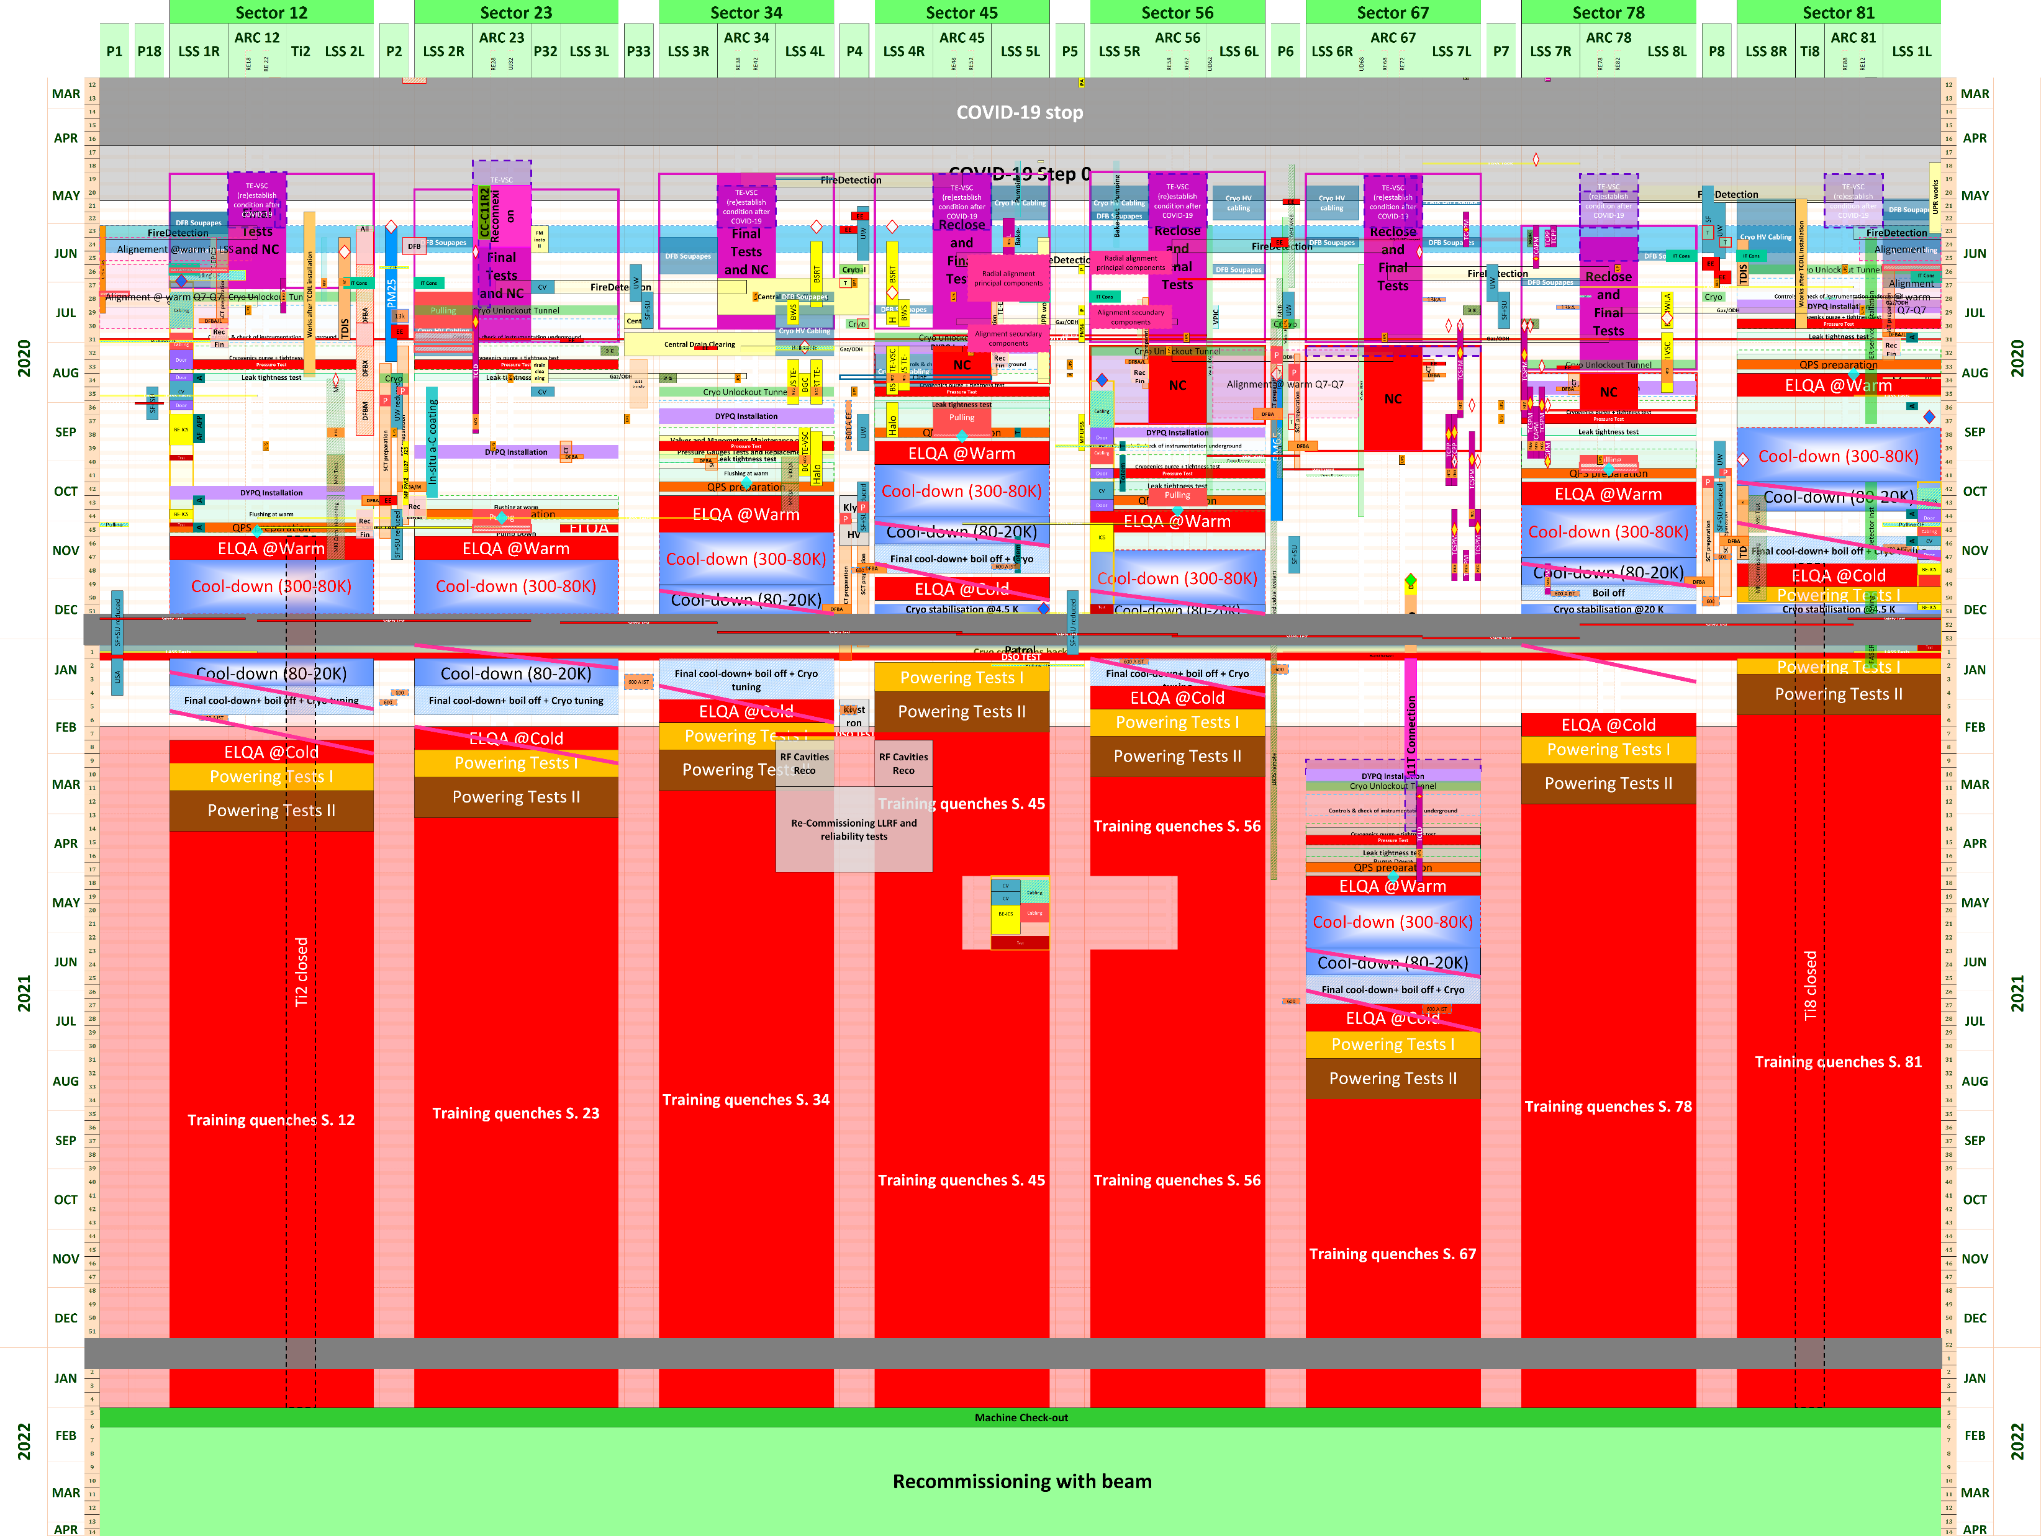

LHC LS2 Baseline V3.0 LHC-PM-MS-0018 v.3.0
3

Slide 4
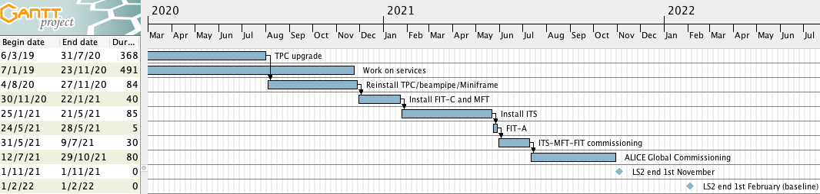
Current master schedule (v42)
Schedule v42:
  Stop ITS operation on Mon Jan 4th 2021
  Stop MFT operation on Mon Oct 26th
  16w global commissioning at the end
RB24 beampipe reinstalled in June 2021 → OK to inject low intensity beam by September 2021
This plan foresees no contingency and 3 months contingency with respect to the LS2 end date of 1st November 2021 and 1st February 2022 respectively
v42

Slide 5
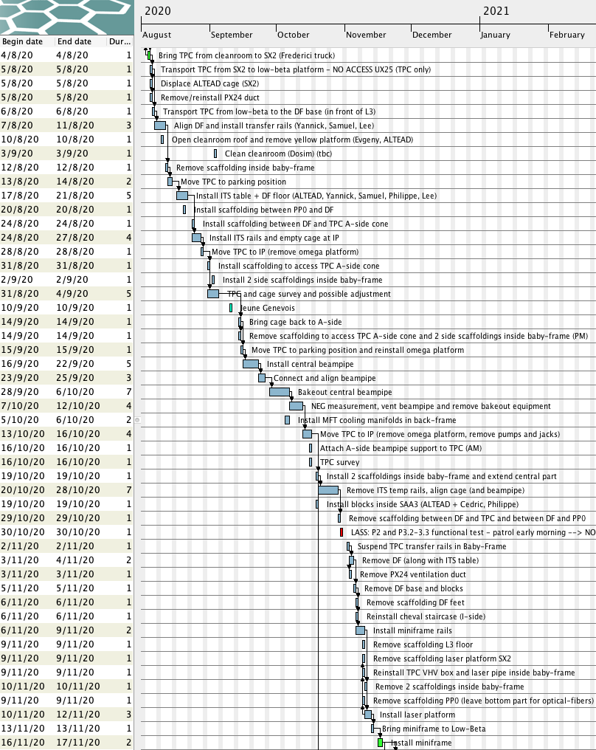
Detector installation sequence
v42
Aug 4th – transportation TPC to SX2
Aug 5th – Sep 15th – reinstall TPC
Cage insertion test, TPC moved to IP, adjusted and put back to parking position
Sep 16th – Oct 12th install central beampipe
Oct 13th – 16th – move TPC to IP – start TPC connections
Oct 19th – Nov 12th – prepare miniframe installation
Nov 16th – 17th – reinstall miniframe

Slide 6
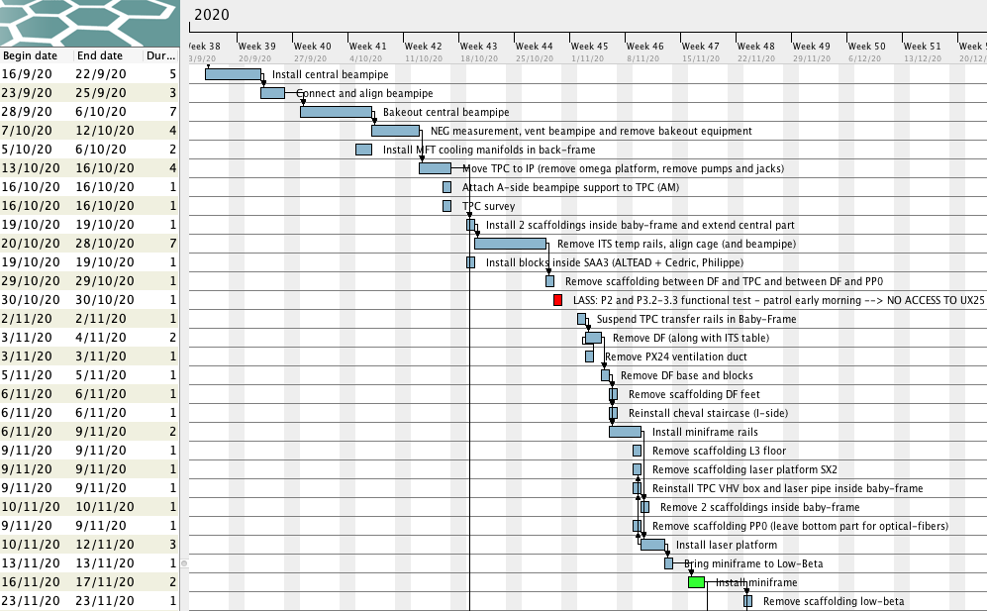
Zoom on coming weeks
Move TPC to IP next Thursday, 15.10

Slide 7
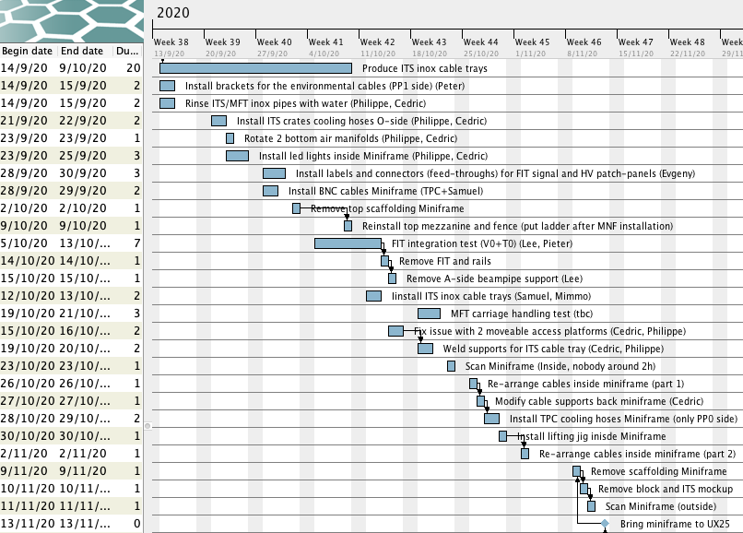
Miniframe

Slide 8
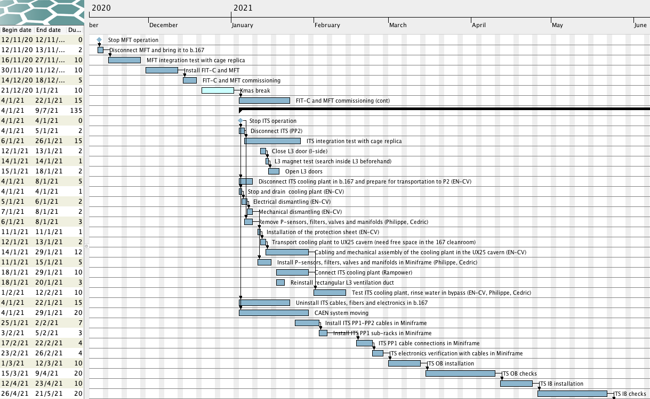
Detailed MFT and ITS installation plan
Mechanical integration tests
ITS cooling plant
ITS services
5w (work in miniframe)
ITS installation

Slide 9
Key dates
Activity | v42
Move TPC to SX2 | 4 Aug 2020
Install TPC (parking position), cage insertion test | 5 Aug – 15 Sep
Install central beampipe | 16 Sep – 12 Oct
Move TPC to IP | 13 – 16 Oct
Install Miniframe | 16 – 17 Nov
FDD-C installation | 1 – 26 Feb 2021
FDD-A installation | 1 – 26 Feb 2021
MFT & FIT-C installation and checks | 30 Nov 2020 – 22 Jan 2021 Disconnect MFT 12 Nov
ITS installation and checks | 25 Jan – 21 May Disconnect ITS 4 Jan
FIT-A installation | 24 – 28 May
ITS & MFT commissioning time | 1 ½ months (6w)
ALICE global commissioning time | 3.5 months (16w)
End of LS2 – stop UX25 access - baseline (contingency baseline option) | 1 Feb 2022 (3 months)
End of LS2 – stop UX25 access - option 1 (contingency option 1) | 1 Nov 2021 (0 months)

Slide 10
Cabling status
Miniframe:
  All cables pulled, all connectors installed and tested
  All cables/fibers will be folded back inside the Miniframe in October, in preparation for the Miniframe installation in the UX25 cavern
Cavern:
  All cables pulled, all connectors installed and tested
Some connectors will be done only after Miniframe is installed (e.g. FIT-A, TPC laser, FDD-A signal)

Slide 11
Optical fibers (EN-EL)
Done:
  Installation and test TPC fibers between CR4 and CR1
  Installation and test fibers for IT (for upgraded network) from CR2 starpoint to CR1 and to CR3
  Optical measurement fibers SR2-SX2
  Installation TPC optical fiber in the cavern between A and C-sides
To be done:
  Installation 6 trunk cables between IT1-IT2 (CR0) → installation w46 (requires to open 2 blocks)
  Installation 2 x FDD optical cables → w48
  Cleaning TRD trigger fibers connectors and replacement of damaged ones → Anastasia to assess situation
  Unfold and connect ITS and TPC trunk cables → w47-48 (19-27 Nov)
  Installation of 2 conventional cable fibers for direct trigger to ITS from CTP → w49 (30 Nov-2 Dec)

Slide 12
Cooling pipes status
Rinse ITS/MFT Miniframe & cavern pipes with water → done
Install missing fittings in PP0, bend PP0 pipes → done
Pipe connections to ITS cooling plant will be done after installation of ITS cooling plant in January (w4-5)
Connections between PP0 and Miniframe will be done using plastic hoses → ordered by Elisa

Slide 13
EN-CV interventions
Big maintenance:
  SF: from Nov 2019 to mid Jan 2020. NO impact on ALICE as both magnets will be OFF – done
  UW: stop UX mixed water for 2 days in week 41/2019 (October) – Tue 8 and Wed 9 Oct – done
  SU: various small perturbations + 1 day stop all cooling UX + 1 day stop all cooling SXL2 in week 16/2020 (April)
Small maintenance:
  UW: from w34 to w37 2020. Stop UX mixed water on Monday 7 September 2020 – done
  SF+SU: weeks 44-47/2020: cleaning towers (stop SF w44-15, no impact) + 1 day stop all cooling UX (9 Nov) + 1 day stop SXL2 cleanroom ventilation (9 Nov)
Ventilation:
  ARC: done
  SXL2 CLR: w43 (19-21 Oct) – stop ventilation for 3 days
  SG2:
  UX25 cavern: done
  MCH and MTG: done
  L3: replace extractor → done
  ITS: → done

Slide 14
CR3 status (A.Augustinus)
February
  Modify water circuit (add TA valves CR3 and CR4) – kept DCS up and running – DONE (10.02 – 21.02)
  Additional rack installed for extension of main network starpoint outside CR2
  Arrival of new racks (25.02)
  Installation 1st row of racks (26.02)
March, April, May
  COVID closure
  Arrival of new servers (28.04, originally foreseen end of March)
  Installation of the servers in the new racks – DONE (finished 15.05)
  Remove TOF cluster – DONE (26.05), last racks removed – DONE (28.05)
June
  Installation of 2nd row of new racks - DONE (03.06)
  Re-installation TOF cluster – DONE and tested (08.06)
  Installation network fibres for network – DONE (25.06)
July – August – September
  Adapt electrical installation for (extended) starpoint outside CR2 – DONE (week 28)
  Reconnection new racks to electricity – DONE (week 30)
  Installation of new Database servers – DONE (week 36)
  Installation of network infrastructure (some network interruptions to be foreseen, details to be defined with IT-CS) – October
    Temporary, network solution available, start commissioning new servers in September
October – November - December
  Migration from old servers to new servers (first central systems, then detector systems) from October
  Removal of old servers and last old racks

Slide 15
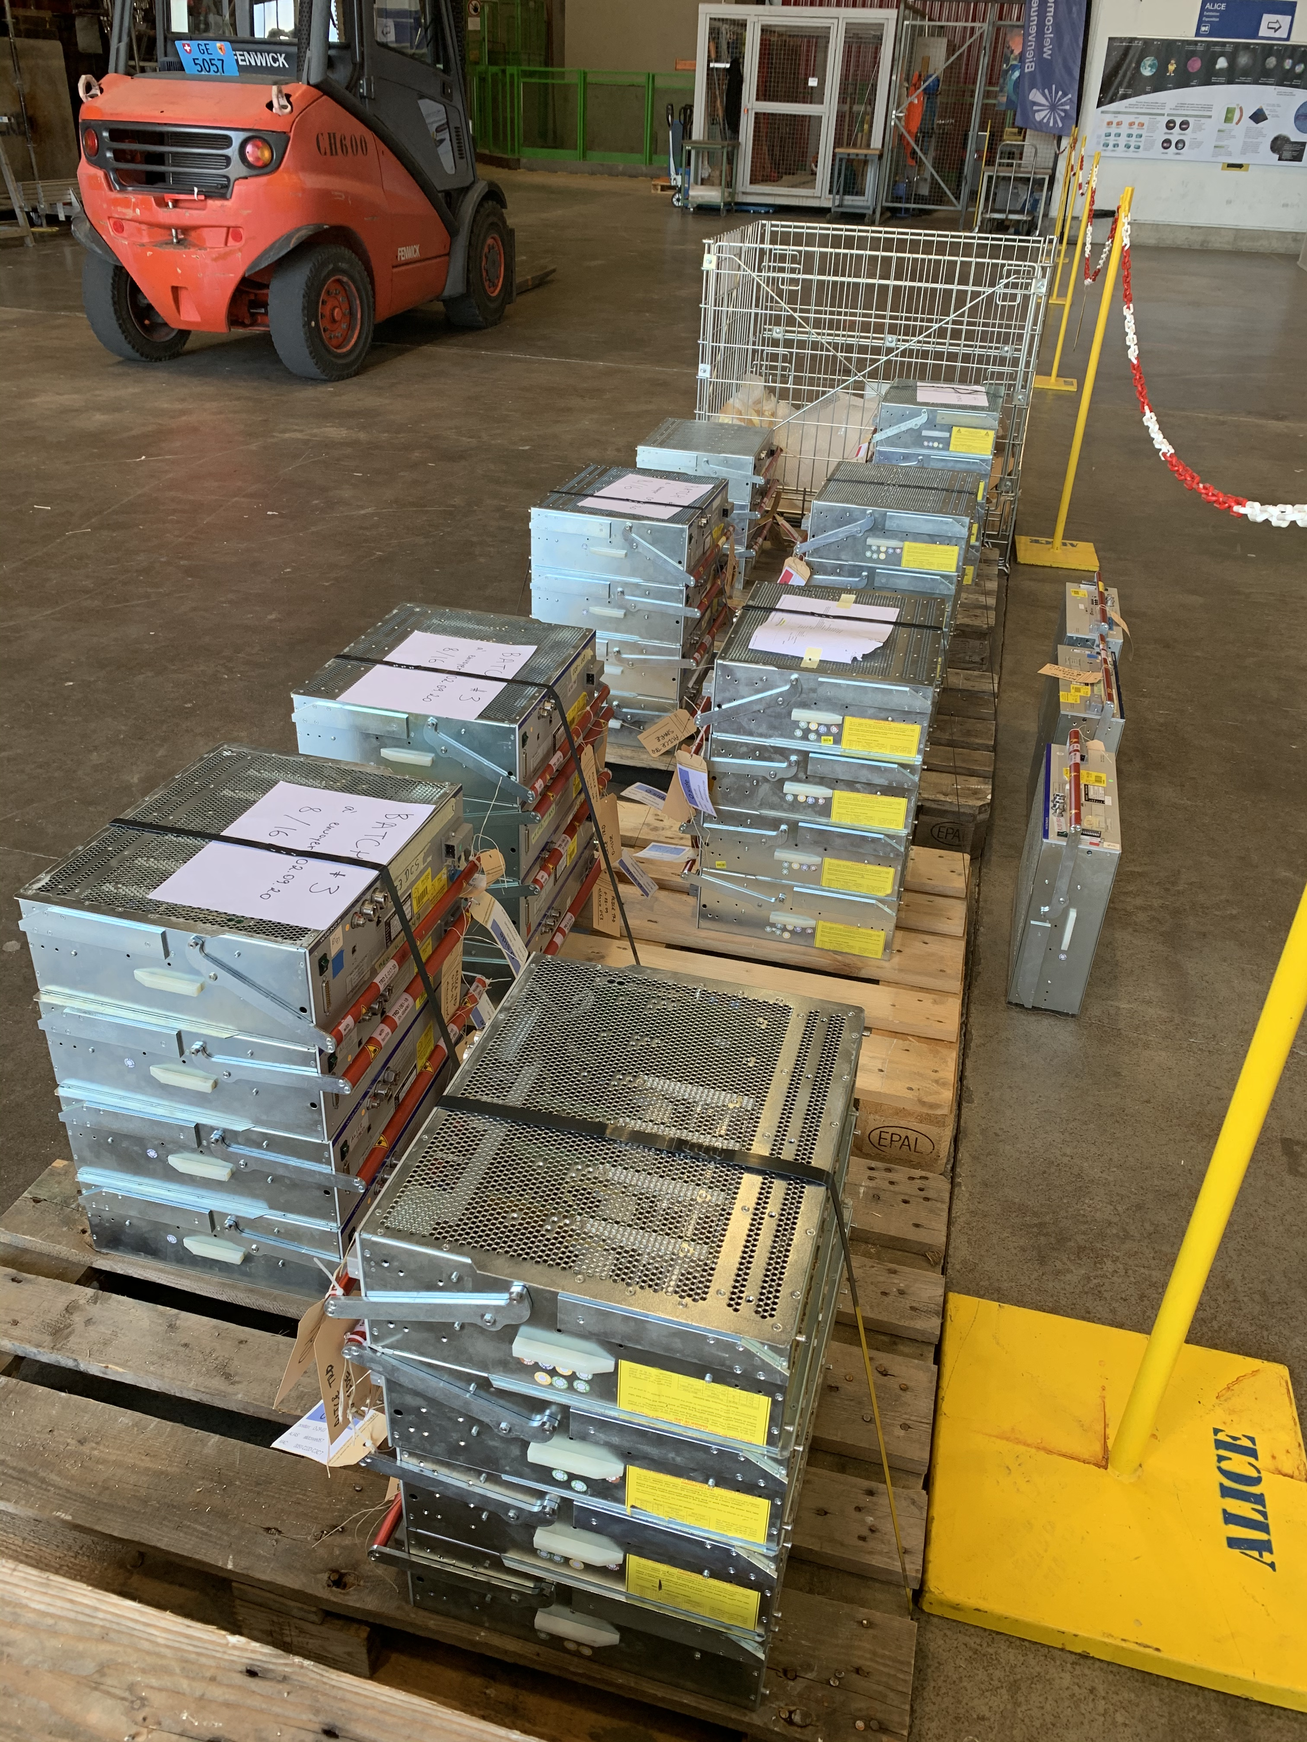
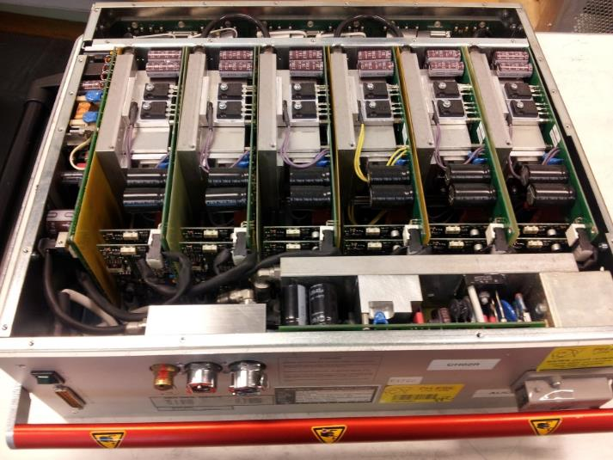
Consolidation Wiener LVPS
193 water cooled power supplies in total (LV and VME)
50 LV supplies done (MCH, TRD) = 25%
Rework in batches (~15 units/week), was started in week 32:
  Disconnection and deinstallation → detectors
  Conditioning → ALTEAD + P2tech
  Transport to EN-EA (Meyrin)
  Rework and test → EN-EA + P2tech (Evgeny and Philippe)
  Transport to P2
  Reinstallation → detectors
Some delay during August holidays. Batches for next weeks are waiting (mainly TRD)
Preliminary plan for further weeks being finalized. If current processing rate can be kept, then all supplies would be done by early November.
  Andre is contacting each detector to establish a detailed planning
 | LV | VME
CTP |  | 11
EMC | 8
FIT (AD,T0,V0) |  | 6
HMPID |  | 2
MCH | 17
MTR | 8 | 2
PHOS | 9 | 1
Spare VME |  | 2
TOF |  | 3
TPC | 22
TRD | 101 | 1
 | 165 | 28
6 modules Wiener LVPS
TRD batches in SX2

Slide 16
Racks status
Racks currently powered on:
  HMPID: I01, I02
  PHOS-CPV: A16, A17
  CTP: C21, C22, C24, C25, C26, C27 (CTP) (and VME crates on)
  MCH: C08, C09, C10, C11, C36, C37, C38, C39
  TOF: O03, O04, O05, O30, O31, O32, I03, I04, I05, I30, I31, I32
  TRD: O06, O08, O26-29, I06, I08, I26-29, C16-19, C29
  Dcal, EMcal: A14, O12
Detectors can be powered, compatible with current activities inside L3

Slide 17
Other activities
2020:
Renovation PX24 access system (PAD-MAD): w33-34 (10-21 Aug) → done
Maintenance PX24 access system (8-11 Sep) → done
Renovation PM25 access system (PAD-MAD): w41-43 (5-23 Oct) → ongoing
LASS contractor test (26-28 Oct): short access perturbations
LASS functional test: no access to UX25 on Friday 30 Oct 2020 (weekend 31 Oct /1 Nov as contingency)
LASS global verification of entire LHC: 1 day no access to UX25 (date tbd)
2021:
DSO test for powering permit: w1 2021 (date tbd) (needed to start LHC powering test)
DSO test for RF recommissioning LSS4: w7 2021
DSO test for powering permit, following UPR53 installation: date tbd
DSO test for beam permit: date tbd
LHC sector test (beam through ALICE): no access to UX25 from 26 to 29 March 2021 (date tbd)

Slide 18
L3 doors closure, magnet test
Proposed plan:
  W51 2020 (14-18 Dec):
    Close O-side door. Check interference with Miniframe. L3 access possible during CERN closure
  W3 2021 (11-15 Jan):
    Tue-Wed: close I-side door (no access L3 on 13 Jan)
    Thu 14 Jan: ramp up L3 to 30kA (4h) – no ventilation (no access L3)
    Fri-Sat: open both doors
Infrastructure needed: primary cooling and new PC cooling (EN-CV), PC (TE-EPC), MCS-MSS (EP-DT), L3 cooling (EP-DT), power (EN-EL)

Slide 19
Scaffoldings
Sem.43, Lun 19 Oct (7:30): pose de deux déportés dans le Baby-Frame + extension partie centrale devant la TPC
Sem.44, Jeu 29 Oct: dépose de la totalité partie centrale devant la TPC + liaison entre Delphi-Frame et PP0 (pour libérer le Delphi-Frame)
Sem.45, Ven 6 Nov: dépose de l'accès aux blocs du Delphi-Frame
Sem.46, Lun 9 Nov: dépose échafaudages Miniframe en SX2 + dépose échafaudage devant la tour laser en SX2 + dépose plancher dans L3 + dépose échafaudage PP0
Sem.46, Mar 10 Nov: dépose des deux déportés dans le baby-frame (pour installer le mini-frame)
Sem.47, Mer 18 Nov: installation petit échafaudage dans Miniframe en UX25 (deuxième rampe escalier) + échafaudage sous Miniframe
Sem.48, Lun 23 Nov: dépose échafaudage Low-Beta (coté I)
Sem.49, Lun 30 Nov: dépose échafaudage sous Miniframe

Slide 20
Day-by-day sequence w40
ALICE technicians
Institutes
Transport
Scaffolding
EN-EA
Other CERN groups
EN-EL
Rampower

Slide 21
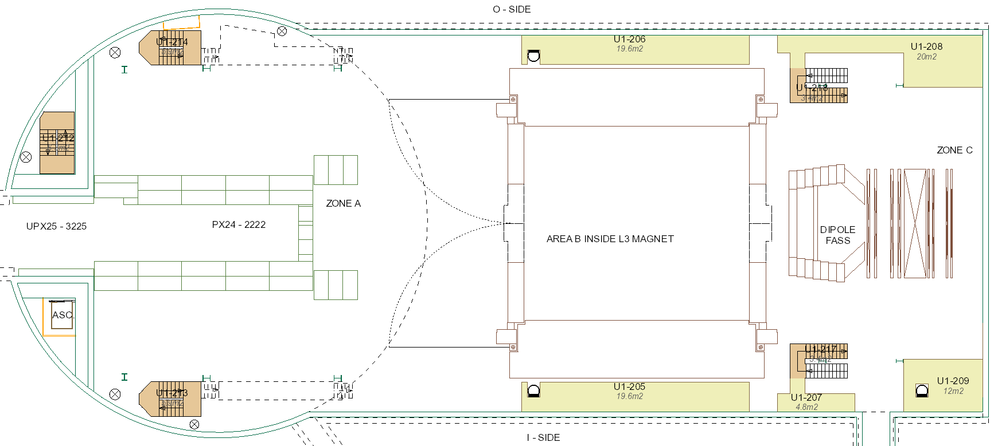
UX25 activities w40 – Mon 28 Sep 2020
EN-HE: reinstall wood protections PX24 lift (AS-724) (9:00 – 9:30)
Bakeout vacuum sector
MCH
TOF
Clock alignment and HV connectors repair (need to access all SMs)

Slide 22
UX25 activities w40 – Tue 29 Sep 2020
Cleaning cavern (Topnet): 13:00 to 15:00
Bakeout vacuum sector
MCH
TOF

Slide 23
UX25 activities w40 – Wed 30 Sep 2020
Bakeout vacuum sector
MCH
TOF
Rinse MFT& ITS cooling pipes (Cedric, Philippe)

Slide 24
UX25 activities w40 – Thu 1 Oct 2020
Bakeout vacuum sector
MCH
TOF
Rinse MFT& ITS cooling pipes (Cedric, Philippe)

Slide 25
UX25 activities w40 – Fri 2 Oct 2020
Cavern lift maintenance (AS-724): no access to UX25 from 6:00 AM to 8:00 AM
Bakeout vacuum sector
TPC gas bellow
MCH
TOF
Rinse MFT& ITS cooling pipes (Cedric, Philippe)

Slide 26
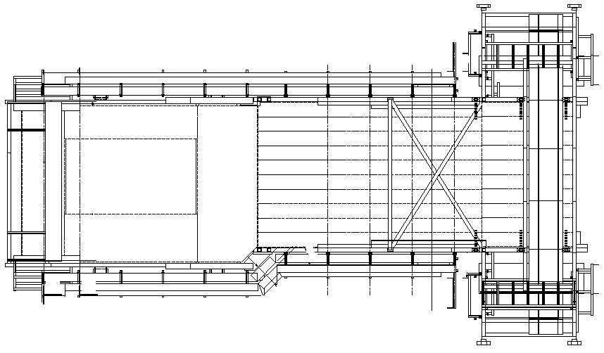
Miniframe activities w40 – Mon 28 Sep 2020
Cleaning Miniframe (Elior)
Produce and install ITS inox cable trays (Antoine) and weld (Cedric)
Install labels and connectors (feed-throughs) for FIT signal and HV patch-panels (Evgeny)
Connect ITS crates hoses with adaptor pieces
(Cedric, Philippe)
Install TPC BNC cables
(Samuel + TPC)
Connect ITS crates hoses with adaptor pieces
(Cedric, Philippe)

Slide 27
Miniframe activities w40 – Tue 29 Sep 2020
Install TPC BNC cables
(Samuel + TPC)
Install led lights
(Philippe, Cedric)

Slide 28
Miniframe activities w40 – Wed 30 Sep 2020
Install TPC BNC cables
(Samuel + TPC)

Slide 29
Miniframe activities w40 – Thu 1 Oct 2020

Slide 30
Miniframe activities w40 – Fri 2 Oct 2020

Slide 31
Day-by-day sequence w41
ALICE technicians
Institutes
Transport
Scaffolding
EN-EA
Other CERN groups
EN-EL
Rampower

Slide 32
UX25 activities w41 – Mon 5 Oct 2020
Modification TPC rack Y07 in CR4 (Cedric, Philippe)
Renovation PM25 access system (PAD-MAD) – w41-42 → tunnel access via PX24
EN-CV: replacement valve on tap-water → no tap-water for 2-3h (AM)
MFT cooling manifolds
Bakeout
120C → 200C
MCH
MFT cooling manifolds

Slide 33
UX25 activities w41 – Tue 6 Oct 2020
Cleaning cavern (Topnet): 13:00 to 15:00
MFT cooling manifolds
PP0 fittings (Cedric, Philippe)
Cool-down
MCH
MFT cooling manifolds

Slide 34
UX25 activities w41 – Wed 7 Oct 2020
MFT cooling manifolds
PP0 fittings (Cedric, Philippe)
NEG measurement
MCH
MFT cooling manifolds

Slide 35
UX25 activities w41 – Thu 8 Oct 2020
Inspection nacelles and elevating platforms
NEG measurement
MCH

Slide 36
UX25 activities w41 – Fri 9 Oct 2020
SNIFFER: upgrade IHM view (11:00)
NEG measurement
MCH

Slide 37
Miniframe activities w41 – Mon 5 Oct 2020
Cleaning Miniframe (Elior)
Delivery FIT-V0 to P2
Weld ITS inox cable trays (Mimmo, Samuel)
Install labels and connectors (feed-throughs) for FIT signal and HV patch-panels (Evgeny)
Remove top scaffolding

Slide 38
Miniframe activities w41 – Tue 6 Oct 2020
FIT integration test

Slide 39
Miniframe activities w41 – Wed 7 Oct 2020
FIT integration test

Slide 40
Miniframe activities w41 – Thu 8 Oct 2020
FIT integration test

Slide 41
Miniframe activities w41 – Fri 9 Oct 2020
Delivery FIT-T0 support structure to P2 (tbc)
Reinstall fences mezzanine (Cedric, Philippe)

Slide 42
Day-by-day sequence w42
ALICE technicians
Institutes
Transport
Scaffolding
EN-EA
Other CERN groups
EN-EL
Rampower

Slide 43
UX25 activities w42 – Mon 12 Oct 2020
Renovation PM25 access system (PAD-MAD) – w41-42 → tunnel access via PX24
MFT cooling
Vent beampipe, remove bakeout equipment
MCH

Slide 44
UX25 activities w42 – Tue 13 Oct 2020
Cleaning cavern (Topnet): 13:00 to 15:00
MFT cooling
Finalize cage layout, remove cooling equipment
TPC BNC cables (Samuel) (tbc)
MCH
TRD should be OFF!

Slide 45
UX25 activities w42 – Wed 14 Oct 2020
Remove omega platform, install hydraulics to move TPC
(Yannick, Mimmo, Samuel)
Install beampipe protection (Peter)
TPC BNC cables (Samuel) (tbc)
MCH

Slide 46
UX25 activities w42 – Thu 15 Oct 2020
Move TPC to IP: no access inside L3
Move TPC to IP, fix TPC to space-frame
(Yannick, Mimmo, Samuel, ALTEAD)
MCH

Slide 47
UX25 activities w42 – Fri 16 Oct 2020
TPC survey
Install A-side beampipe support (Lee)
TPC survey
Connect TPC gas
MCH

Slide 48
Miniframe activities w42 – Mon 12 Oct 2020
Cleaning Miniframe (Elior)
Install ITS cable trays
(Mimmo, Samuel)

Slide 49
Miniframe activities w42 – Tue 13 Oct 2020
Mezzanine (Cedric, Philippe)
Install ITS cable trays
(Mimmo, Samuel)

Slide 50
Miniframe activities w42 – Wed 14 Oct 2020
Move FIT-V0 to SXL2 (put in boxes)
Open FIT
(Lee)

Slide 51
Miniframe activities w42 – Thu 15 Oct 2020
Modify ITS access structure (Cedric, Philippe)
Remove FIT mechanism and beampipe support (Lee)
Modify ITS access structure (Cedric, Philippe)

Slide 52
Miniframe activities w42 – Fri 16 Oct 2020
Modify ITS access structure (Cedric, Philippe)
Modify ITS access structure (Cedric, Philippe)

