Slide 1





advanced Training @ CERN
Pedro Abreu, abreu@lip.pt
Lisbon, November 2019

Slide 2
// The programmes at/by CERN
For people already at CERN (Scientists, Engineers, Technicians, Staff, Students, etc)
  Academic Training – specialized courses in ~1 week, few hours/day
For young scientists/Ph.D. Students in 2 weeks intensive training outside CERN
  ESHEP – European School of High Energy Physics (former CERN School of Physics)
  organization: CERN+JINR (Dubna, Russia); in Pt: Caramulo (2000), Évora (2017)
  CSC – CERN School of Computing; in Pt: Tróia (1987), Funchal (1998), Braga(2014)
  CAS – CERN Accelerator School; 2-5/yr; in Pt: Cascais(1996), Sesimbra(2002,2019)
For graduates
  Training programmes – Fellows, Trainees, Apprenticeships
For undergraduate students in Physics/Engineering Physics (3 yrs.studies)
  CERN Summer Students programme – 2-3 months at CERN
Teachers Programmes – International (2/yr, 2 weeks), National (~35/yr, 1 week)
2/17

Slide 3
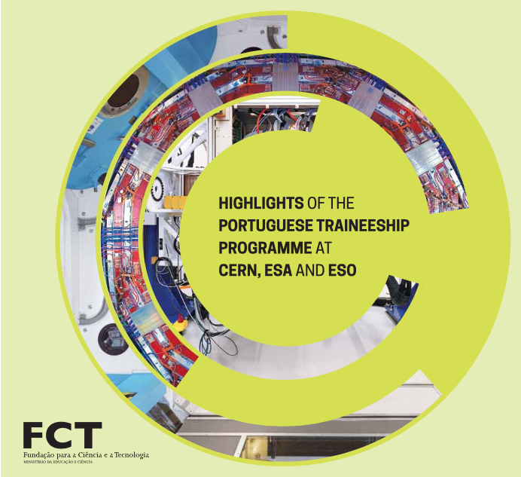
// Trainees – FCT BEST Fellowships
Programme launched in 1996 by FCT + AdI (now AnI)
One year contract with possibility of renewal for another year
Evaluation very positive, in report published by AdI in 2010 and in
brochure published by FCT in 2015
“The FCT programme is one (…) of the more relevant advanced training programmes in international scientific organisations.
It promotes the international recognition of the competence of our engineers and helps to insert Portuguese senior staff in the most prestigious international institutions, well beyond what could be expected for a small country.”
Gaspar Barreira, 2015
3/17

Slide 4
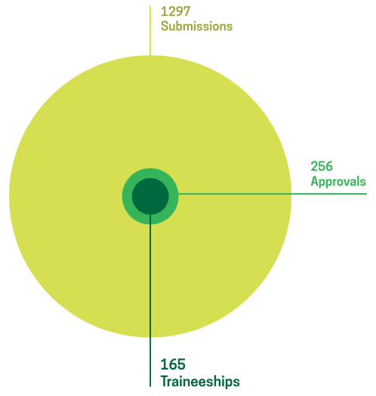
// Trainees – FCT BEST Fellowships
Statistics update 2015-2019
259
Submissions
1996-2014
40
Approvals
29
Traineeships
[The Portuguese Traineeship Programme] changed the course of my life by opening the doors to a fulfilling career in a unique scientific, multicultural and challenging environment.
Bruno Sousa
Trainee@CERN 2008–2009
4/17

Slide 5
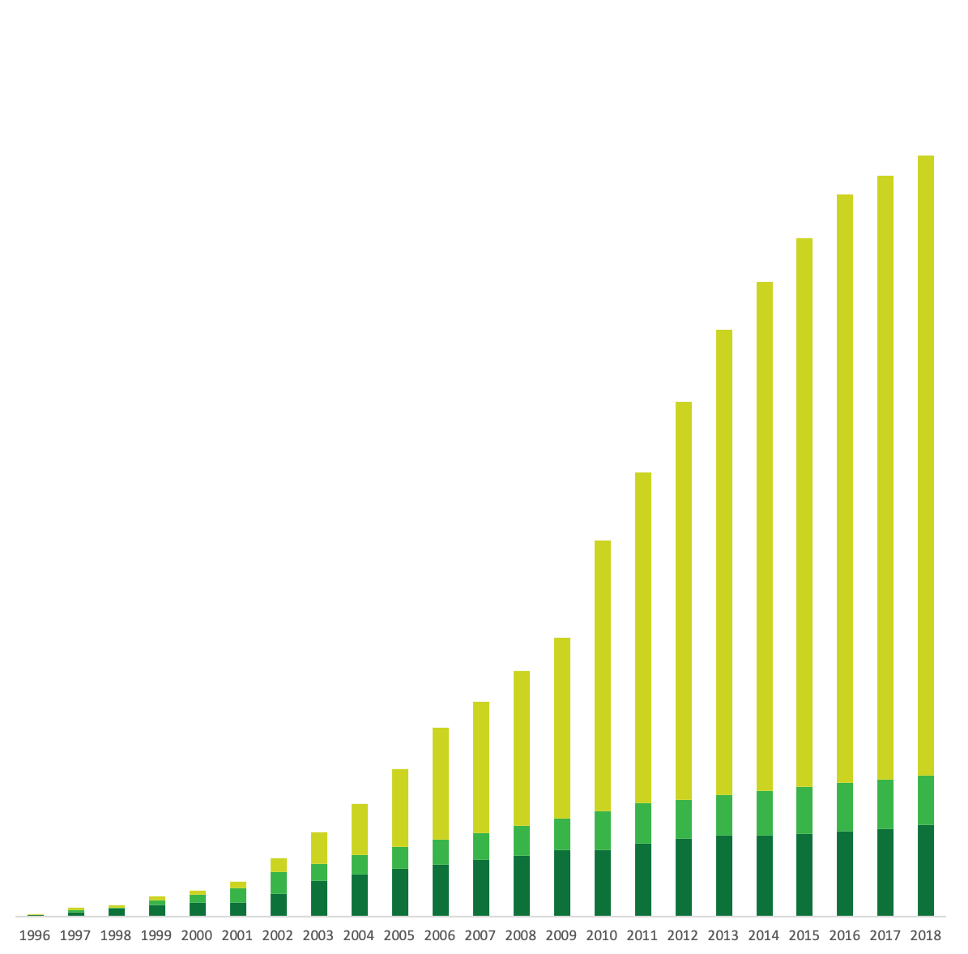
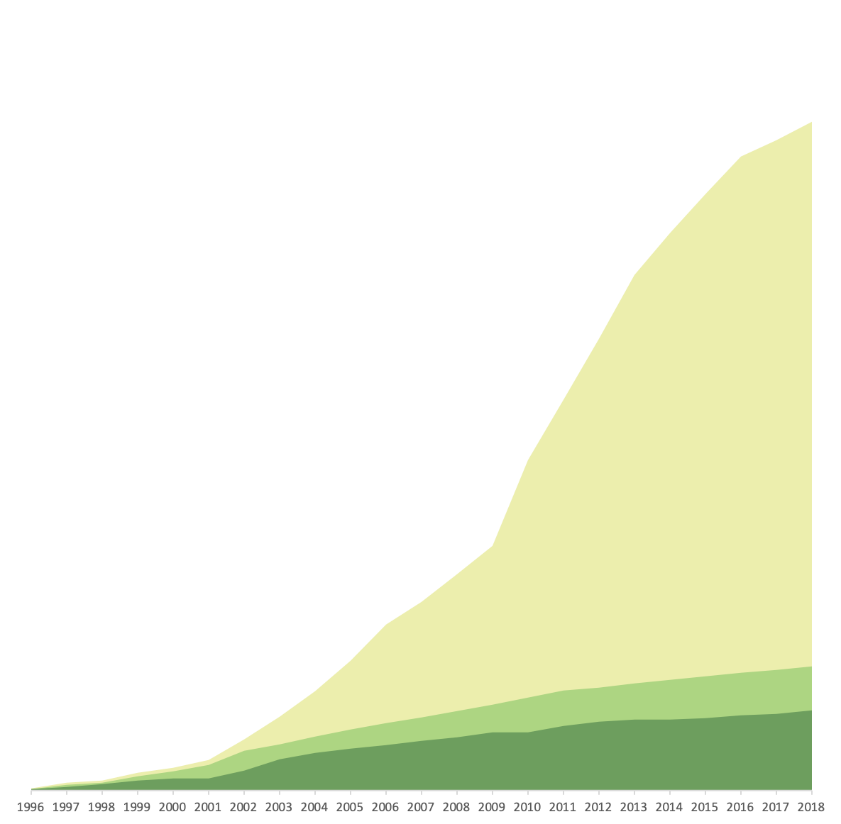
// Trainees – FCT BEST Fellowships
1556
Statistics Accumulated 1996-2019
1556 Submissions
288 Approvals
194 Traineeships (mostly 2 years)
“It’s a great place to start a career,
it’s a great place to learn new skills, make new friends…”
288
194
5/17

Slide 6
// Trainees – FCT BEST Fellowships
Next edition – 2019 Call (starting year 2020)
27 Projects proposed by CERN
Call launched on November 4th
deadline next November 30th
“For more than ten years (…) Portugal has been very effective(…)
The input quality of the young engineers has been so far excellent, and their professional growth at the end of the trainee program has been impressive. (…)”
Sergio Bertolucci
Director of Research and Computing @CERN, 2010
6/17

Slide 7
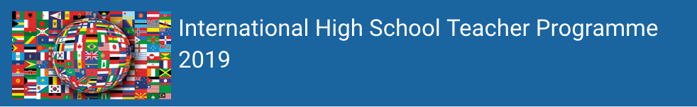
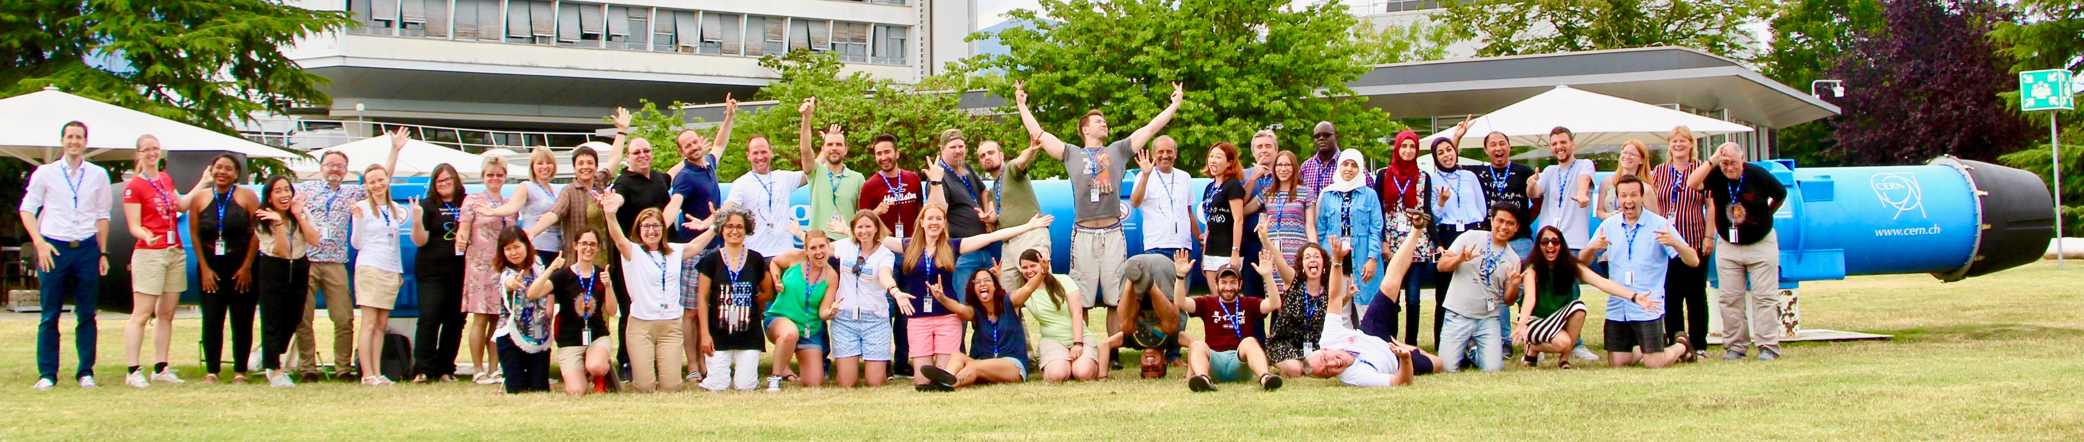
// Teachers Programmes
High School Teachers Programmes at CERN started in 1998 (3 weeks long, 1/year)
International, now 2 weeks long, 2 editions/year (July, August), holidays time
Up to 48 teachers from many countries, in particular 1-2 from CERN member states
PT
7/17

Slide 8
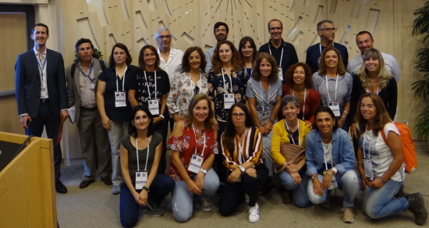
// National Teachers Programmes
Member State National Teachers programmes launched in 2006
One pilot programme in 2006 (Hungary) and since then about 35 programmes / year
One week only, in formation time
In the language of the Member State and many more opportunities per country
20 PT Teachers/programme
CERN
Org.
Prog.
Coord.
PTLTP
2019
8/17

Slide 9
// CERN PTLTP
Portuguese [Language] Teachers Programmes yearly from 2007 up to now
In Portuguese Language, avoiding linguistic barriers (specially for questions)
One week, formation time, officially certified for the Teacher’s Career Progression with the Ministry of Education
Organized by CERN and LIP, with partial financial support from
Portugal started immediately in 2007, organizing one programme / year
Portugal proposed to receive teachers from Brazil and Mozambique in 2009, and from other Portuguese speaking countries since 2010, becoming the first non-English
international programme
Promote/increase interactions between Portuguese teachers and scientists (at CERN or in the country) and, since 2009, including Brazilian scientists
Promote/increase interactions between teachers in portuguese speaking countries
9/17

Slide 10
// CERN PTLTP – Intensity!
Theory:
Introd. Particle Physics
Astroparticle Physics
Accelerators/Detectors
Data Acquisition&Treatment
Applications
Universe/Cosmology
Practice:
Hands-on a Cloud Chamber
Hands-on real LHC Data
Visits to CERN Expts.+Labs
Sunday
Friday
THEORY
Visits
THEORY
LUNCH
Hands-on
Hands-on
Visits
Peddy-Paper
GVA in 3hours
Revisions!
Cinema!
Official Dinner
Fun: Film “Particle Fever” + Questions&Answers, peddy-paper@Geneva in teams…
10/17

Slide 11
// CERN PTLTP – Participants!
 | 2007 | 2008 | 2009 | 2010 | 2011 | 2012 | 2013 | 2014 | 2015 | 2016 | 2017 | 2018 | 2019 | Total
Datas | 10-14/9 | 1-5/9 | 30/8-4/9 | 5-10/9 | 4-9/9 | 26-31/8 | 1-6/9 | 24-29/8 | 30/8-4/9 | 28/8-2/9 | 3/9-8/9 | 2/9-7/9 | 1/9-6/9
Candid | 205 | 241 | 191 | 218 | 190 | 250 | 162 | 236 | 187 | 183 | 170 | 181 | 222 | 2063
Candid.(new) | 205 | 169 | 78 | 130 | 98 | 165 | 57 | 121 | 96 | 63 | 40 | 48 | 77 | 1182
Pt. | 43 | 45 | 44 | 45 | 41 | 35 | 34 | 35 | 24 | 22 | 20 | 20 | 20 | 428
Br. |  | 1 | 11 | 20 | 20 | 30 | 31 | 30 | 22 | 20 | 20 | 20 | 20 | 245
Mz. |  |  | 5 | 4 | 4 | 4 |  | 2 | 2 | 1 |  |  |  | 22
STP |  |  |  | 1 | 1 | 1 | 1 | 1 | 1 | 1 |  |  |  | 7
CV |  |  |  | 1 | 1 | 1 |  | 1 | 1 |  |  |  |  | 5
An. |  |  |  |  | 4 |  |  |  |  |  |  |  | 2 | 6
TL |  |  |  |  | 1 | 3 | 3 |  | 2 |  |  |  |  | 9
GB |  |  |  |  | 1 |  |  |  |  |  |  |  |  | 1
Total | 43 | 46 | 60 | 71 | 73 | 74 | 69 | 69 | 52 | 44 | 40 | 40 | 42 | 723
11/17

Slide 12
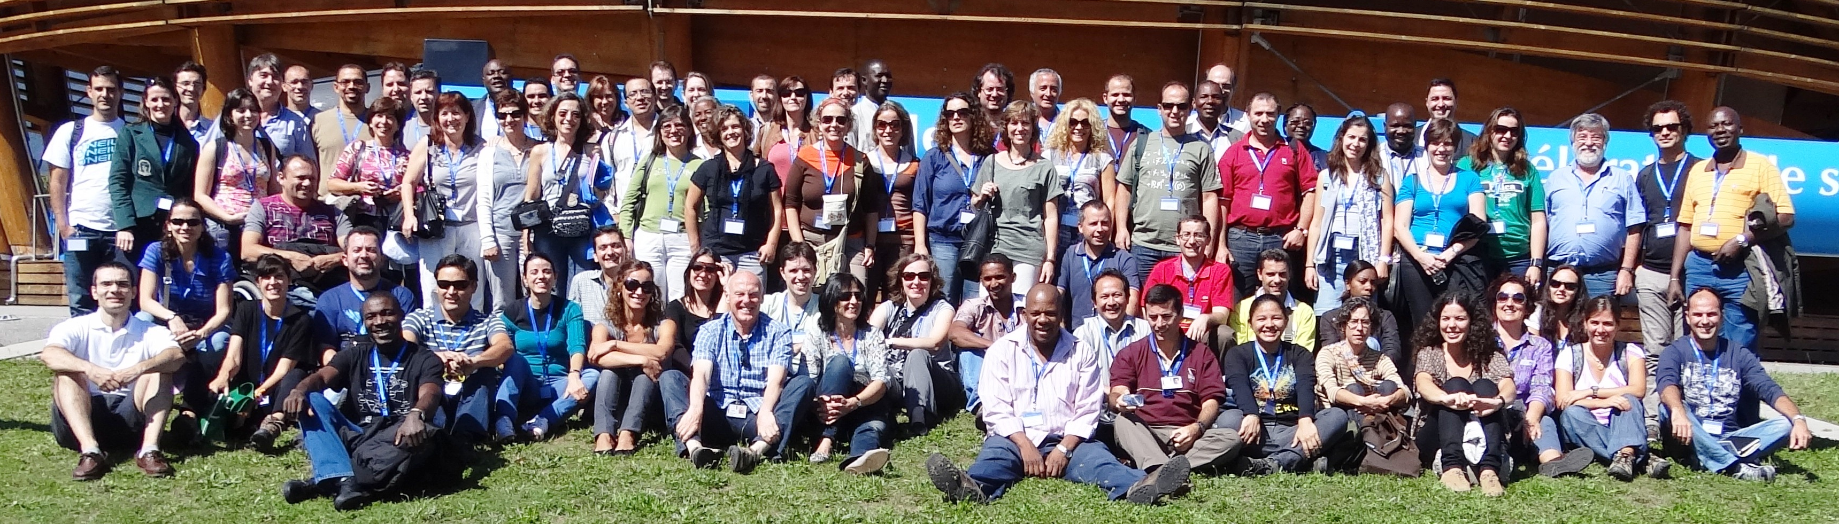
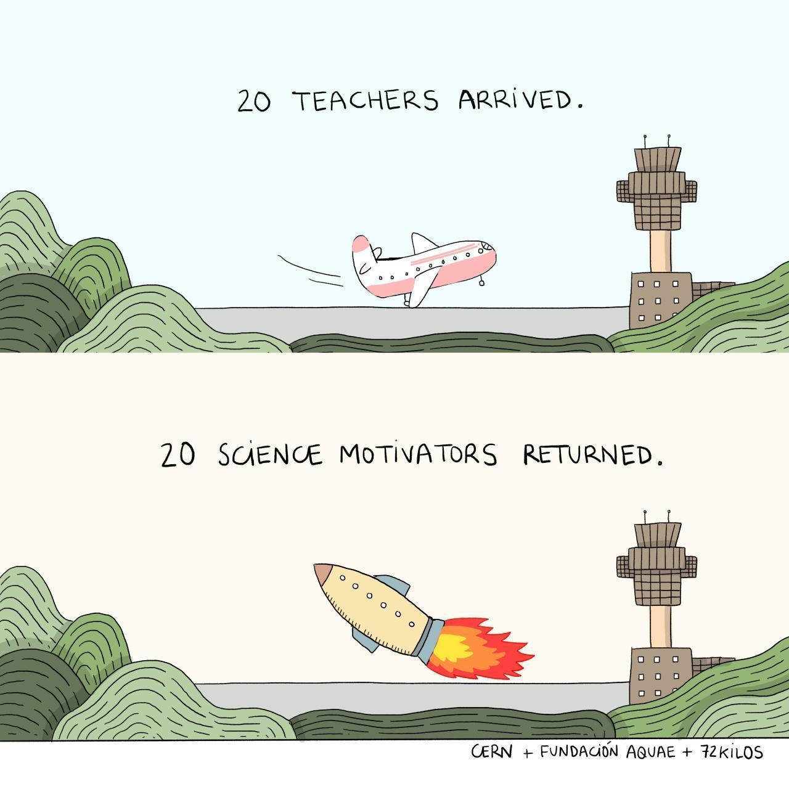
// CERN PTLTP – All Pt-Speaking countries
2011 – the full house – 73 Teachers – among the largest programmes at CERN (now fixed to maximum of 48)
73
X
41 Pt, 20 Br, 4 Ao, 4 Mz, 1 CV, 1 STP, 1 GB, 1 TL
Very rich session about teaching conditions in all the countries
73
X
“The most important training programme that I have participated in my life” as spoken by many teachers.
12/17

Slide 13
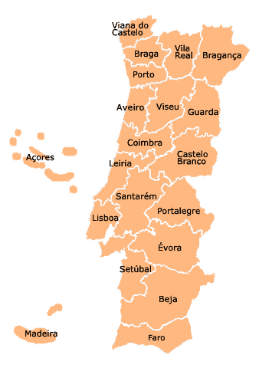
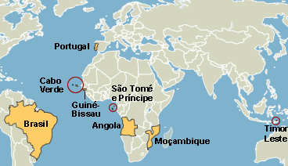
// CERN PTLTP – Teachers from all over PT
and from PT-Speaking Countries:
13/17

Slide 14
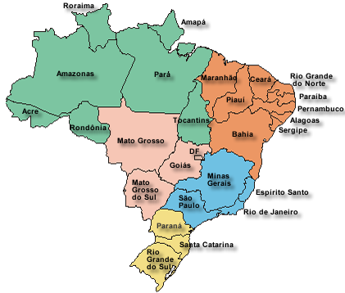
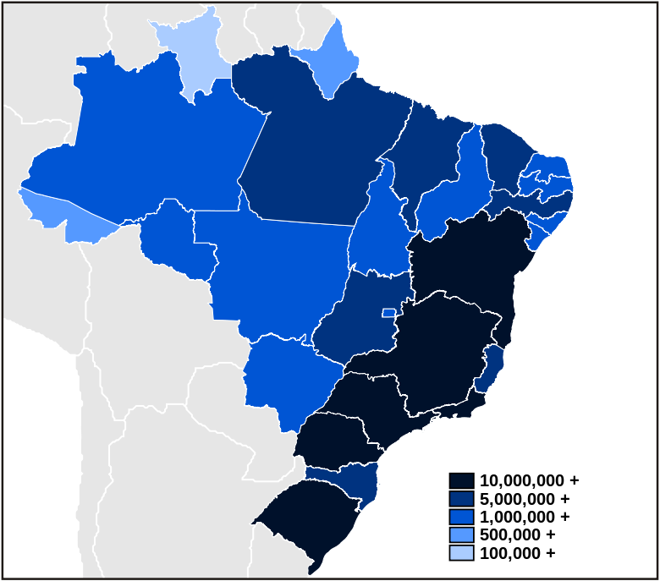
// and from
Brasil
14/17

Slide 15
// Impact from CERN PTLTP’s
Evaluation questionnaires: CERN PTLTP’s => 4.88 ± 0.15 / 5
Exponential increase in
  requests of School visits to CERN
  requests for virtual visits at the schools to the CERN Experiments
  adhesion and participation in the IPPOG’s Int’l Masterclasses in Particle Physics
  participation in our outreach activities (European Researchers Nights, S&T Weeks)
  requests for seminars at their schools / events
  mails! (questions, suggestions, news, etc)
  participation in public sessions and other events promoting Particle Physics in their schools, including the preparation and operation of Cloud Chambers
  promotion of CERN and of Particle Physics in their communities and in other events (talking about CERN to the native people in the Amazon isolated villages)
15/17

Slide 16
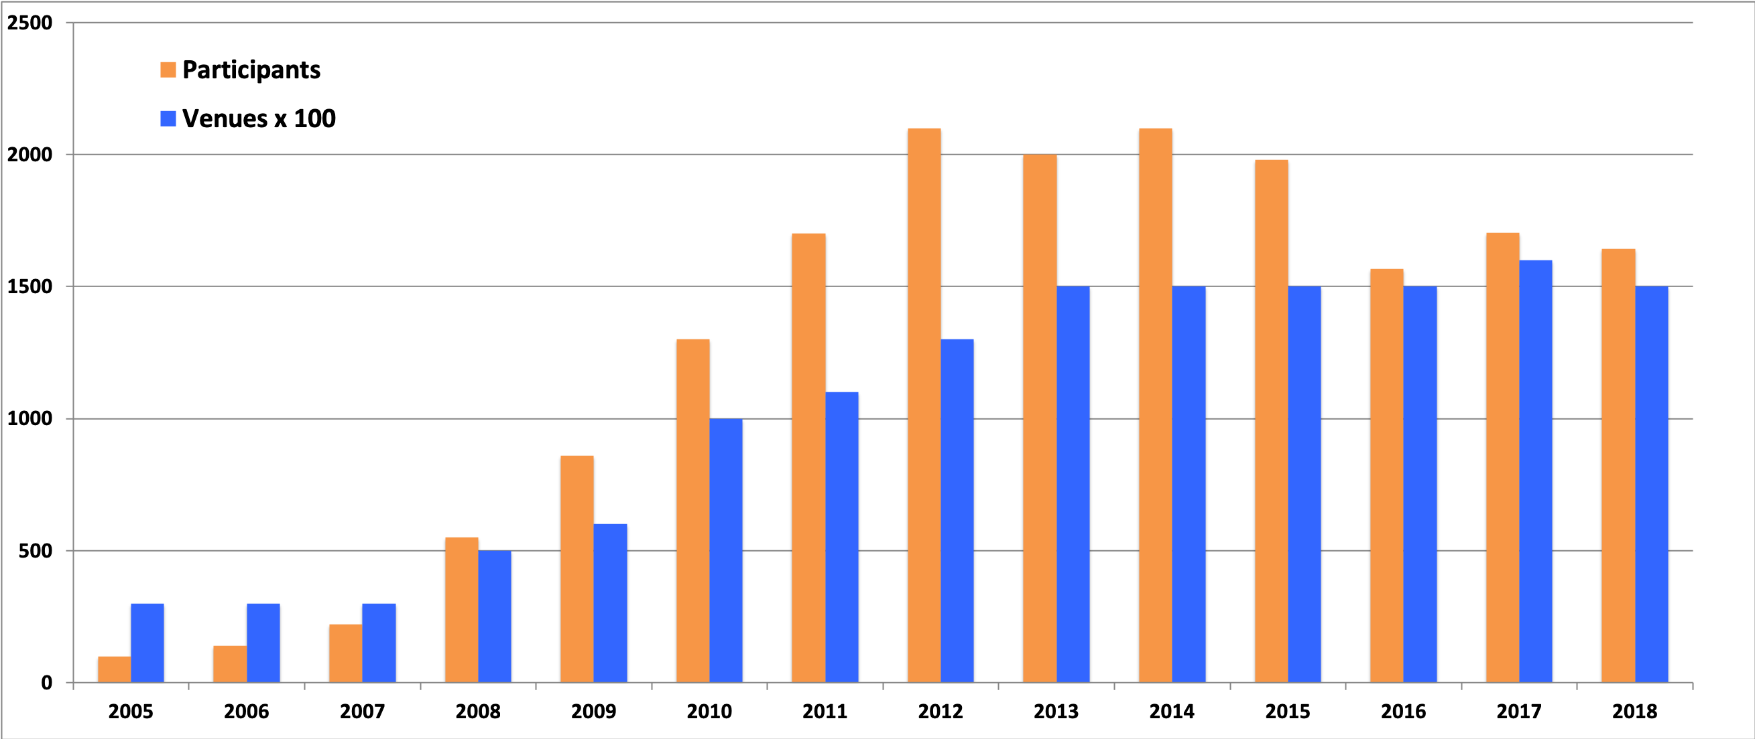
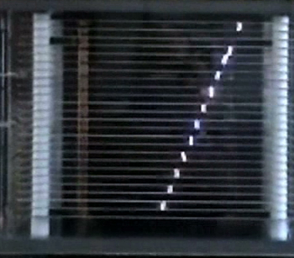
// Coming
back!
2000
Enormous increase in
Masterclass participants
and in public sessions
1st CERN
Port.TP
Enormous Increase in
School Visits to CERN
(PT and BR – also in Virtual Visits)
Great increase
in Seminars at Schools
Several Cloud Chambers
built at the schools!
40+ since
2015
16/17

Slide 17



Thanks!
(this is a big thanks!)
to all the people collaborating in all these activities!
...and for your attention!
Planting
a future
Any questions?
You can find me at abreu@lip.pt
17/17

