Slide 1


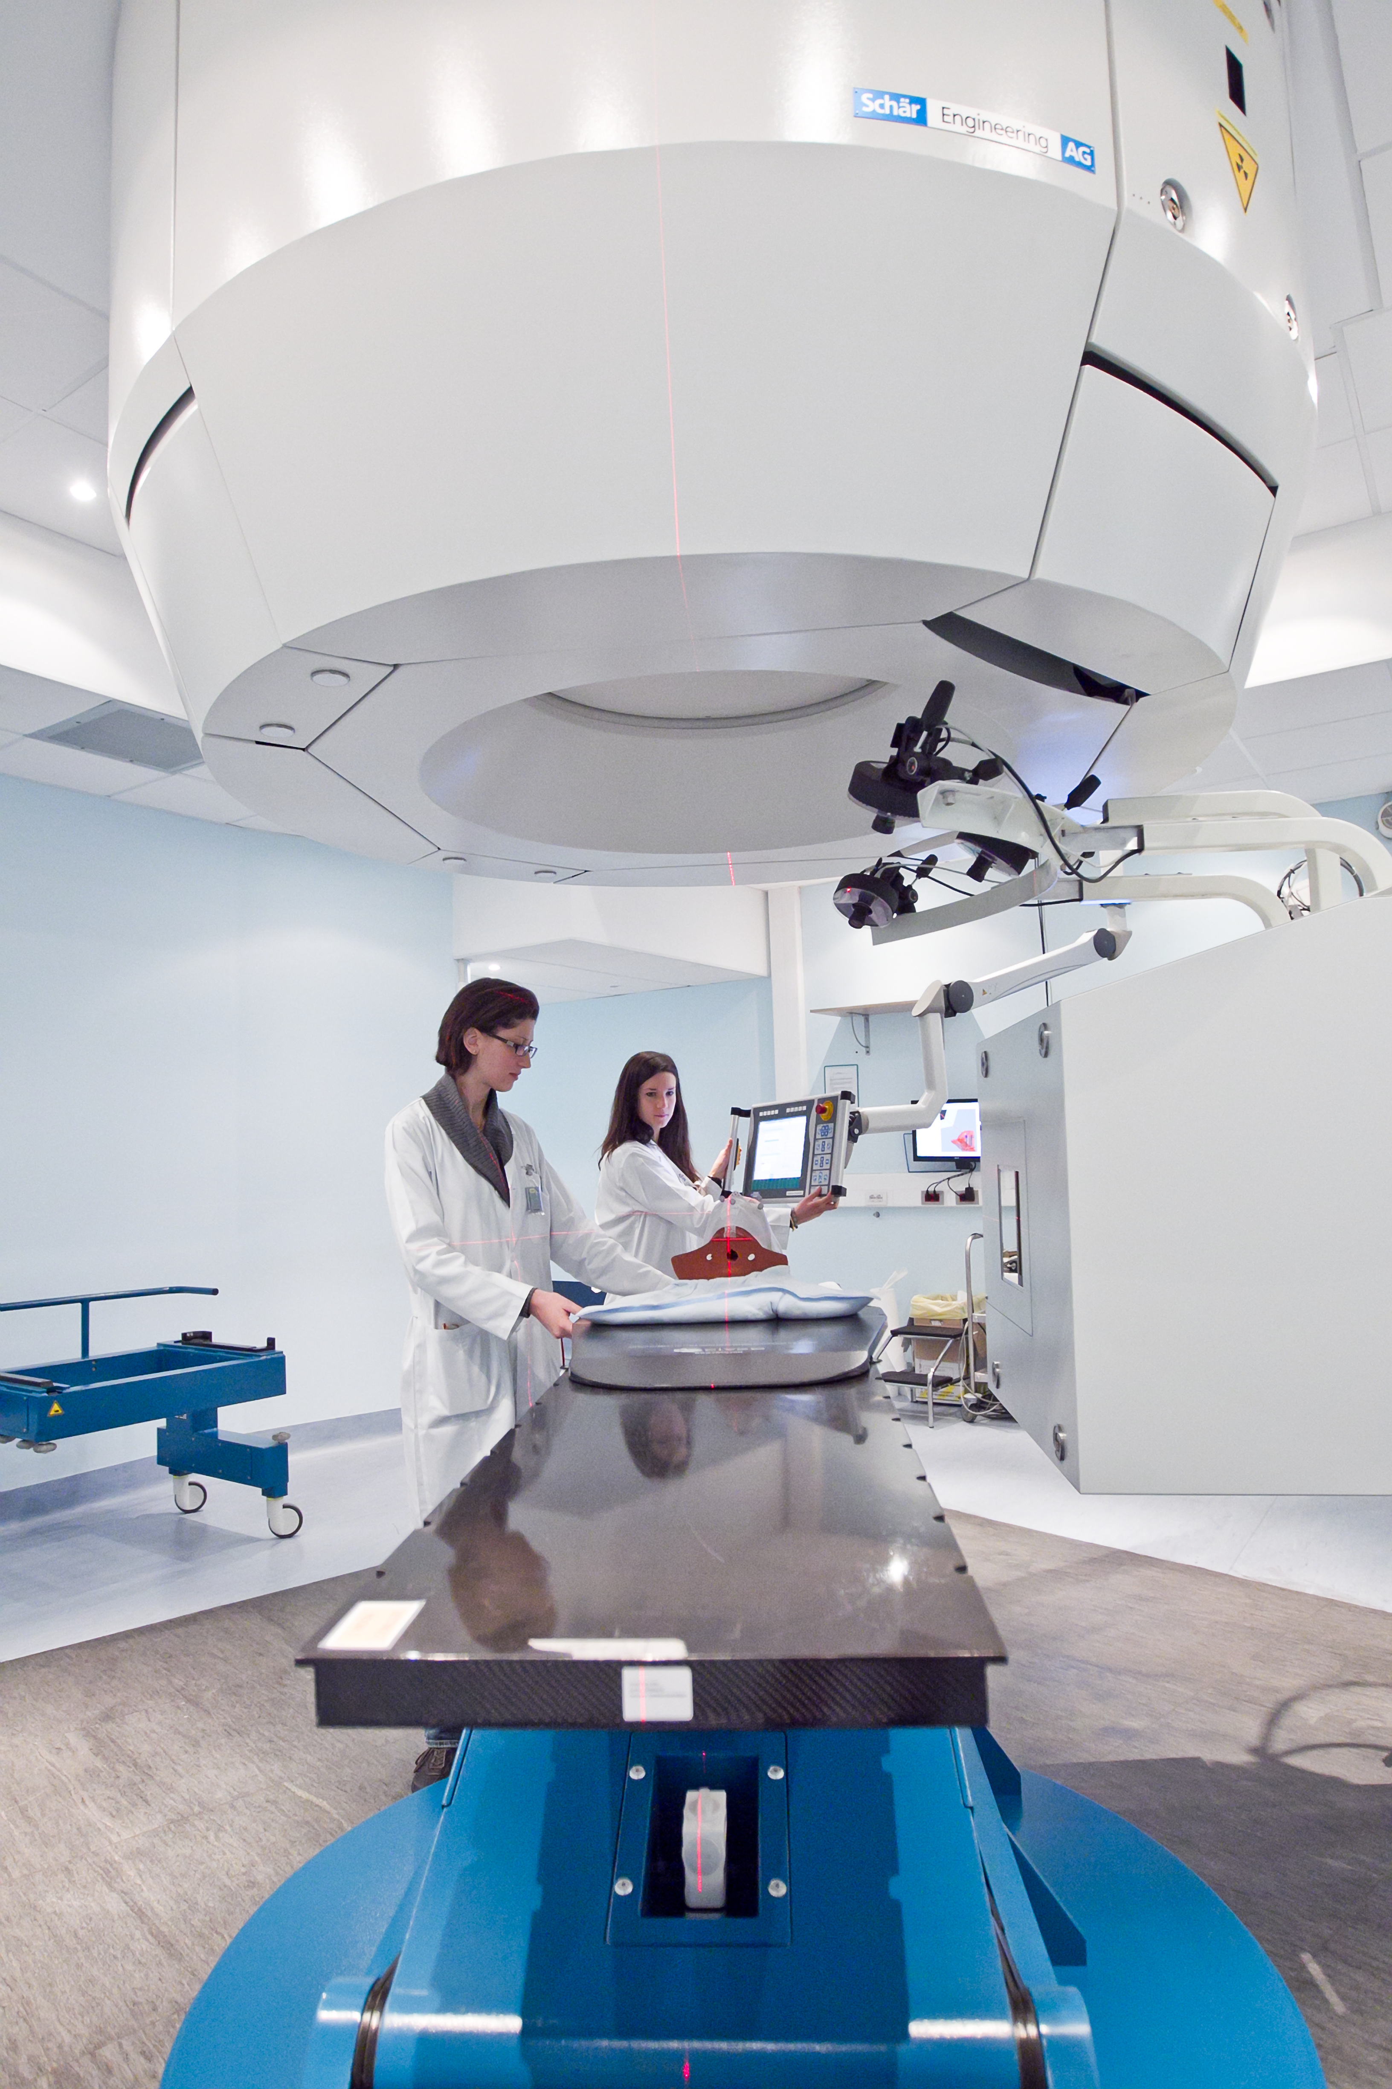
Fundamental research (and much more …) at CERN

Slide 2
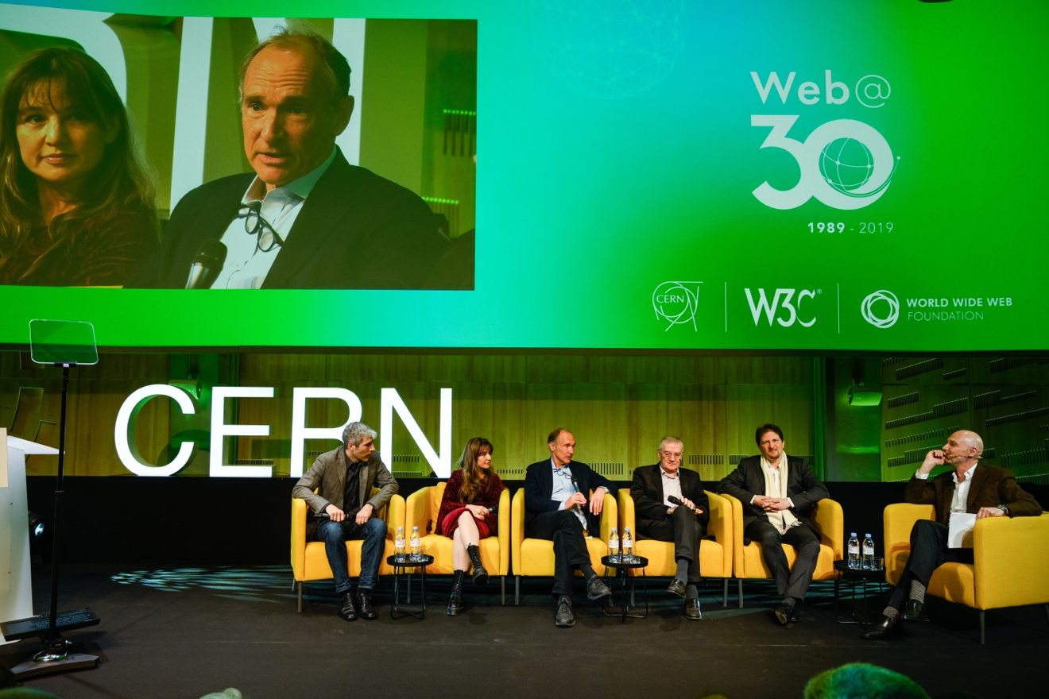
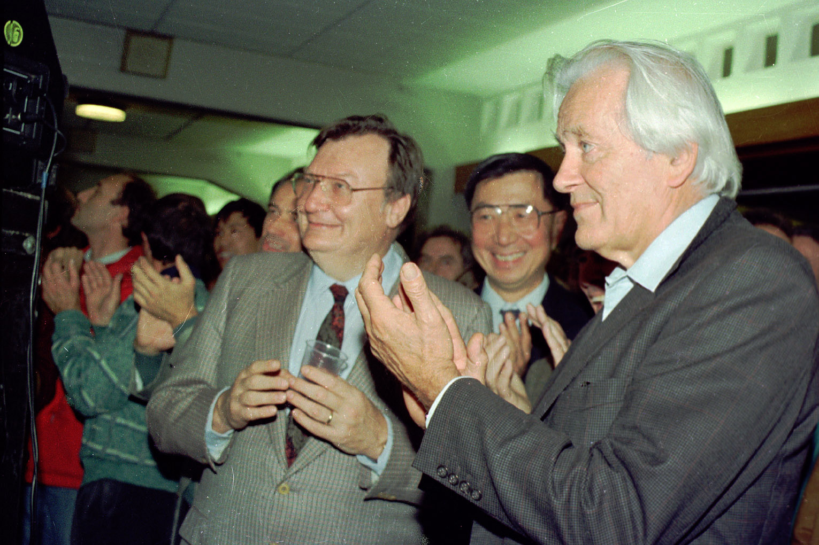
CERN : the largest particle physics laboratory in the world
Intergovernmental organisation based in Geneva
Mission:
science: fundamental research in particle physics → discoveries (e.g. Higgs boson 2012)
technology and innovation → transferred to society (e.g. the World Wide Web, medical applications)
training and education
bringing the world together: ~ 18000 scientists, > 110 nationalities
Samuel Ting,
Nobel prize, 1976
Carlo Rubbia,
Nobel prize, 1984
George Charpak,
Nobel prize, 1992
WEB@30 celebration, 12 March 2019 at CERN,
with T. Berners-Lee, former CERN staff member

Slide 3
CERN was founded in 1954: 12 European States
Today: 23 Member States
23 Member States: Austria, Belgium, Bulgaria, Czech Republic, Denmark, Finland, France, Germany, Greece, Hungary, Israel, Italy, the Netherlands, Norway, Poland, Portugal, Romania, Serbia, Slovakia, Spain, Sweden, Switzerland and the United Kingdom
8 Associate Member States: Croatia, Cyprus, India, Lithuania, Pakistan, Slovenia, Turkey, Ukraine
6 Observers to Council: Japan, Russian Federation, USA, EU, JINR/Dubna, UNESCO
~ 2600 staff, ~4400 in total on payroll
~ 13600 users from all over the world
Budget (2019) ~1200 MCHF (on average: ~ 1 cappuccino/year per European citizen):
→ Member States contribute in proportion to their income: Portugal: 1.1% (~ 12.5 MCHF/year)

Slide 4
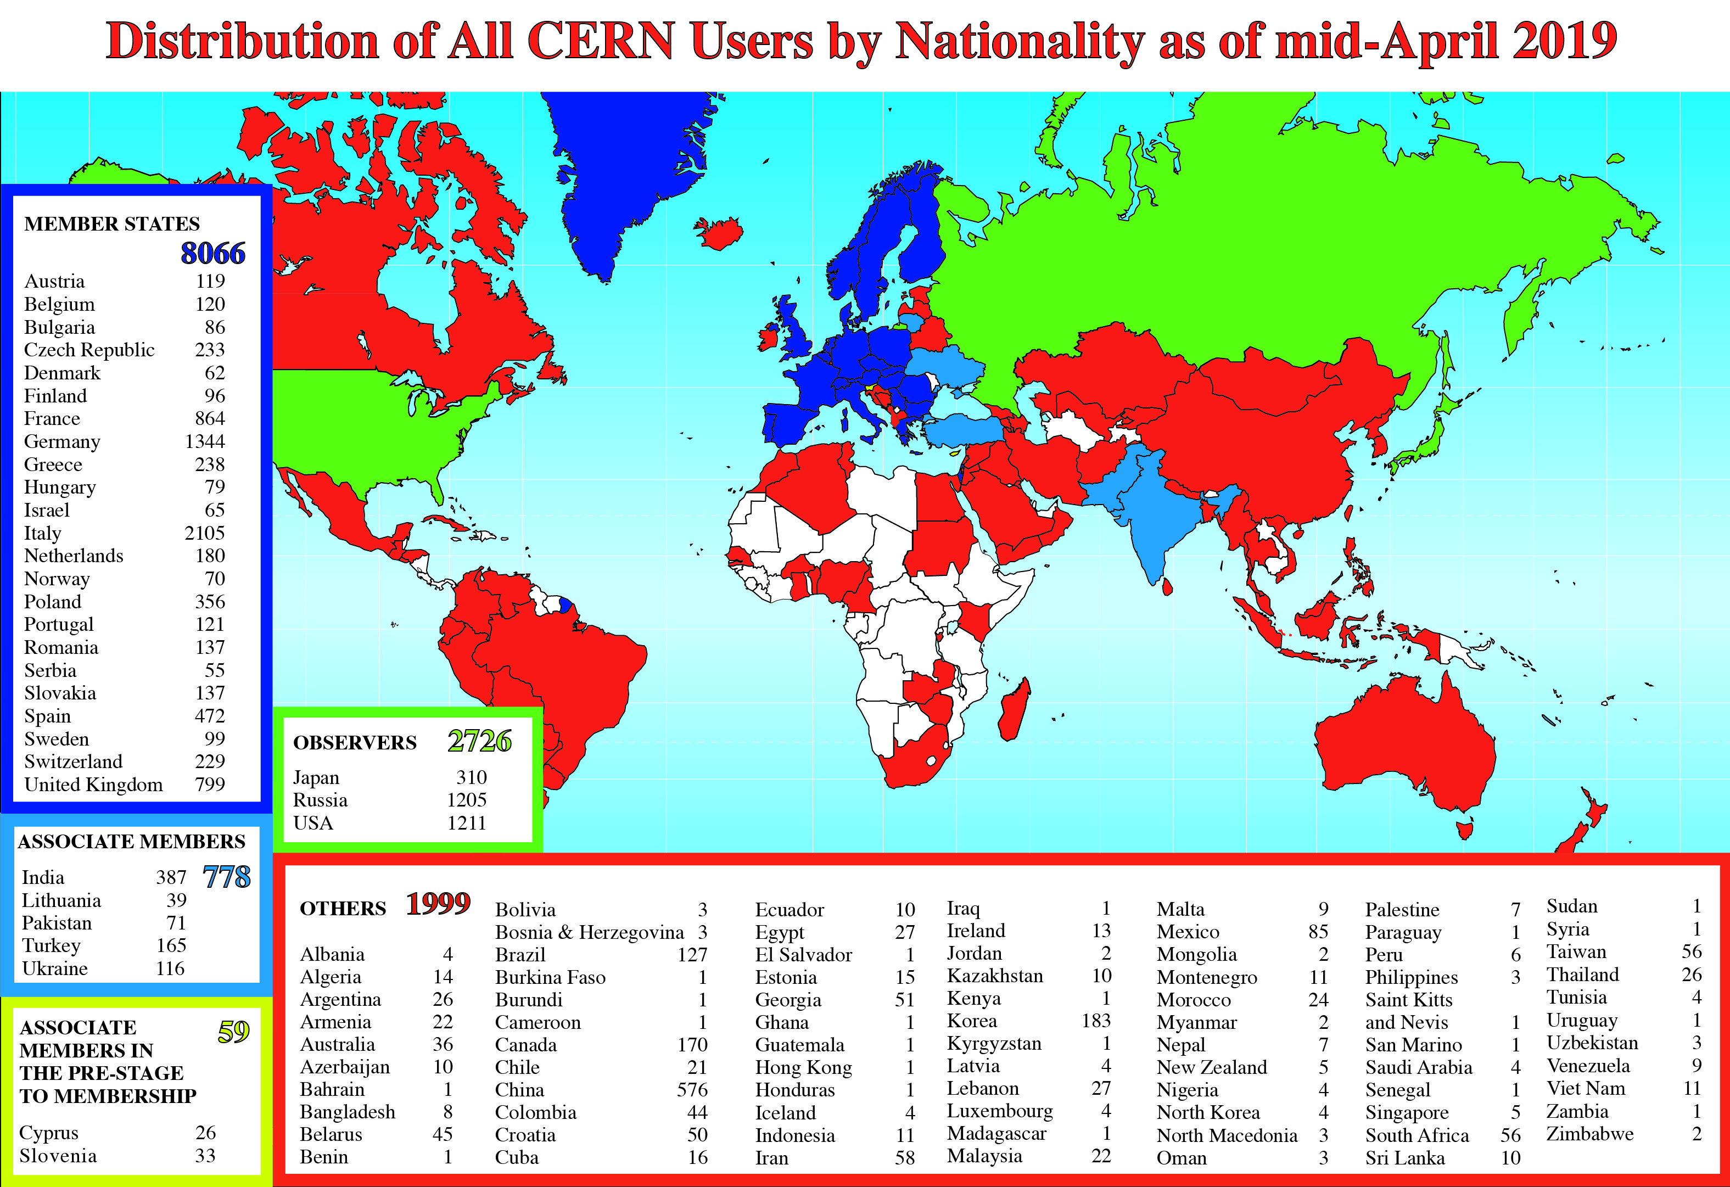
CERN: 57 staff, 22 fellows, 4 Doctoral Students

Slide 5
Age distribution of scientists working at CERN
27
Female scientists: ~ 18% overall
They were ~ 8% in 1995.
~ 10% of the young people stay in particle physics:
where do the others go?
> 3000 PhD students
65

Slide 6
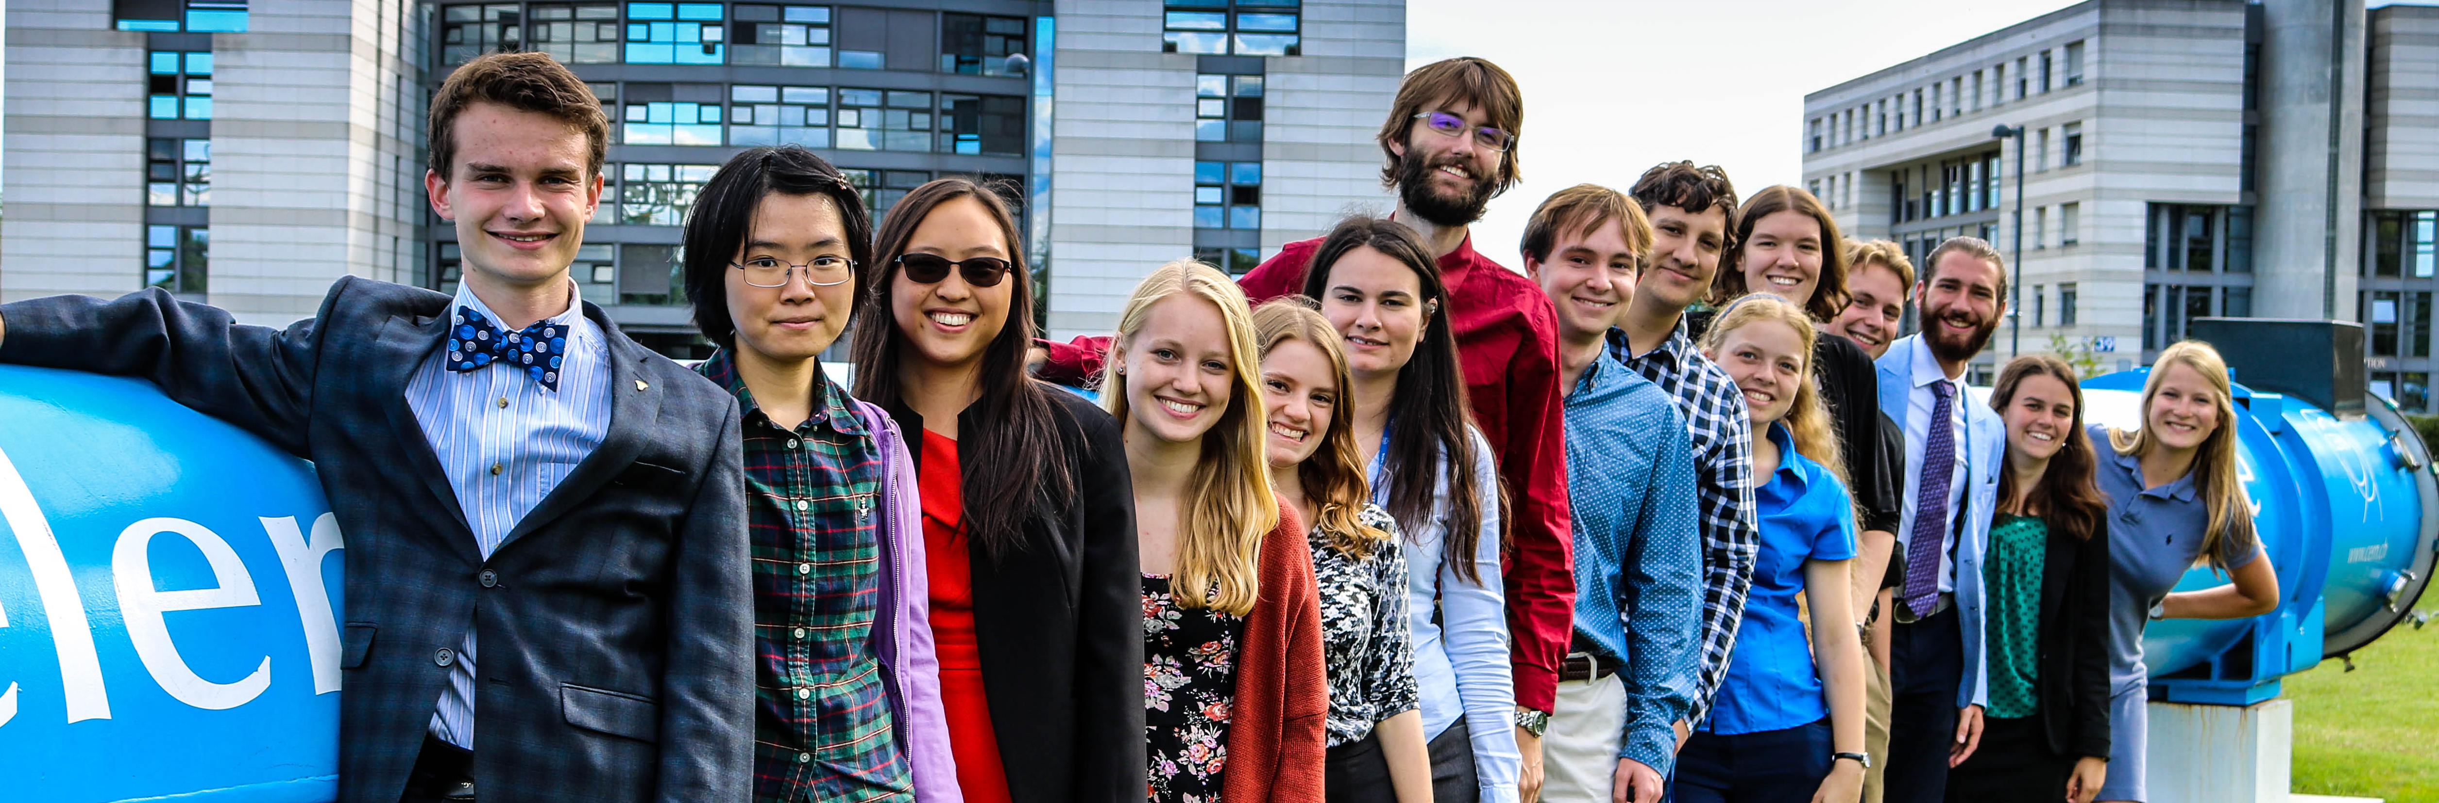
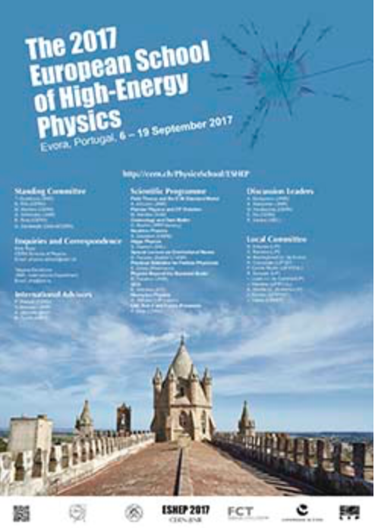
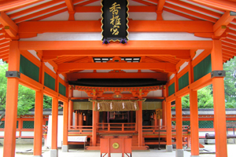
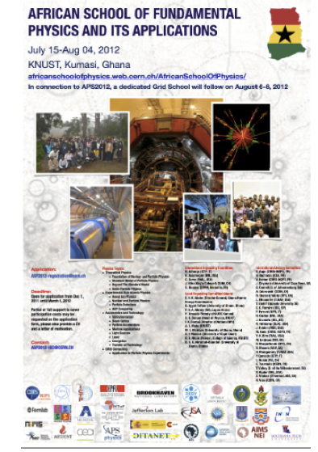
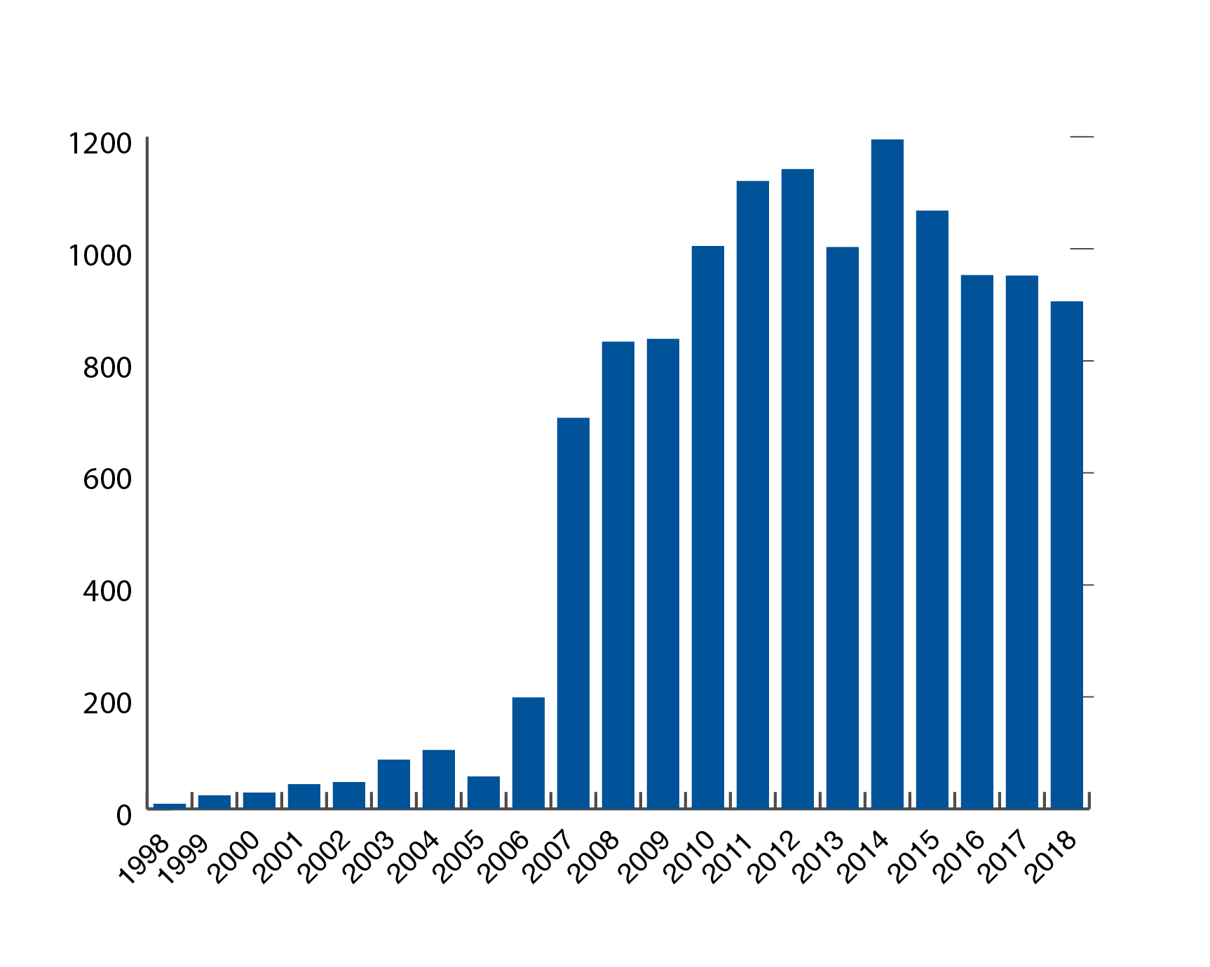
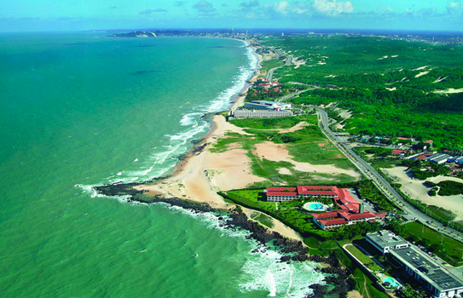
CERN education activities
Europe/Russia School
Asia-Europe-Pacific School:
India 2014,
China 2016,
Vietnam 2018
For young researchers
For physics/engineering students
For high school students
For school teachers
Teachers’ Programme 1998-2018:
total 12320 participants (Portugal: 453)
Latin American School:
Ecuador 2015,
Mexico 2017,
Argentina 2019
African School:
Ghana 2012,
Senegal 2014,
Rwanda 2016,
Namibia 2018

Slide 7
CERN education activities
Europe/Russia School
Asia-Europe-Pacific School:
India 2014,
China 2016,
Vietnam 2018
For young researchers
For physics/engineering students
For high school students
For school teachers
And ~130000 visitors every year (300000 requests)
> 60% are high-school students; ~ 80% come from > 700 km away
Teachers’ Programme 1998-2018:
total 12320 participants (Portugal: 453)
Latin American School:
Ecuador 2015,
Mexico 2017,
Argentina 2019
African School:
Ghana 2012,
Senegal 2014,
Rwanda 2016,
Namibia 2018

Slide 8
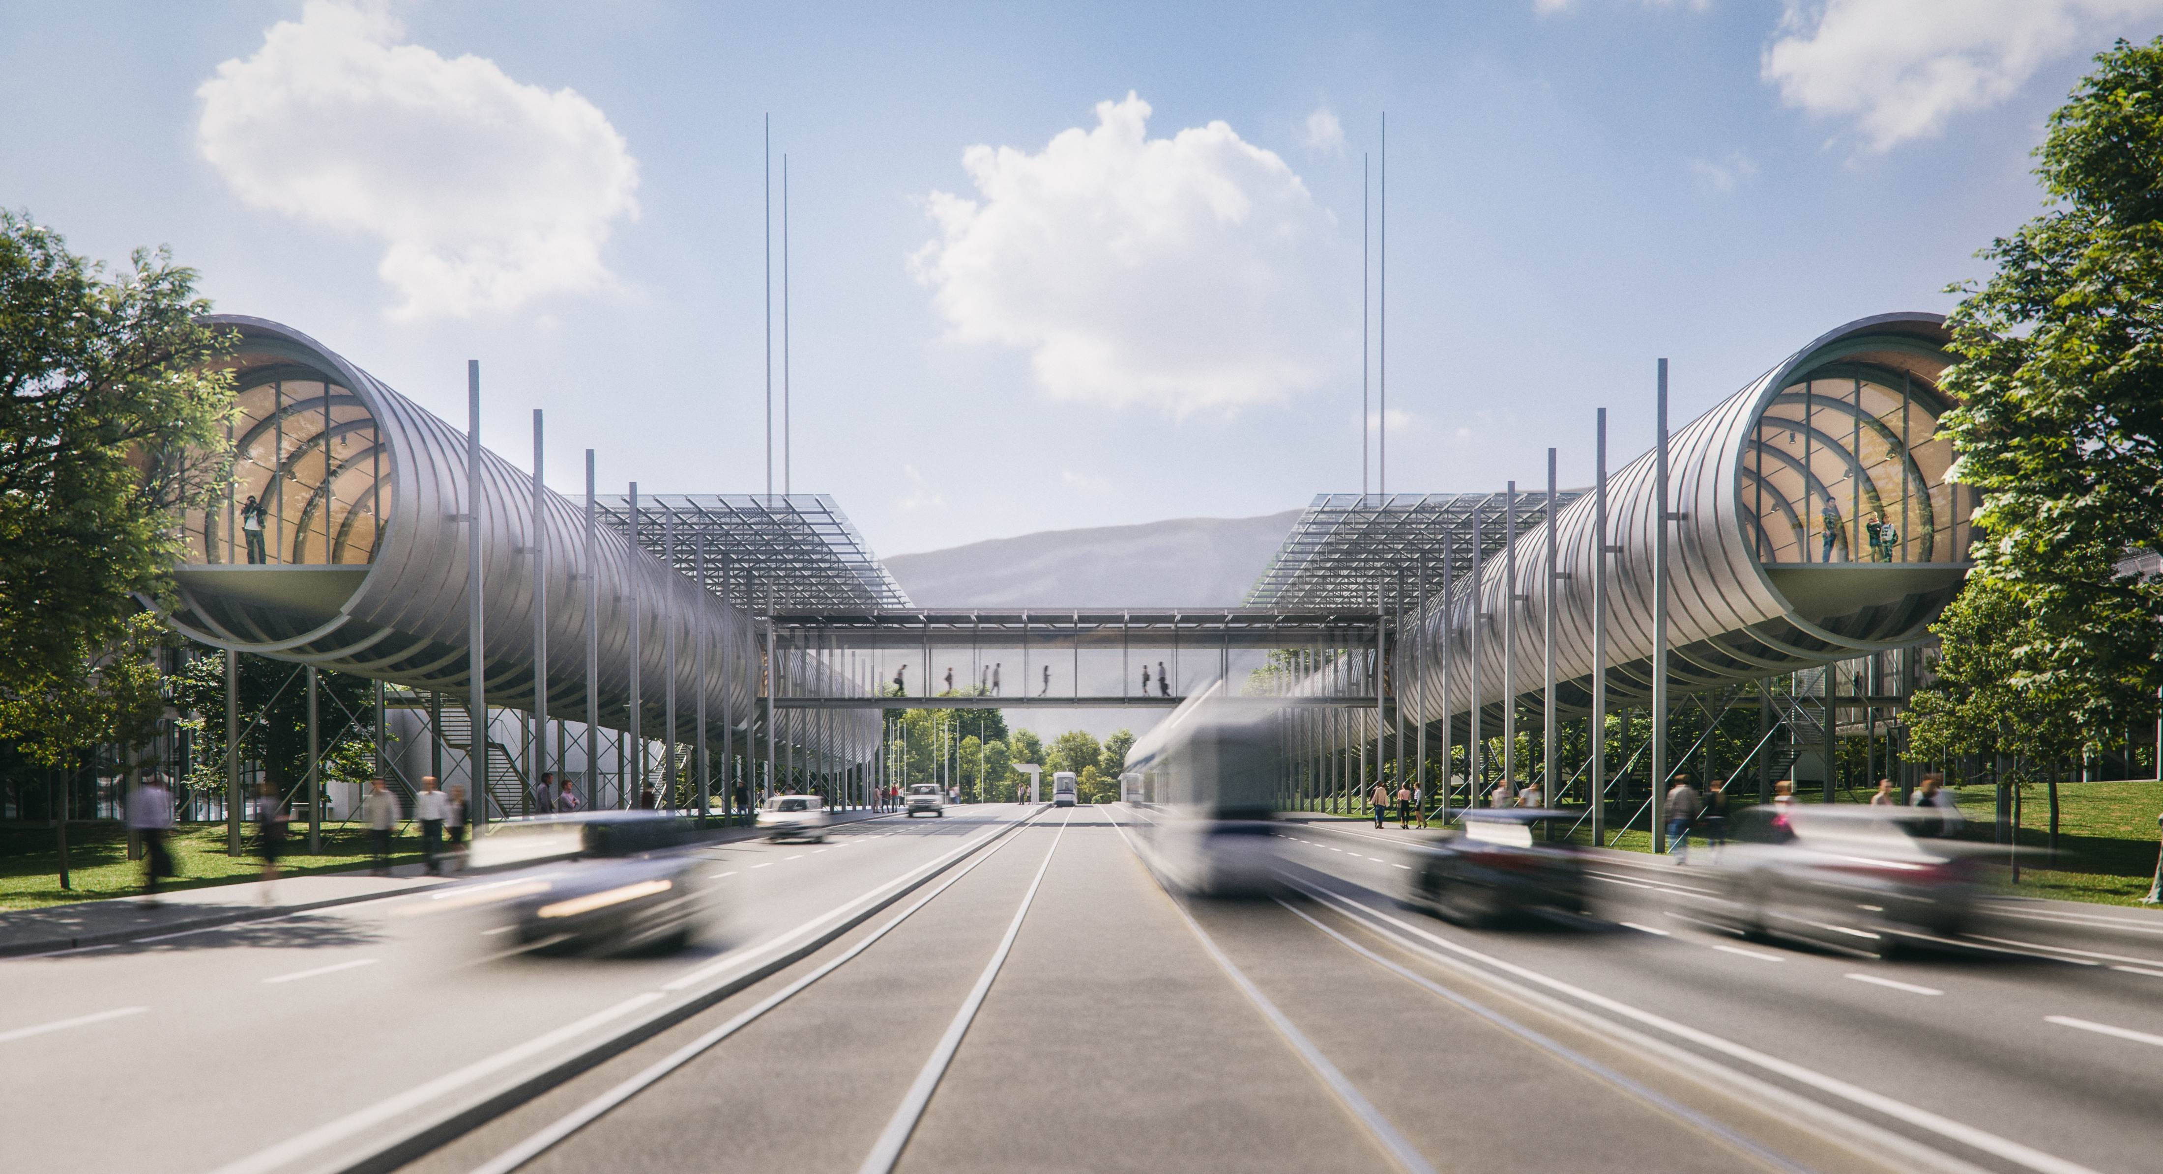
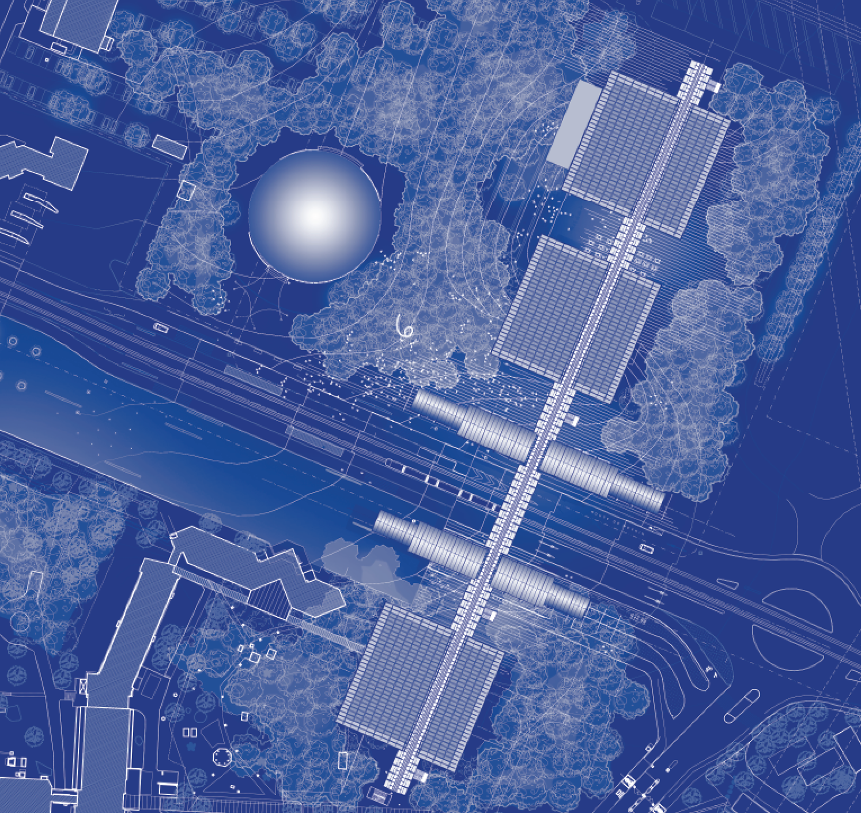
CERN Science Gateway
A new facility for education and outreach targeting the general public of all ages. It will include exhibitions, immersive spaces and laboratories for hands-on physics experiments for school children and students from 5 years up. Expect at least 300,000 visitors annually.
It will be housed in an iconic building complex designed by architect Renzo Piano
Construction will start mid-2020 and will be completed end 2022
Total cost: ~ 79 MCHF to be entirely covered from external donations. 67 MCHF secured so far.
It will allow stronger collaboration with education and outreach initiatives in CERN’s Member States

Slide 9
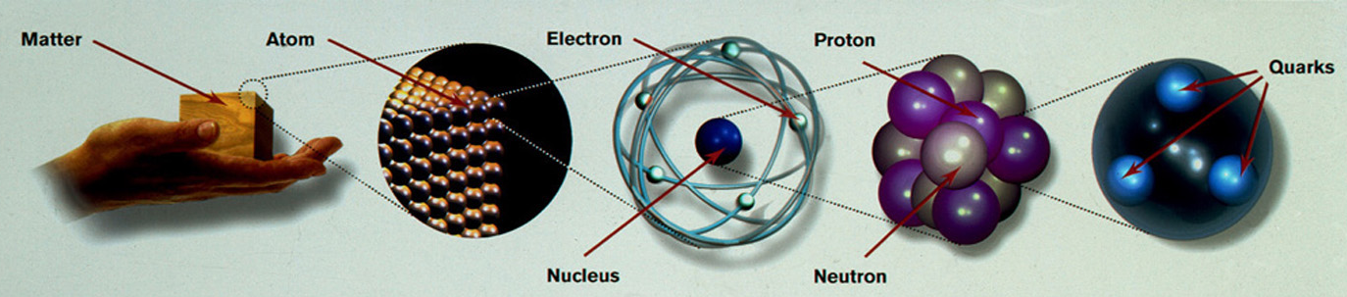
CERN’s primary mission is SCIENCE
Study the elementary particles (e.g. the building blocks of matter: electrons and quarks)
and the forces that control their behaviour at the most fundamental level
10⁻¹⁰ m
10⁻¹⁴ m
10⁻¹⁵ -10⁻¹⁸ m
Particle physics at modern accelerators allows us to study the fundamental laws of nature
on scales down to smaller than 10⁻¹⁸ m
insight also into the structure and evolution of the Universe
from the very small to the very big …

Slide 10
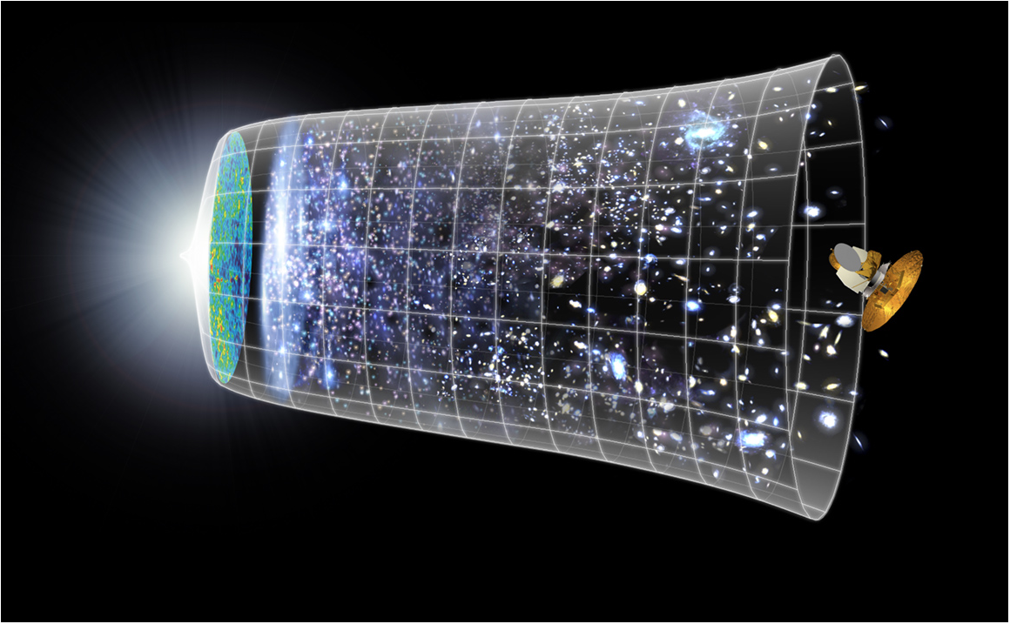
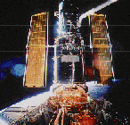
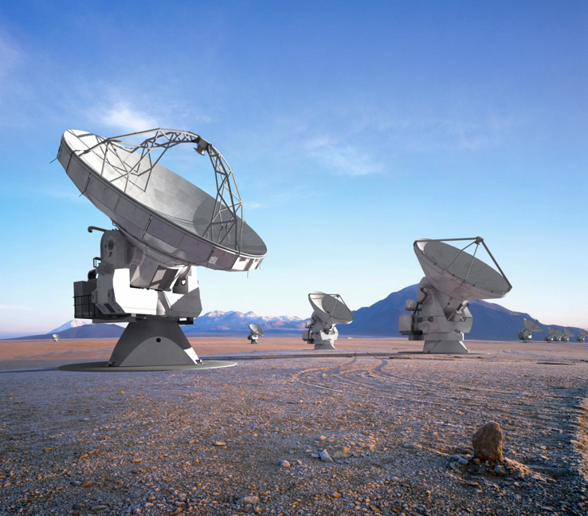
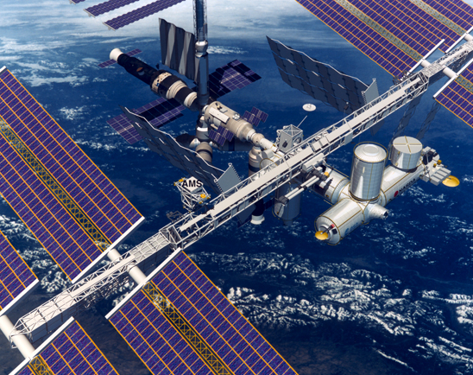
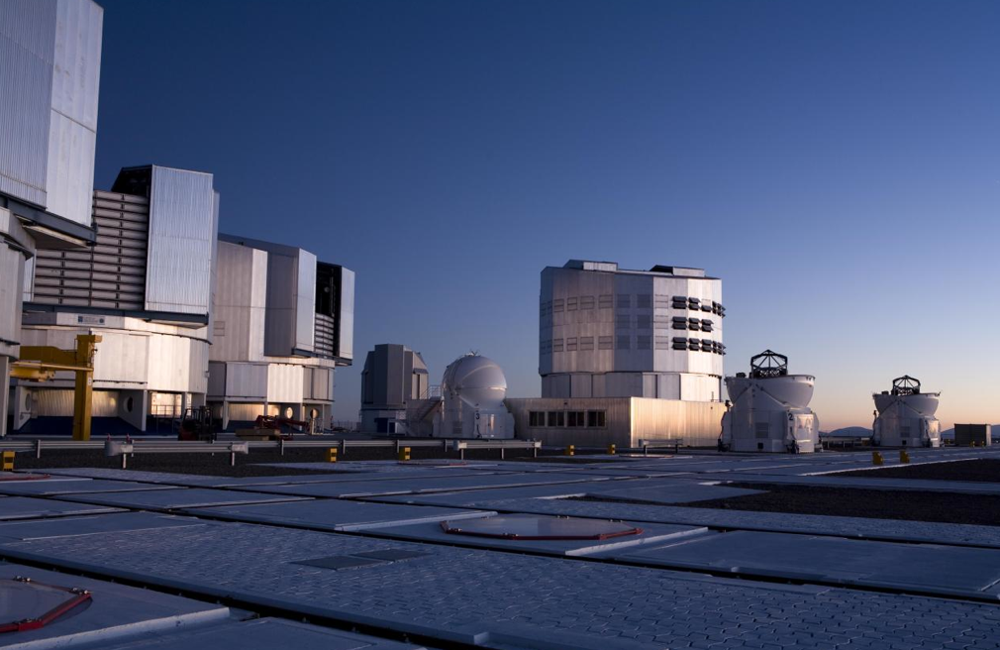

Evolution of the Universe
Telescopes
Big Bang
Hubble
ALMA
Accelerators
VLT
AMS
380,000 years
13.7 Billion Years
Today
10²⁸ cm

Slide 11
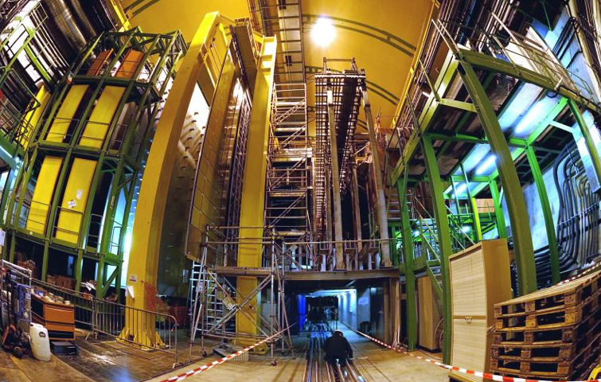


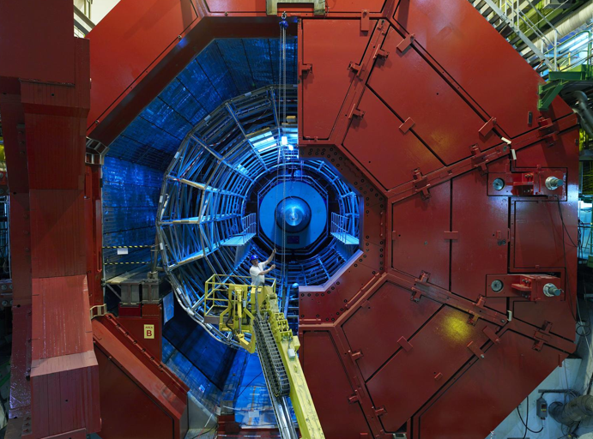
The Large Hadron Collider (LHC):
the most powerful accelerator ever
27 km ring, 100 m underground
operation started in 2010 → exploration of new energy frontier
CMS
LHCb
ATLAS
ALICE
On 4th July 2012, ATLAS and CMS announced the discovery of a new (very special!) particle:
the Higgs boson

Slide 12
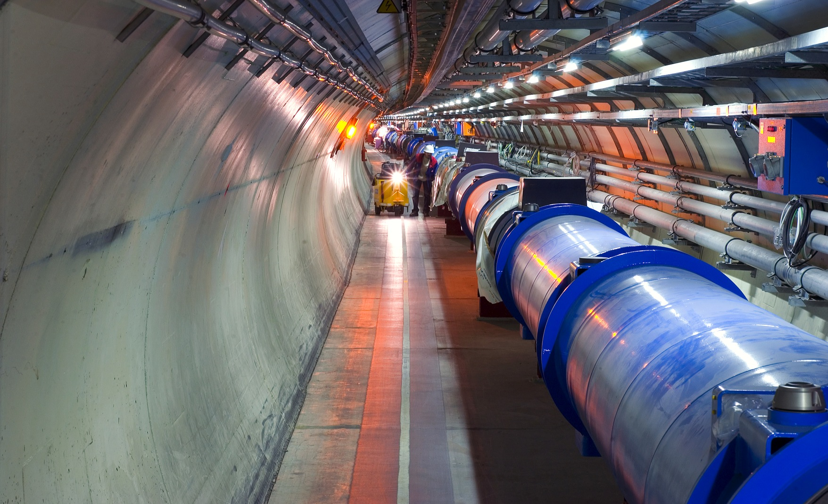
Accelerator:
1232 high-tech superconducting magnets
(built by Alstom, Ansaldo and Babcock-Noell)
magnet operation temperature: 1.9 K (-271 ⁰C)
→ LHC is one of coldest places in the universe
number of protons per beam: 200000 billions
number of turns of the 27 km ring per second: 11000
number of beam-beam collisions per second: 40 millions
collision “temperature”: 10¹⁶ K

Slide 13
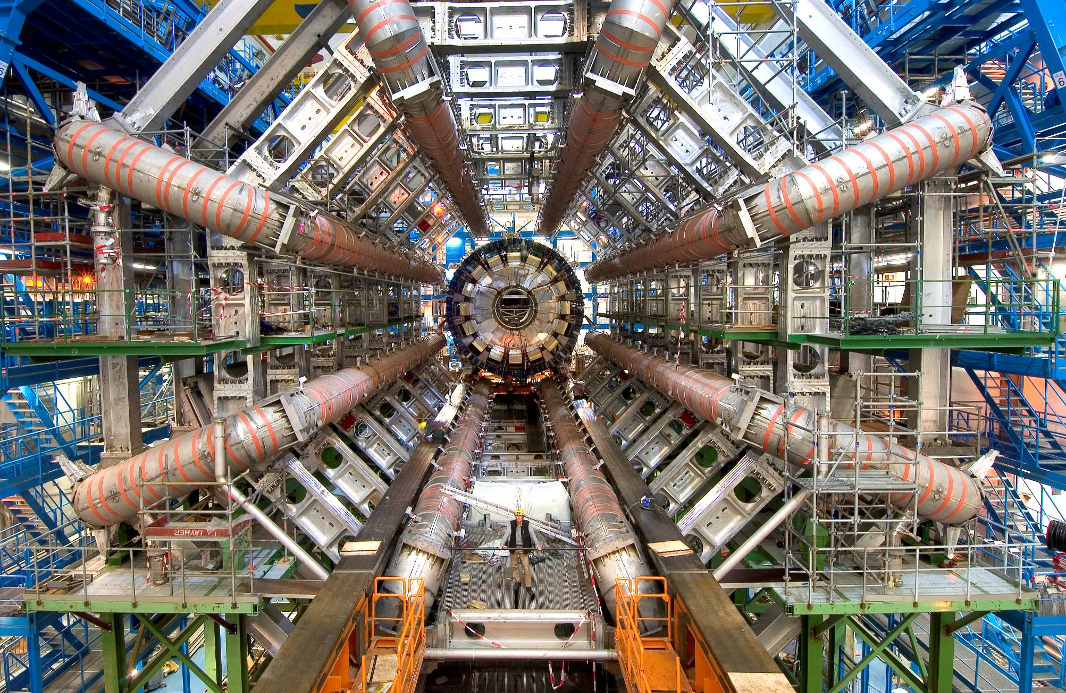
Detectors:
size of ATLAS: ~ half Notre Dame cathedral
weight of CMS experiment: 13000 tons (more than Eiffel Tour)
number of detector sensitive elements:
~100 millions
cables needed to bring signals from detector to control room: 3000 km
data in 1 year per experiment: >10 PB (20 million DVD; more than YouTube, Twitter)

Slide 14
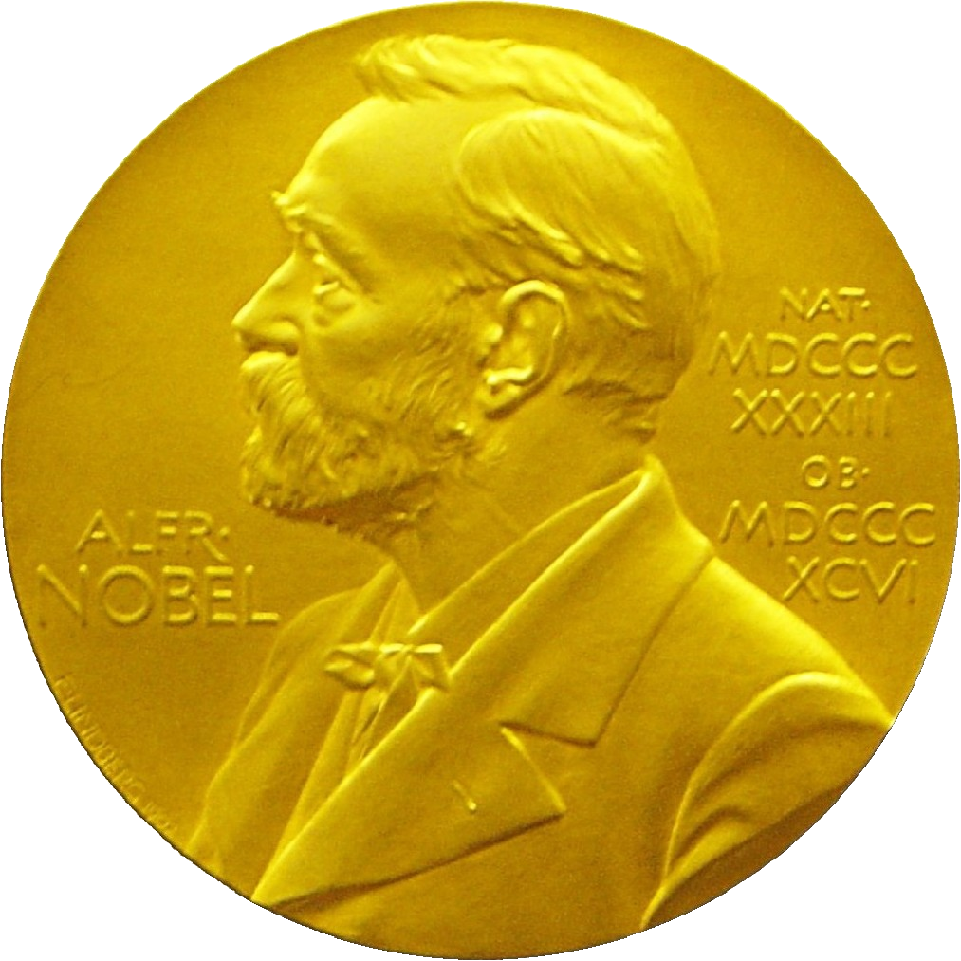
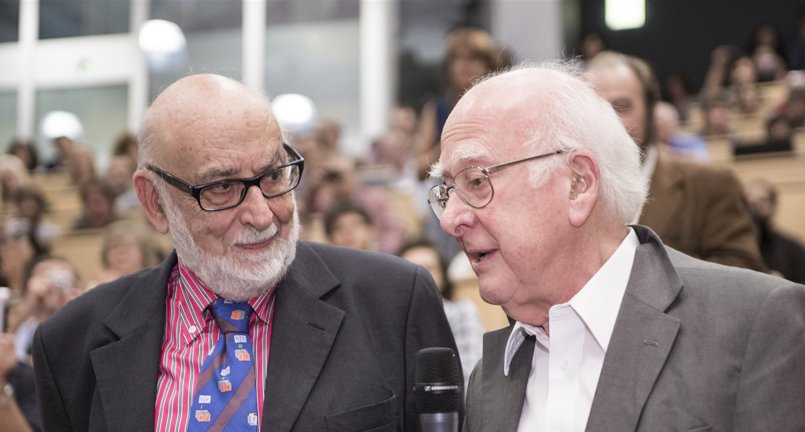
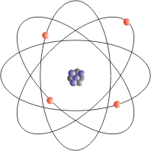
Discovery in 2012 → Nobel Prize in Physics in 2013
Note: a world without the Higgs boson
would be very strange. Atoms would not
exist → universe would be very different
The Nobel Prize in Physics 2013 was awarded jointly to François Englert and Peter W. Higgs "for the theoretical discovery of a mechanism that contributes to our understanding of the origin of mass of subatomic particles, and which recently was confirmed through the discovery of the predicted fundamental particle, by the ATLAS and CMS experiments at CERN's Large Hadron Collider”.

Slide 15
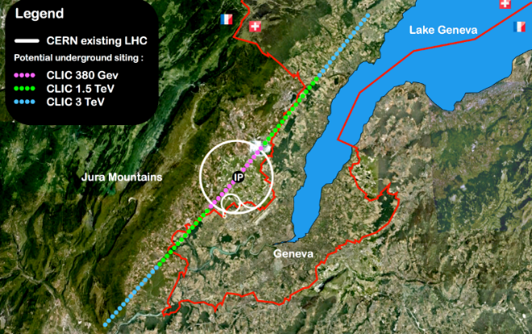
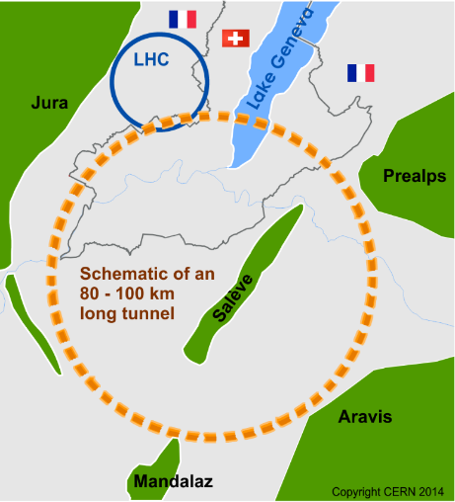
Which accelerator after the LHC ?
Various options for future, more powerful colliders being studied and the needed, advanced technologies being developed
FCC: Future Circular Collider: 100 km ring for e⁺e⁻ and proton-proton collisions
CLIC: e⁺e⁻ linear collider 11 km → 50 km tunnel
Competition with China
Competition with Japan

Slide 16

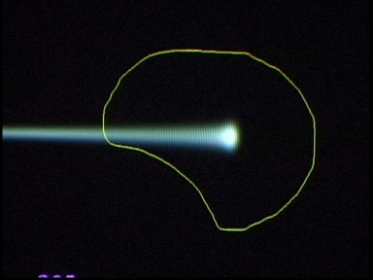
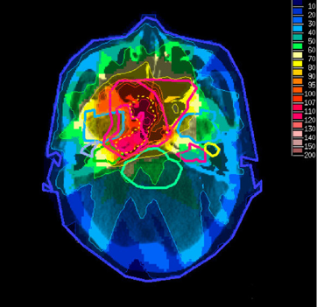
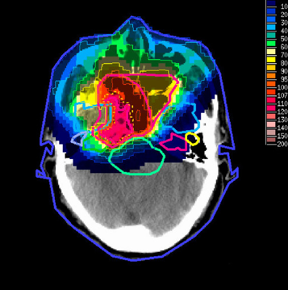

Complex, high-tech instruments needed in particle physics → cutting-edge technologies developed at CERN and collaborating Institutes → transferred to society
Examples of applications: medical imaging, cancer therapy, solar panels, material science, airport scanners, cargo screening, food sterilization, nuclear waste transmutation, analysis of historical relics, etc. etc. … not to mention the WEB …
Tumour Target
Hadron Therapy
Protons
light ions
X-ray
protons
Particle accelerators: ~30’000 worldwide, of which ~17’000 used for medical applications
E.g. Hadron Therapy: > 50000 patients treated in Europe (14 facilities for protons, two for Carbon ions)
Imaging
e.g. PET scanner (based on CERN technology) is main cancer diagnostic technique since 2000
(great contributions from Portugal!)

Slide 17
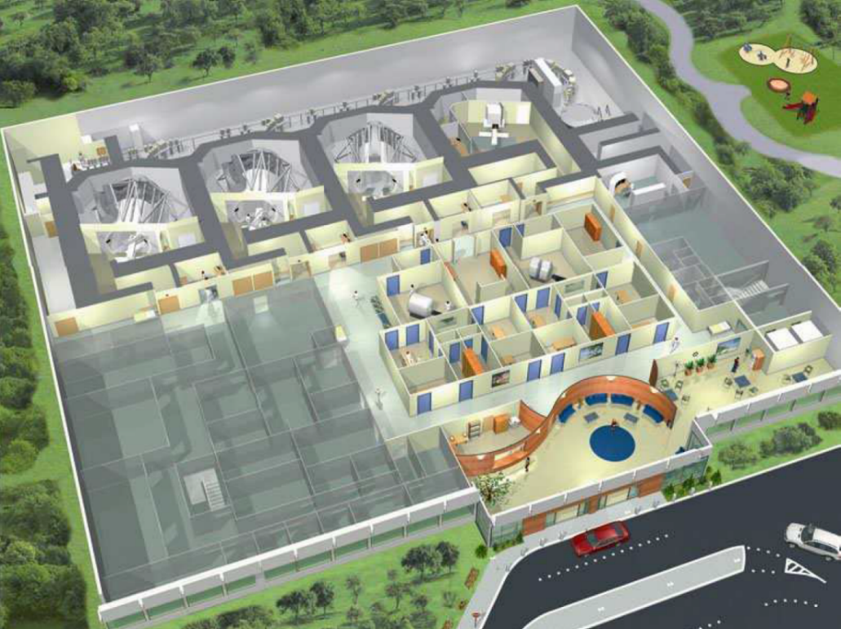
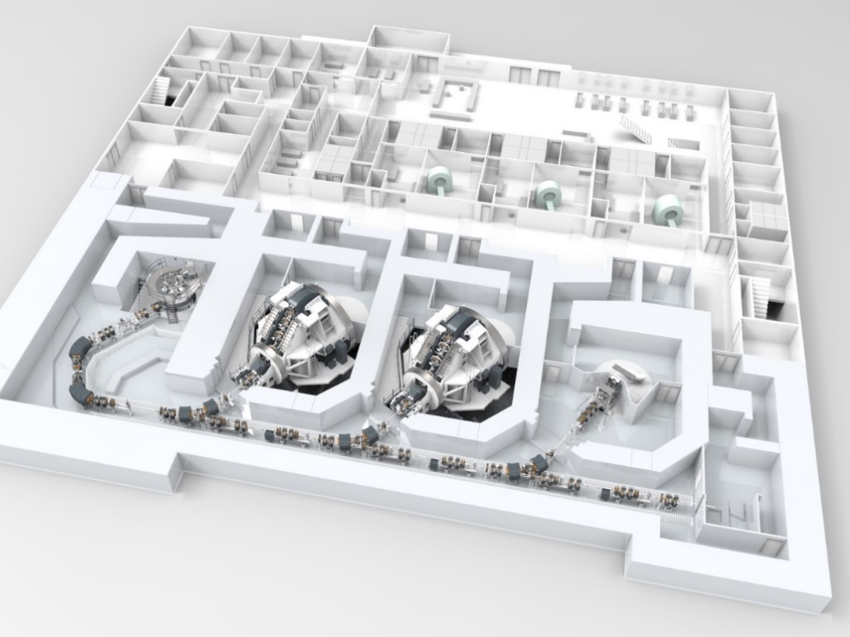
Plans for proton therapy in Portugal
Typical multi-room configurations units for proton therapy from IBA (Belgium, left) and Varian (US, right): 2-3 rooms for patients and 1 room for research.
Goal would be to treat ~ 700 patients/year initially.
First unit would be located at the Campus Tecnológico e Nuclear of Instituto Superior Técnico.
FCT is committed to fund a training program for physicians and researchers over the next five years.
Notes:
17

Slide 18

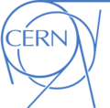
Portugal and CERN
Portugal joined CERN as a Member State in 1986
The Laboratório de Instrumentação e Física Experimental de Partículas (LIP) was created at the same time to carry out all activities related to experimental particle physics, involving researchers coming from universities as well as LIP’s own scientific staff
Strong participation in LHC (ATLAS, CMS) and other experiments (CLOUD, COMPASS, ISOLDE, nTOF) and strong partner in the GRID
Strong participation in R&D programmes for medical application (Clear PEM, PET consortium)
Training/Education:
  Excellent example of engineer training programme
  Very successful teacher training and outreach programmes
Very balanced approach between contributions at CERN and investments at home and very good industrial relations

Slide 19

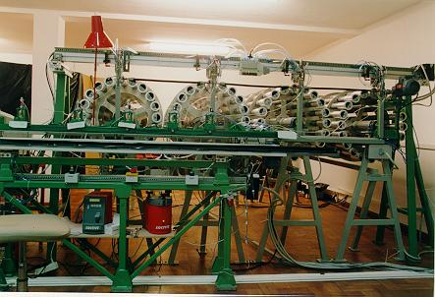
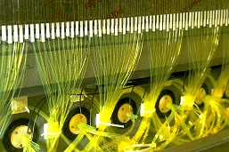
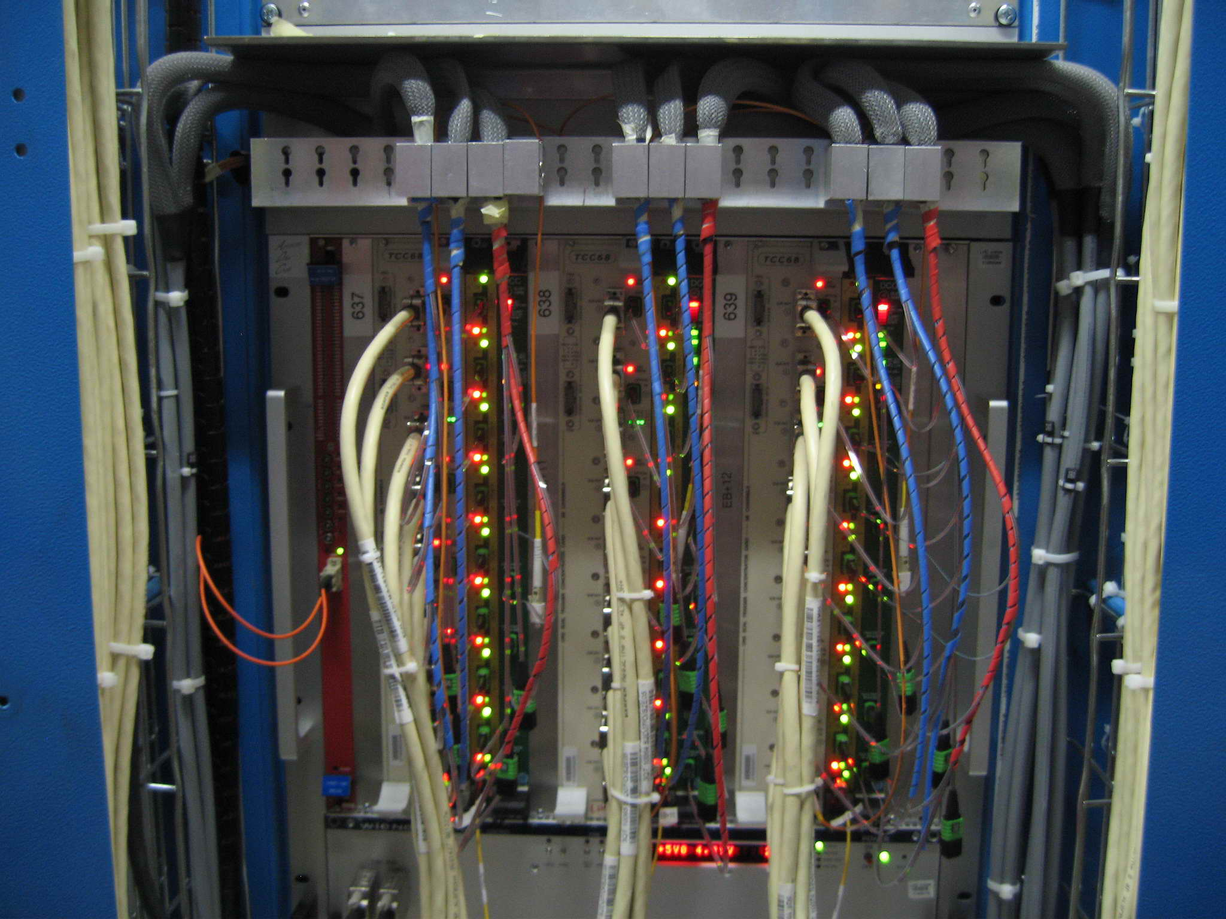
Contributions to the ATLAS and CMS experiments at LHC
LIP is a member of ATLAS since 1992
LIP is a member of CMS since 1992
Major role in the construction of the TileCal Hadron Calorimeter and Trigger/Data Acquisition system, in collaboration with industry and technology institutes
  Major role in the construction of the Trigger and Data Acquisition of the Electromagnetic Calorimeter, in collaboration with industry and technology institutes
Robot for fiber insertion.
600 000 fibers inserted in Lisbon and later in Coimbra
WLS optical fibers routing.
Fiber aluminization done in Lisbon
ECAL Trigger/DAQ hardware:
18 Crates; 240 Modules; 1200 Mezzanines
3000 optical links; 2500 electrical links
  Detector Commissioning and Operation
  Data analysis
  Detector Commissioning and Operation
  Data analysis

Slide 20

Thank You!
Accelerating Science and Innovation
Notes:
20

Slide 21
EXTRAS
Notes:
21

Slide 22
LHC built to address outstanding questions in fundamental physics
What is the origin of the masses of the elementary particles
(quarks, electrons, … ) ? → related to the Higgs boson
95% of the universe is unknown (dark): e.g. 25% of dark matter
Why is there so little antimatter in the universe ?
What are the features of the primordial plasma permeating the
universe ~10 μs after the Big Bang ?
Are there other forces in addition to the known four ?
Etc. etc.

