Slide 1
Beam-Beam DA Simulations
N. Karastathis, Y. Papaphilippou
with many thanks to
R. De Maria, R. Tomas, F. van der Veken
WP2 Meeting
03.12.2019
OUTLINE
Operation with larger crossing-angle
Impact of failing a4/b5 correctors at the end of leveling.
Operation below the diagonal.
Collapsing the separation bump with CC off.
Notes:
Antonia

Slide 2
1. Colliding with Larger Crossing Angle

Slide 3
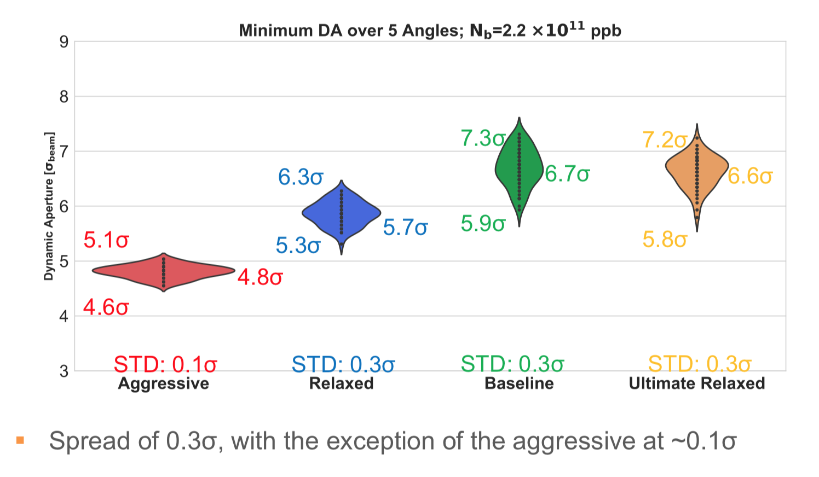
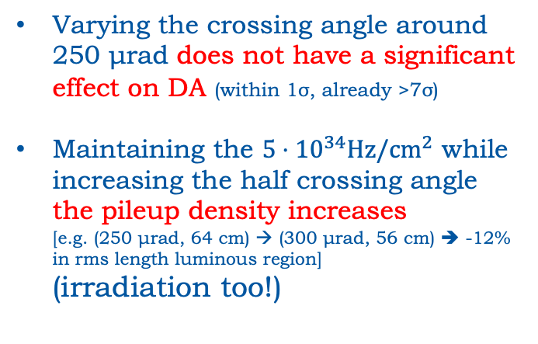
Start of Leveling (CC on)
Varying the crossing angle around 250 μrad does not have a significant effect on DA (within 1σ, already >7σ)
Maintaining the $5⋅{10}^{34}Hz/cm^{2}$ while increasing the half crossing angle the pileup density increases
[e.g. (250 μrad, 64 cm) → (300 μrad, 56 cm) ➔ -12% in rms length luminous region]
(irradiation too!)
250 μrad
209 μrad
154 μrad
As a reminder from 7th HL-LHC Collaboration meeting @ Madrid:
While the DA is not significantly restricted, the spread of the minimum DA among the 60 seeds is at the level of 0.3 σ, for various half-crossing angle values.
133 μrad

Slide 4
Start of (Nominal) Leveling
CC ON
CC OFF
With the CC off, the available DA area is increased (especially for DA around 4-5σ), while the peak DA is not significantly impacted.

Slide 5
Start of (Nominal) Leveling
CC ON
CC OFF
For the given Working Point, selected to optimize the DA at the start of leveling, the impact of the CC is not so significant.

Slide 6
End of Leveling
Similar results are
found at the end of
leveling.

Slide 7
2. Failing IT Correctors a4, b5

Slide 8
IT correctors failure at the end of leveling
For Seed #13
a4
failing a4 (kcsx3)
failing b5 (kcdx3)
The impact of the failed correctors is < 1σ (seemingly less significant than b6).
b5

Slide 9
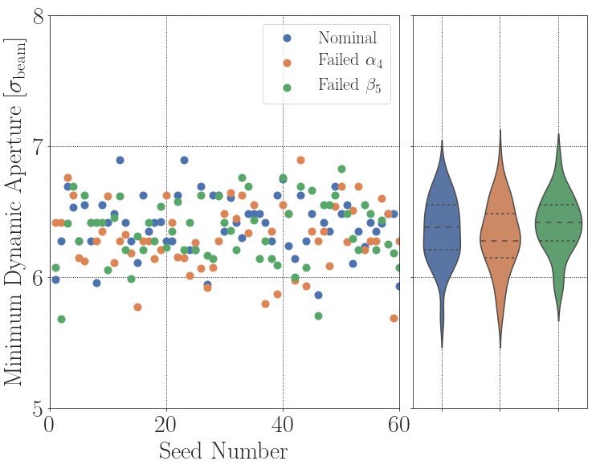
IT Correctors Failure at β*=15 cm & Nb = 1.2e11 ppb
Choosing $\left(Q_{x}, Q_{y}\right)=(62.315, 60.320)$ and running for all seeds

Slide 10
3. Operation Below the Diagonal

Slide 11
Injection
We have already seen that when the polarity of the octupoles is negative, if only the incoherent BB part is considered there is some margin below the diagonal.
Our DA simulations do not include the diffusive effect of e-cloud.
  The impact of e-cloud would be to push the vertical tune to larger values, i.e. approaching the coupling resonance, if we were operating below the diagonal.
  We need to include an a realistic model for the coupling rather than selecting a tune distance.
  We need additional tools to quantify this in order to even consider it as a viable operational option.

Slide 12
Pre-Squeeze
At Pre-Squeeze the available DA is more than sufficient in any configuration.
rATS = 1.7
rATS = 2.2
rATS = 3.0

Slide 13
Start of Collisions (β*=0.4 m)
If we now consider the start of collisions with various tele-indices
rATS = 1.7
rATS = 2.2
rATS = 3.0

Slide 14
Start of Collisions
ABOVE
NB #1: With the tools available at the moment, the additional
margin in DA is NOT an indication of improvement!
NB #2: We need a more realistic effective model for the coupling
rather than just selecting a tune distance.
BELOW

Slide 15
During the leveling
ABOVE
BELOW
Under this configuration, reaching 15cm with DA>6σ is not possible when operating below the diagonal (even when no coupling etc) is taken into account!

Slide 16
4. Collapsing the separation bump with high tele-index and the CC off

Slide 17
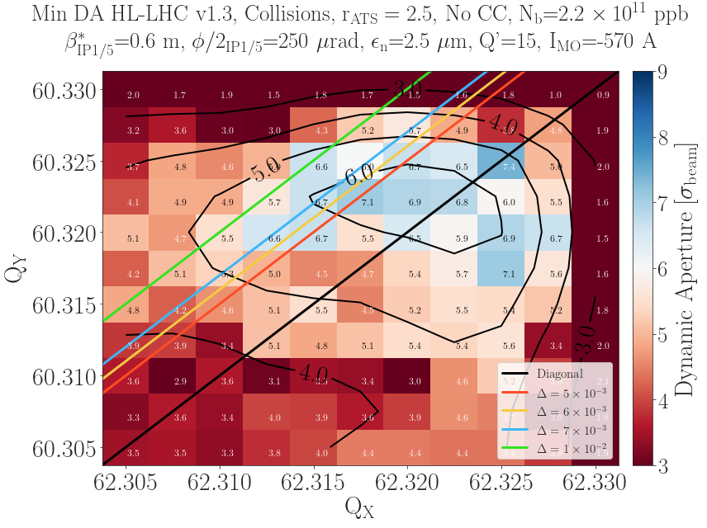

Start of Collisions (β*=0.6 m)
rATS = 1.9
rATS = 2.2
rATS = 2.5
For
$$Δ=5×{10}^{−3}$$
+10%
+11%

Slide 18
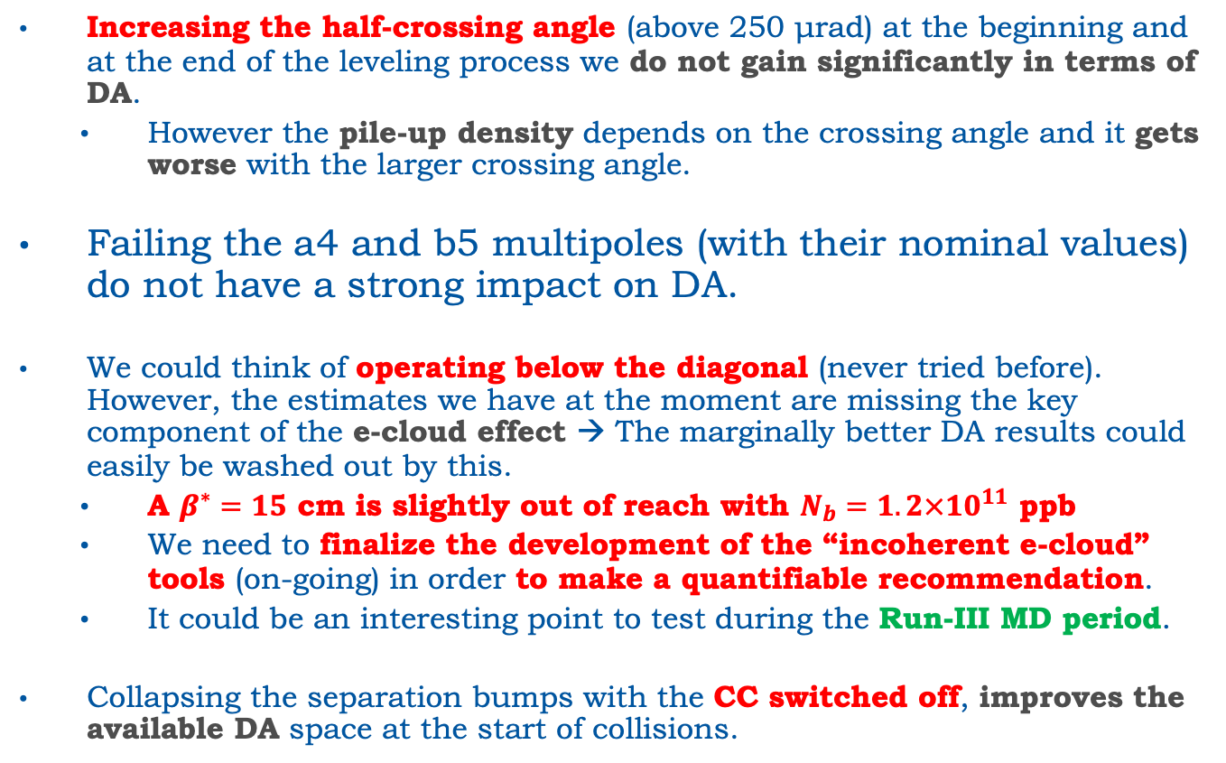
Summary
Increasing the half-crossing angle (above 250 μrad) at the beginning and at the end of the leveling process we do not gain significantly in terms of DA.
  However the pile-up density depends on the crossing angle and it gets worse with the larger crossing angle.
Failing the a4 and b5 multipoles (with their nominal values) do not have a strong impact on DA.
We could think of operating below the diagonal (never tried before). However, the estimates we have at the moment are missing the key component of the e-cloud effect → The marginally better DA results could easily be washed out by this.
  A $β^{∗}=15$ cm is slightly out of reach with $N_{b}=1.2×{10}^{11}$ ppb
  We need to finalize the development of the “incoherent e-cloud” tools (on-going) in order to make a quantifiable recommendation.
  It could be an interesting point to test during the Run-III MD period.
Collapsing the separation bumps with the CC switched off, improves the available DA space at the start of collisions.

Slide 19
BACKUP

Slide 20
Operating with Larger Xing
For a bunched beam with longitudinal density
luminosity is calculated as
where the loss factor
and a kernel:
Therefore the RMS Length of the luminous region is :
Gaussian
So in our case depends on β* and φ/2

Slide 21
Errors @ Start of Leveling
7th HL-LHC Collab Meeting
250 μrad
209 μrad
154 μrad
133 μrad

Slide 22
Extending XB

