Slide 1
(Co-)activities in PS central building
No water for air conditioning until 21/02/2020
Signal cabling activities
  13/08 to 23/09/2019; Patrick Lelong, EN-EL → finished in 353/R-002
Renovation of electrical power distribution to racks
  Scheduled for 26/08-05/11; James Devine, EN-EL → completed
Installation of optical fibres (on top of racks, after the power distribution renovation)
  Q3-4/2019, fibres 151-359 done; Jean-Marc Lassauce, EN-EL
  Installation of central distribution in CR12
  Infrastructure (trenches) for rack-to-rack patch connections
Ethernet socket installations
VME crates removed from b. 359 racks → Reinstallation in December?
Racks for Finemet cavity (b. 151), exchanged → needs re-cabling
VME power supply renovation → Few supplies sent for maintenance
Controls installations
  Benjamin Ninet, BE-CO → pulse repeaters in CR33/35 done
  CR13 pulse distribution ongoing

Slide 2
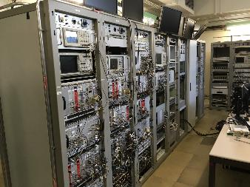
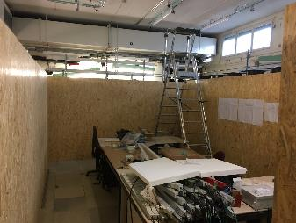
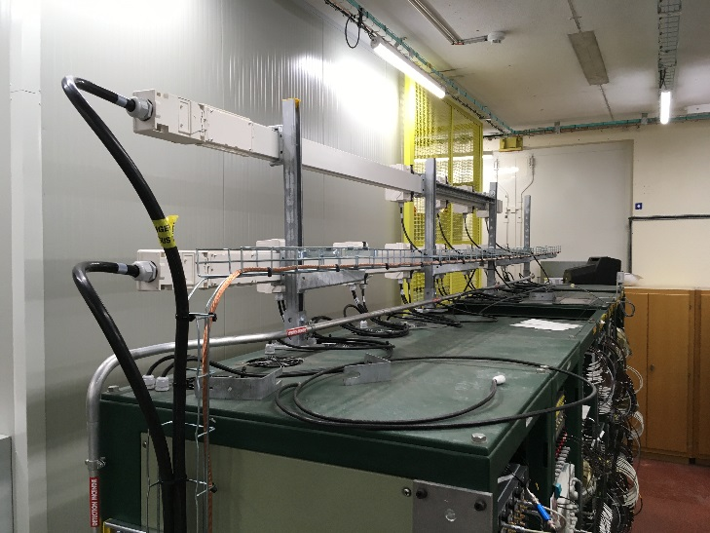
Renovation of electrical distribution
Before
All racks powered again
  10 MHz distribution
  Master clock generation
Installation of over-temperature emergency off (Luca, Kevin)
During
After

Slide 3
Beam control: Status and next steps
Production of VXS modules for PS completed/ongoing
(link to dfs)
Production of spare 1-turn delay feedback boards ongoing
Detail synoptics for new LLRF
Configuration of new crate for RF train distribution
  Validate in the lab before removal of frontend to b. 353
  (cfv-353-alltd)
  Prototype fractional divider?
Layout of front-ends in b. 151 (20/40/80 MHz)
  1 front-end for functions timings for cavity controller
  (cfv-151-allbc1?)
  4 front-ends for timings and AVC surveillance:
  20 MHz, 40 MHz, twice 80 MHz
  (cfv-151-allc20, cfv-151-allc40, cfv-151-allc80-08, cfv-151-allc80-88-89?)

Slide 4
Upcoming
Reconnections of frontends to network
  Kindly followed by BE-CO installation team
Powering of further equipment
  Requires network and CR13 general pulse distribution
Pulse repeater renovation, rack-by-rack
  Collaboration with BE-CO installation team
Rack layout for CR10, CR11 (core beam control)
  Preparation of infrastructure, VXI crates
  Installation requests

Slide 5
Status of hardware developments
 | Hardware |  | Comments
Module | Prototype | Series
CTU |  | ✓ | Hardware completed
Fractional divider (AWAKE/PS) | ✓ | 02/2020 | Completing prototype validation Series production
AVC surveillance | 02/2020 |  | Design phase
Master DDS FMC | 02/2020 |  | Almost ready for design office
Master clock divider | 03/2020 |  | Development starting?
Clock/sync adaptor | 02/2020 |  | Finalization of design, then review

Slide 6
Status of firmware developments
 | Hardware | Firmware |  | FESA
Module |  | Test | Operational | class
CTU | CTU | ✓ | 12/2019 | 12/2019
Fractional divider (AW./PS) | new | (✓) | 02/2020 | 03/2020
Radial position detection | PS 1-TFB board | ✓ | ✓ | 12/2019
Internal function generator | n.a. | ✓ | ✓ | 12/2019
Synchronous 4-ch. receiver | PSB mother b. | 01/2020 | 03/2020 | 03/2020
Fast data concentrator | PSB mother b. | 02/2020 | 04/2020 | 04/2020
Slow data concentrator and distributor | SVEC | 06/2020 | 07/2020 | 07/2020
Beam loops calculation | PSB mother b. | 05/2020 | 06/2020 | 06/2020

Slide 7
Status of firmware developments
 | Hardware | Firmware |  | FESA
Module |  | Test | Operational | class
Clock/sync adaptor | New | 12/2019 | 02/2020 | 02/2020
Master clock, DDS-FMC | SVEC | 02/2020 | 02/2020 | 03/2020
Master clock divider | New | 03/2020 | 04/2020 | 04/2020
20/40/80 MHz cavity contr. | PS 1-TFB board | 12/2019 | 02/2020 | 03/2020
Coupled-bunch feedback | PS 1-TFB board | 12/2019 | 02/2020 | 02/2020
AVC surveillance | New | 02/2020 | 04/2020 | 04/2020

