Slide 1
PS 200 MHz cavity controller
Matteo P.

Slide 2
200MHz Cavities
Cavities for longitudinal blow-up
  Deliver stable beam to experiments and accelerators
  6 cavities in the PS
  6 cavities in the SPS
  Resonance frequency ≈ 200MHz
Low-level RF system needed to drive the cavities
  Implementation using µTCA board
  Reutilize already implemented blocks from SPS

Slide 3
Operation Modes
Blow-up function
  PS only operation
Beam transfer to SPS
  Synchronous with SPS 200MHz cavities
  Cavities in the PS are driven as if they were part of the SPS RF system
Select operation mode accordingly:
  PS blow-up
  SPS beam transfer
  Neither

Slide 4

Overview
Generate RF
  Synchronous with $f_{rev}$ of the beam
    Either from PS or SPS
  Close to $f_{0}=199.948 MHz$ resonance
Regulate cavity voltage

Slide 5
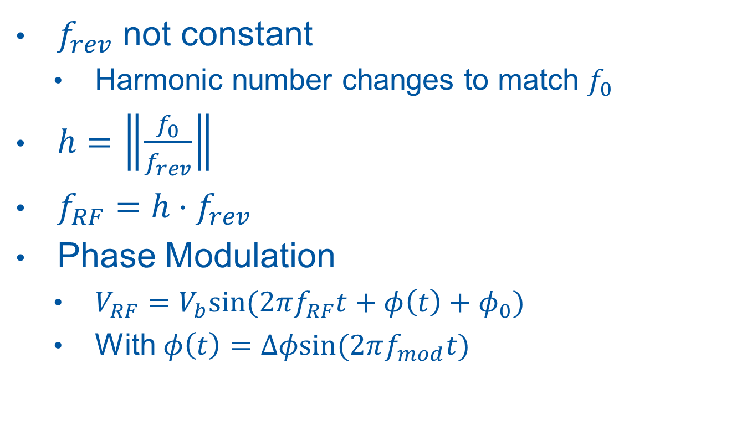
Blow-up
$f_{rev}$ not constant
  Harmonic number changes to match $f_{0}$
$h=\left\|\frac{f_{0}}{f_{rev}}\right\|$
$f_{RF}=h⋅f_{rev}$
Phase Modulation
  $V_{RF}=V_{b}sin⁡(2πf_{RF}t+φ\left(t\right)+φ_{0})$
  With $φ\left(t\right)=Δφsin⁡(2πf_{mod}t)$

Slide 6

Beam Transfer
Generate $V_{RF}$
$V_{RF}$ sync with SPS
  FTW ($f_{rev}$) input coming from SPS

Slide 7
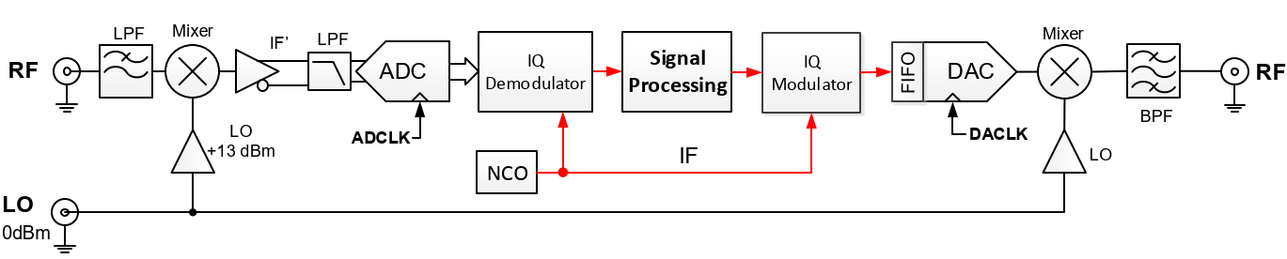

SPS 200Mhz Cavity Controller
Direct sampling (Under-sampling)
  $f_{s}=125MHz$
  $f_{LO}=180MHz$ generated off-board
Upconversion of generated RF signal
Need to generate IF sync with beam
G:\Departments\AB\Groups\RF\Machines\SPS\LowLevel\TWC200\

Slide 8
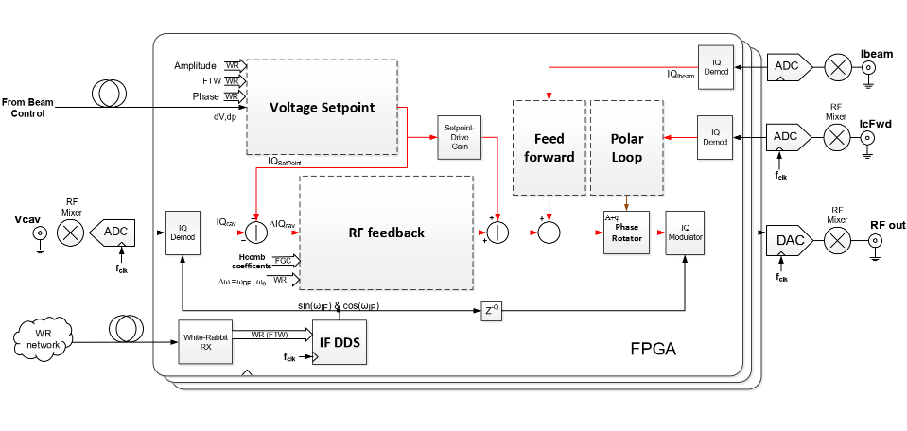
SPS 200Mhz Cavity Controller
ddede
A.Spierer, G:\Departments\AB\Groups\RF\Machines\SPS\LowLevel\TWC200

Slide 9
SPS 200Mhz Cavity Controller
Streamline components not needed on PS

Slide 10
SPS 200MHz Cavity Controller
RF feedback block can be reused
  One turn feedback can be off
  Voltage set point kept active
NCO for SPS is too complex for PS
  Build another NCO with phase mod
SPS NCO for SPS operation
  Ensures synchronicity with white rabbit (WR)
  No need for FSK on PS cavities

Slide 11
PS 200MHz Cavity Controller
Use SPS memory map for SPS operation
  Board can be seen as extra cavities
New mapping of registers for PS operation

Slide 12
Inputs/Memory Map
FTW (PS) decoded on dedicated chip
  No need to bring FTW clock to FPGA
LO provided by external generator
Common registers/Inputs?
Need for other analog signals?
Analog/digital outputs?

Slide 13
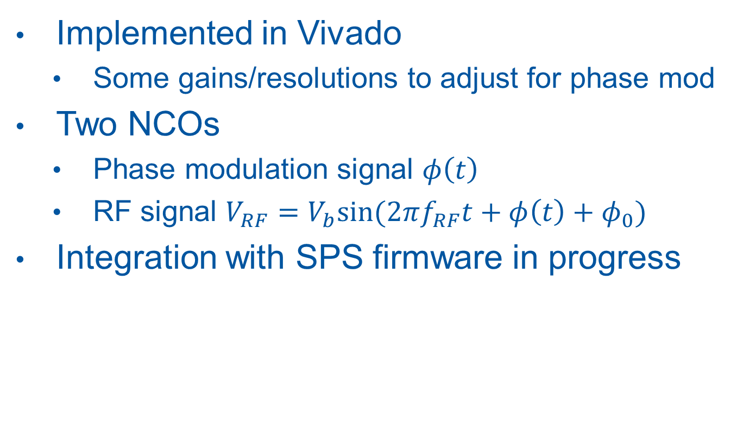
PS NCO
Implemented in Vivado
  Some gains/resolutions to adjust for phase mod
Two NCOs
  Phase modulation signal $φ\left(t\right)$
  RF signal $V_{RF}=V_{b}sin⁡(2πf_{RF}t+φ\left(t\right)+φ_{0})$
Integration with SPS firmware in progress

Slide 14

PS NCO
Arithmetic block
  Calculates h and $f_{if}$ accordingly to the inputs
DDS provided by Xilinx
  Same settings used in SPS $→$ reusability

