Slide 1
20/40/80MHz Cavity Controller
Ben Woolley
Nathan Pittet

Slide 2
Repeat Florian’s results in the lab
In order to learn the behaviour of the system and perform sanity checks.
Using PyChebDHWA to parse the memmap and read/write to the registers via VME.
Perform simple open loop measurement with the VNA.
Then add a test cavity (40 MHz LC resonator), calibrate for the cavity transfer function, adjust e-delays to move phase of feedback to 180 degrees and switch on the FB for all 11 harmonics.

Slide 3
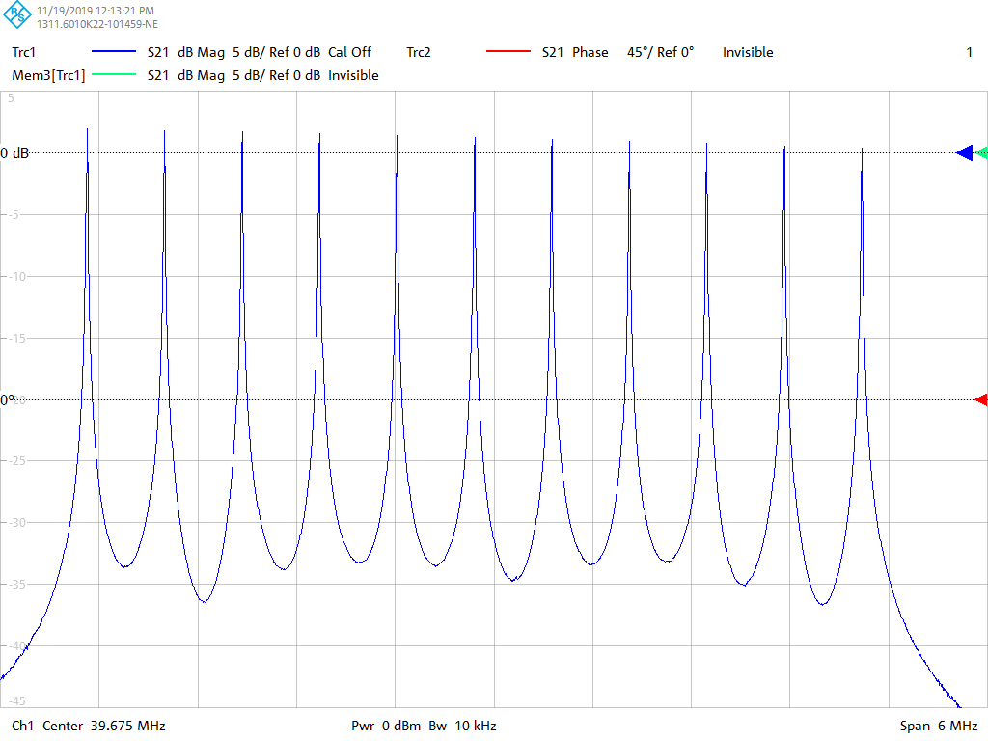
Repeat Florian’s Results: Open Loop
Open loop test, simply switch on all 11 feedbacks at maximum gain and let the VNA drive the ADC and sample the DAC.

Slide 4
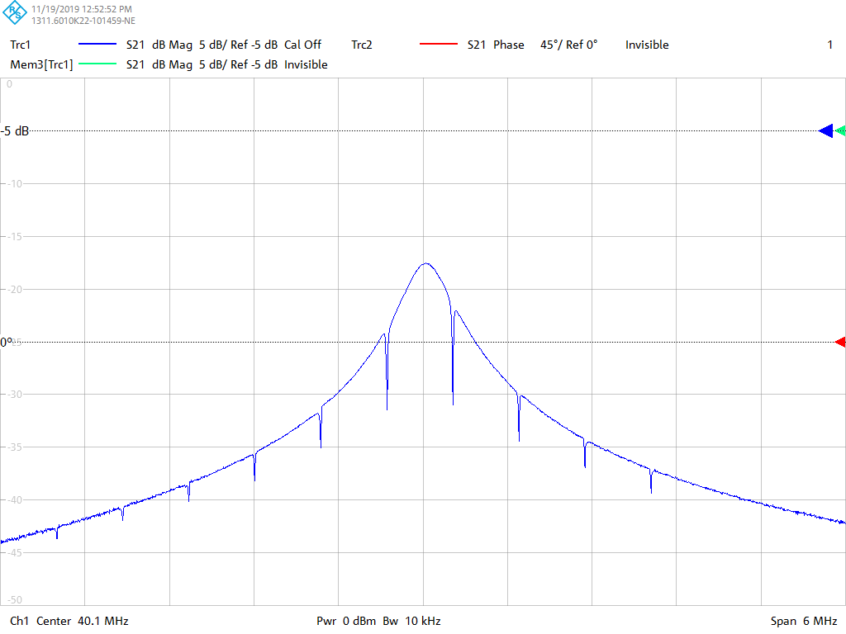
Repeat Florian’s Results: Closed Loop (Small LC Cavity)
Need to give the board a sweeping clock and enable calibration mode.
  A calibration table of phase against frequency is written.
Then lock the clock to a single frequency, then switch on each FB harmonic one at a time and adjust the e-delay until the feedback notch has maximum gain. (Ideally this would be automated…)
Once all are adjusted then turn all FB harmonics on.

Slide 5
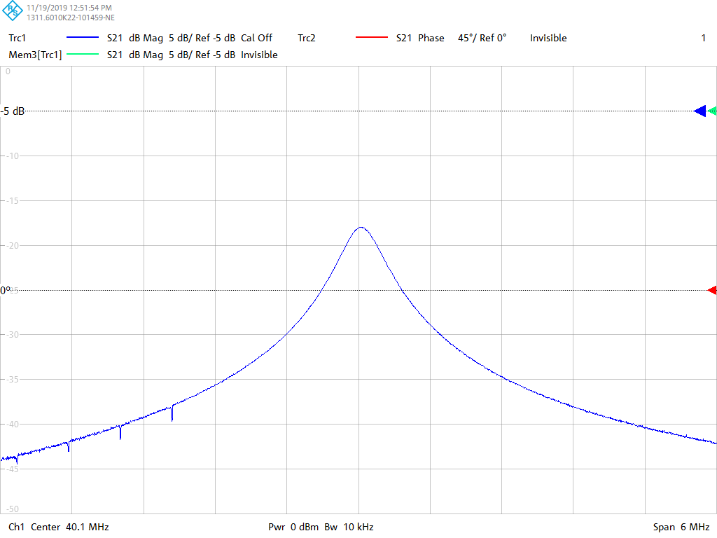
Swept Clock

Slide 6
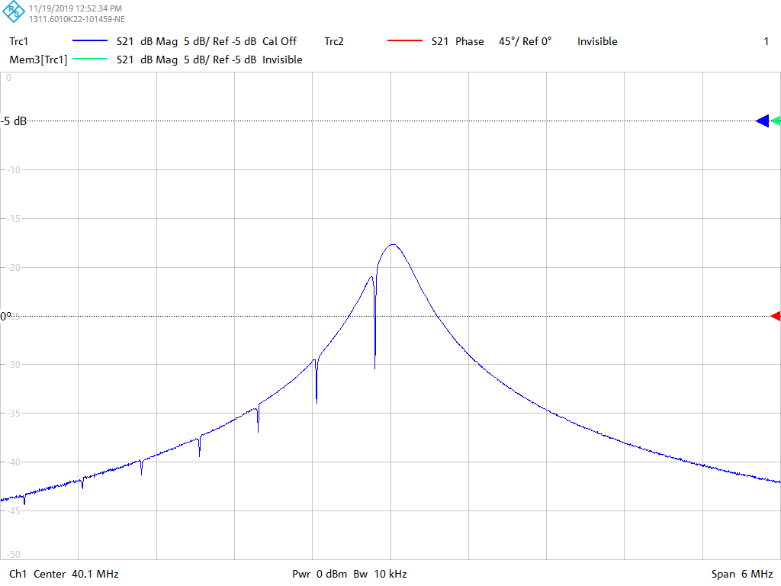
Swept Clock

Slide 7
Swept Clock

Slide 8
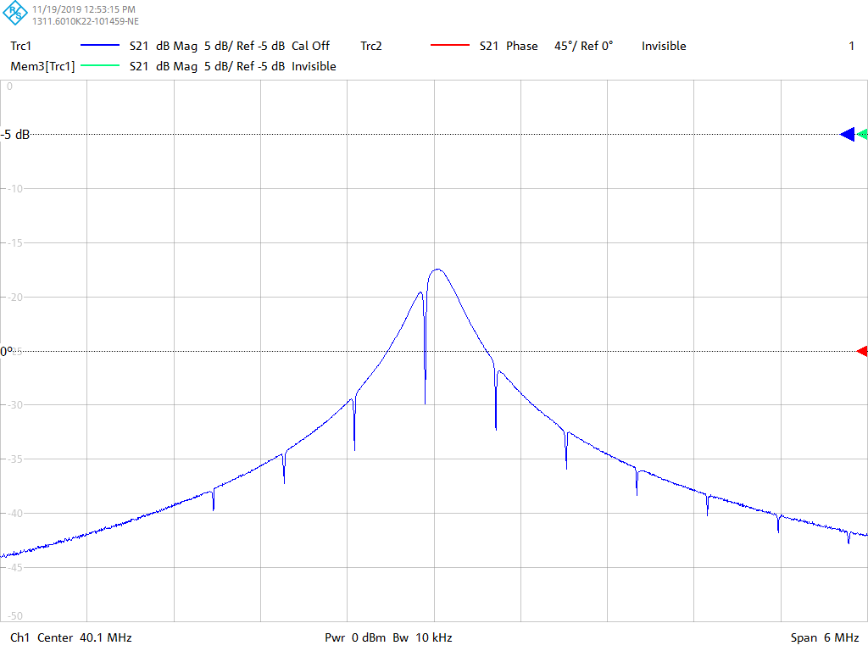
Swept Clock

Slide 9
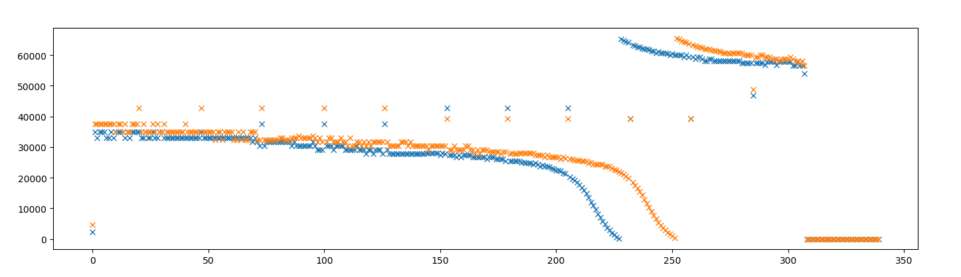
Calibration Table Glitches/errors

Slide 10
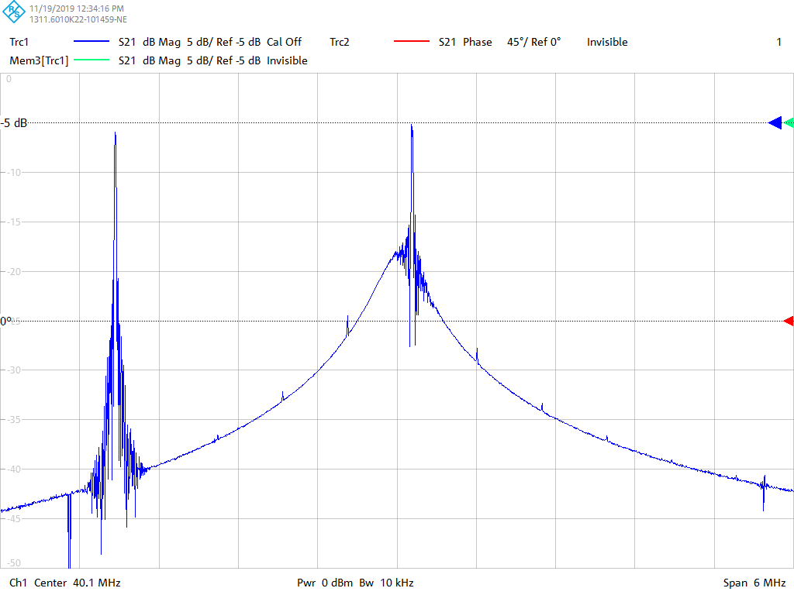
Overflow Glitches!?! When delays are wrong

Slide 11
Overflow Glitches!?!

Slide 12
Overflow Glitches!?!

Slide 13
Overflow Glitches!?!

Slide 14
HFCC Open Loop

Slide 15
HFCC Closed Loop (Small LC cavity)

Slide 16
Calibration Glitches MHFB + HFCC

