Slide 1





Machine Learning for Top-Quark Pair Kinematic Reconstruction
Darren Chan & Maggie Wang
Professor Pekka Sinervo (Supervisor)
August 11th, 2021

Slide 2
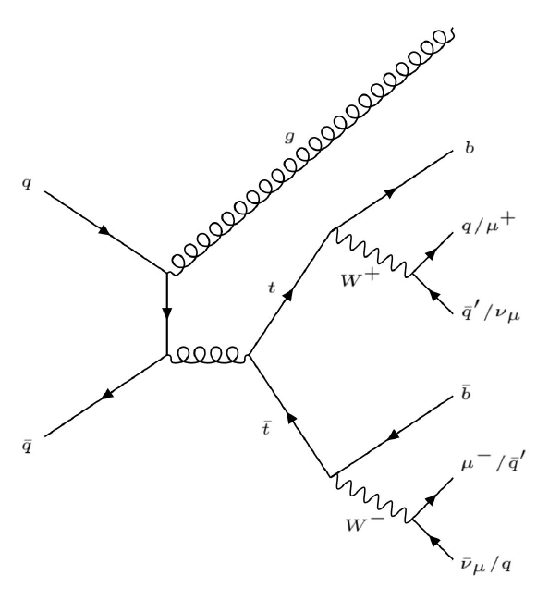

Background and Goals for ML Reconstruction
Studying production in 13 TeV pp collisions (hadronic and semileptonic)
AngryTops package: BLSTM neural network that predicts decay pair kinematics
Our goal: improve AngryTops and compare to existing statistical algorithms
Fine-tune training parameters and improve quality of input events
K. Mahtani, University of Toronto Department of Physics, (2021).

Slide 3
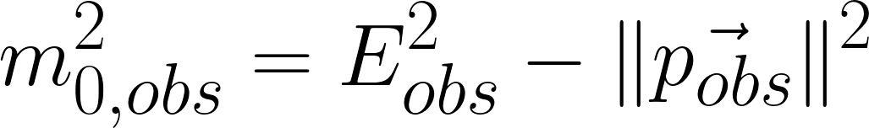
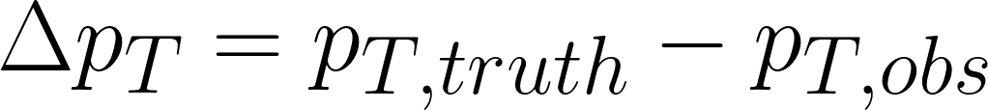
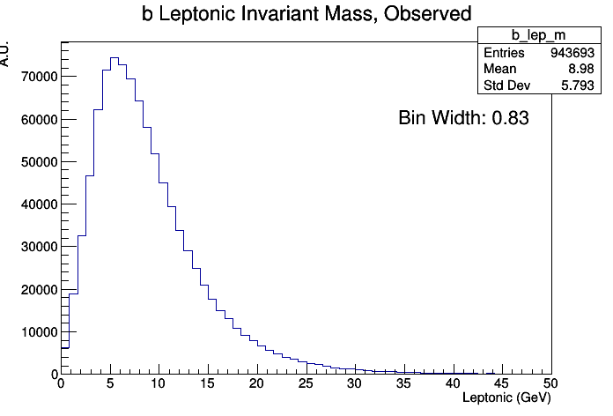
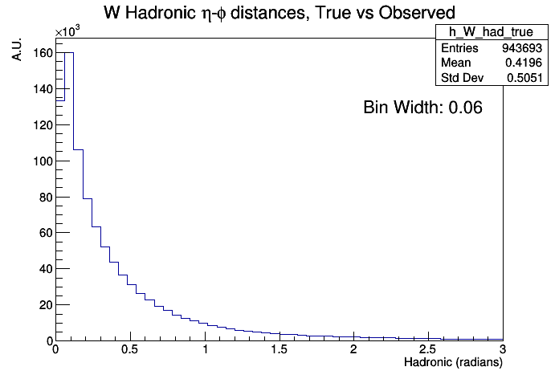
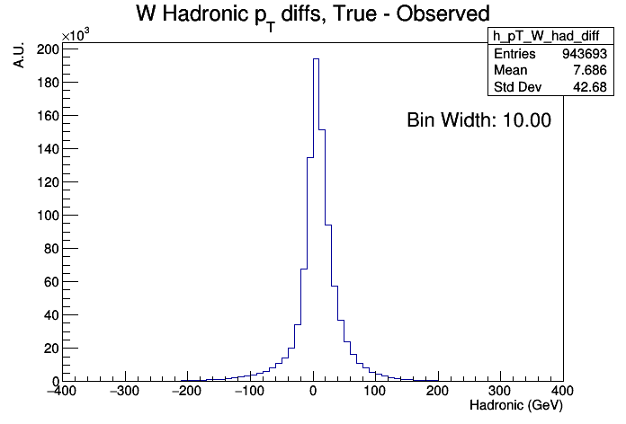
Jet and Parton Matching
Initial sample contains ~9.5 million events reconstructed by detector
High-quality events have observed muon + jets closely matched to MC-generated truth partons
Search for jet combo with lowest η-φ distance -> best match to truth partons
Variables for cuts: Invariant mass, η-φ distance, and p_{T} difference

Slide 4
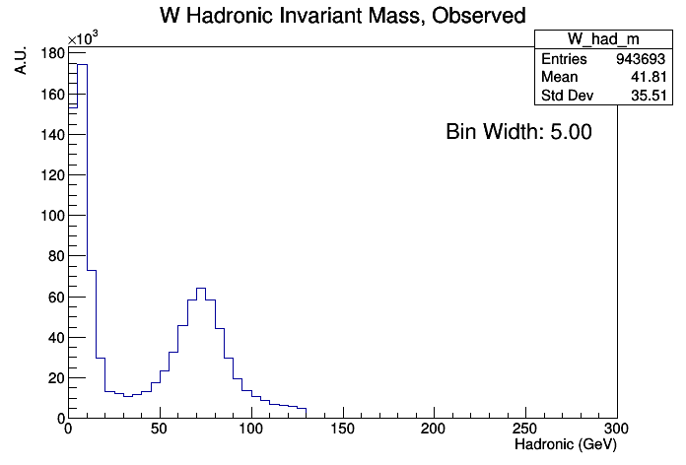
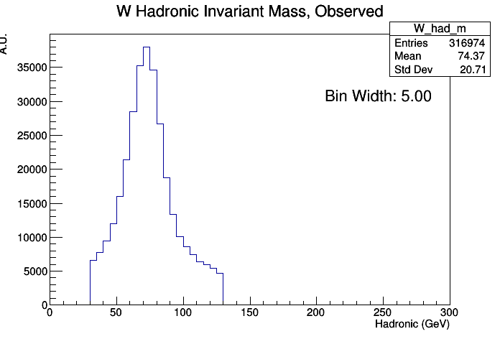
Hadronic W Matching
Ignore b-tagged jets
Look for best 2 jet match using mass, distance, and p_{T} criteria
  Then 3 jets, and 1 jet
Most of the best-matched W daughters were 2-jet Ws so 57% of events pass matching criteria
➡

Slide 5
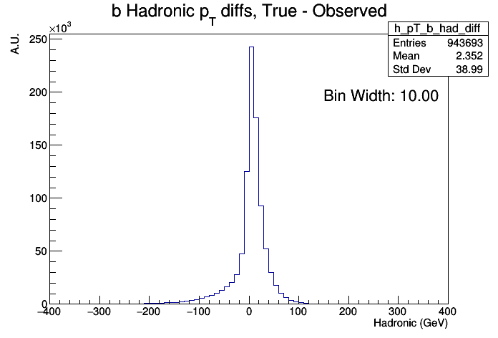
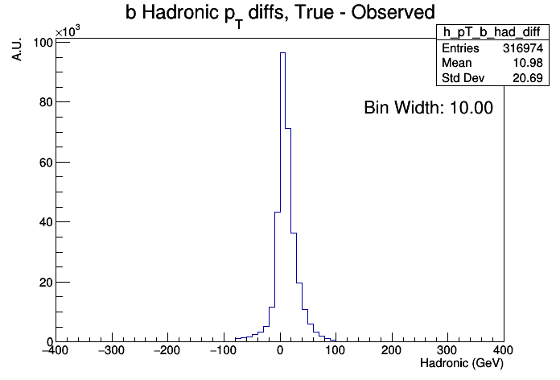
Leptonic W and Bottom Quark Matching
Sum muon p_{T} and missing E_{T} to get observed leptonic W p_{T}
  not a combinatorial problem, 93% of events pass cuts
b quarks matched to closest single jet; cuts only on distance and p_{T} criteria
➡

Slide 6
Summary of All Cuts ✂️
Retain events that satisfy mass, p_{T}, or η-φ distance criteria
34% events remaining after all cuts (3.1 million)
 | Had W | Lep W | Had b | Lep b
Mass | (30, 130)
pT | (-100, 100) | (-100, 120) | (-80, 100) | (-80, 100)
η-φ Distance | (0, 0.8) | (0, 1) | (0, 0.8) | (0, 0.8)
Events Remaining for each parton | 57.3% | 92.5% | 82.1% | 82.6%

Slide 7
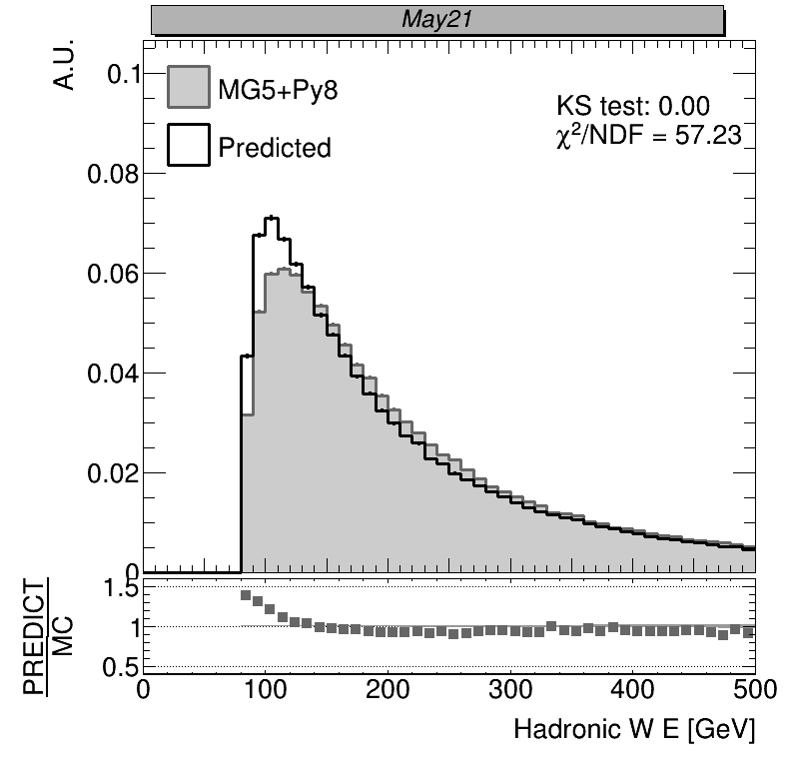
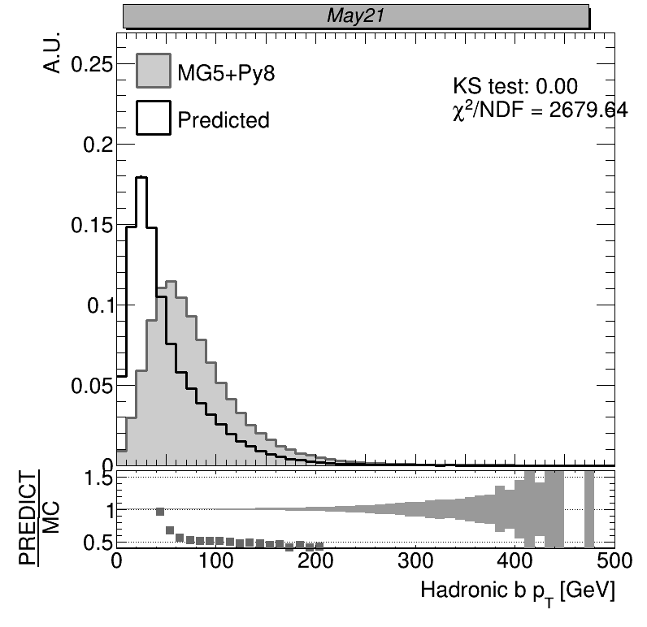
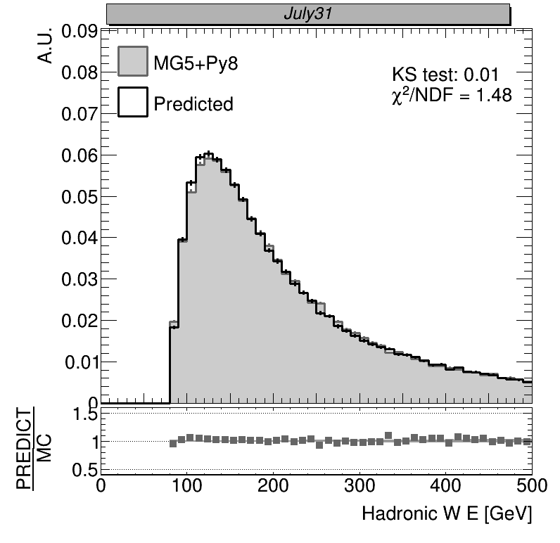
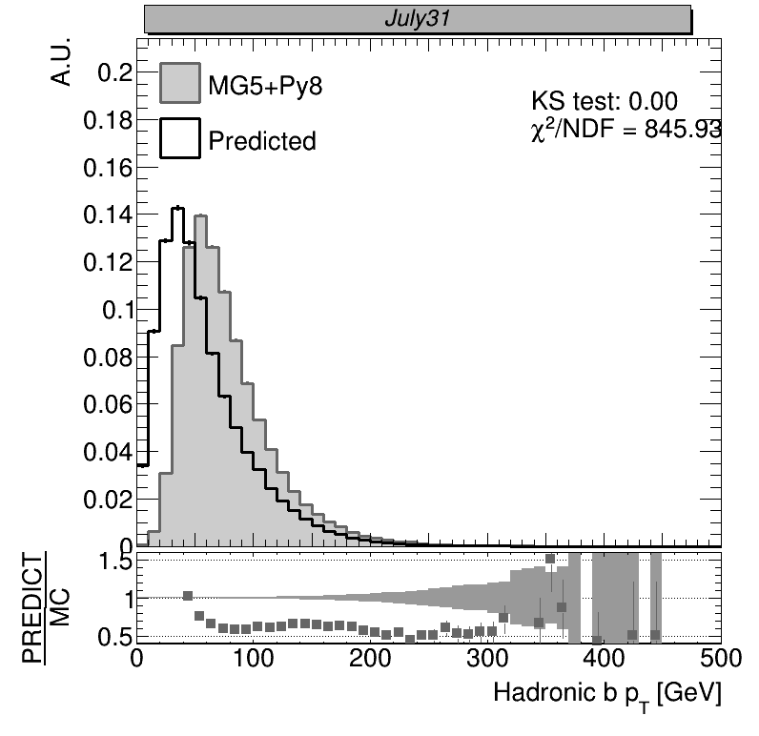
Training Results
Had W correlation coefficients increase the most!
Training on full dataset
 | Original | Increase
Had b p_{T} | 0.59 | +0.09
Lep b p_{T} | 0.75 | +0.05
Had t p_{T} | 0.76 | +0.09
Lep t p_{T} | 0.86 | +0.03
Had W p_{T} | 0.62 | +0.13
Lep W p_{T} | 0.90 | +0.01
Training on high-quality subset only

Slide 8


Summary and Next Steps
Successfully implemented algorithm to identify high-quality events in sample
  Network performs better when trained only on high-quality subset
Continue developing AngryTops package
  Using different network architectures
  Number of training epochs
  Augment data
For comparing truth to predicted particles, replace correlation plots with event-by-event metrics
Compare with “best-in-class” algorithms

