Slide 1


CERNopedia:
Making Knowledge Accessible
To All
CERN Summer Student Session 2021
Vaibhavi Gawas
Supervised by: Jens Vigen

Slide 2
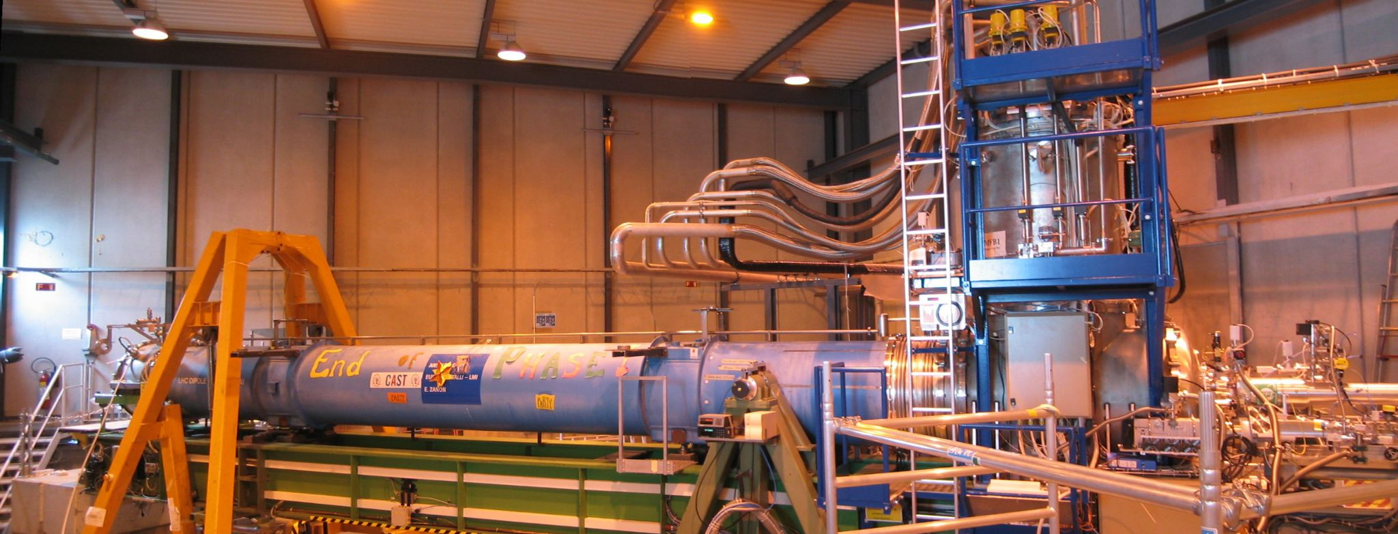
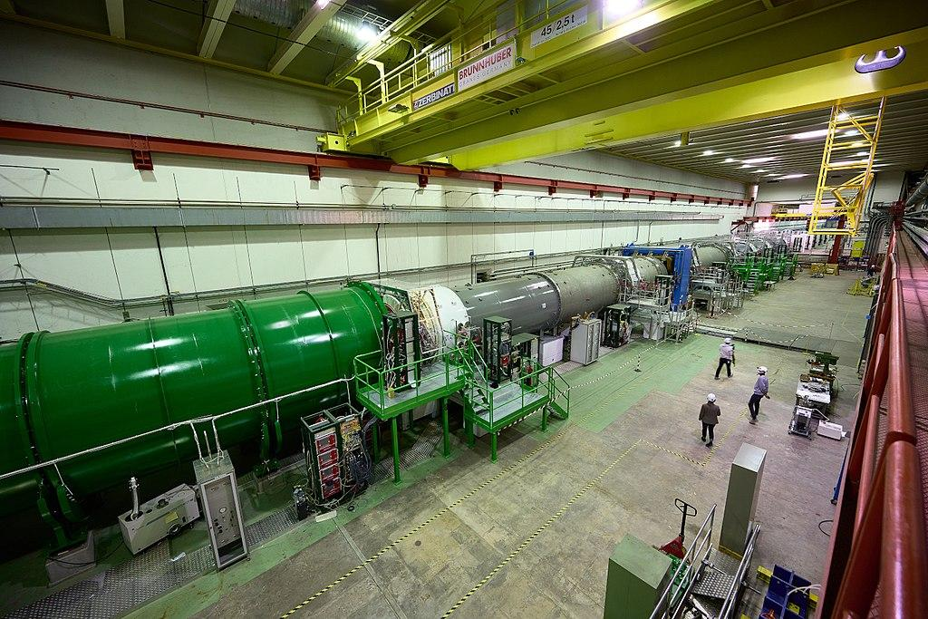
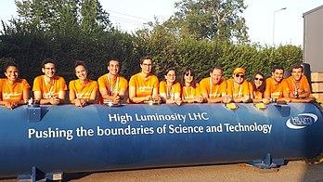
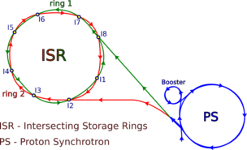
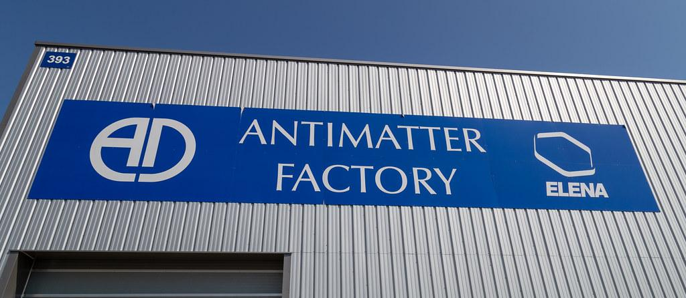
My Summer at CERN
Updating, Extending, Writing CERN and Particle Physics related Wikipedia articles!

Slide 3

Why Wikipedia?
Wikipedia
A look at CERN’s and Wikipedia’s Goals...
“Imagine a world in which every single person on the planet is given free access to the sum of all human knowledge. That's what we're doing”: Jimmy Wales
CERN
Deliver world-class scientific results, knowledge
Increase return to the MS and AM states tates
= CERN+Wikipedia+Students
Necessary to increase CERN’s visibility and the support of governments and the public
Strengthen CERN’s impact on society
Strengthen Scientific communication;
Open Access to knowledge.
Fabiola Gianotti, on behalf of CERN’s Directorate Council, 25/3/2021, CERN/SPC/1153/RA CERN/3556/RA
Notes:
Wikipedia's purpose is to benefit readers by acting as a widely accessible and free encyclopedia; a comprehensive written compendium that contains information on all b branches of knowledge

Slide 4
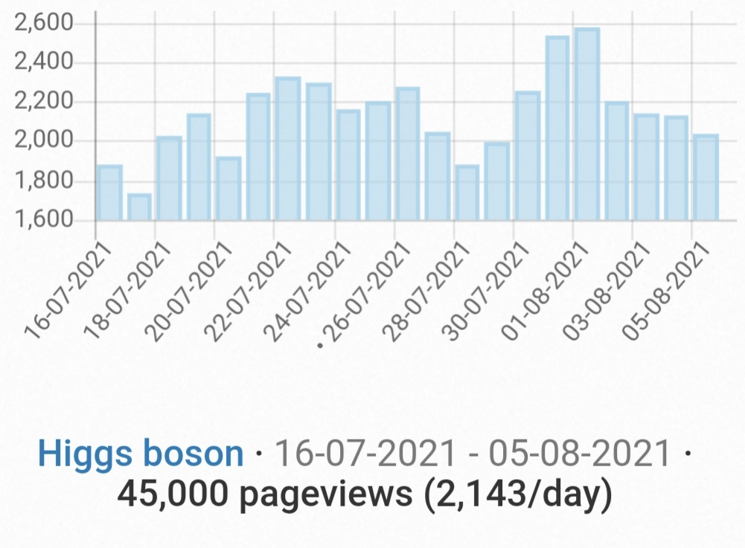
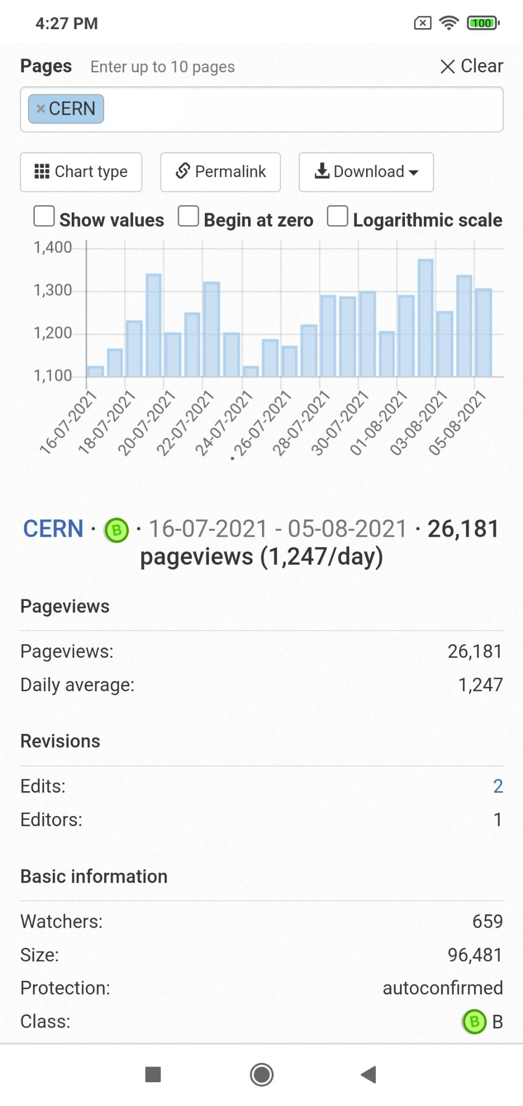
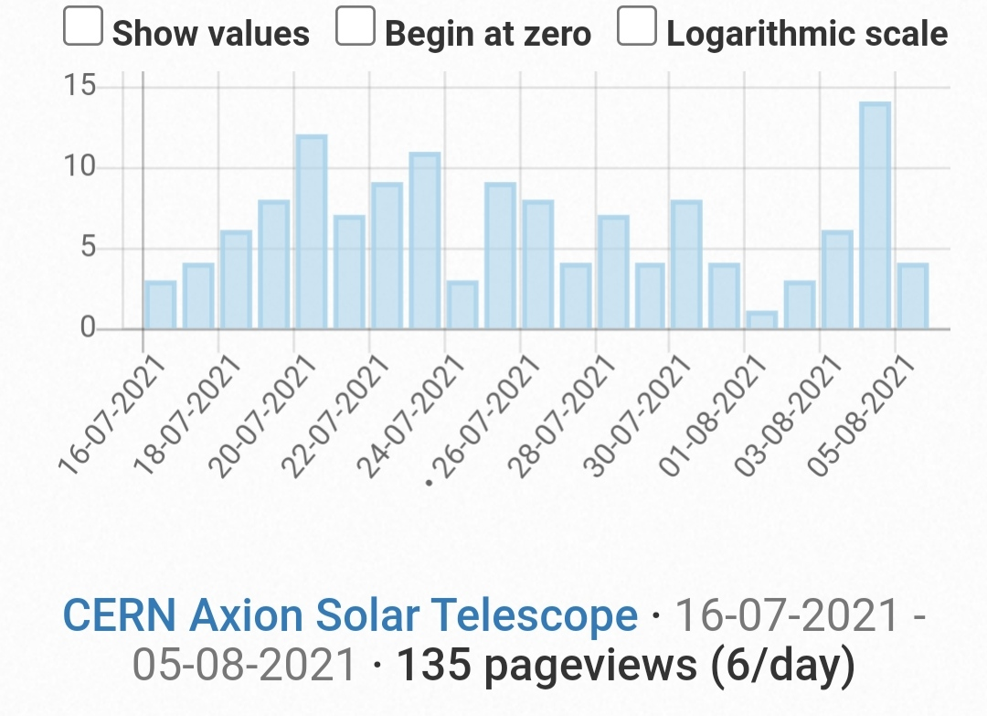

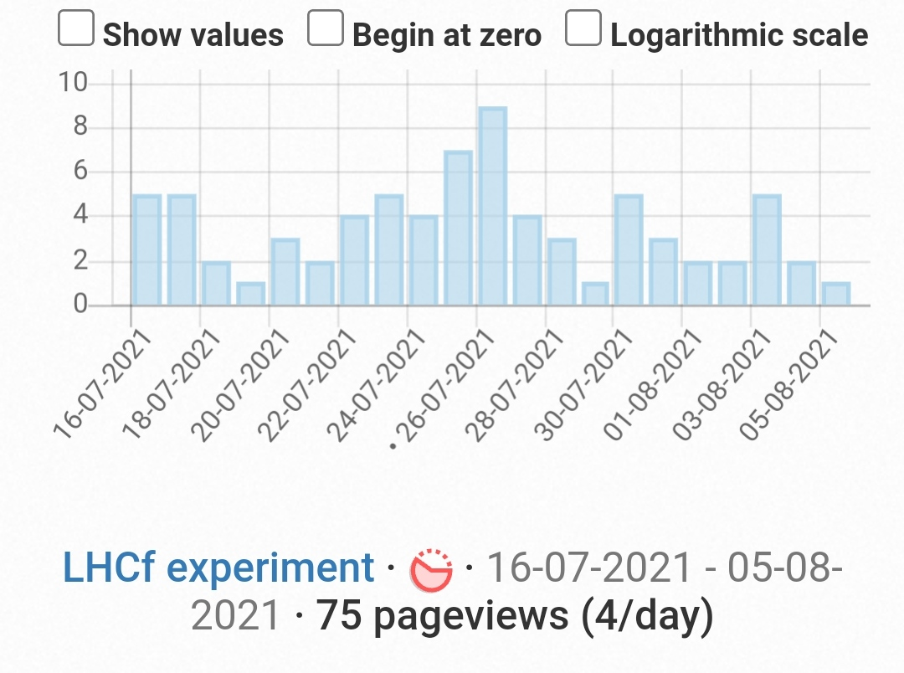
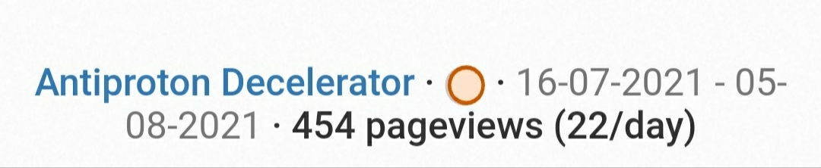
Have a look at some statistics...
Why Wikipedia?
https://pageviews.toolforge.org/

Slide 5
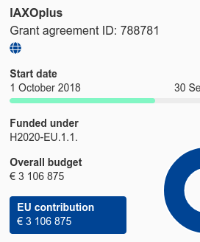


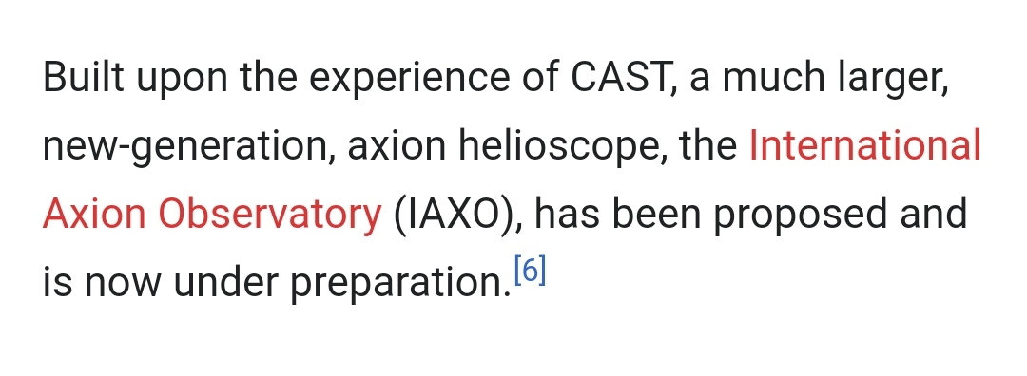
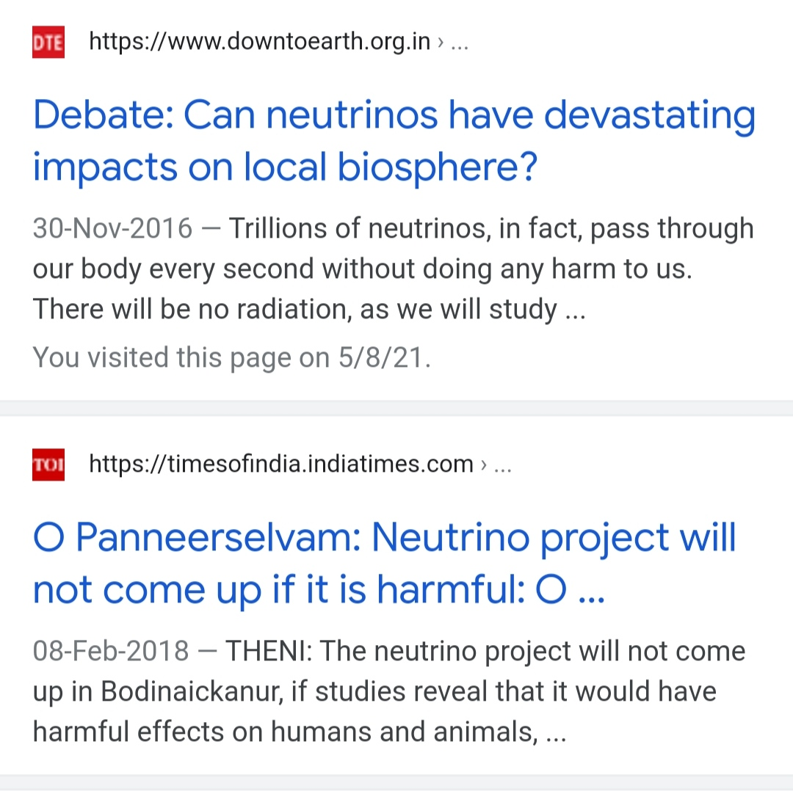
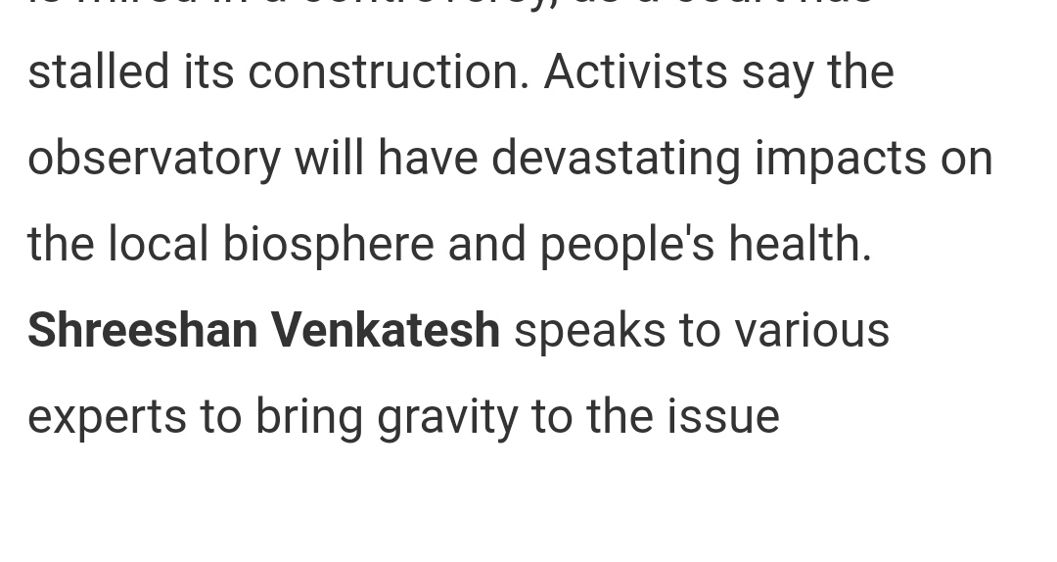
Audience of CERN Wikipedia articles...
Why Wikipedia?
Student Community
General Public
Media and Newsrooms
Government and Donors
Organisations/Activists
Students finding great Wikipedia articles for Assignment!
Wikipedia Article
People reading a great wiki article on an unfamiliar topic

Slide 6
Why Wikipedia ?
Why We Read Wikipedia
arXiv:1702.05379 2017
Hub of most simplified articles
Can be easily located on web
Large audience for CERN
Easy Editing
Beware of over 1000 administrators
Reviewed content
Inline citations and references
Or always gives heads-up otherwis
Structured and Comprehensive
Hub of most simplified articles
Can be easily located on web
Large audience for CERN
Easy Editing
Beware of over 1000 administrators
Reviewed content
Inline citations and references
Or always gives heads-up otherwise
Structured and Comprehensive
Motivation
Work/school project, Personal decision, Current event, Media, Conversation, Bored/random, Intrinsic learning
Information
Quick fact look-up, Overview, In-depth.
Prior knowledge
Familiar, Unfamiliar

Slide 7
Writing a CERN-related Wikipedia article
CERN-CDS
CERN-Courier
CERN-News
INSPIRE-NET
Symmetry-Magazine
Find a Topic
Find Verified Sources of Information
Publish, Improve, Update!
Binge-Read the Information
This can go on forever...
Why Students should contribute?
Way to learn about any topic in depth.
Contribution to science outreach.
Project-Proposals
Technical-Design-Reports
Thesis
Publications
Sci-Comm Articles
Review
Check how it fits on Mobile device
Write more, extend content
Read Even More
Remember the Wiki-Rules
A good writer is a good reader first
Create your first draft/edit on Wikipedia

Slide 8
CERN ARTICLES
CERN FACILITIES
High Luminosity LHC
Intersecting storage rings
Antiproton Decelerator
ELENA
CERN
EXPERIMENTS
Trap experiment
Cern Axion Solar telescope
AD- experiments (9)
NA64
International Axion Observatory
Scattering and Neutrino Detector
PARTICLE
AND NUCLEAR PHYSICS
Fixed-target experiments
Stable Massive particles
Flavour problem
Nuclearites
PEOPLE AT CERN
Jeffrey Scott Hangst
Stefan Ulmer

Slide 9
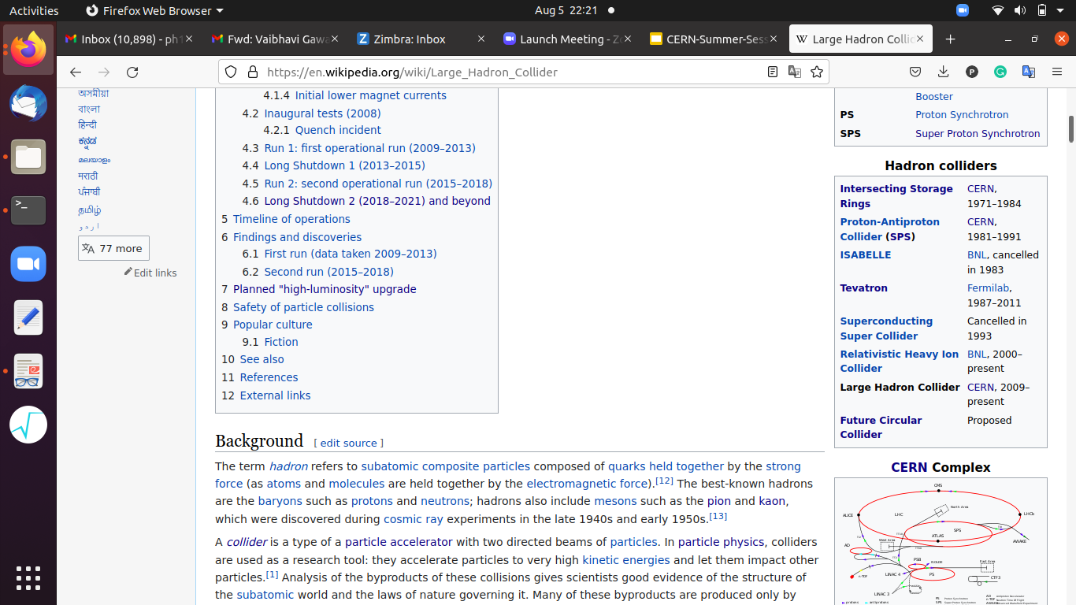
Wikipedia Beyond the Main Article Content
References
Side templates
arXiv:1702.05379, 2017
CERN/SPC/1153/RA CERN/3556/RA
https://diff.wikimedia.org/2018/03/15/why-the-world-reads-wikipedia/
https://pageviews.toolforge.org/
External links
https://cds.cern.ch/collection/Photos
https://cds.cern.ch/record/2278355/
THANK YOU EVERYONE!
Further reading
See Also
https://courses.lumenlearning.com/readinganthology/chapter/wikipedia-is-good-for-you-by-james-purdy/
https://en.wikipedia.org/wiki/Wikipedia:Why_Wikipedia_is_so_great
https://www.youtube.com/watch?v=1tMDTVtieSQ

