Slide 1


SBNOnline proposed updates
George Salukvadze
Ivane Javakhishvili Tbilisi State University / CERN
EP-NU Meeting
November 19, 2020

Slide 2
Current state
Currently SBNOnline provides monitoring for several hundreds of sensors of the SBND and Icarus
The sensors include temperature, cathode high voltage, PMT status, electrical and timing information
SBNOnline uses PostgreSQL database which contains data archived from EPICS.
It’s accessed from control room PC (physically or via VNC) after connecting to Fermilab VPN by opening a webpage https://sbn-online.fnal.gov (shortcut available on PC under /home/Desktop).
This will be changed in the future to remove VPN from the procedure and allow direct access from ICARUS Control Room PC at CERN (based on IP)

Slide 3
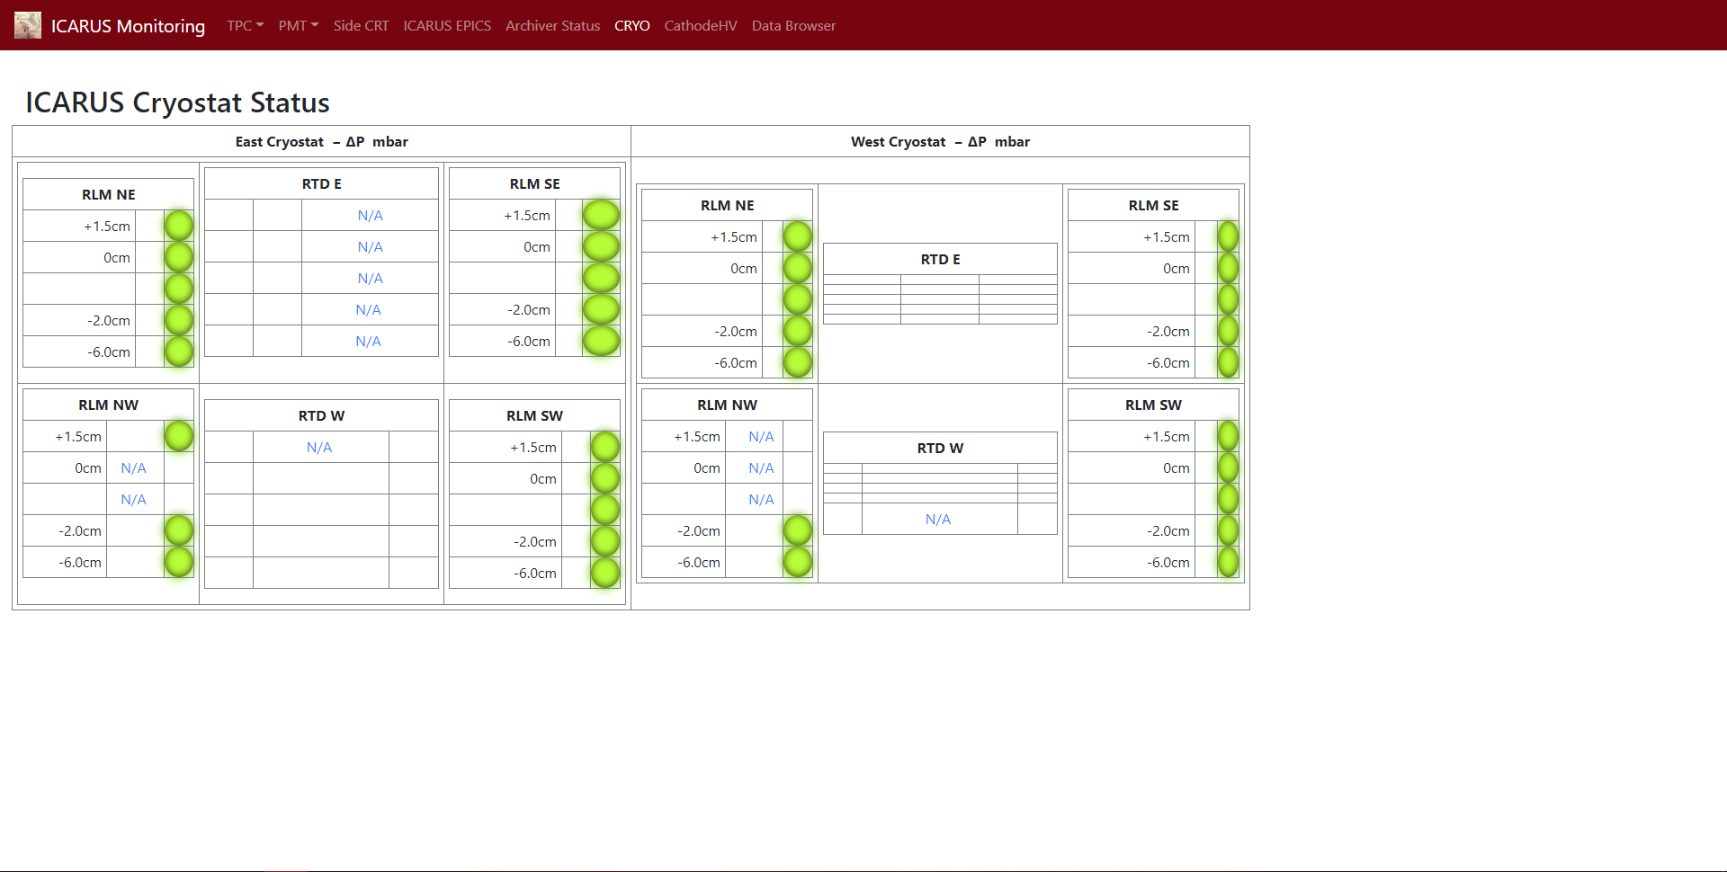
Example (Cryostat status)

Slide 4
Proposed updates
In order to simplify monitoring for the shifters, the unification of all the interfaces is proposed
For this, DCS sensors, DSS alarms data should be brought to SBNOnline
First page to appear will contain data from TPC Power Supply units and should be available next week
The SBNOnline is planned to serve as a unique monitoring and data quality analysis tool for all subsystems of detector and to be used in tandem with control tools.

Slide 5
Development plan
First steps:
  Add TPC power supply sensors pages
    ETA: November 23-29
  Fix SQL-Injection vulnerability
    ETA: November 30 – December 6
Port the code from Python 2 to Python 3
  ETA: January 11-17 (to be done in parallel to other parts)
Bring the rest of existing data from DCS to SBNOnline
  PMTs
    ETA: January 4-10
  Electrical
    ETA: January 11-17
Bring DSS Alarms to SBNOnline
  ETA: February 15 – March 15 (due to discussions necessary in order to see how to archive alarms in DB)
Bring newly added data from DCS to SBNOnline
  ETA: March 15 - … (to be done in parallel and as new sensors are added to DCS)

Slide 6
Contributors
Code:
  Gray Putnam
  George Salukvadze (since about a month ago)
General discussions:
  Geoffrey Savage
  William F Badgett Jr
  Wesley Robert Ketchum
  Angela Fava
  Bruce Howard
  Umut Kose

