Slide 1
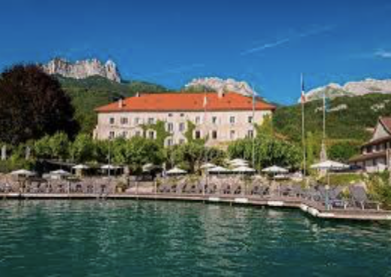
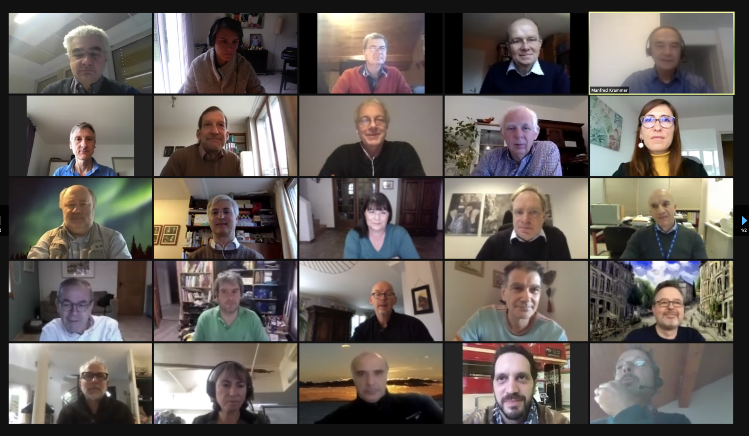
Short EP-Retreat Report
Yearly meeting of TC/TL
Normally in the Abbay de Talloires
This time nicely from home

Slide 2
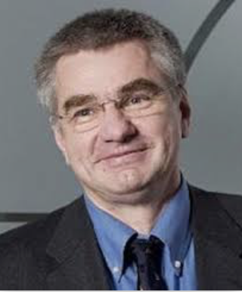
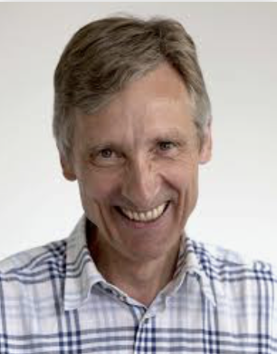
Welcome to Joachim Mnich
New CERN director of research and computing as of 1/1/2021, taking over from E. Elsen

Slide 3
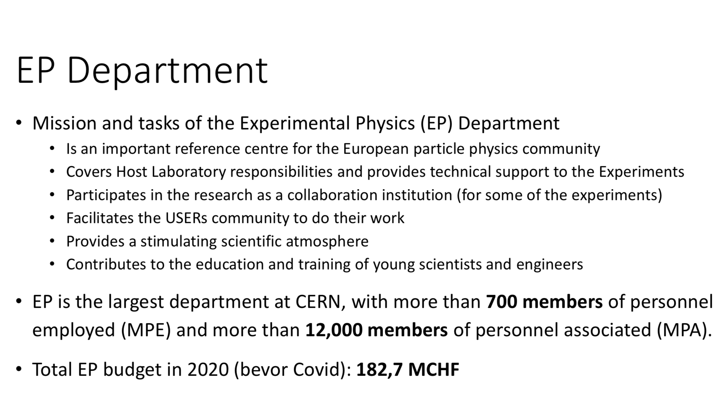
Introduction

Slide 4
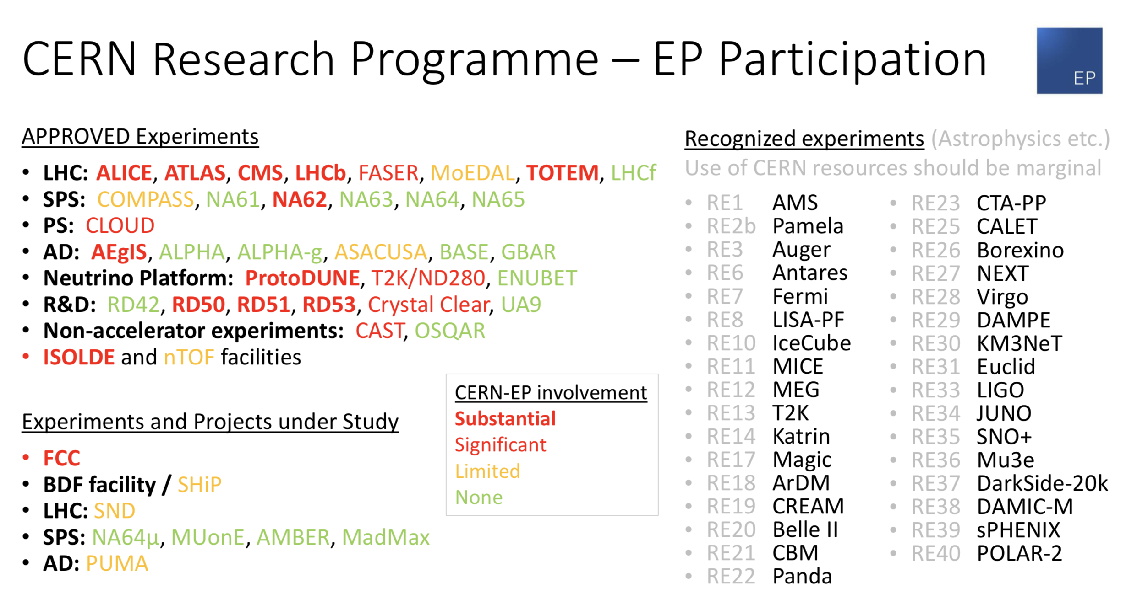
Introduction

Slide 5
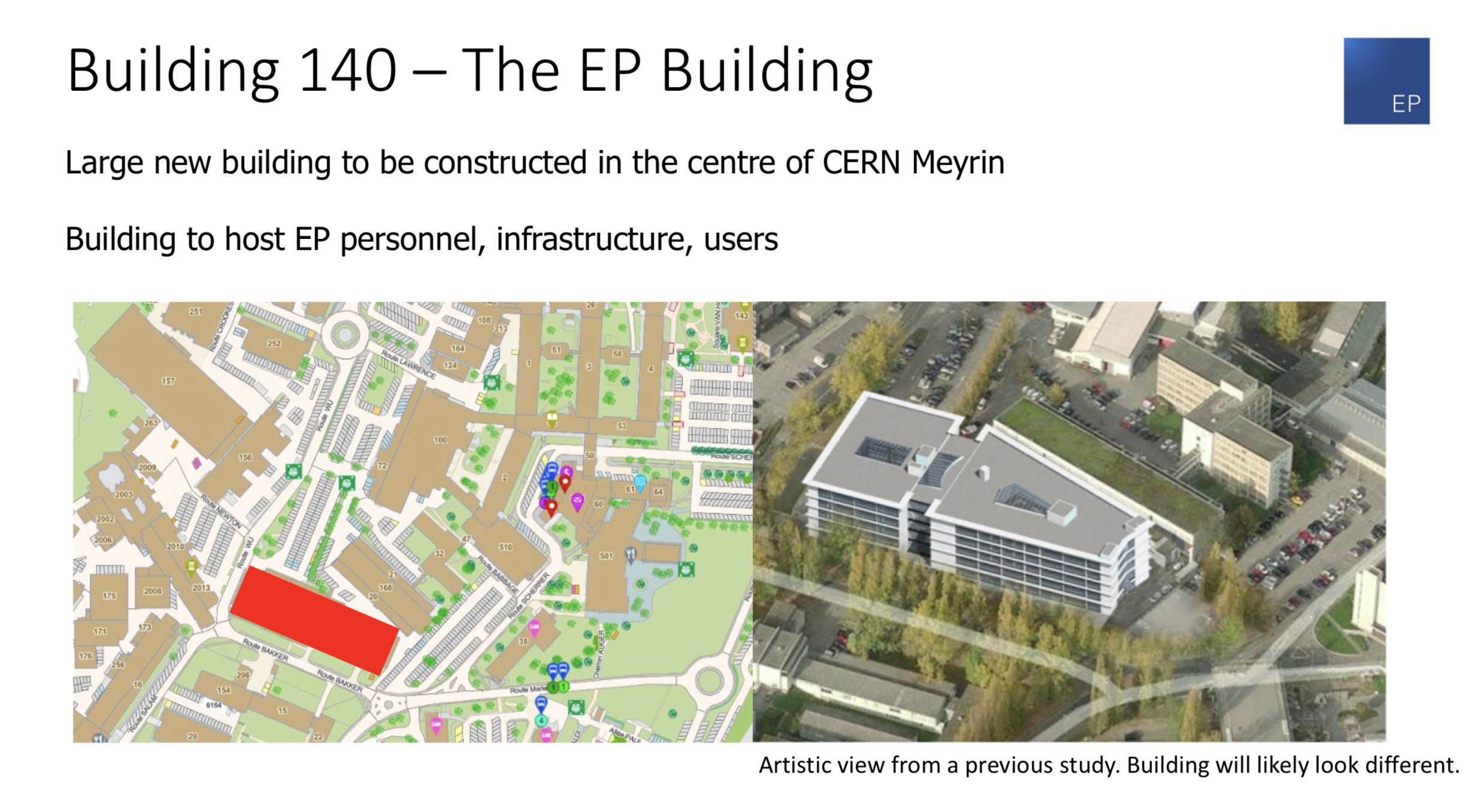
New Building for EP…

Slide 6
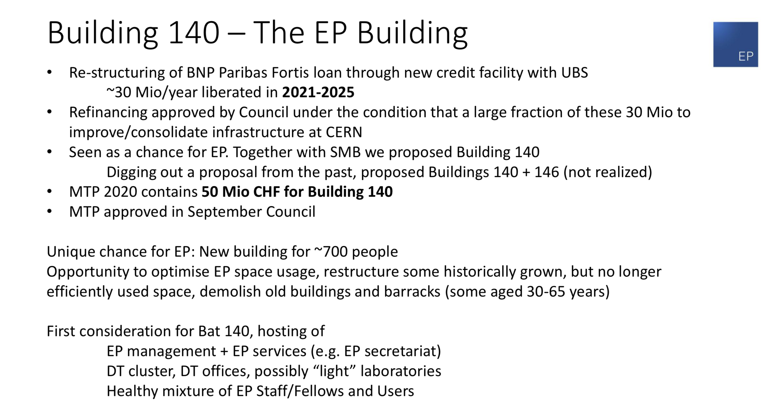
New Building for EP
Building ready in/after 2025.. ?

Slide 7
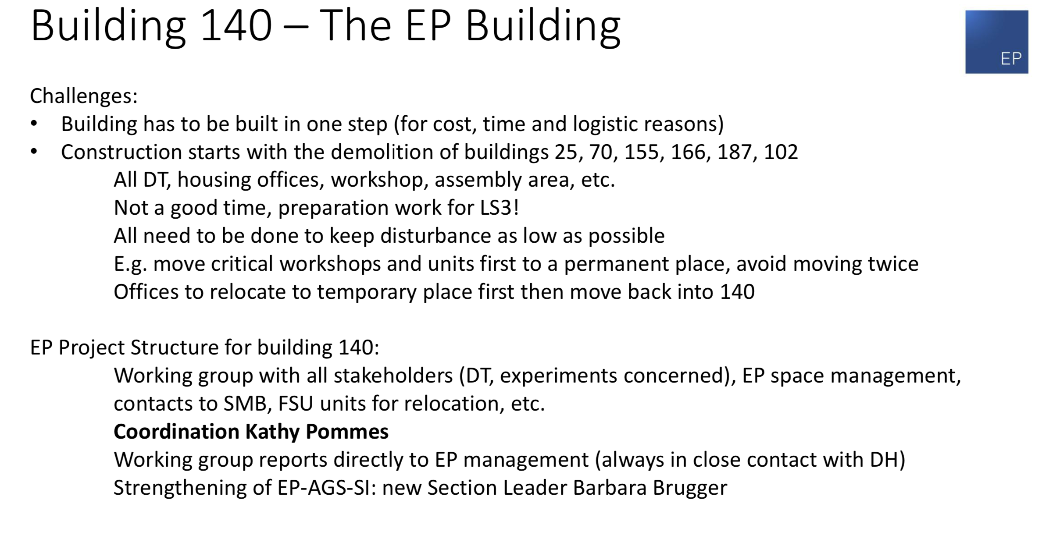
New Building for EP
Building ready in/after 2025.. ?

Slide 8
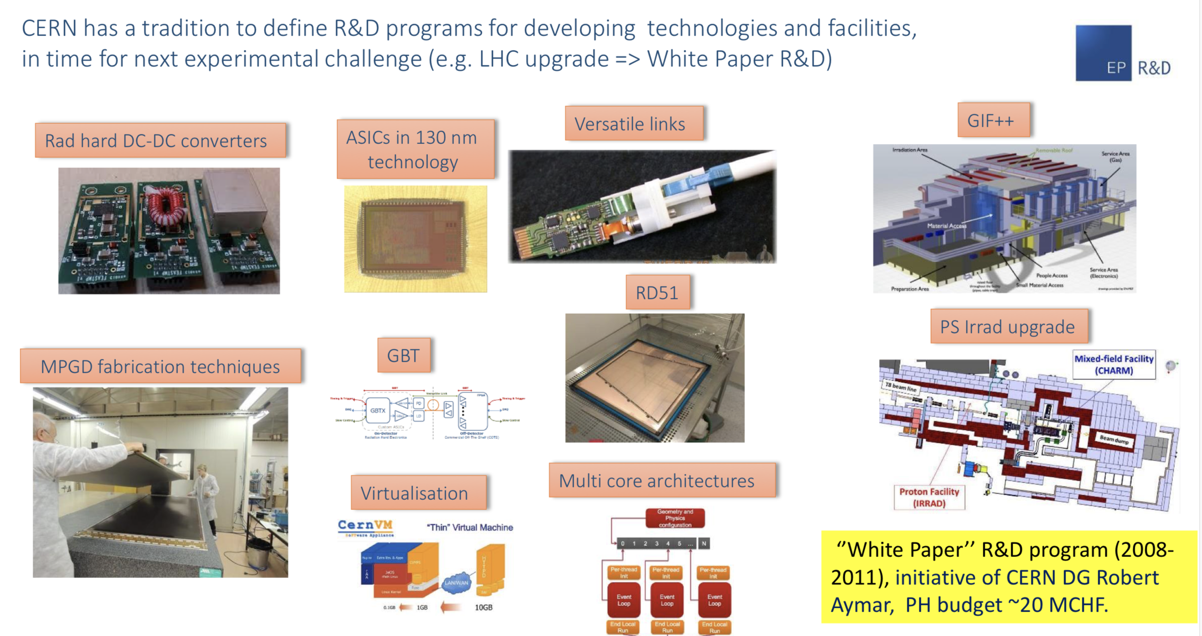
Detector R&D @CERN

Slide 9
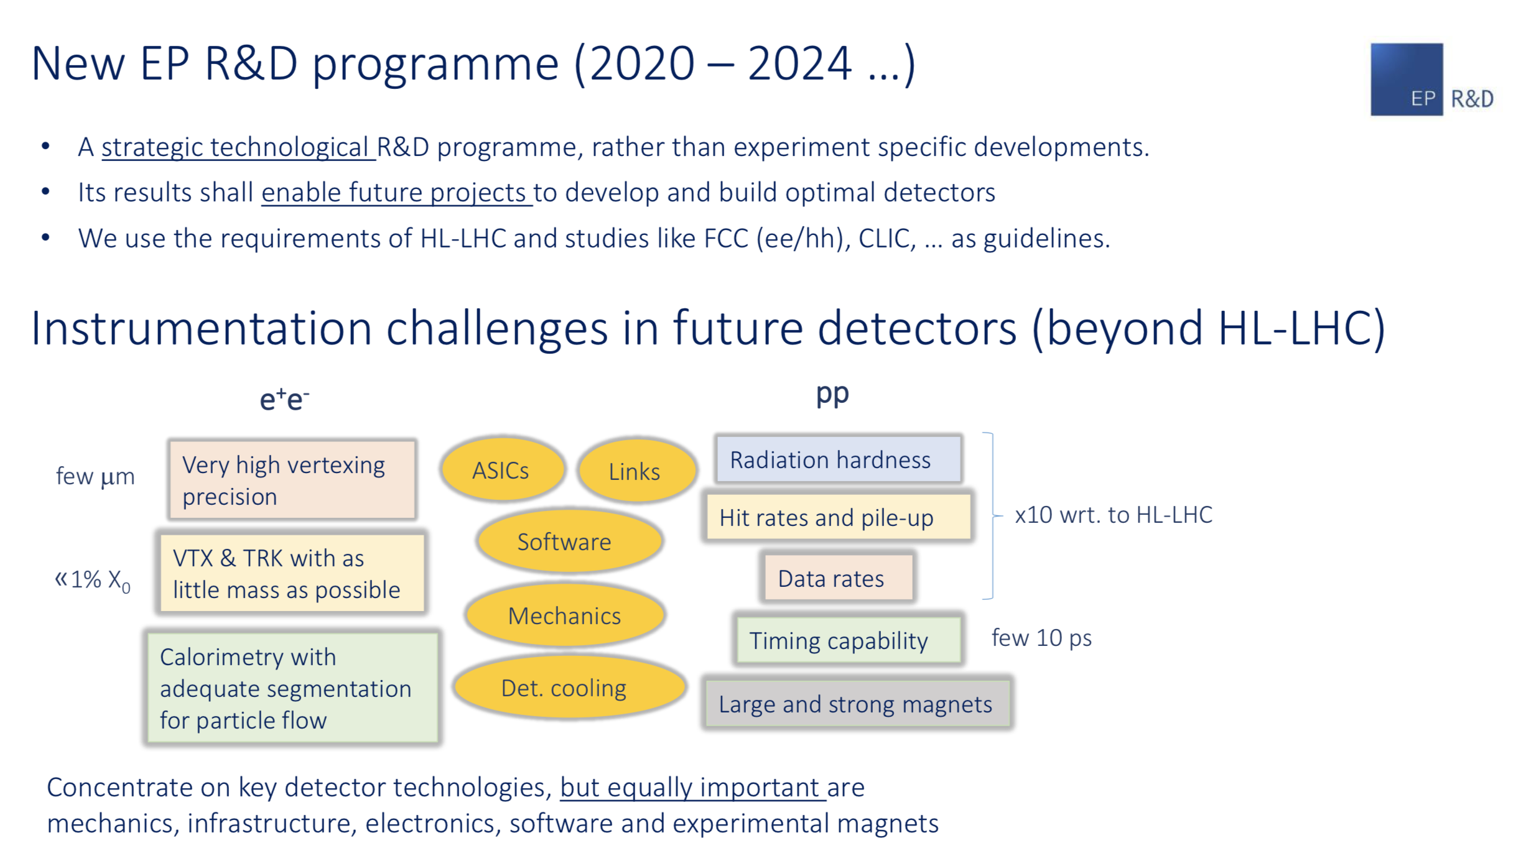
Detector R&D

Slide 10
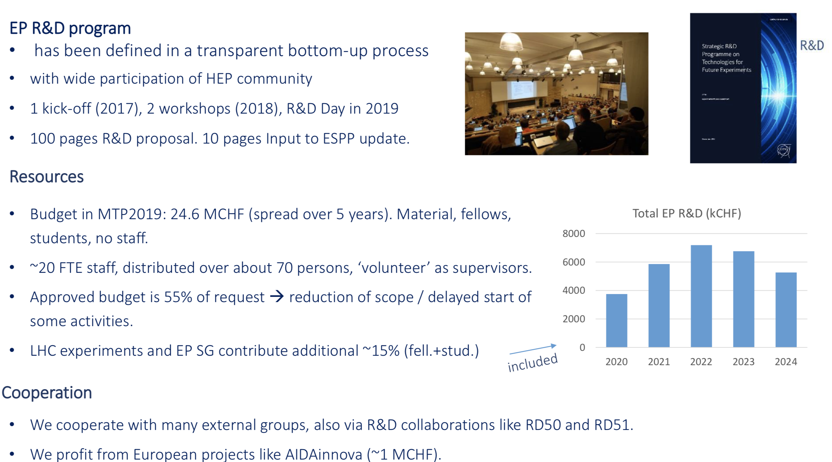
Detector R&D

Slide 11
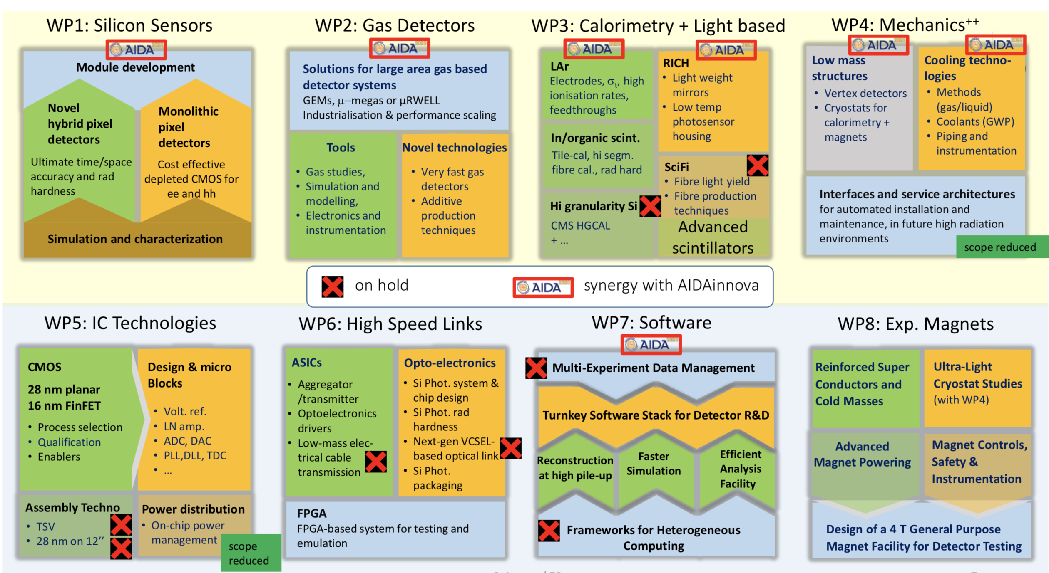
Detector R&D

Slide 12
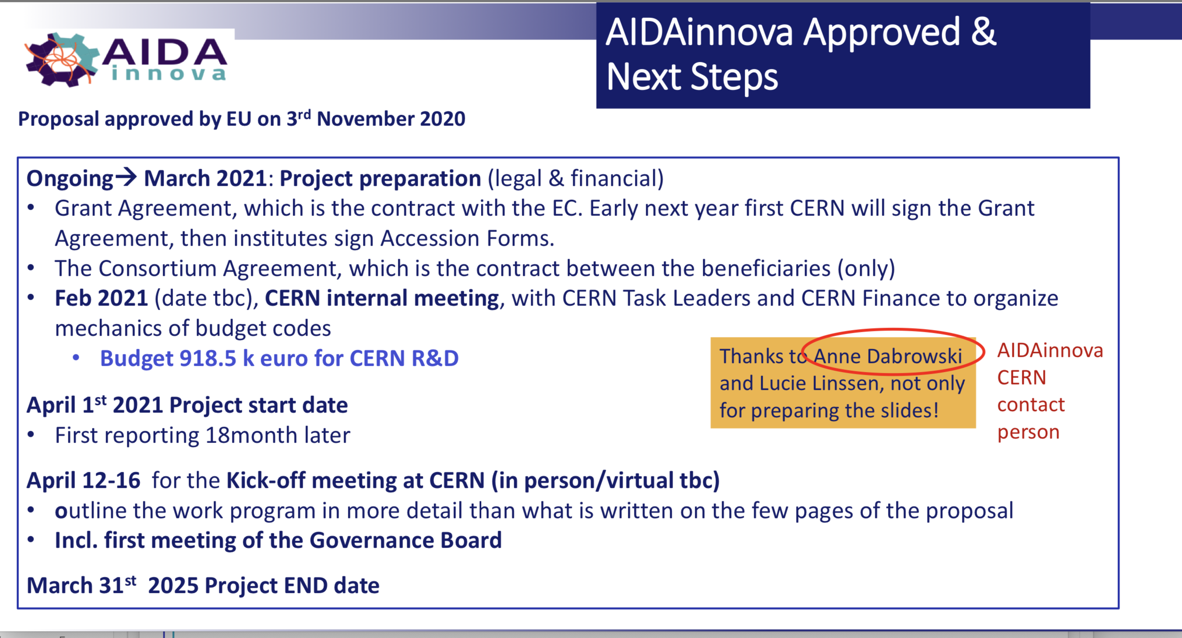
Detector R&D

Slide 13
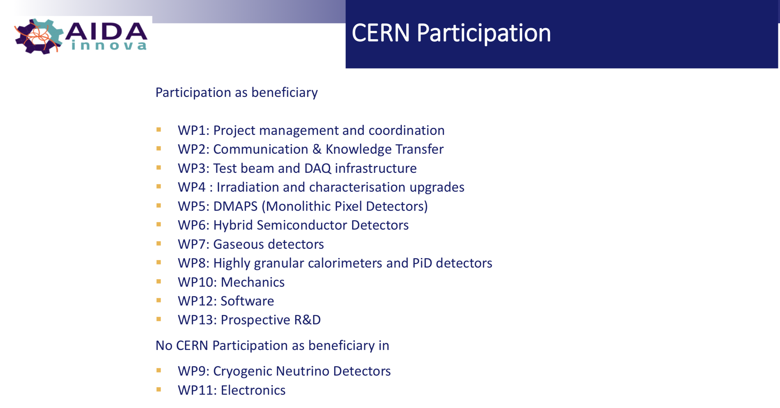
Detector R&D

Slide 14
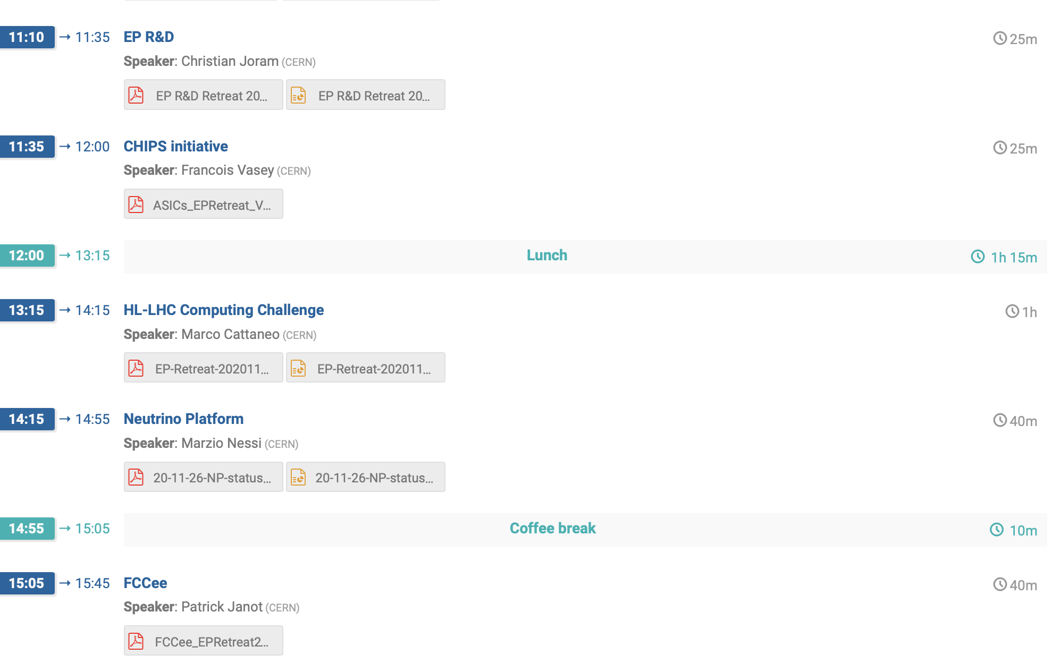
Program
ASICs @ CERN
Hard problem!
Nice overview
A new EP group?

