Slide 1
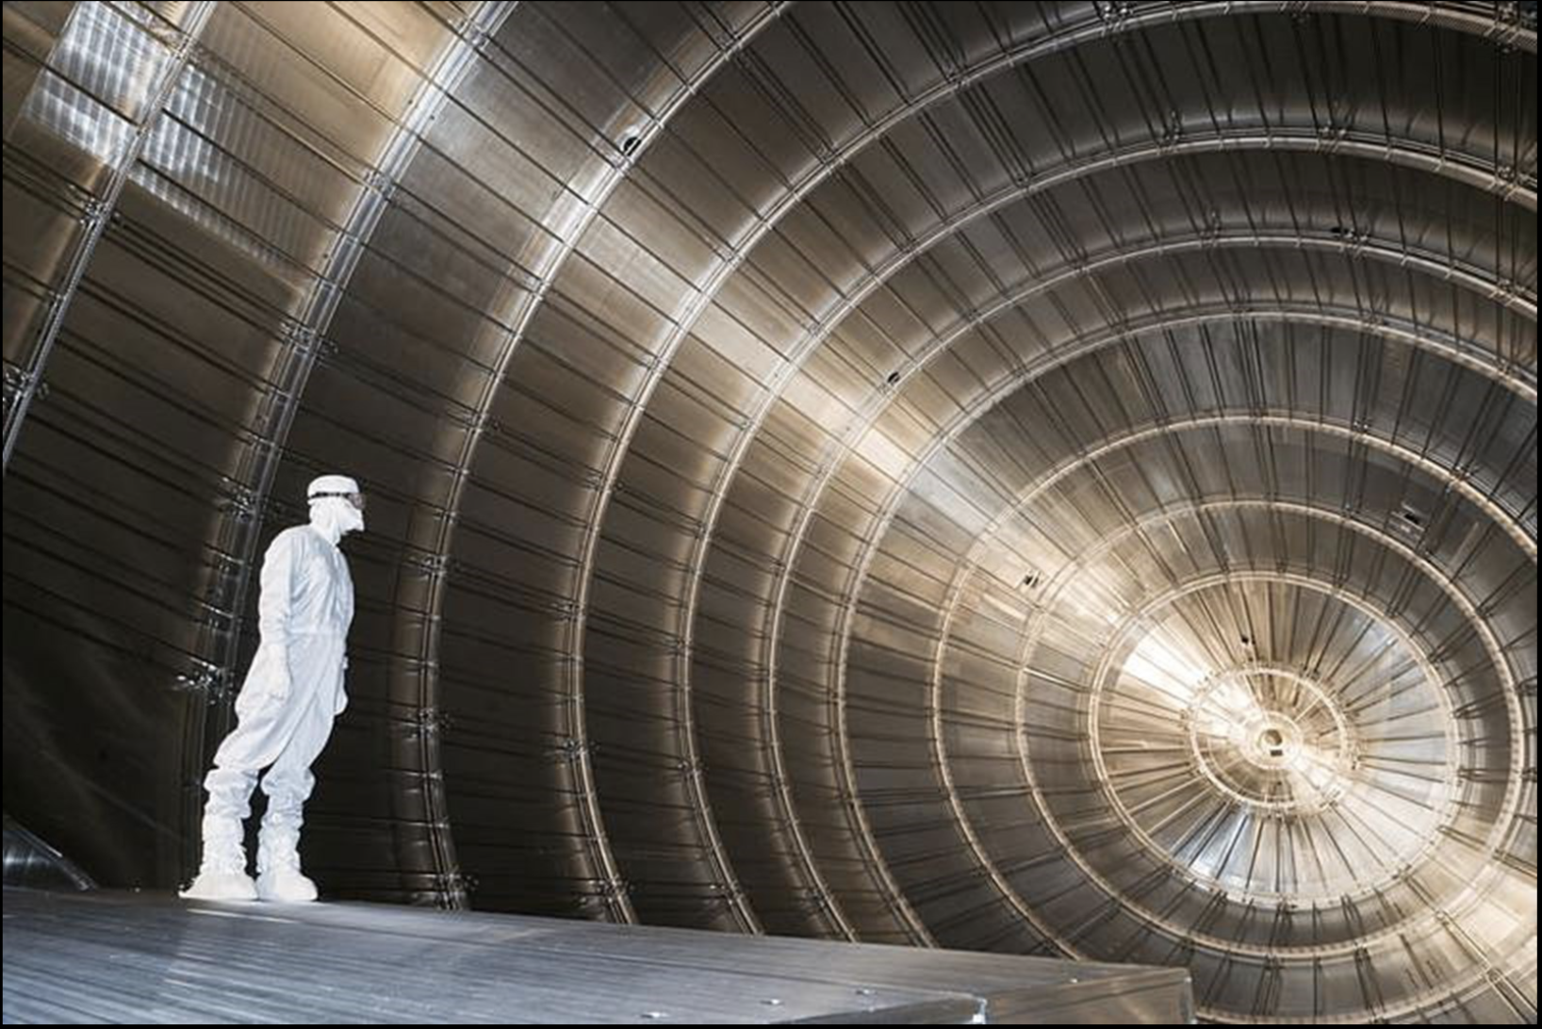
Neutrinos!
Present Understanding & Future Prospects
Albert De Roeck
CERN, Geneva, Switzerland
26 July 2021 Maria Laach/Bad Honnef

Slide 2

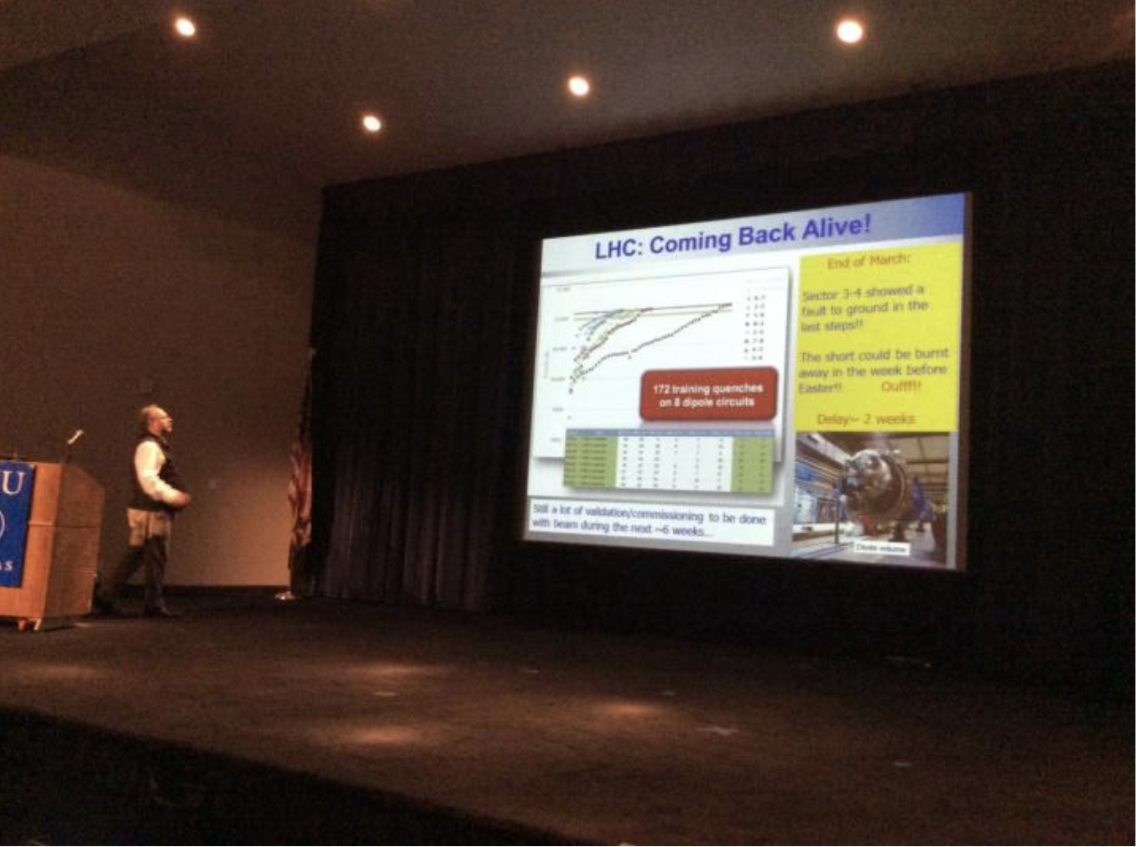
Lecture(r) Today
Prof. Albert De Roeck
• CERN, Geneva Switzerland
• University of Antwerp, Belgium
• NTU, Singapore
• Adjunct Prof. at UCDavis
Live from CERN, Geneva
(travel restrictions)
Some slides taken from CERN ATC
(S. Soeldner-Rembold)

Slide 3
3 Lectures
Lecture 1:
  Introduction to neutrinos
  History of neutrino physics and open questions.
Lecture 2:
  Neutrino oscillation physics
  Neutrino properties
Lecture 3:
  Cosmological neutrinos
  Searches for the 4th generation
  Next generation of neutrino experiments & LHC

Slide 4
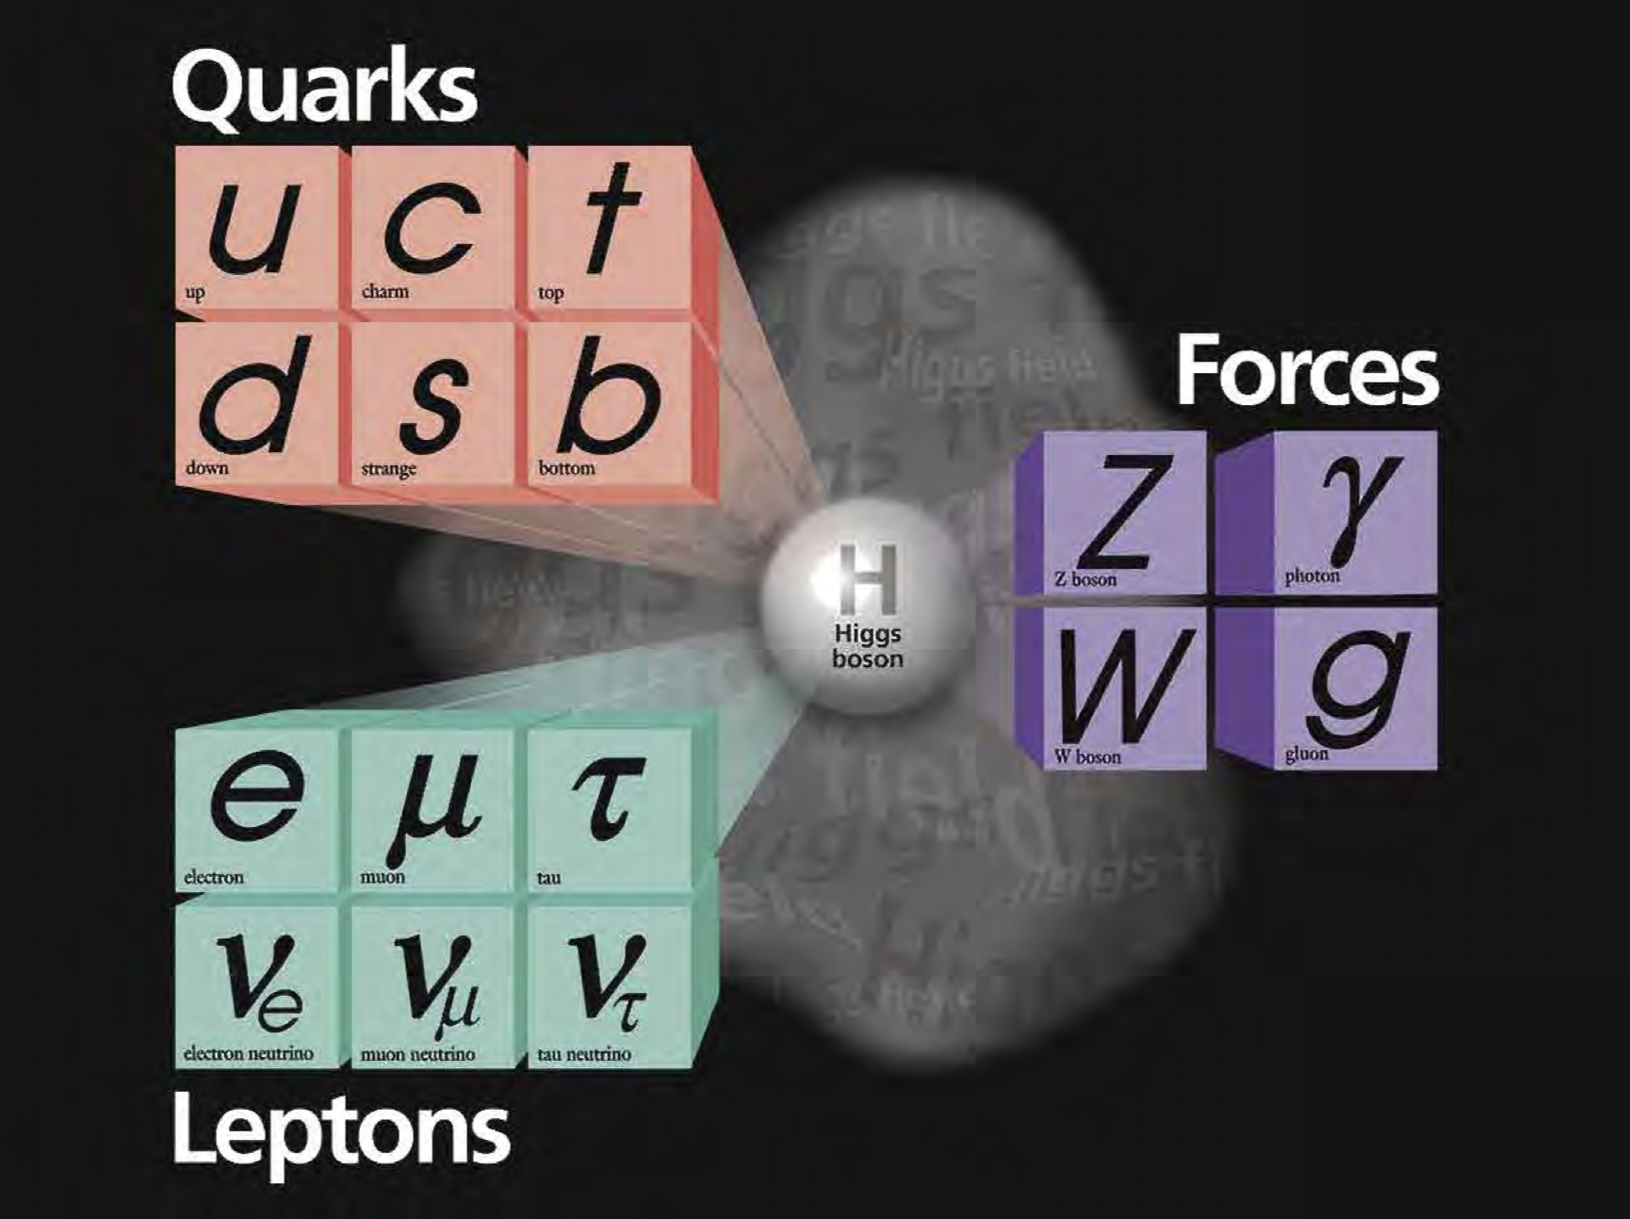
…
The Standard Model

Slide 5
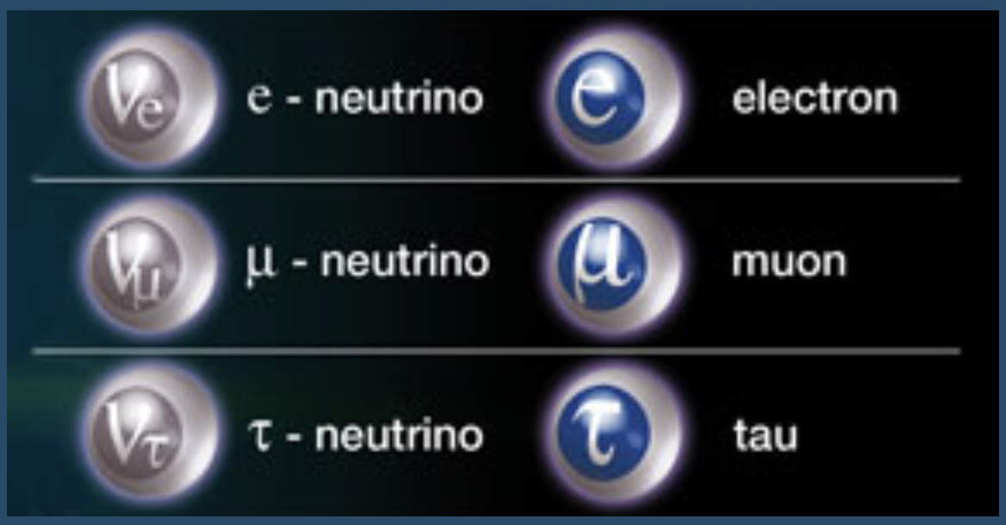
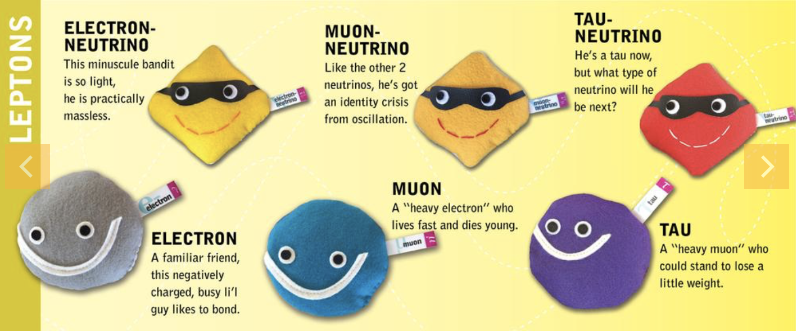
Neutrinos
Neutrinos come in three different types: three flavors

Slide 6
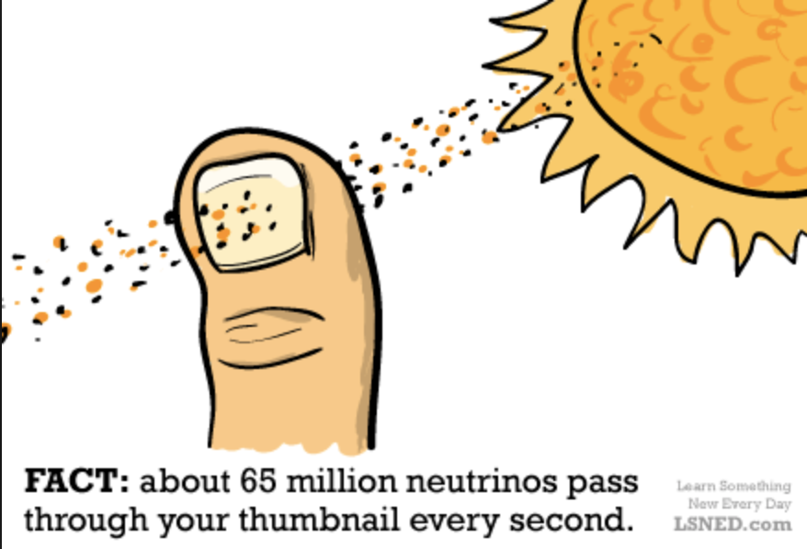
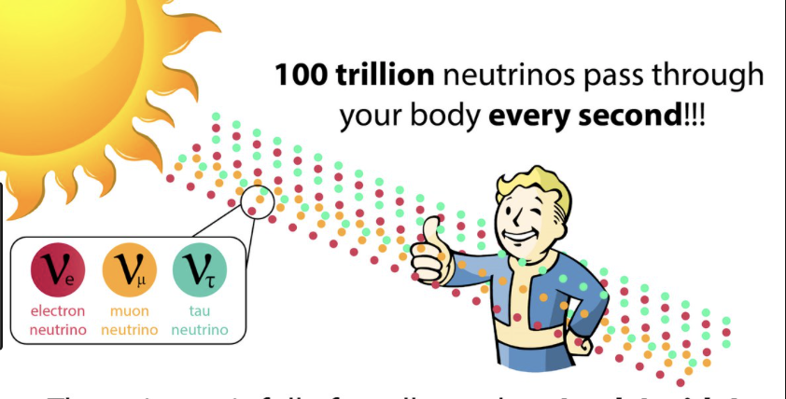
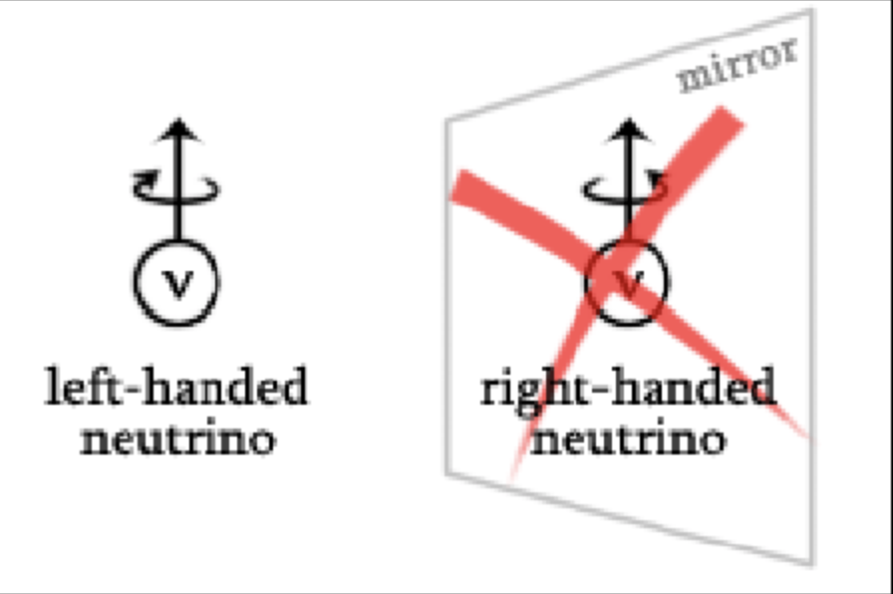
Neutrinos
Neutrinos are fundamental particles
Neutrino are ghostly particles
Trillions (10¹²) of neutrinos pass per second through you for every second of your life! They come from the sun
Neutrinos need a light year of lead (~10¹³ km) be stopped with 50% chance
There are a billion neutrinos for each atom in the Universe. There are ~3.10⁸ neutrinos per cubic meter-relic neutrinos
Their sheer number must mean they have important role in the Universe
Neutrinos have a fixed/single chirality ->
65 billion neutrinos pass
An (American) billion = 10⁹ = 1000000000

Slide 7

Neutrinos
Neutrinos are mysterious particles
Have only weak interactions
The only neutral matter particles in the Standard Model
Neutrinos could be their own anti-particle
Are mass-less in the (minimal) Standard Model but were recently found to have very tiny masses
Neutrinos are Chameleons: They can change flavour!!
At the same time neutrinos are essential parts of our Universe and our
very existence, and can provide answers to some of the key fundamental
questions today: matter-antimatter asymmetry, dark matter…

Slide 8
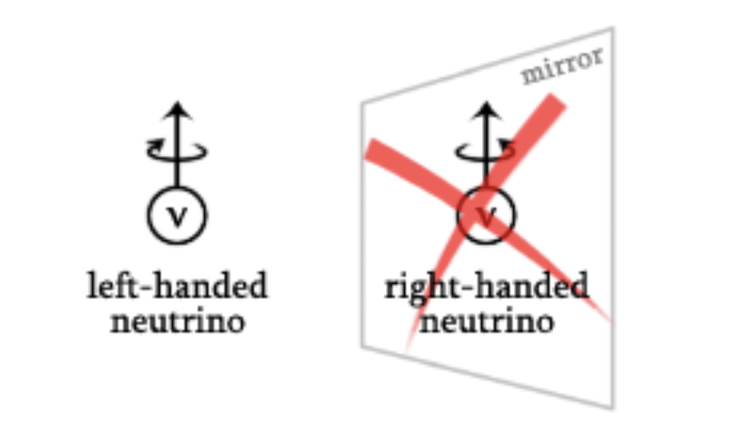

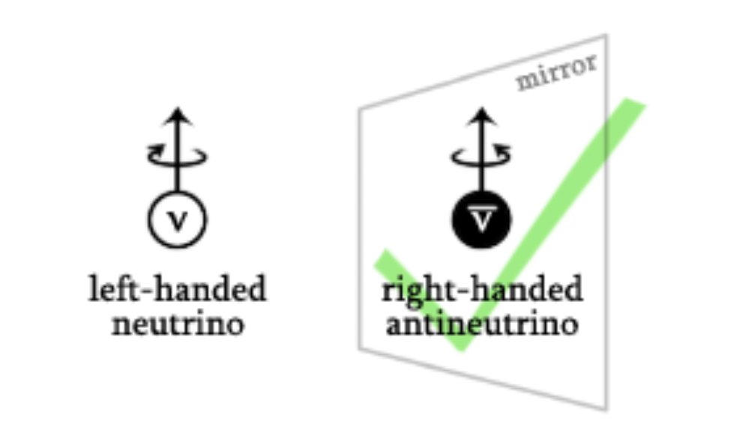
Neutrinos
We basically do not know how
a neutrino looks like in the mirror
-- unlike for the other elementary
particles.

Slide 9
Neutrinos
Where do neutrinos come from?
Neutrinos are produced everywhere
  Solar neutrinos
  Atmospheric neutrinos
  Primordial/relic neutrinos from the big bang
  Neutrinos from supernova explosions
  Nuclear reactor created neutrinos
  Accelerator created neutrinos
  Geoneutrinos, radioactive decay, even from your body
Neutrinos are the most abundant matter particles in our Universe

Slide 10
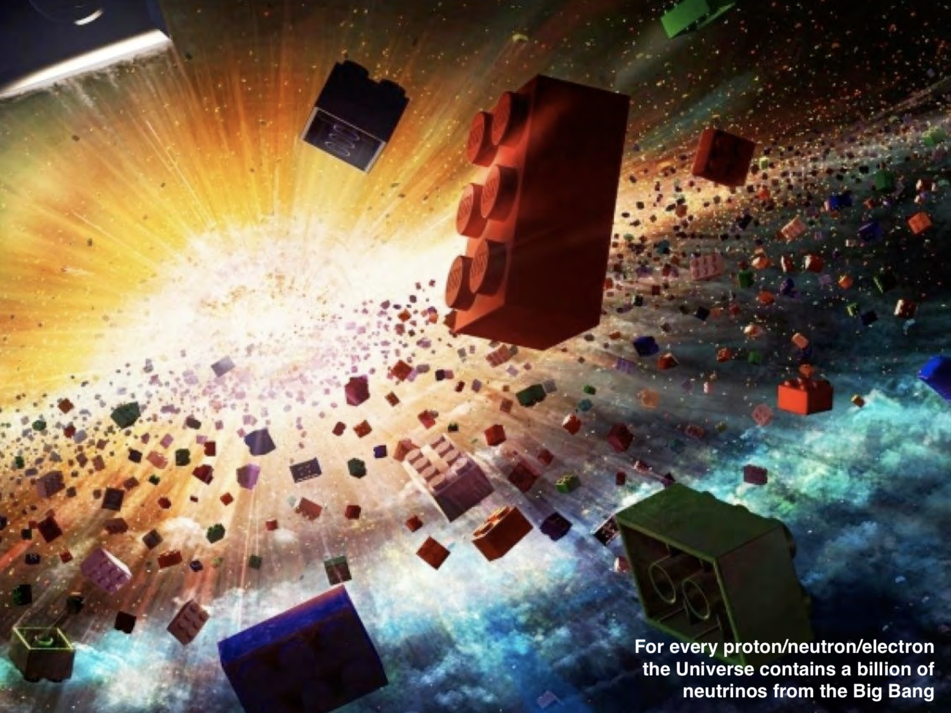
Plenty of neutrinos in the Universe

Slide 11
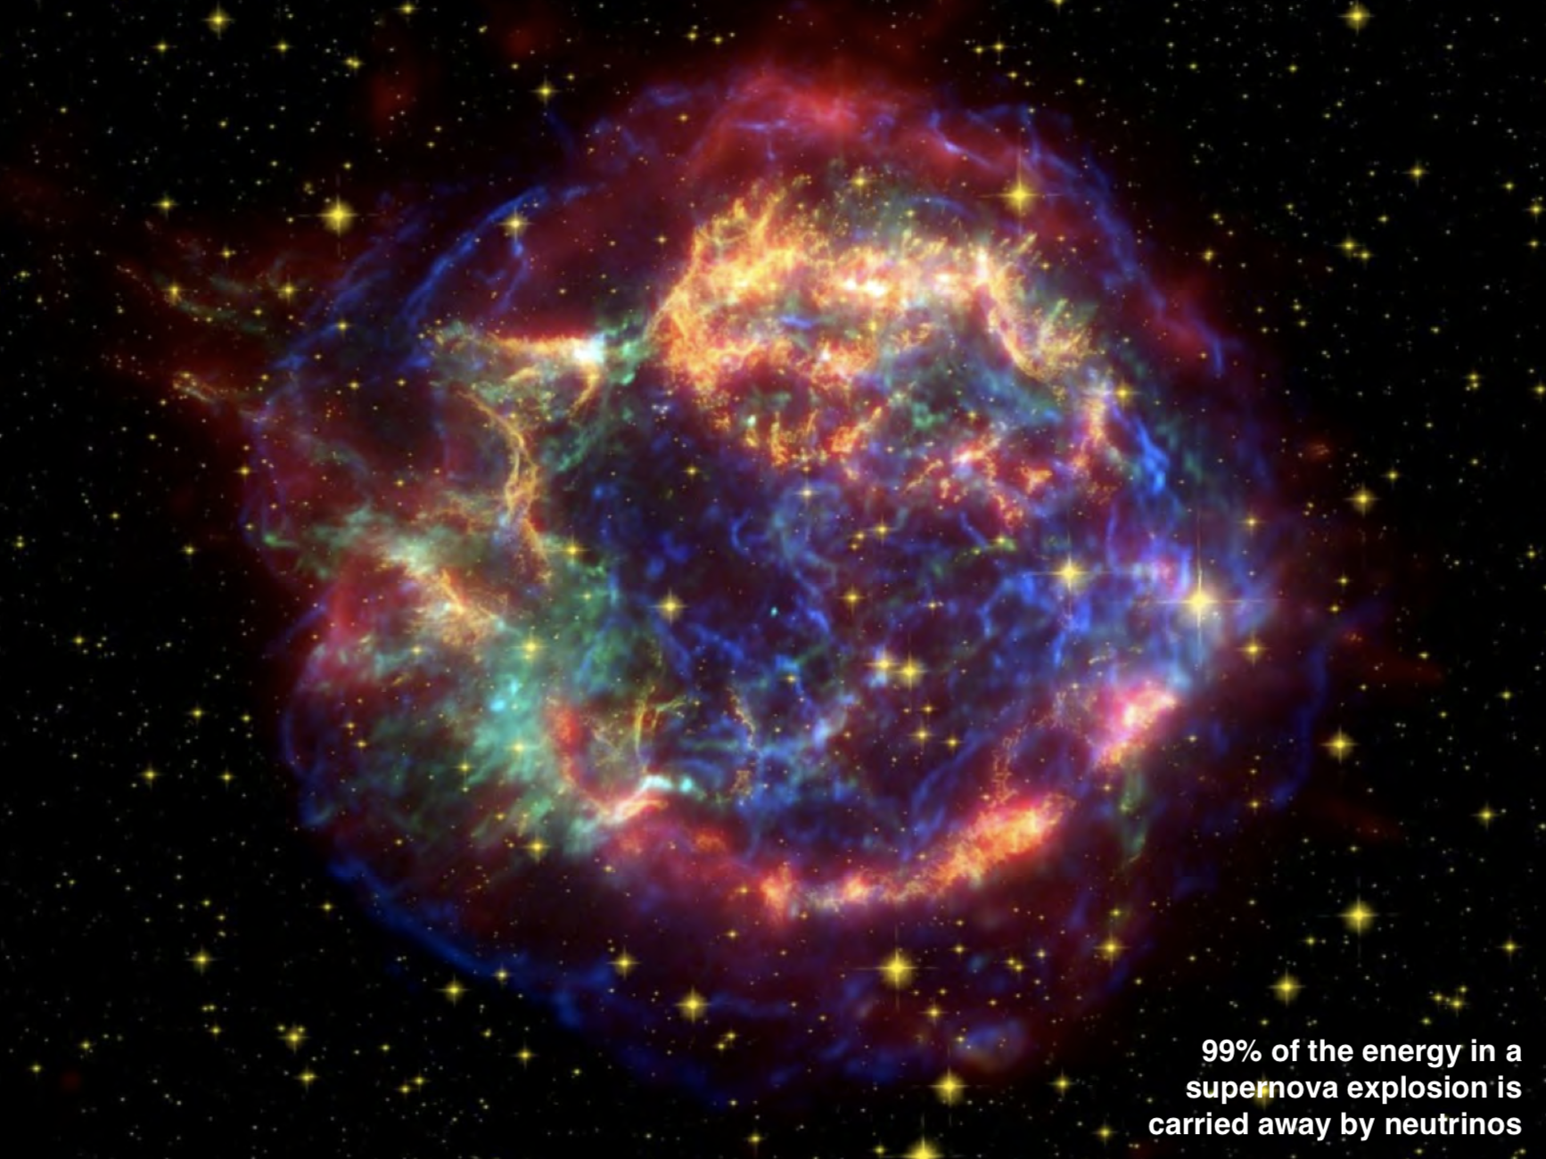
Neutrinos give crucial insight on Supernovae explosions

Slide 12
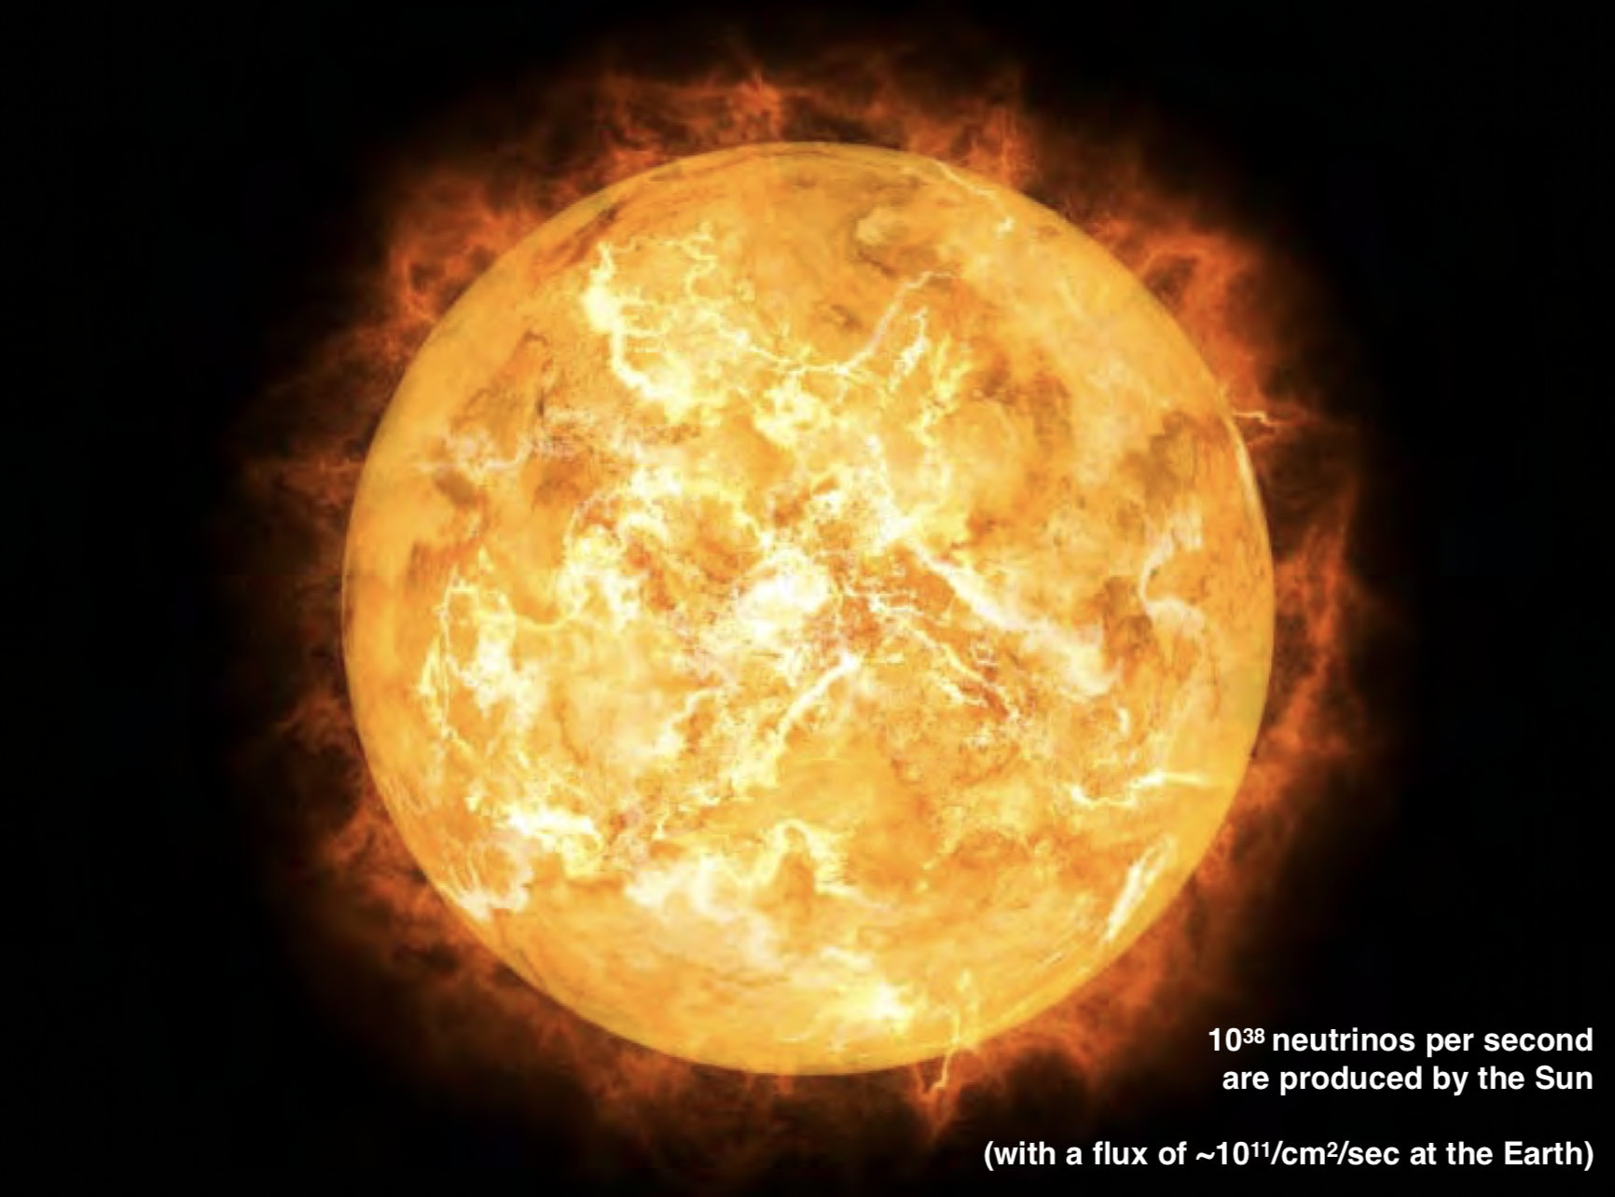
…
Neutrinos allow us to to look into the heart of the sun

Slide 13
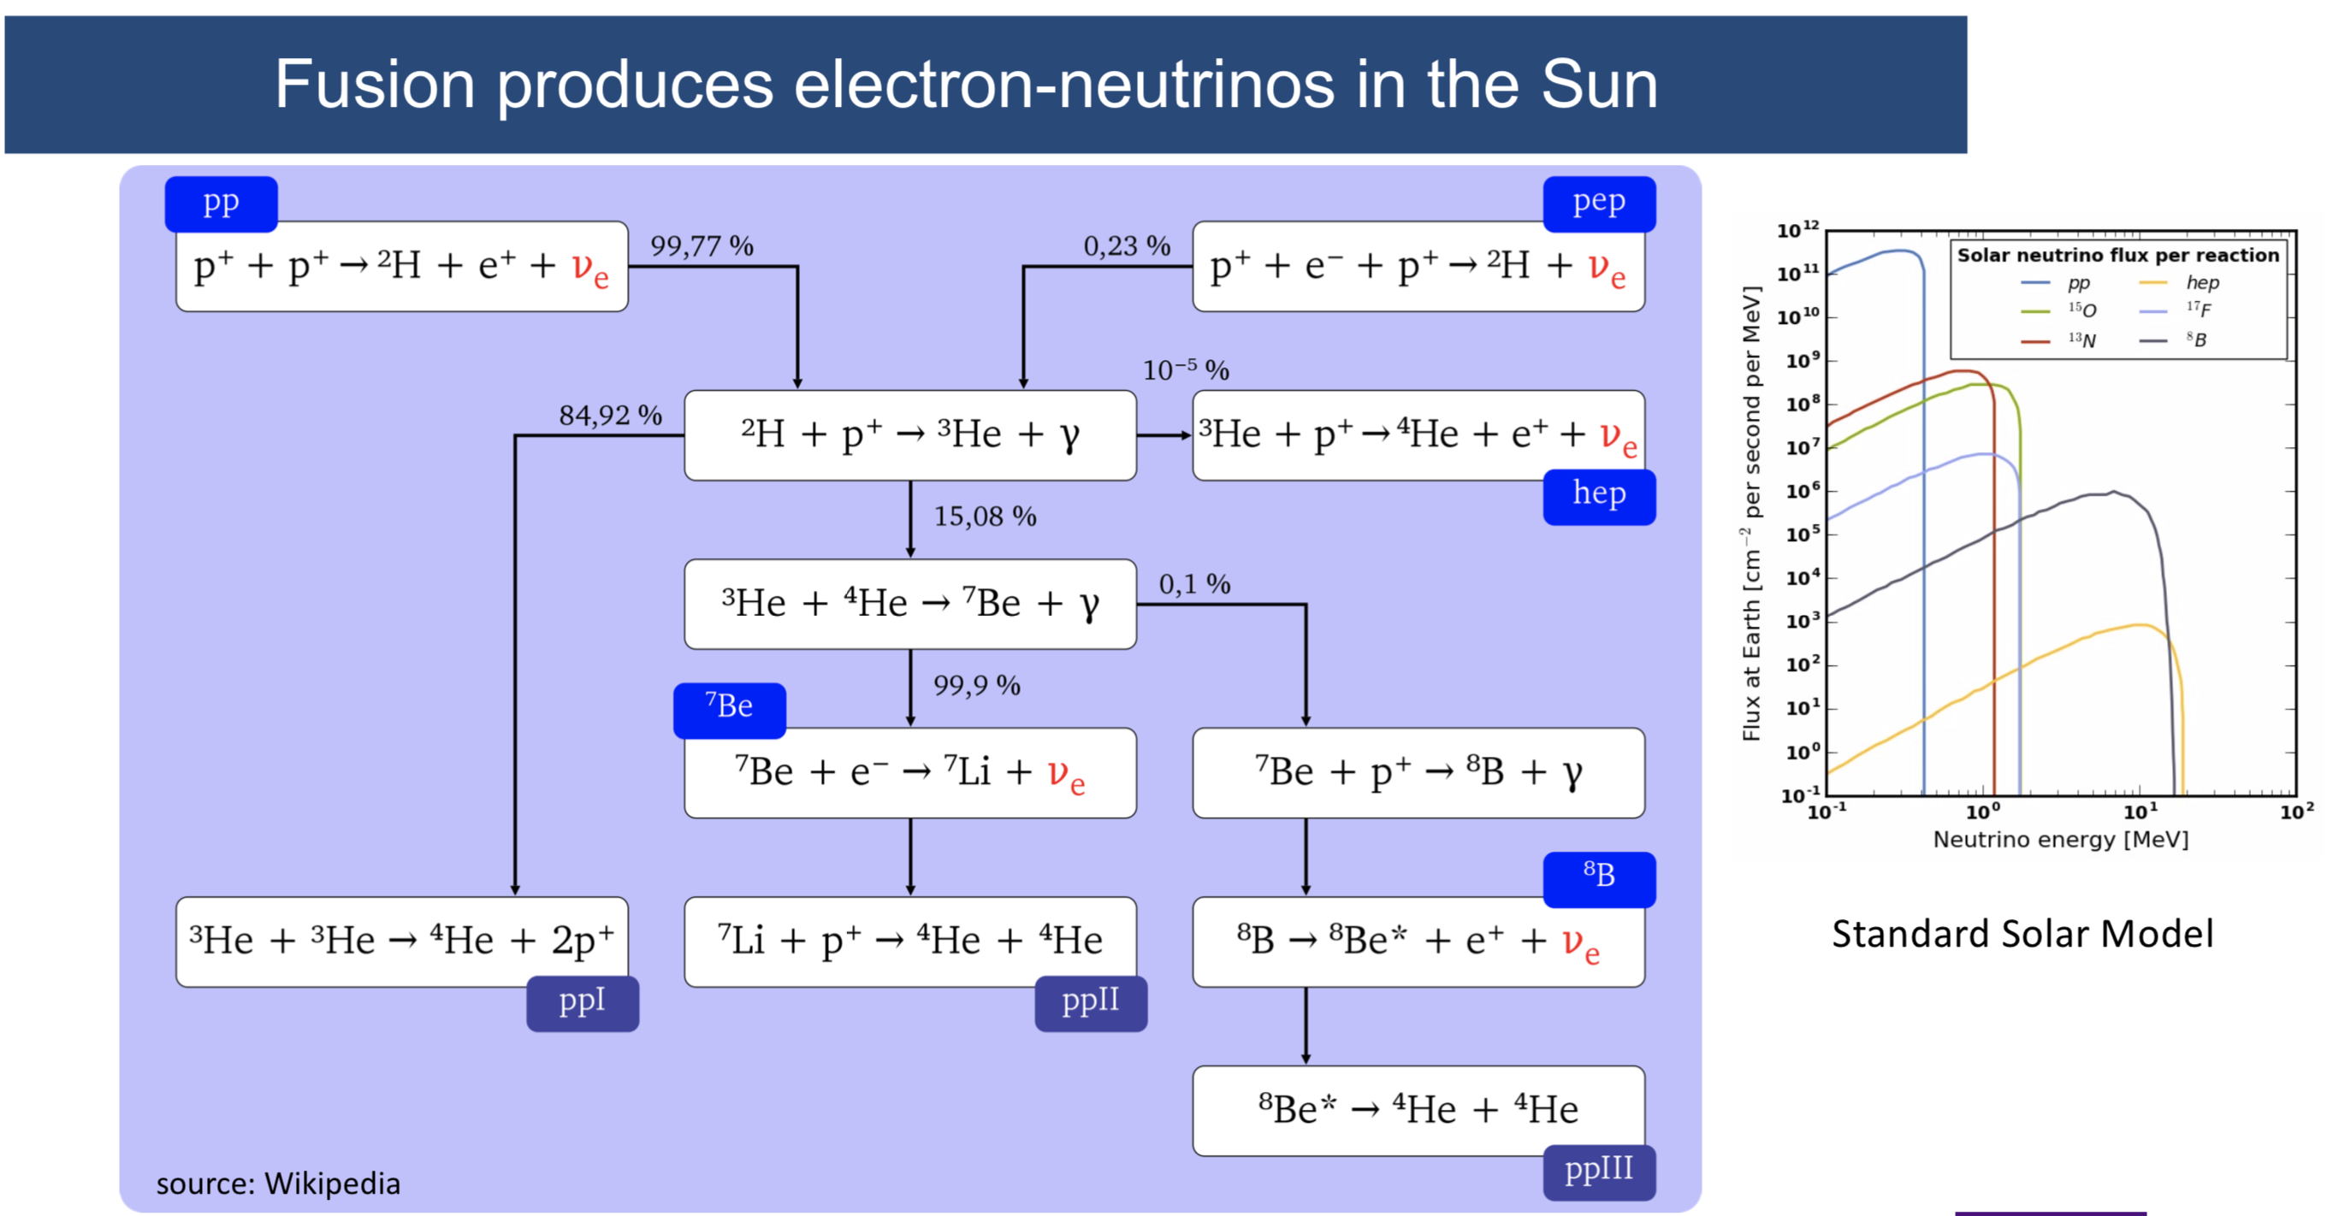
Solar Neutrinos
Neutrino measurements allow to understand how the sun works

Slide 14
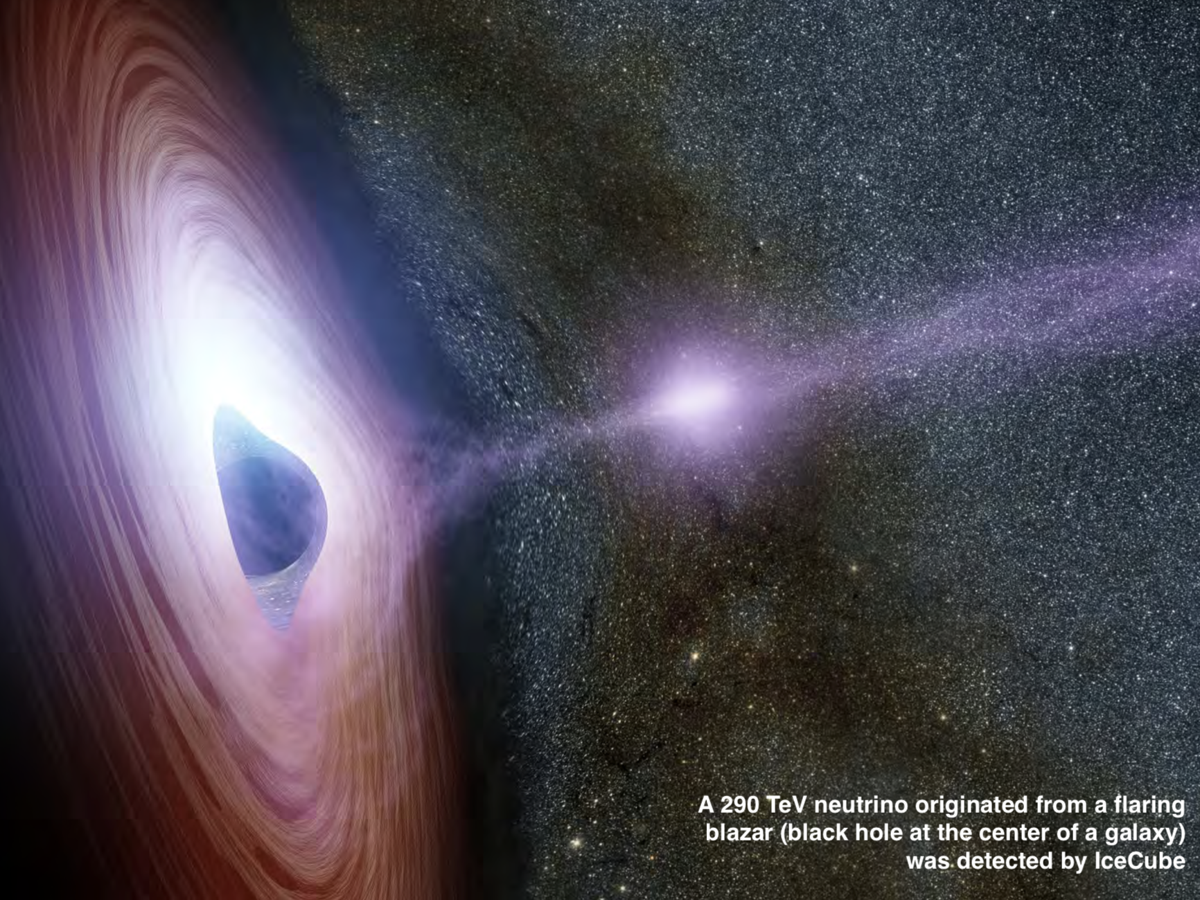
…
very high energy neutrinos from outer space

Slide 15
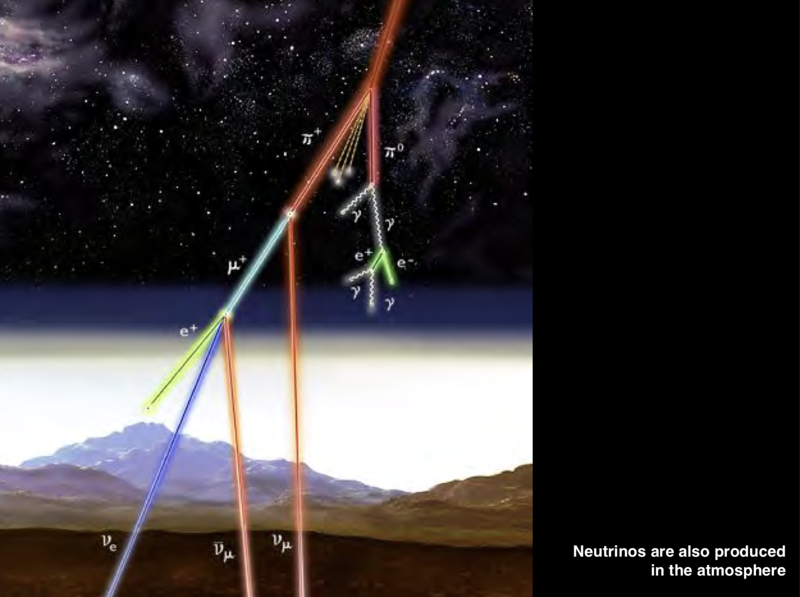
…
Neutrinos from cosmic rays

Slide 16
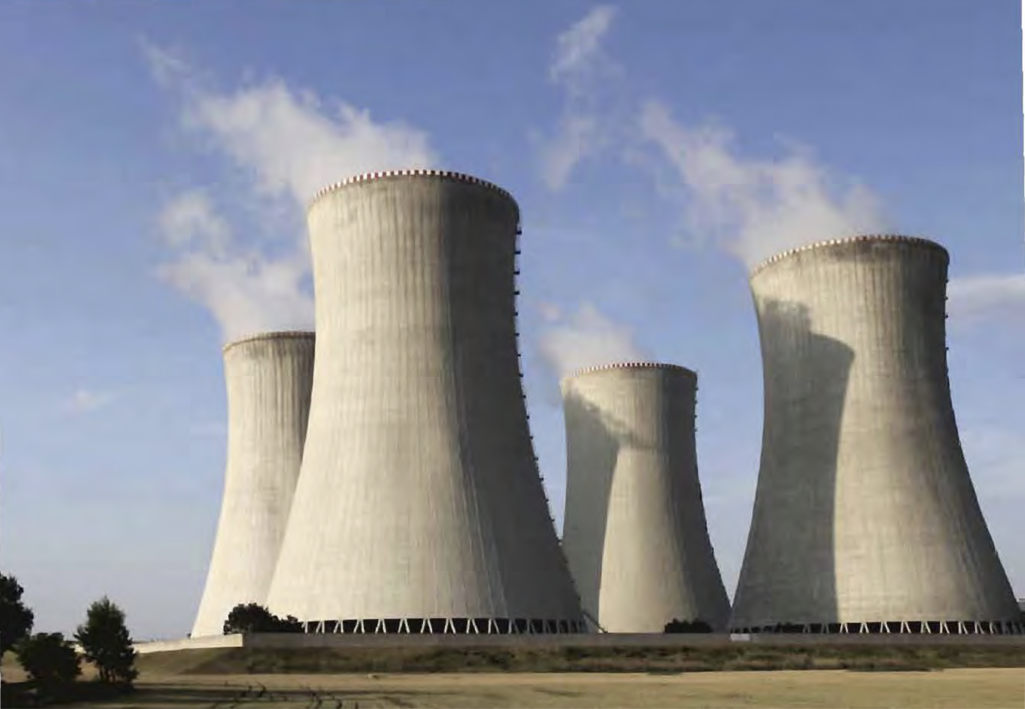
…
Reactors produce > 10²¹ neutrinos per second

Slide 17
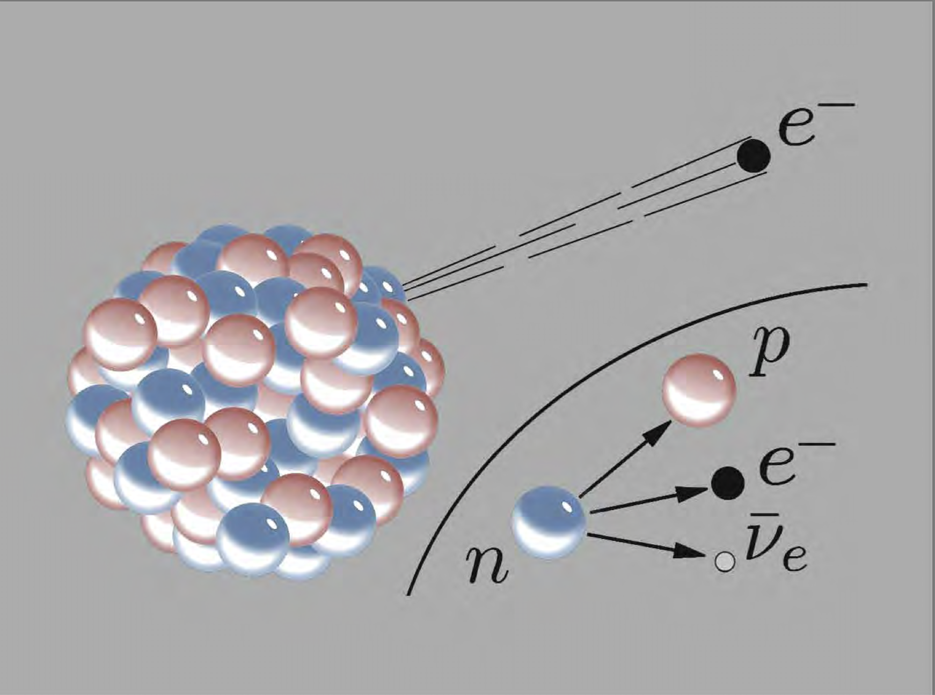
…
Radioactive beta-decay
The process that led to the postulation of the neutrino

Slide 18
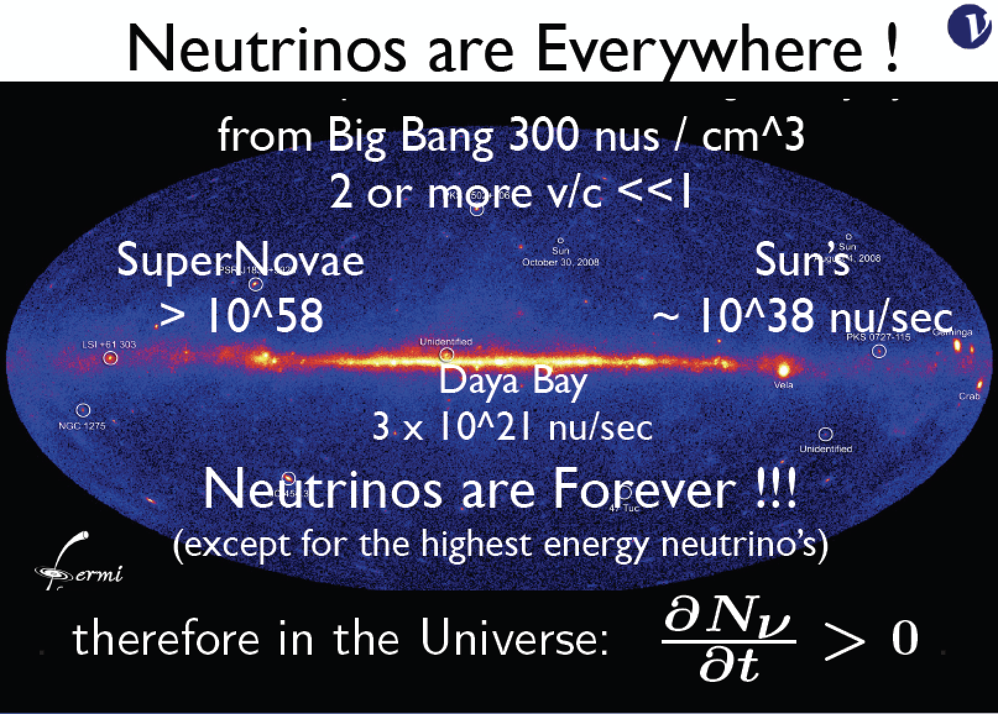

Slide 19
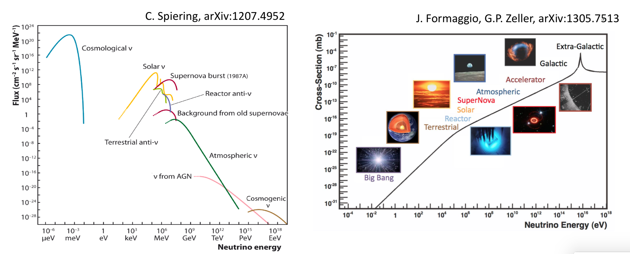
Neutrino Sources, Flux and Cross Sections

Slide 20
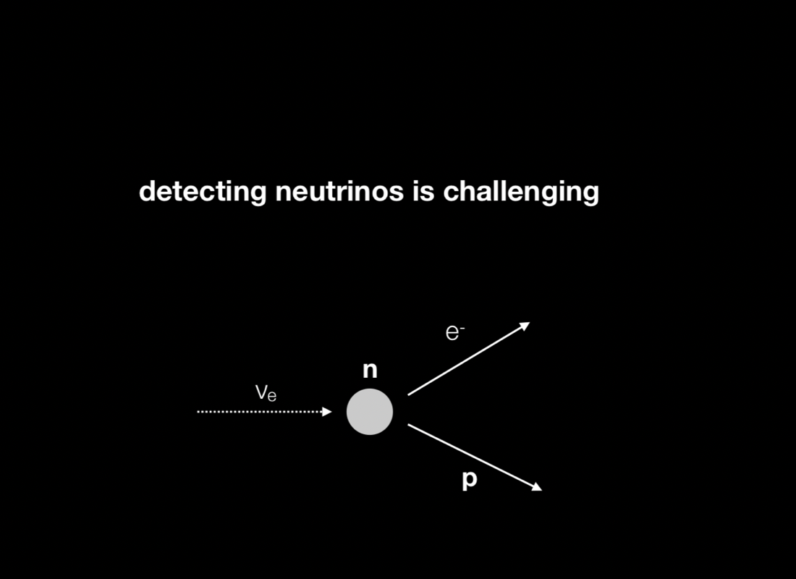
Neutrinos interact very weakly with matter

Slide 21
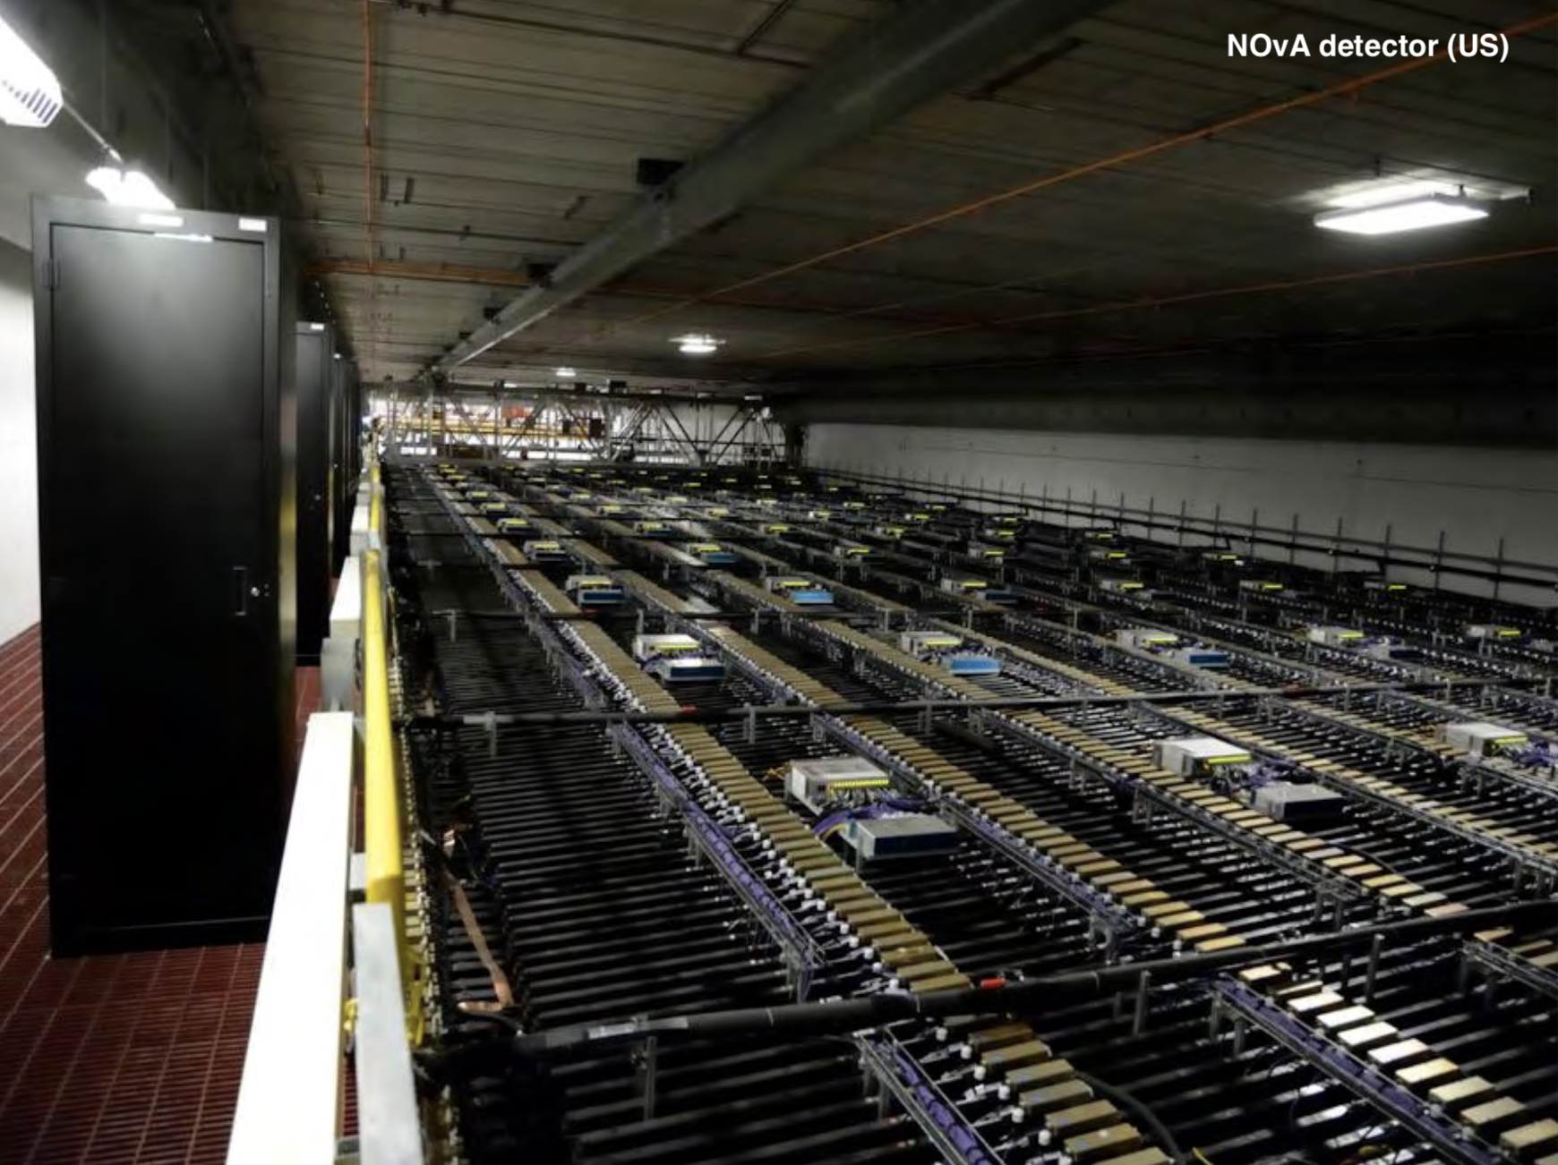
Very large detectors are needed

Slide 22
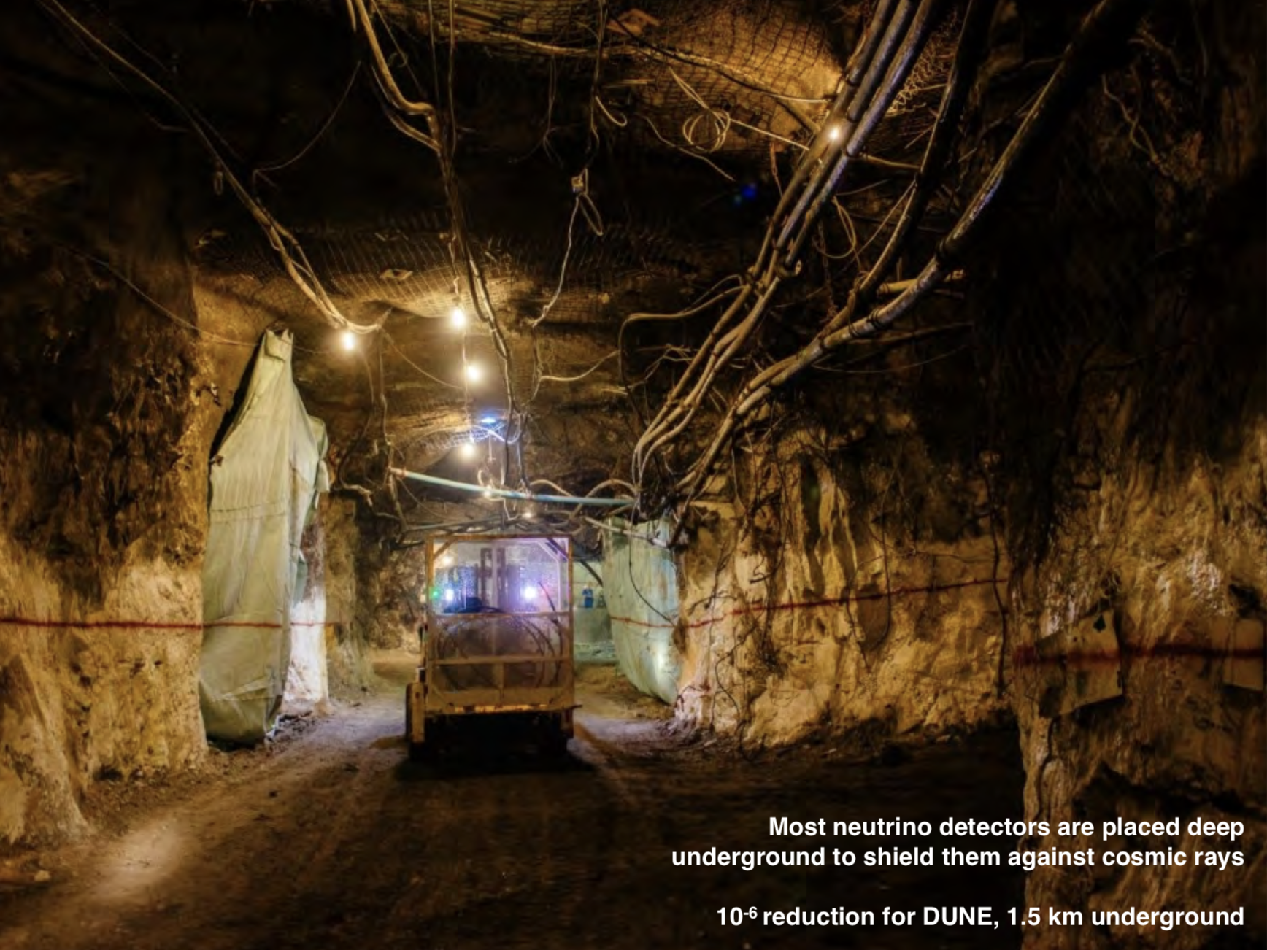
…
And often they are placed far underground

Slide 23
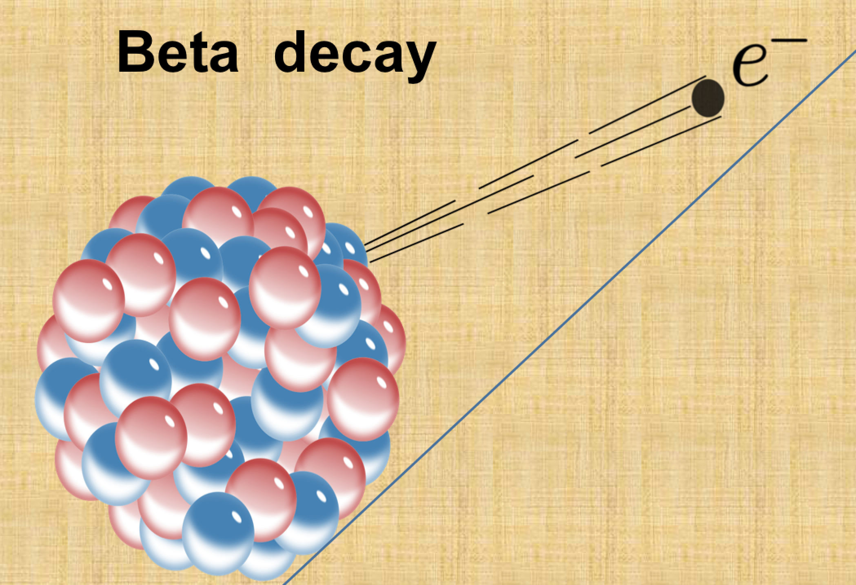
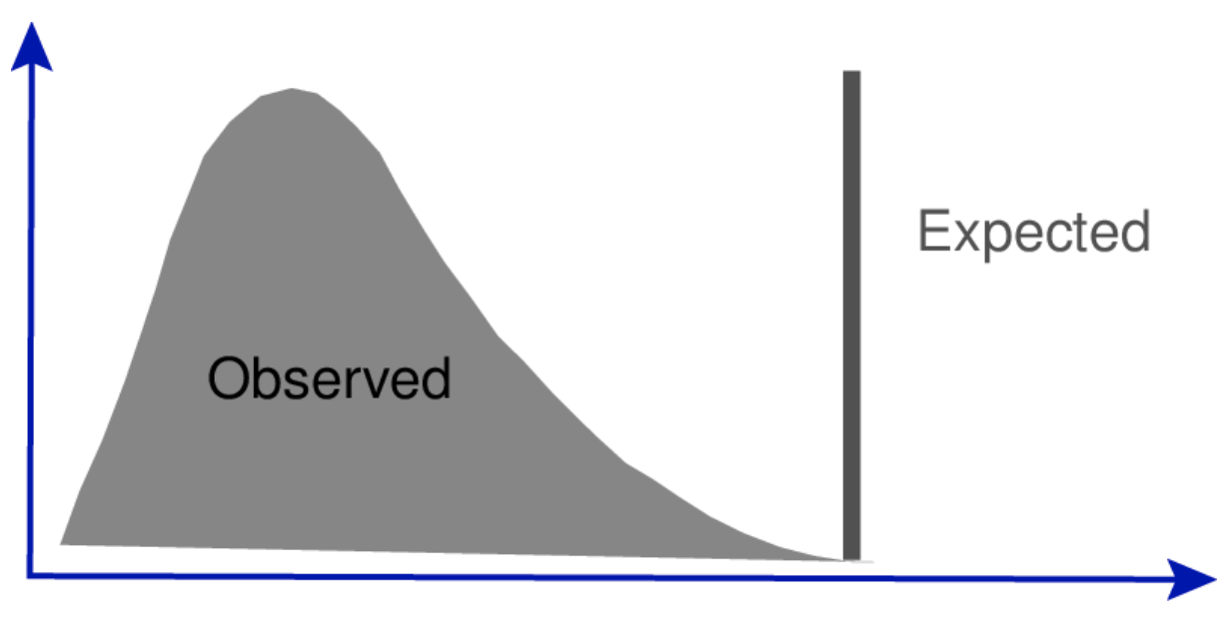
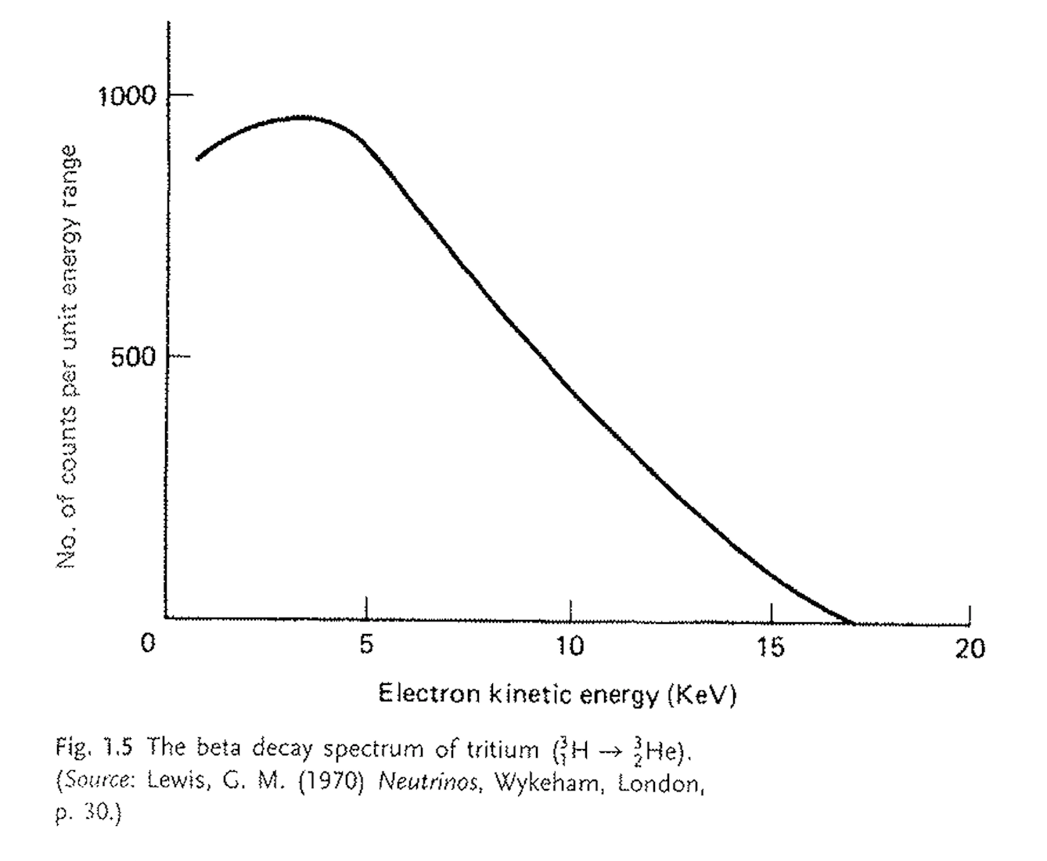
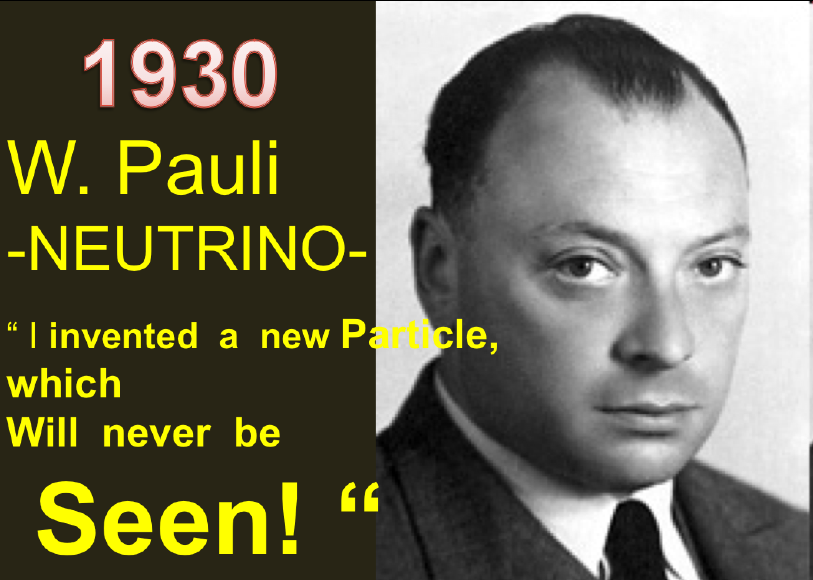

Neutrinos were introduced in 1930!
If the process is A -> B + electron, the energy
of the electron should be at a fixed value.
This is not the case! Energy-momentum not
conserved in Beta-decays?
β-decay
Pauli proposed instead the process:
But he believed we could never detect this particle!!

Slide 24
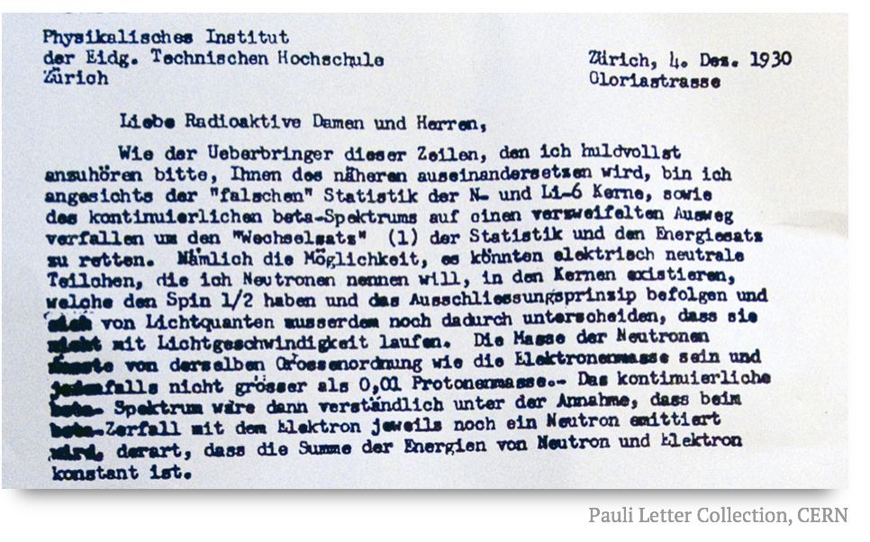
Neutrinos are know to us since 1930!
Pauli did not believe energy-momentum conservation was violated
He proposed a desperate way out: a new ‘invisible’ particle
He called it the neutron.
He also stayed away from the conference because of a ball in Zurich..

Slide 25
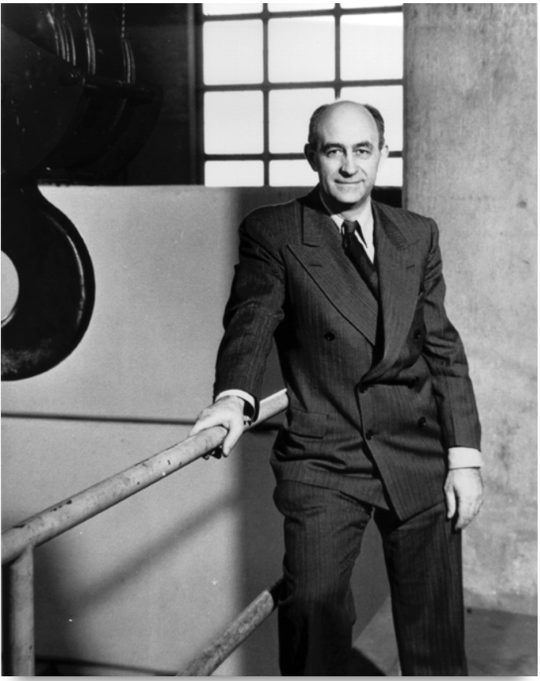
Neutrinos are known to us since 1934!
1934
Enrico Fermi, father of the world’s first
nuclear reactor, coined the term “neutrino”
which is Italian for “little neutral”
He proposed a theory for β-decay
including the neutrino, a first formulation
of the weak force…
This is one of the keystone papers for the
Later development of the Standard Model
Funny enough his paper got refused by
Nature magazine
(criticism: nothing practical in this paper)

Slide 26
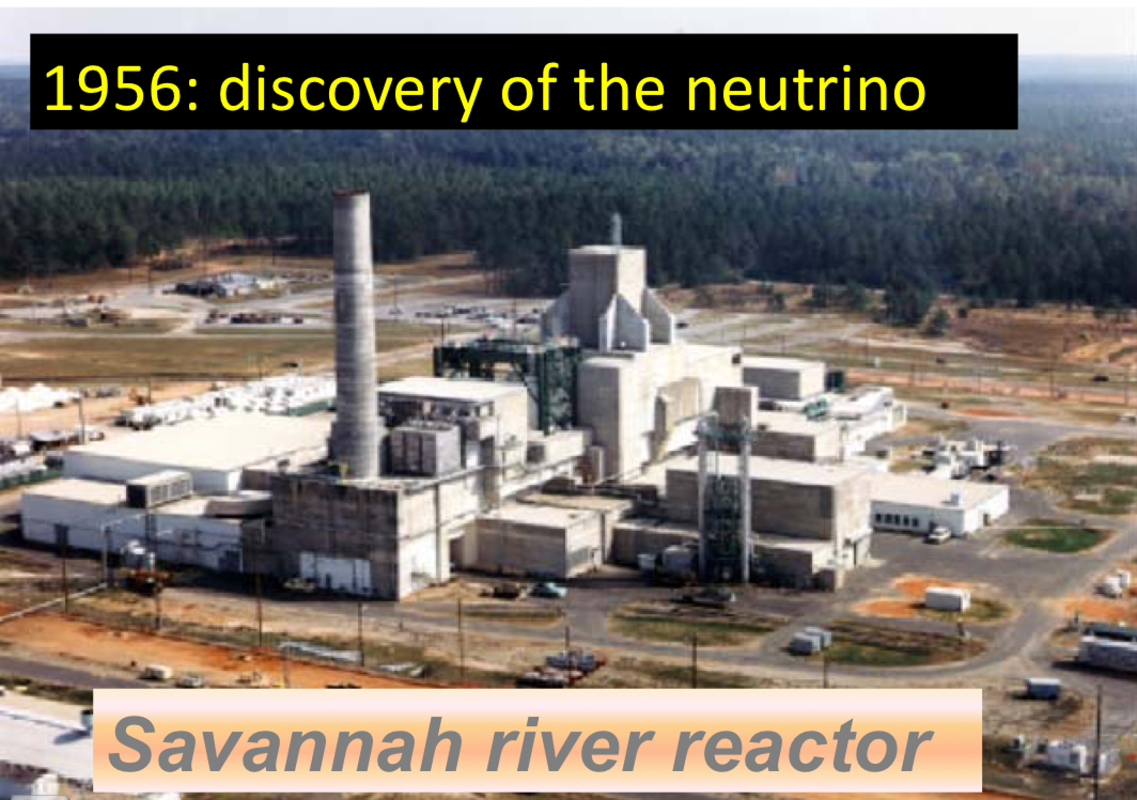
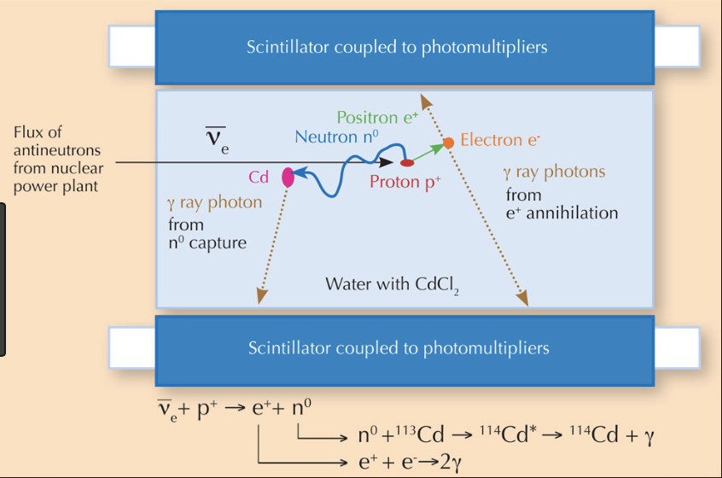
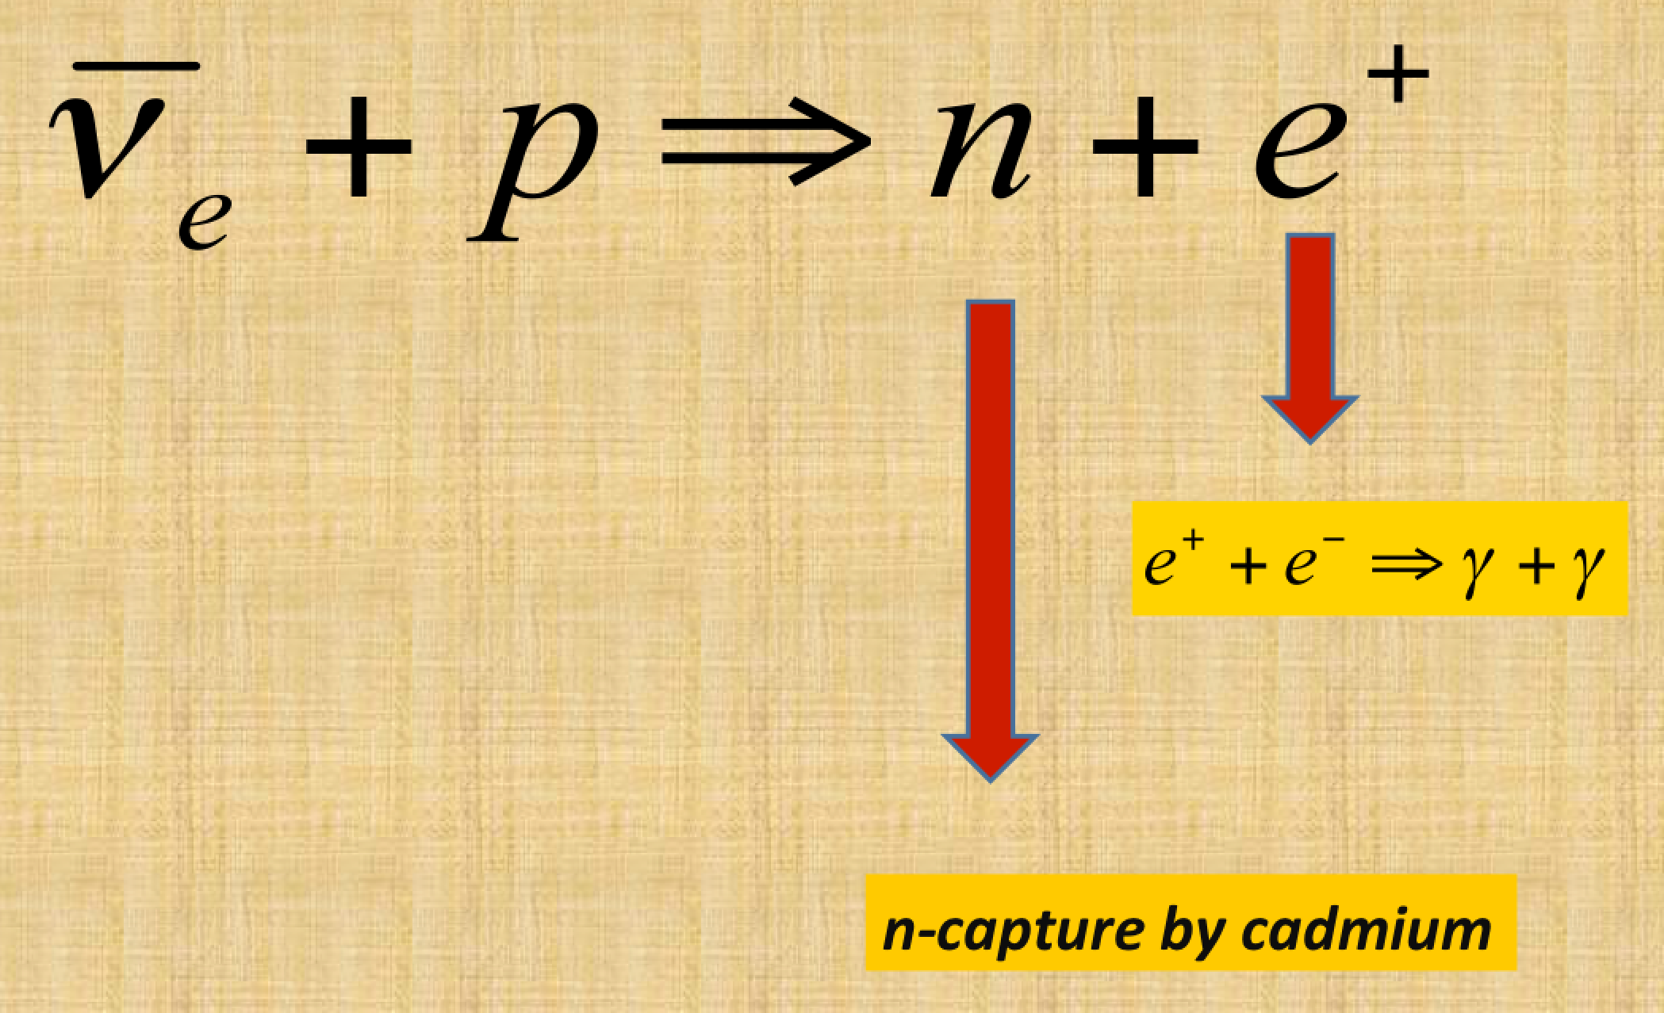
The Discovery of the Neutrino
It took 26 years to detect this particle.
Cowan and Reines put a detector
close to the reactor in South Carolina
and observed the inverse beta decay
process (few events/hour)
Early reactors gave
10¹⁹ neutrinos/sec
The neutrino really exists!
5 μsecond delay

Slide 27
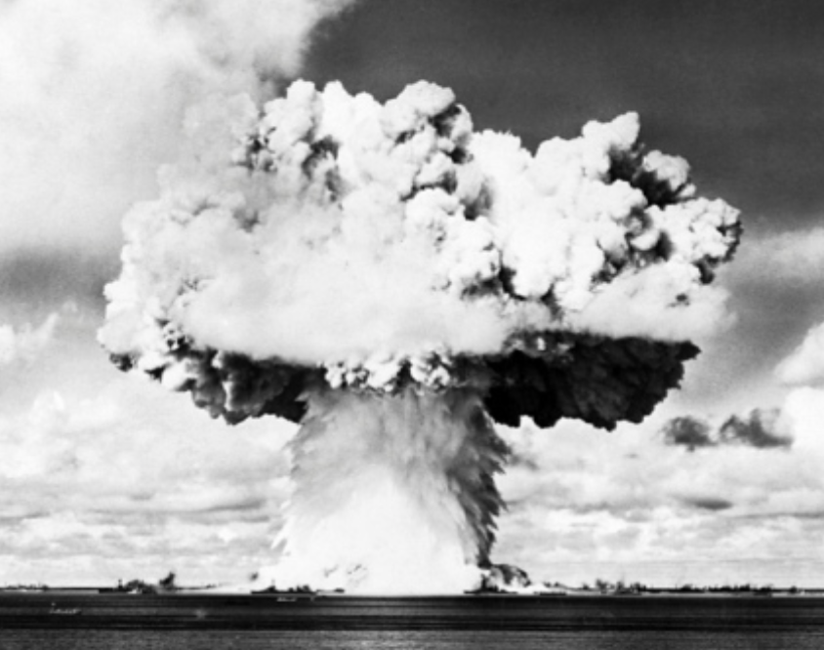
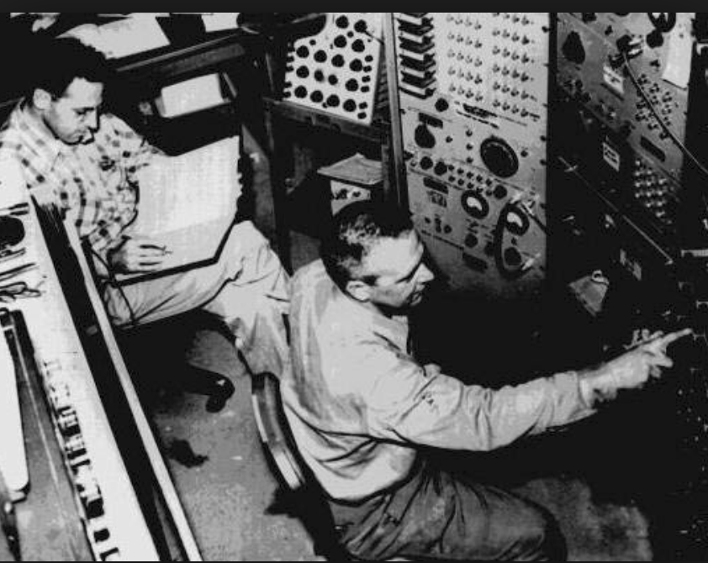
The Discovery of the Neutrino
This was however not the first idea
of Cowan and Reines.
They had originally proposed (and
got approved for) putting an
experiment close to an even more
intense source of neutrinos nml
100m distance from an atomic blast!
They abandoned that idea when the
realized there were certain
‘practical problems’ for the
detector… (to survive)

Slide 28
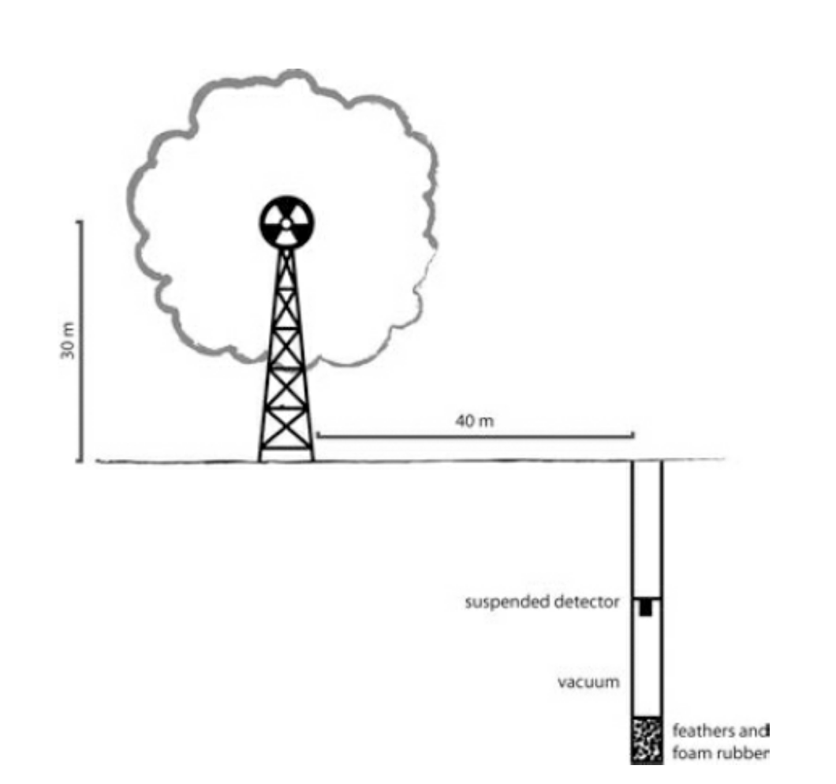
The ”Original” Cowan and Reines proposal
Got approved and funded
… but was never tried out
Neutrino intensity at a
nuclear blast is ~1000
times that if a reactor

Slide 29
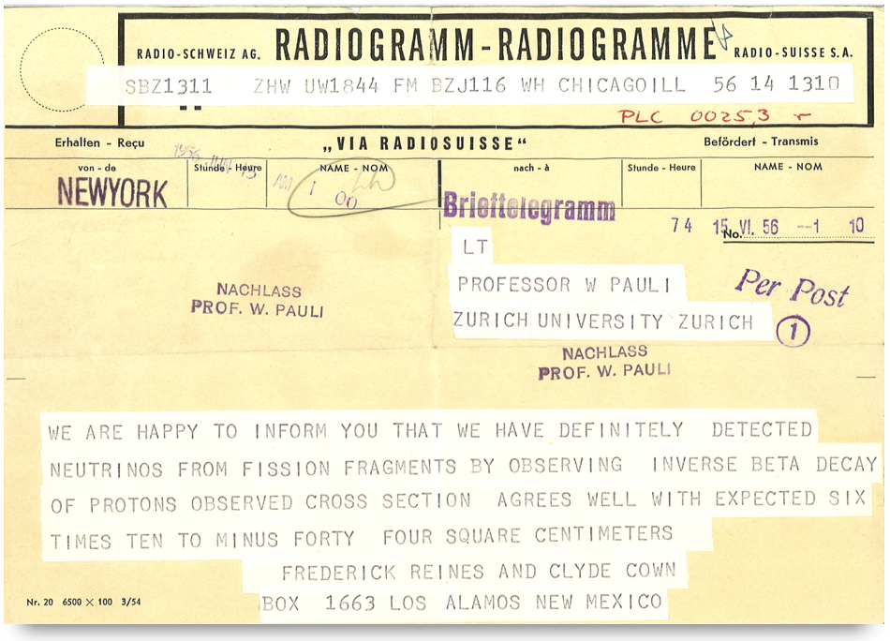
The Discovery of the Neutrino
1956: the first experimental evidence from project “Poltergeist”,
informing Wolfgang Pauli..

Slide 30
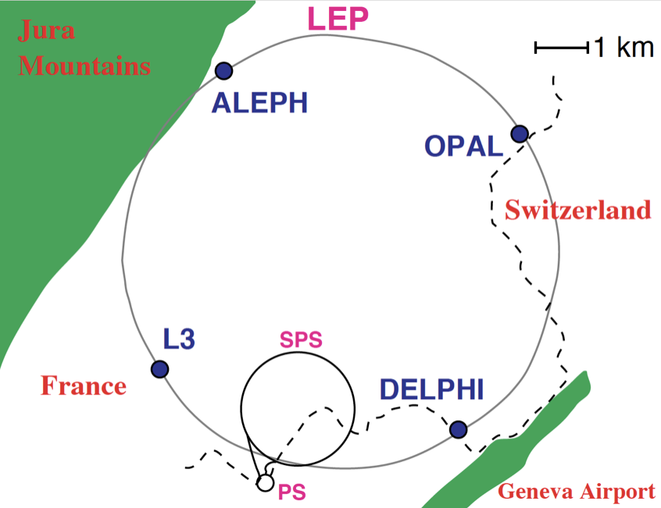
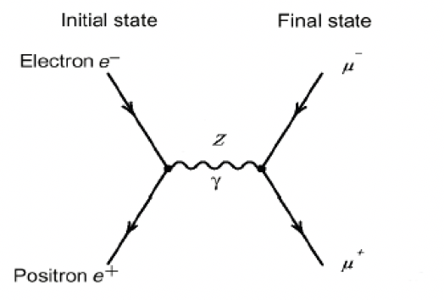
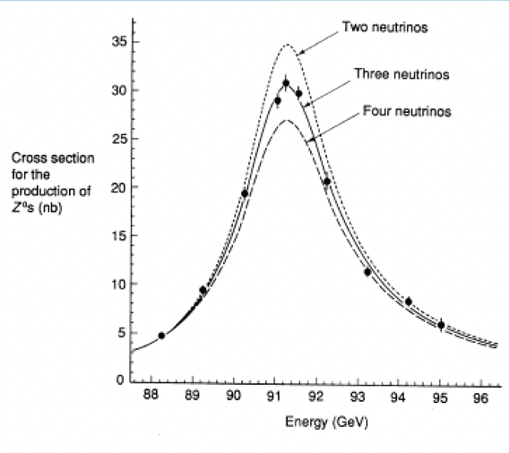
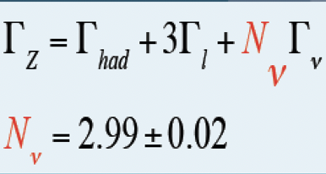
How Many Different Neutrinos?
LEP e+e- collider at CERN (1988-2000)
Detailed study of the Z-boson
The width of the Z-boson
gives the number of neutrinos
LEP: three active neutrinos with mass<45 GeV

Slide 31
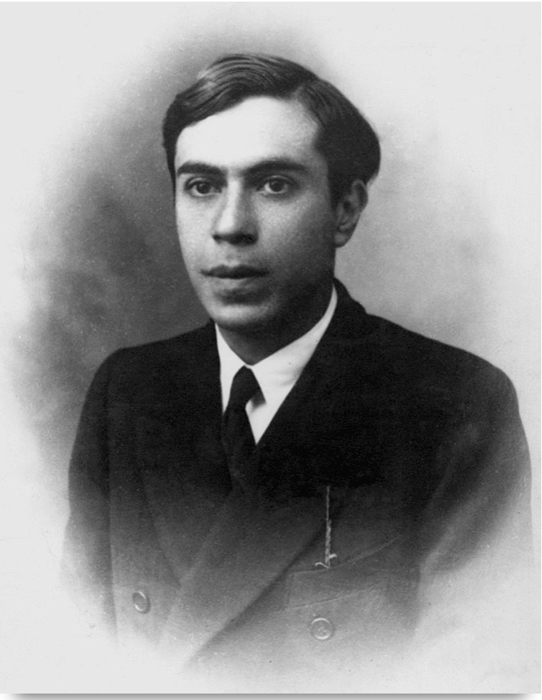

More Neutrino Personalities
1937: Ettore Majorana
He postulated that neutrinos could be their
own antiparticles. This special class of particles
came to bear his name: Majorana particles
Majorana disappeared in 1938 on a boat trip from Sicily
1957: Bruno Pontecorvo
He hypothesized that neutrinos may oscillate, or
change from one type to another and would go on to
develop that theory over the years as more flavors
were discovered.
He also predicted that supernovae, the giant explosion
of a dying star, would release an enormous amount
of energy in the form of neutrinos
Pontecorvo disappeared … to the east block in 1950

Slide 32
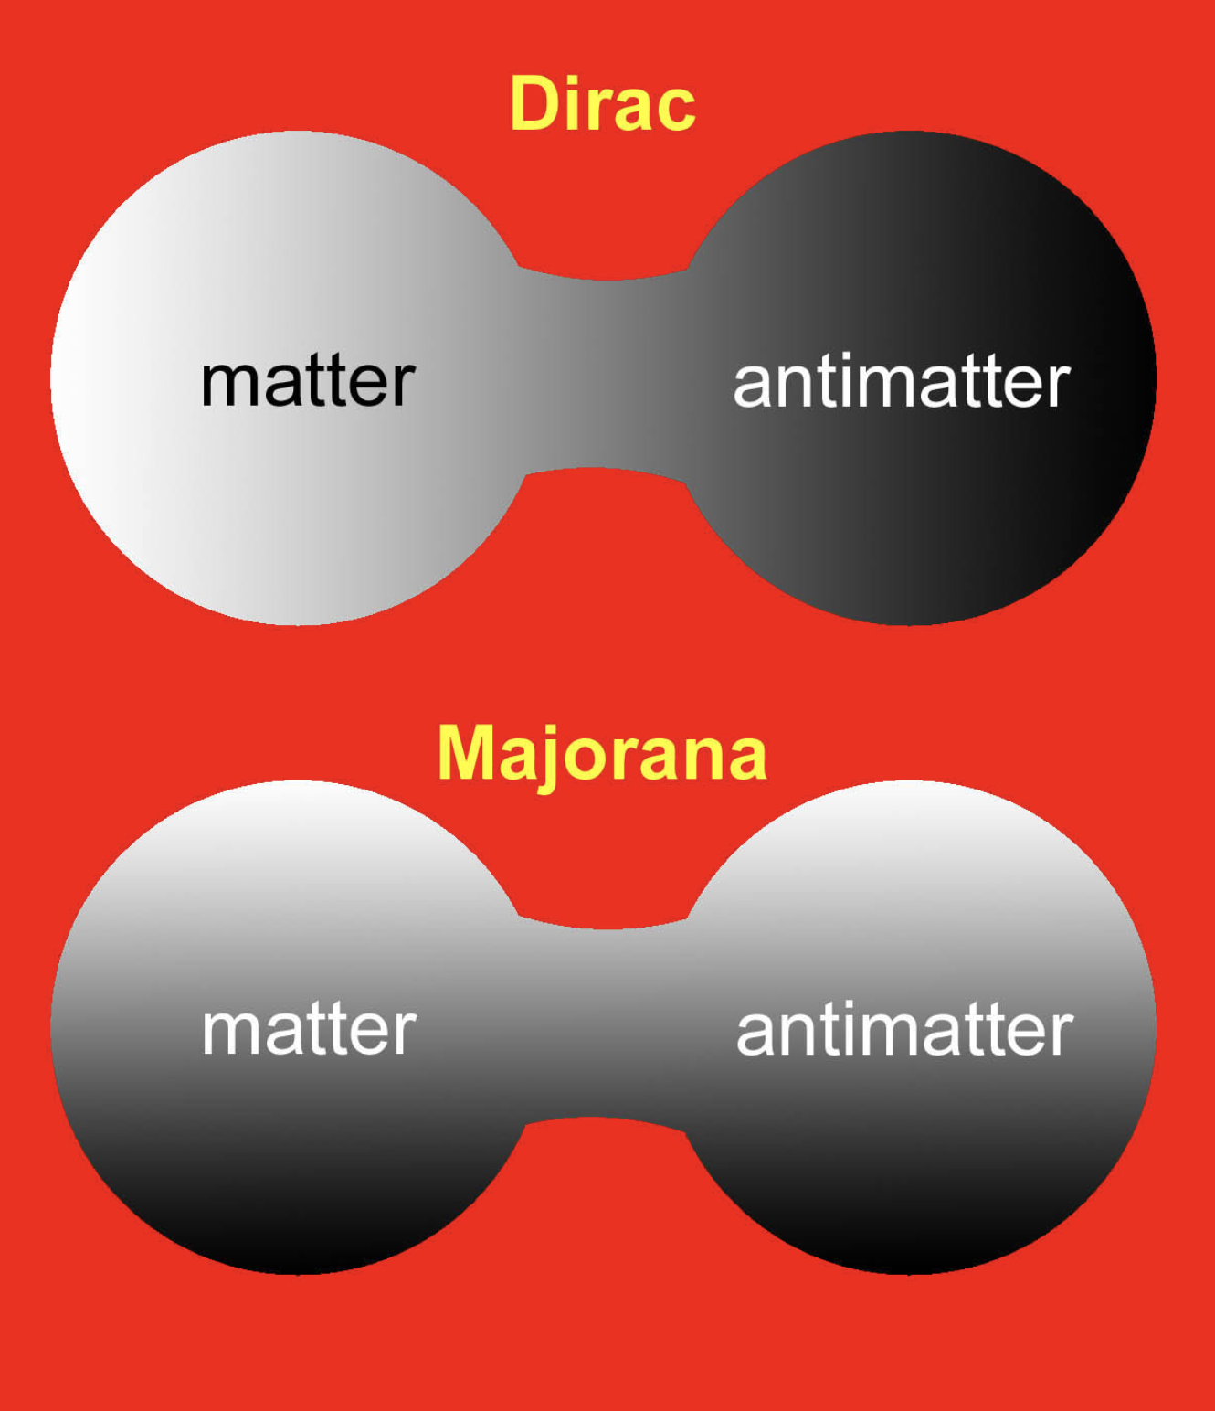
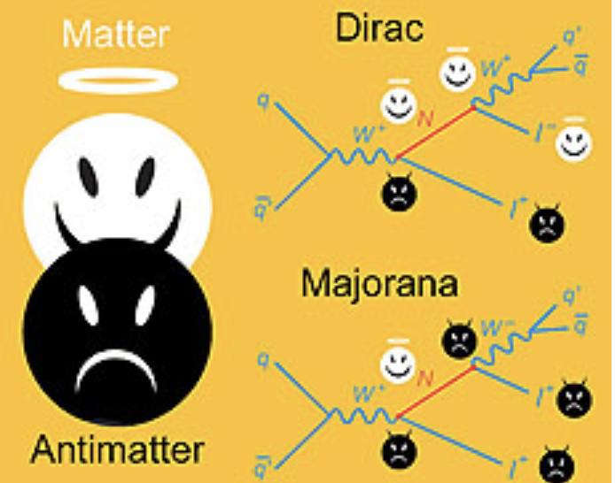
Majorana Neutrinos
A Majorana fermion is a fermion that is its own antiparticle
A Dirac fermion particle and antiparticles are not the same
Fermions with electric charge (ie all fermions except neutrinos) are by definition Dirac fermions
Neutrinos COULD be Majorana Fermions, but not demonstrated yet -> The goal of neutrinoless double beta decay experiments
Neutrino mass -> allows for Majorana mass terms

Slide 33
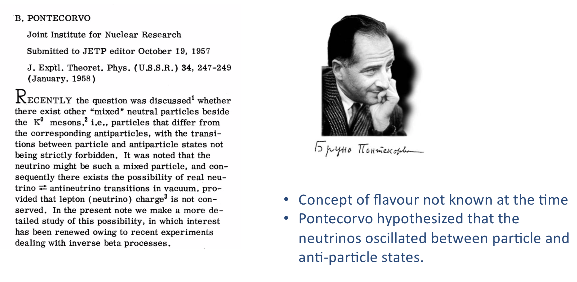
Pontecorvo & Neutrino Oscillations

Slide 34
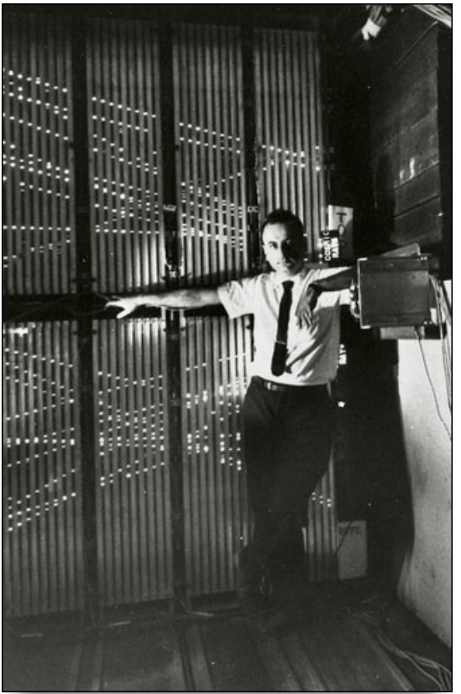
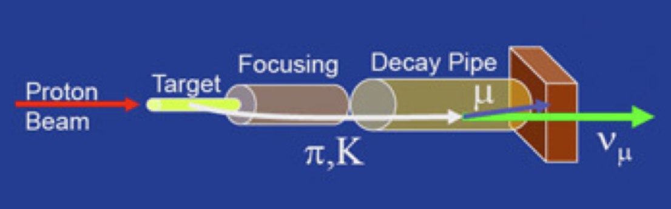
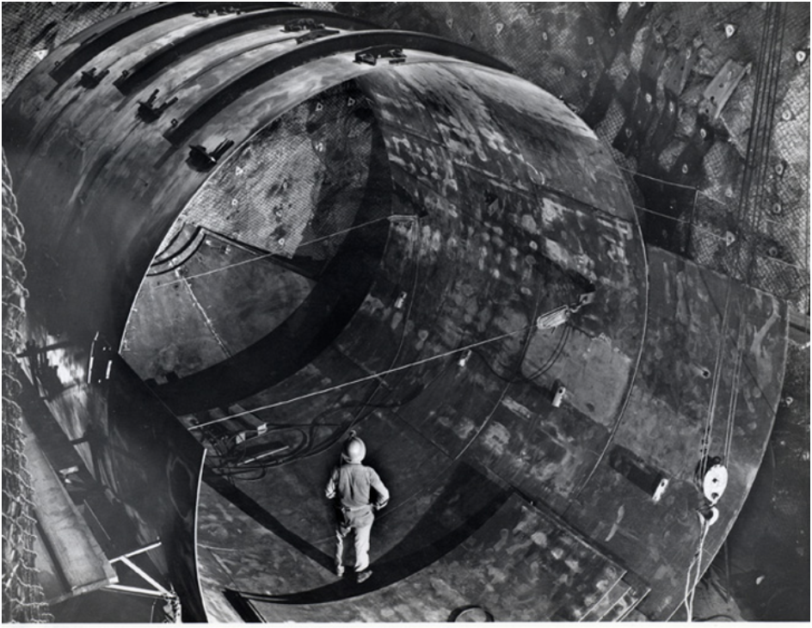
Neutrinos in the 1960s
1962: Lederman, Schwartz and Steinberger
discovered the existence of second type of neutrino
at the AGS in Brookhaven: the muon neutrino
1968: Davis and Bahcall and the solar
neutrino problem. Only 1/3 of the
expected (electron) neutrino rate
was observed. What was wrong?

Slide 35
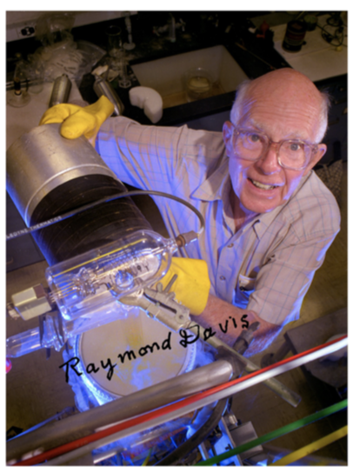
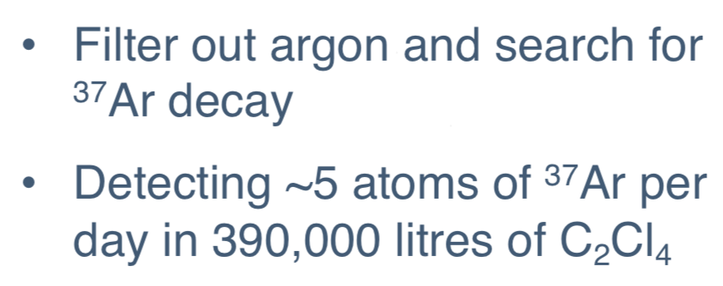
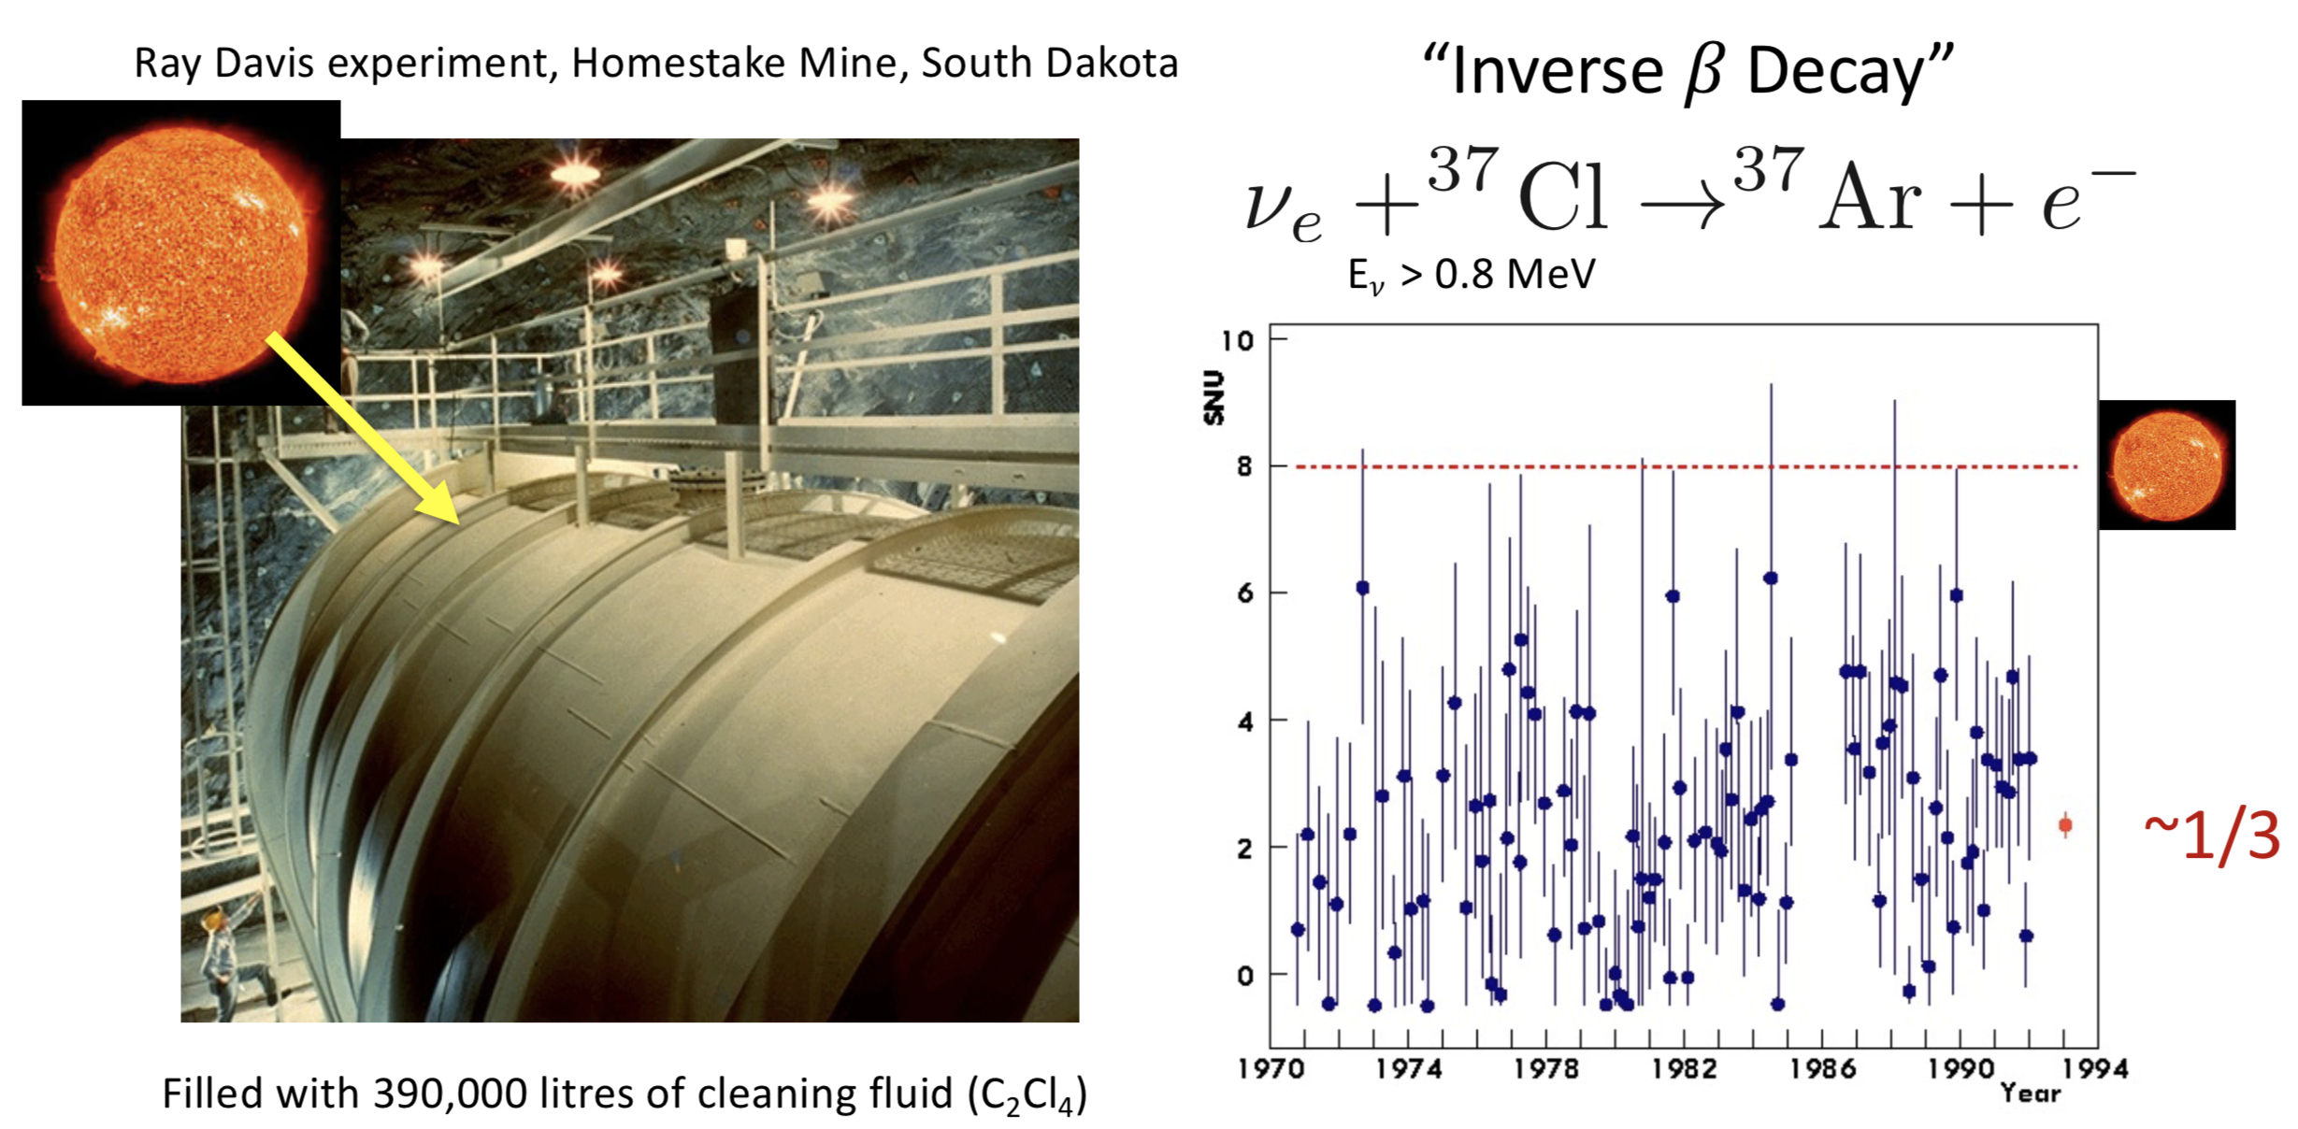
Davis and Bahcall

Slide 36


Neutrinos in the 1970s
1973: Discovery of the “neutral currents” as predicted from the
Electroweak Theory: neutrino + proton -> neutrino +X
A triumph for the emerging Standard Model !

Slide 37


Neutrinos in the 1980s
1987: A supernova, a dying star, exploded in the
Large Magellanic Cloud. Most of the energy is
released as neutrinos. The Kamiokande and IMB
experiments –both large experiments conceived
to detect proton decays– saw a dozen of neutrino
events during the burst of O(10) seconds.
The neutrinos arrive at the earth before the light
does (and could trigger an SN observation)
1987: Kamiokande (Japan) and IMB
(US) detect atmospheric neutrinos.
Echoing the solar neutrino problem:
the experiment found a smaller ratio
of muon neutrinos to electron
neutrinos than expected. This became
the atmospheric neutrino anomaly

Slide 38

Neutrino Anomalies at the Time

Slide 39


Atmospheric Neutrinos
Cosmic rays hit the atmosphere
at 30 km height.
These produce particles that
decay and give neutrinos
Some neutrinos are produced close
to the detector.
Others thousands of km away from it
Neutrinos hitting the detector ‘from below’ travelled much longer than others

Slide 40





SuperKamiokande
50,000 tons of ultra-pure
water, watched by
13,000 photomultipliers

Slide 41


Neutrinos Oscillate! (1998)
23 years ago!
1998: The Super-Kamiokande experiment in Japan used a massive
underground detector filled with ultrapure water.
They announced first evidence of neutrino oscillations. The experiment showed
that muon neutrinos disappear as they travel through the earth to the detector
It also offered an explanation for the observed solar neutrino discrepancy.

Slide 42

Neutrinos Oscillate! (1998)
E. Lisi
Re-interpretation
Workshop
17/2/2021
Neutrino Oscillations first firmly established with atmospheric neutrinos

Slide 43



Neutrinos in 2000+
2002: The Sudbury Neutrino Observatory
(SNO) used heavy water in a detector
deep underground in Canada, announced
conclusive evidence on solar neutrino
Oscillations, by measuring the sum of
all neutrino interactions as well.
This was the final answer to
Ray Davis’ solar neutrino problem:
Neutrinos from the sun transformed
from the electron variety onto other
flavors as they travelled to earth
1000 tons of heavy water in a 6m radius vessel, viewed by 9600 photomultiplier tubes

Slide 44

SNO Demonstrates Flavor Change
SNO could show conclusively the 2/3 missing electron neutrinos appear
with a different flavor in the detector -> Neutrino oscillations!!

Slide 45

Neutrinos Oscillations!
Atmospheric and solar neutrinos oscillate!!

Slide 46

Neutrino Oscillations
Important discovery in 1998: neutrino oscillations
Neutrino oscillation is a quantum mechanical phenomenon whereby a neutrino created with a specific lepton flavor (electron, muon, or tau) can later be measured to have a different flavor. The probability of measuring a particular flavor for a neutrino varies between 3 known states as it propagates through space
Neutrino oscillations only possible if neutrinos have a non-zero mass! Neutrino oscillations -> Neutrinos have mass!!

Slide 47


Neutrino oscillations
Neutrino
interaction
Neutrino travel
through space
(*) Pontecorvo-Maki-Nakagawa-Sakata Matrix
Flavor states

Slide 48

Neutrino Oscillations
The bizarre world of Quantum Mechanics: particles and waves
Take that the neutrino particle is a hybrid of two mass states v1 and v2
as it travels through space the associated waves of these mass states
advance at a different rate
Hence the picture looks as follows: (propagation as a superposition
of two masses)
length or time
➜
The neutrinos change identity (flavor) along the way…!!

Slide 49

Two Flavour Oscillations

Slide 50

Two Flavour Oscillations

Slide 51


Neutrino Oscillations
Neutrino oscillations is a pure Quantum Mechanical effect
The effect depends on the mass difference between flavor states
Absolute mass values? Mass hierarchy?

Slide 52
Neutrino Oscillations
Since 20 years an active field of study and data from many experiments collected:
  Long baseline accelerator experiments (LBL)
  Short baseline reactor experiments
  Atmospheric neutrinos
  Solar Neutrinos
  Neutrinoless double beta decay experiments
LBL experiments in the US and Japan

Slide 53
End of Lecture 1
Neutrinos oscillate and hence have a tiny mass, as found in atmospheric neutrinos and neutrinos from the sun
How small are the masses?
What generates the neutrino mass?
How do the neutrinos mix in the mass states?
Is the neutrino a Majorana particle?
=> Lecture 2: Look at recent experimental data

Slide 54
Backup

Slide 55



Note: MSW or Matter Effect
When neutrinos travel over long distances through dense matter (Sun, Earth), their propagation is modified through coherent forward scattering off electrons (…like light in matter)
This effect modifies the flavour oscillation probability (Mikhaev, Smirnov, Wolfenstein). Once the neutrino leaves the sun it is in a pure mass eigenstate consisting predominantly of the muon and tau flavors; no more further oscillation until it reaches earth.
The MSW effect predicts a flavor conversion of solar neutrinos, that is independent of the distance between the sun and earth, of a factor 3 for the electron neutrinos (without any fine tuning)

Slide 56
Right handed neutrinos?
Where are all the right-handed neutrinos and the left-handed antineutrinos?
Still a mystery but if these right-handed neutrinos exist they will be very different from the left-handed neutrinos we know. Probably they are much heavier, or do not interact via the weak force but instead interact only via gravity or via weak mixing, so-called “sterile neutrinos”.
Right-handed neutrinos are expected to be singlets under the electromagnetic, the weak, and the strong interactions
These right-handed neutrinos are a good candidate for the sterile neutrinos that have been hinted at through various experiments but not yet discovered. Many experiments are trying right now to see whether these sterile neutrinos really do exist. (-> lecture 3)

Slide 57
Dirac & Majorana Masses
Unlike the other fermions, the electrical neutrality allows neutrinos to acquire mass by coupling a neutrino to an anti-neutrino through a so-called “Majorana” mass term/contribution.
In addition they may also acquire mass through the normal Higgs interaction which couples left-handed particles to right-handed particles, i.e. through the so-called Dirac mass terms.
A Majorana mass term is forbidden for charged fermions because it violates the conservation of charge, but there is nothing that forbids Majorana mass terms for neutrinos. If neutrinos have both Dirac and Majorana mass terms, the so-called ‘see-saw’ mechanism may take place, in which there exists four neutrino states per family (just like there exist four states of the electron e-_{L} e-_{R}, e+_{L} e+_{R}), but so that in addition to the known, light left-handed neutrino (and antineutrino), two heavier ones may exist. Searches are ongoing (see Lecture 3)
The Majorana mass terms are totally unknown, any right-handed neutrino mass between a fraction of and eV up to a fraction of the GUT scale (10¹⁵ GeV/) is conceivable.

Slide 58

SuperKamiokande
Explained if muon neutrinos oscilate with tau neutrinos with max. mixing

Slide 59

SNO Experiment Challenge

Slide 60

Neutrinos

