Slide 1
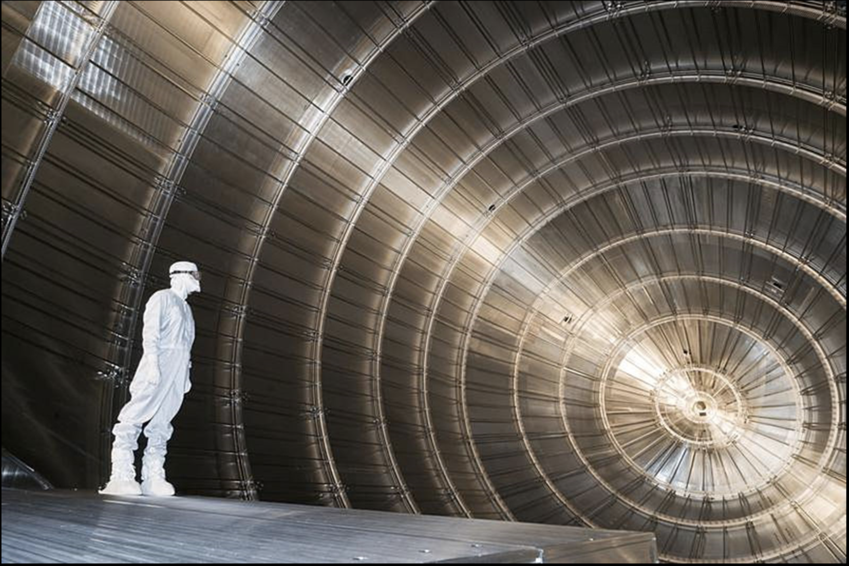
Neutrinos!
Present Understanding & Future Prospects
Albert De Roeck
CERN, Geneva, Switzerland
28 July Maria Laach/Bad Honnef

Slide 2
3 Lectures
Lecture 1:
  Introduction to neutrinos
  History of neutrino physics and open questions.
Lecture 2:
  Neutrino oscillation physics
  Neutrino properties
Lecture 3:
  Cosmological neutrinos
  Searches for the 4th generation
  Next generation of neutrino experiments & LHC

Slide 3
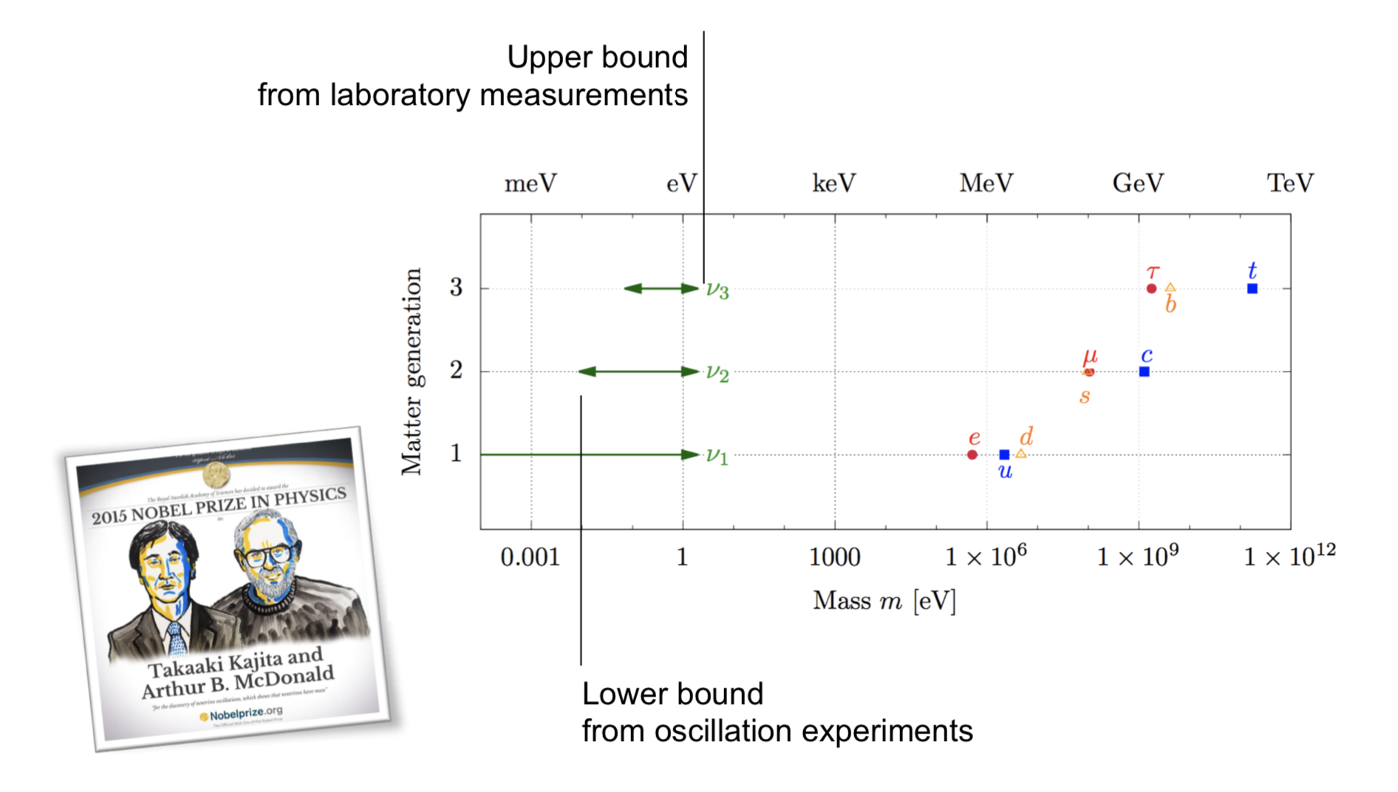
Neutrino Mass
Neutrinos have small masses compared other known fermions

Slide 4
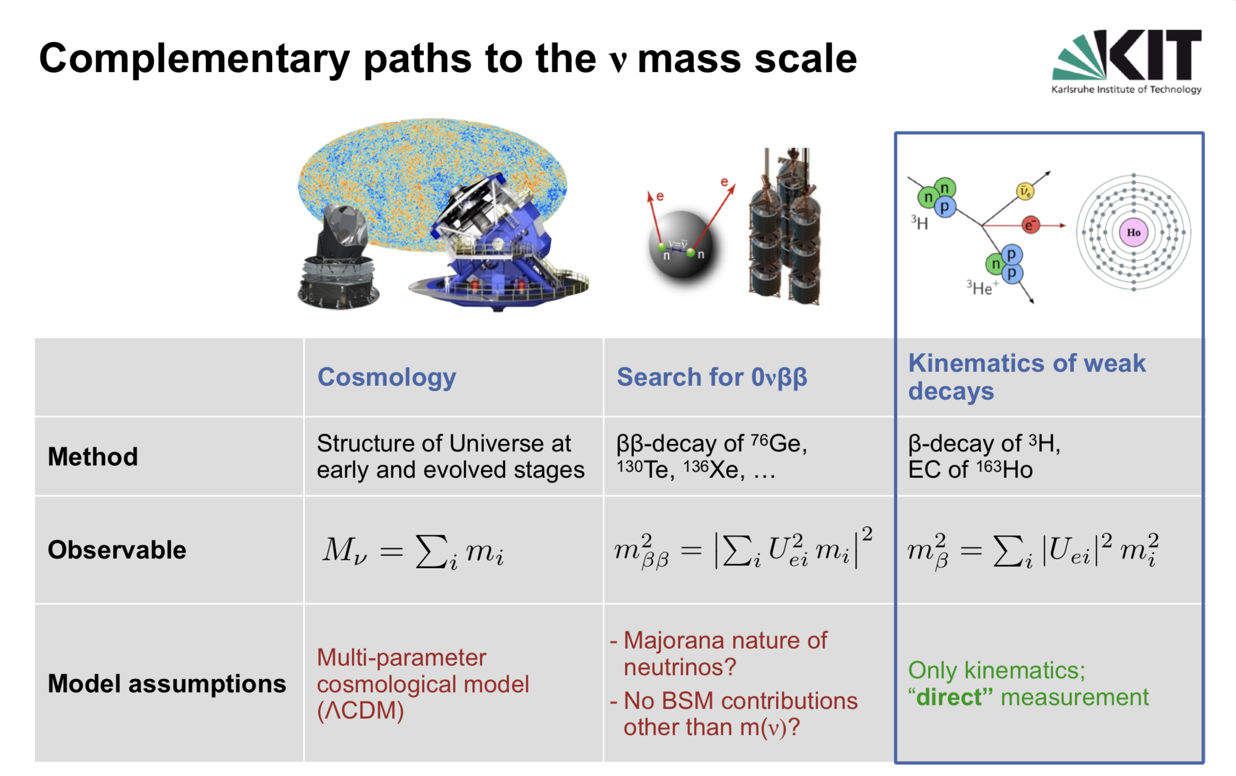
Neutrino mass measurents

Slide 5
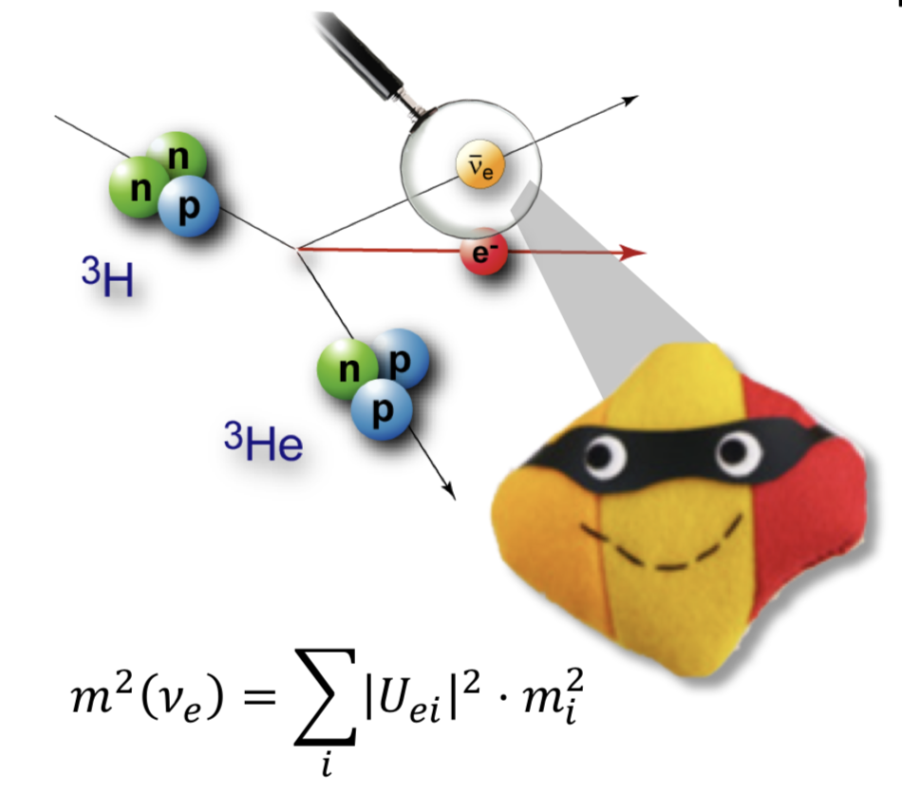
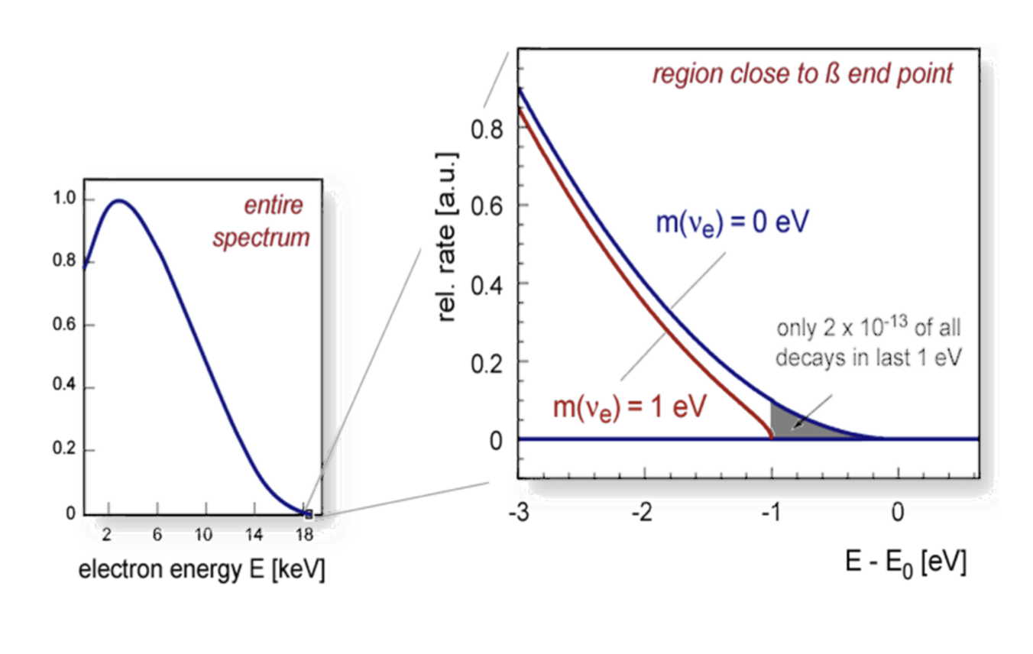
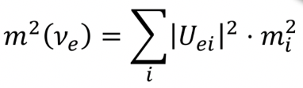

Neutrino Mass Measurements
The KATRIN experiment: endpoint measurement of tritium decay
What is measured really in this experiment is the effective electron anti- neutrino mass defined by with the PMNS mixing elements

Slide 6
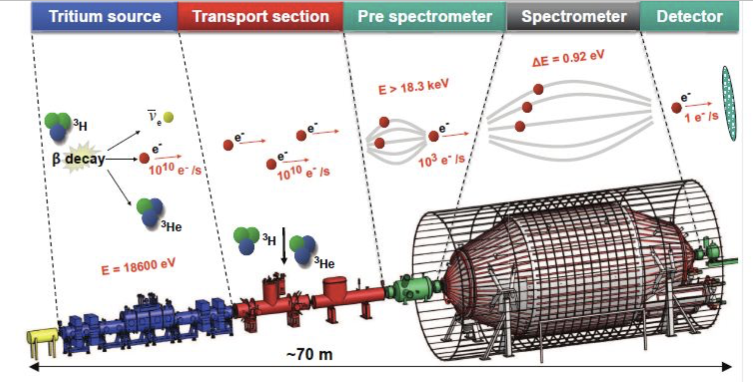
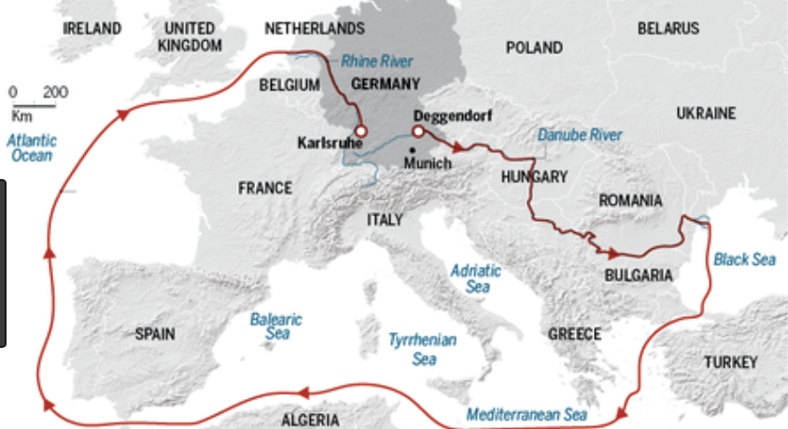
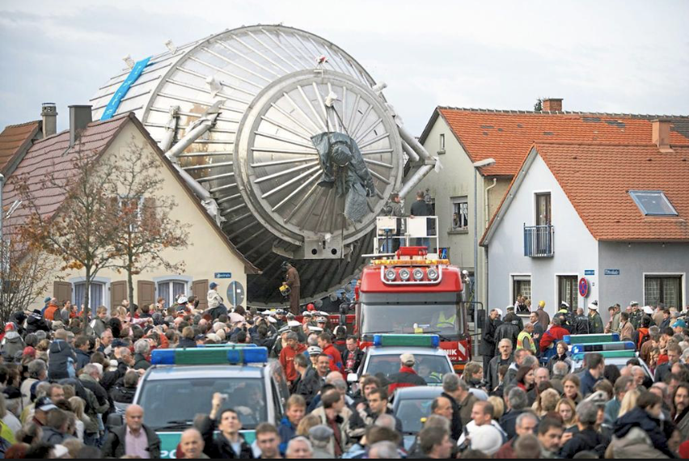
KATRIN Experiment: the Mass of ν_{e}
The KArlsruhe TRItium Neutrino experiment (KATRIN) is designed to measure the mass up to projected sensitivity of 0.2 eV
To achieve this, KATRIN will perform high-precision spectroscopy of the endpoint region of the tritium beta-decay spectrum.
Recent result Mν_{e} < 1.1 eV (September 2019)

Slide 7
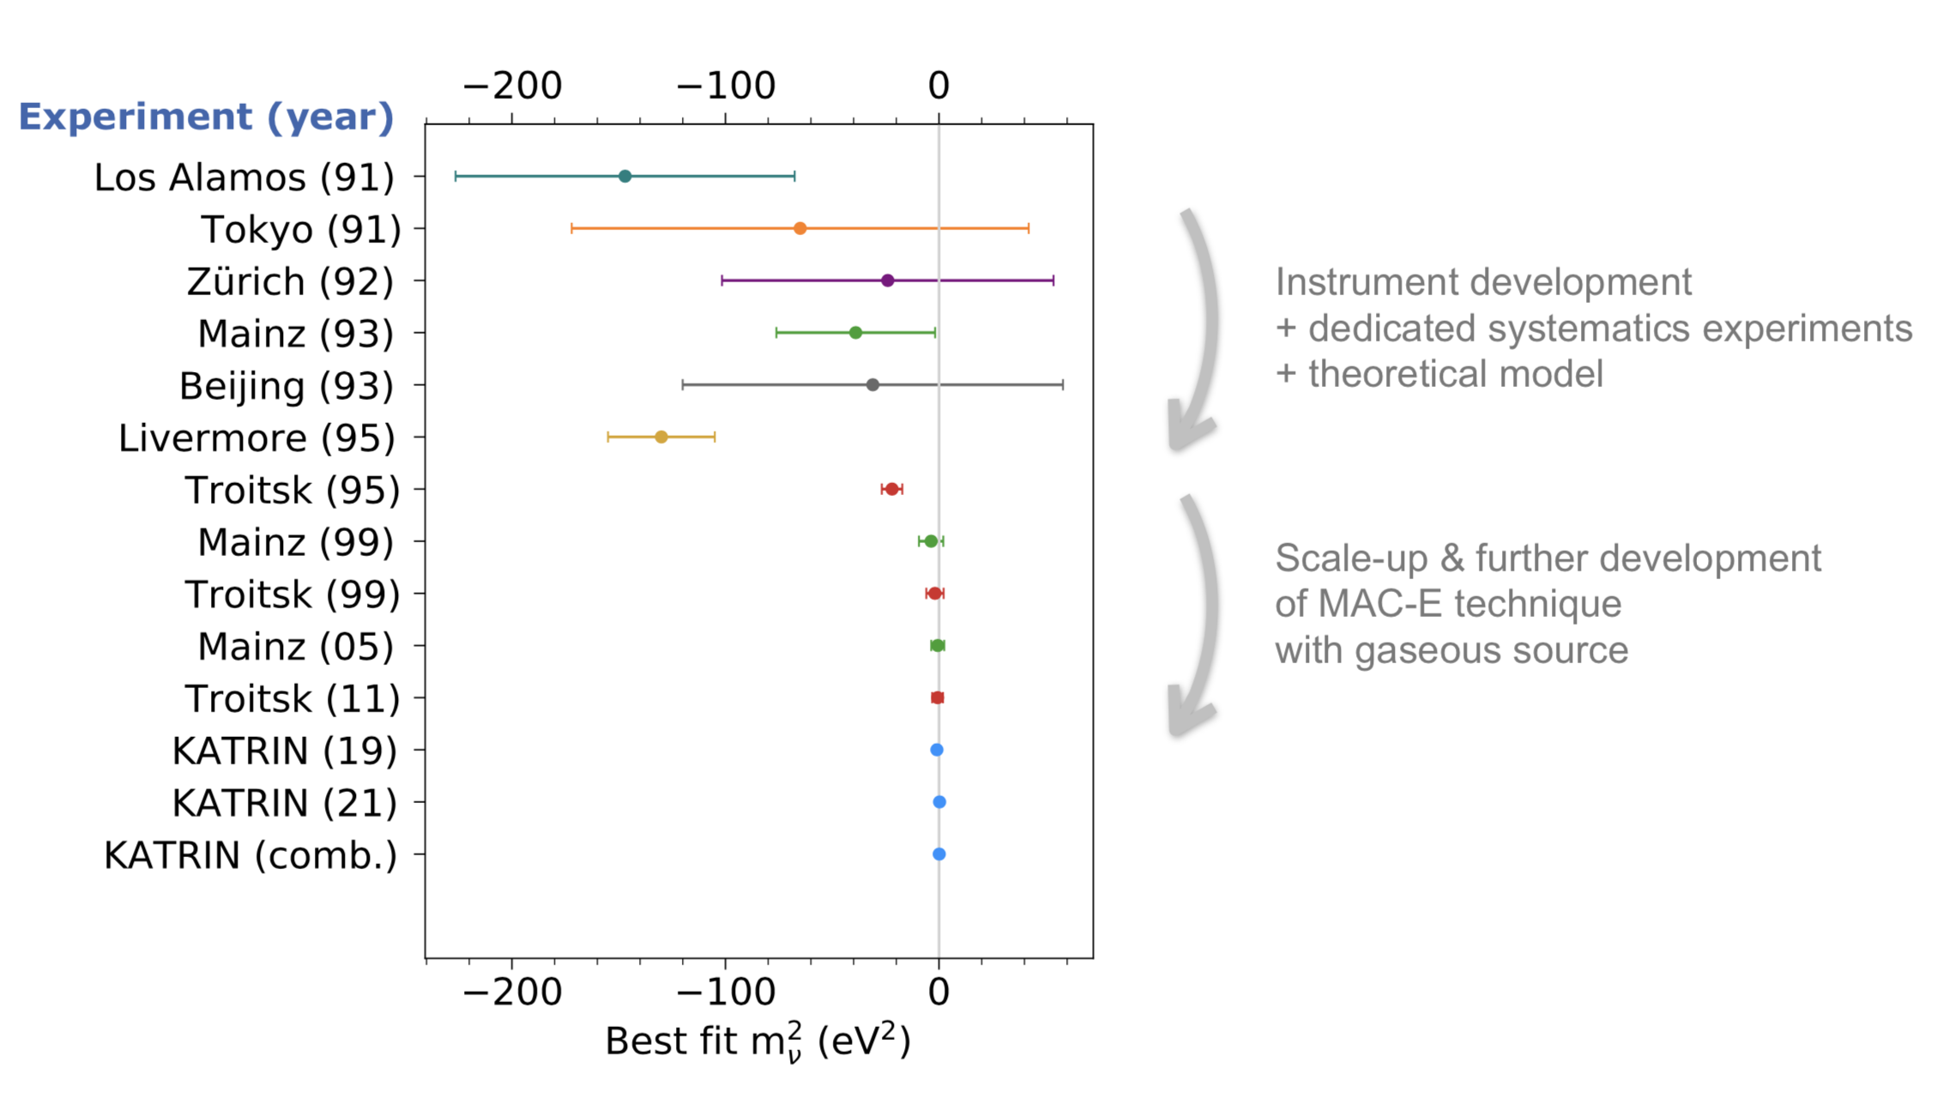

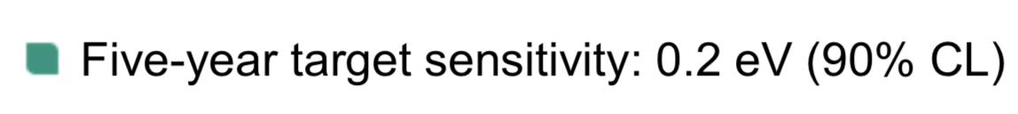
KATRIN Experiment: the Mass of ν_{e}
World evolution
over last 30 years
Latest Result (May 2021):
arXiv:2105.08533

Slide 8
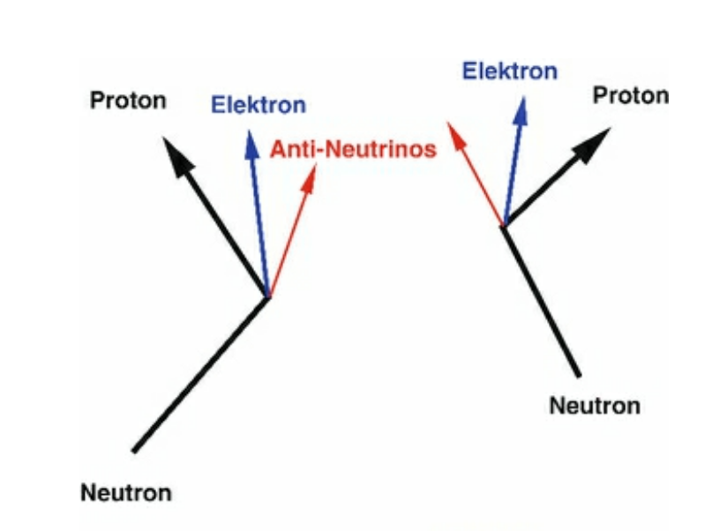
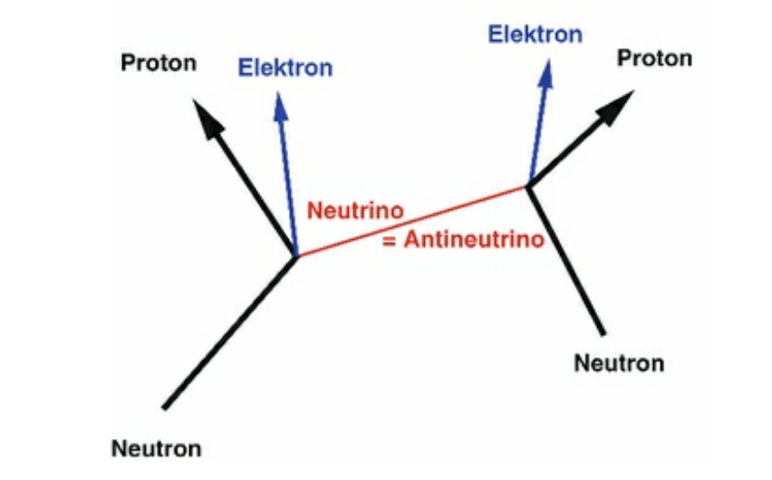
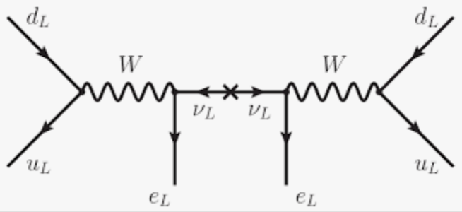
Neutrinoless Double Beta Decay
Are neutrinos their own antiparticles? We do not know this yet!
The highly anticipated experimental test is the observation of neutrino-less double beta decay, ie two simultaneous beta-decays within one nucleon, without neutrino emission

Slide 9
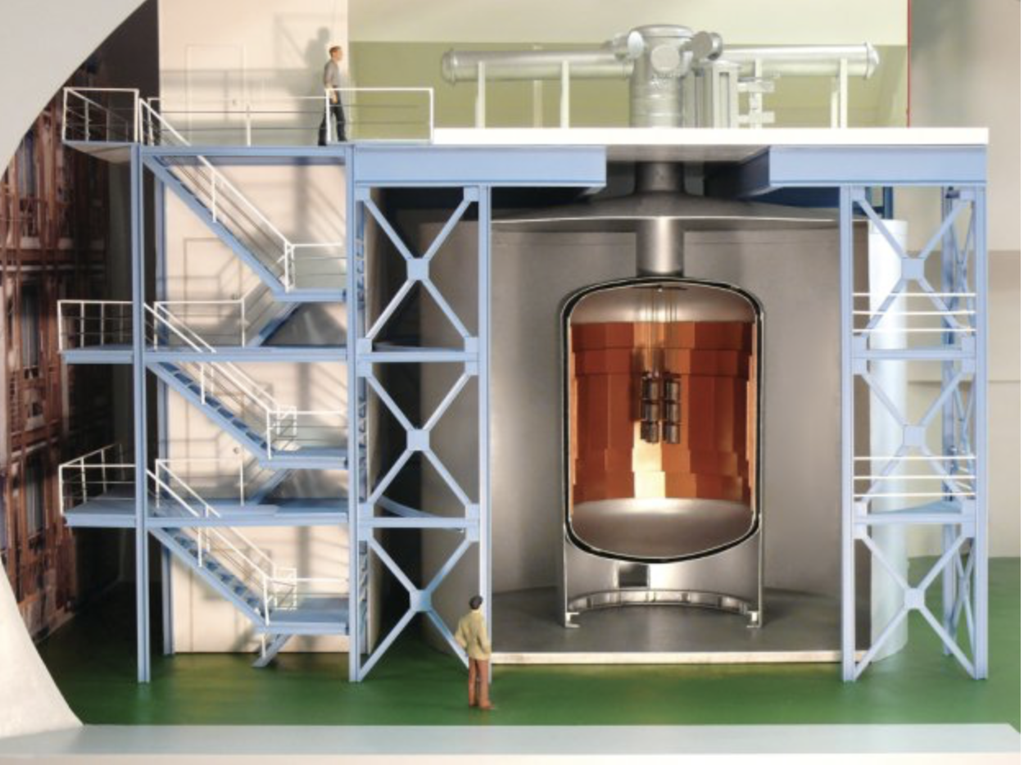
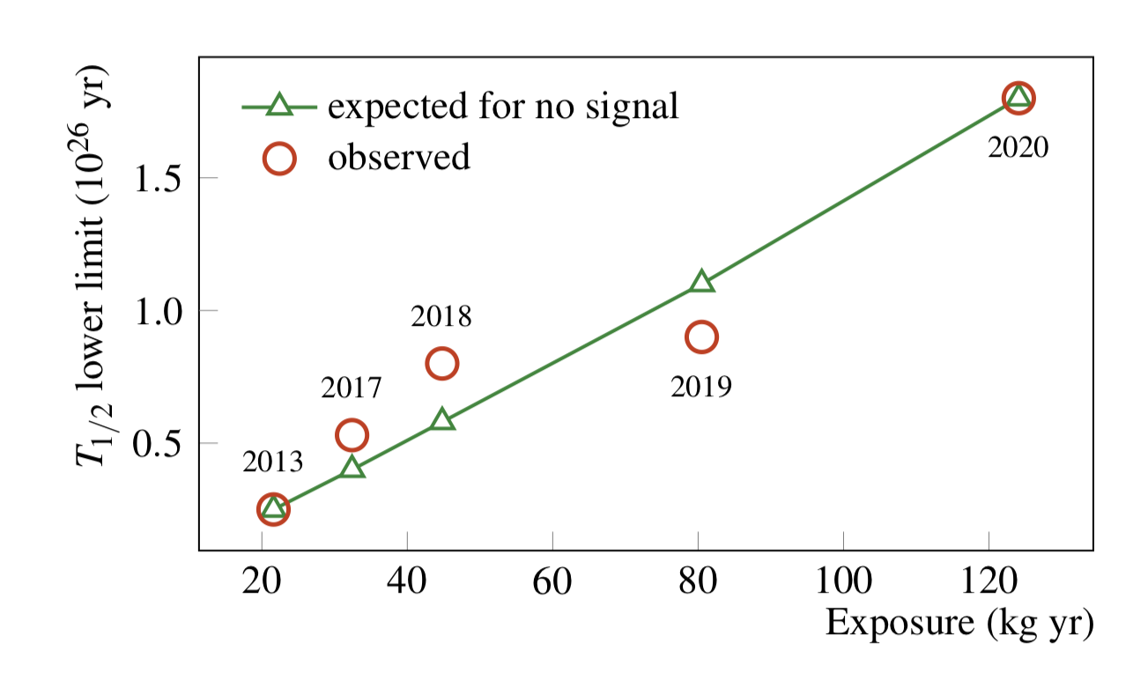
Neutrinoless Double Beta Decay
GERDA (GERmanium Detector Array) experimemt at LNGS (Gran Sasso/IT)
127.2 kg.year exposure
between 2011-2019
Experiment now completed
No 0𝝂𝝂𝜷 signal observed ☹
Final results: arXiv:2009.06079
Lower limit (90% C.L.) on the 0νββ
decay half-life of ⁷⁶Ge set by GERDA
as a function of the exposure

Slide 10
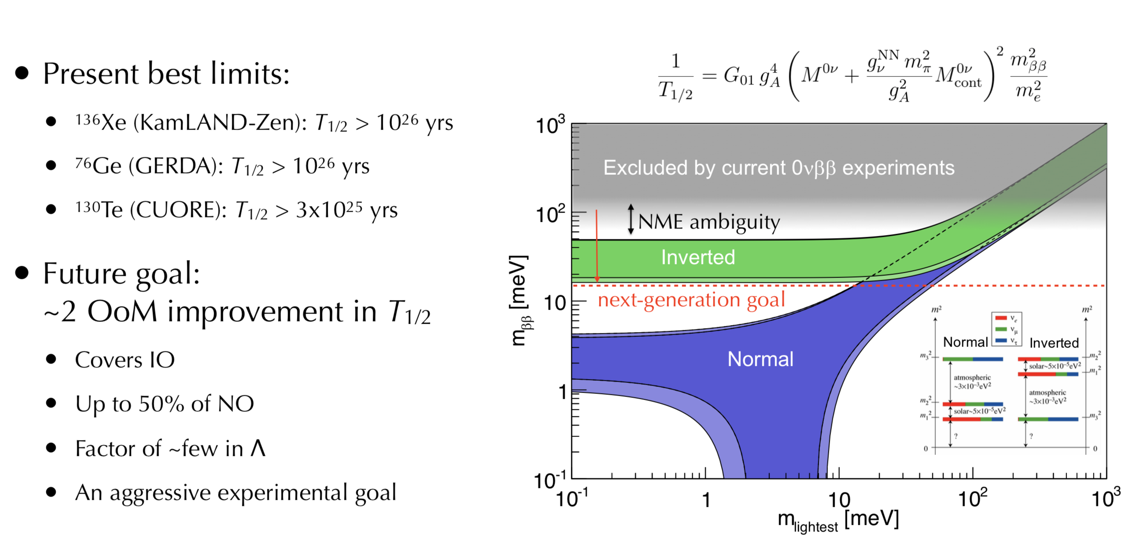
Neutrinoless Double Beta Decay
Experimental status
Many experiments operating, planned or in R&D: LEGEND, SNO+, NEXT…

Slide 11
Neutrinos & Cosmos
Neutrinos very relevant for cosmological studies. Examples:
  Neutrinos affecting the Big Bang nucleo-synthesis.
  Relic neutrinos from the Big Bang: cosmic neutrino background, probe beyond the CMB horizon
  Neutrinos from supernova explosions: study supernova dynamics
  Mass limits on neutrinos and number of different neutrinos from cosmology (eg from Planck)
Sum of the mass of all the neutrinos in the Universe is larger than that of all the stars

Slide 12
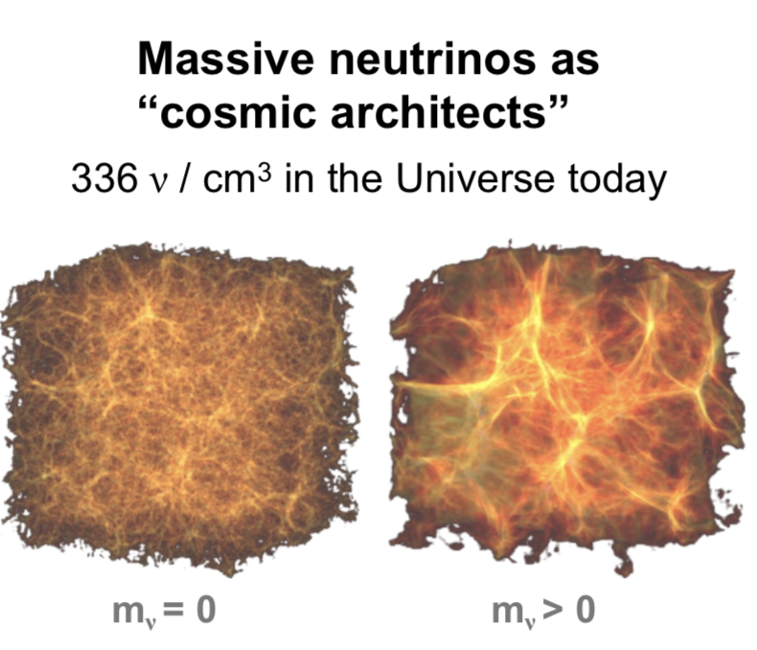
Neutrinos and Structure
If the mass of the neutrinos would be 40 eV or more, the universe would have already collapsed under its own gravity before human beings could walk the earth…

Slide 13
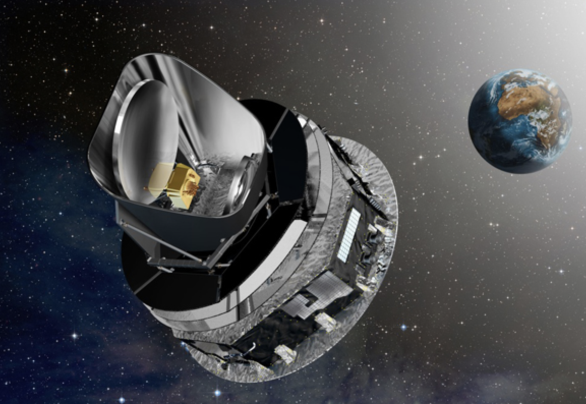

Neutrino Mass
Cosmological limit on the sum of the masses of neutrino flavors e.g. from the Planck satelite experiment:
This assumes however that neutrinos are stable with a lifetime larger than the age of the Universe
If decays are allowed the limit can as much as 1eV
These measurements are sensitive to the neutrino masses through the gravitational effects of the relic neutrinos left over from the Big Bang on the CMB

Slide 14
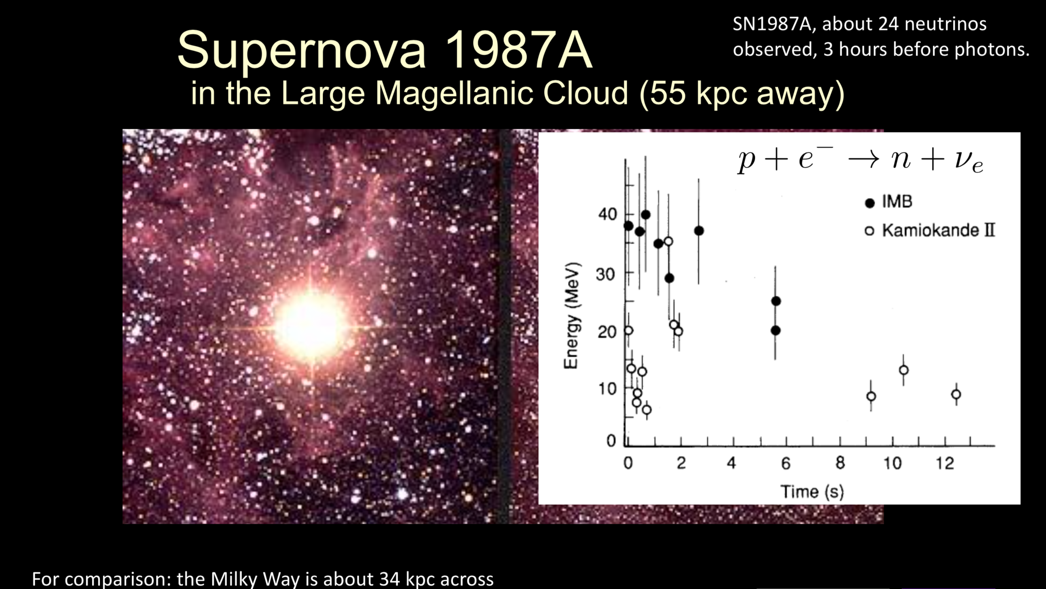
Study of Supernova Explosions
In 1987 in total ~24 events were detected in 3 experiments

Slide 15
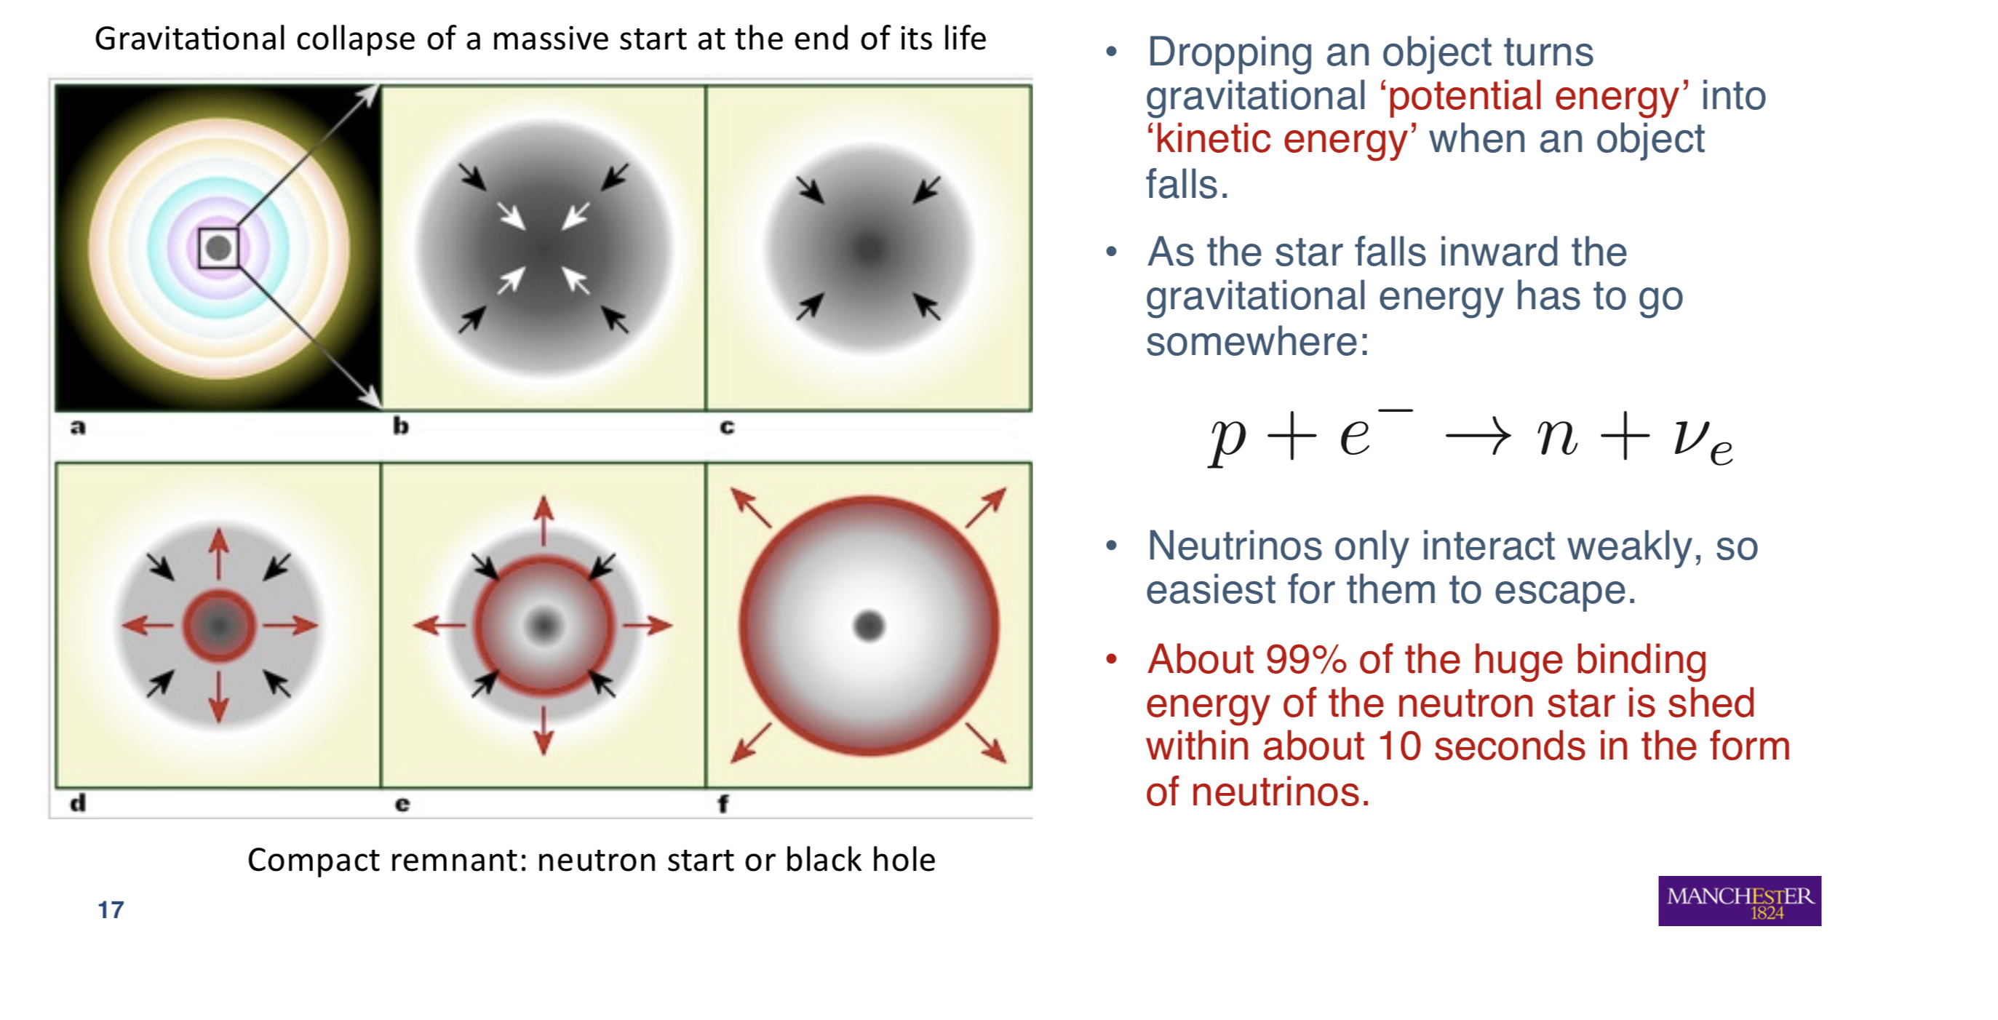
Type II Supernovae
We are waiting for the next nearby supernova to go off (it is kinda late….)

Slide 16
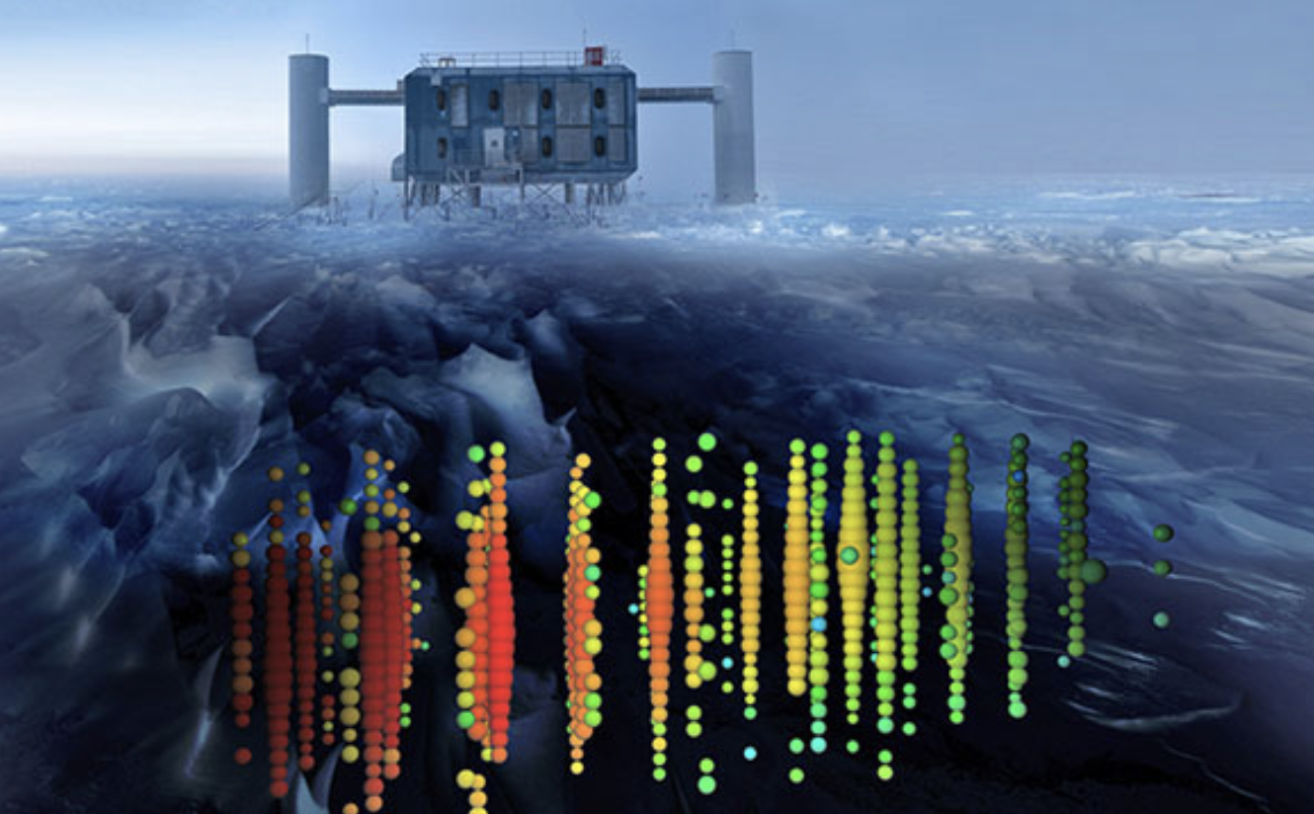
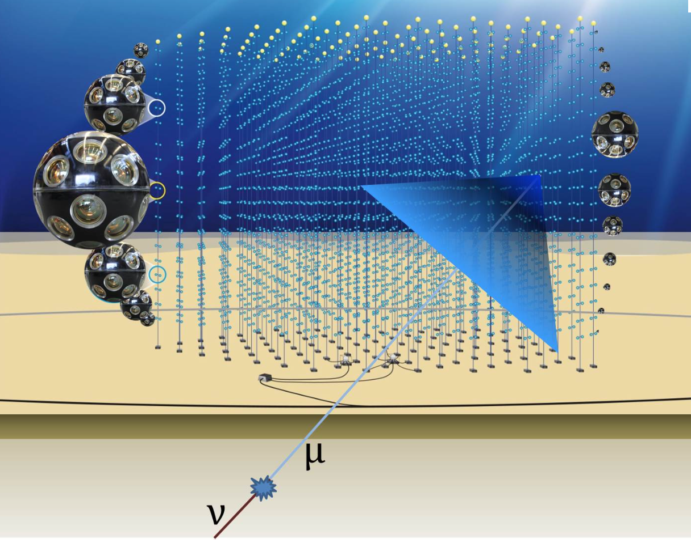
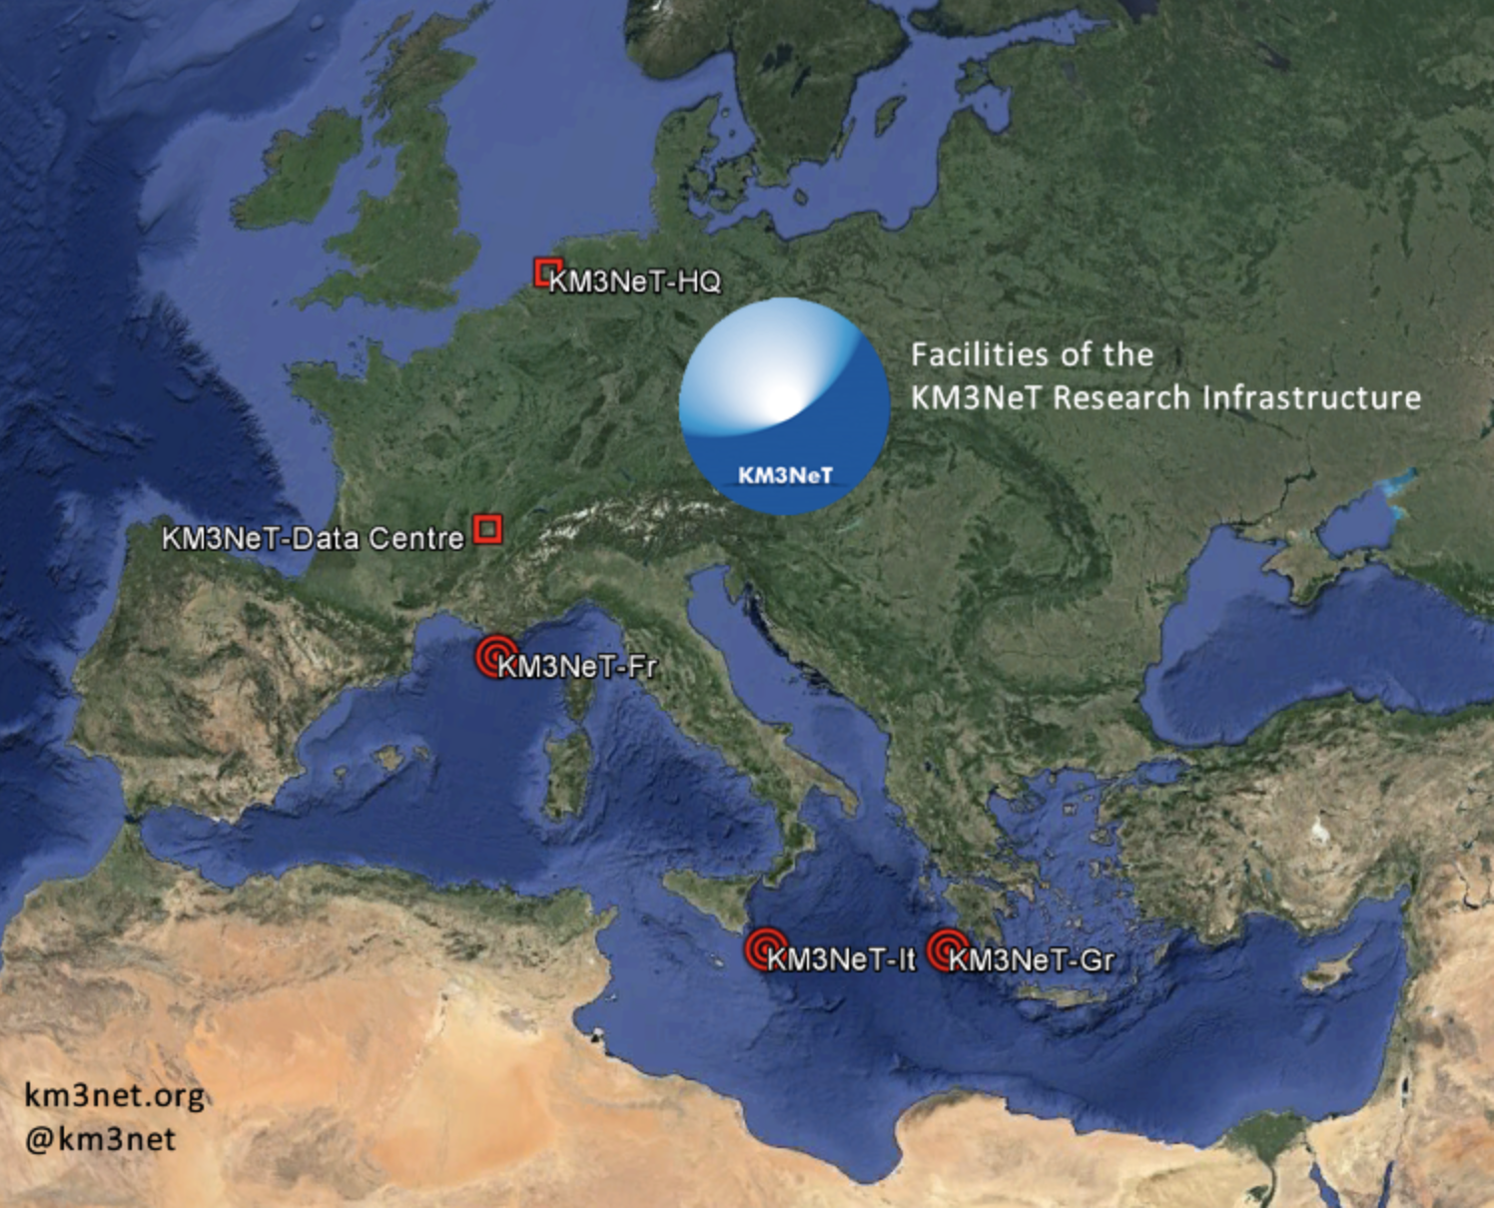
Neutrino Astronomy
Build gigantic detectors 1 km³ of size and beyond…
Use the resources of planet Earth
The IceCube Experiment
-> In the ice of Antartica
The KM3NET Experiment
-> In the Mediterranian Sea

Slide 17

Neutrinos in the Ice

Slide 18
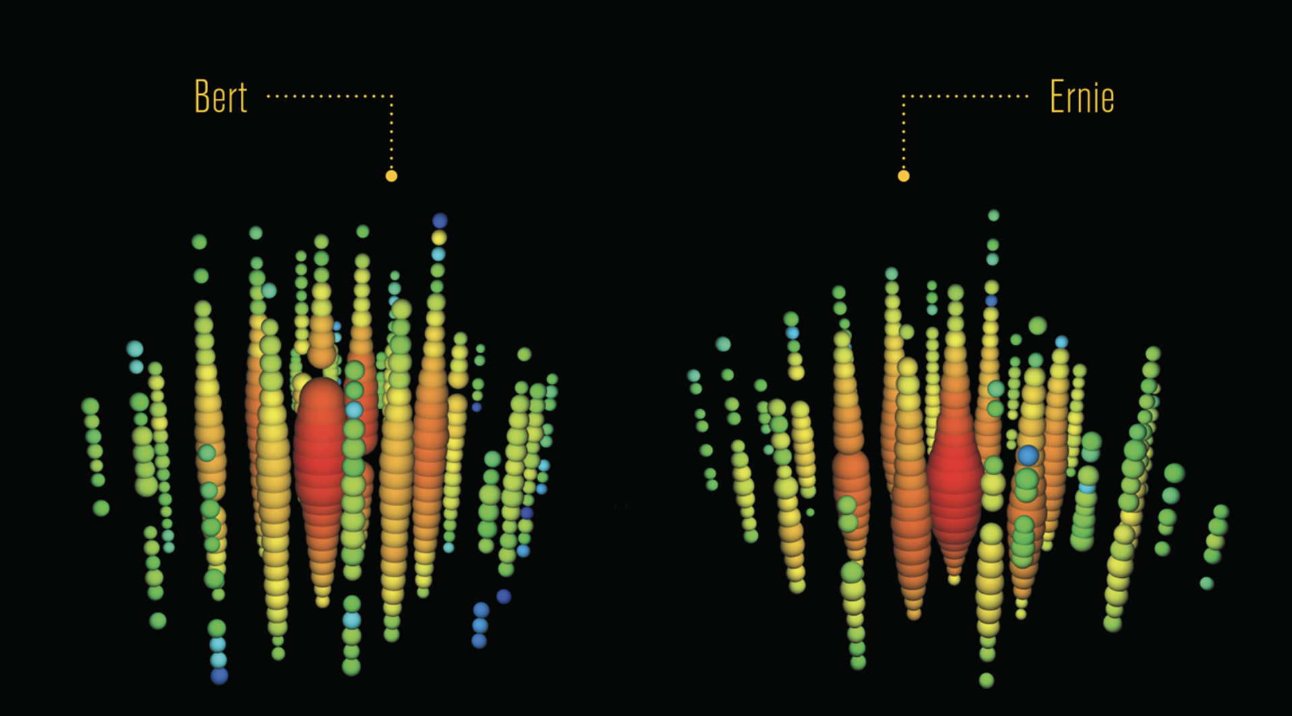

Most Energetic Neutrino Interactions
2012: Extra-galactic neutrinos with energies around 1-2 PeV observed
in the IceCube detector (1 PeV = 10⁶ GeV)
They were named “Bert” and “Ernie

Slide 19
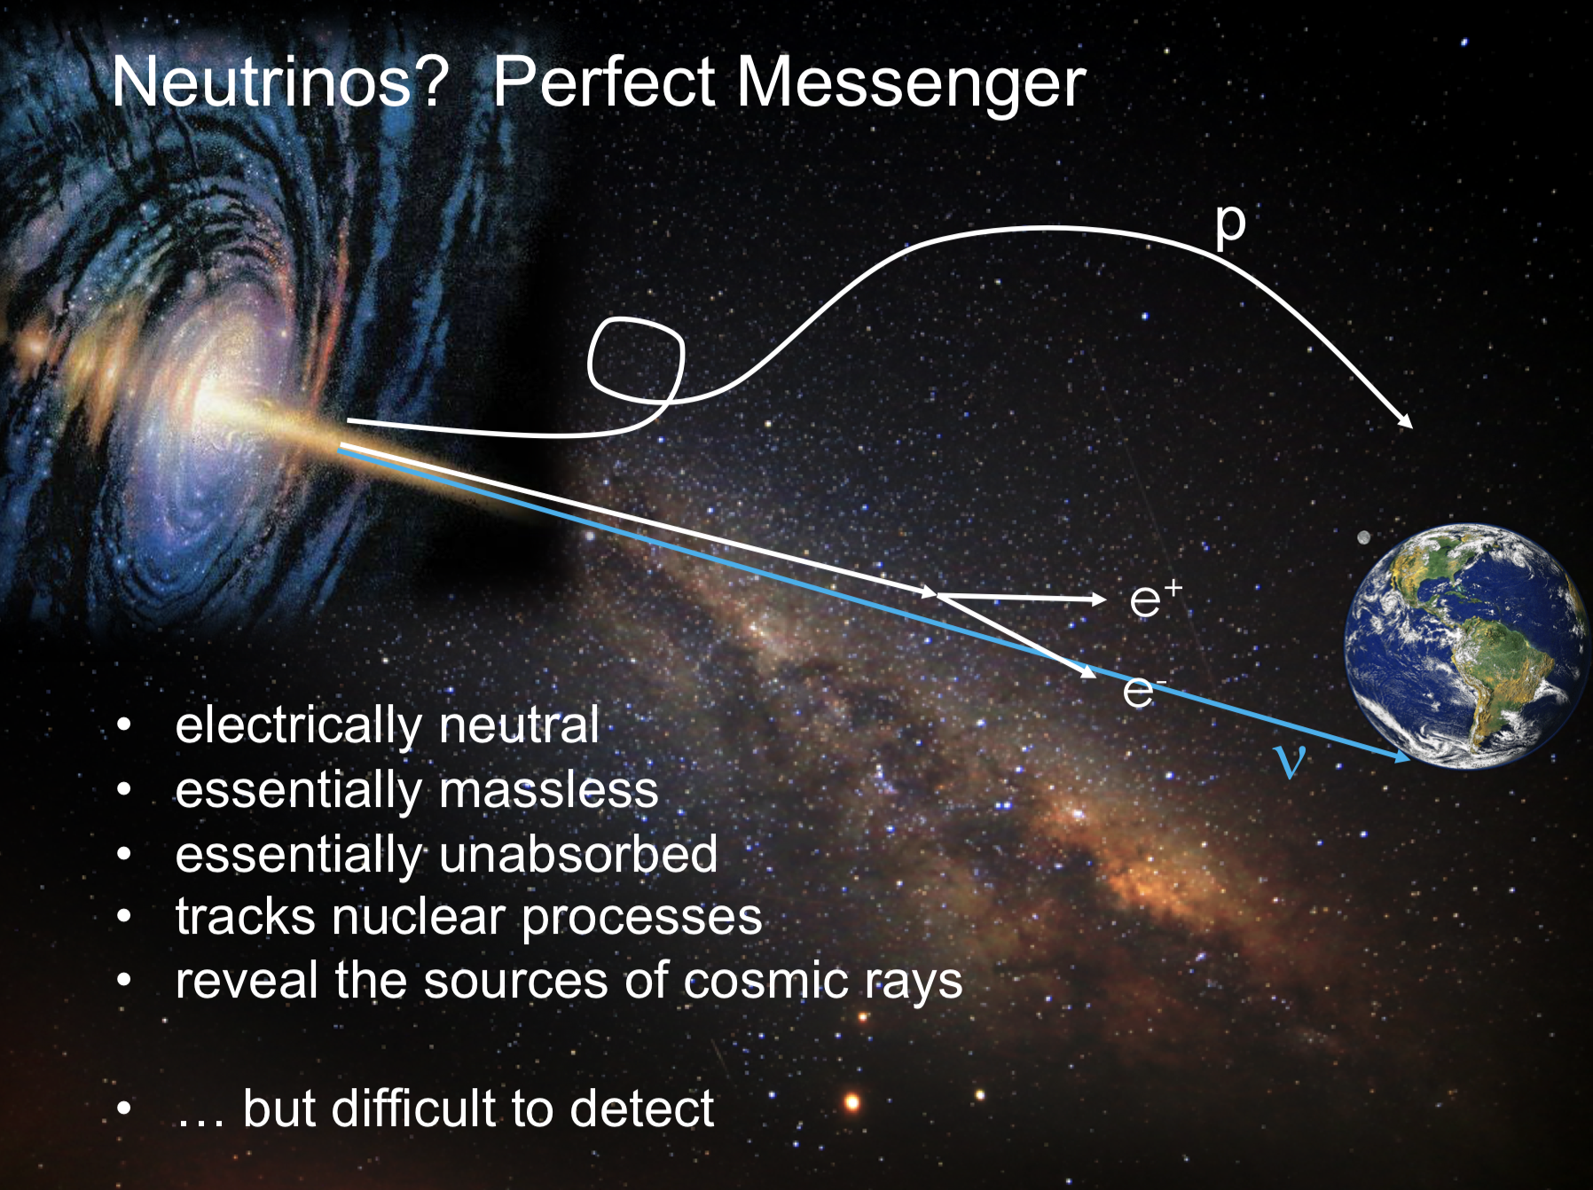
Multi-Messenger Astronomy
Now: (Icecube)
neutrinos +photons
Next?
neutrinos and
gravitational waves?

Slide 20
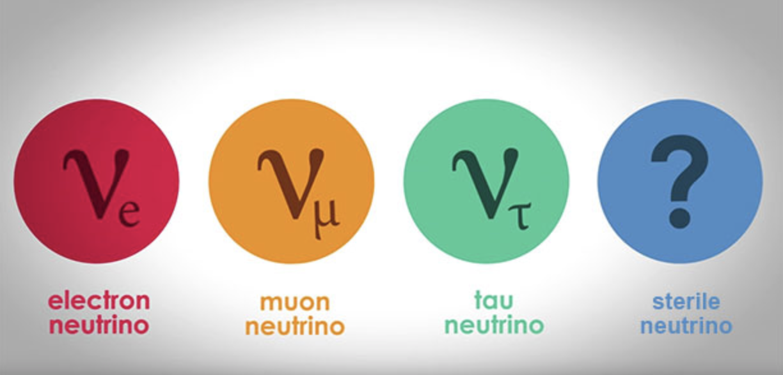
Are there more than 3 Neutrinos?
Is there is a 4th (5th…) neutrino then it has to be quasi-sterile, ie should not couple significantly to other fermions and bosons, as we know from measurements at LEP
Could mix with the known neutrinos
Some indication since more than 10 years (LSND, reactor anomalies, Gallium anomalies)
The interpretation is still controversial/unclear..

Slide 21
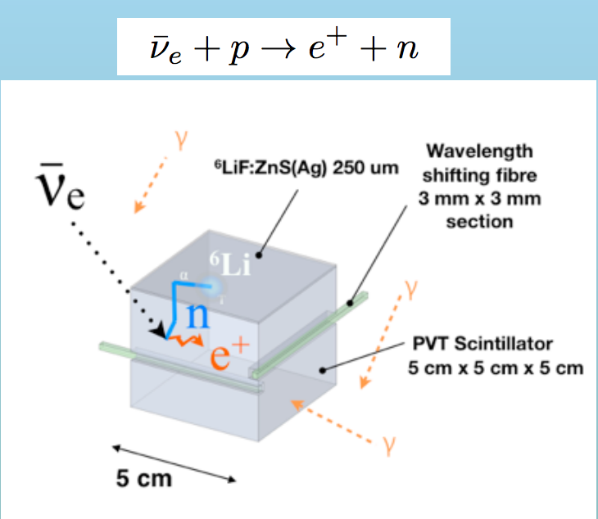
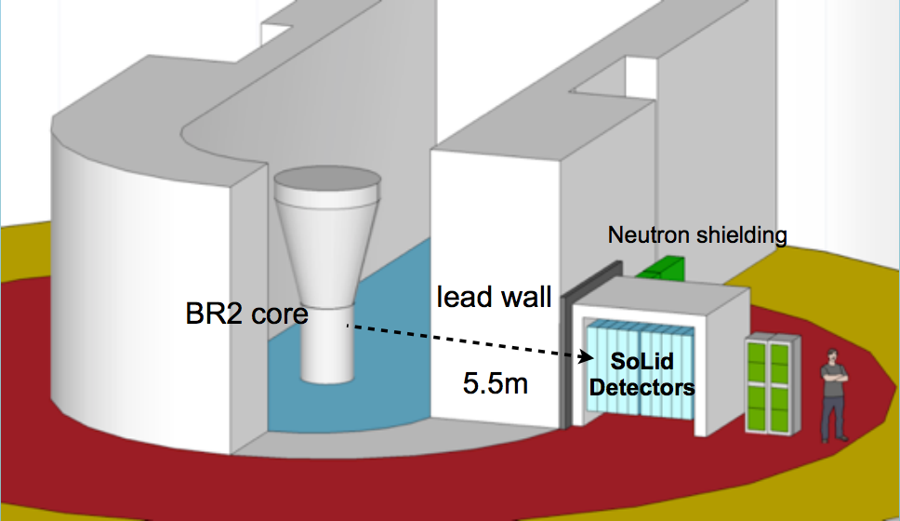
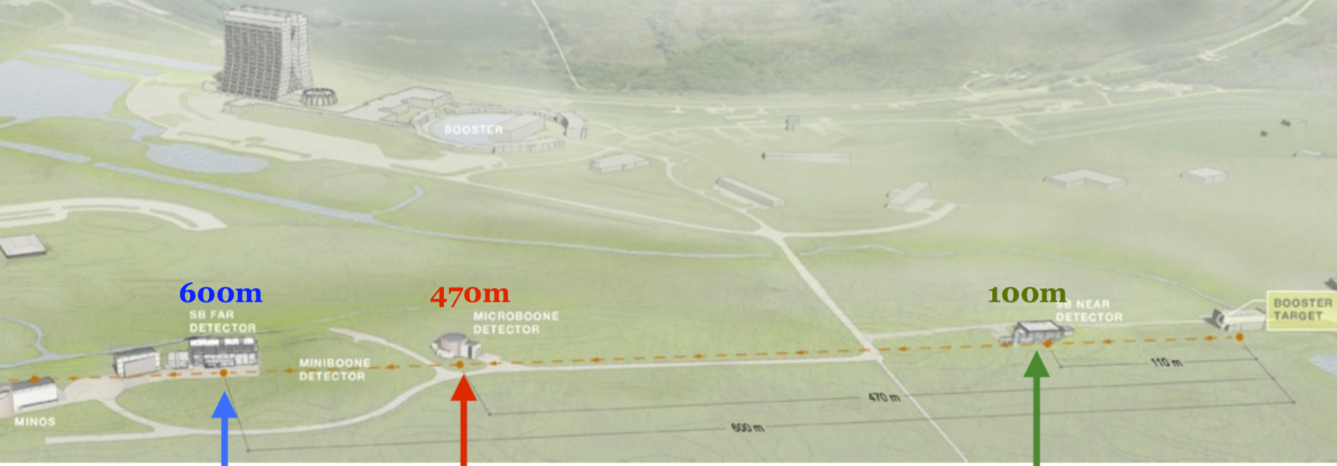
New Short Baseline Experiments will check!
Experiments at reactors, eg the SoLid
experiment @BR2 reactor in Belgium
Also: Prospect, STEREO, DANSS, NEOS
FNAL Short-Baseline Neutrino programme:Neutrino beam from Booster
Start ~2020
ICARUS T600
(476 t)
MicroBooNE (89 t)
SBND (112 t)

Slide 22
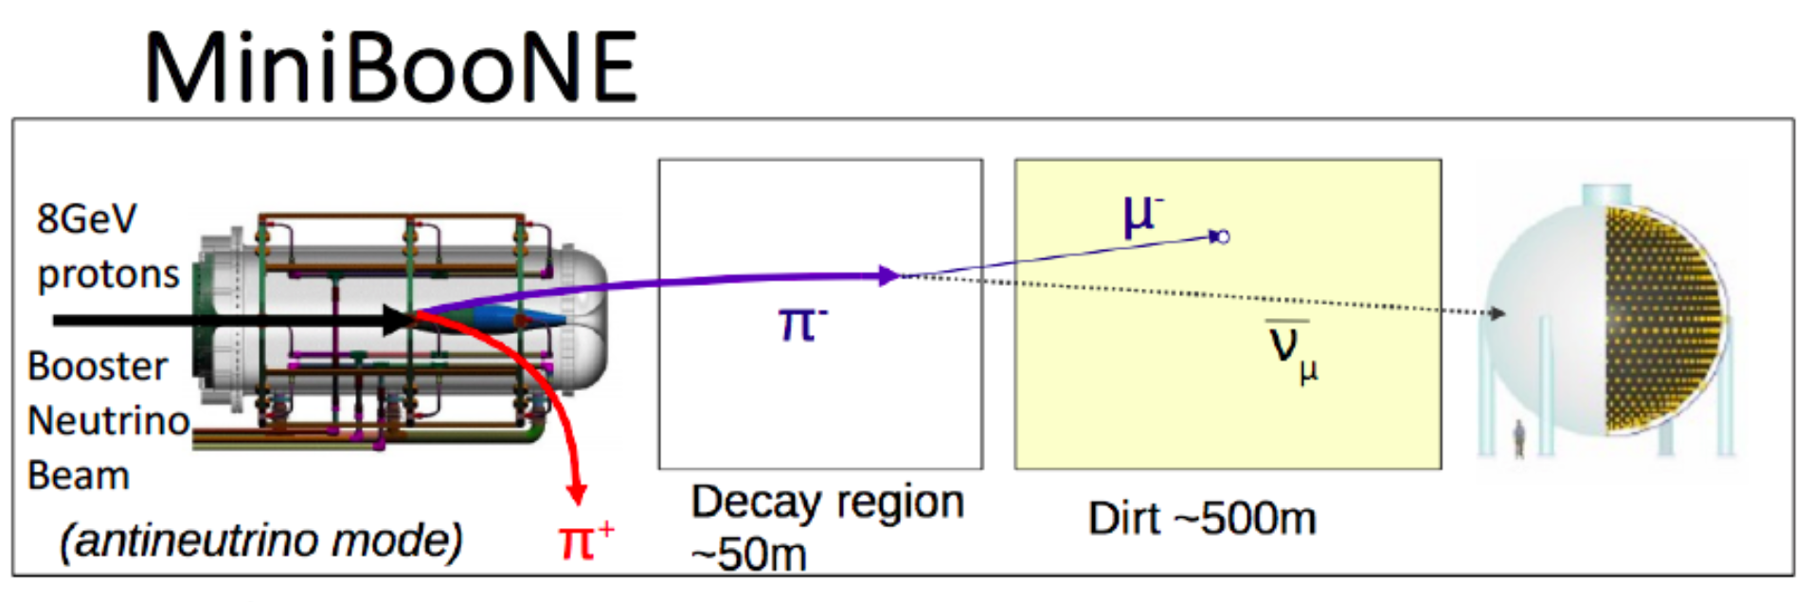
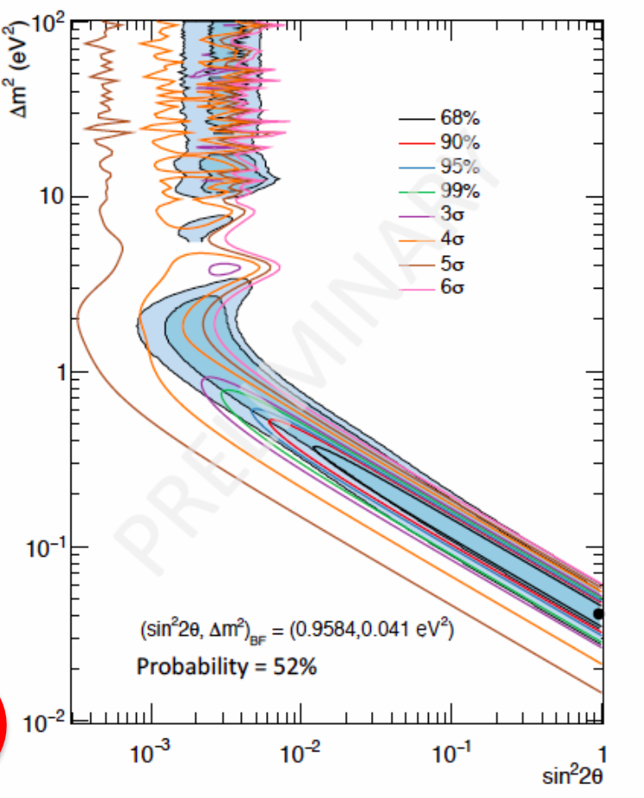
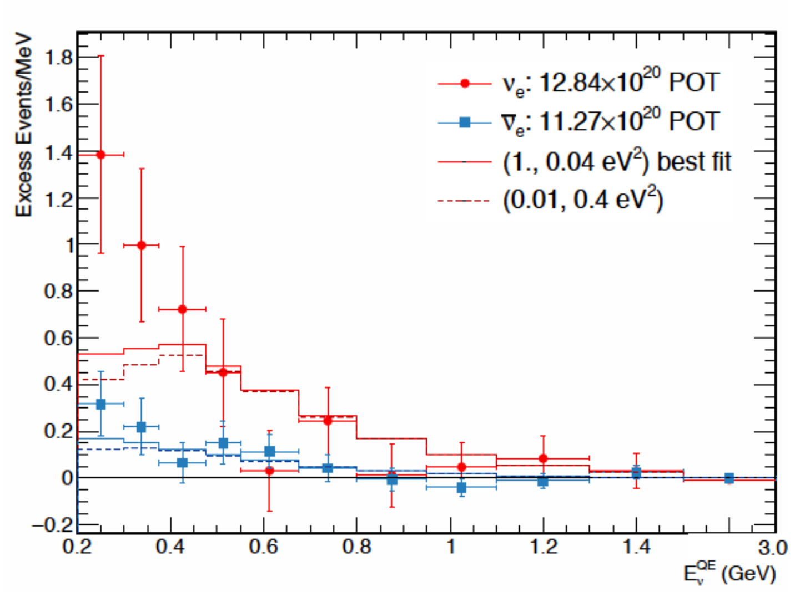
MiniBooNE 2018
Search for electron neutrino
appearance in short baseline
accelerator experiment.
6.3 sigma excess reported
combining the data with LSND
arXiv:1805.12028
Excess of events over expectation
Conform with LSND
excess 10 years ago
Preferred
region
Caused by a new sterile neutrino?
The jury is still out..

Slide 23
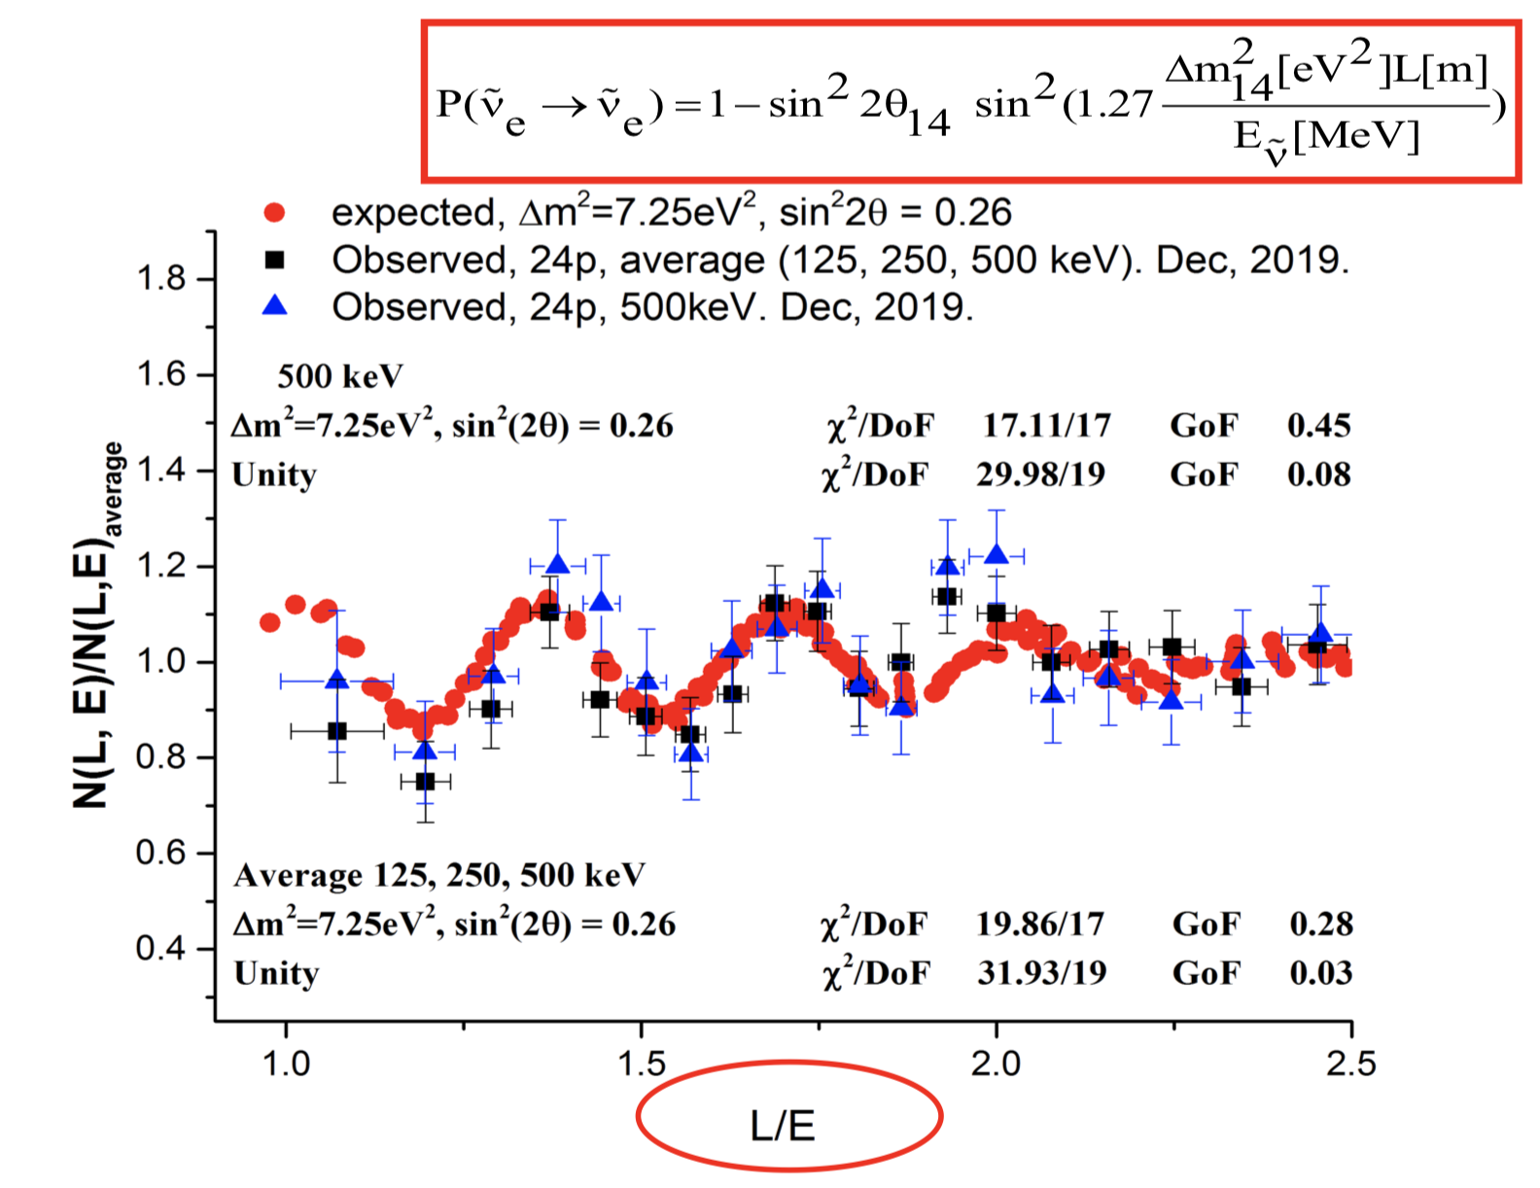
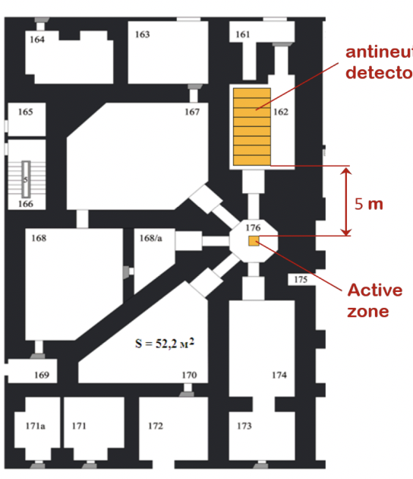
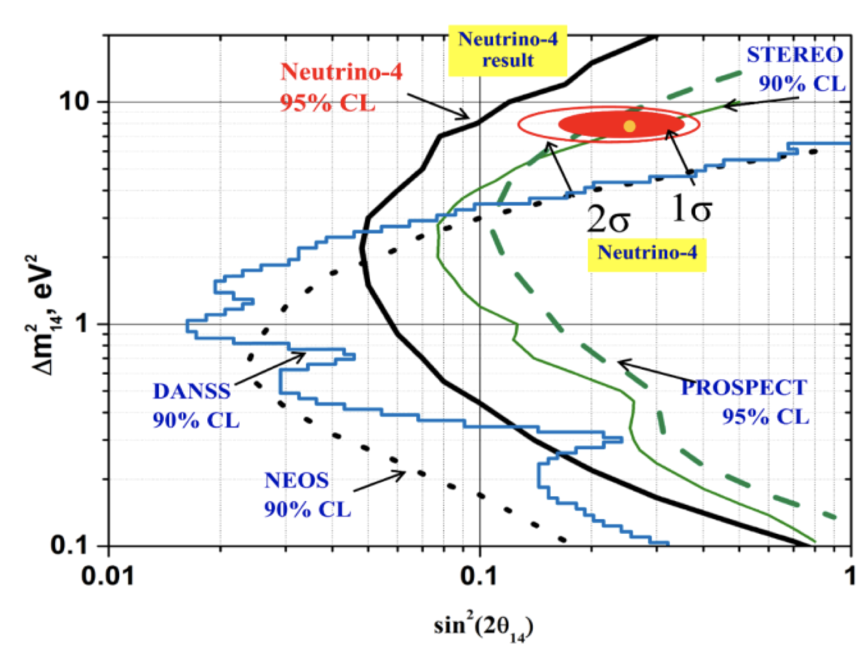
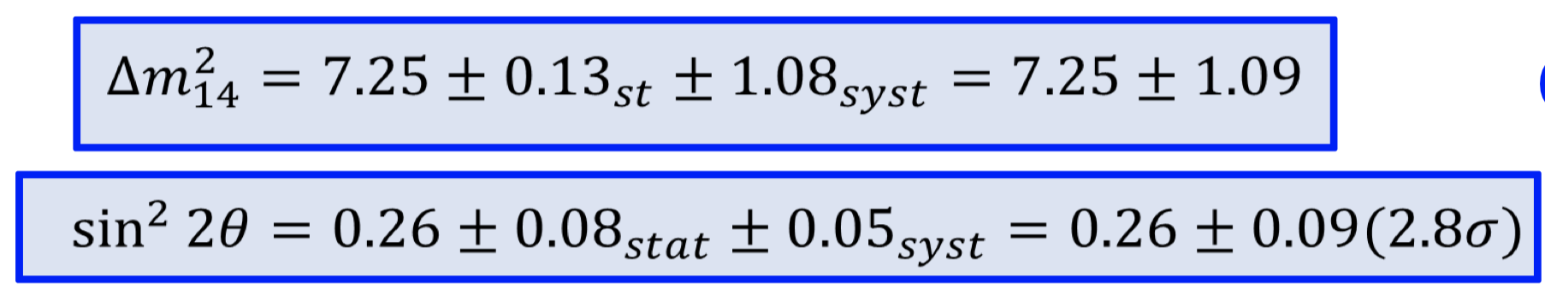
Neutrino-4 Experiment: 2020
2m³ liquid
scintillator
detector at a
90 MW reactor
in Russia
3 years long
measurement
2.8𝞼 signific.
arXiv:1809.10561 (Jan 2020)
Data analysis strongly critized
Issues with the energy resolution
Less biased approach -> ~2.2𝜎 effect only
“No-oscillation scenario” not excludedat 3𝜎
The jury is still out!
arXiv:2101.06785
Notes:
𝞼

Slide 24
The Future
“The age of precision physics with neutrinos”
Detectors for oscillation physics studies

Slide 25
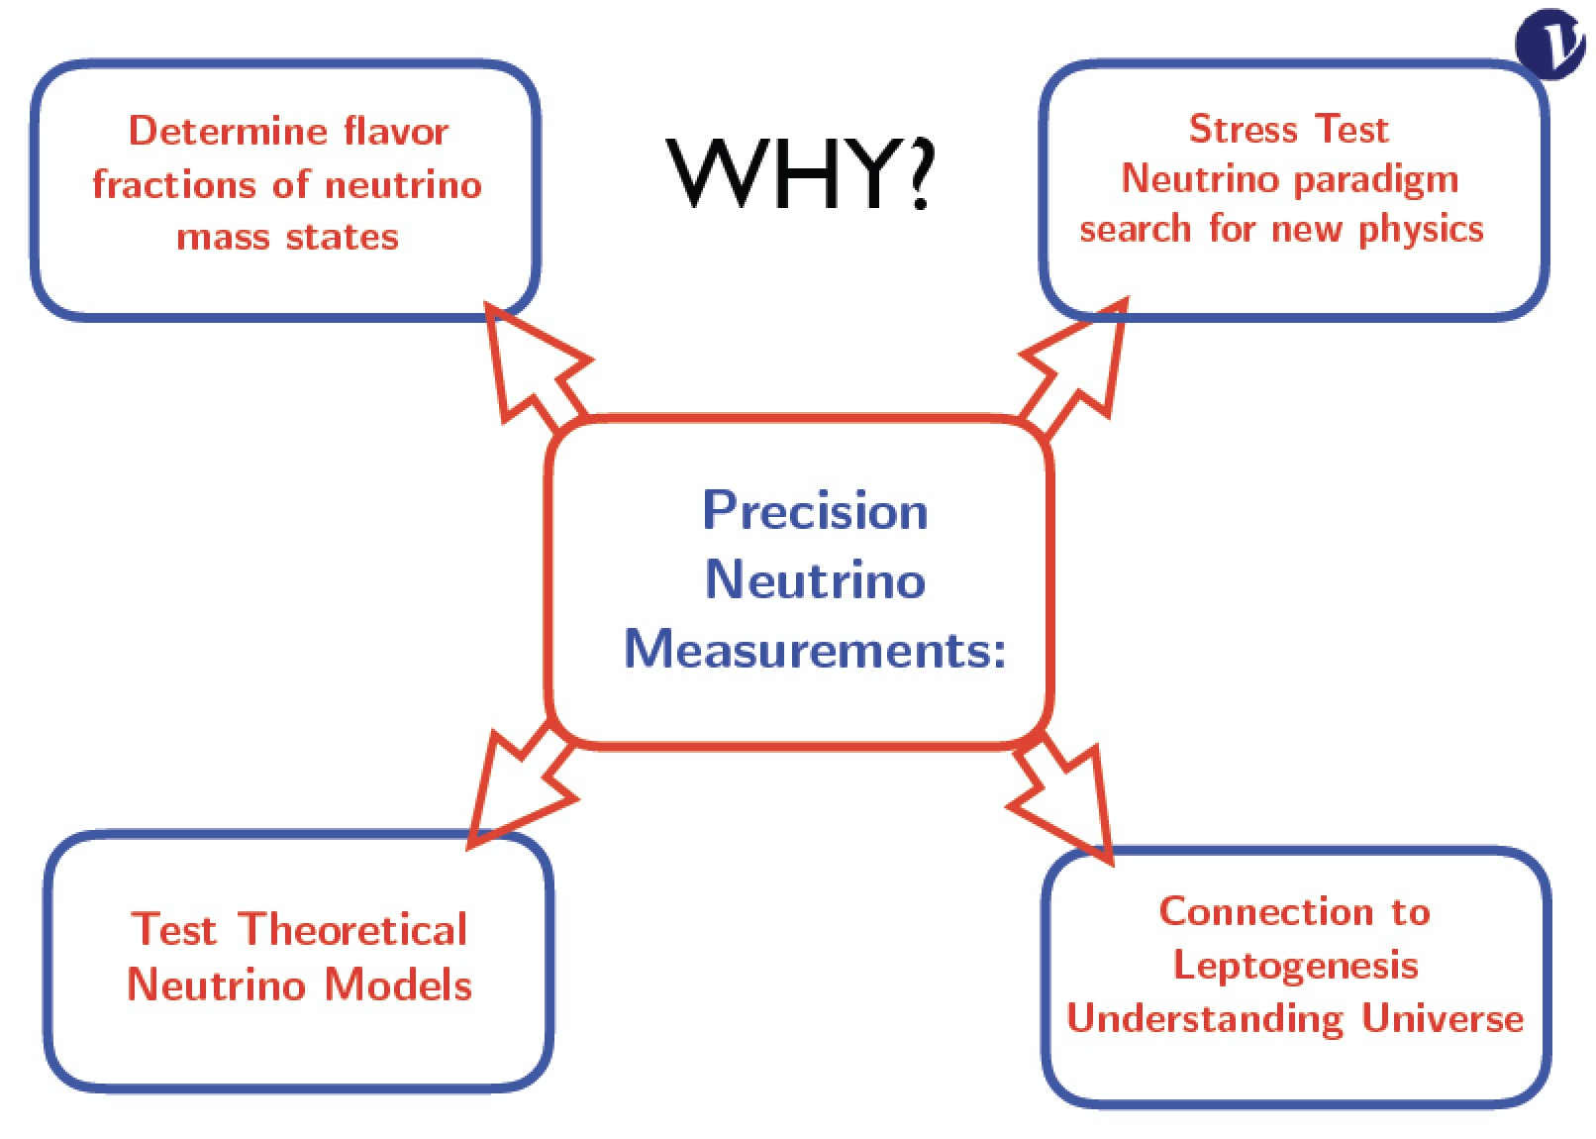
Precision Neutrino Physics
We are entering the era of precision neutrino physics !!

Slide 26
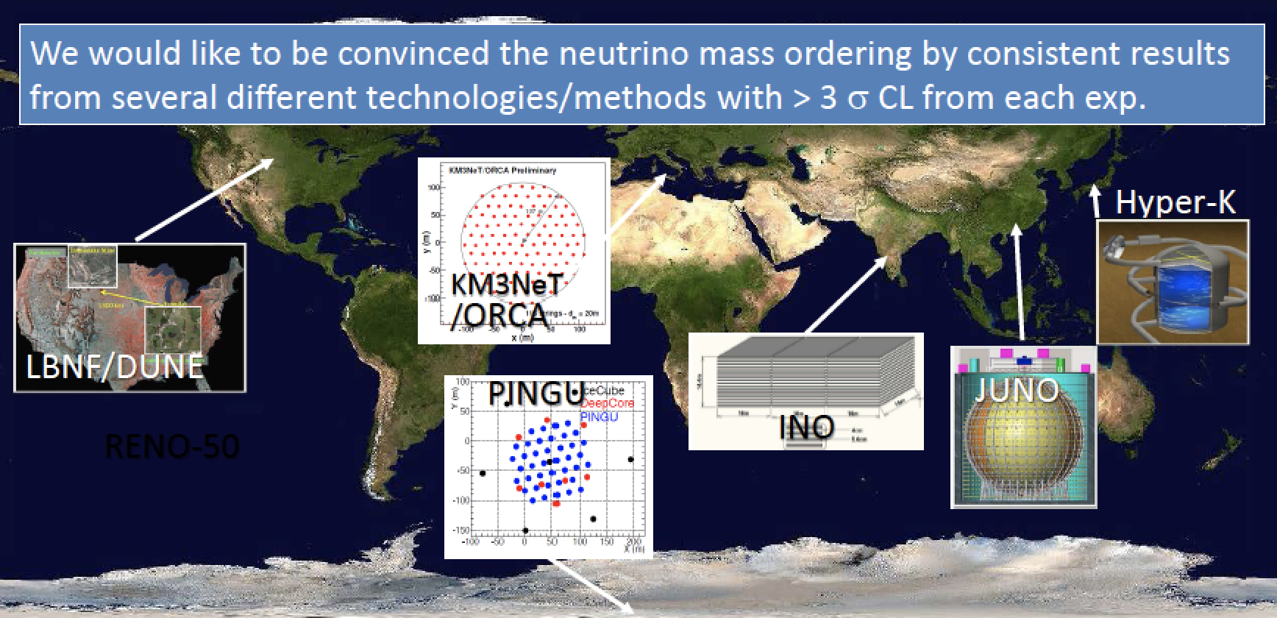
Future Neutrino Experiments
Eg. experiments that will contribute to the mass ordering question

Slide 27
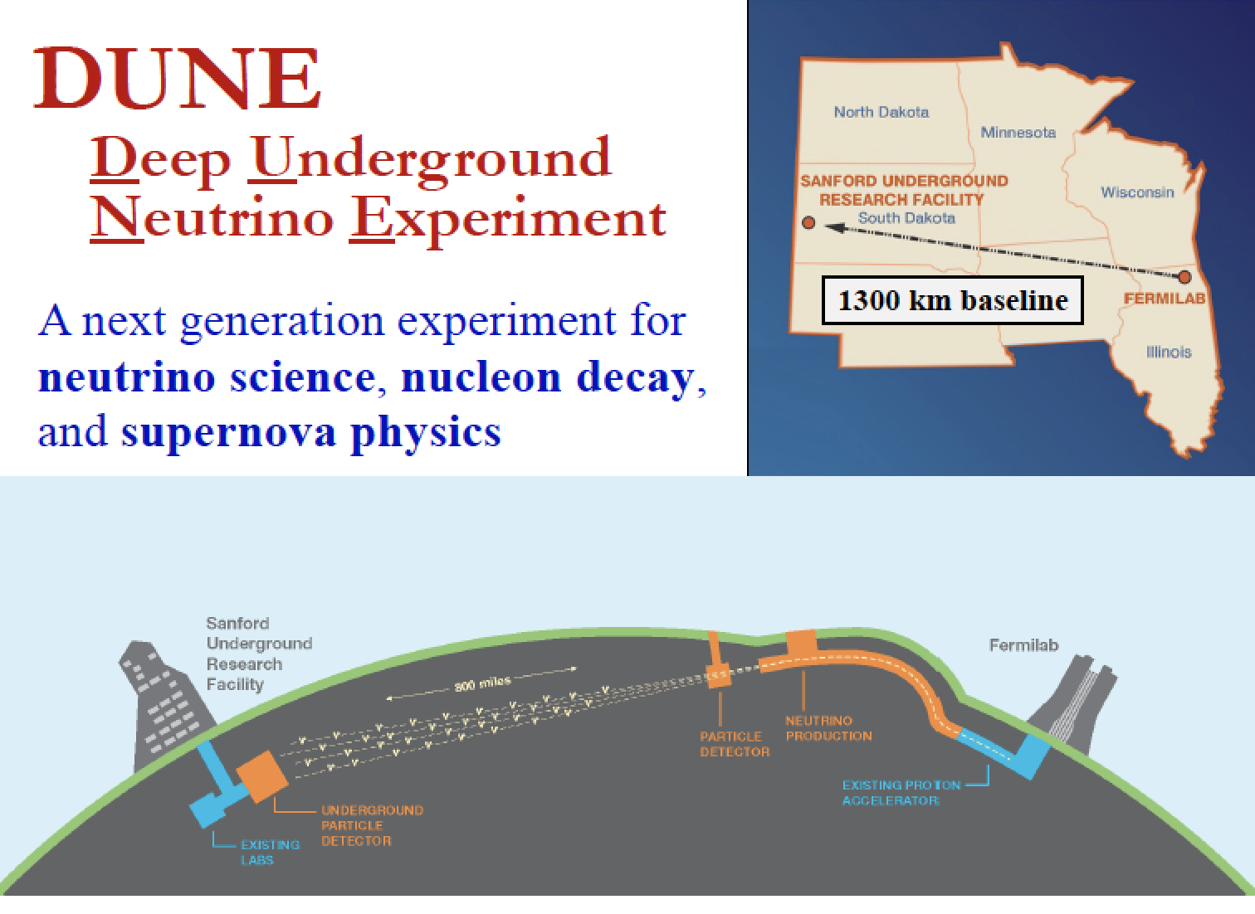
Operation starts in 2027

Slide 28
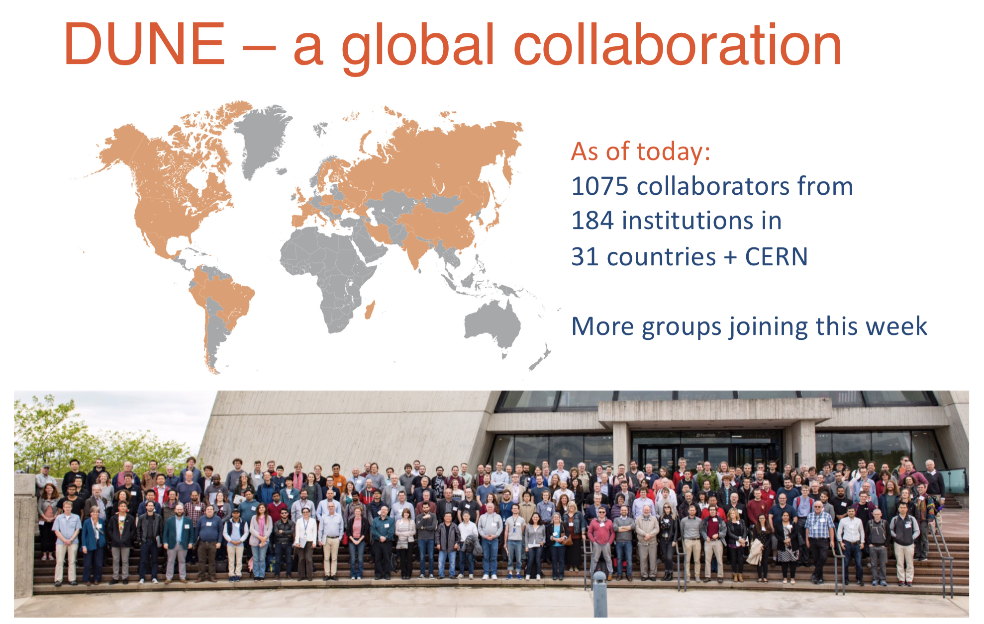

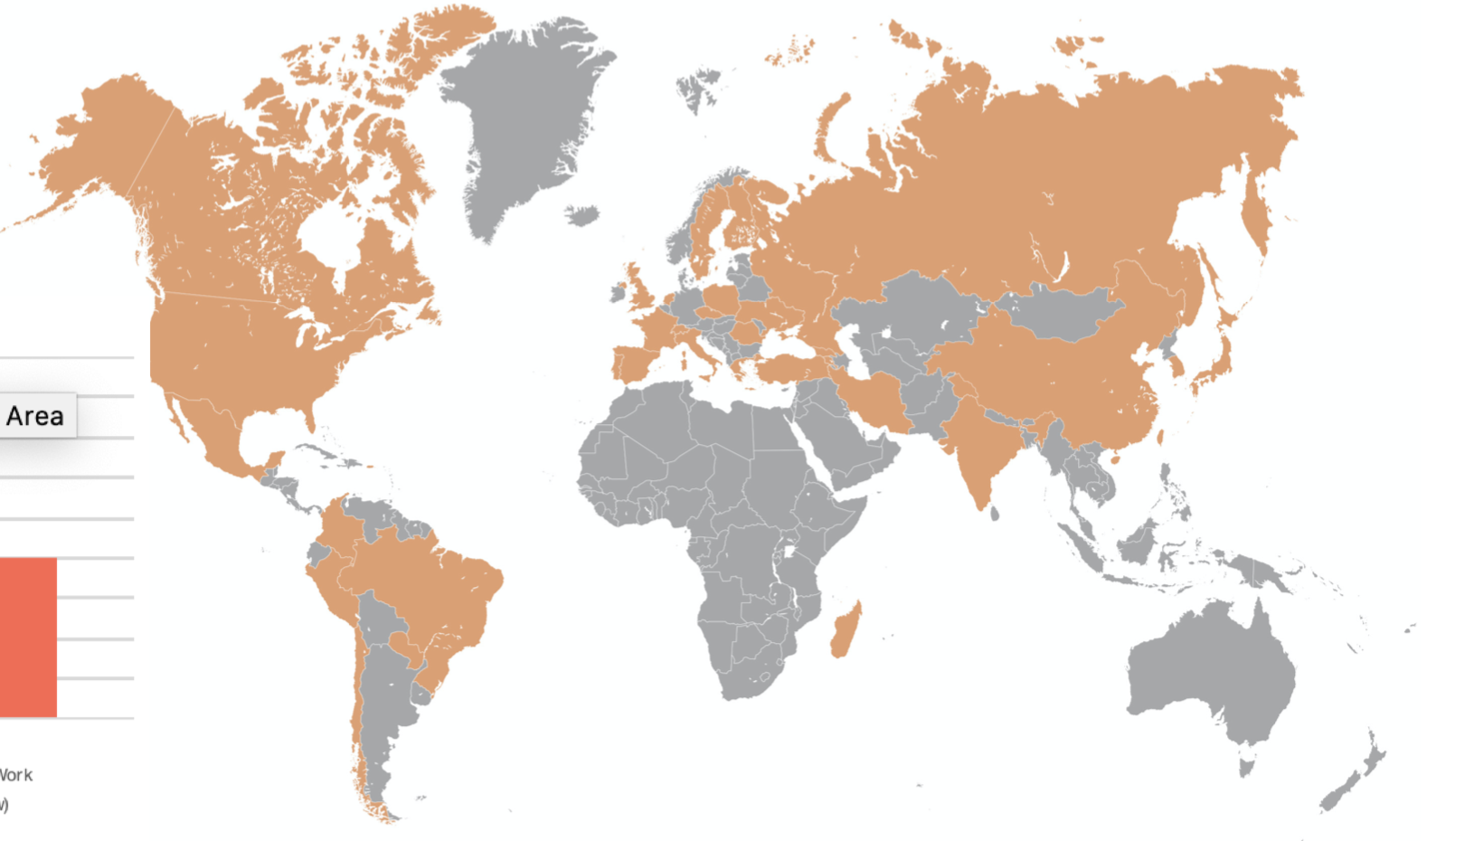
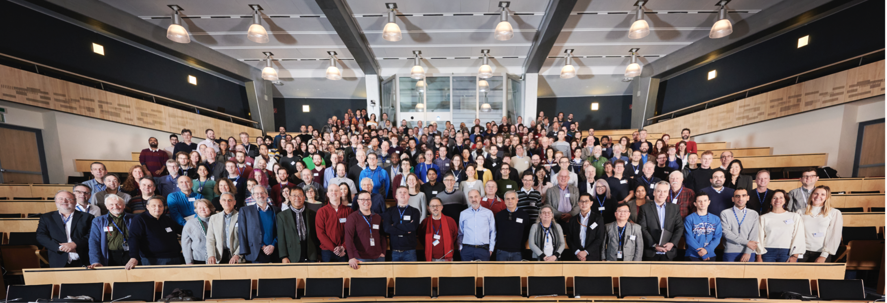
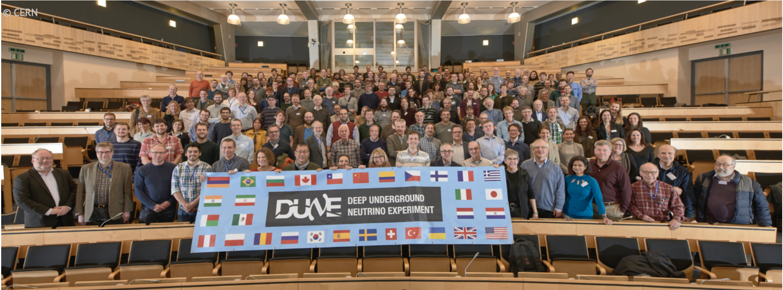
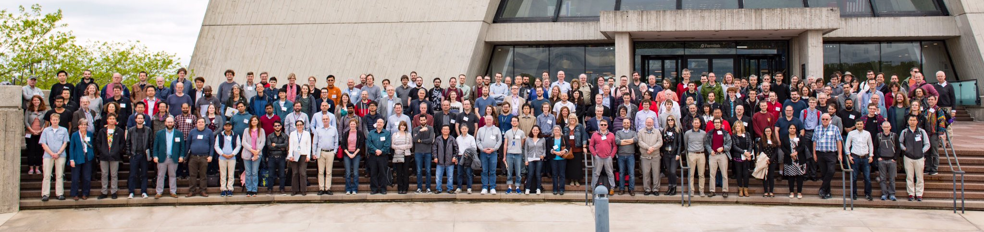
Status October 2020:
  1229 collaborators from
  184 institutions in
  31 countries + CERN
  Still more groups joining
An international science collaboration
1106 collaborators from 184 institutions in 31 countries
Collaboration meeting at CERN end of January 2020 -> 350 participants!

Slide 29
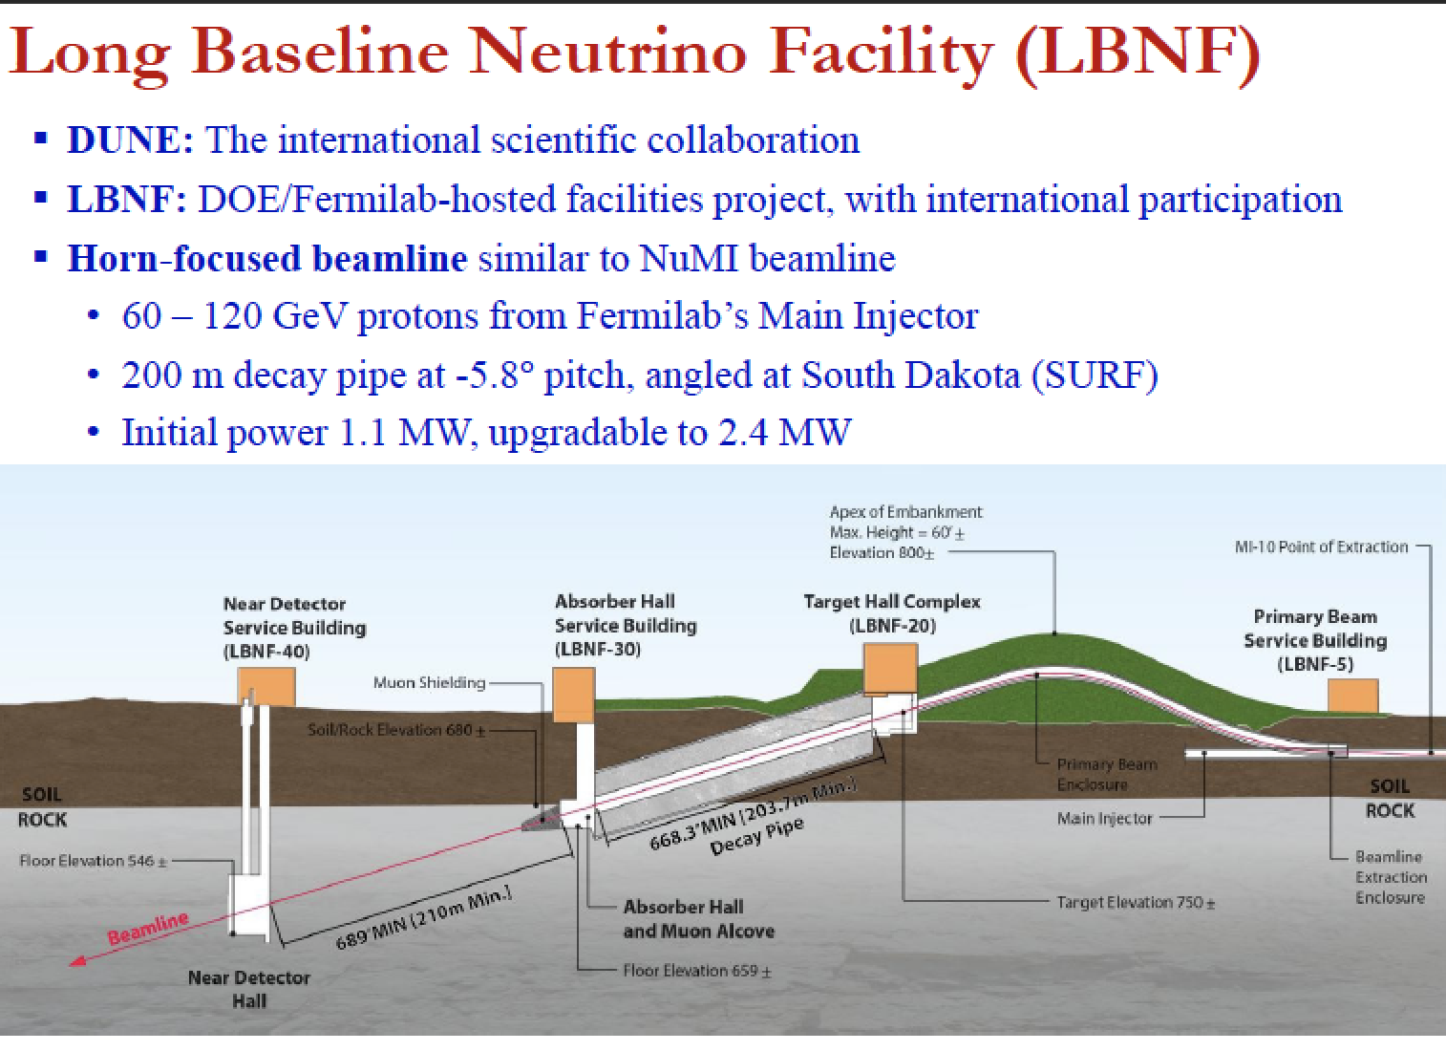

Slide 30
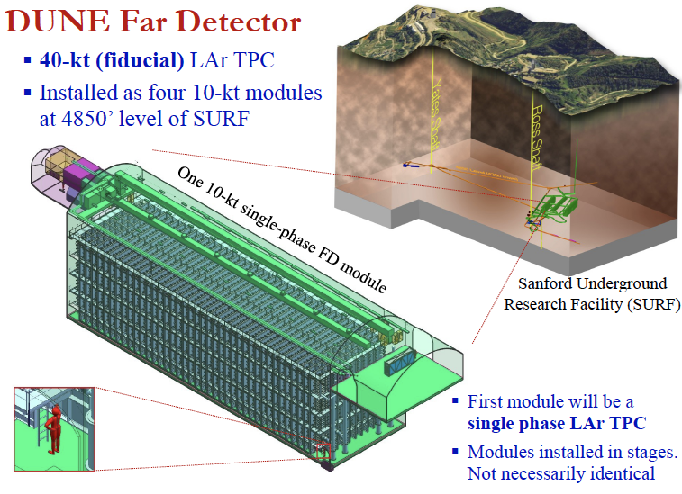
16x16x60m³
1.5 km underground

Slide 31
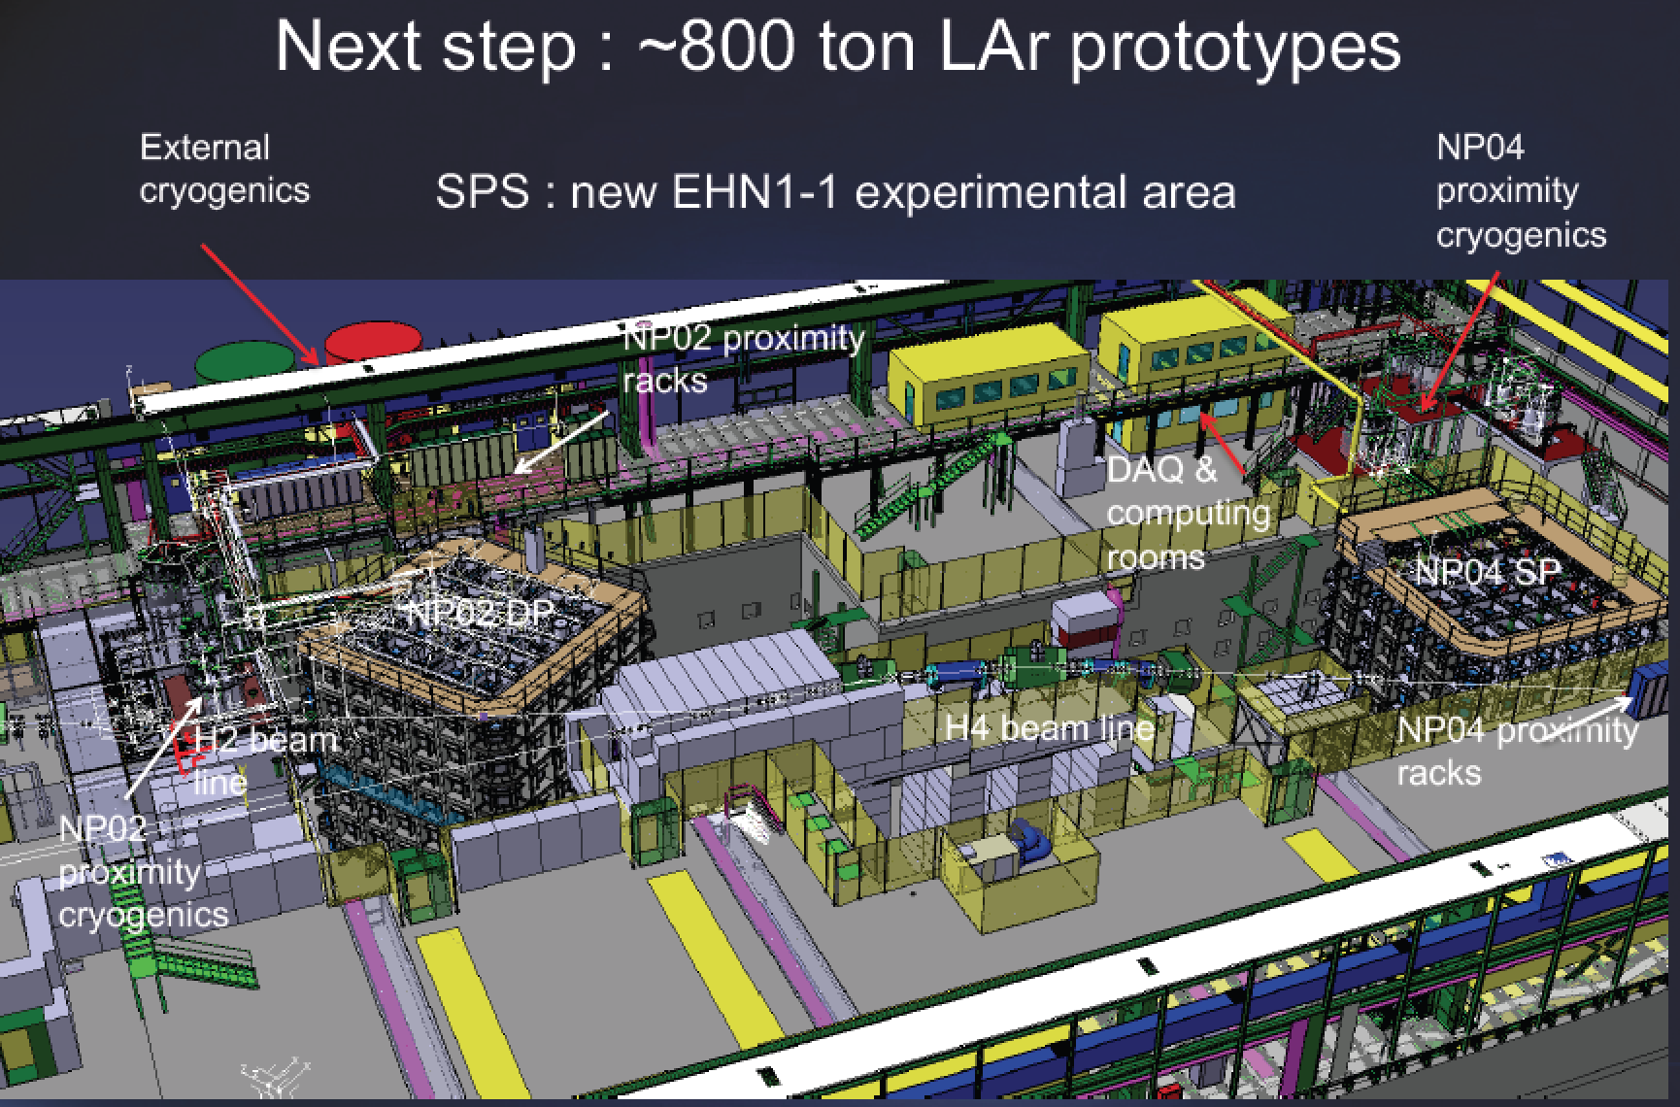
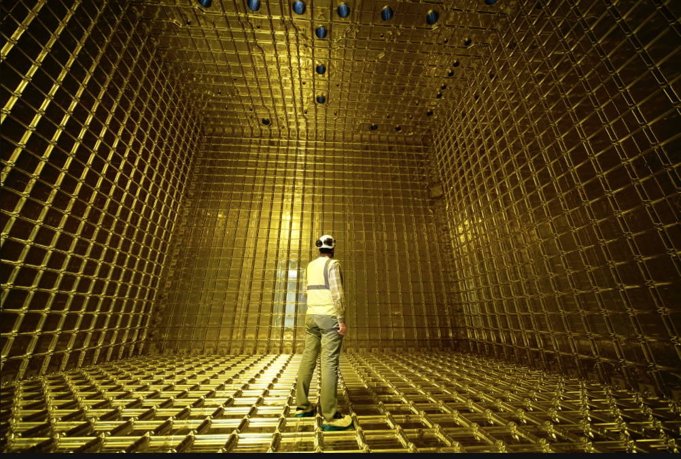
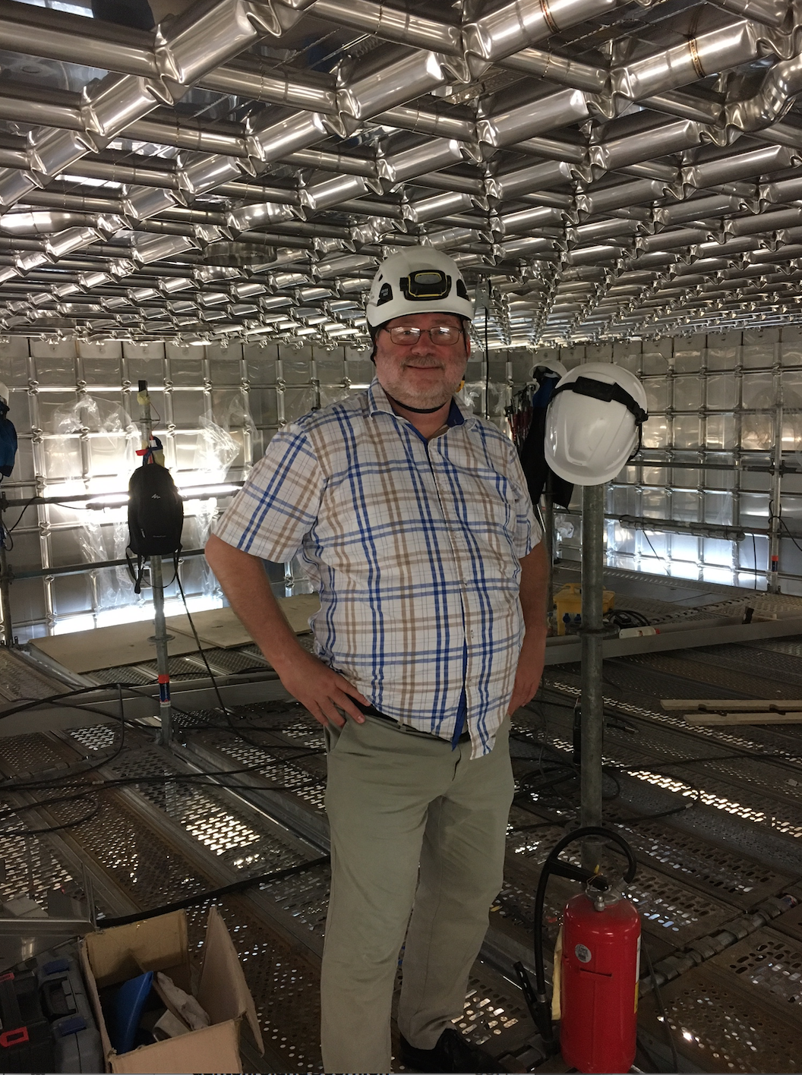
The ProtoDUNEs at CERN

Slide 32

The near detector is necessary
to normalize te neutrino flux
It will also be used for searching
for BSM physics

Slide 33


Slide 34
Measurement Strategy
DUNE simulation
~1,000 𝜈_{e} / 𝜈͞ ‍_{e} appearance events in 7 years!
(normal ordering)
Global Fit
Oscillation Parameter
~10,000 𝜈_{𝜇} / 𝜈͞ ‍_{𝜇} events

Slide 35


CP Violation and Mass Ordering
CPv sensitivity
Mass ordering sensitivity
Updated Sensitivity with realistic systematics and reconstruction
  Move quickly to potential CP violation discovery
  Rapid, definitive mass ordering determination (>5𝜎)

Slide 36

Matter Effects
The probability for 𝝂_{e} appearance:
both δ_{CP} and a (matter effect) switch signs in going from the 𝝂_{μ} → 𝝂_{e} to the anti-neutrino process
The origin of the matter effect asymmetry is simply the presence of electrons and absence of positrons in the Earth.

Slide 37

Supernova Signal in DUNE

Slide 38

Physics Beyond The Standard Model

Slide 39

Hyper-Kamiokande

Slide 40

Hyper-Kamiokande

Slide 41


The JUNO Experiment
The Jiangmen Underground Neutrino Observatory (JUNO) is a 20 kton multi-purpose liquid scintillator detector (~20 times the size of present detectors, including 18000 20’’ PMTs) being built in a dedicated underground laboratory (700 m underground) in China and expected to start data taking in 2022/2023.
Its main physics goal is the determination of the neutrino mass ordering using electron anti-neutrinos from two nuclear power plants at a baseline of about 53 km. With an unprecedented energy resolution of 3% at 1 MeV, JUNO will be able to determine the mass ordering with a significance of 3-4 sigma within six years of running.
The JUNO Collaboration has
~several hundred physicists

Slide 42


Future Neutrino Experiments

Slide 43

Next Generation Experiments
Access to the second oscillation maximum -> increased sensitivity to CPV
Further distance -> larger matter effects -> increased sensitivity to MO/NSI

Slide 44

Next Generation Experiments
Use LAPPDs
Maybe a technlogy option for the DUNE 4th detector (> 2030)?

Slide 45

Next Generation Experiments
European Spalation Source, Lund
Also: new/tagged beams
NuStorm muon storage ring
…
Experiments ready by ~2035?

Slide 46

The INO Neutrino Observatory
arXiv:15005.07380
The India-based Neutrino Observatory (INO) Project is the plan to build a world-class underground laboratory at approx. -1200 m for non-accelerator based high energy and nuclear physics research in India. The laboratory will consist of a large cavern of 132x26x20m and several smaller caverns.
Construction of a Iron Calorimeter (ICAL) detector for studying neutrinos, consisting of 50k tons of magnetized iron plates arranged in stacks with gaps in between where 2x2m RPCs are inserted
Neutrino energy range >1 GeV, angular precision ~1 degree, magnetic field(!)…
The prime focus of this experiment is to explore the Earth's matter effect by observing the energy and zenith angle dependence of the atmospheric neutrinos in the multi-GeV range.
Exploring new physics searches.

Slide 47
New Opportunities with New Facilities
The new faciltities are generally large, often based on cutting edge detector technologies
These detectors allow for programs for searches for new physics not directly related to neutrinos
This is drawing increasing attention in the community, in particular related to the “high intensity frontier”
Reversely, the Large Hadron Collider can also contribute to the neutrino physics program
  Searches for right-handed neutrinos (heavy and light)
  BSM physics (extra dimensions, SUSY…)
  New: Neutrino experiments at the LHC!

Slide 48



NDs as Beam Dump Experiments
High intensity frontier for low mass particles with very weak couplings
->upcoming neutrino experiments (SBL, LBL) foresee very high intensity beams
Near Detector:
few 100m away
from the dump
> 10²¹ POT/Year
These experiments can perform searches for low mass New Physics particles eg
-HNL/sterile neutrinos
-dark photons
-ALPs
-mini/millicharges
…
Example millicharges:
arXiv:1907.08311
arXiv:1806.03310

Slide 49


Searches for Low Mass Dark Matter
Light dark matter produced at the accelerator (meson decays)
production
Elastic scattering

Slide 50




Heavy Neutral Leptons
Neutrino portal: νMSM (Neutrino Minimal Standard Model)
Minimal extension of the SM fermion sector by Right Handed HNLs: N1, N2, N3.
D.Gorbunov, M.Shaposhnikov JHEP 0710 (2007) 015
At the LHC…
First LHC results on prompt studies
Majorana/Dirac? Now studies with displaced jets/lepton analyses. L~ 1m?

Slide 51

Heavy Neutral Lepton Searches
Projection for the DUNE Near Detector (7+7 years)
HNLs produced in meson decays (pions, kaons, Ds…)
H.Sfar,
G. Christodoulou
ADR
in arXiv:2103.13910

Slide 52




Neutrinos @ the LHC: Examples
Searches for right-handed
neutrinos at the LHC
SND and FASER-Nu are 400m
forward of the IPs and can study
TeV-neutrinos with emulsion detectors
νMSM (Neutrino Minimal Standard Model)

Slide 53


Neutrinos @ the LHC: SND@LHC
SND is 400m forward of the IPs and can
Study TeV-neutrinos with emulsion and
tracking+muon/calo detectors
SND= Scattering and neutrino detector

Slide 54

First Observed neutrinos in FASER-𝞶
These are the first ever directly observed neutrinos at the LHC!!

Slide 55


Slide 56

3 Other Nobel prizes for Neutrino Physics
2002: R. Davis and M. Koshiba
1995: F. Reines
1988: L. Lederman, M. Schwartz and J. Steinberger

Slide 57

SUMMARY: Neutrinos
Neutrinos studies is a vibrant field of research, and has still many open questions! Right-handed partners? Strong CP violation? More than 3 neutrinos? Non-Standard Interactions? Are neutrinos their own anti-particle?
Now comes the age of neutrino precision physics with DUNE & T2HK and neutrino astronomy: look inside the sun, understand supernovae explosions, multi-messenger astronomy…
Detailed study of PMNS oscillation parameters by experiments is key to the understanding
Large experiments are really “observatories”
The history of neutrino research showed many surprises. What surprise is waiting for us next??

Slide 58



More on Neutrinos..
books
school

Slide 59
Neutrinos and New Physics
Neutrinos have connections to many other BSM or New Physics ares, also studied eg at the LHC
Connection with GUTs (heavy righthanded neutrinos)
Supersymmetry (sneutrinos and other)
Extra dimensions/wormholes
Dark matter
Leptogenesis
Dark energy
Cosmology/inflation/abundance of H/He changes when more than 3 neutrinos
Time travel? (right handed neutrinods in extra dimensions)??
….

Slide 60


Slide 61



Atmospherics and Supernovae
Sensitivities to Lorentz and CPT violation
400kton.year
Analyzed in the SME (Standard
Model Extension) framework
conventional
oscillation
SME
Atmospheric neutrino flux
Oscillation free coefficients

Slide 62

Astronomy with Neutrinos

Slide 63



Searches for Low Mass Dark Matter
Multi-component boosted dark matter
arXiv:1803.03264
D. Kim, ADR, … new paper in
preparation
Also boosted dark matter from the sun

Slide 64

The 9th LHC Experiment is for Neutrinos!

Slide 65

Neutrinoless Double Beta Decay

