Slide 1
DESY Status and Plans DIOS (Datalake Infrastructure)
Aleem Sarwar, Paul Millar, Patrick Fuhrmann
(DESY)
December 11th, 2019

Slide 2
dCache-Support
Exampler dCache-Support Model
Video Conference
Annual dCache Workshop
Mailing list
Ticketing System dCache-Support chat group https://chat.projectescape.eu/group/dcache_support
ESCAPE Wiki Page
<number>
Dec 11th, 2019
muhammad.aleem.sarwar@desy.de

Slide 3
Prometheus & dCache-demo
 | Prometheus | dCache-demo
Maintenance Mode | Data is wiped and rebuild every day | Well-maintained instance with a reasonable capacity
New Features | As soon as available | Short delay
Stability | Unstable | Stable and Reliable
WebDAV URL | https://prometheus.desy.de/ | https://dcache-demo.desy.de:2443/
GUI Link | https://prometheus.desy.de:3880/ | https://dcache-demo.desy.de/
Login | via X.509 certificate, OIDC, sci tokens
Diverse protocols | HTTP/WebDAV, Xrootd, SRM, GridFTP,...
PerfSONAR (DESY Network)
<number>
Dec 11th, 2019
muhammad.aleem.sarwar@desy.de

Slide 4
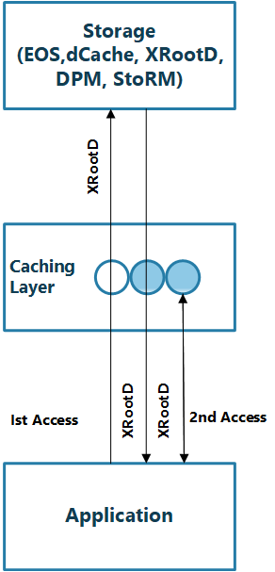
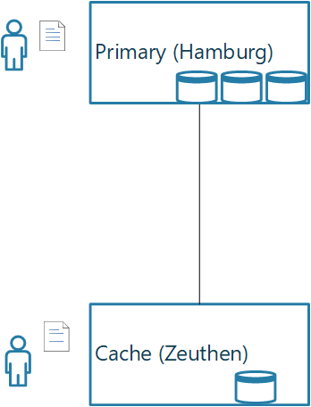
Current Status and Future plans
XCache
XCache | dCache
Being used from few years | Being used from last 15 years
Short access time | Greater access time
Data Integrity loss | Data Integrity Preserve
Storage Capacity | Storage & caching capacity
Efficient | Robust
dCache
Plans for 2020
Fault tolerance dCache-Support
<number>
Dec 11th, 2019
muhammad.aleem.sarwar@desy.de

