Slide 1


Update: Studies on PS injection bump closure
M. Schenk*, A. Huschauer
CERN, Switzerland
*also at EPFL, Switzerland
Acknowledgments: B. Balhan, J. Borburgh, M. Fraser, A. Oeftiger, T. Pieloni
13. December 2019

Slide 2
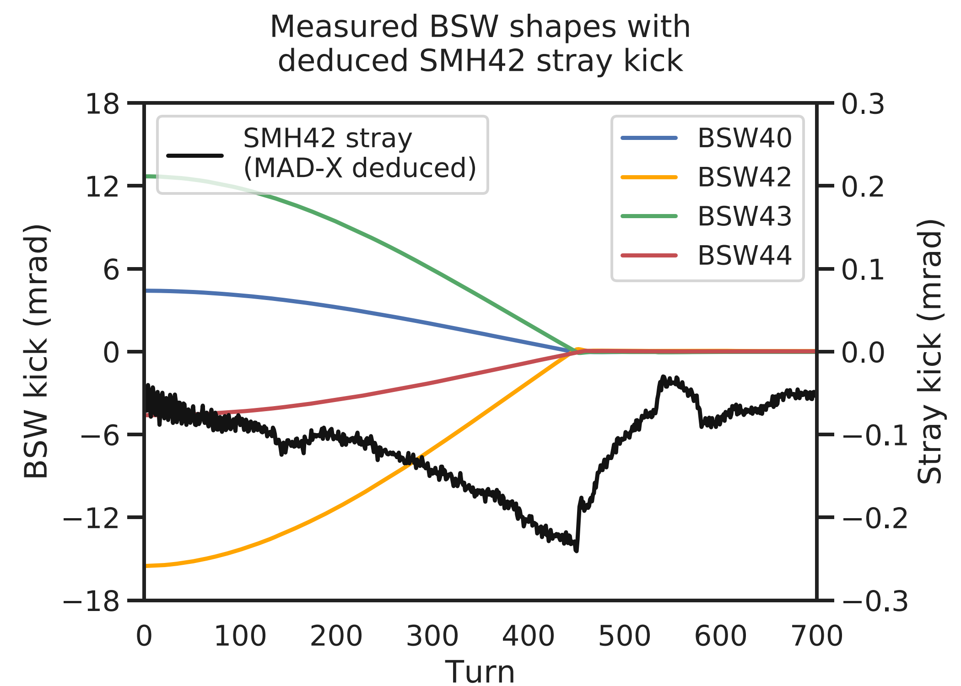
Effect of SMH42 stray field
MAD-X matching
Idea by M. Fraser: study impact of stray field kick at location of SMH42
Study procedure
  Use BSW waveforms from oscilloscope measurements (2015) directly with conversion from LSA (no calibration or change of shapes this time)
  Perform MAD-X matching to measured orbit data with stray field kick at SMH42 as single free parameter
Roughly comparable to dedicated stray field measurements (see last slide)
Max. field is at end of bump collapse
Very slow decay after
Stray kick amplitude here up to -0.25 mrad
Significantly higher than expected from B.dl measurement at e.g. 55 mm from septum blade (kick amplitude ~ -0.07 mrad)
Measured B.dl at 15 mm from blade => kick ~ -0.3 mrad

Slide 3
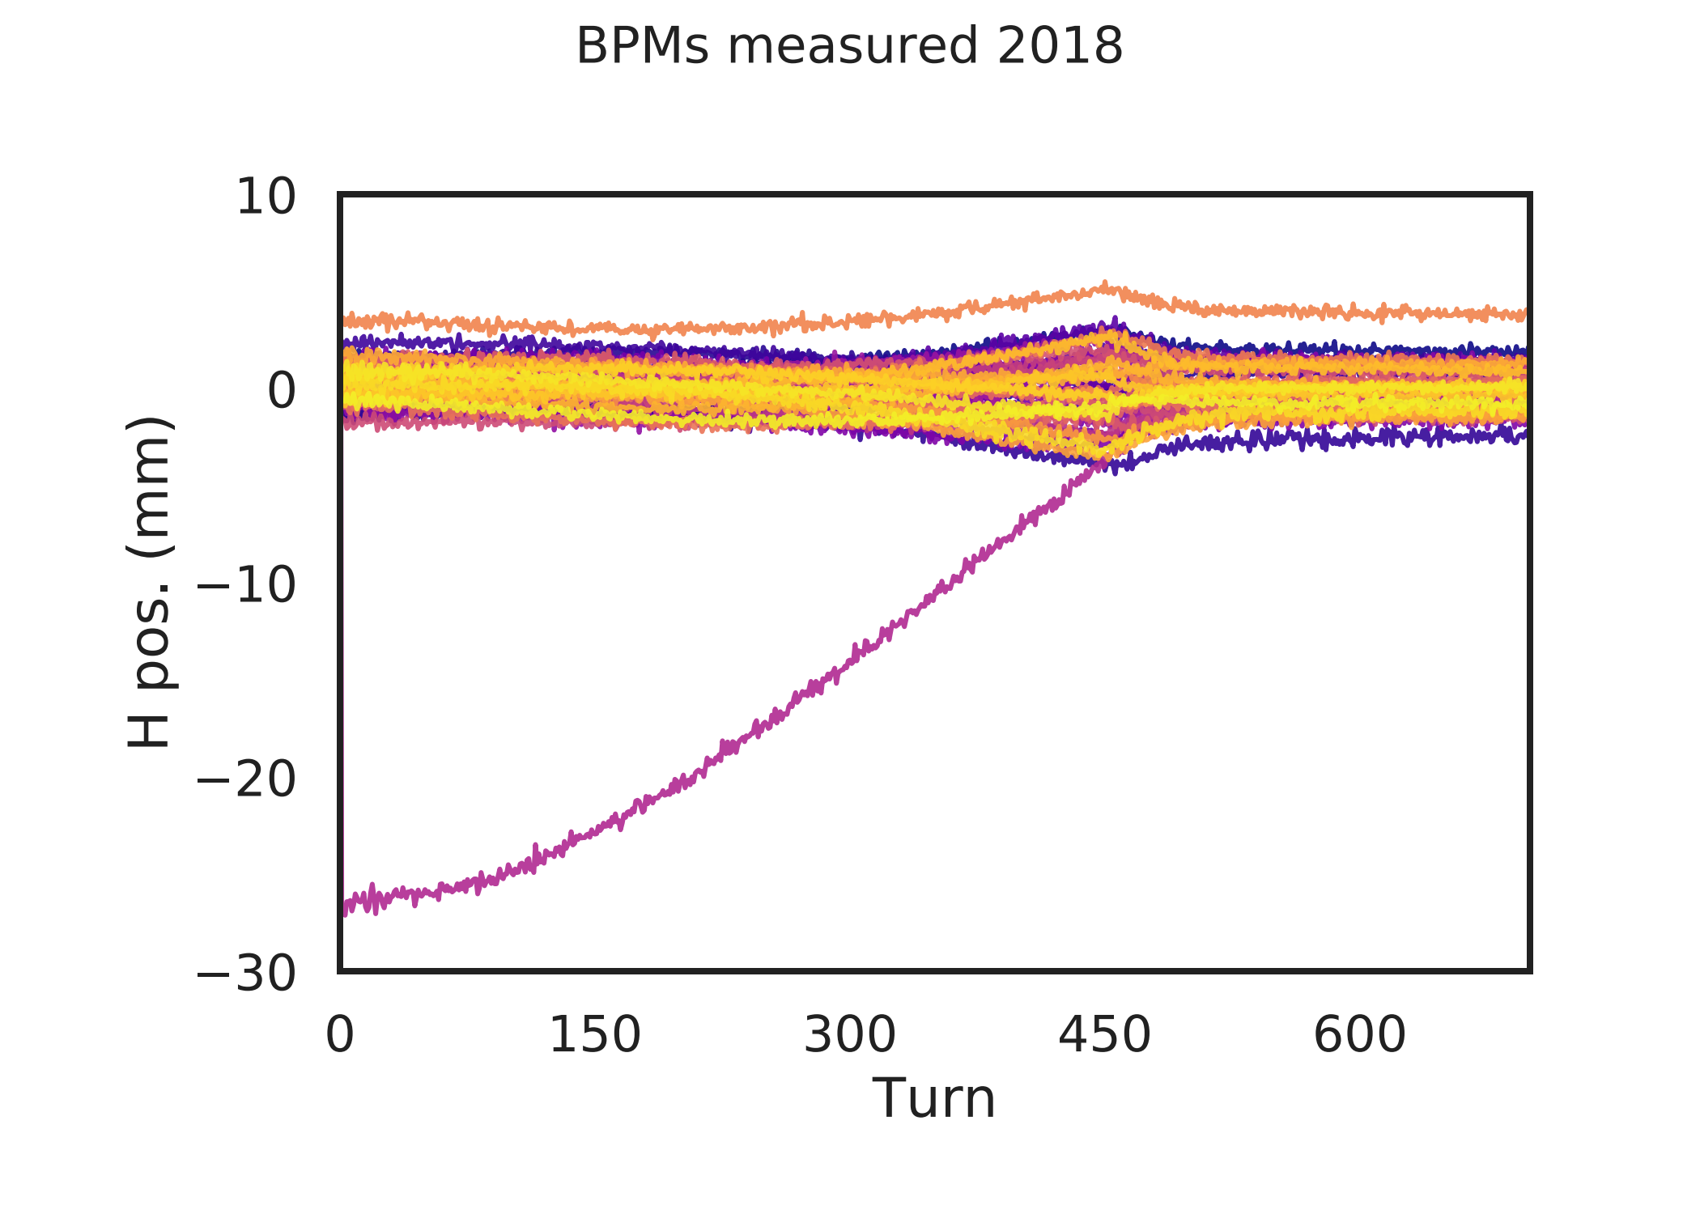
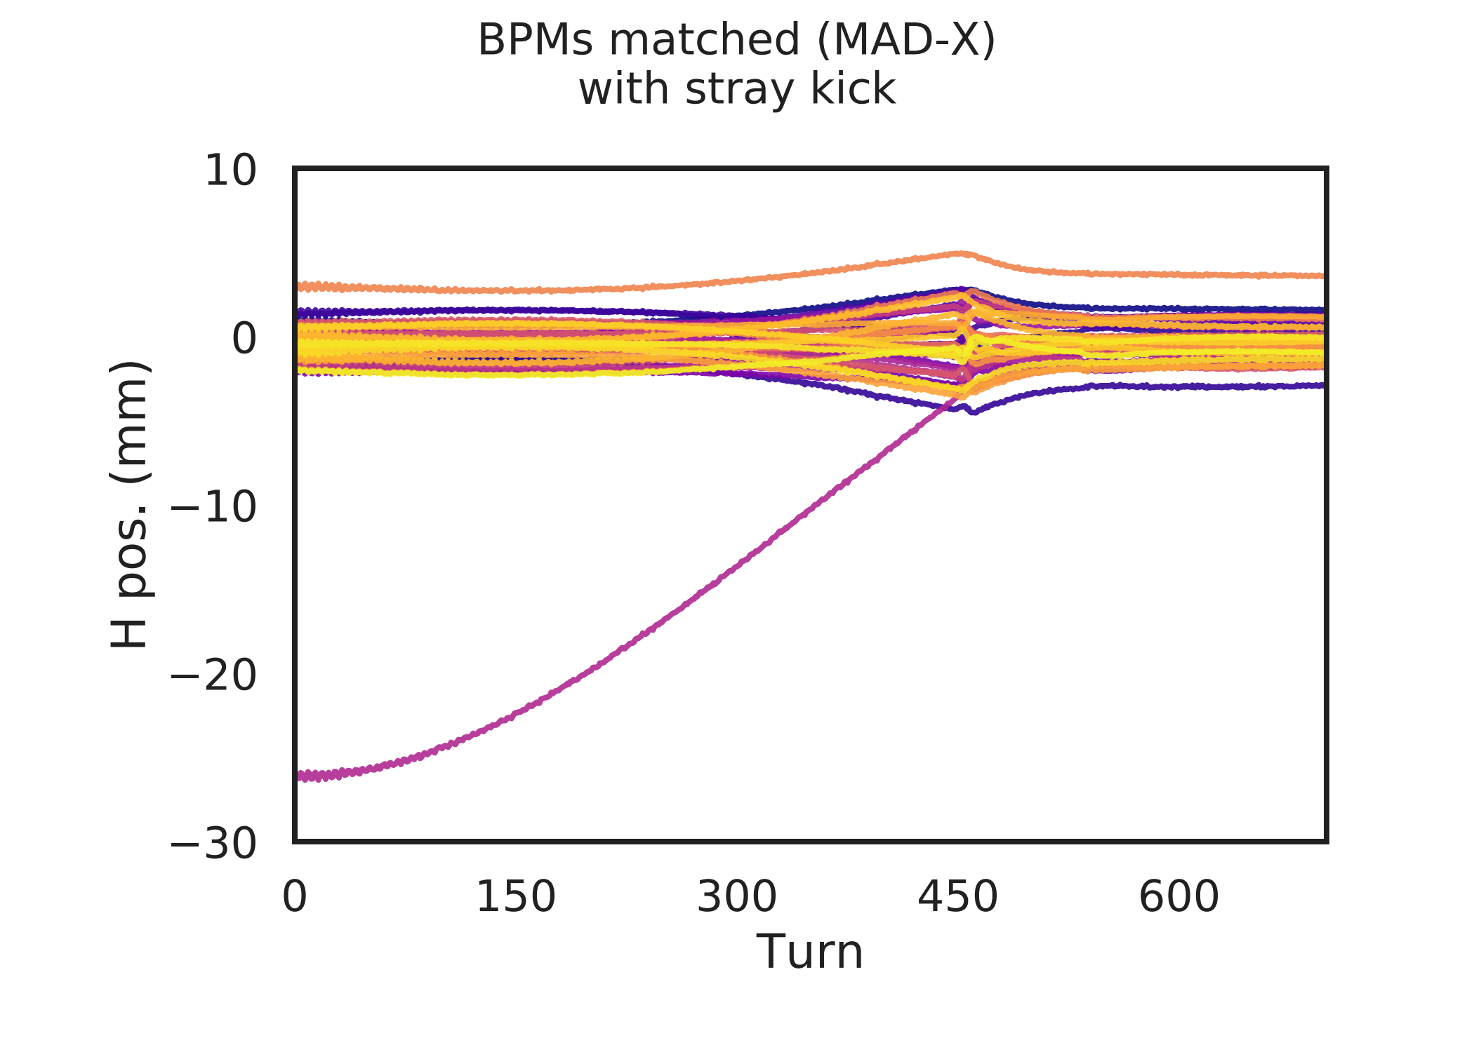
Effect of SMH42 stray field
MAD-X matching: quality check
Quality of orbit matching is good
1 free parameter is enough
Stray field kick from SMH42 could be valid explanation for discrepancy between measured BSW waveforms and what was obtained with MAD-X ignoring stray field
(see main talk, slide 12)

Slide 4
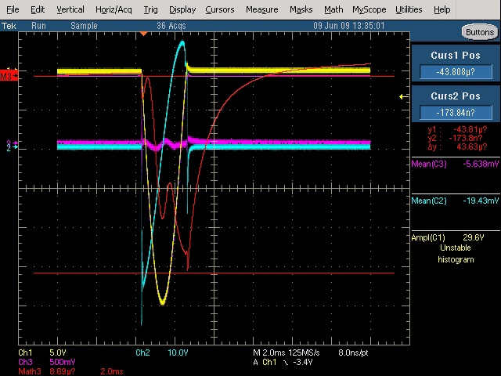
Effect of SMH42 stray field
Measured stray field
Measurement from 2009
Bump waveform given in yellow
Measured stray field (red) at
20 mm from septum blade
Origin of ‘double peak’ not clear

