Slide 1
How we can improve accounting data quality?
Julia Andreeva, CERN
WLCG Accounting Task Force meeting

Slide 2
The problem to be addressed
After many years of working on the WLCG accounting system , we still face inconsistencies of data measured by different parties (sites, experiments, central LCG accounting systems like APEL and WSSA)
These inconsistencies are indicators of the fact that accounting data quality can be improved
Several ways to tackle the problem:
  More active involvement of site administrators to check monthly accounting data
  Enable straight forward way to compare data coming from various sources
  Defining better workflow and responsibilities for chasing faulty data, inconsistencies, etc…

Slide 3
More active involvement of site administrators in data validation
Current workflow:
1). Monthly accounting reports are generated by the EGI portal based on APEL data for CPU, manually injected T1 only data via REBUS UI for disk and tape usage
2). Reports are sent to sites by WLCG project office
3). Sites are supposed to check reports and complain in case of problem. However, data can not been changed in APEL quickly. Investigation of the issue and fixing data can take months
4). Often the problem is not noticed for a long time and is being discovered while preparing RRB report
New workflow:
1). Monthly accounting reports will be generated by CRIC based on data validated by sites.
2). Sites will get notification with the request to validate auto-generated data. Auto-generated data is coming from WAU (see presentation of Boris) Primary sources :APEL for CPU, WSSA for storage. The validation interface is currently being validated by T1s, next month (November data) , T2 will be included as well
3). Validated data will be pushed from CRIC to WAU. There will be a possibility to see both auto-generated and validated data
4). Inconsistencies (generated vs validated) should be followed up. Need to discuss today, how we go about it.

Slide 4
Accounting data validation workflow
2. Sites are
notified
WAU
1. Raw monthly summaries
CRIC
Sites
3. Sites perform validation
5. Validated monthly summaries
4. Monthly accounting reports generated

Slide 5
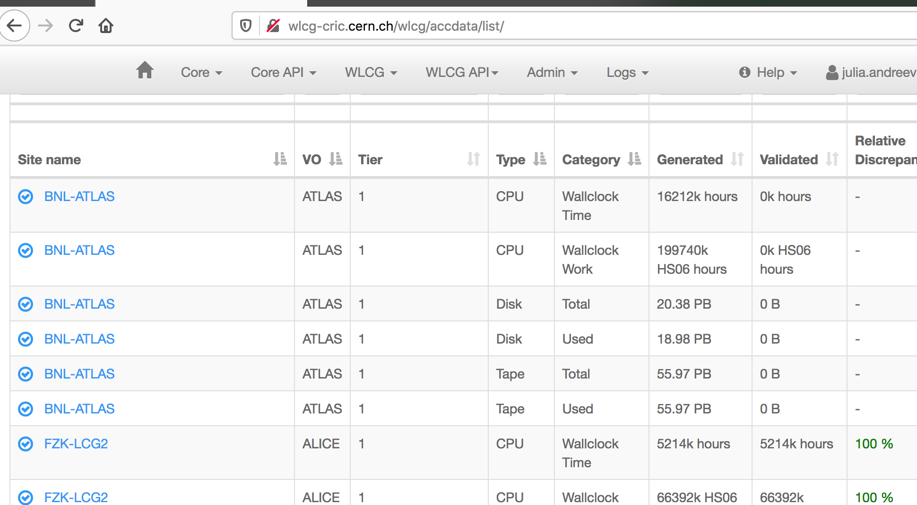
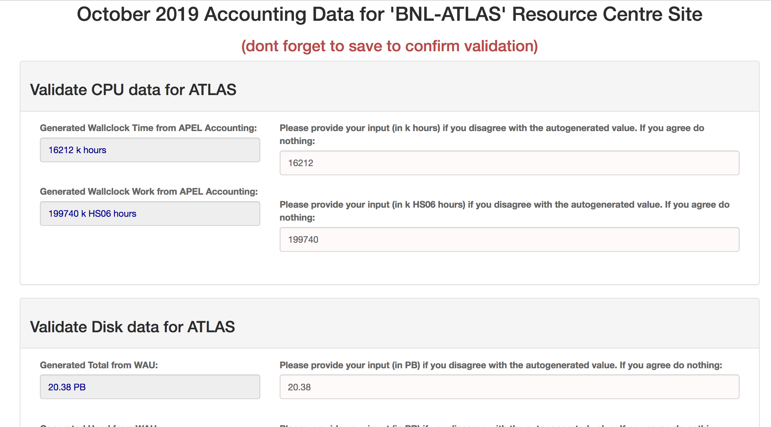
Accounting data validation UI (1)

Slide 6
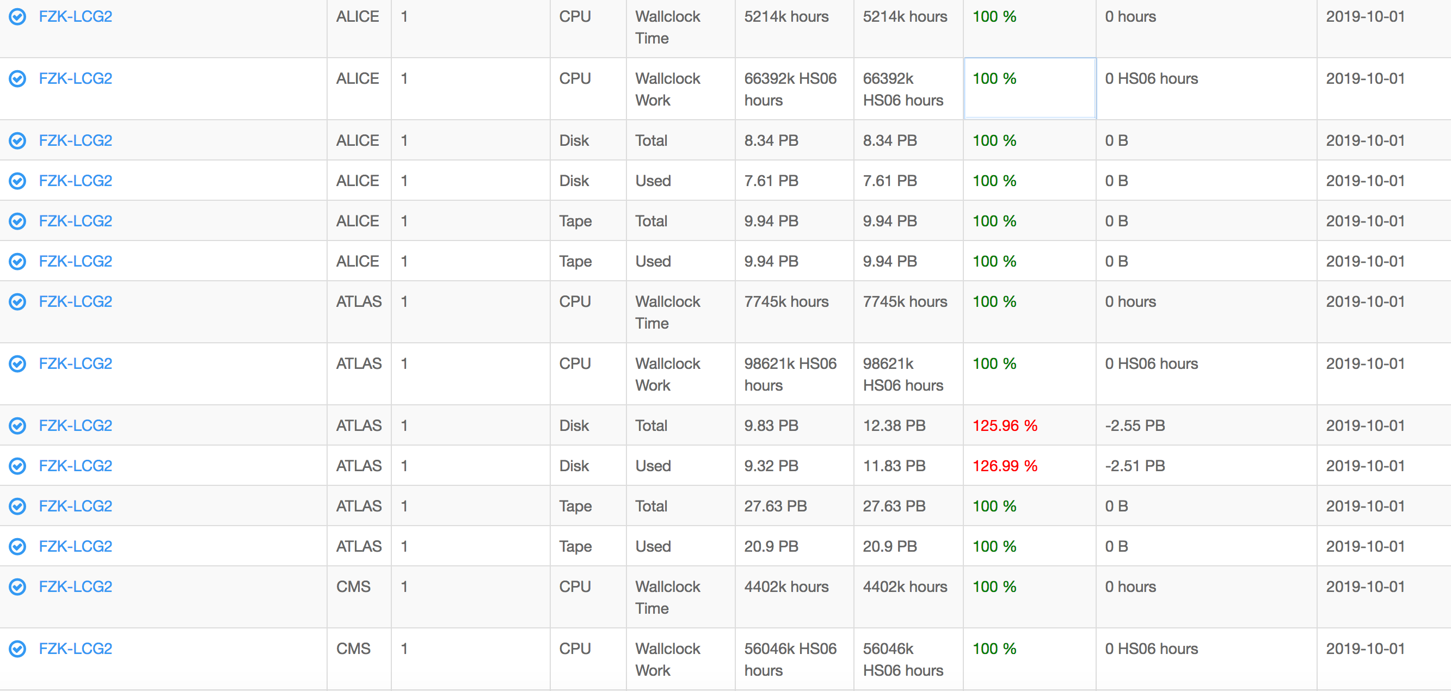
Accounting data validation UI (2)
User is required to be authorized to edit site level data
Request of privileges is enabled on the UI and has been tested
Currently any difference is colored in red. We need to agree on the threshold when we need to follow up

Slide 7
  Enable straight forward way to compare data coming from various sources
What we have now
1). Accounting validation application contains:
APEL monthly summaries (per site /per experiment) retrieved from the EGI portal are
Experiment monthly summaries, retrieved where possible from the experiment specific systems
Ratio between the two
Possibility to see history of comparison
2). Implemented in the SSB framework. Will retire soon since SSB framework is not ported to MONIT
3). Though being useful, was not actively used by the sites.
4). No central effort to check and chase and fix inconsistencies
New scenario
1). For all types of accounting data (CPU, disk and tape usage) WAU will contain data from 3 sources:
  Auto-generated (APEL & WSSA)
  Validated (after validation from CRIC)
  Experiment specific accounting
2). Enable Dashboard to easily spot inconsistencies between all available data sources.
3). Still might not be effective, if there is no agreed workflow of how we follow up on those inconsistencies

Slide 8
  Defining better workflow and responsibilities for chasing faulty data, inconsistencies, etc…
We have no central effort to follow up accounting issues.
Since accounting metrics are not critical for computing operations , they can stay unnoticed for a long while and are being addressed with low priority
Can we do better?
Agreed on the contribution from Olga Kodolova to check monthly comparison reports and create summary of the most problematic sites
However, we need engagement of the experiment experts

Slide 9
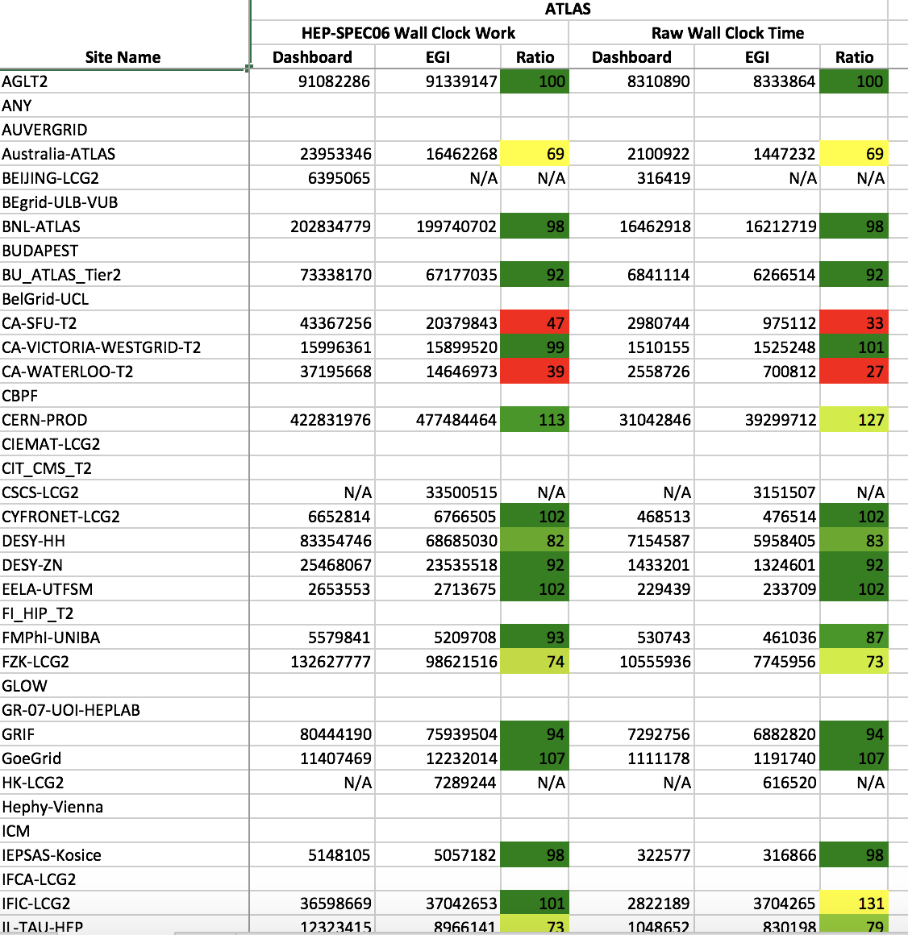
Follow up on inconsistencies (APEL vs experiments)
Set up twiki page for monthly reports: https://twiki.cern.ch/twiki/bin/view/LCG/DataQualityChecks
Currently perform exercise only for ATLAS
Monthly generated excel table attached to the page
Table with conversion factors comparison (used by APEL vs used by experiments) attached to the page
Should we rather create a googledoc with excel page data, comments, GGUS tickets, etc…?

Slide 10
Discussion
How experiment experts are involved and can help in debugging and fixing accounting issues?
For sites: Alessandro suggested that if we decrease number of checks we require from the sites, there are better chances to get them involved. We might need to think that in the future we create per site monthly report with accounting and availability and require one time action from the site if something is wrong with site data. This is doable, however, will require development effort, since availability and accounting are handled independently
Other suggestions what we can do better?

