Slide 1
WAU Dashboard
Boris Vasilev
Julia Andreeva
Dimitrios Christidis
Panos Paparrigopoulos

Slide 2
WAU Dashboard Overview
WAU (WLCG Accounting Utility) Dashboard
WAU = Combination of WSSA and CPU accounting data.

Slide 3
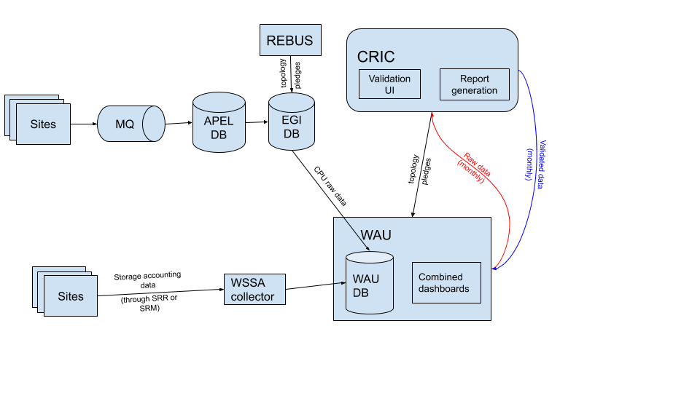
Where data comes from?
CPU accounting data
Storage accounting data

Slide 4
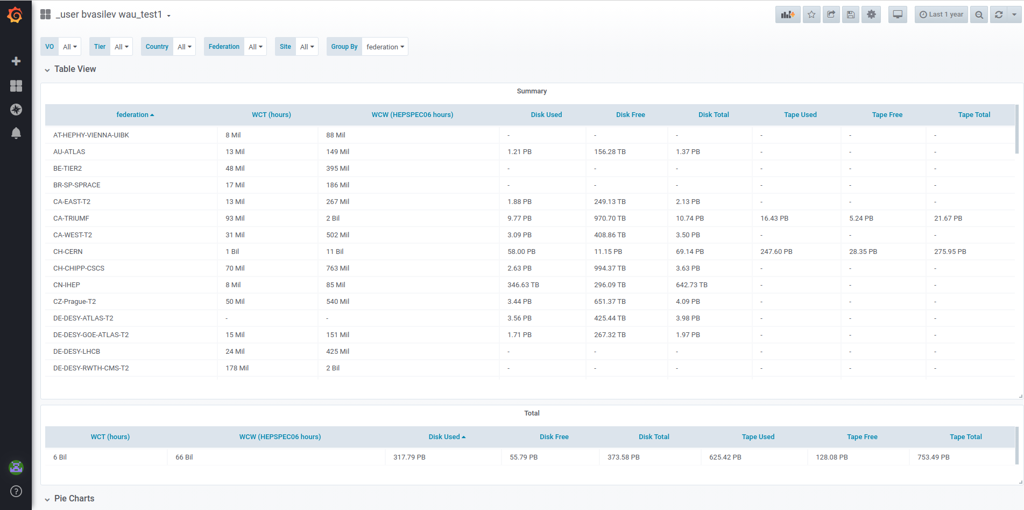
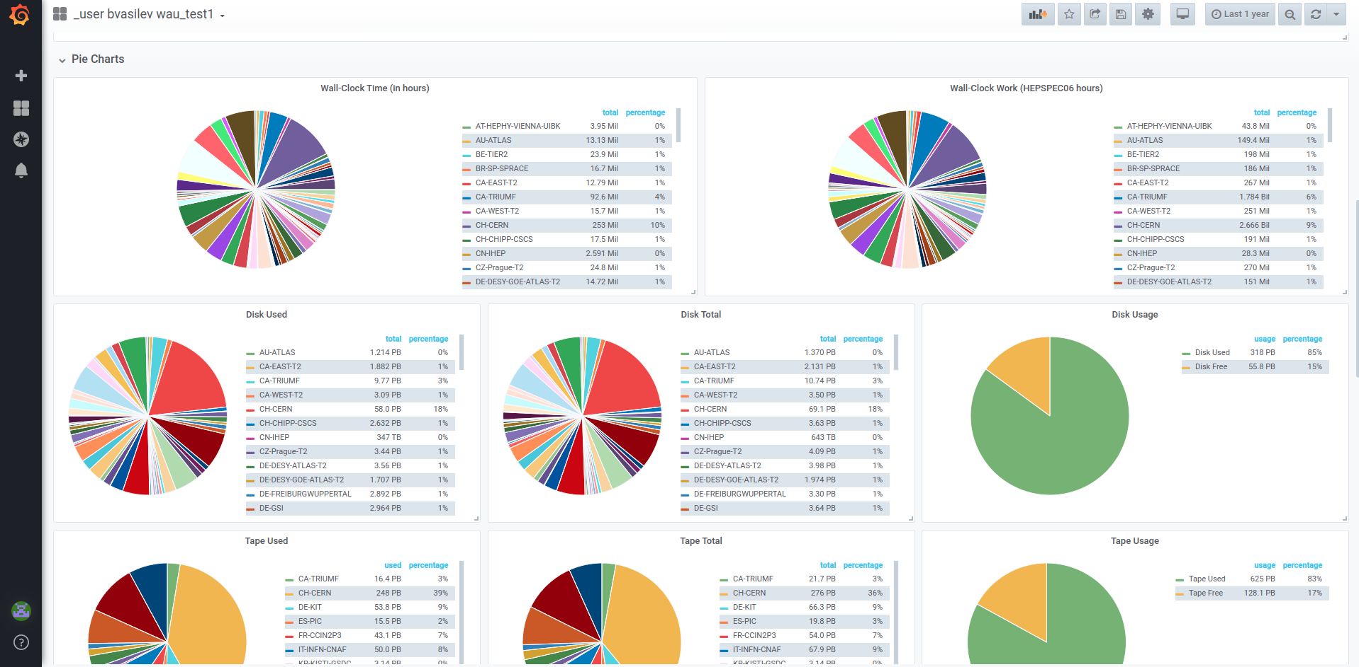
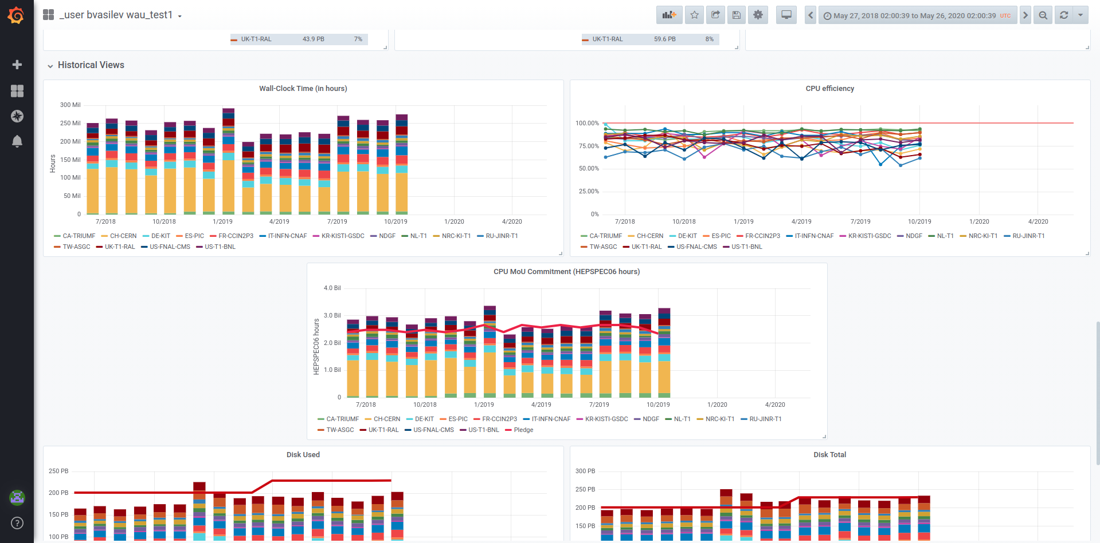
Current state of the dashboard

Slide 5
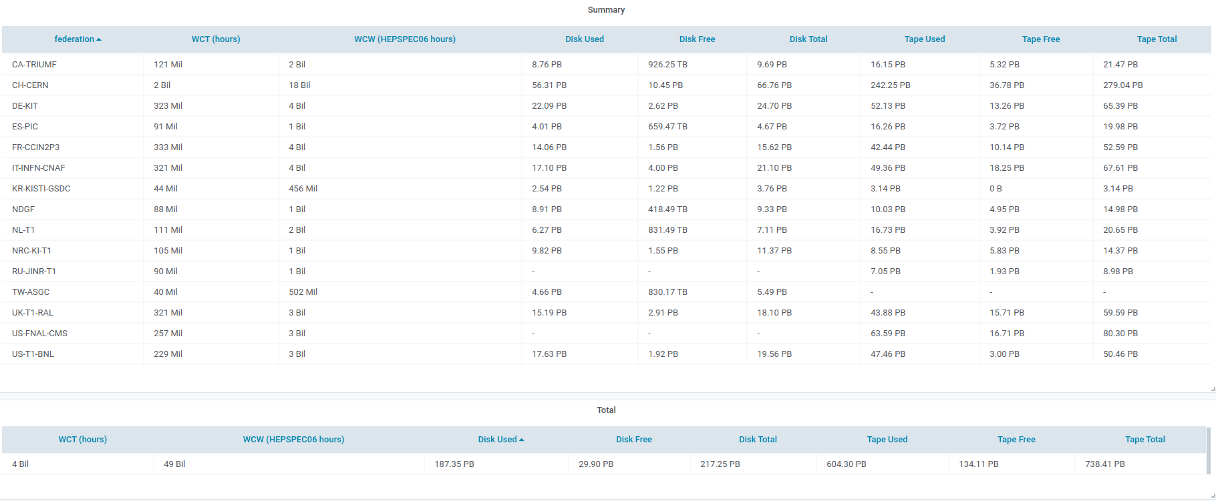
Current state of the dashboard
CPU data (from EGI)
Storage data (from WSSA)

Slide 6
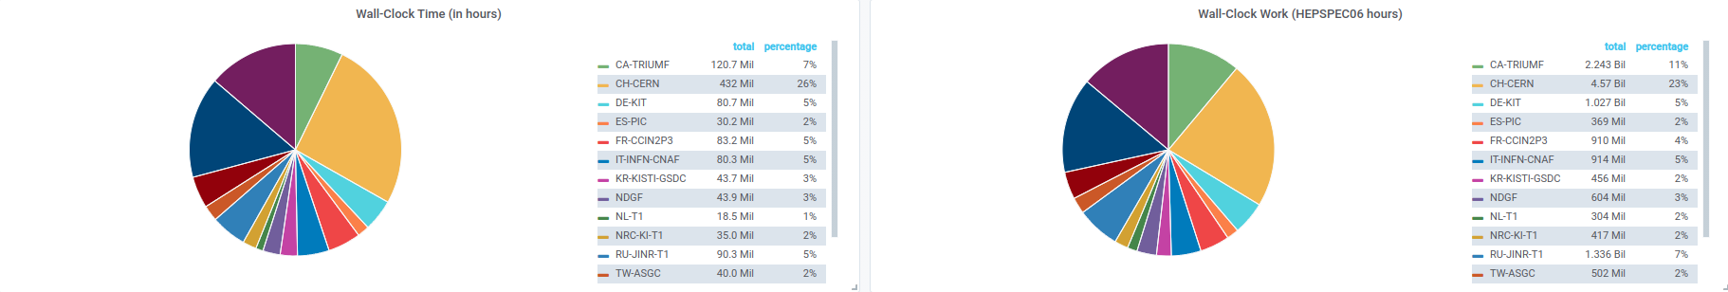
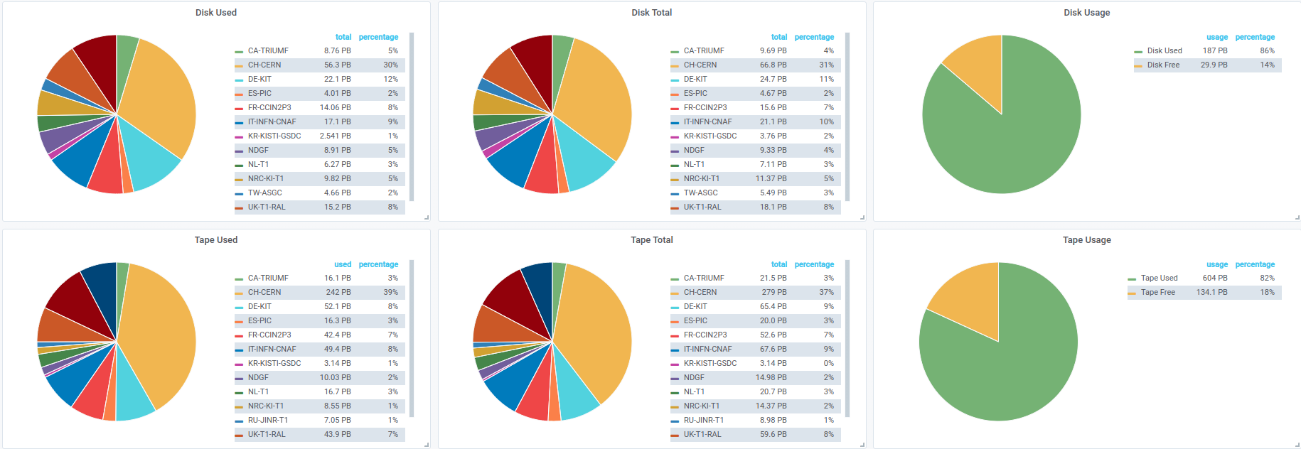
Distribution of resources

Slide 7
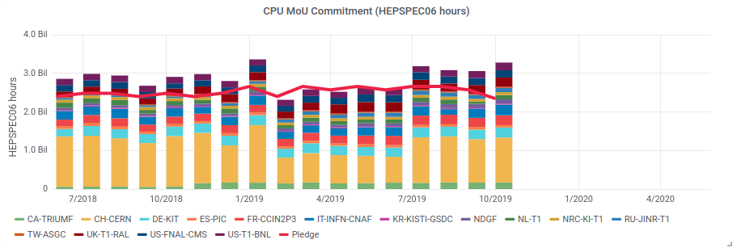
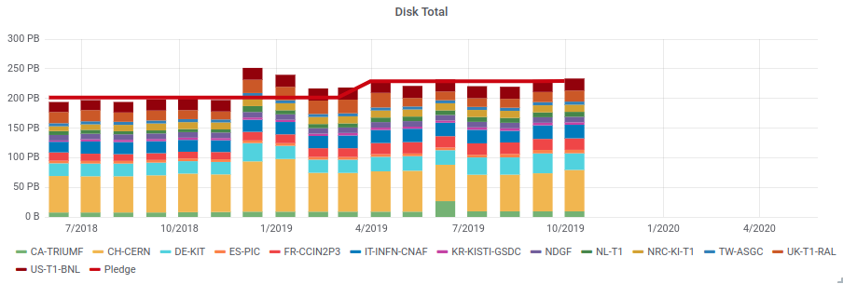
Historical view of the MoU commitments

Slide 8
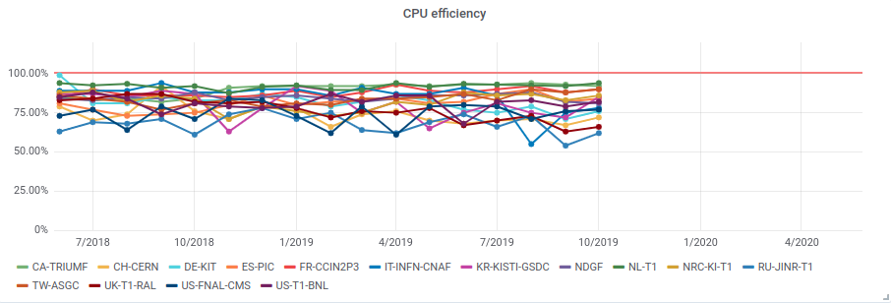
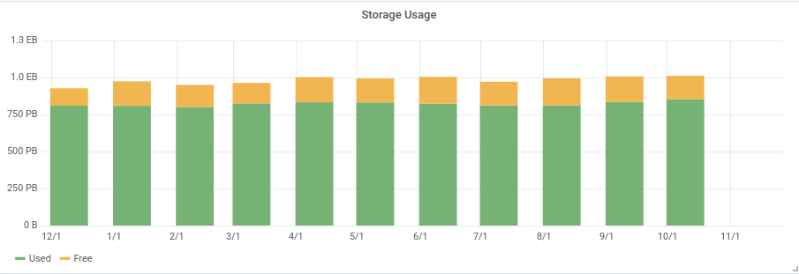
Resource utilization

Slide 9
DEMO: https://monit-grafana.cern.ch/d/6rLvYKhZk/wlcg-accounting-utility-generated?orgId=20

Slide 10
Future improvements
Add a dashboard to display validated data
Consistent color scheme across all plots
Import experiment accounting data into WAU and enable possibility to compare them with those which are generated by APEL/WSSA and those which are measured by the site.
Implementation of the dashboard which would expose comparison between different sources and allow to easily spot inconsistencies

Slide 11
Thank you for your attention!

