Slide 1

WELCOME to the:
Hands-on school on the production, detection and use of neutron beams
Carlos GUERRERO and Begoña FERNANDEZ
Universidad de Sevilla, 41012 Seville, Spain
Centro Nacional de Aceleradores (CNA), 41092 Seville, Spain
September 21st 2022

Slide 2












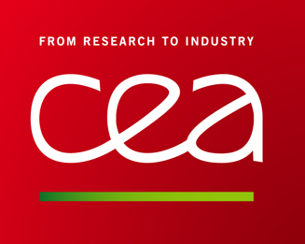




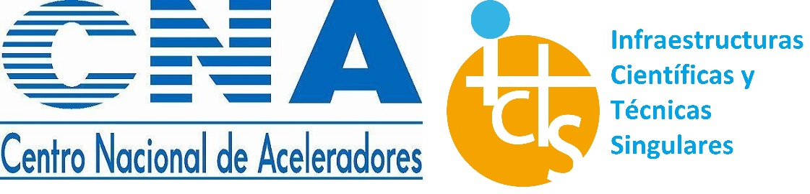





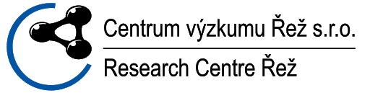



www.ariel-h2020.eu

Slide 3
H2020-ARIEL
Training & Education of Nuclear Data Experts
[WP1 & WP2: 261 K€]
TRAINING
Mobility support for up to 30 research stays for up to 12 weeks for Early Stage Researchers and external senior experts
[WP4: 303 k€]
EDUCATION
4 Summer Schools will be organized at the HISPANOS, the JGU Triga reactor, the CIEMAT and NESSA facilities
[WP5: 525 k€]
TRANSNATIONAL ACCESS
About 3000 hours of beam time will be funded for TAA at any of the 22 partner laboratories
[WP3: 903 k€]

Slide 4
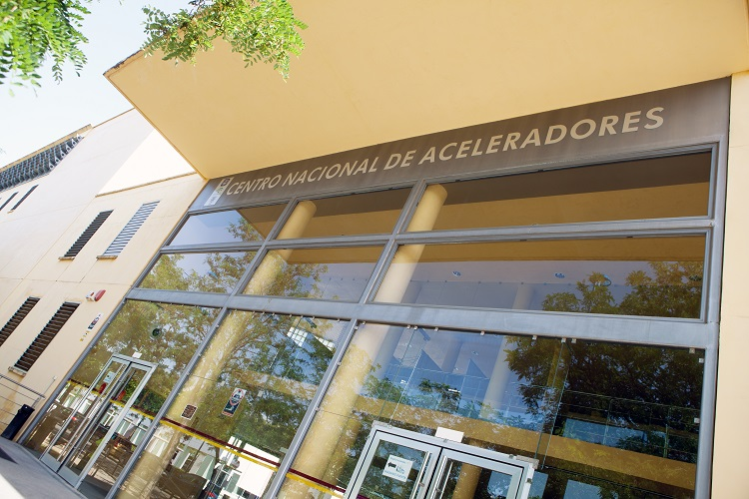
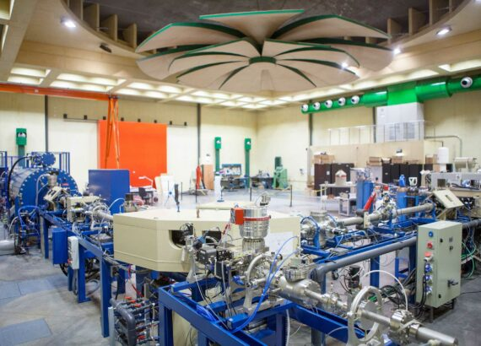
Hands-On sessions
Laboratory sessions at CNA (26-30, September) (more info. @CNA)
Fast neutrons: Time-of-flight with a fast pulsed neutron beam and detectors providing pulse shape discrimination (B. Fernández, CNA)
Epithermal neutrons: Neutron capture MACS measurements by activation (C. Guerrero, CNA)
Thermal neutrons: neutron moderation and n-imaging (plus X-ray radiography) (M.A. Millán)
Fission neutrons: study of the neutron emission from ²⁵²Cf with ³He detectors (A. Tarifeño, IFIC)

Slide 5
Online sessions
There are many profiles among the participants, let us give you an introduction to neutron production, detection and use (astrophysics, nucleat technology and medicine) so we that we are ready to make the most out of the HANDS-ON school. We don’t want to leave anybody behind.
ZOOM sessions (21-22, September) (45 min. + 10 min. Q&A)
Interaction of neutrons with matter (J.L. Taín, IFIC)
Principles and examples of neutron production (C. Guerrero, CNA)
Principles and examples of neutron detection (D. Cano-Ott, CIEMAT)
The role of neutrons in astrophysics and neutron beam experiments (C. Domingo, IFIC)
The role of neutrons in nuclear technology and neutron beam experiments (F. Álvarez & V. Bécares, CIEMAT + C. Guerrero, CNA)
The role of neutrons in medicine and neutron beam experiments (I. Porras, UGR)

Slide 6
Thank you for joining & Welcome to the H2020-ARIEL HISPANOS School

