Slide 1
Overview on preparing the LHC tunnel for the cores works – slides for discussion
S. Maridor, M. Mendes, M. Modena, P. Fessia
HL-LHC Cores Opening (Integration Meeting) – 25.11.2019

Slide 2
Disclaimer
The content of these slides was based on previous discussions held in the series of HL-LHC cores meetings.
These slides sum up all those discussions with concrete propositions about the preparation needed on the 8 places where the vertical cores coming from the HL-LHC will arrive in the LHC tunnel.
They are meant to be a basis for discussion and not yet a final solution.

Slide 3
Point 1 (Left and Right, situation is symmetric)

Slide 4
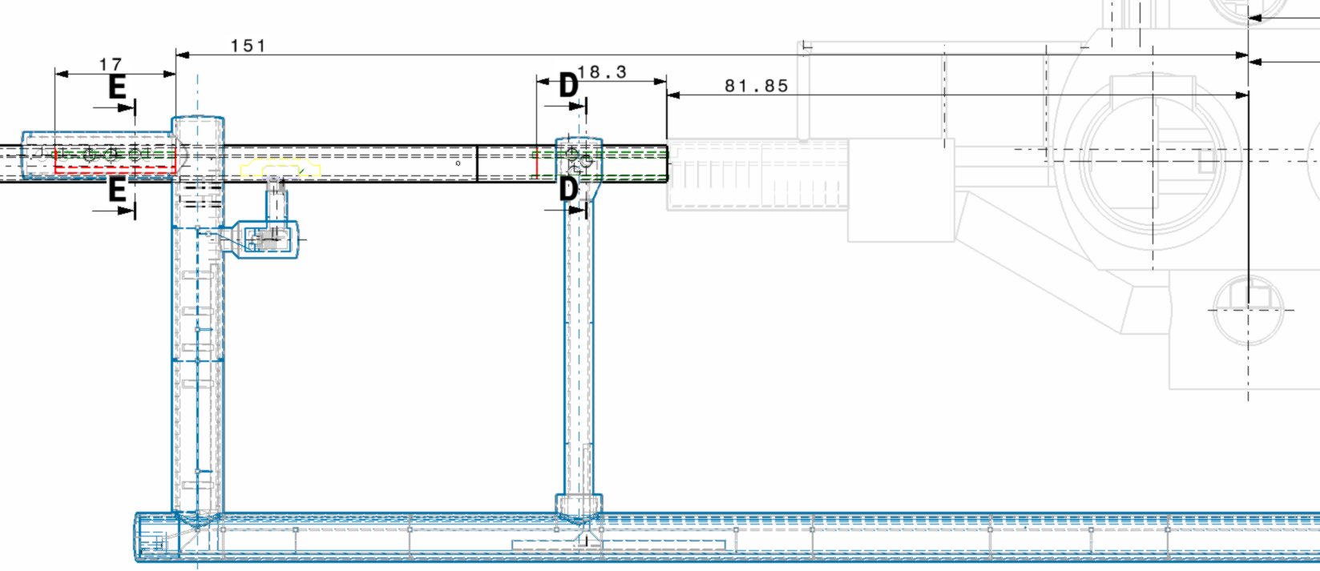
LHC Point 1 - LEFT

Slide 5
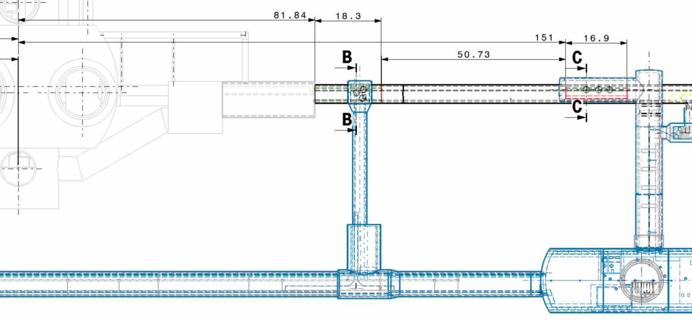
LHC Point 1 - RIGHT

Slide 6
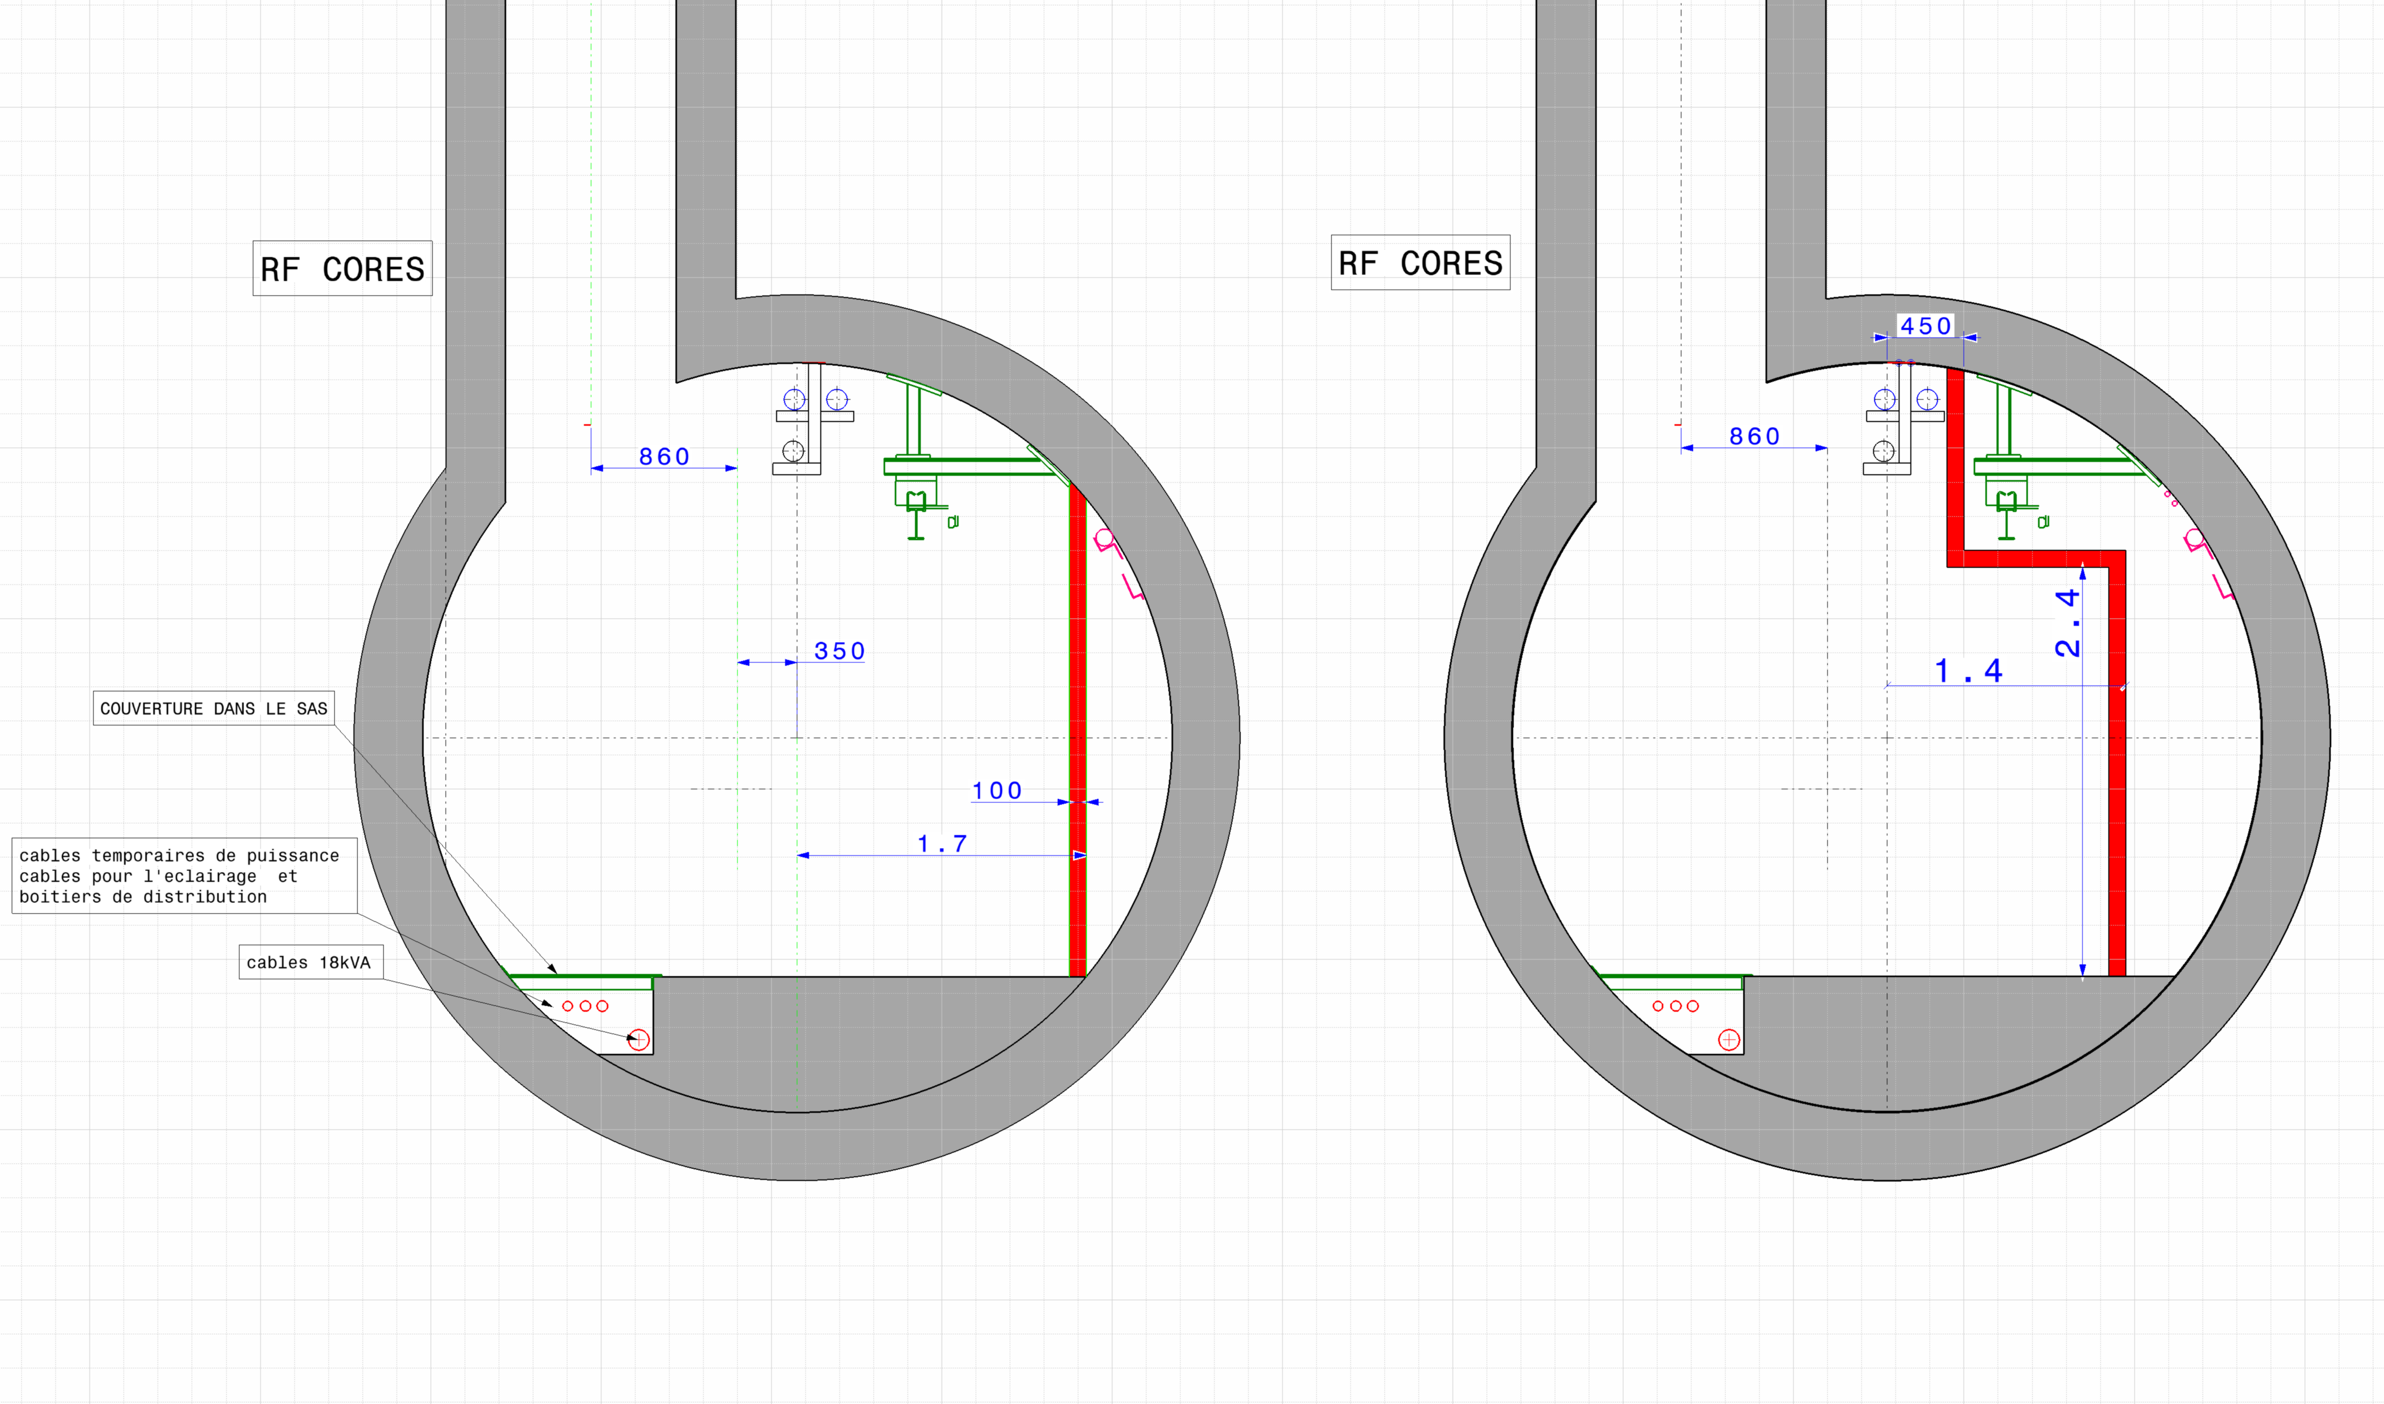
SAS LEVEL UA13/17 (RF CORES)
OPTION
1.1 m2
0.2 m2
Considered free area for ventilation: 1.3m², corresponding to a flow of 18,000 m³/h – i.e. no need to activate smoke extraction mode, assumes no hot works in adjacent sectors

Slide 7
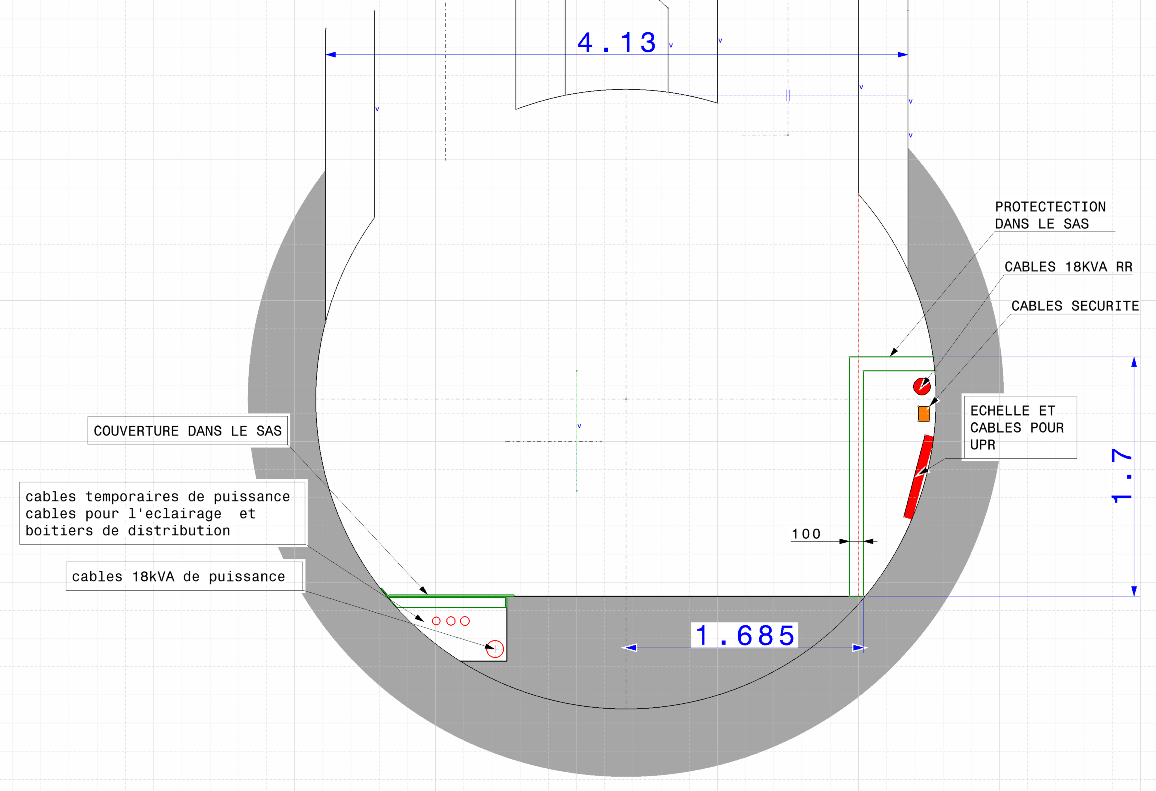
SAS LEVEL UL13/17
Still need to find the space for ~0.3m2 of space for ventilation: flexible duct? False floor? Others?
0.7 m2
Cables protection & possible way of ventilation
0.2 m2

Slide 8
Point 5
(situation is asymmetric)

Slide 9
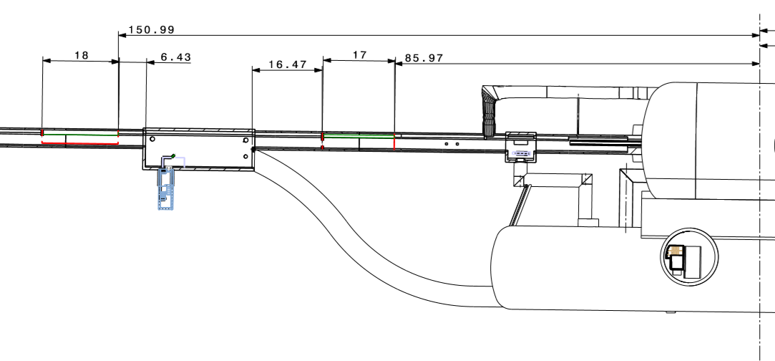
LHC Point 5 - LEFT

Slide 10
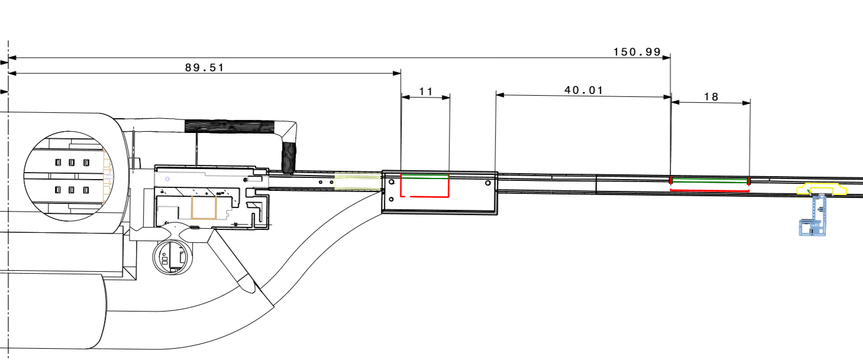
LHC Point 5 - RIGHT

Slide 11
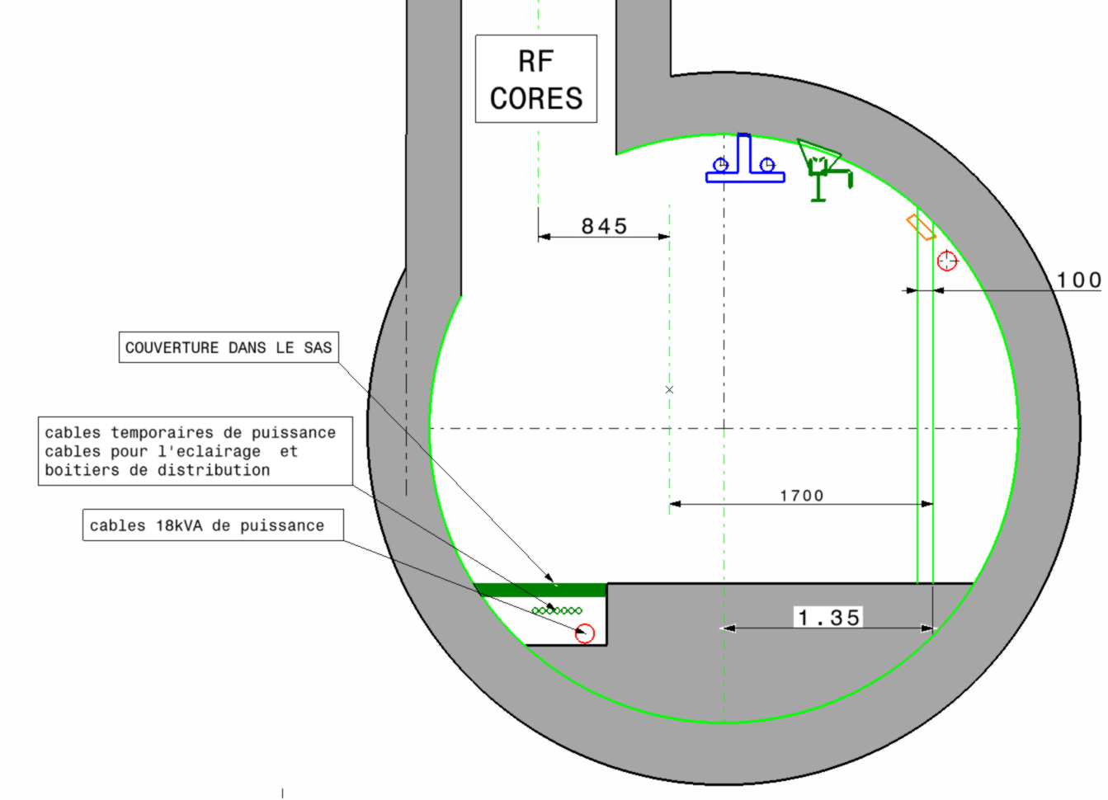
SAS LEVEL UA53 (RF CORES)
Considered free area for ventilation: 1.2m², corresponding to a flow of 18,000 m³/h – i.e. no need to activate smoke extraction mode, assumes no hot works in adjacent sectors
(18kA displaced)
1 m2
0.2 m2

Slide 12
SAS LEVEL UA57 (RF CORES)
Considered free area for ventilation: 1.2m², corresponding to a flow of 18,000 m³/h – i.e. no need to activate smoke extraction mode, assumes no hot works in adjacent sectors
(18kA displaced)
1 m2
0.2 m2

Slide 13
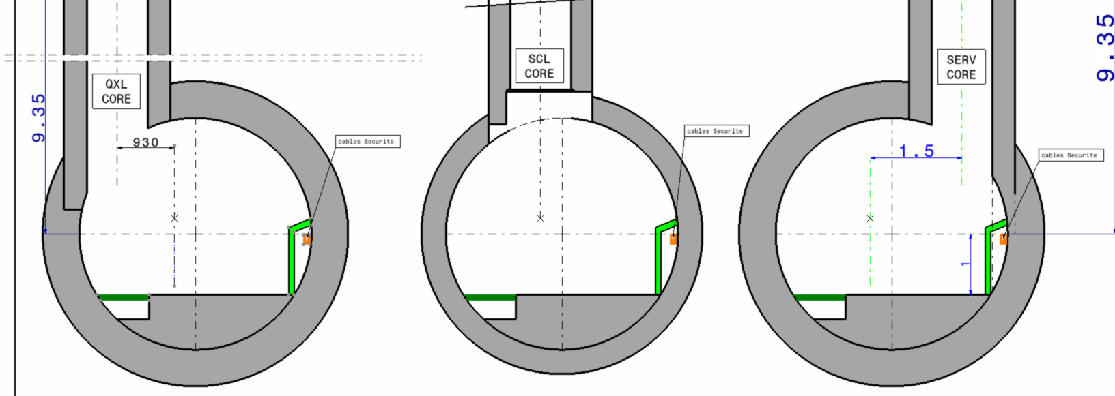
SAS LEVEL UL53
- “cul-de-sac”, LHC ventilation here is not an issue!
- But fresh air must be supplied to the chantier…
0.2 m2
0.7 m2
Cables protection & possible way of ventilation

Slide 14
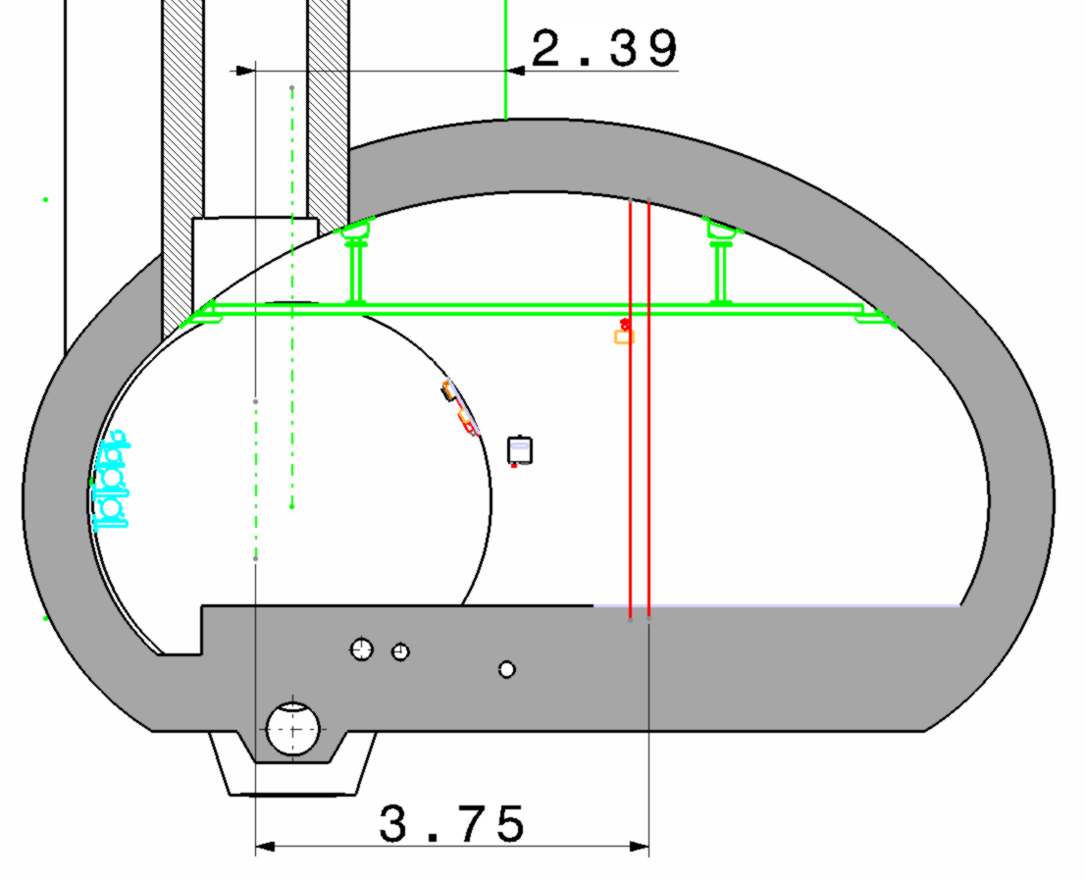
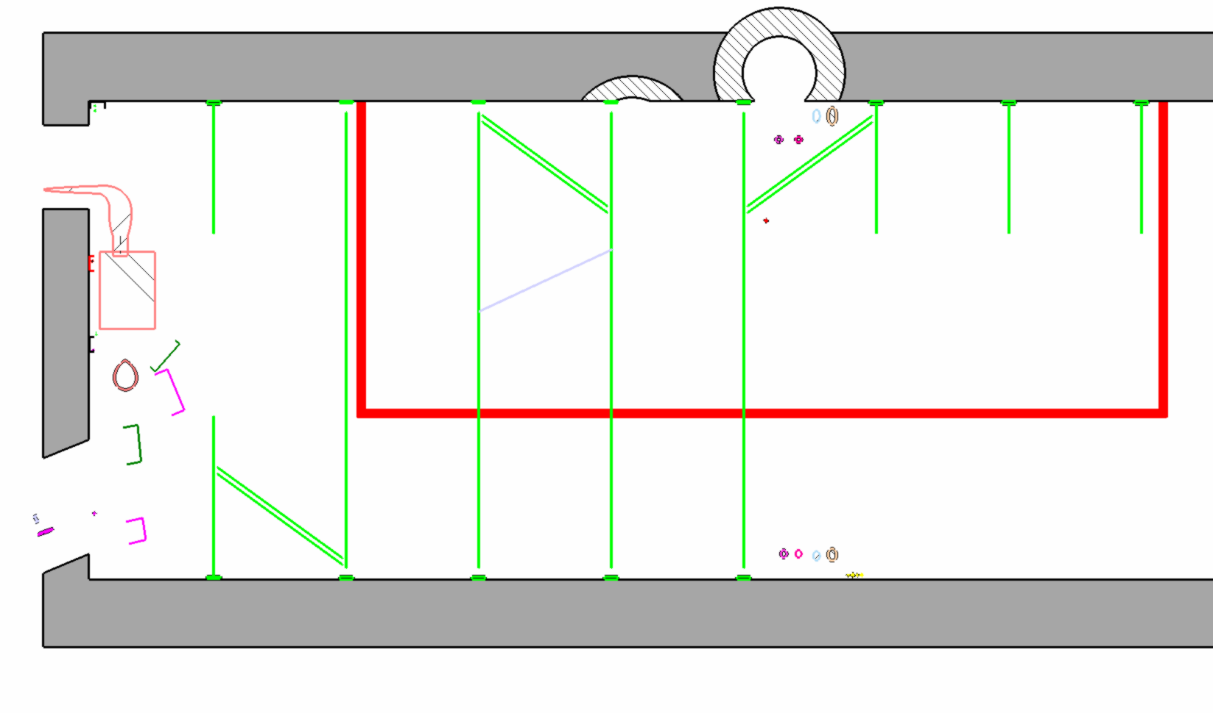
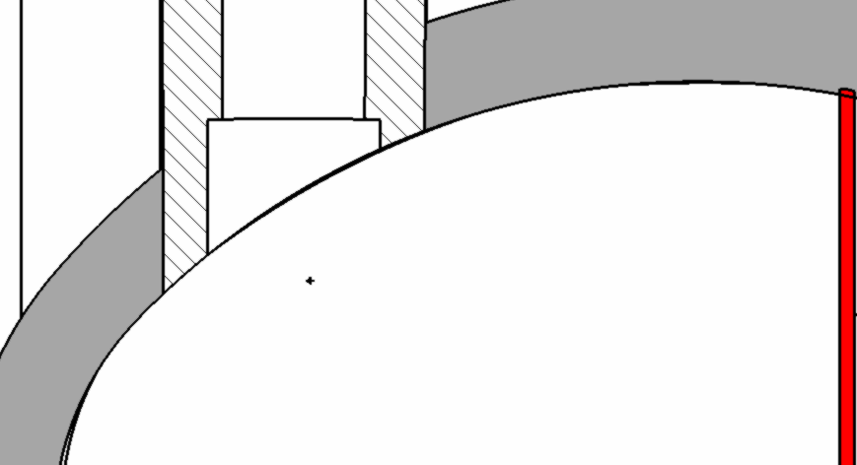
SAS LEVEL UL57
No issues with LHC ventilation;
Minimizing the SAS allows minimizing the infrastructure to dismantle
11 m

Slide 15
Spares slides
FOR DISCUSSION

Slide 16
Smarteam 3d models
R571+sas : st1217587_01
Uj57+sas : st1217523_01
R532 +sas : st0938781_01
R541 +sas : st0938795_01
R171+sas : st0927074_01
Ri132+sas : st09405588_01

Slide 17
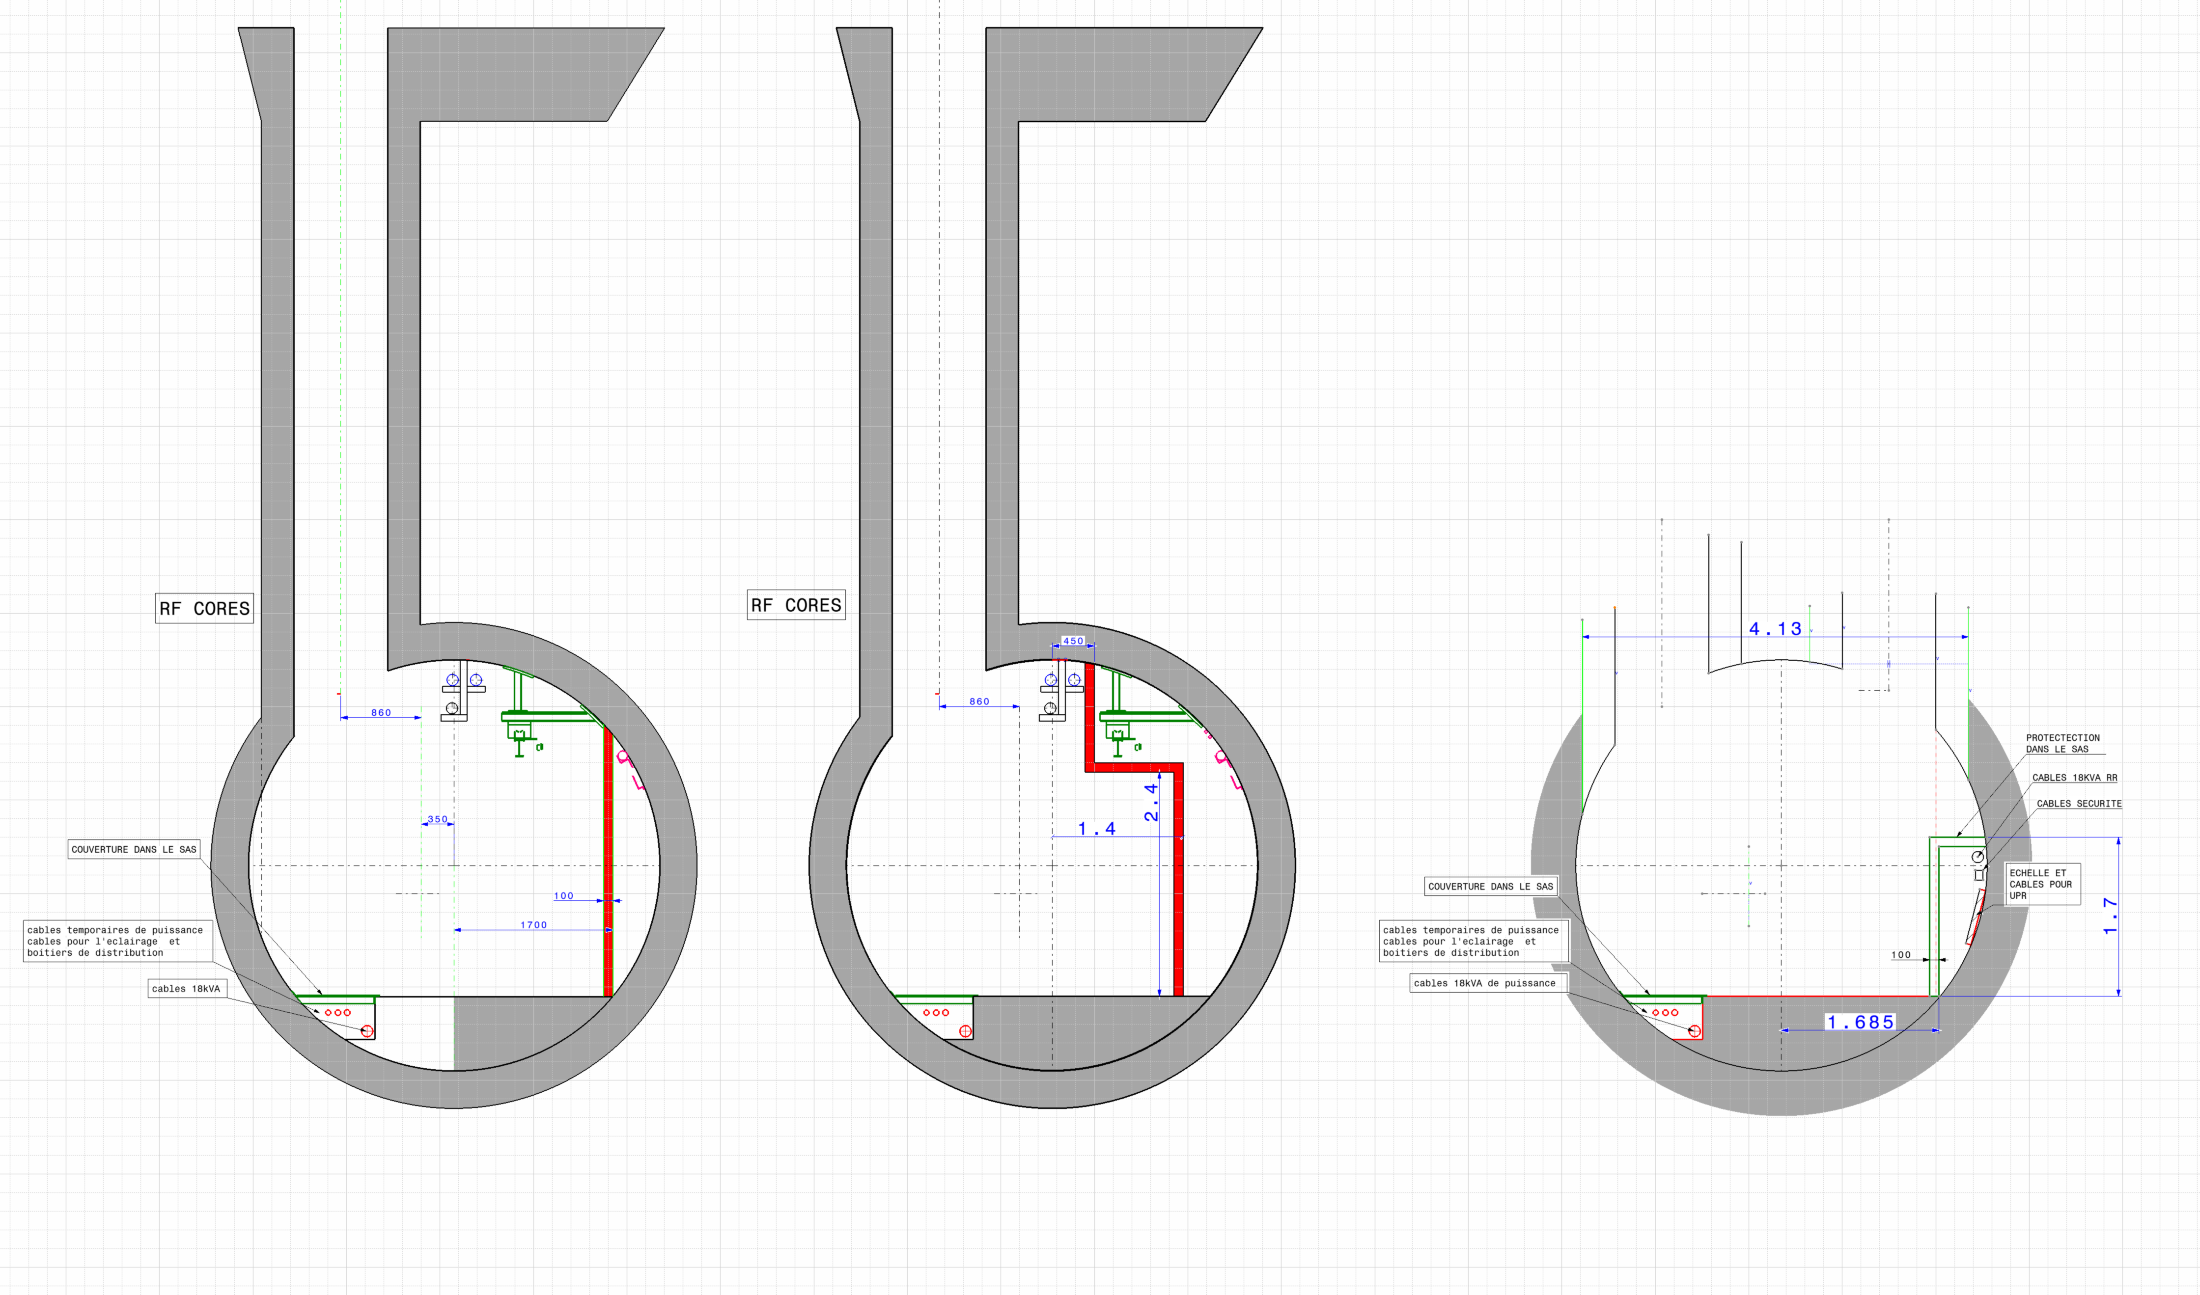

Slide 18
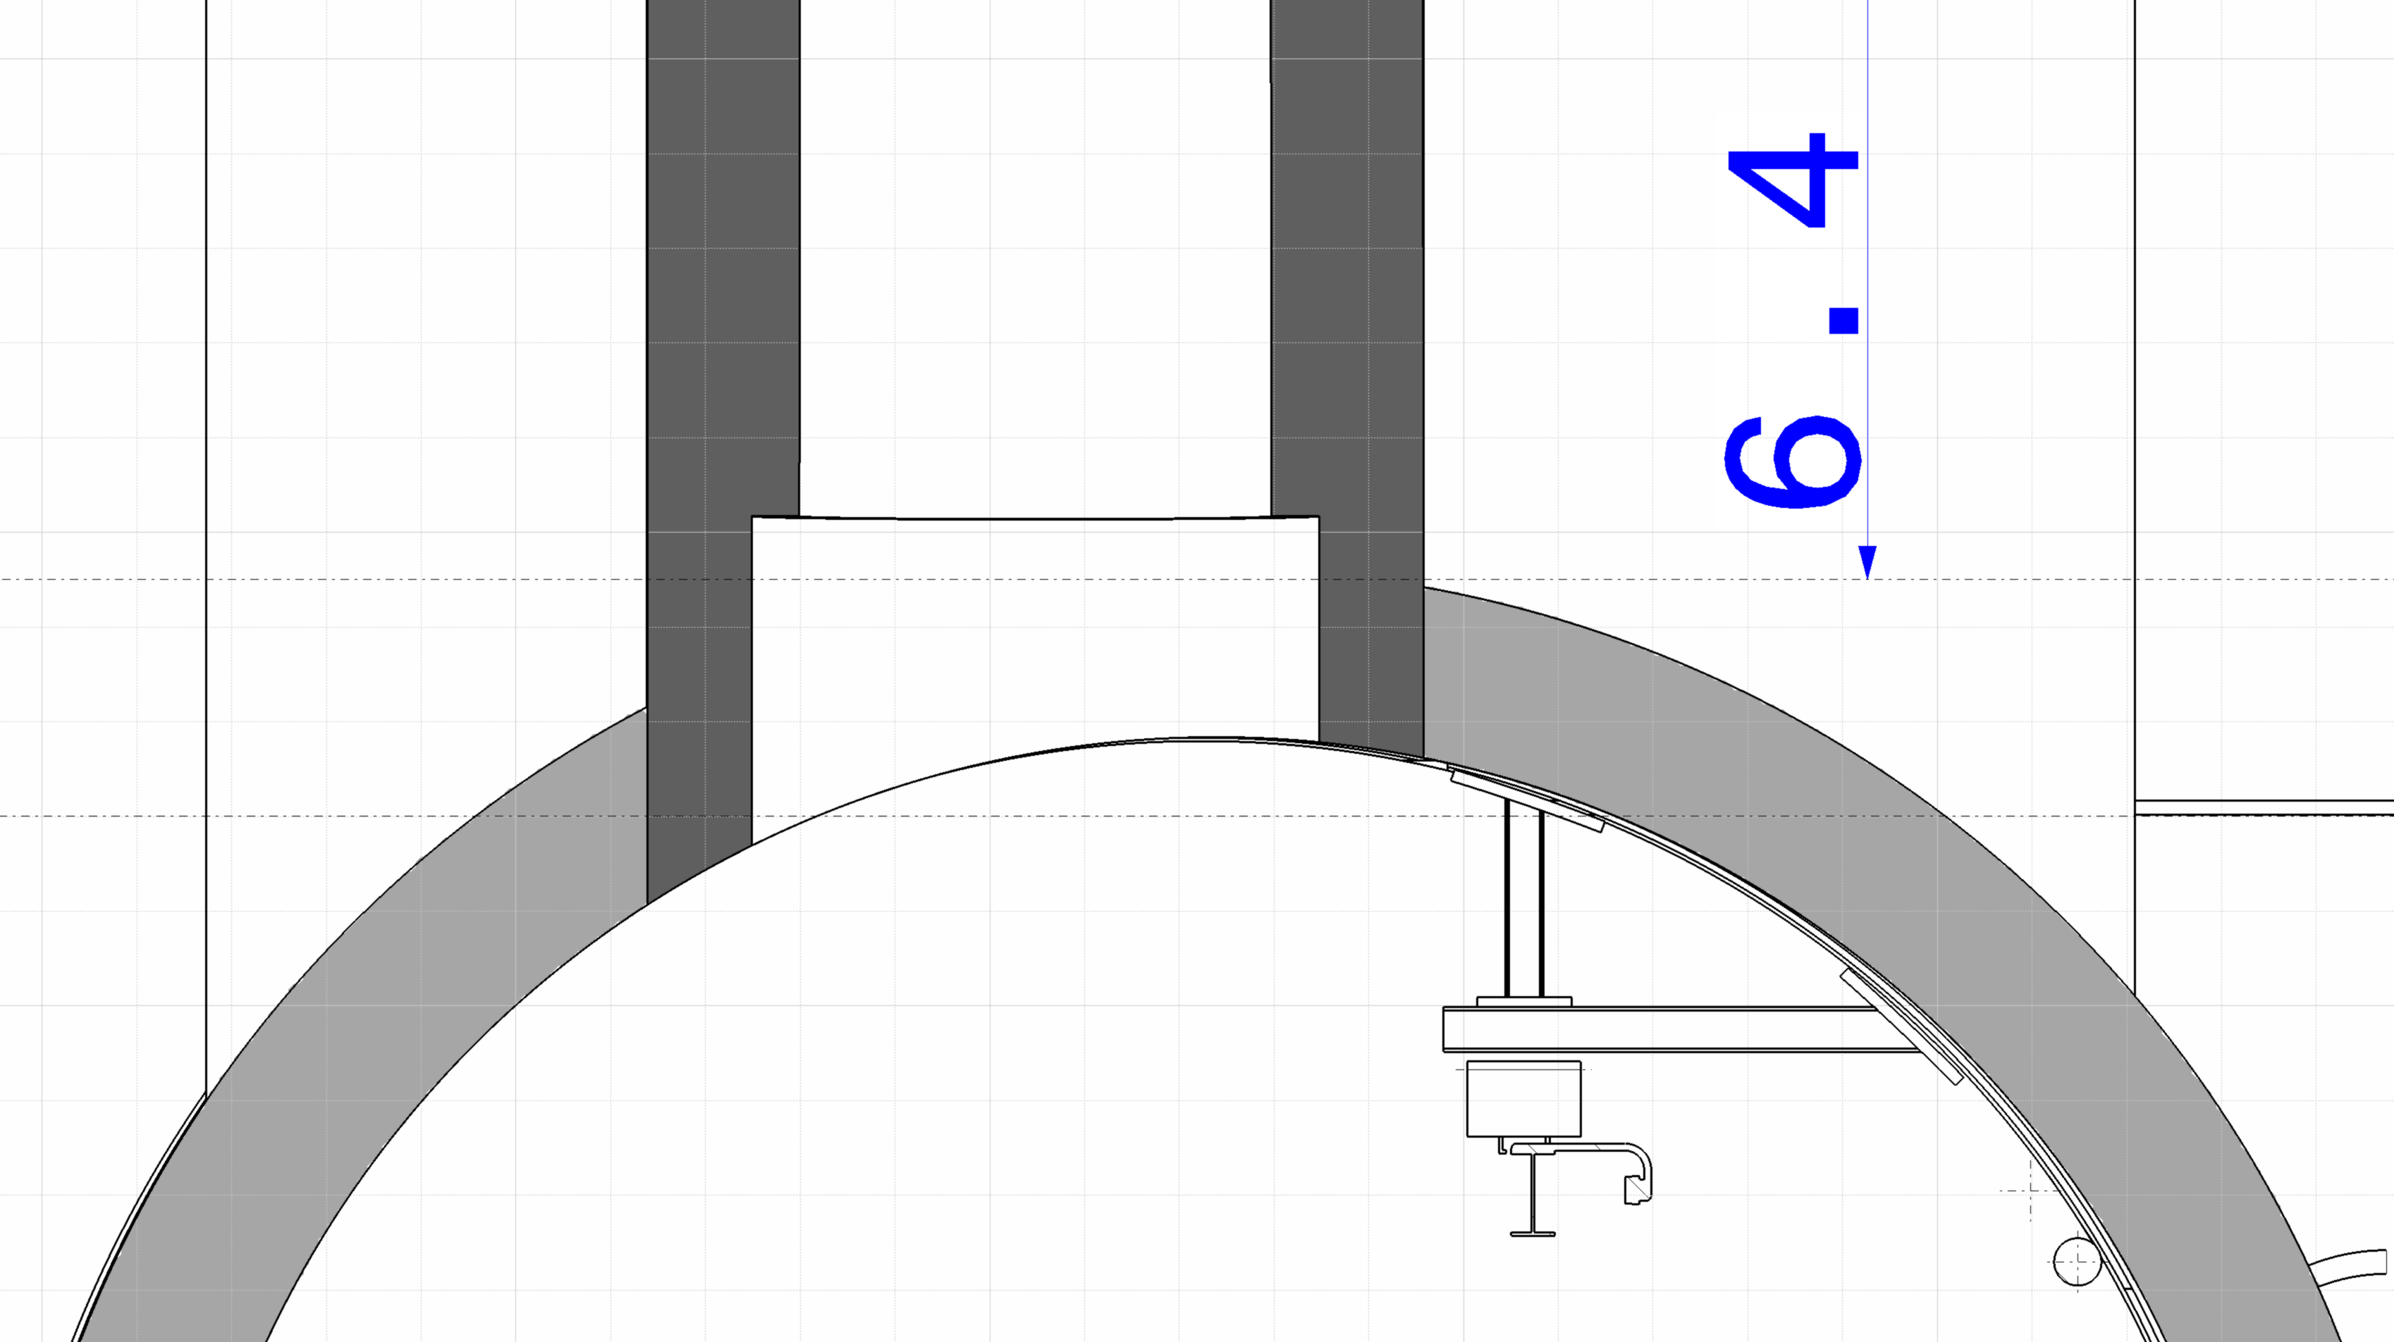
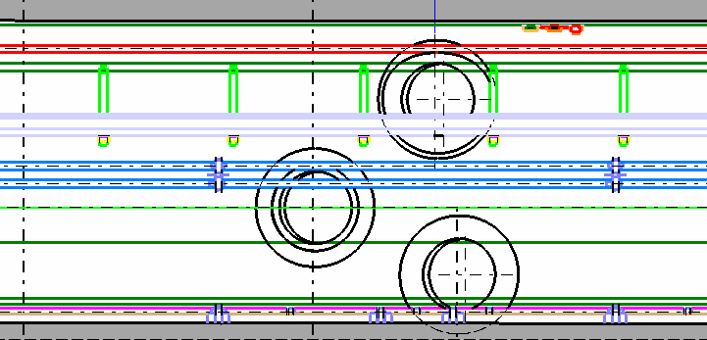
FOR DISCUSSION
REMOVE ONLY 2 SUPPORTS?
PROPOSE TO CUT A MINIMUM OF RAIL AND PIPES

Slide 19
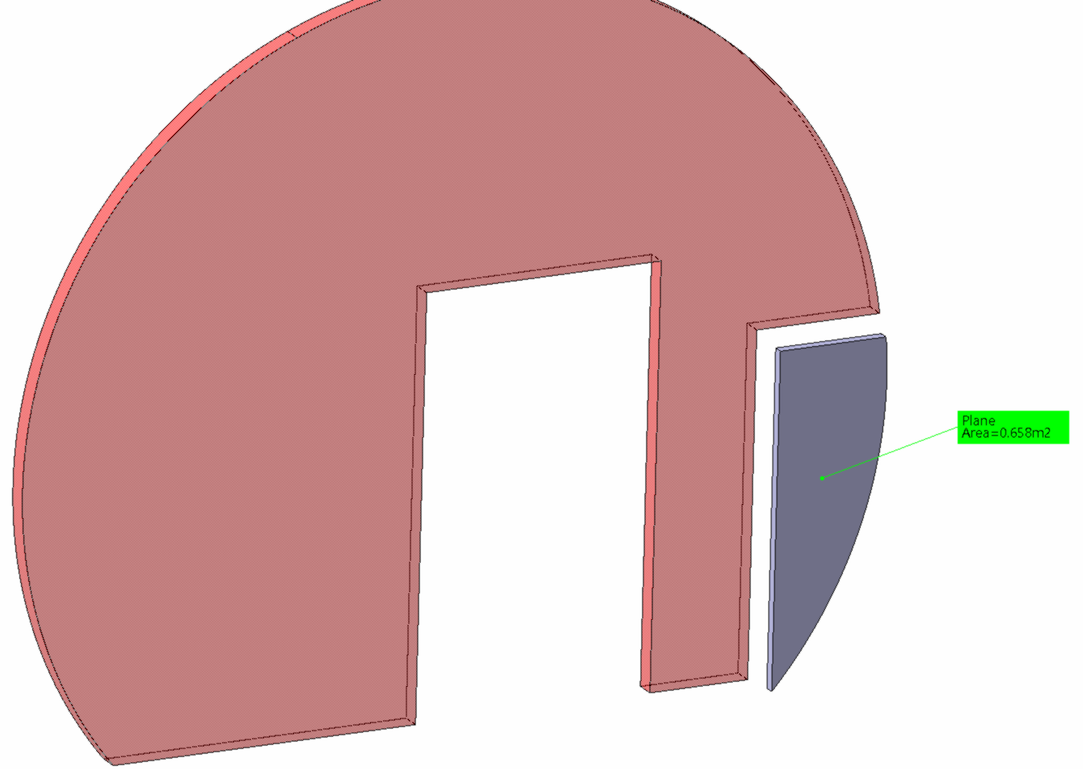
FOR DISCUSSION
UL_XX
Possible air passage

Slide 20
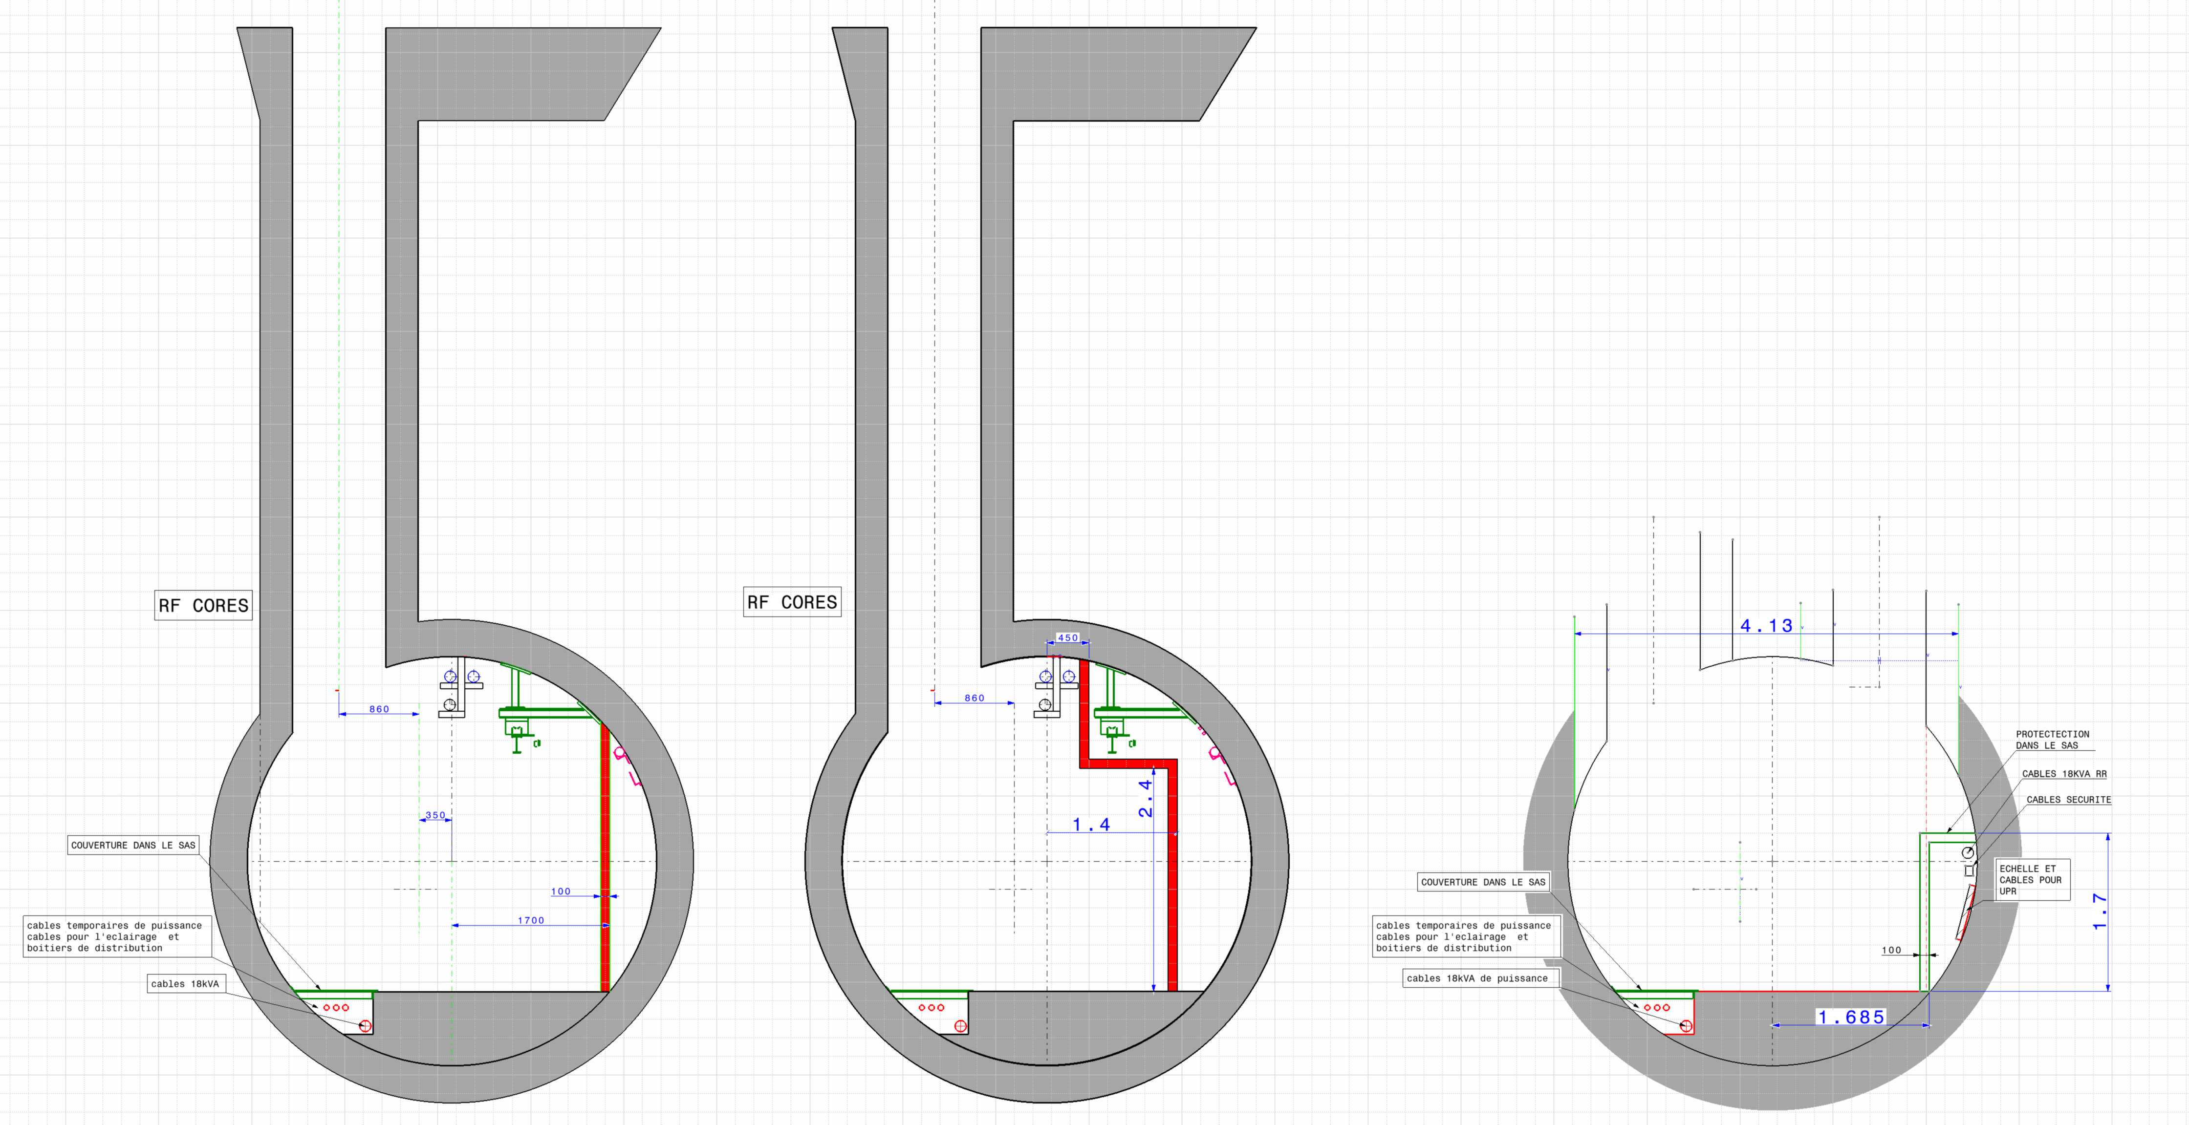
FOR DISCUSSION

Slide 21
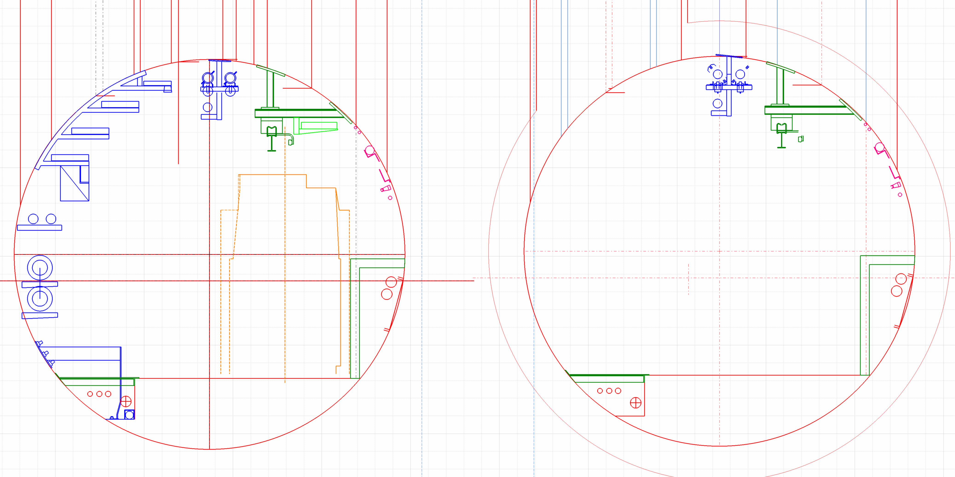
FOR DISCUSSION

Slide 22
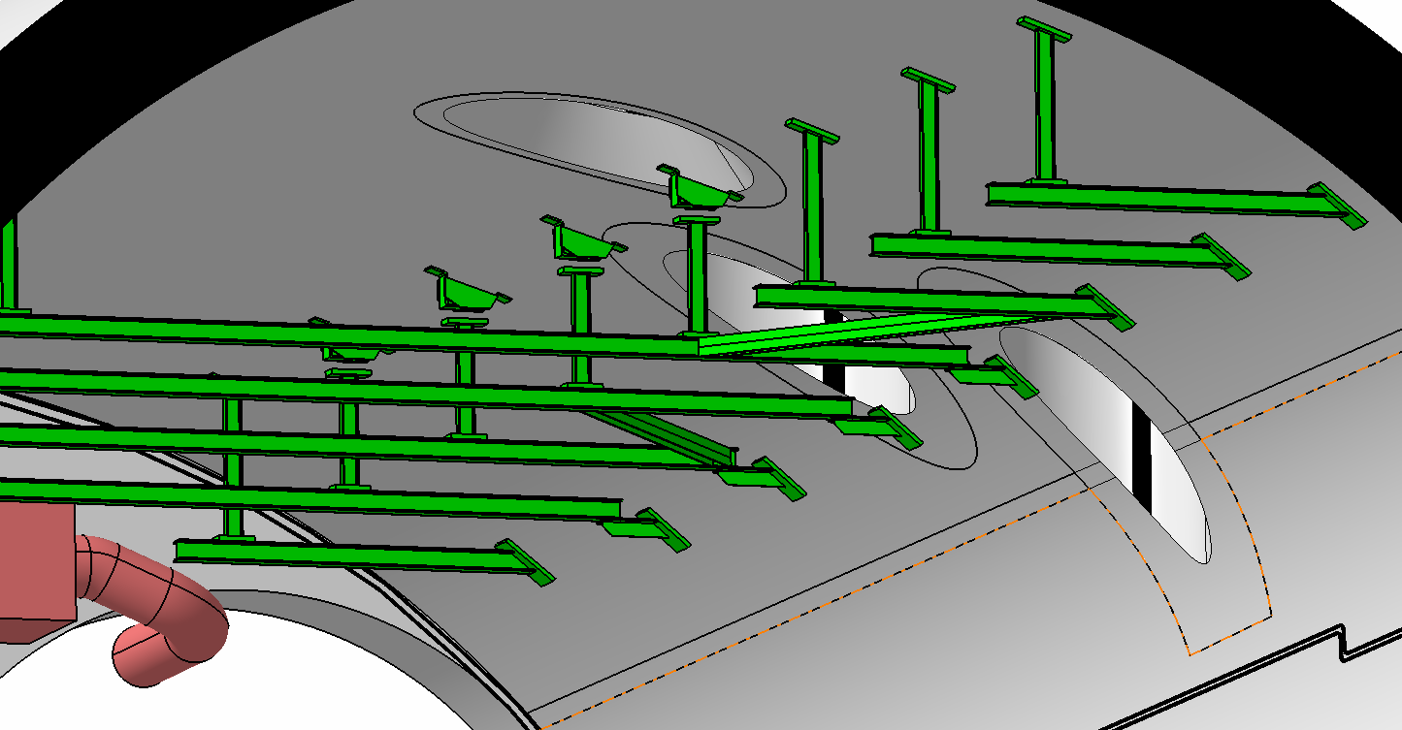
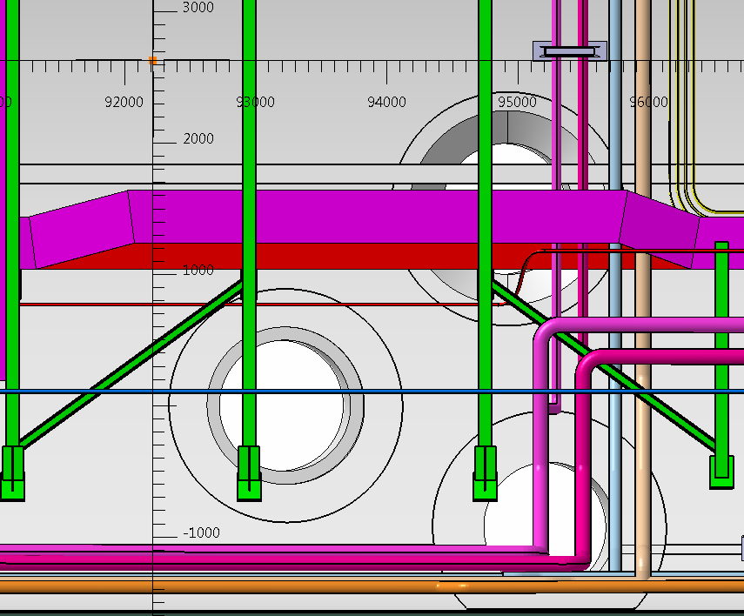
FOR DISCUSSION
REMOVE ONLY 2 SUPPORTS?
PROPOSE TO CUT A MINIMUM OF RAIL AND PIPES
Part of metallic structure MUST be dismounted and
Modified . (Who is in charge?)

Slide 23
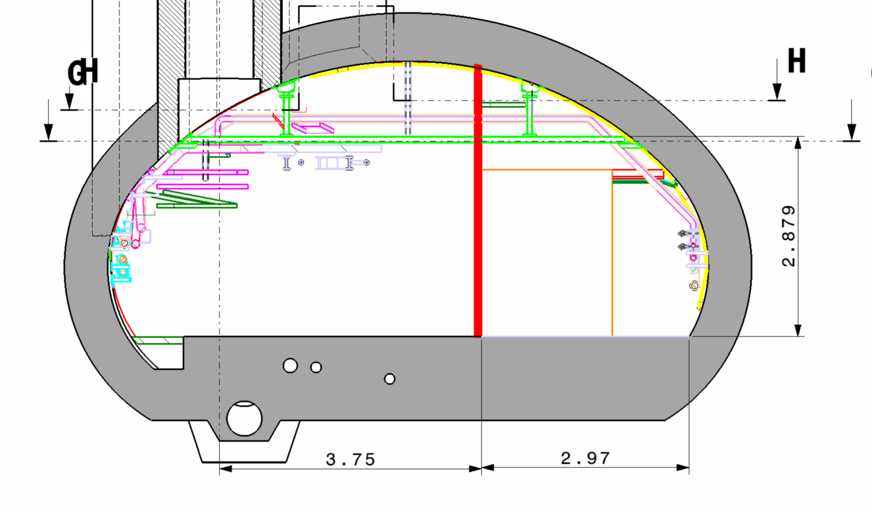
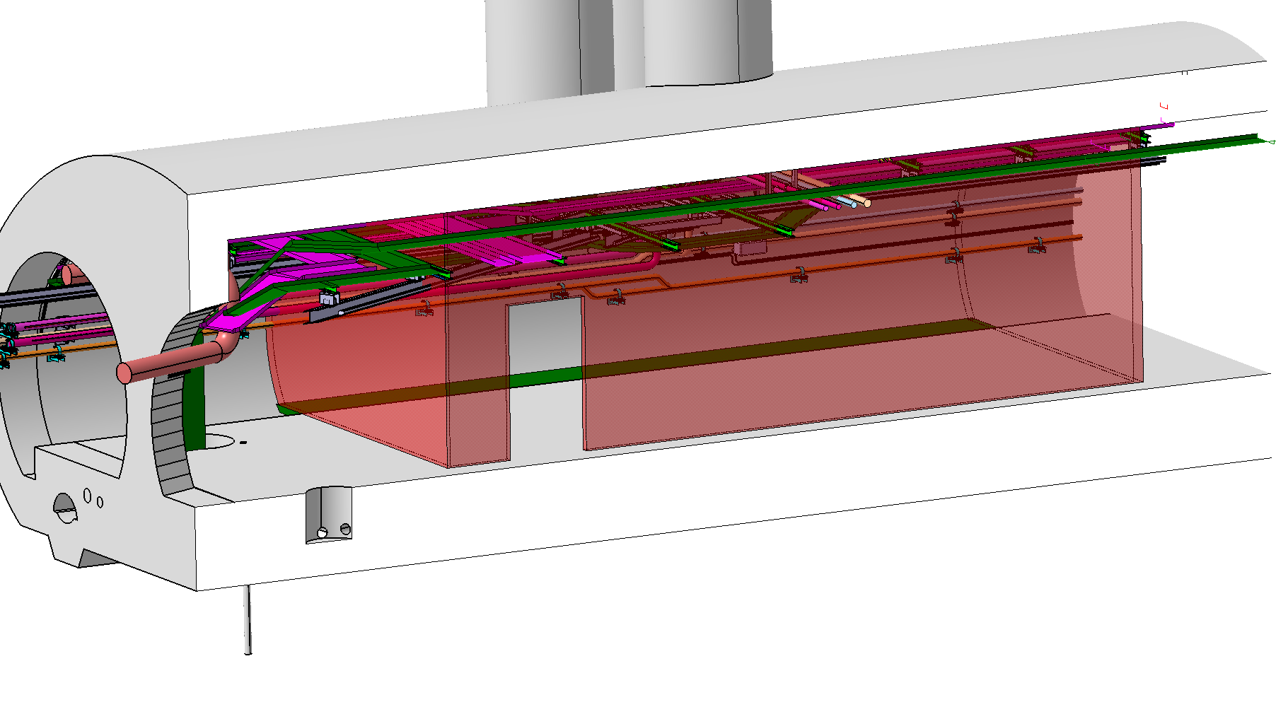
FOR DISCUSSION

Slide 24
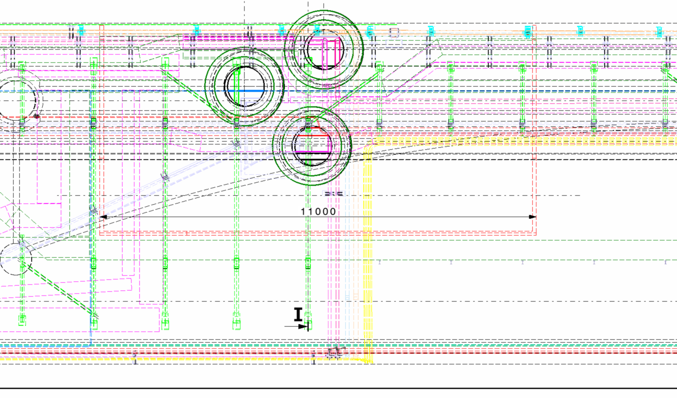

Slide 25
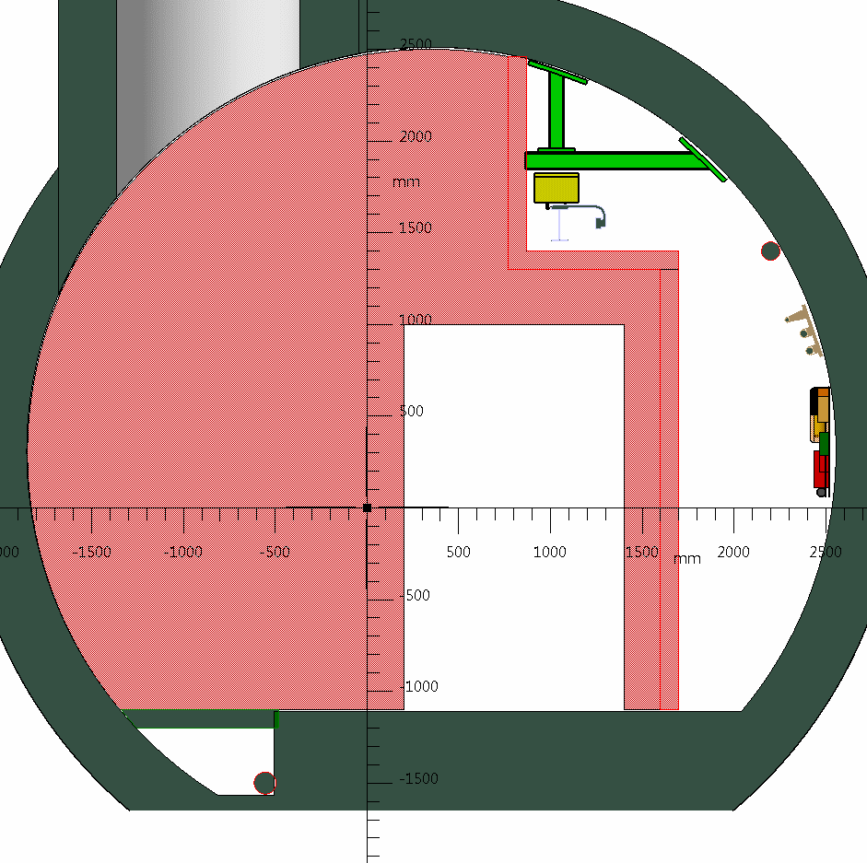
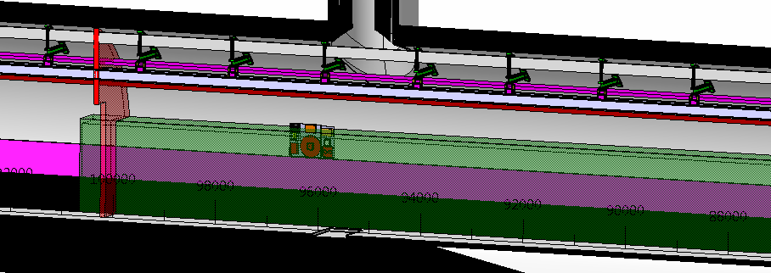
UAs
More air passage

Slide 26
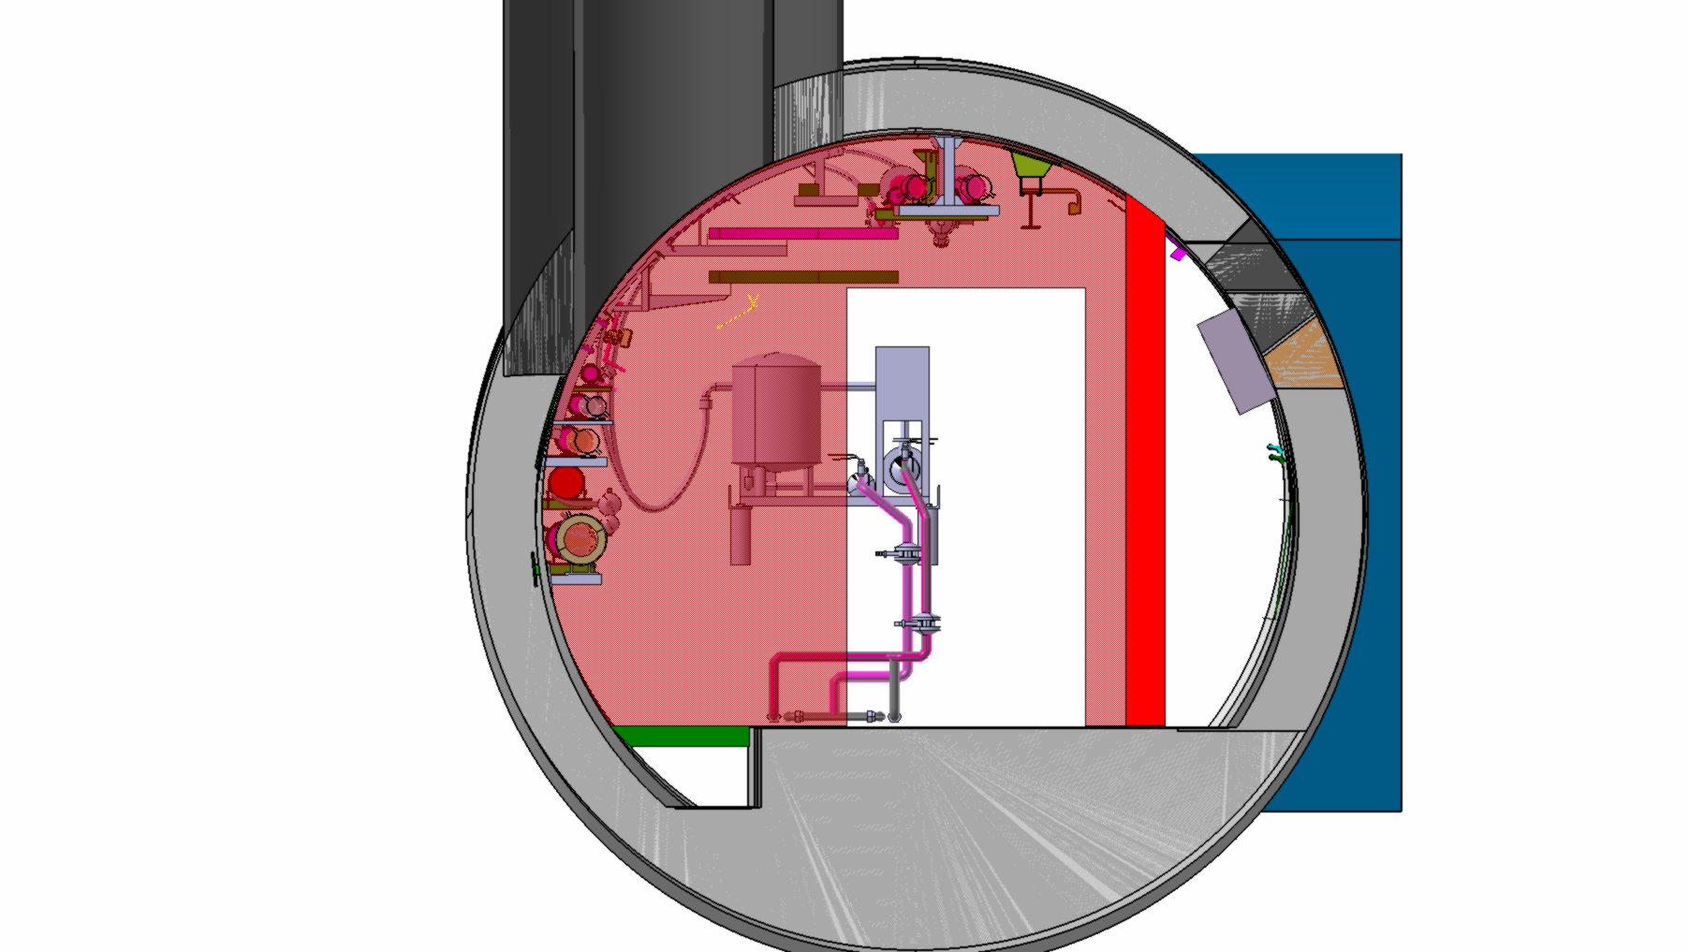
r571

Slide 27
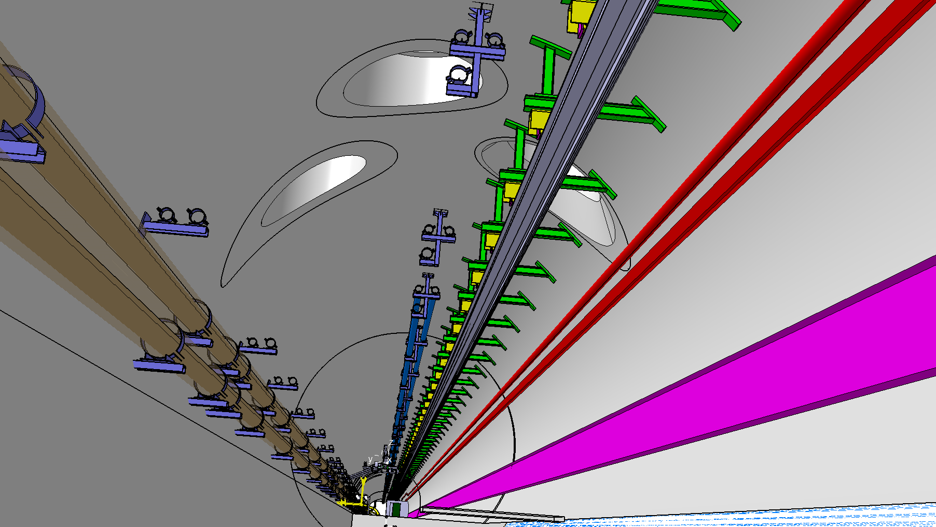
Limit as much as possible parts to CUT during cores drilling

Slide 28
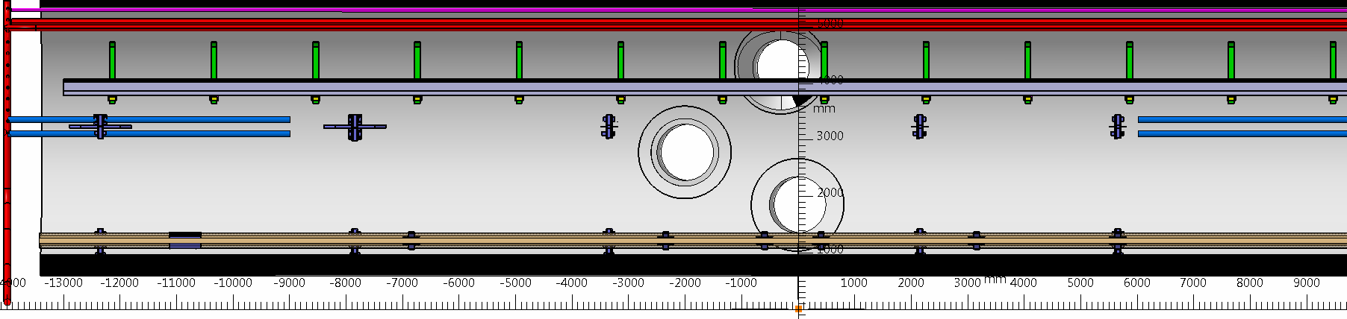
Limit as much as possible parts to CUT during cores drilling

Slide 29
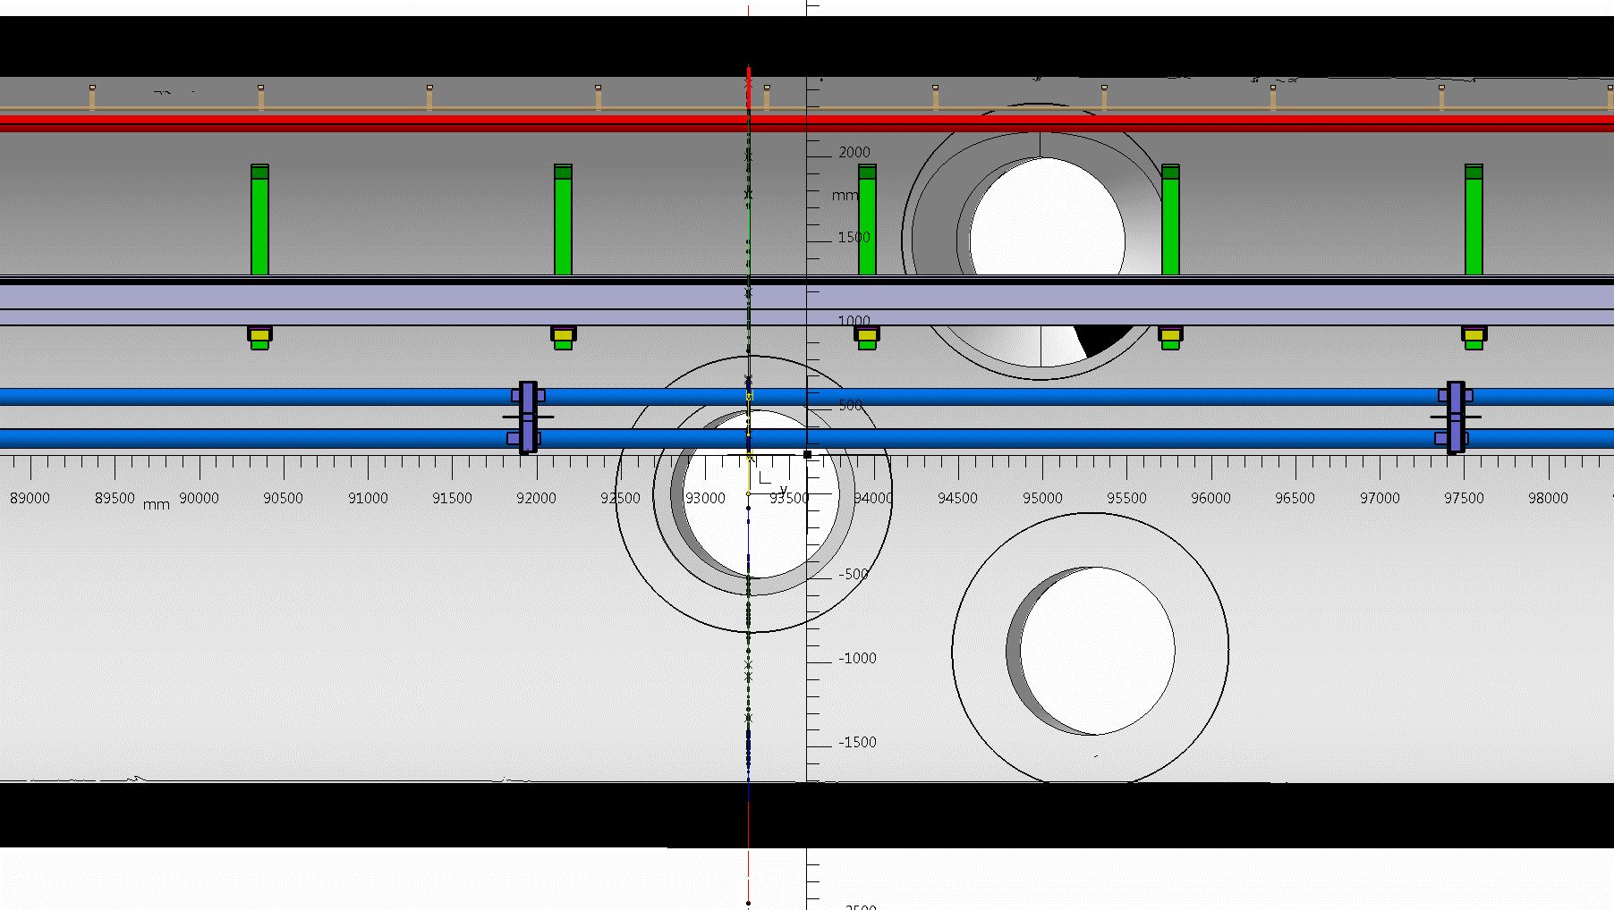
Limit as much as possible parts to CUT during cores drilling

Slide 30
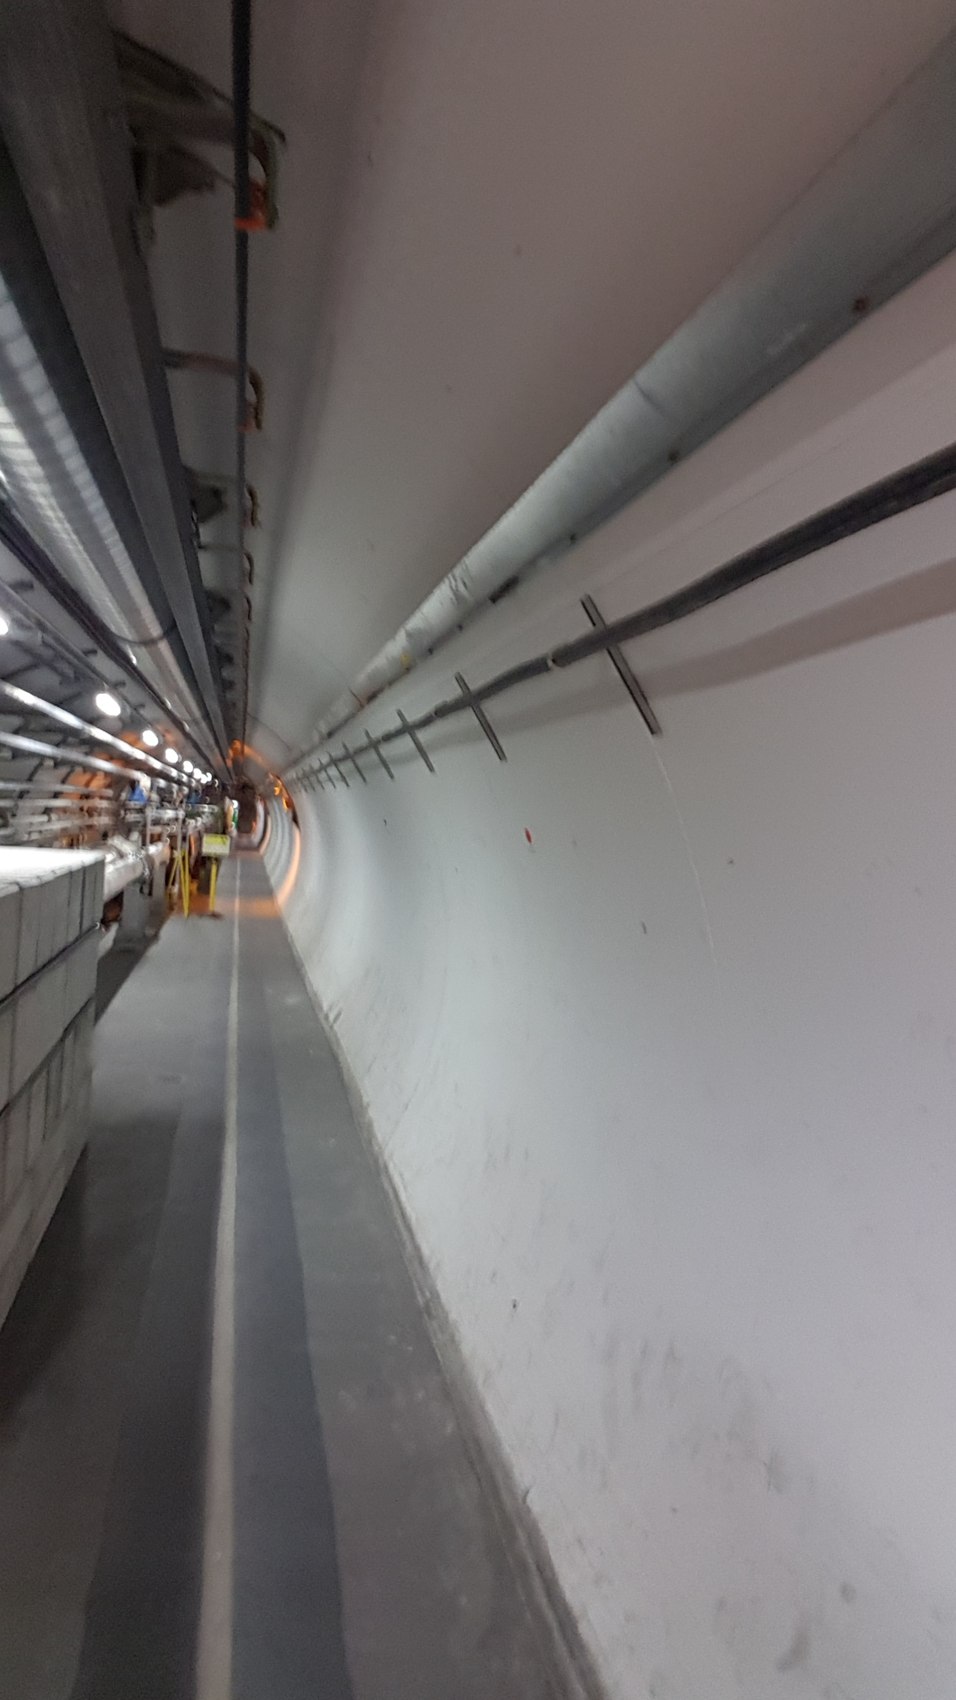
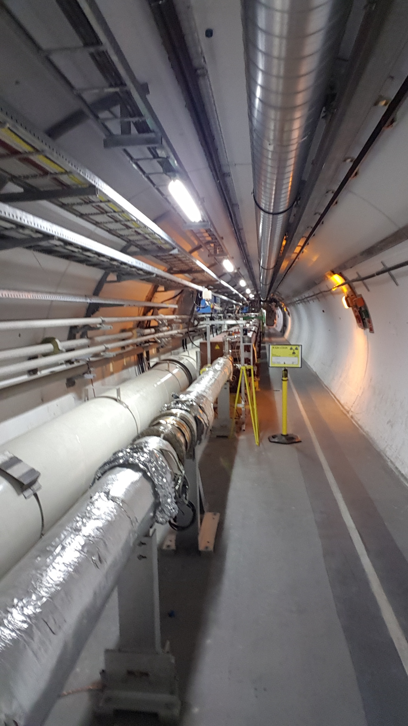
LHC Point 5 – LEFT – UL 53 Cores
L01A ES
L01A ES (Control Safety Cables) - To be displaced ( ~30-40cm)
R 541 – Transport Side
R 541

Slide 31
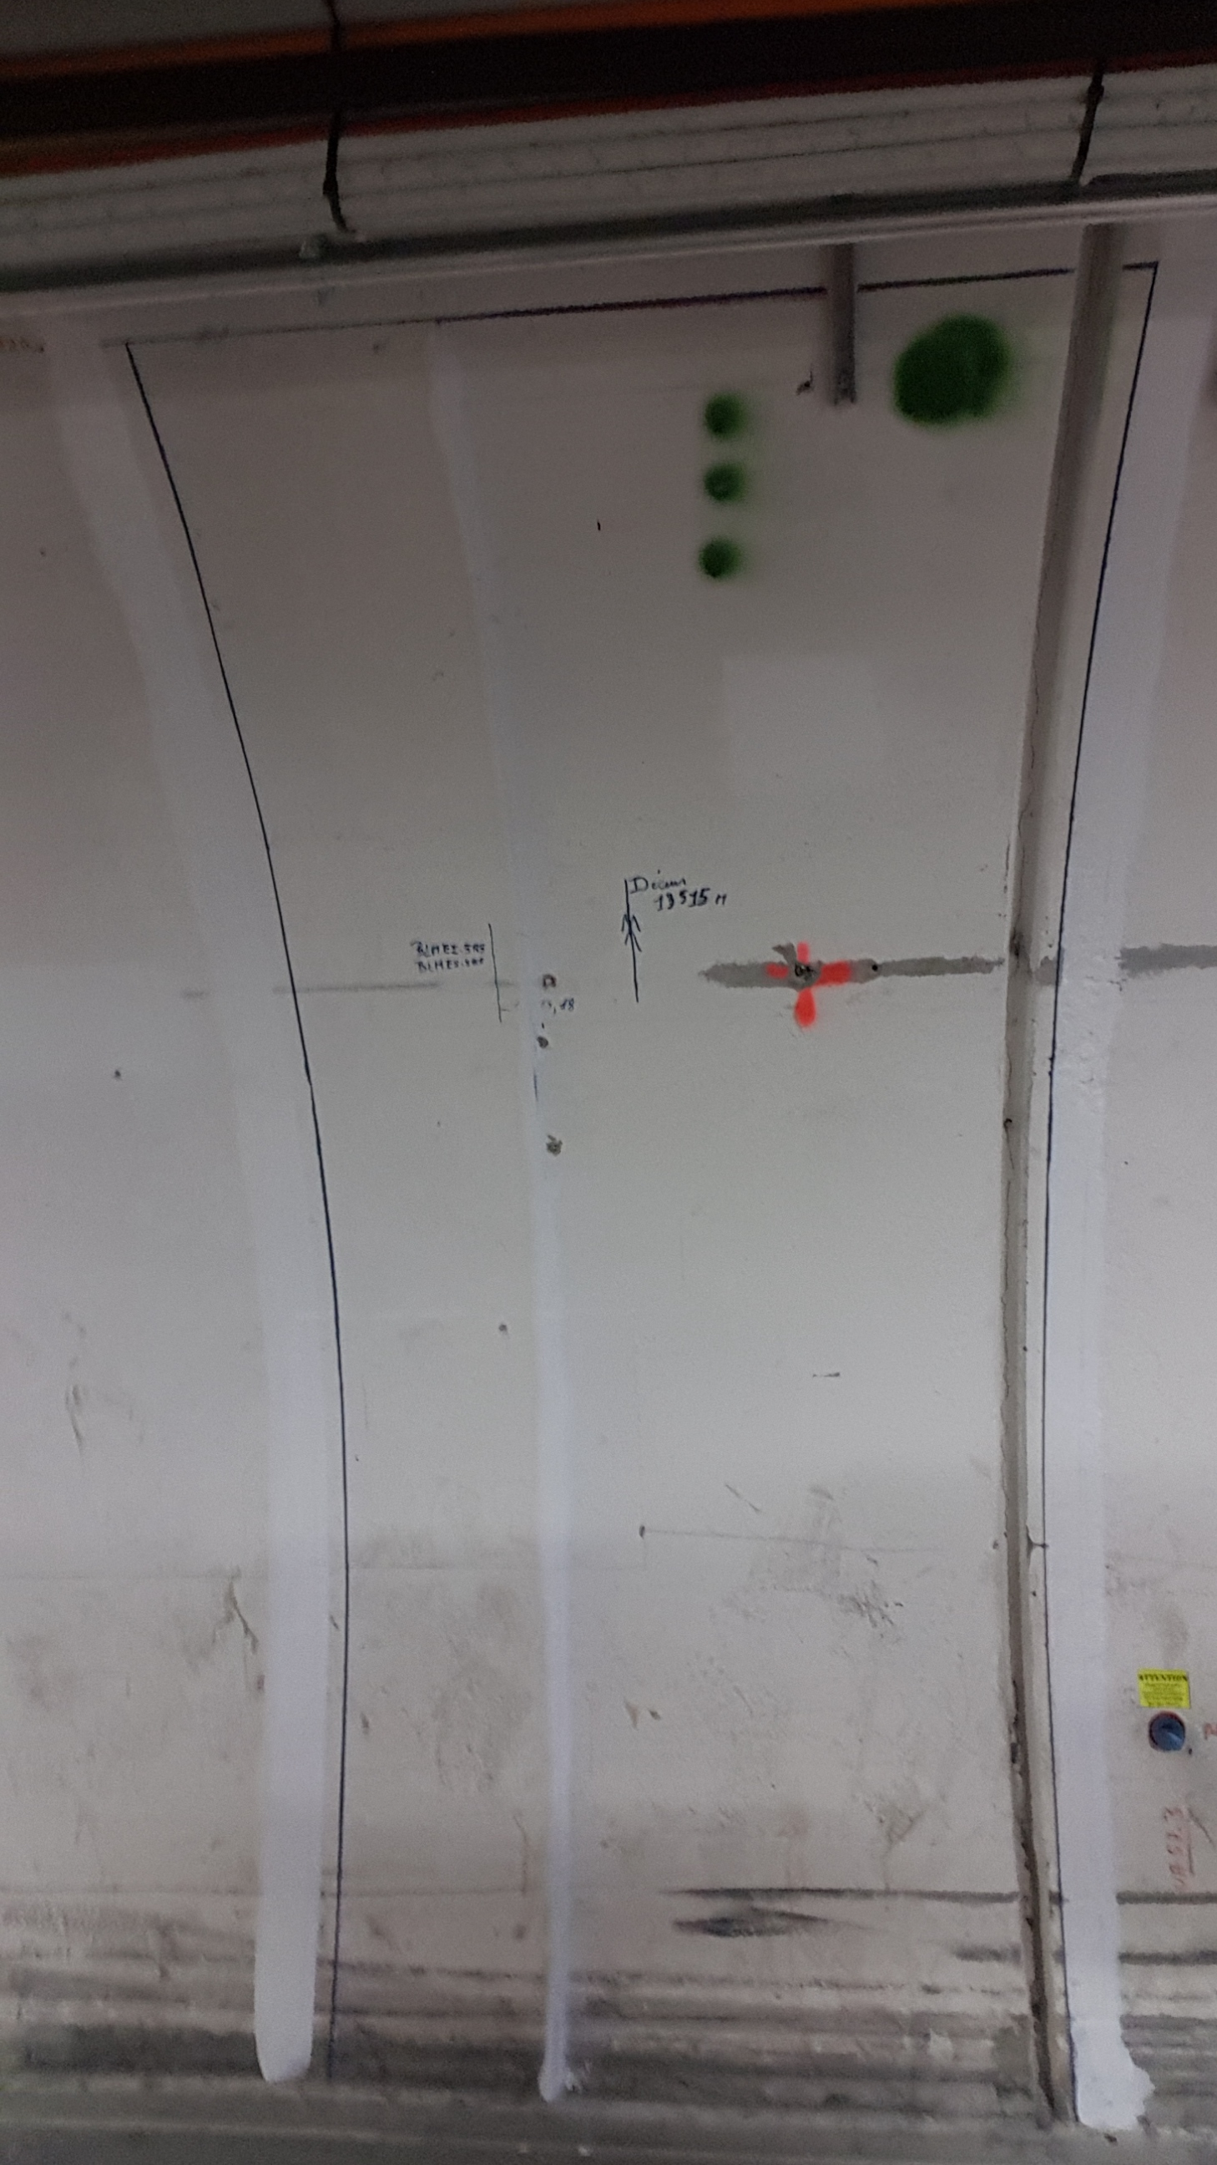
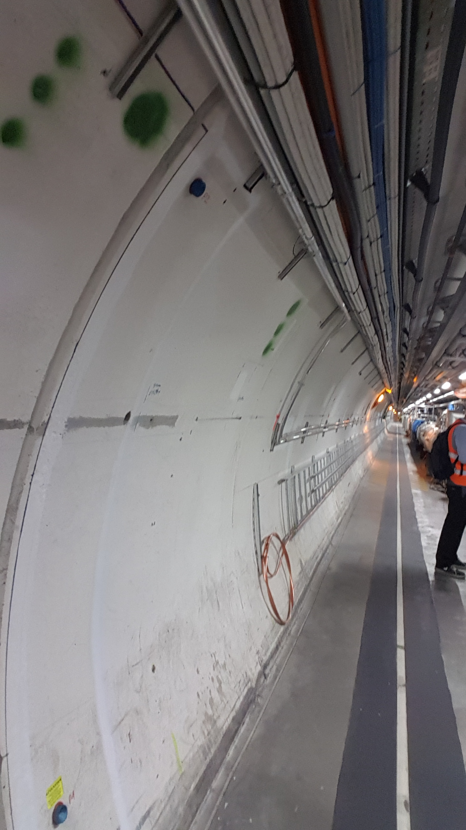
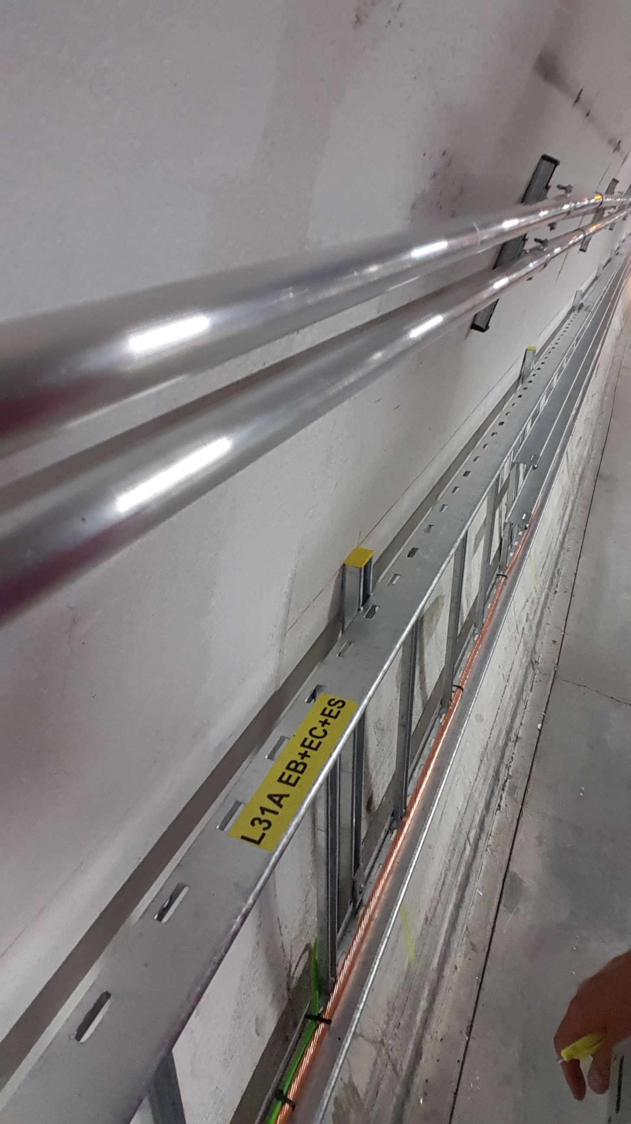
LHC Point 5 – RIGHT – UPR57

Slide 32
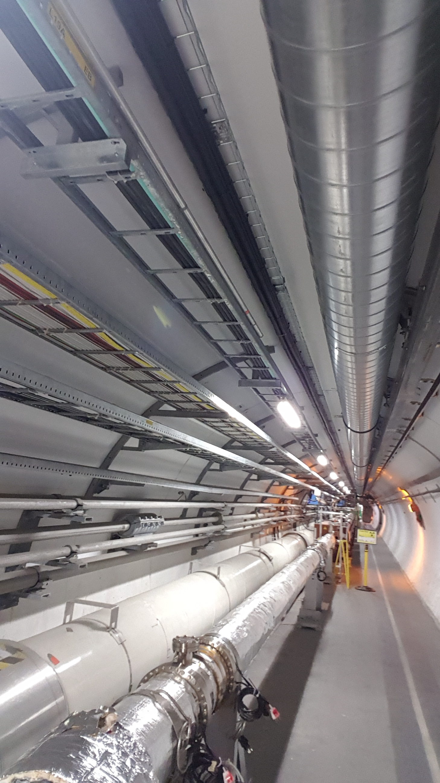
LHC Point 5 – LEFT – UL 53 Cores
R 541

Slide 33
Thank you for your attention

