Slide 1
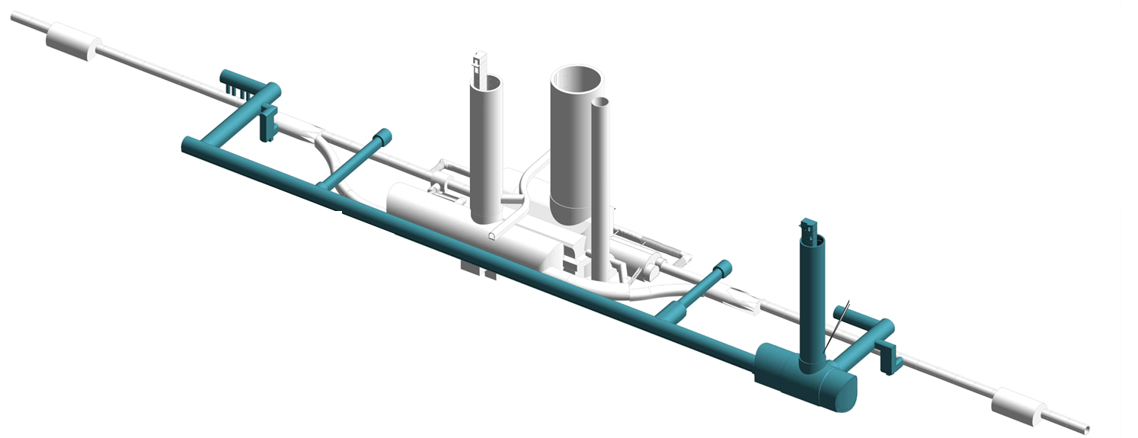
HL-LHC Vertical Cores
Status Employer’s requirements for TechSpec
WP17.1 Civil Engineering
C.Gasnier
25/11/2019

Slide 2
AGENDA
Baseline (Reminder)
Employer’s requirements specification:
  RadioProtection
  Transport
  LHC Ventilation
  Worksite Ventilation
Open points

Slide 3
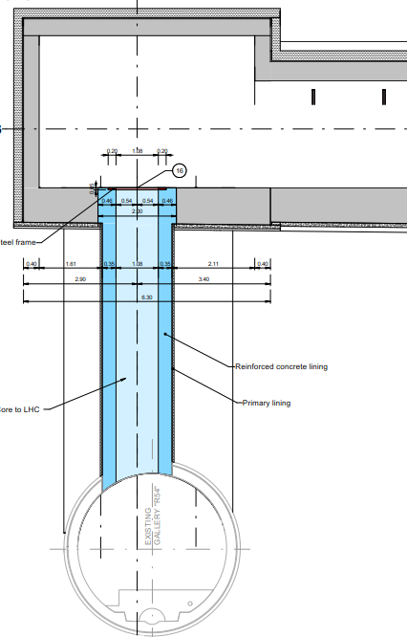
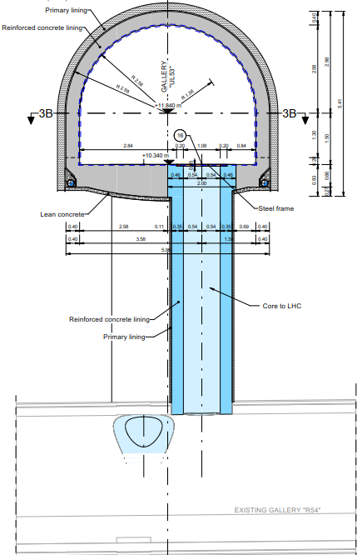
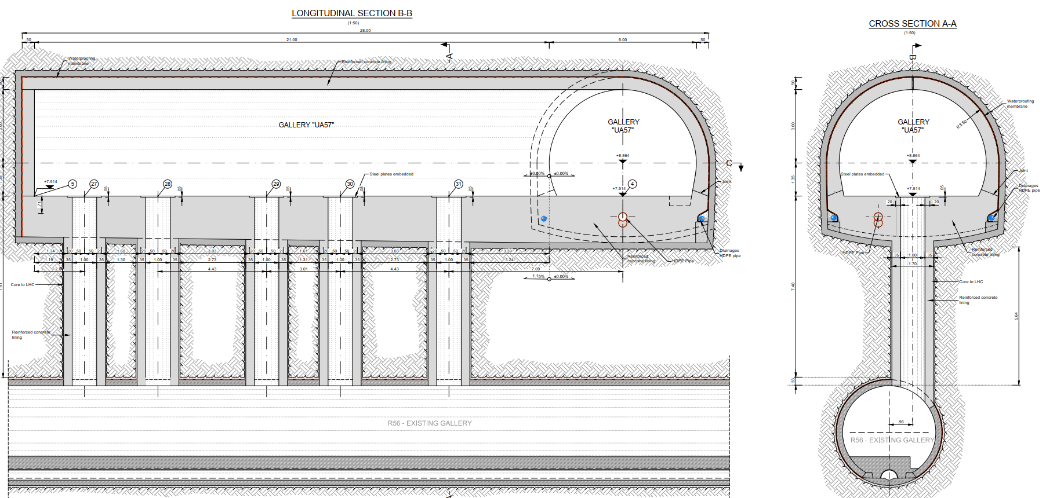
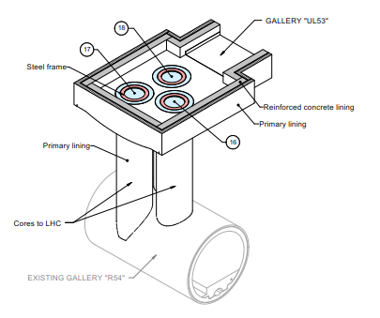
HL-LHC Vertical Cores – Geometry
UAx3
(3 pcs)
24 cores in total, 6 per IP side:
  3 in the ULs:
  3 in the UAs:
Internal Diameter: 1m, excavation length: 5 to 7m
WP15 has mentioned the possibility to add an additional core in UAs ➔ What is the status?
ULx3
(3 pcs)
ULx7
(3 pcs)
UAx7
(3 pcs)
ULs
* Position fixed
UAs
* final core positions to be defined, liberty to move the cores position longitudinally

Slide 4
Employer’s Requirements Specification
Radio-Protection
Memo to be provided:
  Excavated material activation assessment (rock & concrete)
  Worksite classification (HL side, LHC side)
  Other RP measures:
    Activation of water used for excavation
    Check of excavation equipment
    …

Slide 5
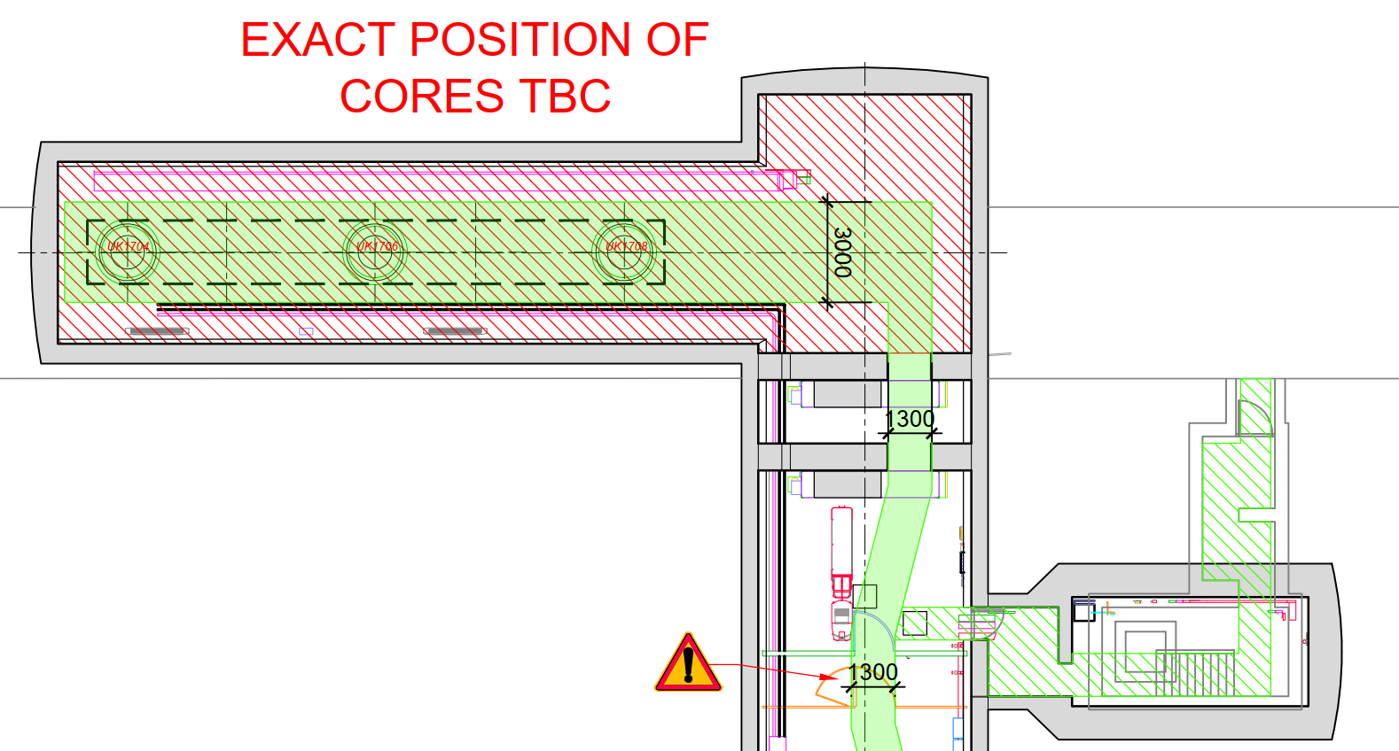
Employer’s Requirements Specification
Transport
  See dwgs :
  HiLumi - SMB - P1 Cores works - V2_190909.pdf
  HiLumi - SMB – P5 Cores works - V2_190909.pdf
  To be updated with:
    UA shielding doors enlarged to respect 1.5m-wide transport corridor
    SAS doors to be enlarged as well (WP15)
1.50m
  Interface EN-HE/contractor for transport support to be written down:
    Between Surface & worksite, EN-HE will take in charge the transport of contractor’s equipment and spoils ?

Slide 6
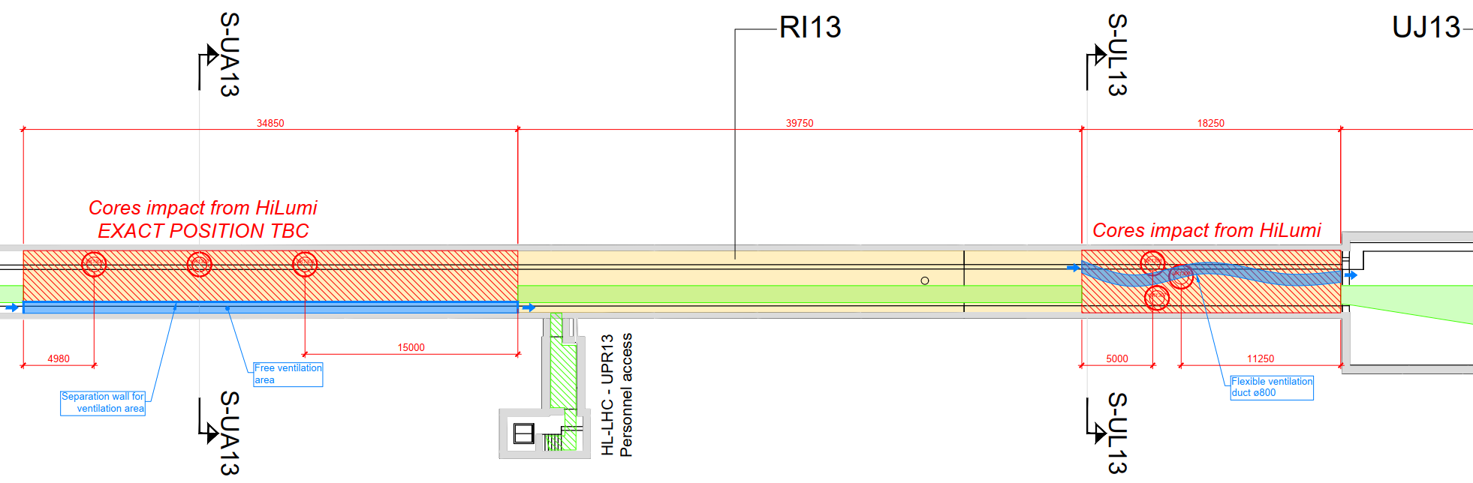
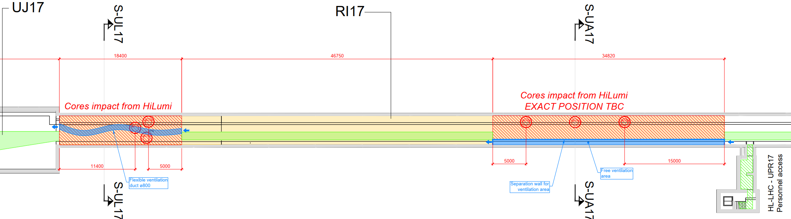
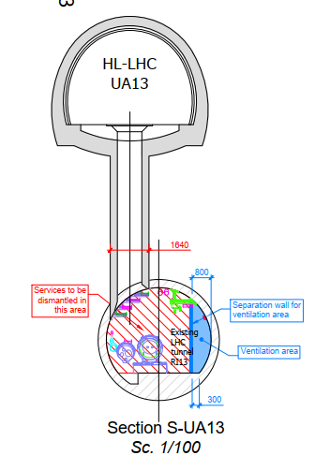
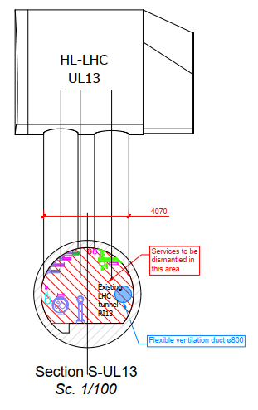
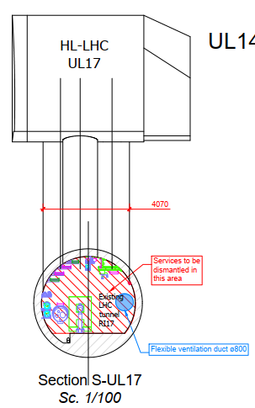
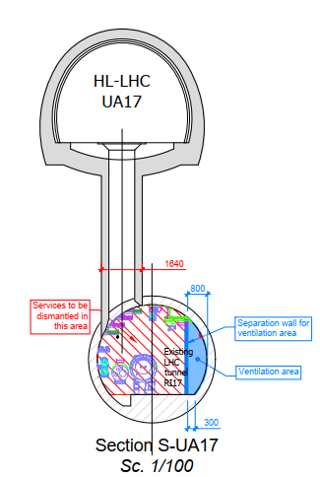
Employer’s Requirements Specification
LHC Ventilation
  See dwgs :
  HiLumi - SMB - P1 Cores works - V2_190909.pdf
  HiLumi - SMB – P5 Cores works - V2_190909.pdf
P1:
  ➔ UL13/17 : flexible duct solution remain open. Both flexible duct and false floor could be mentionned in specification. To be discussed.

Slide 7
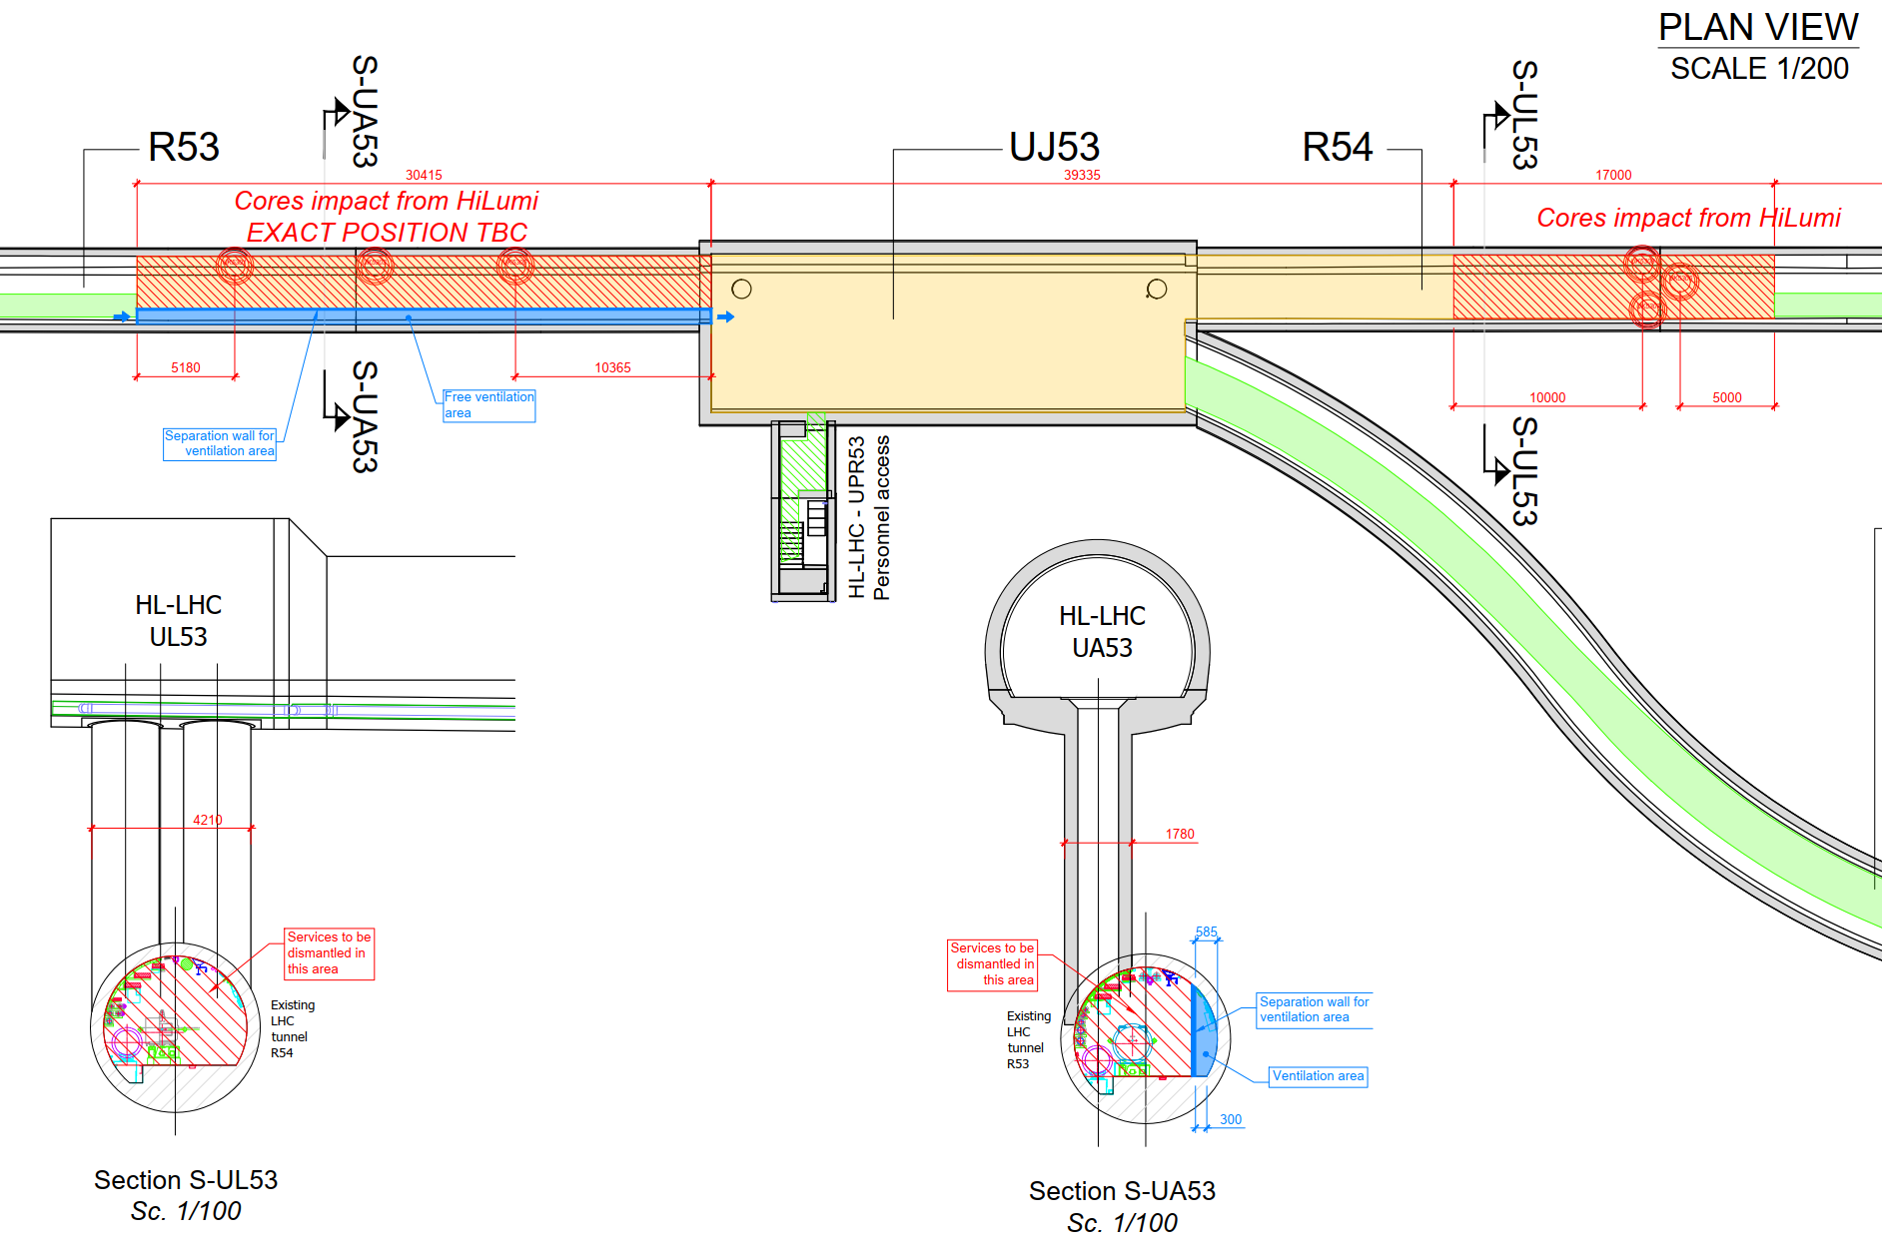
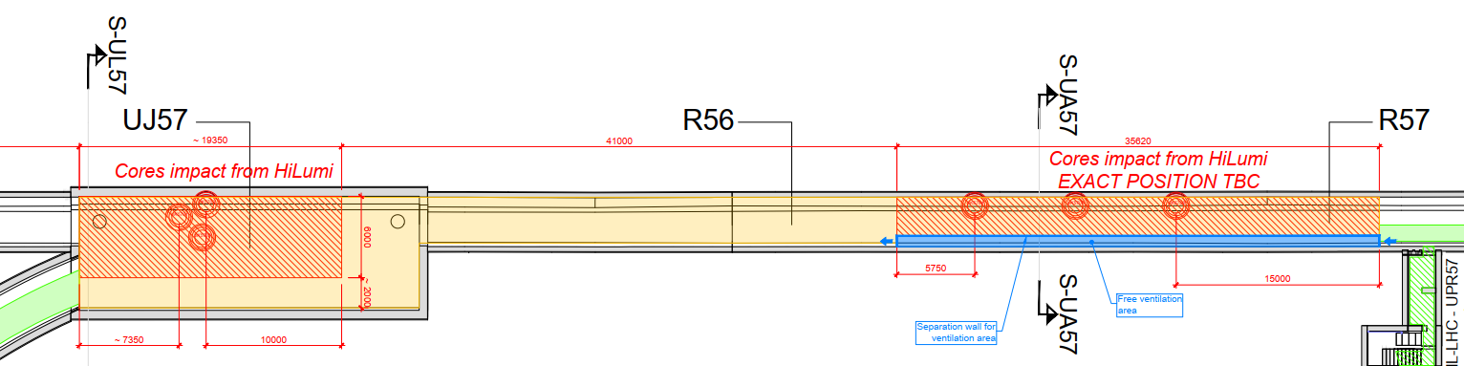
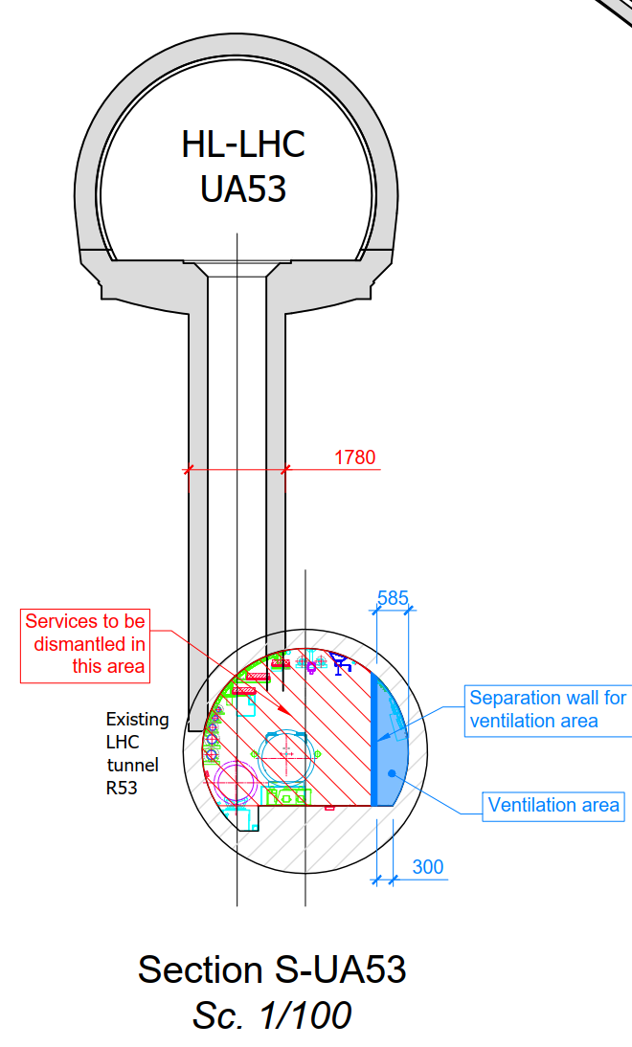
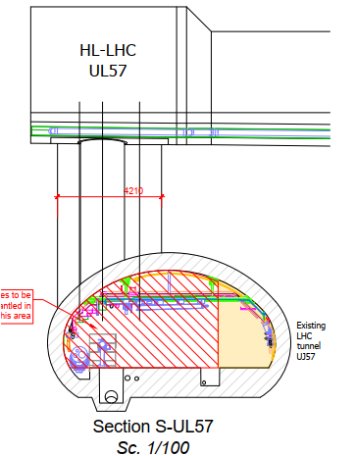
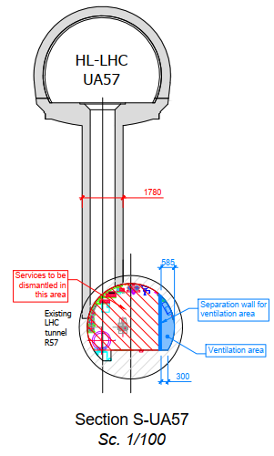
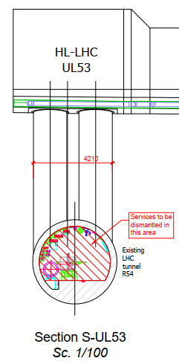
Employer’s Requirements Specification
LHC Ventilation
  See dwgs :
  HiLumi - SMB - P1 Cores works - V2_190909.pdf
  HiLumi - SMB – P5 Cores works - V2_190909.pdf
P5:

Slide 8
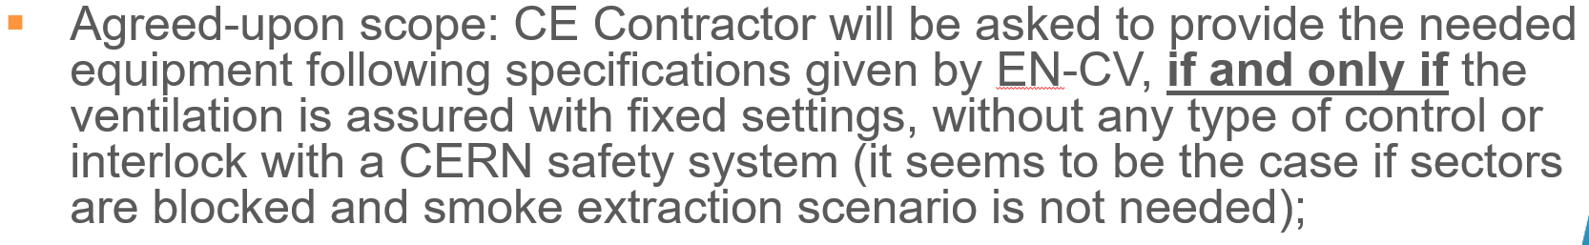
Employer’s Requirements Specification
LHC Ventilation
  See dwgs :
  HiLumi - SMB - P1 Cores works - V2_190909.pdf
  HiLumi - SMB – P5 Cores works - V2_190909.pdf
Extract from WP 17 meeting 26/09/19:
  What is the status on this topic ?

Slide 9
Employer’s Requirements Specification
Worksite Ventilation
Ventilation specifications for dust control to be defined:
  In terms of type of filters?
  Air quality ?
  ➔ Support from EN-CV to define the requirement

Slide 10
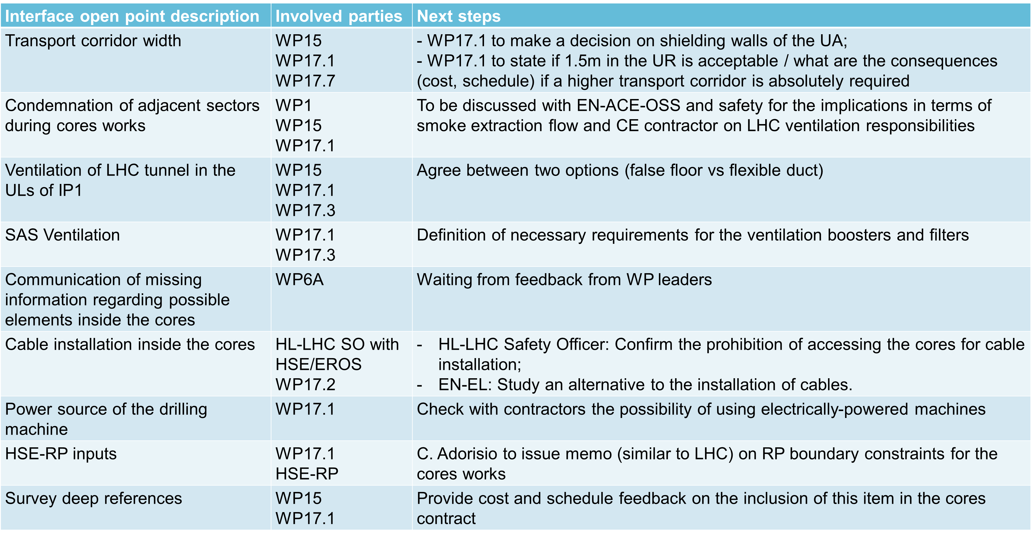
Employer’s Requirements Specification
Open points from WP17 meeting 26/09
OK
PENDING
PENDING
PENDING
PENDING
PENDING
PENDING

Slide 11
Thank you!

