Slide 1
11th HL-LHC Vertical Cores Meeting
Update on user requirements inside the HL-LHC Vertical Cores (UA and UL)
M. Mendes on behalf of WP15 (P. Fessia, S. Maridor, M. Modena), with inputs from all users (WP4, WP6A, WP9, WP17.2, WP17.3) and L. Tavian

Slide 2
How we got here...
Current baseline for SMB does not include any element inside and/or around the cores.
But it was realized that (almost) all users actually need some kind of interface inside and/or around the cores to support their equipment.
This was mostly triggered by WP17.2, who were requiring not only a supporting system for their cable trays, but also a way to access the inside of the cores.
WP15 then conducted a survey, in July-August-September, with all concerned WPs to collect their requirements (WP4, WP6A, WP9, WP17.2, WP17.3).
In parallel, WP17.2 held discussions with safety to understand if the request to have personnel accessing inside the cores was feasible. In September-2019, this option was abandoned due to safety concerns, and now there is a different baseline for the EL cores (see slide 5).

Slide 3
Requirements
WP9-Cryo (UL core on LHC machine side):
  E-mail from S.Claudet of 19-9-2019:
  “Cryo will adapt and consider civil concrete as a boundary condition”.
WP4-RF (2 UA cores closer to the IP centre)
  E-mail from E. Montesinos of 1-10-2019:
  “circumferential halfen-rails (does not matter the type) embedded in the concrete every 2 meters, capable of sustaining loads of up to 300kg for each connection to the halfen, for a maximum of 4 connections.”
  In addition, not foreseen to have people going inside the cores – e-mail from E. Montesinos of 18-11-2019:
  “We do not intend to have people inside the cores. We will invent a tool that will allow us to assemble them in the gallery and move them inside the core (without us being inside). We do not know yet what will be this tool, but surely from outside the cores…”

Slide 4
Requirements
WP6A-SC links (central core of UL)
  E-mail from R. Betemps on 25-11-2019:
  “The proposal of WP4-RF is compatible with our requirements.”
  They also stated the following:
    “The access to these Halfen rails to fix the supporting structure of the 2 SC links should be clarified: We imagine possible getting an access in this core for personnel to fix at several points the base supporting structure before starting the SC link installation.”
    This might be an issue, it needs clarification with Safety Office of HL-LHC project with safety partners at CERN (not WP15 scope).
  Moreover, WP6A has presented in several occasions (DFX reviews, integration meetings) they need to use the end part of the SC link core to install supports for the DFX; the idea would be to install a metallic ring in the inner part of the core (only in the bottom, in the connection to the LHC tunnel) where the DFX would be fixed. WP17.1 is waiting for the formal release of an WP6A document where the loads to take in consideration are stated.

Slide 5
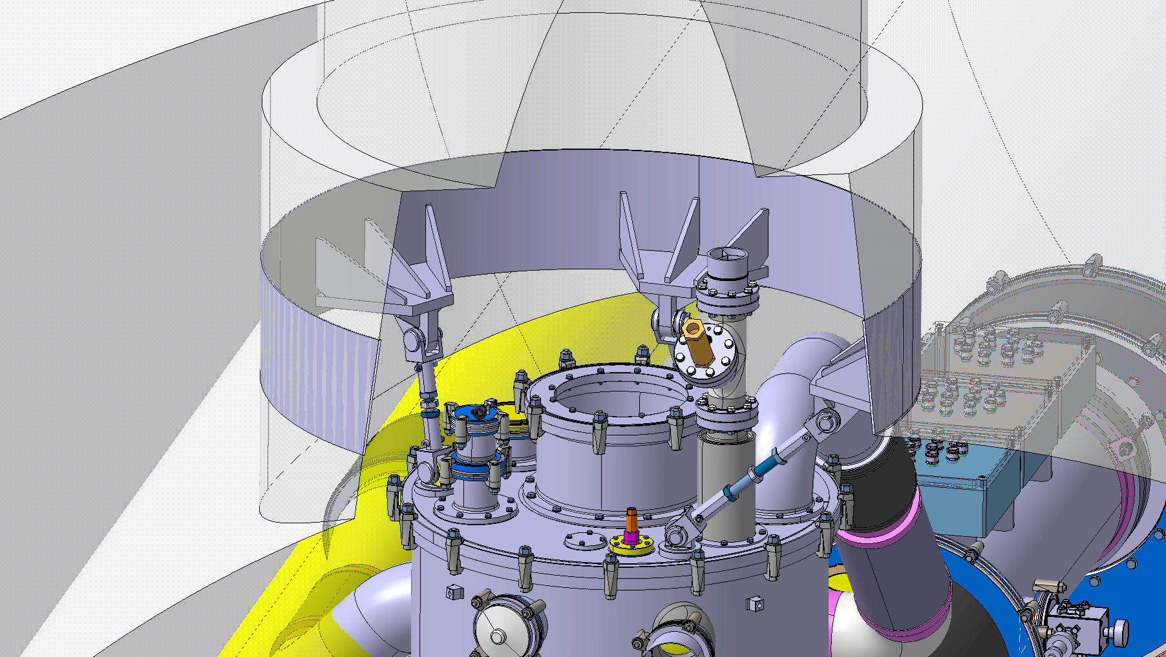
Requirements

Slide 6
Requirements
WP17.2 – EN/EL (UL core on the LHC transport side; and UA core closer to the arc)
  Option to fix cables in cable trays directly inside the cores has been abandoned, for safety concerns (it implied having people descending inside the cores). It was also limiting severely the space available for cable routing, and making it very difficult to install cables after the first installation;
  EN-EL proved it is possible to have the cables sustaining their self-weight, but it is absolutely crutial to guarantee that they do not superpose inside the core and on the surface. (see presentation by D. De Luca on WP17 coordination meeting of 26-09-2019).

Slide 7
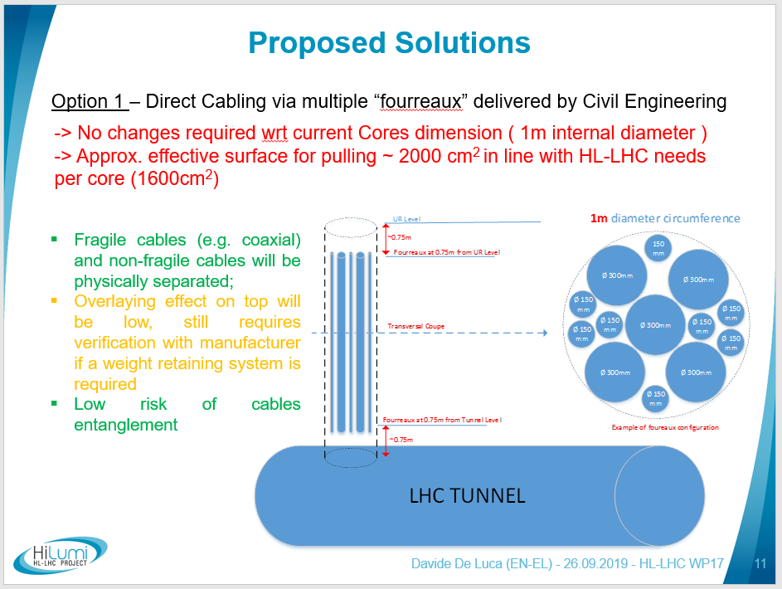

Slide 8
Requirements
WP17.2 – EN/EL (UL core on the LHC transport side; and UA core closer to the arc)
  Option to fix cables in cable trays directly inside the cores has been abandoned, for safety concerns (it implied having people descending inside the cores). It was also limiting severely the space available for cable routing, and making it very difficult to install cables after the first installation;
  EN-EL proved it is possible to have the cables sustaining their self-weight, but it is absolutely crutial to guarantee that they do not superpose inside the core and on the surface. (see presentation by D. De Luca on WP17 coordination meeting of 26-09-2019).
  This new baseline still needs some consolidation, but the 1-meter diameter core should be kept.
  Install, inside the core and throughout its whole length, a separation structure (multiple options possible: circunferential fourreaux with different diameters; dividing the 1m circular core in smaller sections with different geometric shapes, etc.). This structure would not be inside the scope of WP17.1.
  The request to SMB would probably be simply a metallic ring protuding slightly at the bottom where this partitioning structure could be sustained.
  Either way, this option is still under study and consolidation.
WP17.3 – EN/CV (UA core closer to the arc, shared with EN/EL, for two small pipes)
  No official requirement, informal statement that EN/CV will “adapt to whatever exists”.

Slide 9
Next steps
From the users:
  Get consolidated requirements from WP17.2
From SMB:
  We would like SMB to issue an iRFI where the understanding of the user requirements are explained, or alternatives proposed
  Get formal approval of this iRFI from all concerned users (WP4, WP6A, WP9, WP17.2, WP17.3)
Define formally with HL-LHC Safety Office and HSE/EROS accessibility constraints inside the cores, with possible exceptions for first installation.

