Slide 2
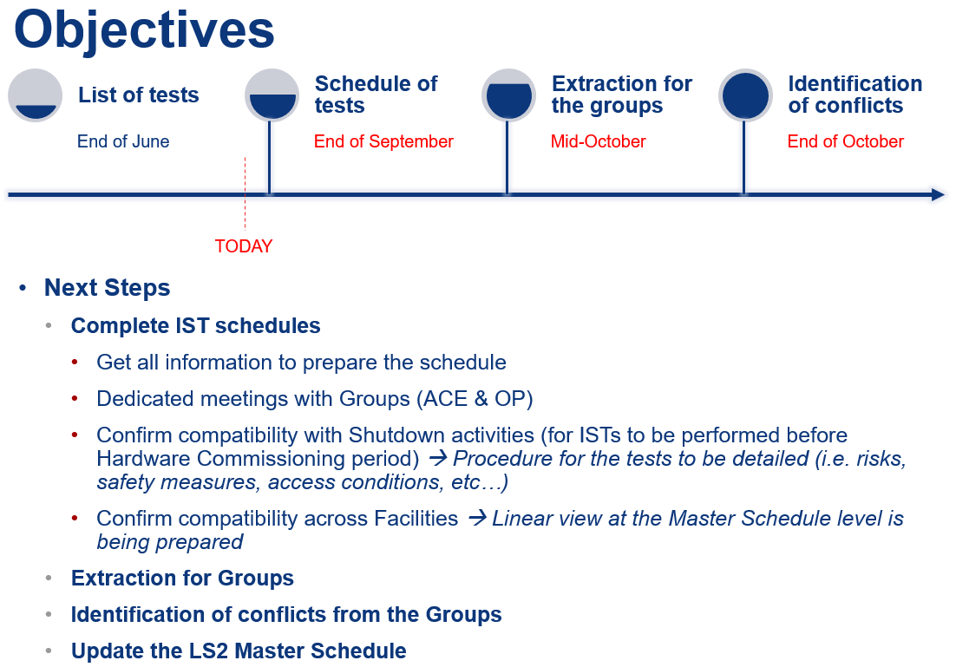
Timeline of objectives
Presentation during the Commissioning Committee on 26th July 2019
Not yet done

Slide 3
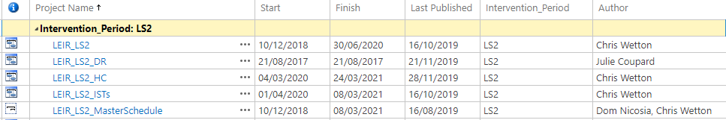
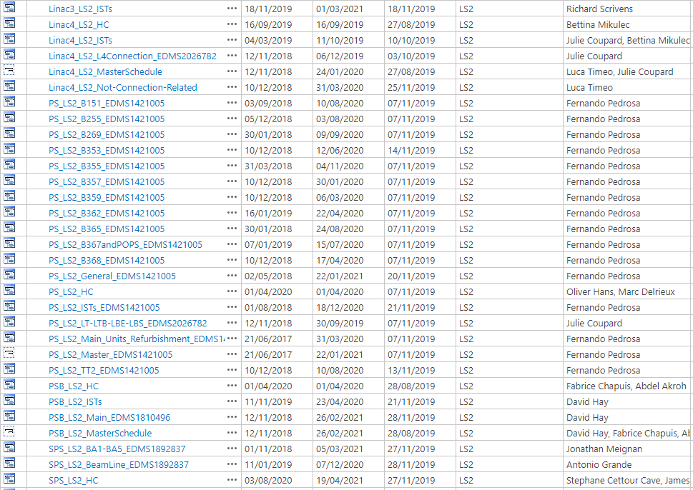
Schedules
Before extracting the data, we need all the schedules on the Project Server
It is important to fill the field “Group” in the schedules

Slide 4
E-mail to be sent
Dear Group Leaders,
All detailed schedules for shutdown and hardware commissioning periods of the injectors are available on the MS Project Server platform of EN-ACE (Project license mandatory). It includes shutdown activities, individual system tests (ISTs), dry runs, commissioning activities. A Gantt viewer has been put in place if you do not have the Project license: https://oss-coordination.web.cern.ch/gantt/latest
Extraction across all facilities is possible using the following instruction available on the MS Project Server platform from EN-ACE only (https://cern.sharepoint.com/sites/Projects-Accelerator-Complex-Schedules/SitePages/Cross-Facility-view.aspx). If you need help for the extraction of data, please contact Julie.
Would it be possible to contact the Facility Coordinators and Re-commissioning Coordinators in case of issue related to one Facility (contact list below) in order they can evaluate if the schedule can be adjusted without impacting the Baseline. This will be followed-up during the Hardware and Beam Commissioning WG organized per Facility.
In order to freeze the ISTs and hardware commissioning schedule according to the shutdown baseline, could you please confirm that you can commit to these dates according to your resource loading before the end of the year ? In case of conflicts identified across several Facilities, please inform us (Julie & Verena).
Thanks in advance,
Regards
Julie & Verena

