Slide 1

ATLAS Safety for LS2
TC / ADO Meeting
10 December 2019
Notes:
TC = Chef de départ

Slide 2
ATLAS Safety Organisation
Director of Research
Eckhard ELSEN
SR-SO
Large Experiment Technical Coordinator and deputies
Ludovico PONTECORVO, Martin ALEKSA (D), Michel RAYMOND (D)
SR-SO
LEXGLIMOS and Safety Team
Laetitia BARDO, Marie-Solène TEURNIER, Laure TRANCHAND, Jacques CAMPAGNA
GSI-SO-4
Shilf Leader in Matters Of Safety (SLIMOS)
Rachel AVRAMIDOU, (Vitali BATUSOV), Natascia DE BORTOLI, Illona KOSTYUKHINA, Alexander SAKHAROV, Edward SARKISYAN-GRINBAUM, Mariya SHIYAKOVA
GSI-SO-4
Territorial Safety Officers (TSO)
Specialized Safety Officers
(SSO)
RPE
Ignacio ASENSI-TORTAJADA, Laetitia BARDO, Kendall REEVES, Andre RUMMLER, Giancarlo SPIGO, Carlos SOLANS-SANCHEZ, Marie-Solène TEURNIER, Laure TRANCHAND
Safety shifter
SLIMOSes (Laetitia, Laure and Marie-Solene)
GSI-SO-2
GSI-SO-6
UX15 (3126)
USA15 (3125)
SDX1 (3178)
SX1 (3185)
SCX1 (3162)
SGX1 (3170)
Mobile Workshop (6691)
SR1 (2175)
Offices (3196)
Offices (3150)
Laetitia BARDO
Marco CIAPETTI
David FRANCIS
Nicolas FISCHER
Andre RUMMLER
Konstantin ZHUKOV
Mito TASEVSKY
Kendall REEVES
Tatiana KLIOUTCHNIKOVA
Rachel AVRAMIDOU
Cryogenic
Electricity
Flammable gas
Lasers
Radiation protection
Johan BREMER
Wieslaw IWANSKI
Givi SEKHNIAIDZE
Claudio SANTONI
Giancarlo SPIGO
2

Slide 3
Operational activities
Preparation and follow of activities underground and surface buildings
Safety tours:
  Safety tours and reports once per week in BB5, 180, 191
  Might be extended to other ATLAS activities B175 (Tile activities) and B188 (Muons activities)
Safety shifts:
  Report every evening with observation and action of the day
USA15, UX15:
  Regular tour during the week to follow daily activities and be present during unusual activities
Tickets
  Creation and follow up : safety and infrastructure
To be present on site and available for questions and remarks
34 VICs since the begin of LS2 (Jan. - Dec. 2019):
  22 underground : Pulling cable, Building of scaffoldings, New Muon cooling station, Etc.
  12 surface : Wi-Fi installation, Pulling optic fiber cable, Change false floor Etc.
  Main themes approached : Work at height, Storage, false floor, Marking/Balisage, Coactivity, etc
Cleaning of the caverns
  Keep the cavern clean and tidy
➔ To maintain good working conditions for everyone

Slide 4
Operational activities
Communication
OPM meeting on Mondays , ATLAS Induction, E-group atlas-opm-cavern-activities
Panel in the lift, display of the IMPACT list close to the dosimeter reader, screen on top of the PADs
To inform you about safety aspects and access restrictions
Radioprotection - with HSE-RP
  TREC : Measure of material , help to use TREC
  Waste : Measure, Replacement of bin
  Follow up : Destructive activities, high dose working position
  6 WDP : 4 activities finished ➔ over estimation of doses except for beam vacuum removal
  To support complying with RP rules
Maintenance – With SMB CERN Store and BE-ICS detection group, ATLAS TC Team
80 Self-rescue Masks –– every year: Verification done directly in point 1 in 1 day
  Impossibility to remove all the self rescue mask at the same time from the TOROID
Pharmacy boxes – every 3 months: Point 1 and 180/191/BB5
Work at height equipment – every year: campaign for at P1 in June since 3 years
10 portable detector ODH/Gas
RP equipment
Gate monitor
Fix smoke and gas detection, evacuation sirens, ODH flashing lights, Red phones,
Etc.
➔ To ensure that safety equipment and systems are working properly

Slide 5
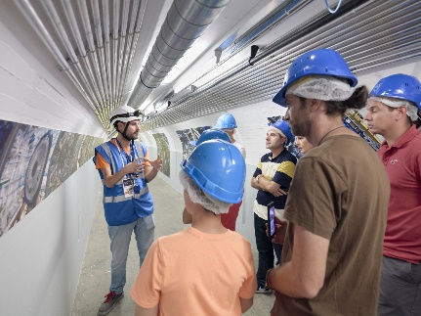
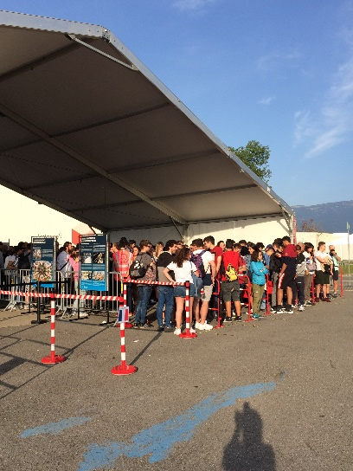
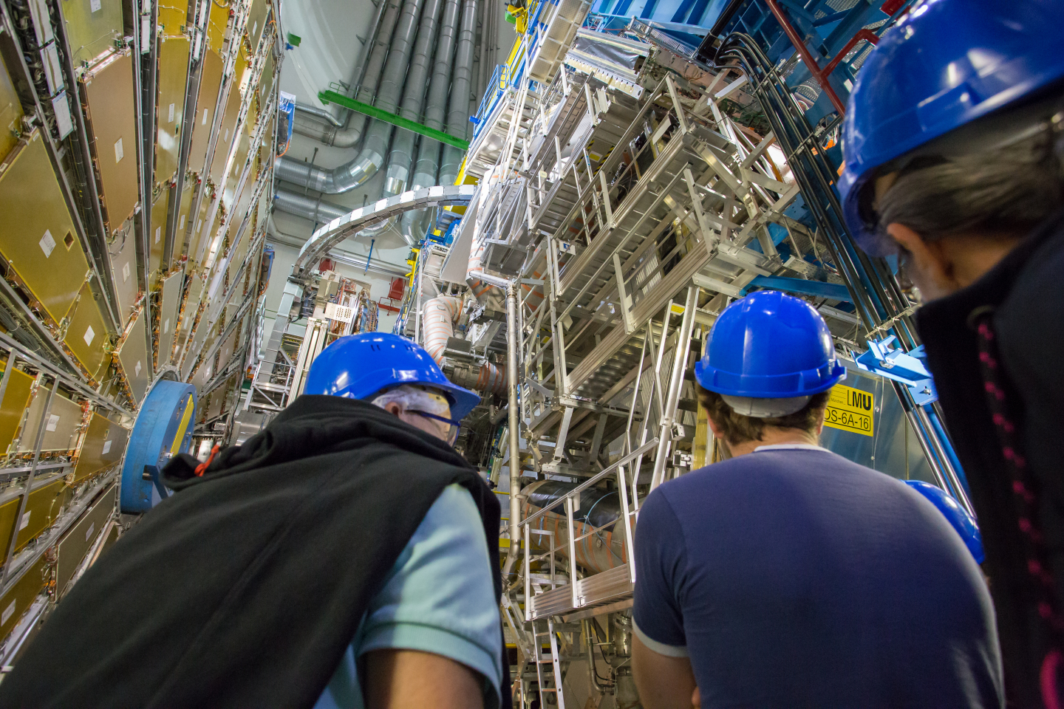
Operational activities
Public visits
Change of the path
  Former platform hide by the ECT
  Test with volunteer on the new path ➔ 6 persons maximum
  343 trained Guides, Dec. 2018 - Oct.2019 (include 264 new guides)
No visit during the change of the lift
Reopening of underground visits on 14 January 2020
Please visitors and provide safety information to ATLAS/CERN collaborators not frequently on site
Open Days
Many volunteers :
  250 for all P1
  Including 136 guides and 22 crowd marshals
Good internal organization in Atlas
Visitors happy ➔ around 3 800 visitors in underground visit
No accident
  ➔ Thank you for your help and support

Slide 6
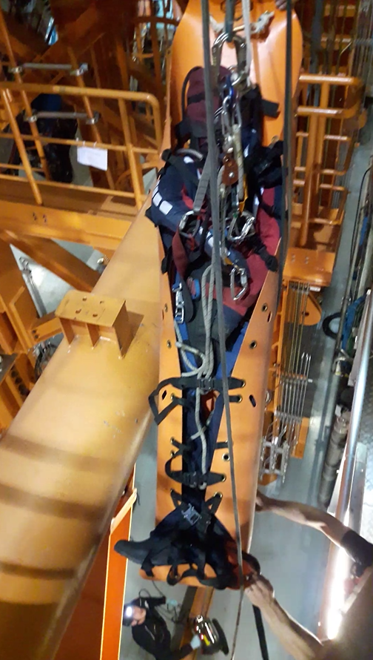
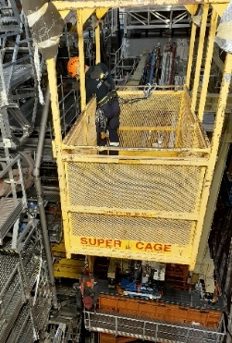
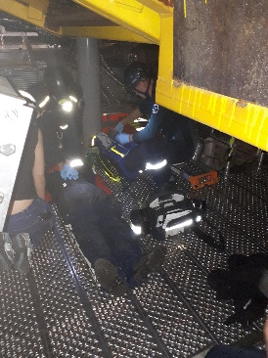
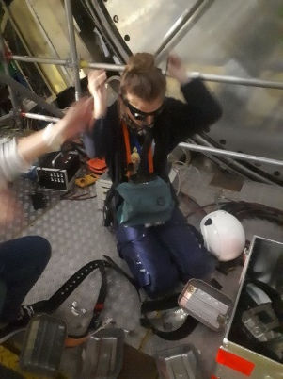
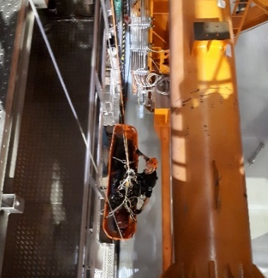
Operational activities
Accident/Incident report
Accident analysis and follow-up when occurring in ATLAS premises
Presentation CERN accident report during OPM every first Monday of the month
To learn, correct and aware about accidents/incidents
Emergency preparedness – with CERN Fire Brigade
New CERN fire fighters induction : Toroid “reconnaissance”
20 March 2019 : ATLAS Underground evacuation – 54 people
23-24 March 2019
  Simulation of heart attack in the Toroid 2 team of firefighter
  Around 45min between the call of the fire brigade and when the victim is on the lift
14 Nov. – 10 Dec. 2019:
  Two rope rescue exercises of a person in the yellow basket and in the minivan
24 October 2019
  Evacuating with self-rescue mask in the Toroid → With project FIRIA
➔ To be prepared in case of emergency situations and improve

Slide 7
SLIMOS activities
Checks and follows up
  Alarms/errors/warnings of the various safety, radiation protection, access, control and infrastructure systems (CSAM, DSS, Sniffer, Gate Monitor, DCS, …),
  Access status (UX15, Toroid, LASS Mode),
  People access status (upon request) and number of people in the underground installations (UX15 and USA15),
  IMPACT for the number of works "in progress” or “waiting for approval” during the shift and sign IMPACT for visit
  Report issues to LEXGLIMOS, OPM and the RPE on shift
  In close contact with Safety shifter
Provides safety and working equipment and maintain them (keys, mobile phones, TETRA phones, temporary tokens, operational dosimeters, ODH meters, RPE equipment, …)
Report all current status/problem/events for the next shift
Work during week-end if needed
➔ First line in contact with ATLAS underground
SLIMOS Handbook (EDMS 189089)

Slide 8
Projects
FIRIA Project - with HSE Fire Experts
Design of a methodology to assess fire in radiological area
Simulation with a new software ➔ 8 fire scenarios : 6 in UX15 and 2 in USA15
ITK Fire risk - with ITK community, ATLAS TC and HSE Fire Experts
Comply with IS41 (The Use of Plastic* and other Non-Metallic Materials at CERN with respect to Fire Safety and Radiation Resistance)
Many discussions :
  Test of flammability will be performed
  Search of solution to not use flammable material or compensatory measure
  Fire risk assessment to describe, identify and analyze the risk
NSW – with ATLAS Cable Team
Installation in the NSW sniffer pipes
Gas
Creation of a methodology to quantify the risk of CO2 leak
Improve the visibility of ODH flashing light in case of evacuation

Slide 9
Projects
Locker Toroid door - with BE-ICS Access system and ATLAS TC Team
Blocked and locked or opening when magnetic field is on
Tests on various lockers to valid the appropriate one
Replace the current one
Safety management – ATLAS Safety Intern
Comply with ISO 45001 – Management systems of occupational health and safety
Improve safety aspects inside ATLAS buildings
Upgrade
Attend upgrade review meeting upon requests
Safety systems: sniffer, smoke detection, Fire extinction systems, …
➔ Safety consultancy/advice for future projects

Slide 10
Last word
Continuous improvement
Thank you for your help

Slide 11
Thank you for your attention

