Slide 1
Infrastructure activities during LS2
TC/section meeting
M. Raymond
December 10th, 2019

Slide 2
Introduction
Infrastructure encloses a large number of systems that are mandatory to operate the ATLAS Detector
All these systems requires periodical maintenance (at least annual)
Some upgrade projects are also planned to be done on LS2
Maintenance & consolidation
  Full maintenance campaigns happened in 2019
  Many maintenance campaign will also happen in 2020
  Most of these interventions are done by experts who are not inside TC
    Examples: Cryogenics, Cooling and Ventilation, Detector Cooling, Electricity, IT network, Safety systems, access system, gas system, Vacuum, Magnet control
  Technical Coordination (and/or EP-ADO) ensures at least a follow-up on all these activities
  Some of them depends directly on us, usually at the interface between Detector and Infrastructure
    Examples: Magnet, DSS, DCS, Racks powering and cooling,
Upgrade Projects on Infrastructure
  Systematic commitment of Technical Coordination, effort depends on projects

Slide 3
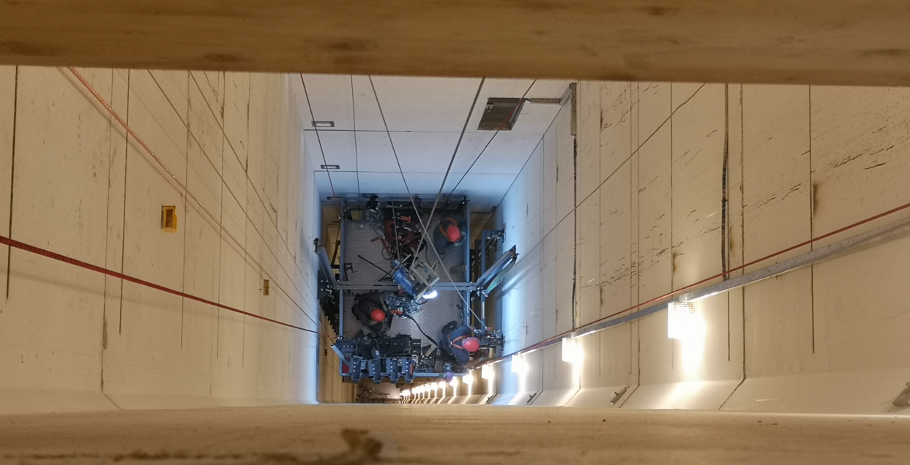
Infrastructure maintenance in 2019
PM15 lift replacement (February – April, 2019)
PX15 lift replacement (October – December, 2019)
EN-EL periodical maintenance for 2019
New power supply for 4x 63U racks in USA15 level 2
LACS upgrade of PX15 and TOROID
EN-CV General Maintenance
Detector cooling (EN-CV, EP-DT)
Upgrade of Ventilation control (EN-CV)
Network consolidation
  Fibres installed (EN-EL)
  Routers and switches replacement (IT-CS)
Safety systems maintenance (BE-ICS)
Vacuum chambers dismounting (TE/VSC)
Daily interventions of EN-HE for transport operations
  Including specific heavy craning (e.g. Small Wheel handling)
PX15 lift replacement

Slide 4
Infrastructure maintenance in 2020
EN-EL periodical maintenance for 2020
  EN-EL week, 6th-13th January 2020 : very disruptive (Power, access to P1, …)
LACS upgrade of UX15 – May-June 2020
EN-CV General Maintenance
  2nd campaign foreseen end 2020
Detector cooling (EN-CV, EP-DT)
  Next campaign to be defined
Safety systems maintenance (BE-ICS)
  2020 maintenance being scheduled
Daily interventions of EN-HE for transport operations
  Including specific heavy craning (e.g. Small Wheel handling)

Slide 5
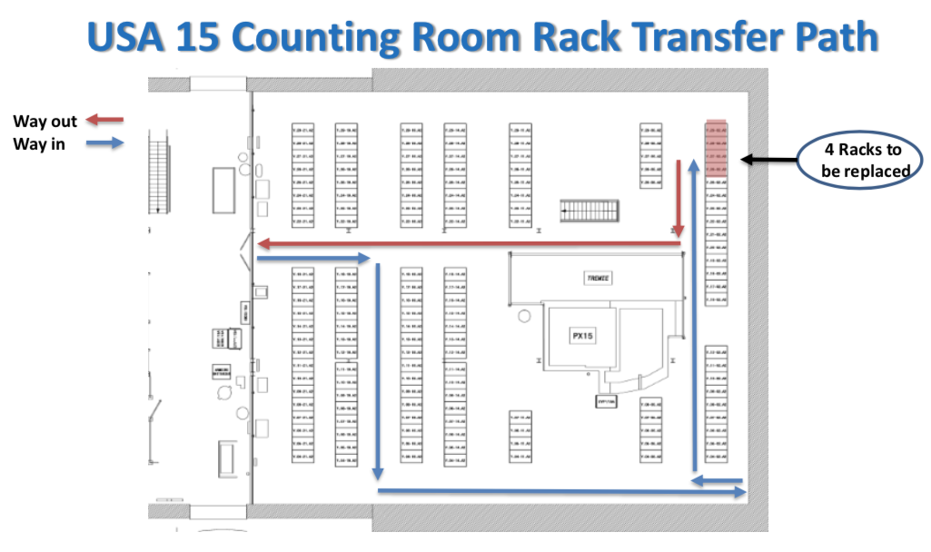
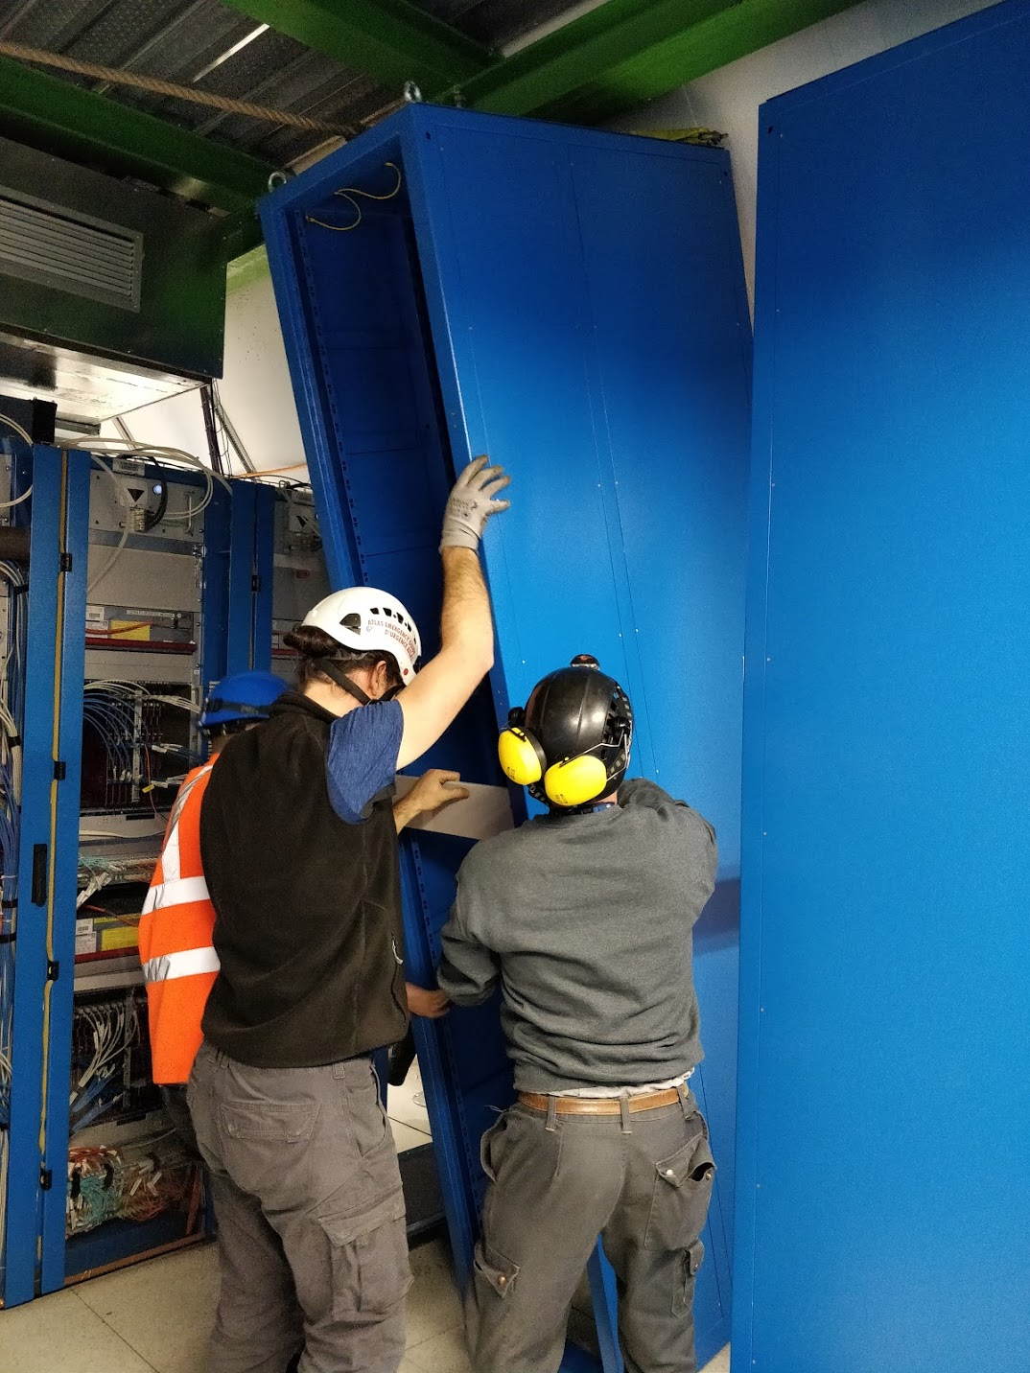
Infrastructure upgrade: 63U racks in USA15
4 racks replaced in USA15 at the start of LS2
  Prototypes of the racks for Phase II
  Related to LAr Phase I upgrade
  Procedure study
  Interference with existing equipment
  New power distribution
Mainly a TC activity : Kendall, Nicolas, Wieslaw
  EN-EL for power distribution
  EN-CV for ventilation duct displacement
  Altéad for transport

Slide 6
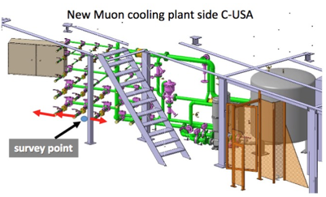
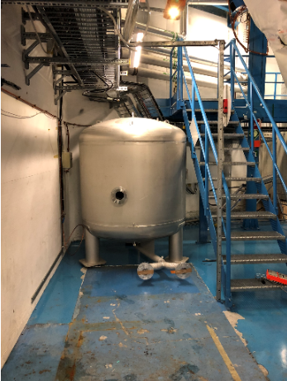
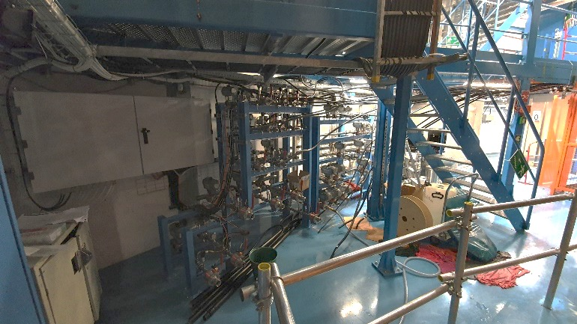
Infrastructure upgrade: Muon Cooling stations
TC Follow-up : Claudio Bortolin, Martin Doubek, Piotr Diurdzia
Replacement of 2 muon cooling stations
From May 2019 to December 2019
Strong commitment of TC Design Office for integration
in the cavern and conflict solving
Installation completed on both sides
Progressive start of cooling loops
Side A – Old system removed, new equipment arriving
Side C – New station installed

Slide 7
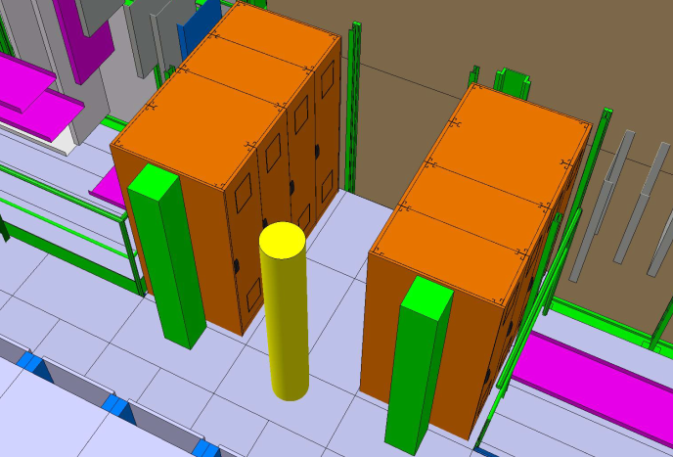
Infrastructure upgrade: Power supply
TC follow-up: Wieslaw Iwanski
    Expansion of UPS from 300 kVA to 600 kVA in US15
      To provide Broad Coverage UPS to the NSW and to Phase II detectors
      All preliminary works are completed (ECR, equipment orders, electrical and mechanical studies, CV piping modifications)
      Reinforcement of supporting structures: end of 2019/beginning 2020 (SMB)
      Decommissioning of old UPS and installation on new equipment
        April - May 2020 (EN-EL), consequences for ATLAS still to be clarified
Consolidation of central UPS distribution in USA15
  Relocation of existing switchboard + installation of 3 sub-switchboards
  Upgrade of monitoring / remote control
  Approved in PLAN but subject to EN-EL confirmation (lack of resources)
      It is expected that the feasibility of this activity in 2020 would be confirmed by the end of this year
600 kVA UPS batteries

Slide 8
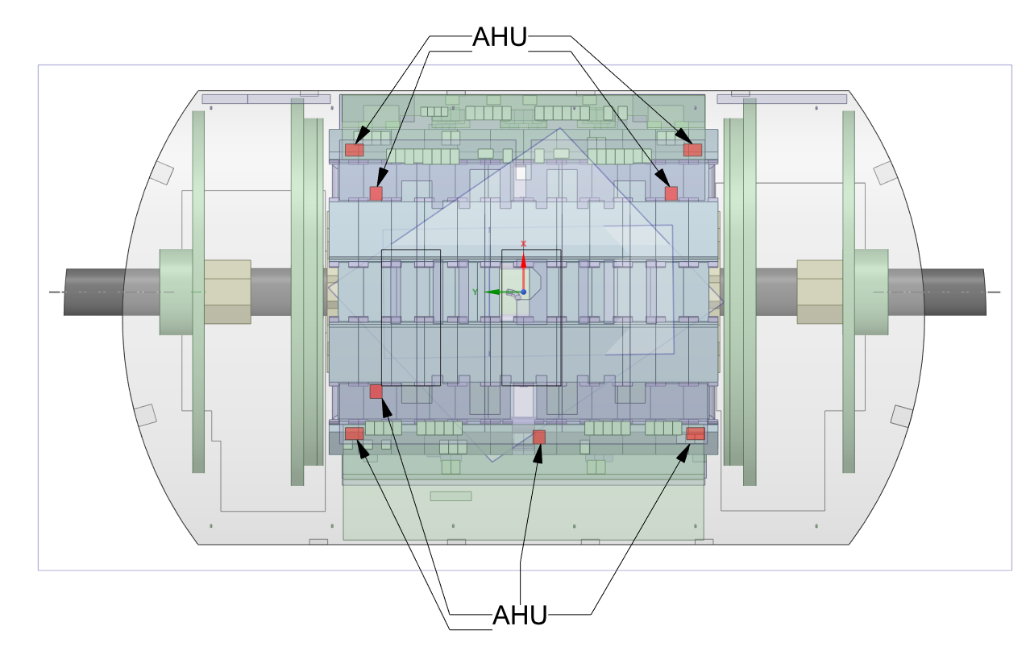
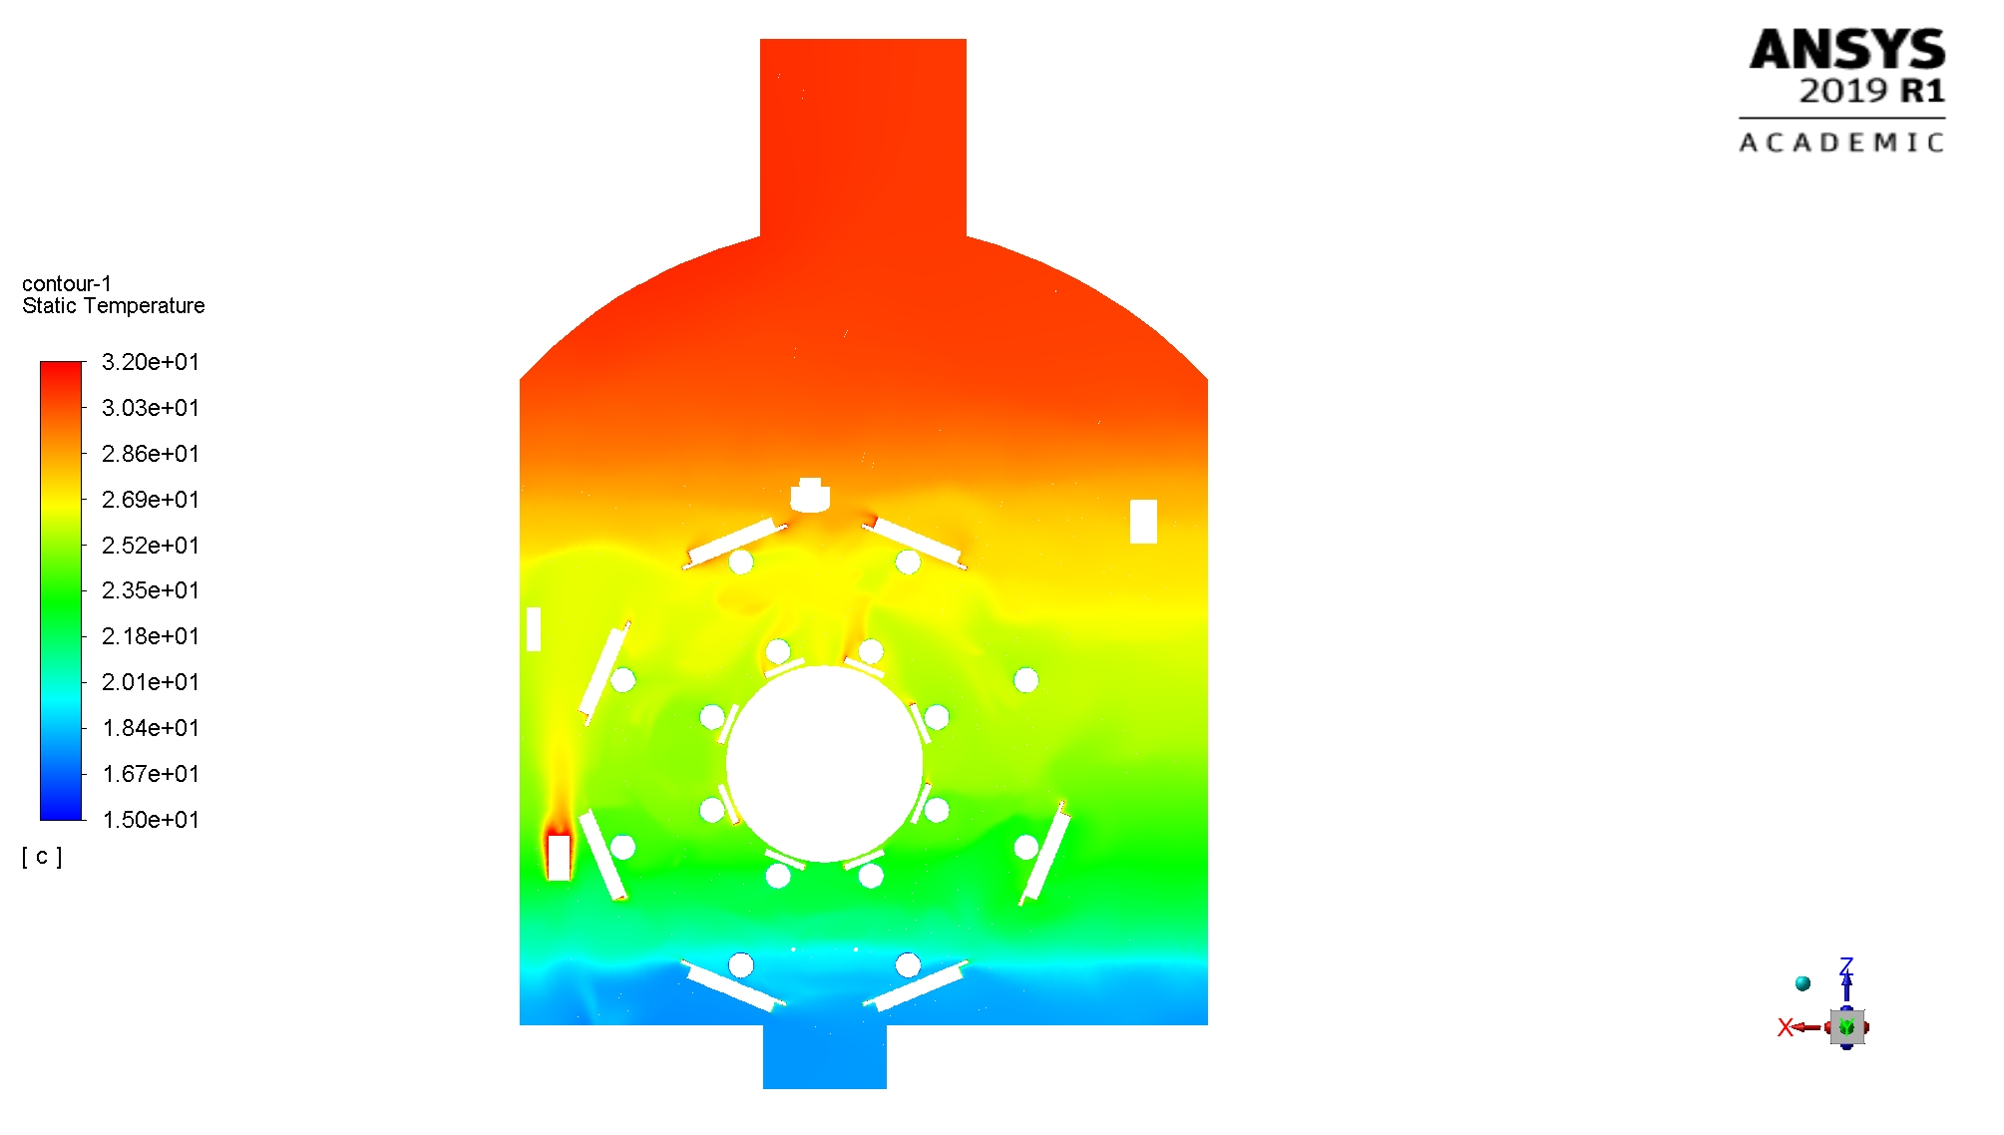
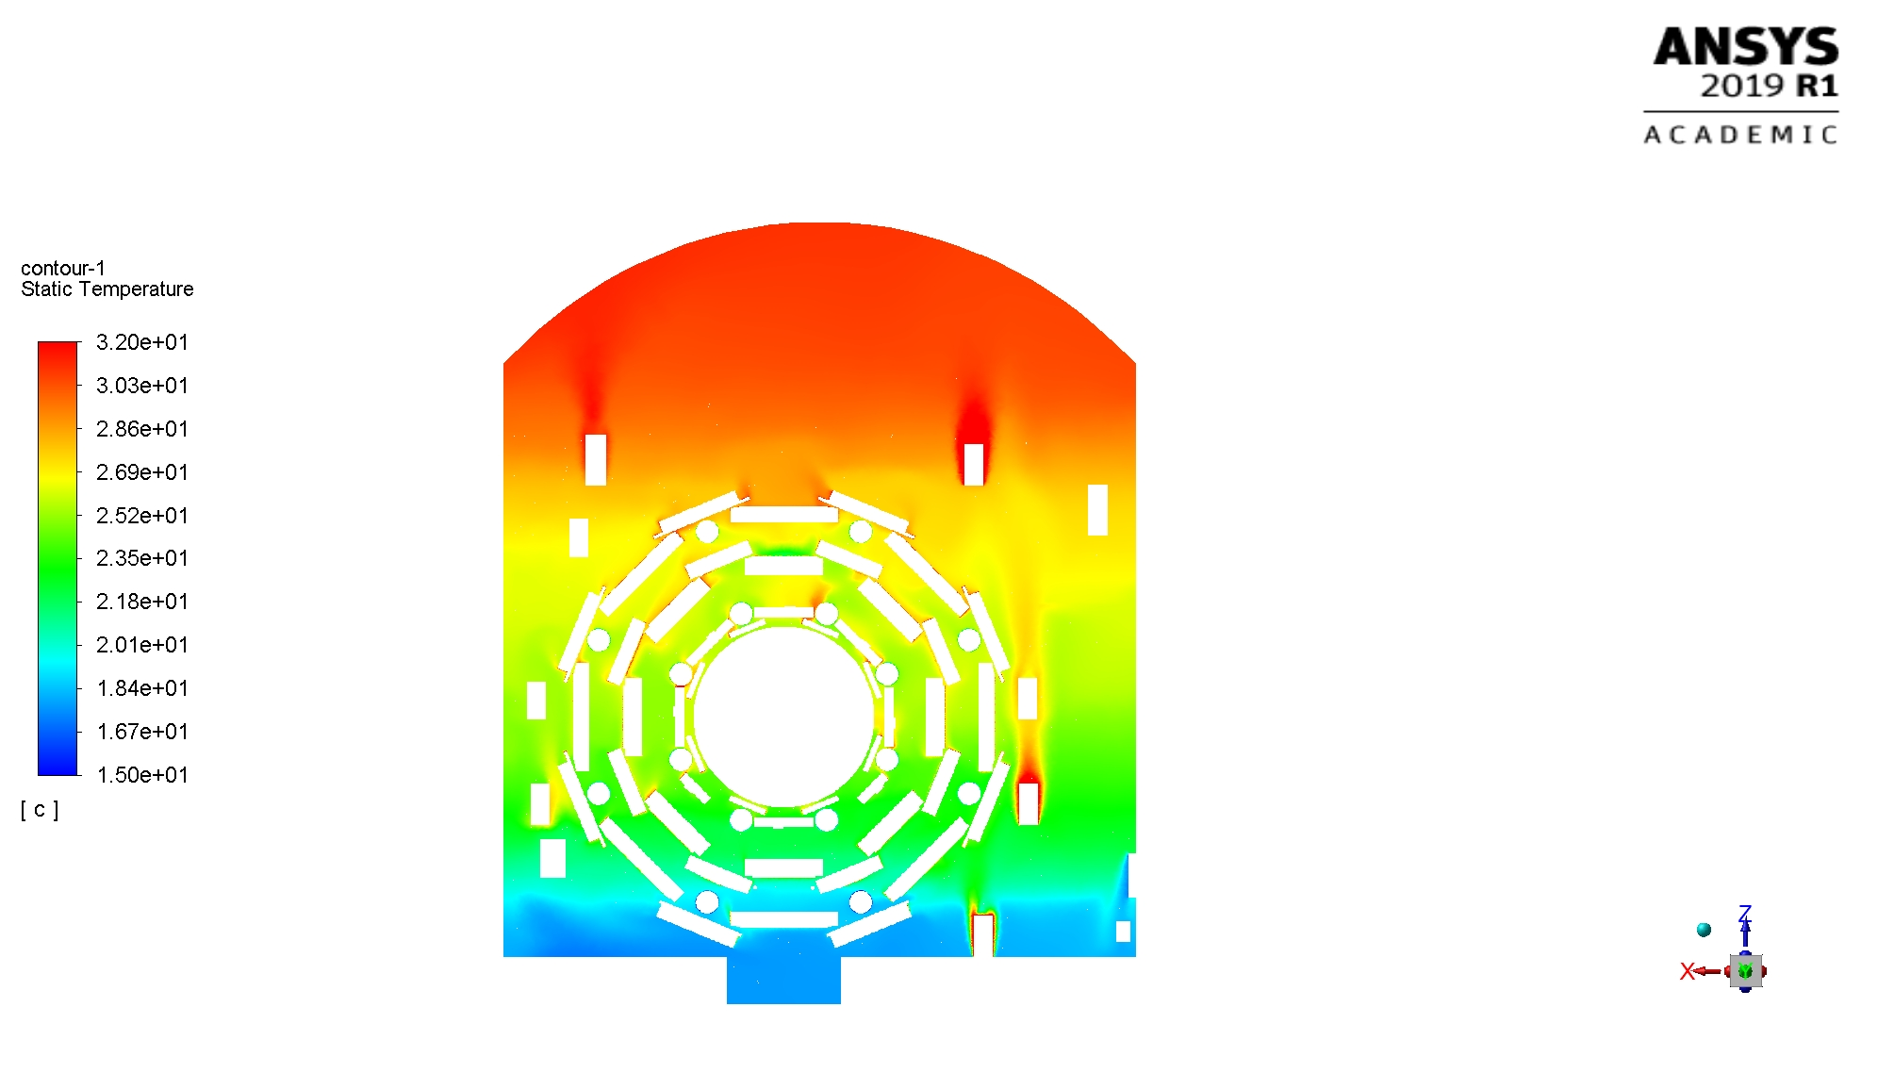
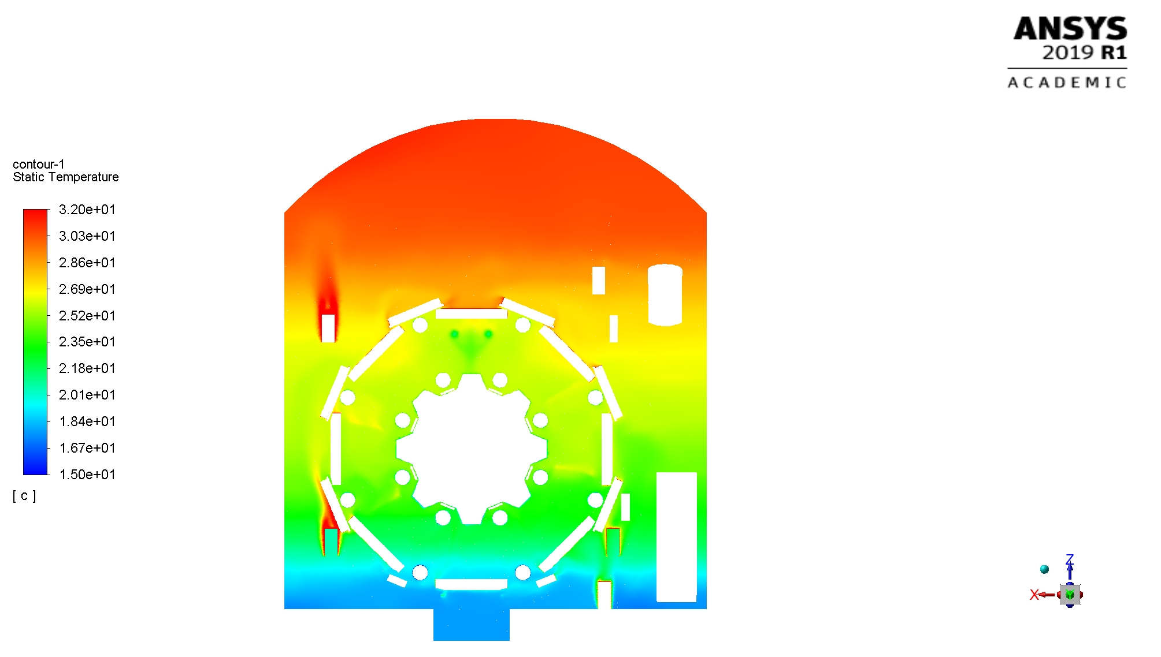
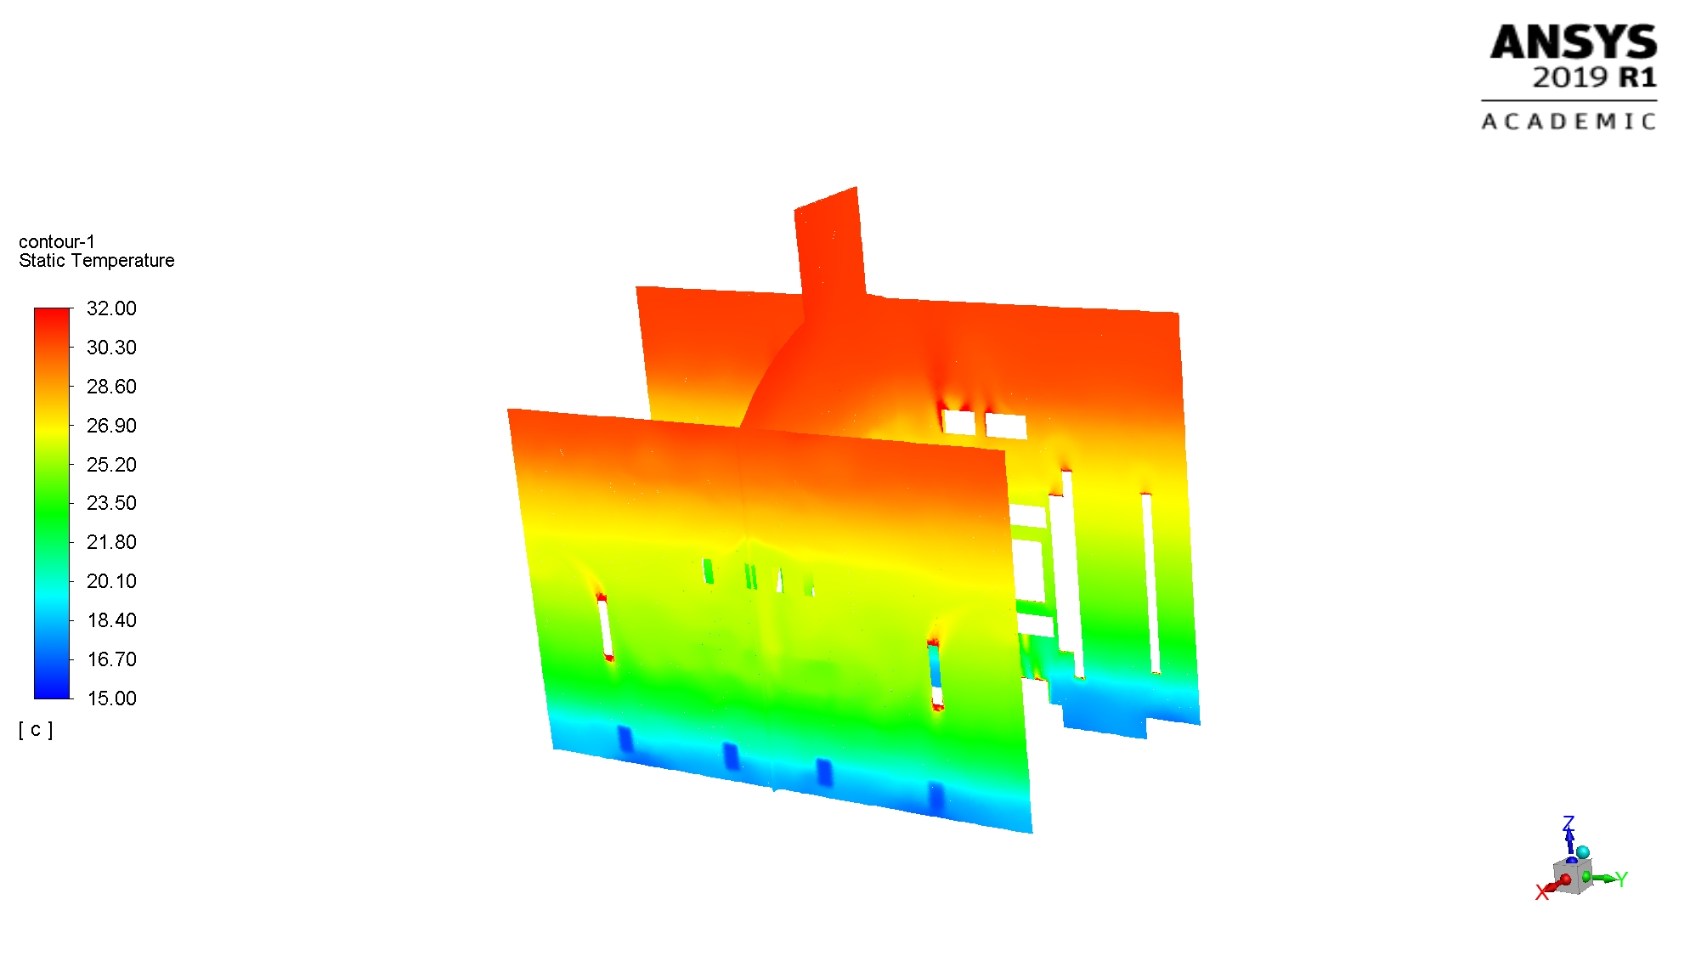
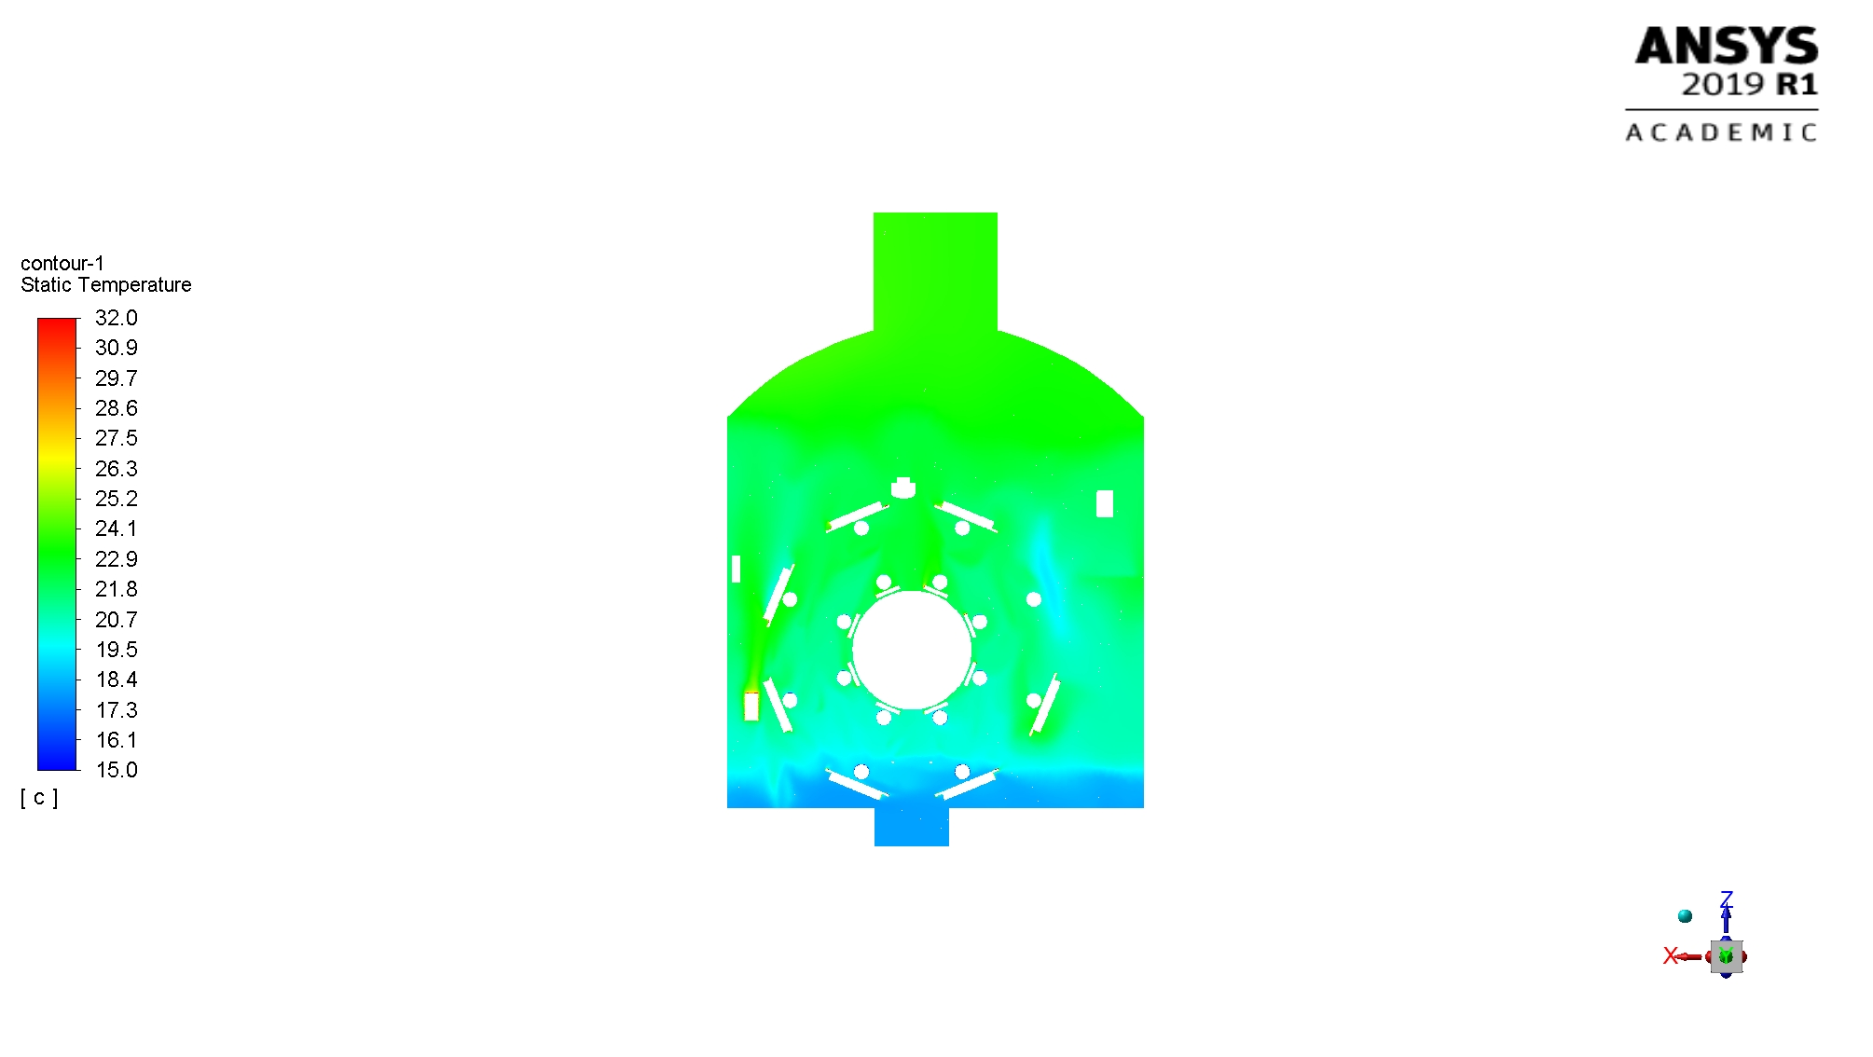
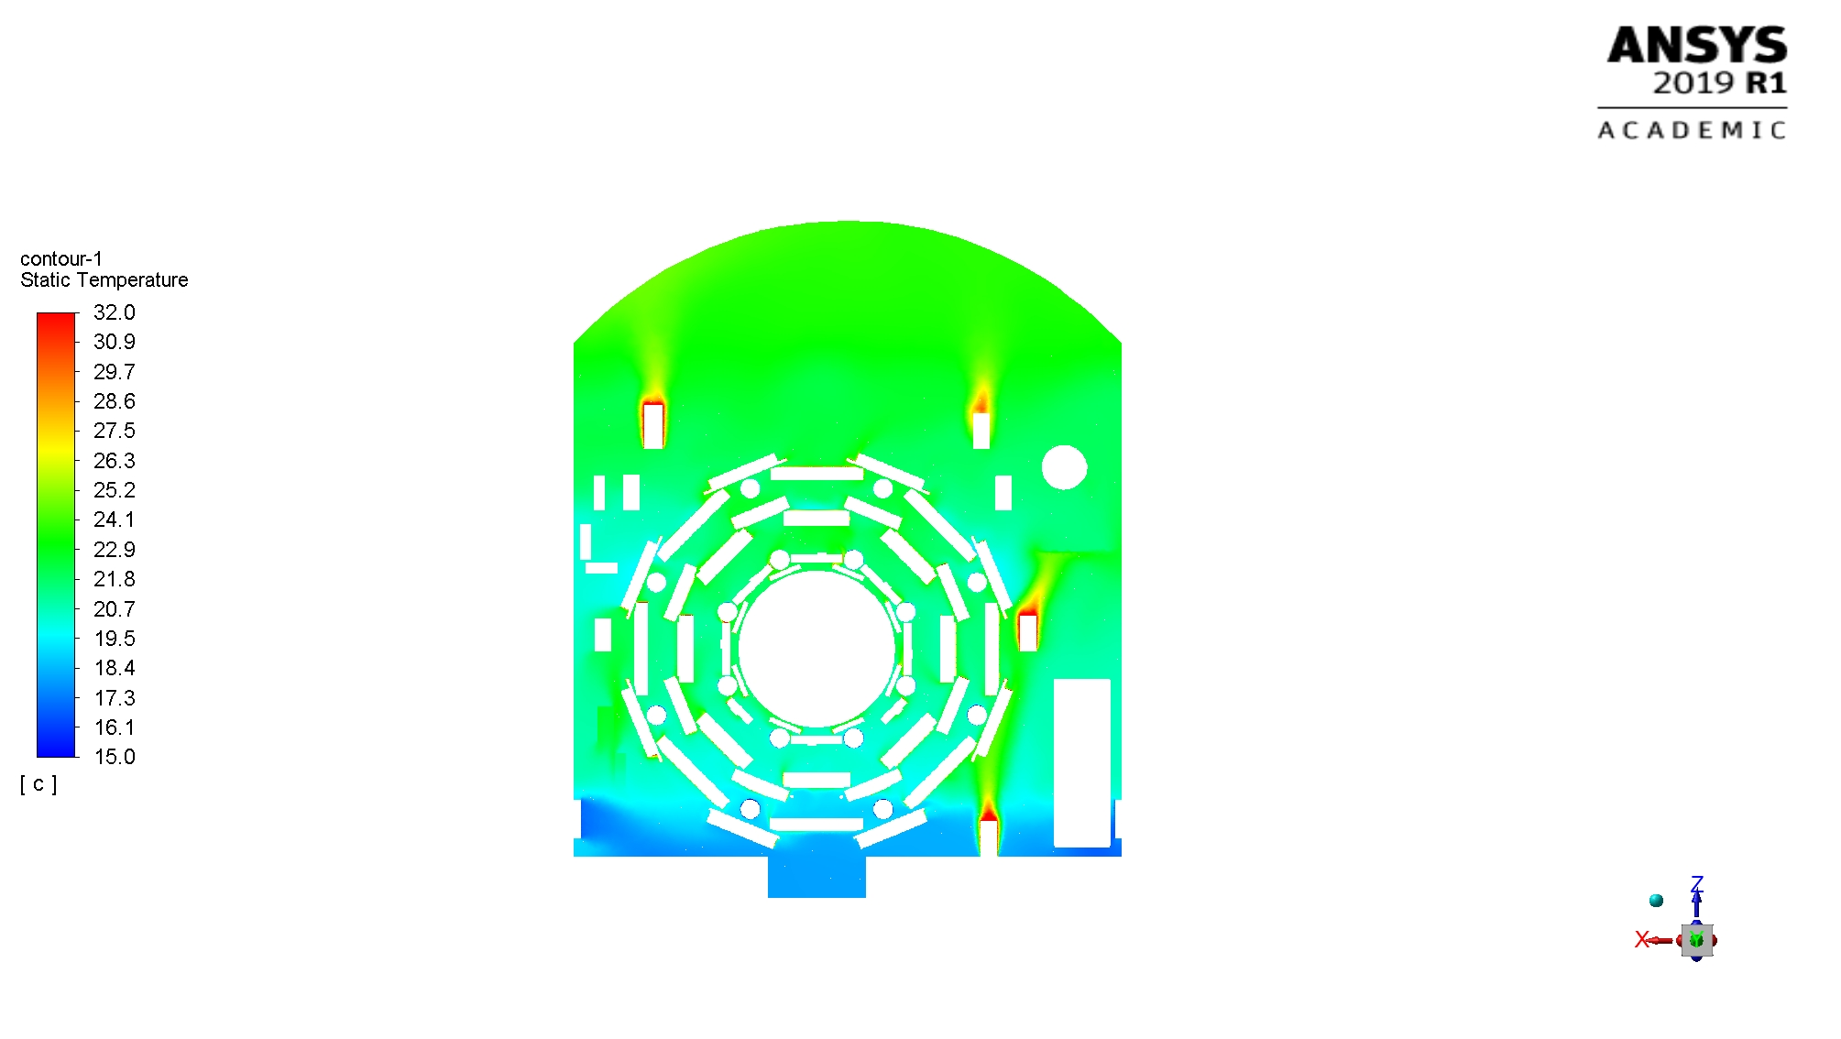
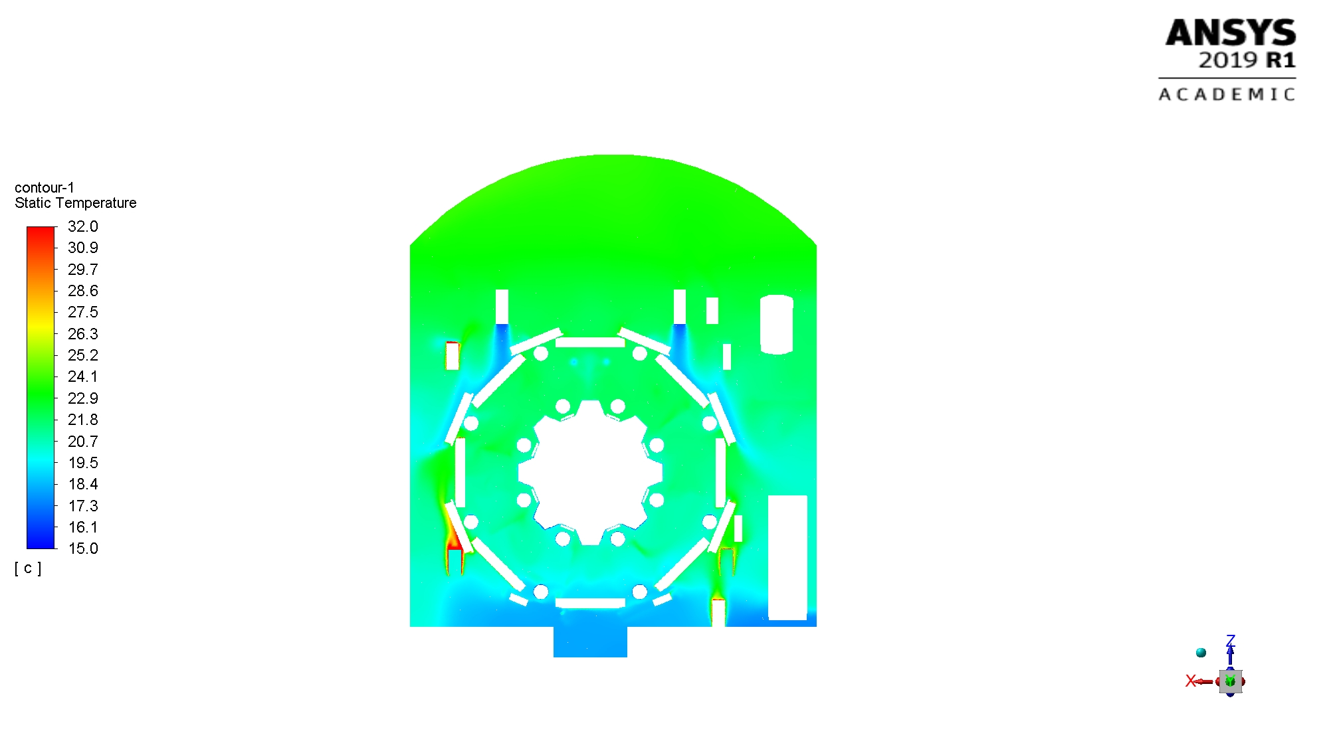
Infrastructure upgrade: UX15 temperature gradient
Upgrade of air distribution in UX15 – TC Follow-up : Marco Ciapetti
  To decrease the temperature gradient inside UX15
  Introduce fan coil units at high level in the cavern that blow cooled air downwards
  Integration study done (EN-CV) in collaboration with ATLAS
  Decision to go forward with the project taken Mid-September
  Procurement of the Air Units ongoing
  Installation and commissioning foreseen to end in June 2020
Z=0
Z=5
Z=10
Without AHU
With AHU

Slide 9
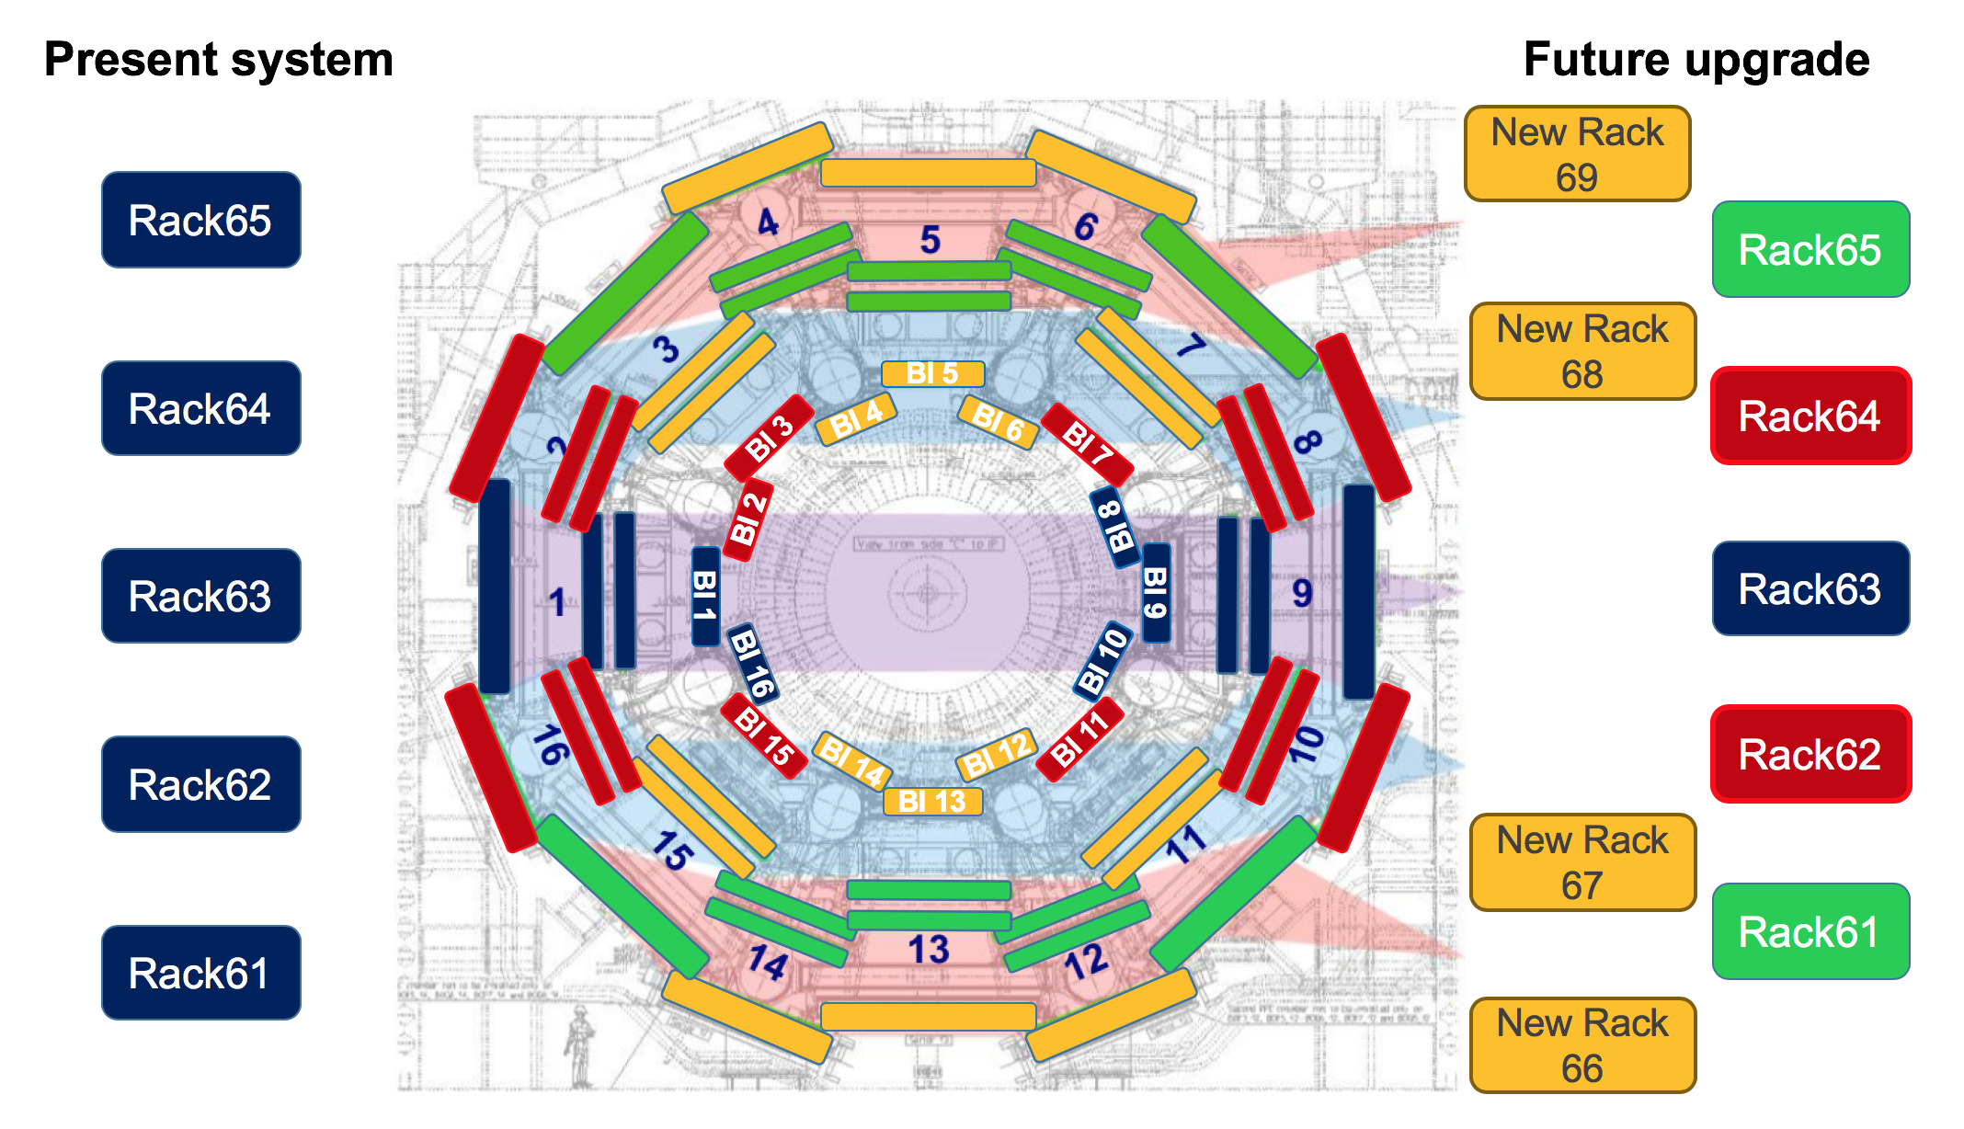
Infrastructure upgrade: RPC gas distribution
    RPC gas system upgrade – TC Follow-up : Marco Ciapetti
      Installation of 4 new gas racks for the RPC and their connection to the gas supply and to the chambers
    Distribution rack design and fabrication (EP-DT)
    Piping procurement, production and installation is a concern (late withdrawal of frame contractor → Tender process takes time)
    Rack installation being started
    Commissioning of the new racks by summer 2020

Slide 10
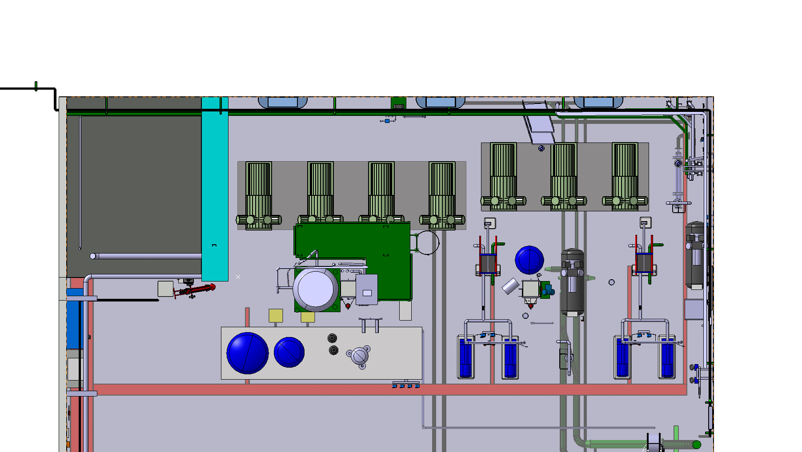
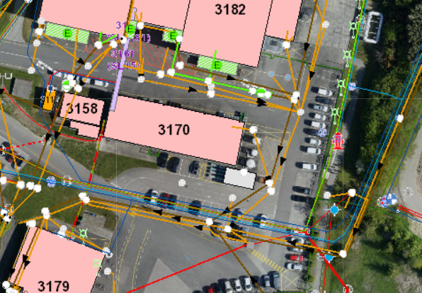
Infrastructure upgrade: CO2 cooling
Plant integration in USA15 – TC follow-up : Raphael Vuillermet
Move two pumps in CV room to allow early installation of CO2 detector cooling plants
Building for R744 (CO2) primary plant – TC follow-up : Ludovico Pontecorvo
Work made official only recently
Involvement of EN-CV, EN-EL, SMB-SE, BE-ICS
To be performed before the end of LS2 when magnets are not powered (interference with magnet bus bar cooling)
Activity discussed and accepted by SMF
Work ongoing on IPP
The construction of this building is on the critical path for the CO2 cooling project for ATLAS Phase II upgrade

Slide 11
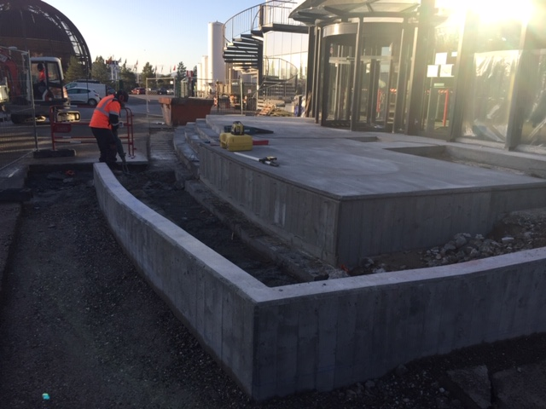
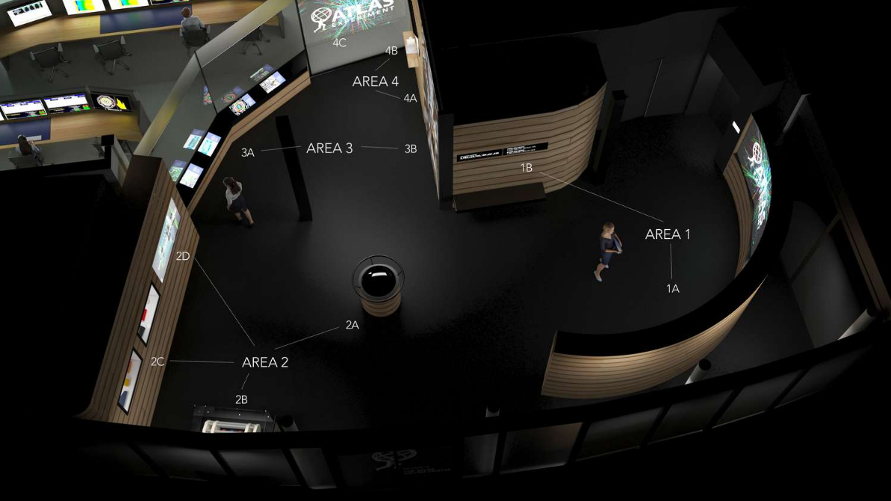
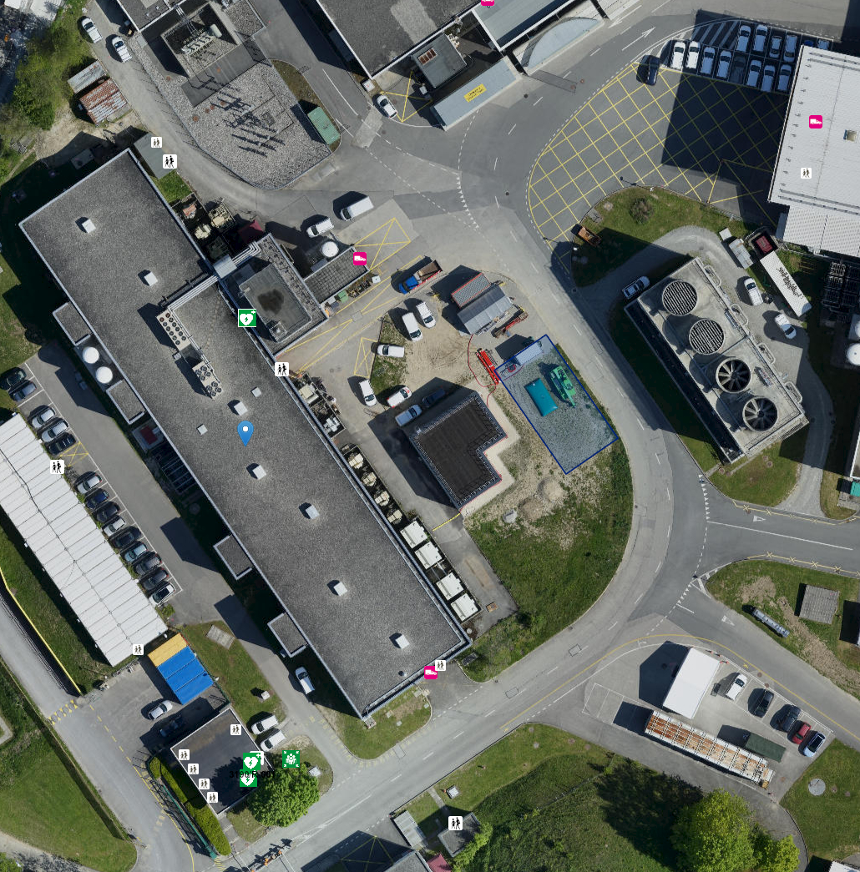
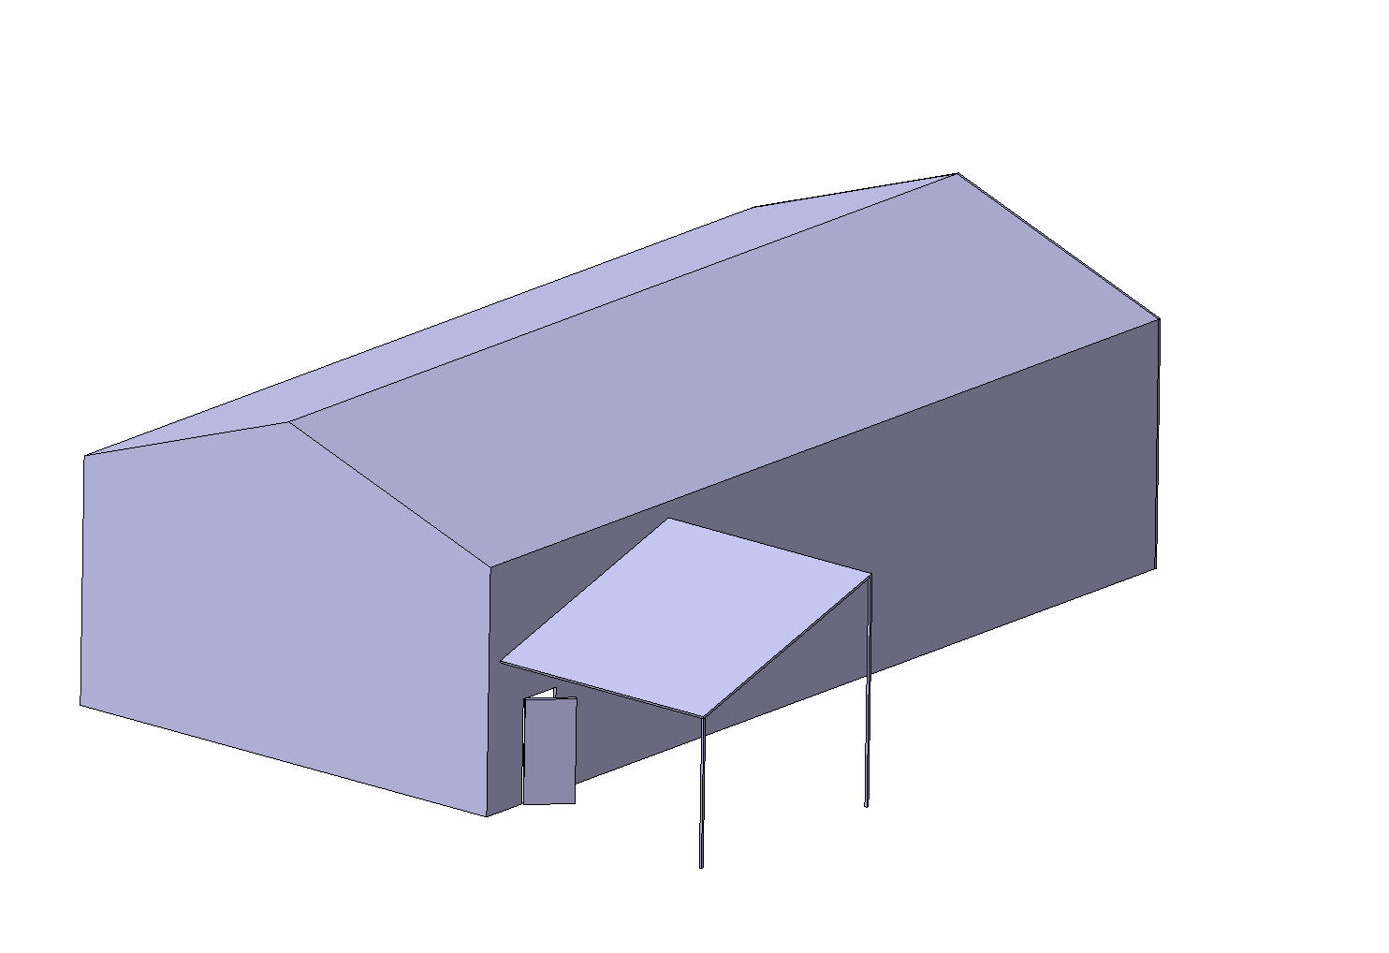
Infrastructure upgrade: Premises
Visitor Centre refurbishment – TC follow-up : Andre Rummler
Stairs work progressing well
New organization and equipment inside
Storage building – TC follow-up : Michel Raymond
  200 m² storage tent agreed at P1
  Order placed
  Slab prepared (building number 3188)
  Installation foreseen Q1 2020

Slide 12
Conclusions
Infrastructure maintenance went well on 2019, 2020 being prepared
Significant infrastructure upgrade
  Many projects must be completed at the end of LS2 (technical reasons)
    63U racks in USA15 (completed)
    New Muon cooling stations in under construction (completed)
    Increase of UPS broad coverage in US15 (spring 2020)
    Decrease of temperature gradient in UX15 (summer 2020 ?)
    RPC gas system
  Other projects could continue after LS2
New activities (decided on 2019)
  Modification in USA15 CV room is expected on LS2 to prepare place for CO2 cooling plants
  New CO2 building is under discussion to house CO2 primary plant
Anticipated work for LS3 : not compulsory but of strong benefit
  Consolidation of central UPS distribution in USA15 : waiting for EN-EL confirmation
  Forward shielding modification (related to Hi-Lumi WP8) : being started

