Slide 1
ADO-PO / TC meeting
10th December 2019
NSW activities
Raphael Vuillermet

Slide 2
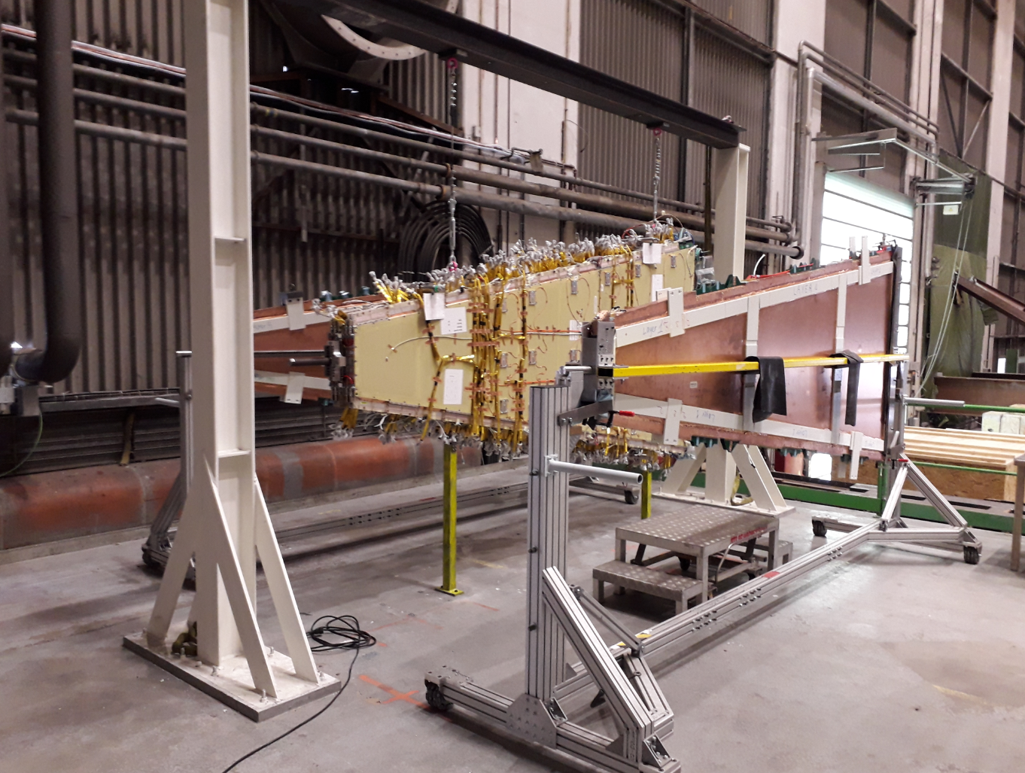
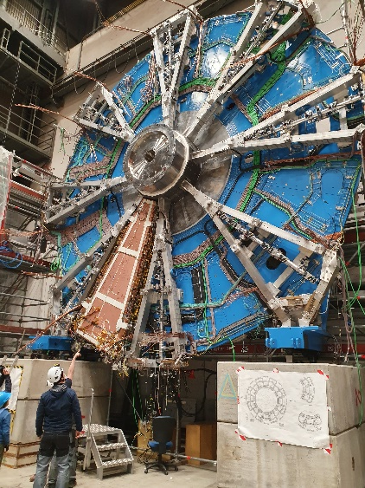
2020 year of convergence for nSW-A
TC is historically involved in this project for the mechanical integration, design, production and assembly
  nJD
  nSW
  Kinematical mounts
  Movement system
  Transport and lifting equipment’s
In 2020 TC team will be involved in the following task
    Assembly of sectors ( MMsTGC) – (8 Small + 8 Large)
    Installation of the sectors (8 Small + 8 Large)
    Mechanical positioning of the sectors
    Installation and adjustment of the 8 Large sector spokes
    Installation of the A-plate
    Installation of the Hub extension + shielding elements
    Assembly of the transport cover
    Adjustment of the lifting tool
    Preparation and participation to the transport operation to point 1
    Transport of the JD/SW and nJD/nSW
    Envelop control
Louis
Christian + Jamie
The whole technical team
Tatiana +Alexander

Slide 3
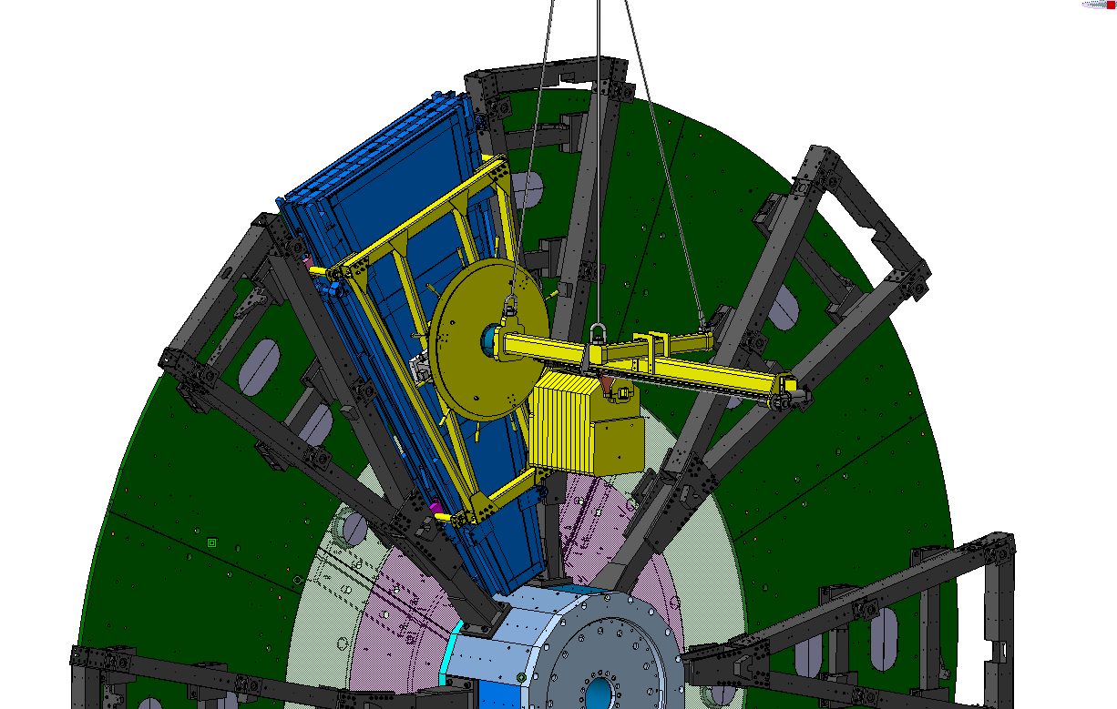
Small sector installation

Slide 4
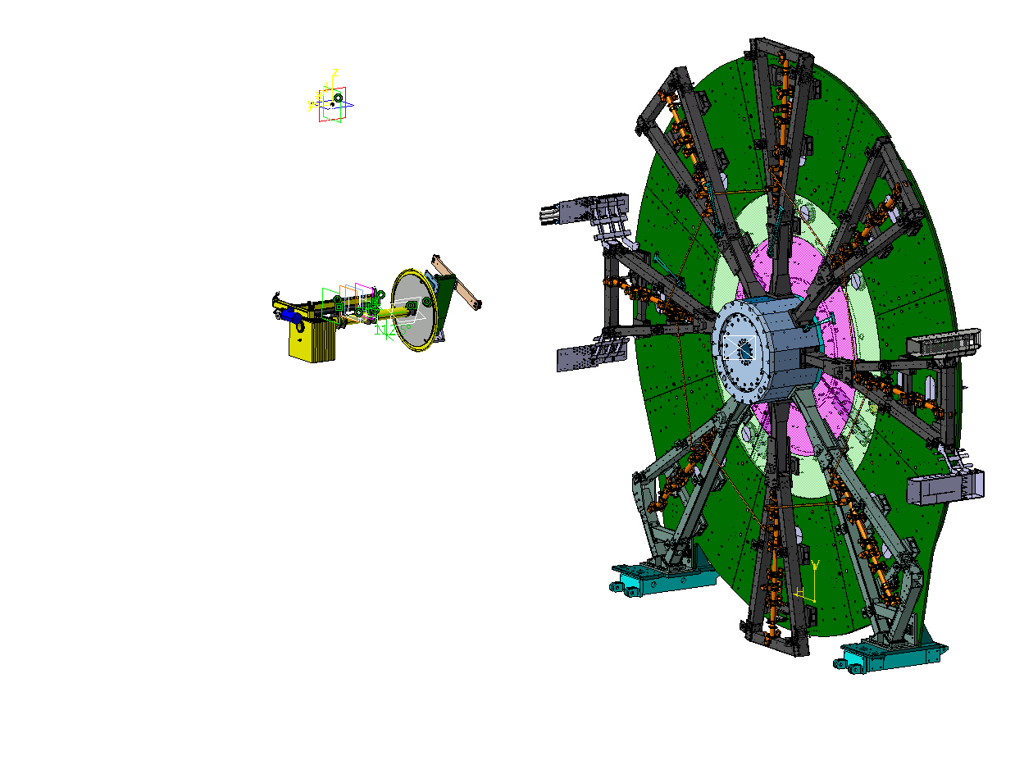
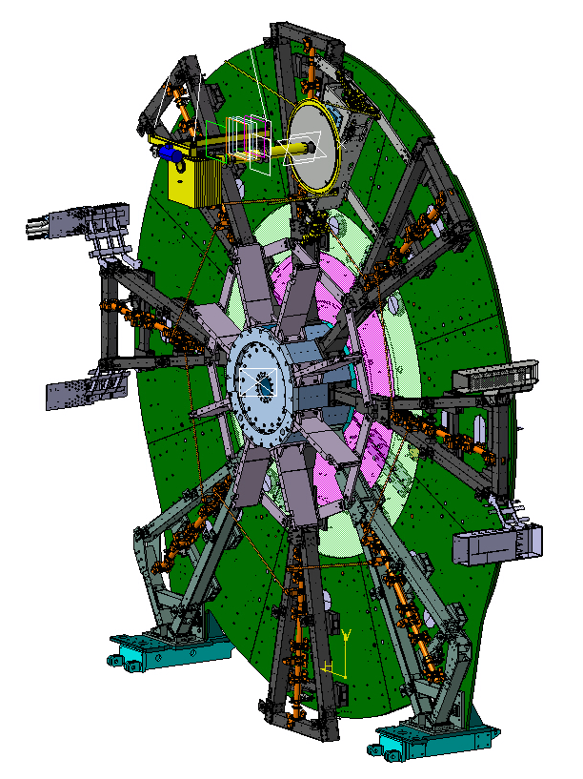
Large sector spokes installation

Slide 5
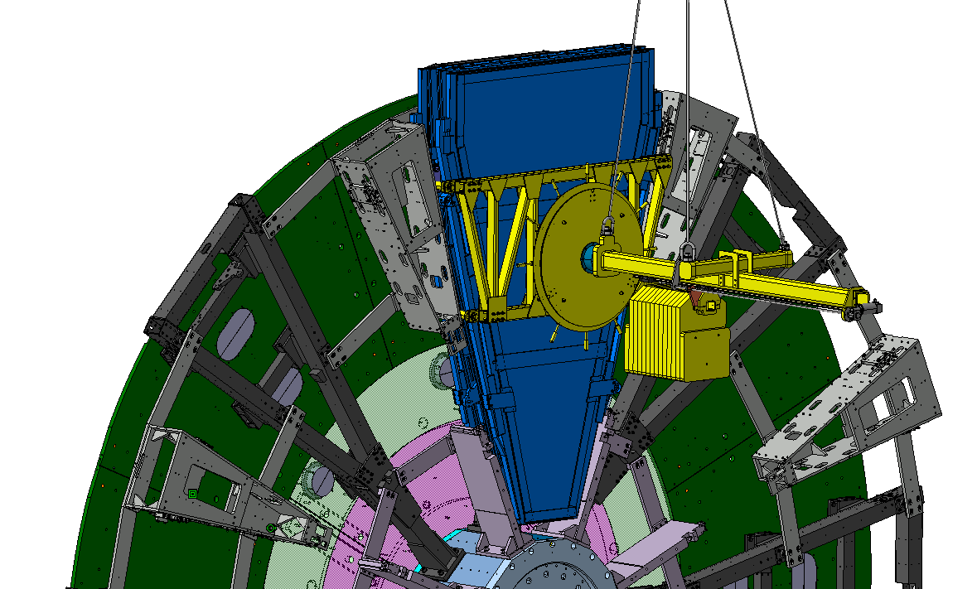
Large sector

Slide 6
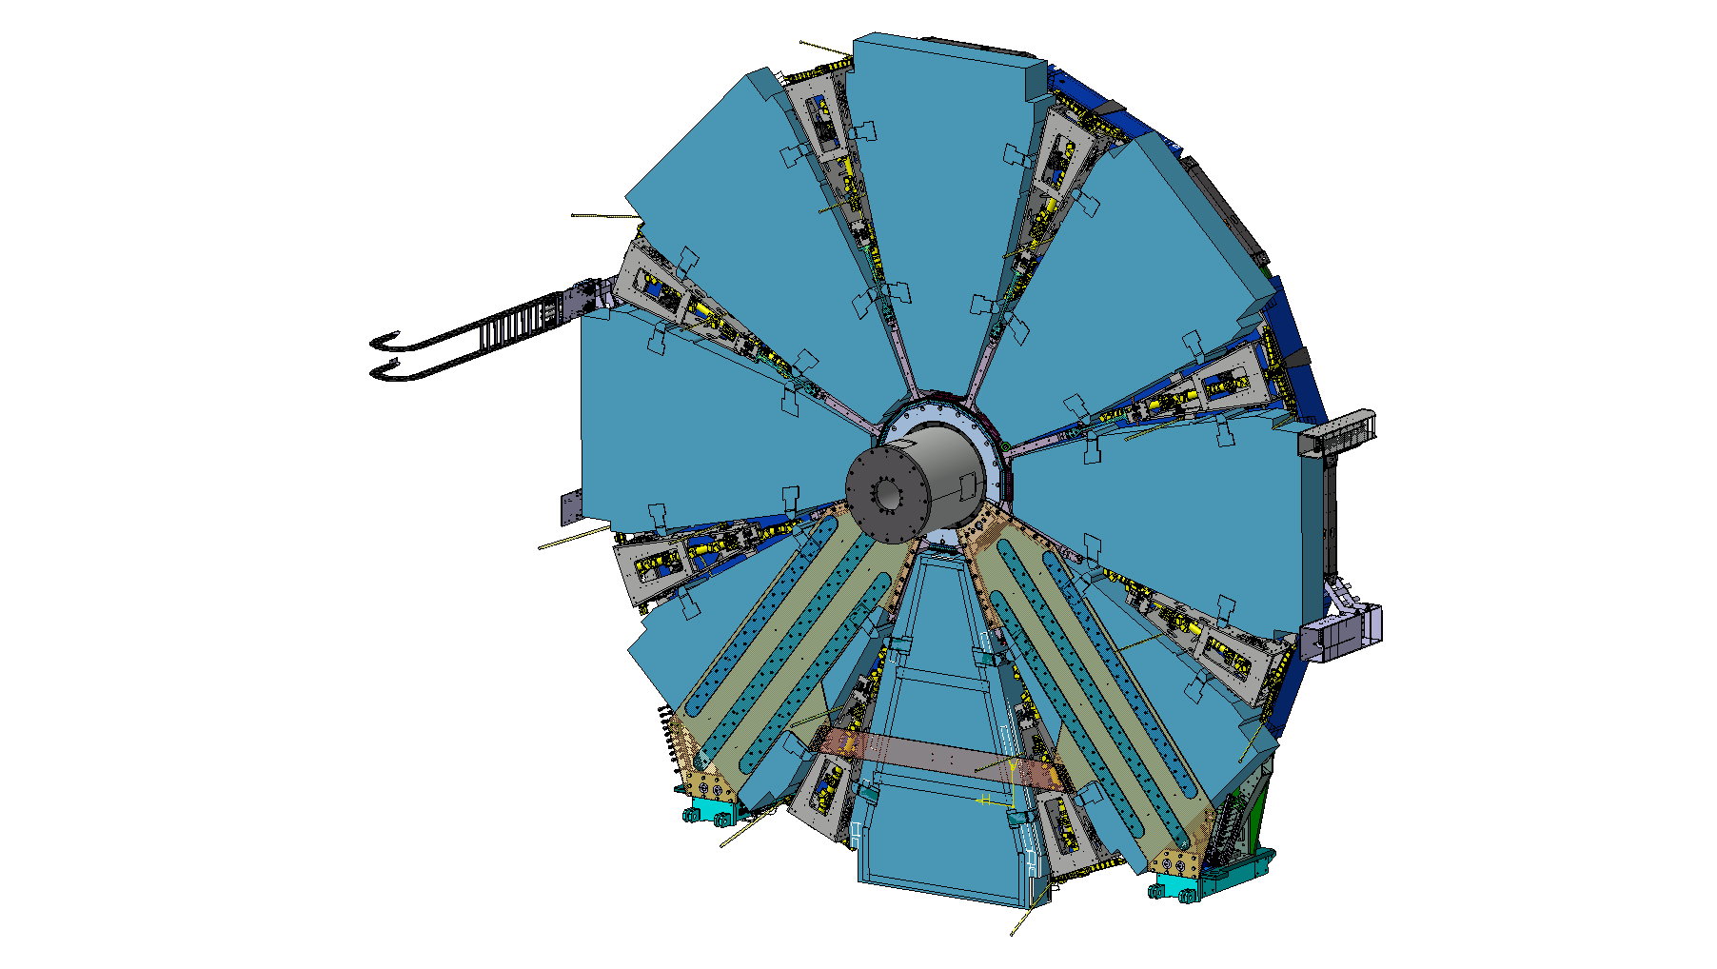
A-plate, hub extension and shielding
Hub extension
A-plate

Slide 7
Assembly of the transport tooling

Slide 8
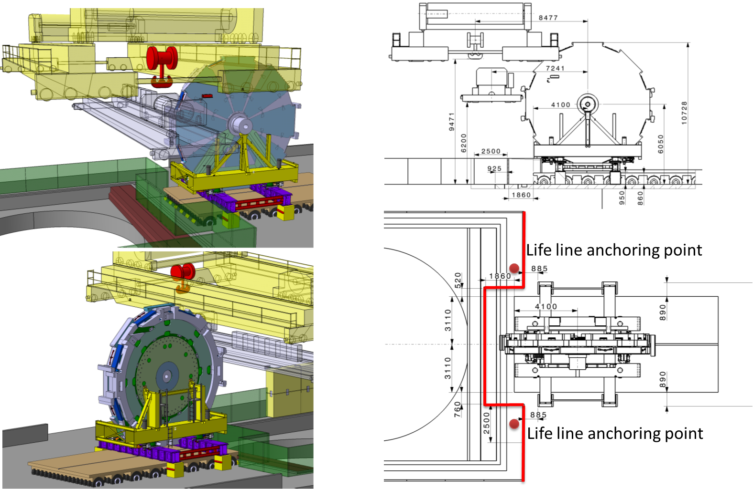
SX1 preparation for the transport

Slide 9
2020 year of challenge
TC team has recently been called to help sTGC team in difficulties on the electronic cooling.
This part is the critical path on the production of the sTGC and therefore on the critical path for the delivery of the NSW-A in time for LS2.
Tasks to be covered by TC
  Propose mechanical solution to solve all mechanical constrains Edouard, Jamie
  Prepare assembly and production drawings Edouard, Jamie
  Get offers for the production of the different parts Raphael
  Organise the assembly operation as well as the necessary tooling Edouard, Jamie, Fred
  Produce the tooling TC techs
  Manage the logistic (production/transport/ storage) Fred
  Prepare the assembly area Fred
  Control the cooling performance Claudio, Martin, Andre
  Make the assembly of the cooling circuit at the required production rate TC techs + support

Slide 10
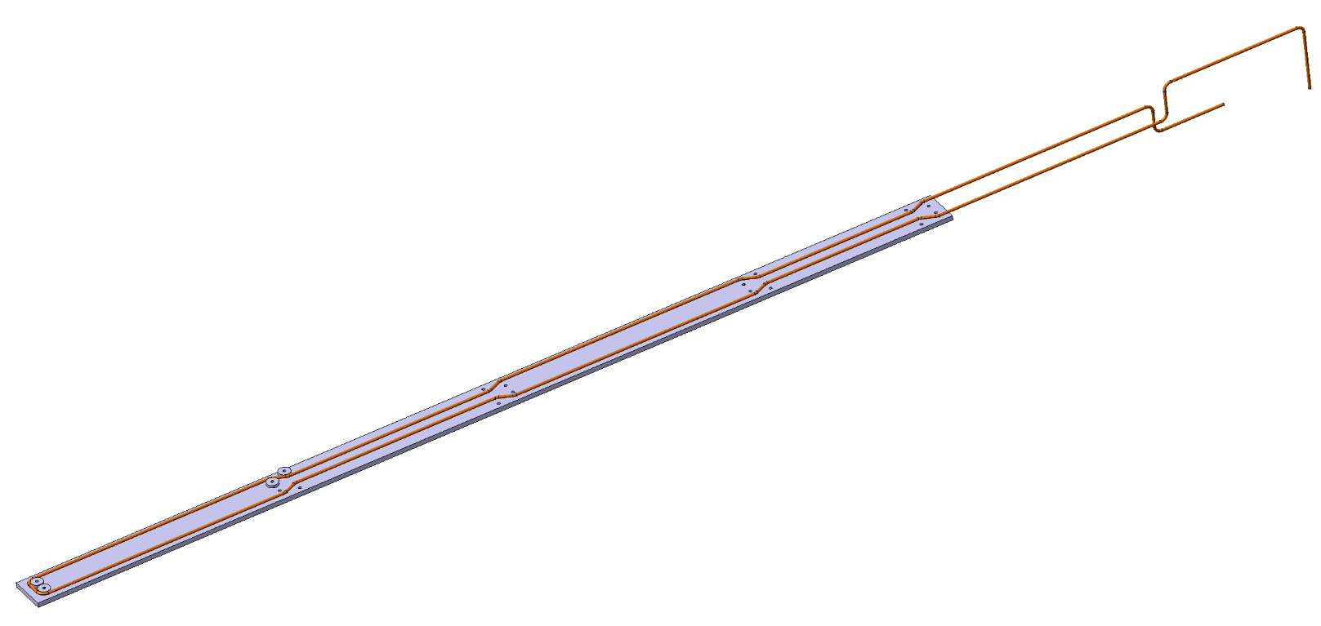
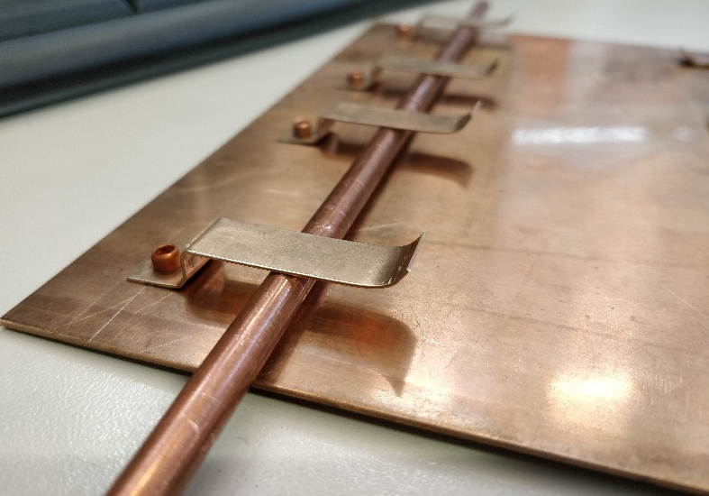
sTGC Cooling preparation
Cooling plate preparation
  Riveting of clips on copper plates
Pipe bending

Slide 11
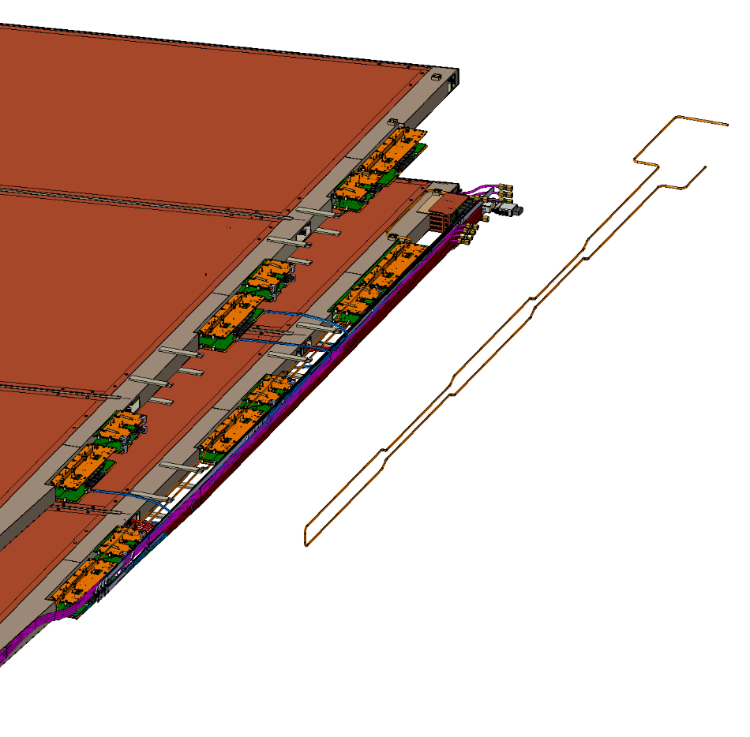
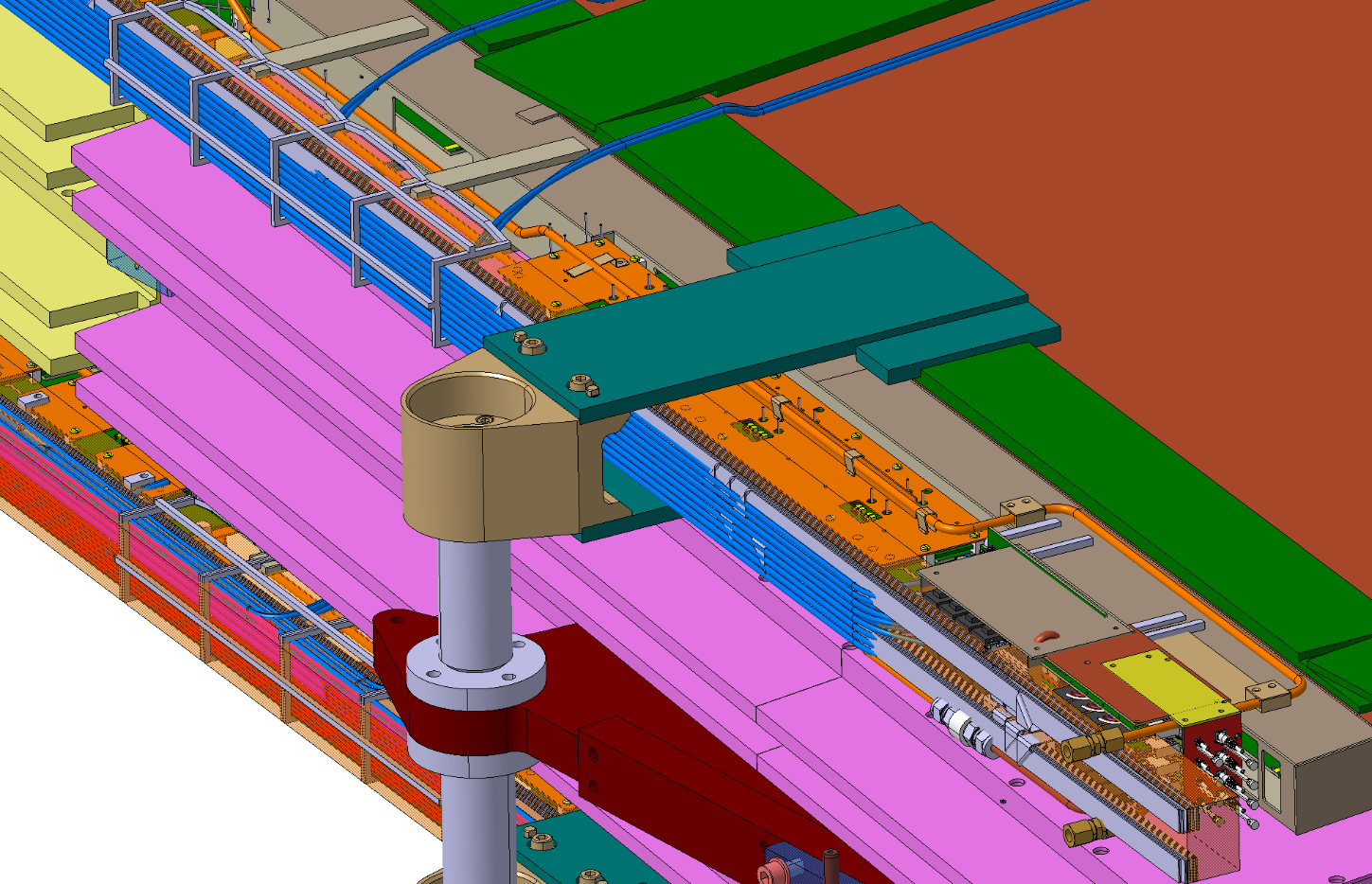
Pipe installation on the wedges
Connection with clips
Fixation of the pipe on the chamber

Slide 12
Schedule of the activities
NSW Delivery target to TC

Slide 13
Conclusion
On top of the LS2 activities and preparation for the transport of the SW and nSW TC team will be strongly committed to the production and installation of the sTGC cooling system.
For this we are currently organizing some additional manpower help from institutes to grow the team and allow the coverage of all TC commitment during 2020
Our involvement in this sTGC task will require
  Flexibility in task assignment
  Flexibility in the timing of intervention, as we will be dependant of the chamber production schedule
  Perseverance as this task will last over the full year
  Communication for technical exchange between the different person intervening
In advance we thanks all of you that will be involved in this project for your understanding and commitments

Slide 14
Resources in ATLAS Design Office
  Raphaël Vuillermet Design office supervisor & Project Engineer
  Giancarlo Spigo RSO & Project Engineer
  Tatiana Klioutchnikova Integration & Project Engineer
  Joffrey Malaquin Opening operations & Project Engineer
  Claudio Bortolin ATLAS cooling activities & Project Engineer
  Marco Ciapetti EAM, Services
  Pavel Maly Fellow
  Wim Van Emden Until August 2020
  Vit Zahradnik 50% TC / 50% ITK
  Alexander Seletskiy
  Lorenzo Quercia Fellow
  Shuvay Singh Project Associate until March 2020 then fellow in ADO-PO-SO (Magnet)
  Edouard Demeure Designer (start of contract beginning of October 2019)
  Peter Kulka Extension until the beginning of 2021
  Shoaib Hafeez Extension until the end of 2020
  Jamie Pinnell Technical activities and Design Office
  Gevorg Akhperjanyan Technical activities and Design Office
  Didier Bertet Logistic support and safety

