Slide 1
ADO-PO / TC meeting
ATLAS Design Office
Engineering activities in 2020
10th of December 2019
Tatiana Klioutchnikova & Raphael Vuillermet
on behalf of Atlas Design team

Slide 2
Activities Overview for 2020
LS2 preparation
nJD/nSW – presentation of Raphael
Services installation follow-up – presentation of Marco
BIS78 – preparation for installation and follow-up
UX15 cavern cooling AHU system integration
USA15 Dummy load system B
SR1 Demo
LS3 design work
Muon BI project – BIS/BIL RPC integration/installation, MDT electronics access
HGTD/ITK envelope studies
PP2 integration
ITK cooling integration
Extended Calorimeter surface integration
Reverse Engineering activities

Slide 3
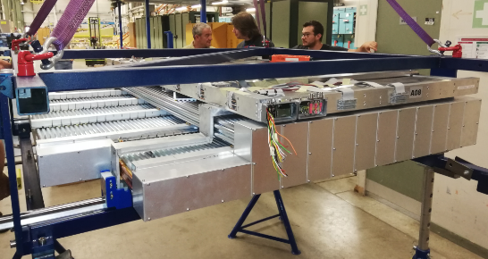
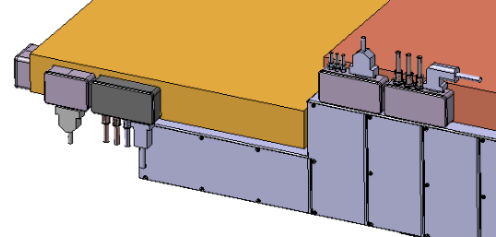
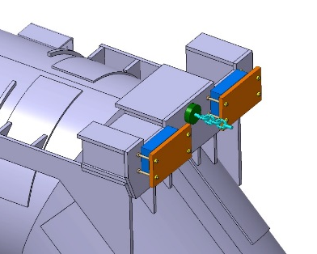
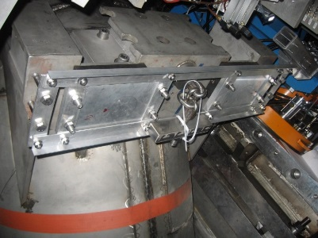
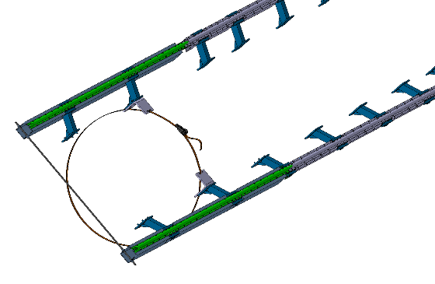
LS2 - Installation BIS78 follow-up
  Check of envelope after sMDT – RPC integration:
  ( Wim, Alexandre, Lorenzo, Jamie, Gevorg )
  Update BIS78 installation procedure with all details
  Prepare material and tooling :
  rail extensions, brackets and reinforcement
  AFT installation tool
  BIS78 installation frame
  Many other small tools
Rail reinforcement
Configuration of on-chamber services is different for most of sectors depending on space in front of NSW – need to be checked carefully before installation !
  AFT installation tool
BIS78 scaffolding and special opening
  BIS78 installation frame
  AFT modification necessary for NSW installation
Rail extensions with brackets

Slide 4
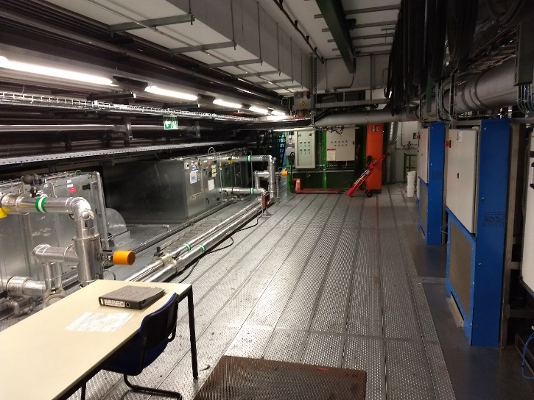
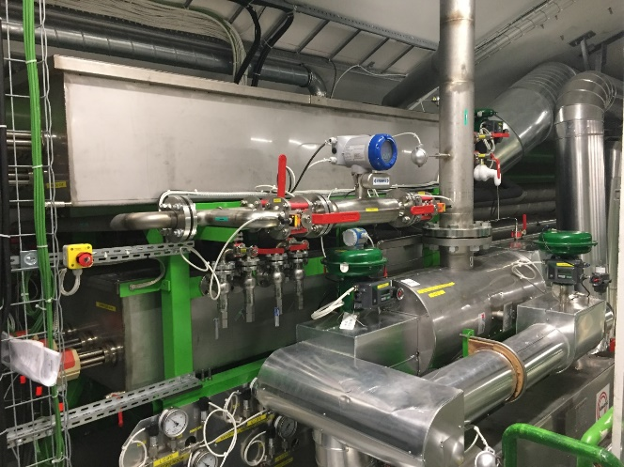
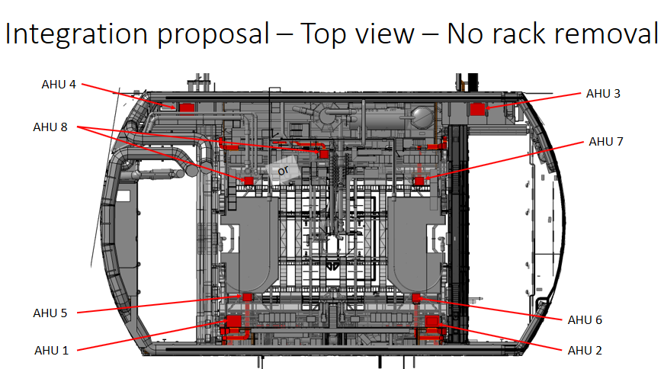
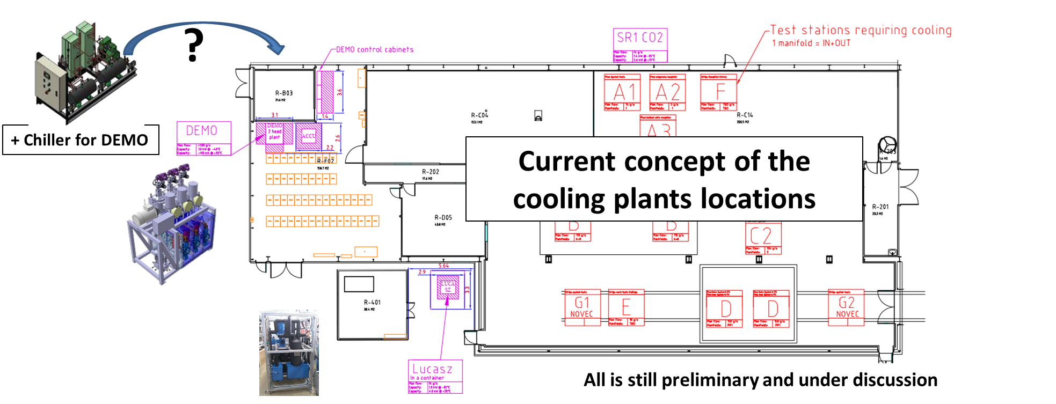
LS2 – integration activities
  1. UX15 cavern cooling AHU system integration
  ( Marco, Edouard )
  USA15 Dummy load system B (Pavel)
Proposed place where the dummy load might be integrated in USA 15
Example of dummy load
SR1 Demo – cooling plant integration (Pavel)

Slide 5
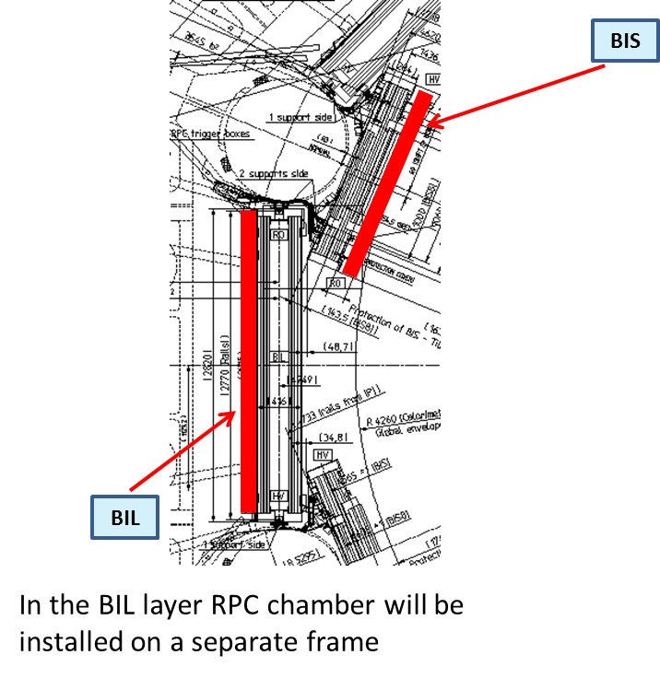
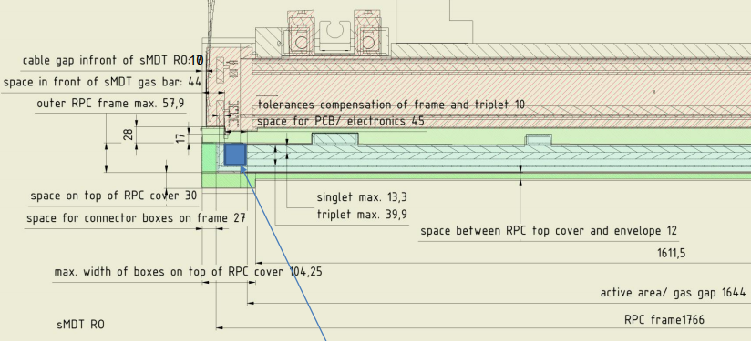
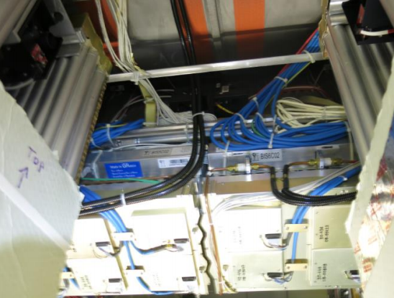
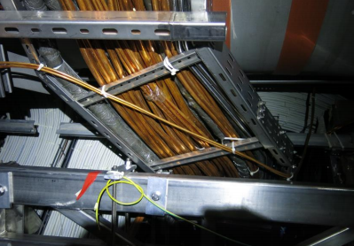
LS3 – BIS MDT/RPC integration studies
Design activity for BIS RPC (Alexandre)
  Follow the RPC services design with muon RPC team to make sure that it will fit in the attributed envelope
  Check accessibility for services connection after BIS installation together with RPC and MDT teams
  Study re-routing of services to accessible place in case of obstructed access
  Study reusability of existing MDT services for sMDT chambers
BIS RPC will be integrated with MDT
sMDT
RPC
Check of space for on-chamber services inside the attributed envelope which should not exceed the current BIS chambers
Accessibility of BIS services through the window between BIL chambers after BIL displacement
Z0 Services in sector 15 obstruct access to BIS1 and BIS2 chambers

Slide 6
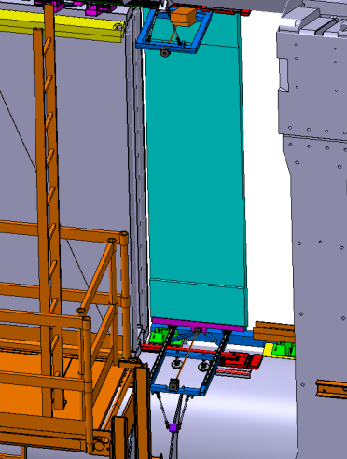
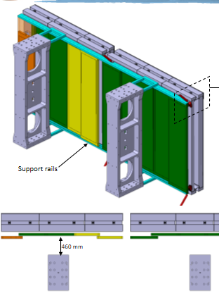
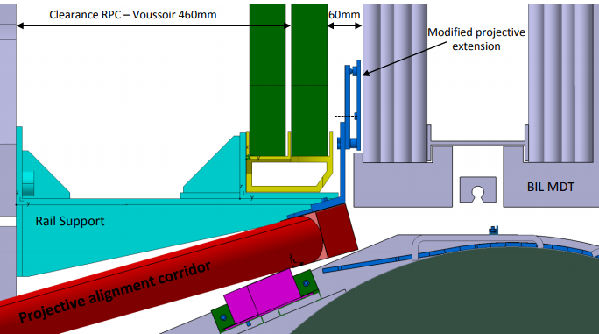
LS3 – BIL RPC integration/installation
Design activity for BIL RPC (Lorenzo, Shoaib)
  Finalize the RPC layout for all sectors in agreement with RPC team
  Follow the RPC services design with muon team to fit in the defined envelope
  Definition of the interface between support and chambers
  Finalize the design of the support structure
  Finalize the design of the installation mechanics
  Definition of the installation scenario
RPC envelope
RPC support- chamber interface
BIL RPC layout proposal
BIL RPC installation mechanics

Slide 7
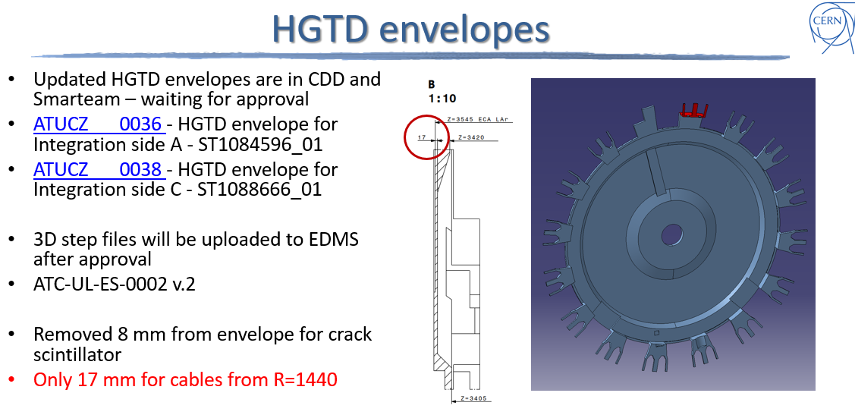
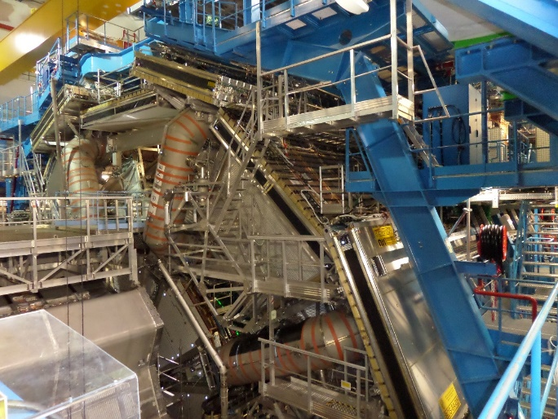
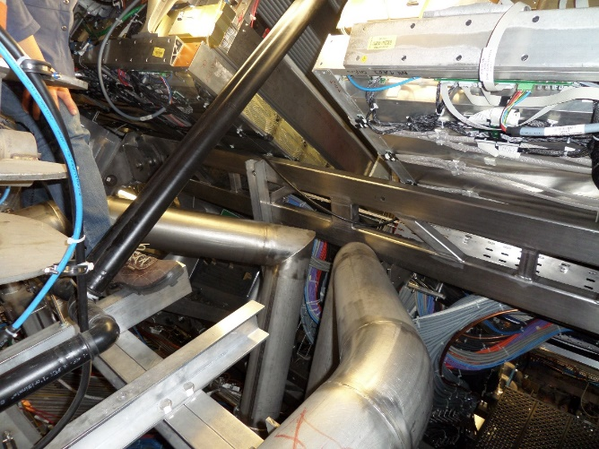
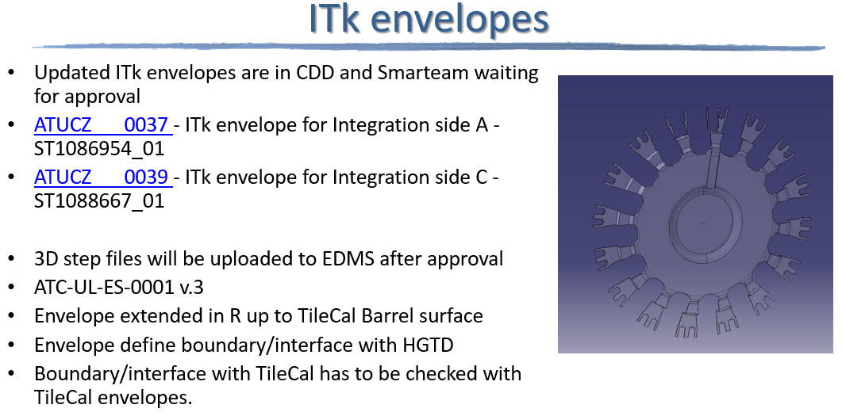
LS3 – Integration activities
MDT RO electronics need to be replaced.
Access studies and platform design (Wim,)
Some examples:
HGTD/ITK envelope studies (Peter, Michel)
No access for Sector3 BOL6.
BML at Z=0; access could be improved with some local platforms

Slide 8
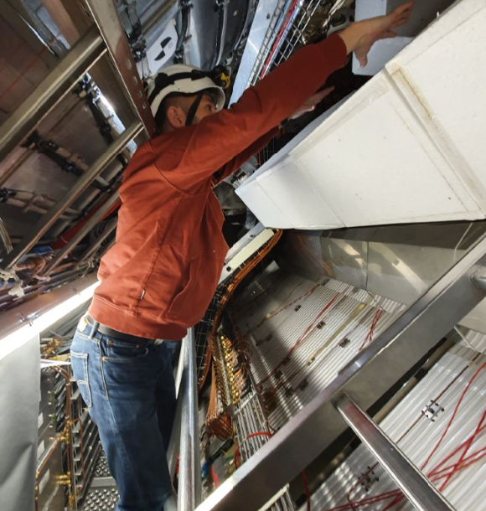
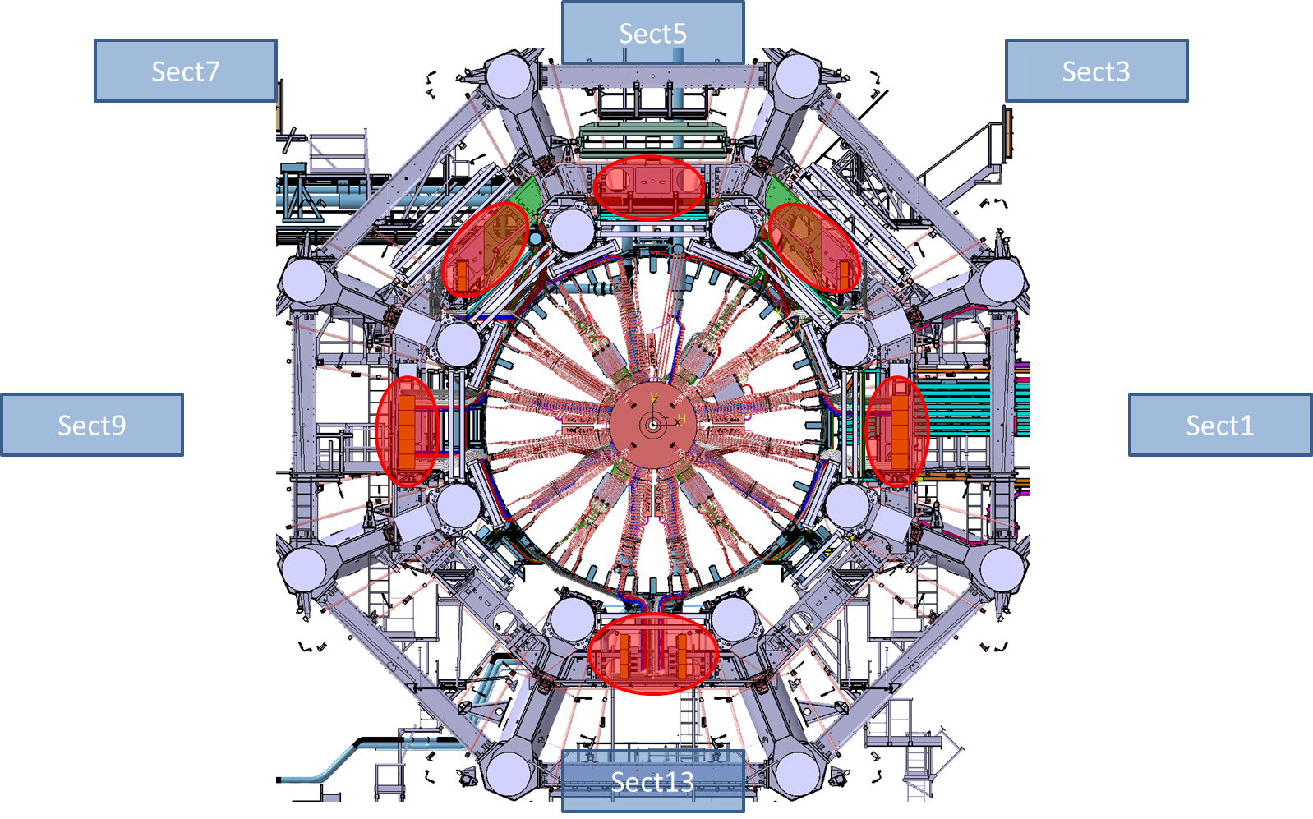
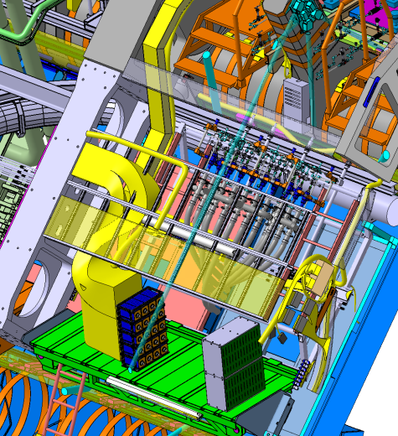
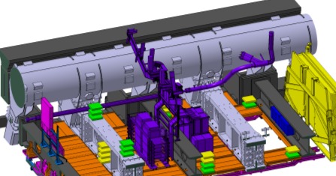
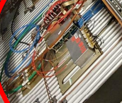
LS3- Integration activities
PP2 Integration (Vit, Raphael, Pavel, Marco, Peter, Alexandre, Lorenzo, Edouard)
Many systems need PP2 area to install path panels during LS
    (LArg, Tile, Muon, ITK (Strips and Pixel),HGTD )
In addition to ITK PP2 more elements need to be integrated in the PP2 area:
BIL RPC chambers + electronic boxes + gas manifolds + services
ITK cooling manifold boxes and cooling pipes
LAr LV power supply crates for Barrel Calorimeter
MDT electronic boxes removed from BIL MDT before RPC installation
Access platforms need to be modified to allow enough space for BIL RPC installation
PP2 is localised in many sectors (1, 3, 7, 9, 13)
Sector 7
ITK cooling manifold boxes
BIL RPC
platforms need to be modified
MDT electr. boxes
PP2
RPC electr. boxes

Slide 9
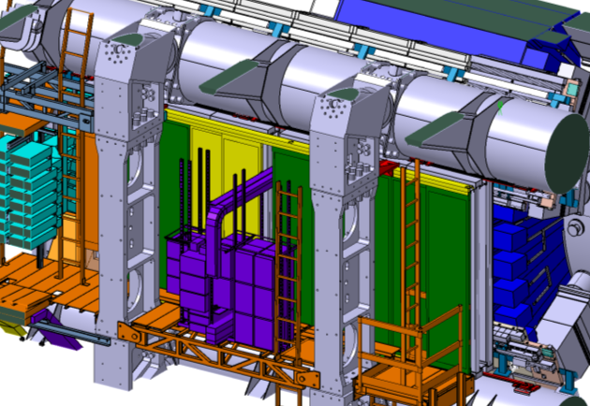
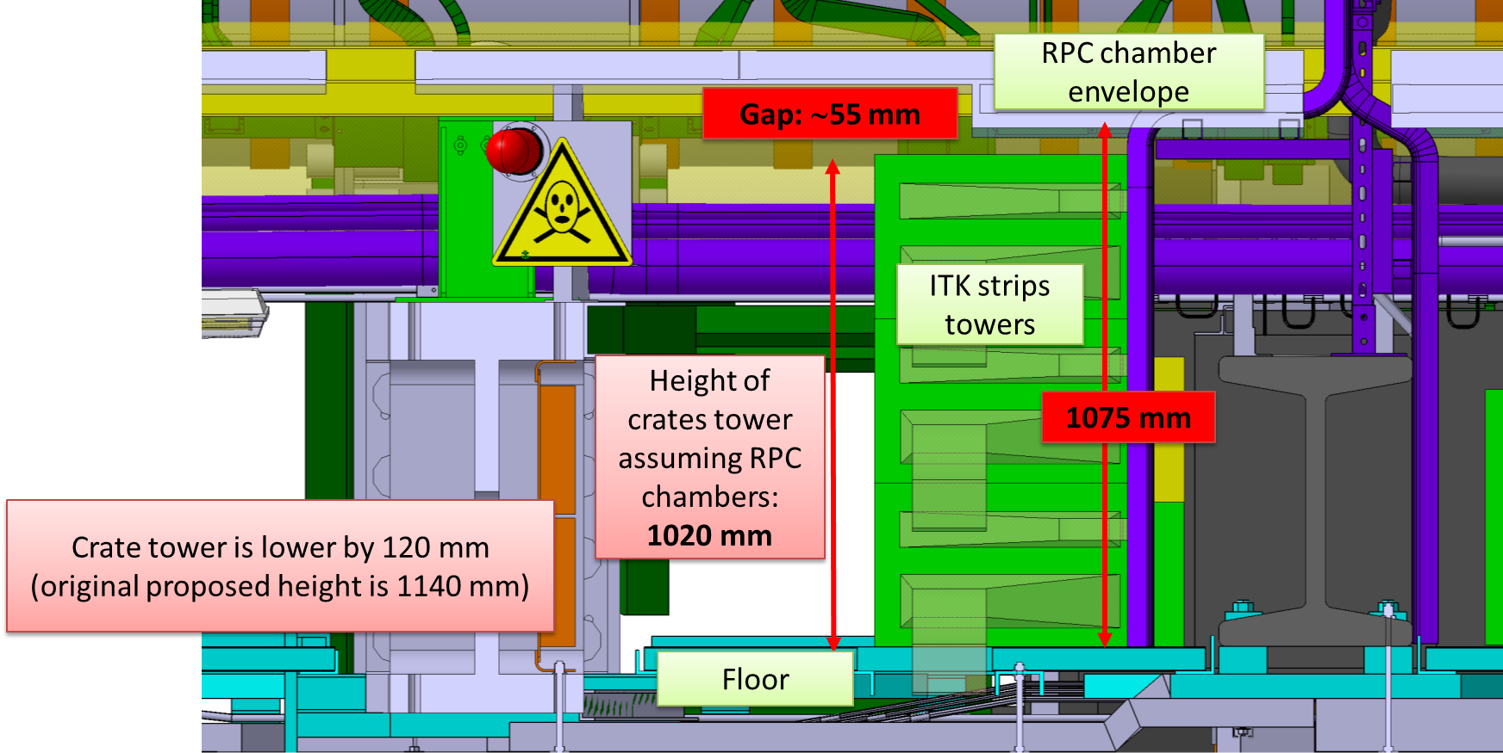
LS3- Integration activities
PP2 Integration (Vit, Raphael, Pavel, Marco, Peter, Alexandre, Lorenzo)
Sector 1
platforms need to be modified
BIL RPC
PP2
Sector 13
Examples of integration environment in sectors 1, 13

Slide 10
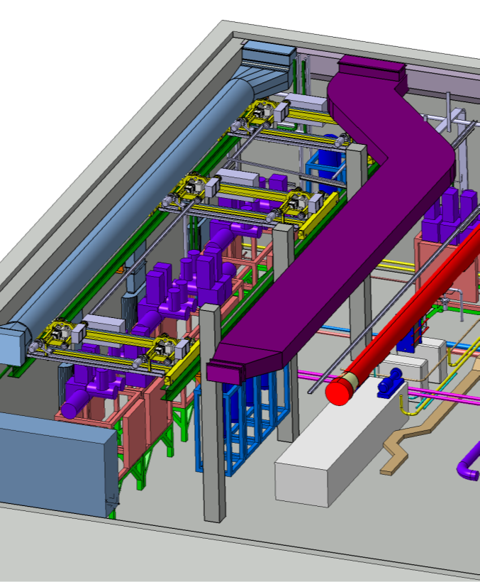
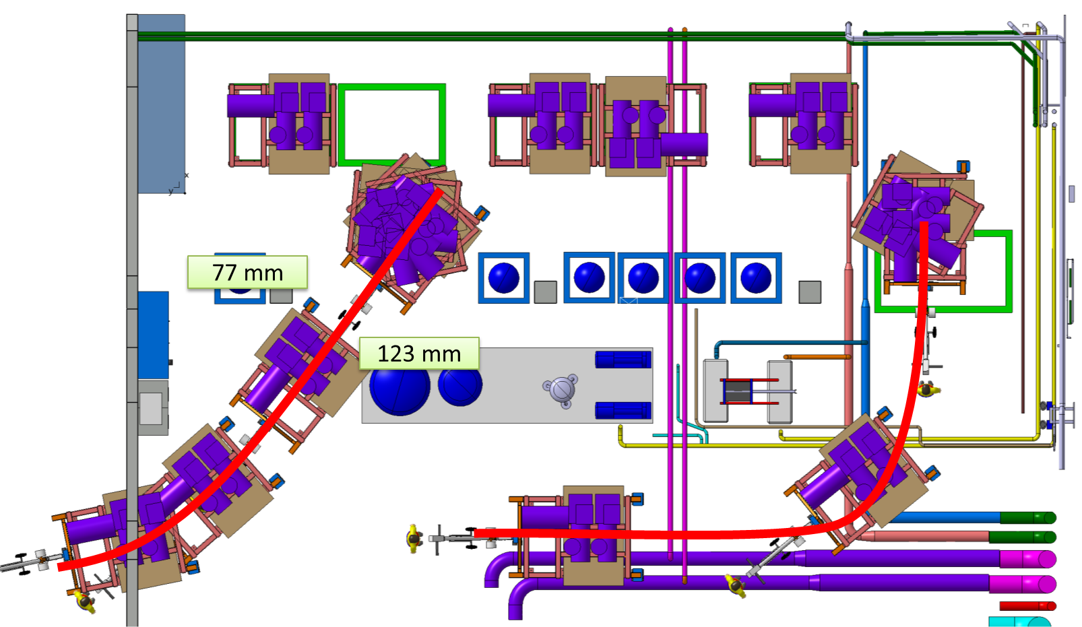
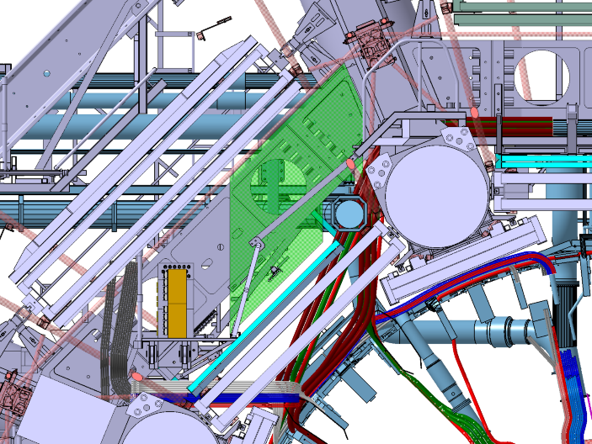
LS3 – Integration activities
CO2 cooling plant and piping integration
- USA 15 (CV room) integration (Pavel,)
USA15 - UX15 cooling transfer lines - environment
  - Manifold boxes integration,
  Cooling line routing in the toroid (Vit, )
ITK cooling lines
ITK cooling manifold boxes envelope

Slide 11
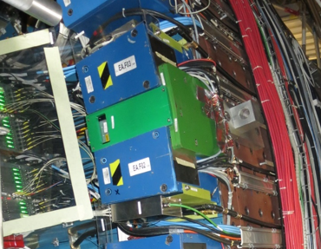
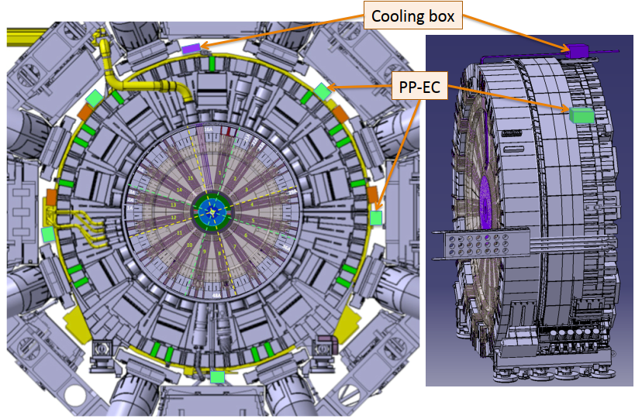
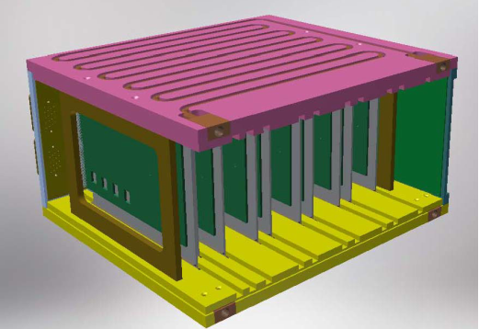
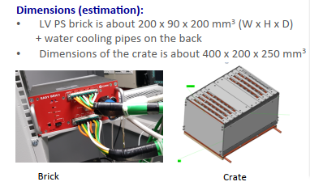
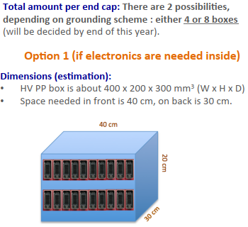
LS3- Integration activities
Extended Calorimeter Surface Integration ( Alexandre)
LAr request to find positions for LVPS in accessible place in RUN configuration
HGTD request to integrate services patch-panels in accessible place in RUN configuration for disconnection before Calorimeter movement
LAr LVPS
13 for crates
+4 HEC
Routing of cables between crates and new position of LVPS to check the cable length
Example of crate for placing LVPS with water cooling
Preliminary study for LAr LVPS positions
Check of accessibility using new designed platforms for NSW services

Slide 12
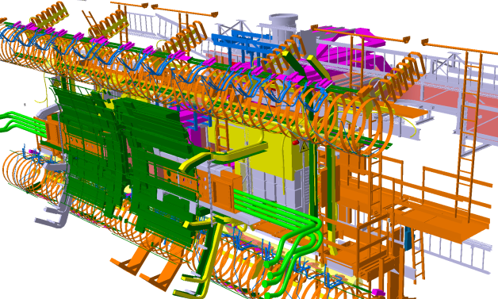
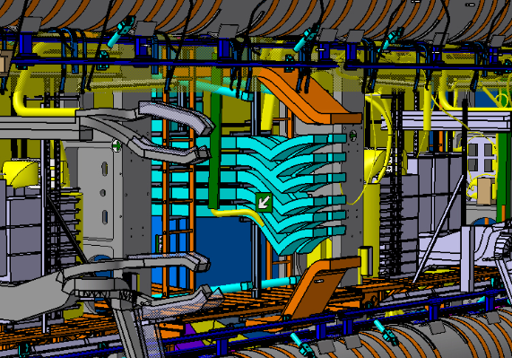
Reverse Engineering activities
  EN-EA-DC is providing some help for reverse engineering activities. They are producing 3D scan and reverse engineering of area according to the agreed plan (Vincent, Kevin)
  Plans for 2020 :
    Cable trays and services in Z0 area to have an up to date CAD model for LS3 service routing activities (Peter, Marco)
    Infrastructure on HS structure outside Toroid area
Example of sector 9 PP2 area ( done in 2019):
Scan is compared with integration model => all missing elements are built according to Scan
Z0 cable trays in sector 1 modified according to SCAN

