Slide 1
WG MC2NC
Review of Activities and Accomplishments in 2019
18th IPPOG Meeting at CERN

Slide 2
New participants in IMC19
U. of Sheffield, UK (ATLAS)
U. of M´Sila, Algeria (ATLAS)
Kaunas, U. of Technology, Lithuania (CMS)
Tomsk, Polytechnic University, Russia (CMS)
Benha, Benha University Egypt (CMS)
UNAH, Tegucigalpa, Honduras (LHCb)
KazNU, Almaty, Kazakhstan (LHCb)
EPFL, Lausanne, Switzerland (LHCb)
MISIS, Moscow, Russia (LHCb)
U. of Sarajevo, Bosnia and Herzegovina (ALICE)
U. of Montenegro, Podgorica (ALICE)
U. Atlantico, Barranquilla, Colombia (MINERvA)
Have been attracted via
National IMC representative / IPPOG rep
Members of steering group
Post-Docs from CERN moving to other labs
World Wide Data Day

Slide 3
New participants in IMC20
India, Jammu University: Ramni Gupta (ALICE)
India, Bose Institute Kolkata: Supriya Das (ALICE)
Romania, University Politehnica of Bucharest: Calin Bira (ATLAS)
Plus all institutes that will join the new Masterclasses (Particle Therapy, Belle II)!
Tuzla, DKFZ, …
Plus International Schools? (attracted via article 1 and 2 in ECIS magazine)
KVIS, Rayong, Thailand signed up for Particle Therapy and ATLAS Masterclasses
Special date in late April

Slide 4
News from Despina
In 2019, the University of Salerno did ALICE masterclasses for the first time.
5 US institutes of ALICE will join the international masterclasses programme this year.
University of Malta Masterclasses (ALICE - strange particles) on 7 November 2017 : myself and colleague Giacinto De Cataldo. They were interested but up to now have not participated in IMC. I contacted them again now.
Sarajevo : Yiota and myself want there in April 2018 and died ALICE masterclasses (in the IMC schedule). I don’t know if they will participate this year. I have just sent them a message asking if they intend to participate this year.

Slide 5
Starting Masterclasses in India (and Far East)
Ken travels to India in Dec *by invitation*
doing CMS Masterclasses
East Asia in Jan
Hong Kong (ATLAS)
Taiwan (CMS)
Japan (Belle II)
Spinoff
Vietnam (CMS)
Still hope for
Korea

Slide 6
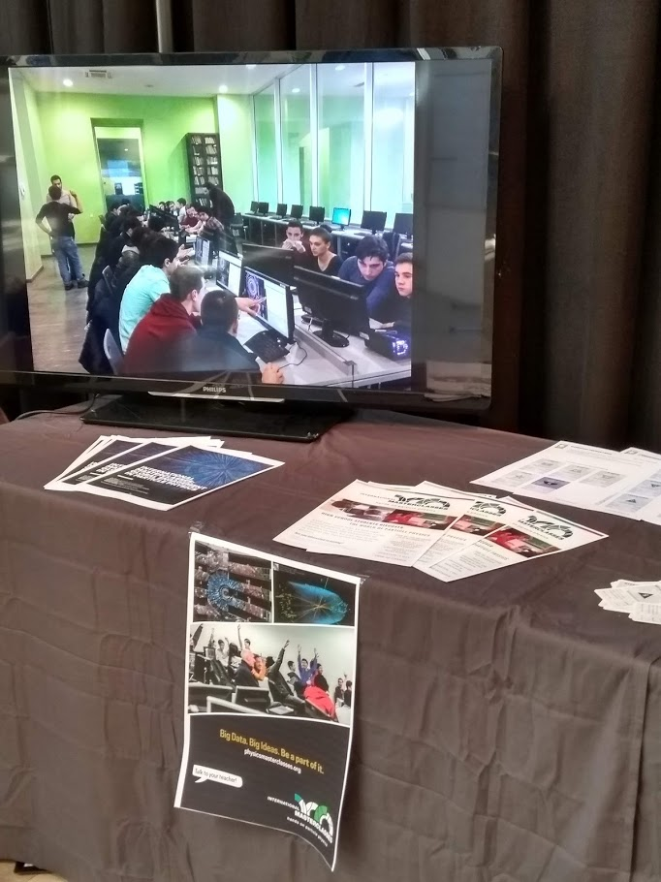
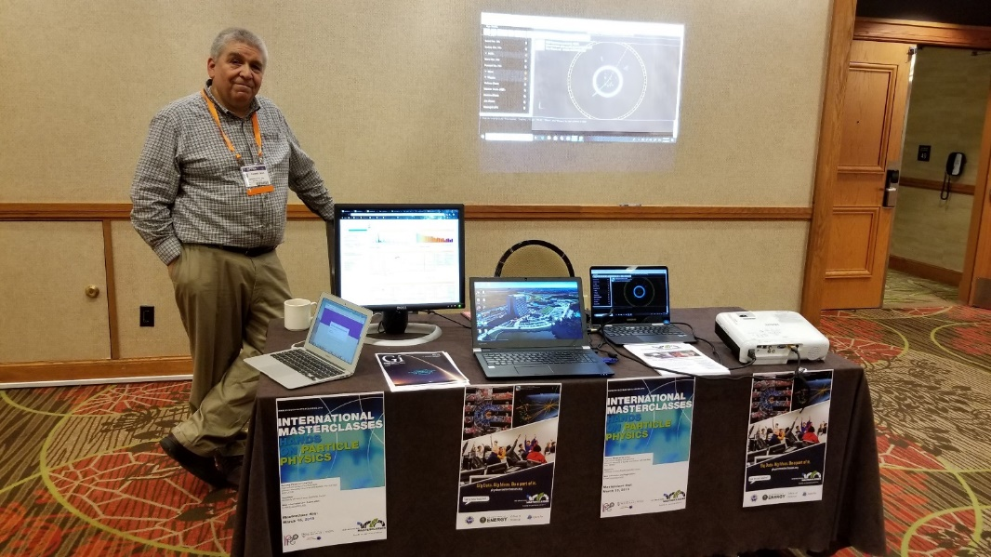
Conferences
Tables at conferences
APS Denver 2019
EPS-HEP Ghent 2019
APS Meeting in Denver, April 2019
EPS-HEP Conference in Ghent, July 2019

Slide 7
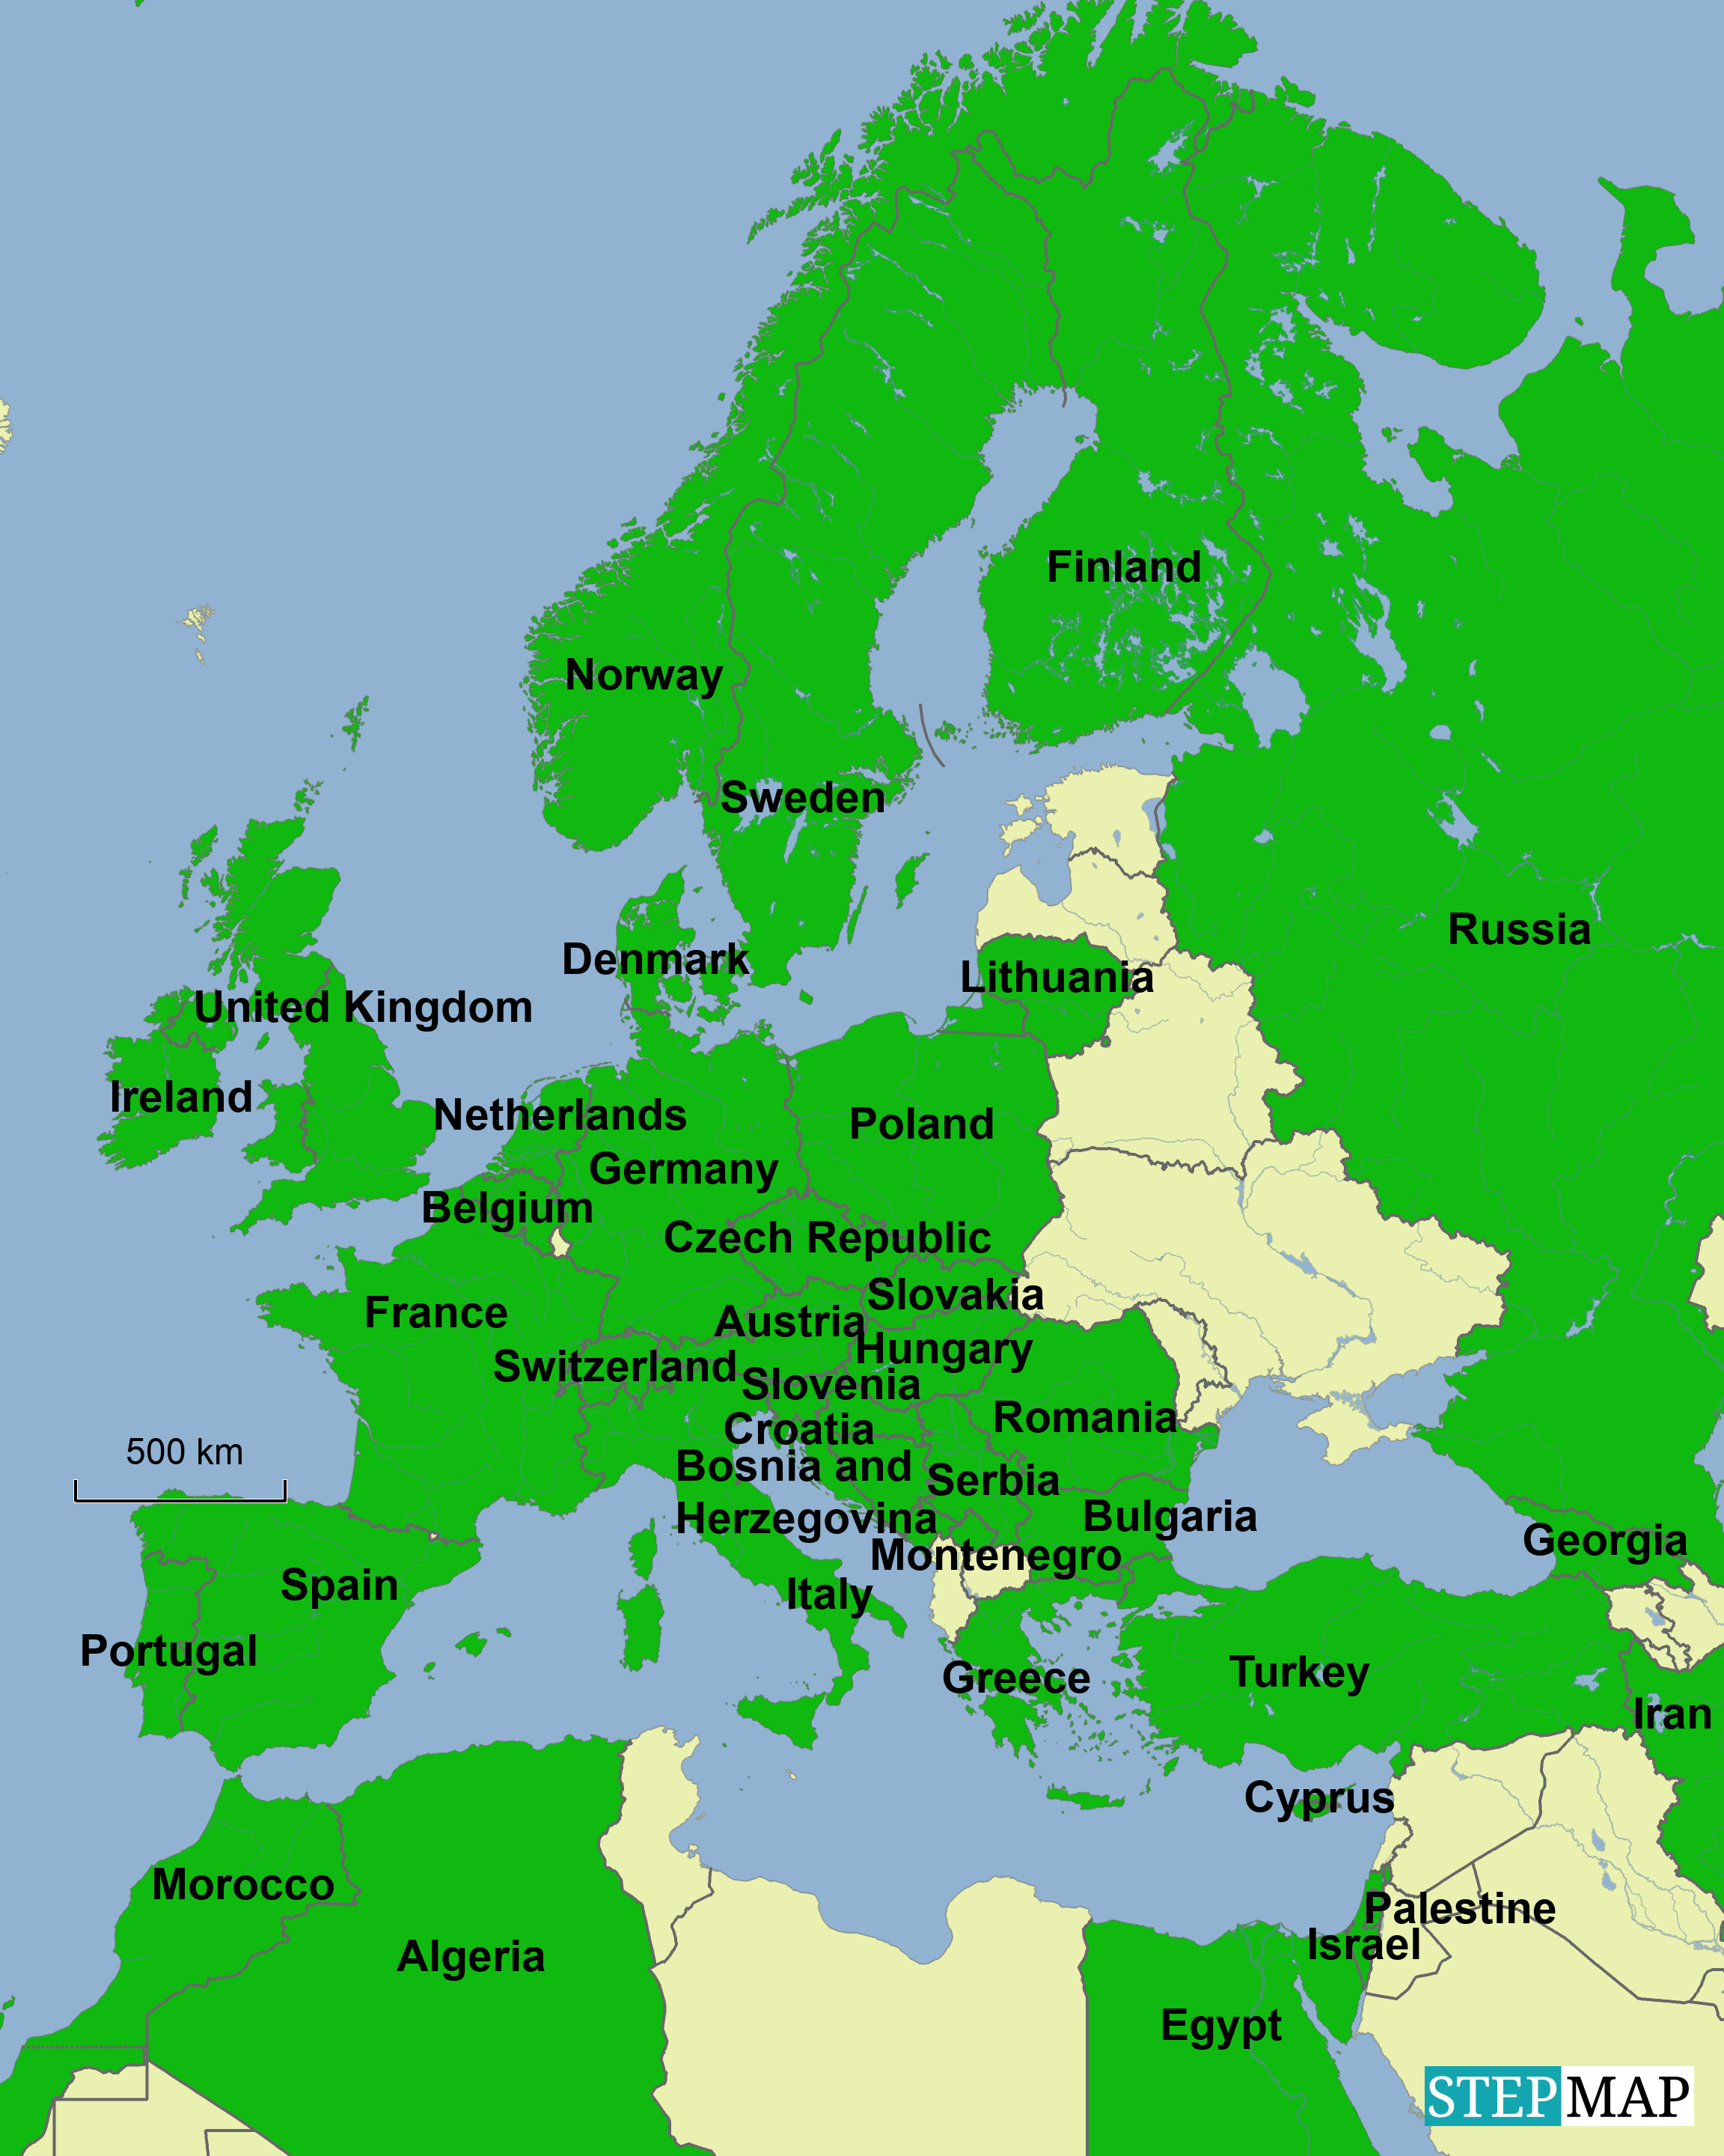
White Spots in Europe
Estonia
Latvia
Belarus
Ukraine
Moldova
Albania
North Macedonia
Armenia
Azerbaijan

Slide 8
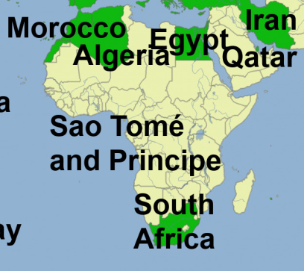
Countries in Africa
Morocco
Algeria
Egypt
Sao Tomé and Principe
South Africa

Slide 9
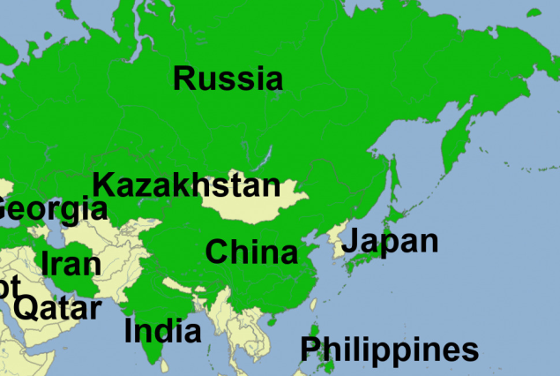
Countries in (Middle) East
Russia
Kazakhstan
Iran
Qatar
India
China
Japan
Philippines

Slide 10
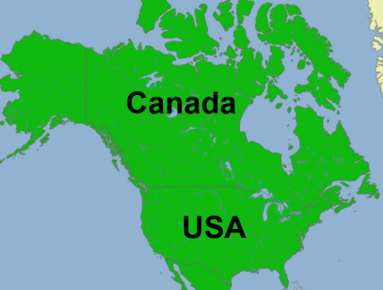
Countries in North America
Canada
U.S.

Slide 11
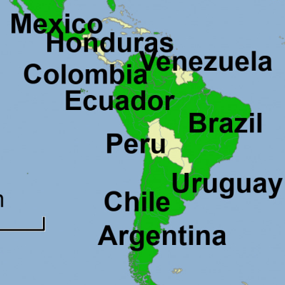
White Spots in Latin America
Bolivia
Paraguay
Guyana
Surinam
French Guiana
Panama
Costa Rica
Nicaragua
Belize
Guatemala
El Salvador
Cuba
Jamaica
Haiti
Dominican Republic
…

Slide 12
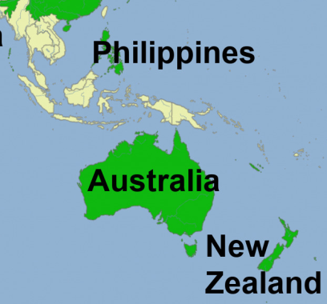
Countries in Asia/Australia
Philippines
Australia*
New Zealand

