Slide 1

HNFS meeting
November 25th 2019
Analysis of Oct. tests at ALBA
M. Siano, B. Paroli, and M. A. C. Potenza
Università degli Studi di Milano, Dipartimento di Fisica

Slide 2
Outline
Introduction to the HNFS method
Issues during Oct. tests
Results of Oct. tests
Simulations
Some considerations on signals
‘HNFS meeting’ - Siano Mirko - 25/11/2019

Slide 3
Introduction
to the HNFS method
‘HNFS meeting’ - Siano Mirko - 25/11/2019

Slide 4
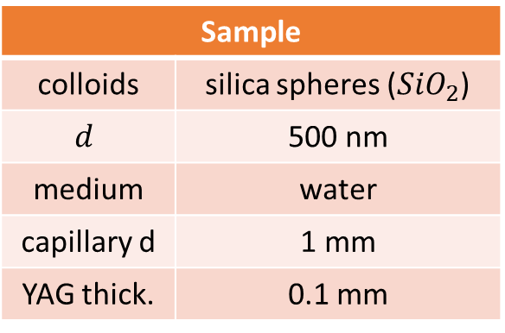
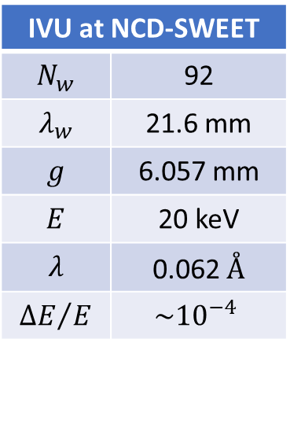


The HNFS setup
$$λ$$
$$z$$
Introduction to the HNFS method
Issues during Oct. tests
Results of Oct. test
Simulations
Some considerations on signals
20x
0.4 NA
IVU at NCD-SWEET
$$N_{w}$$ | 92
$$λ_{w}$$ | 21.6 mm
$$g$$ | 6.057 mm
$$E$$ | 20 keV
$$λ$$ | 0.062 $Å$
$${ΔE}/E$$ | $$\sim {10}^{−4}$$
Sample
colloids | silica spheres (${SiO}_{2}$)
$$d$$ | 500 nm
medium | water
capillary d | 1 mm
YAG thick. | 0.1 mm
Basler scA1300-32gm
1296x966
3.75x3.75 µm²
ET = 50 ms
‘HNFS meeting’ - Siano Mirko - 25/11/2019

Slide 5
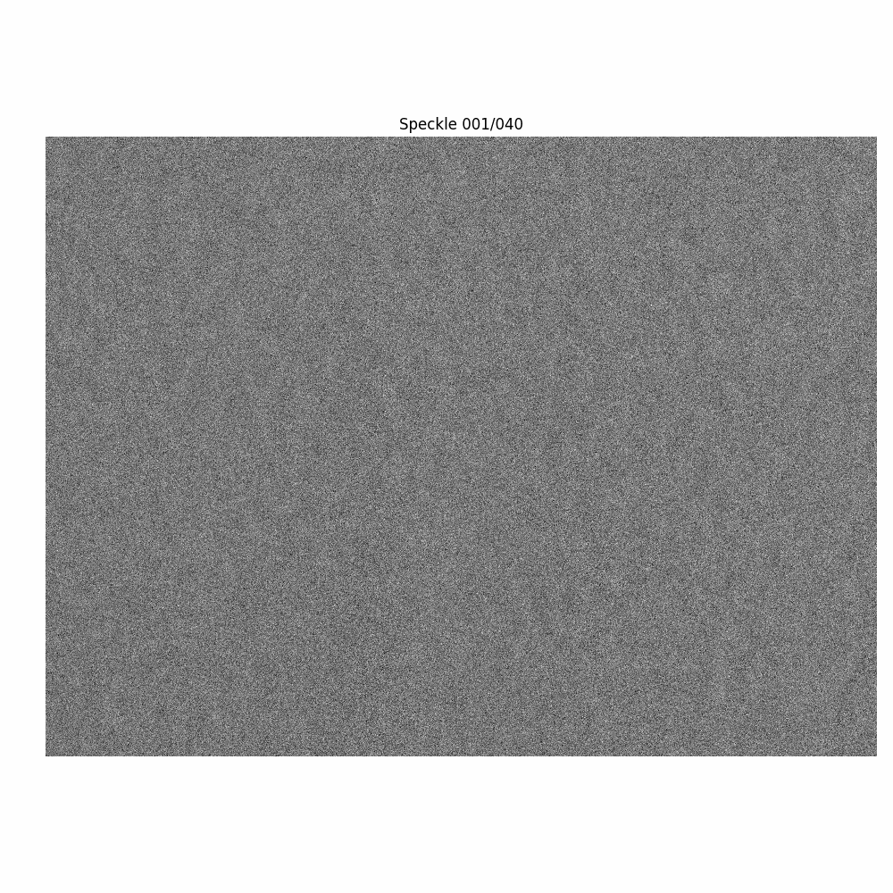
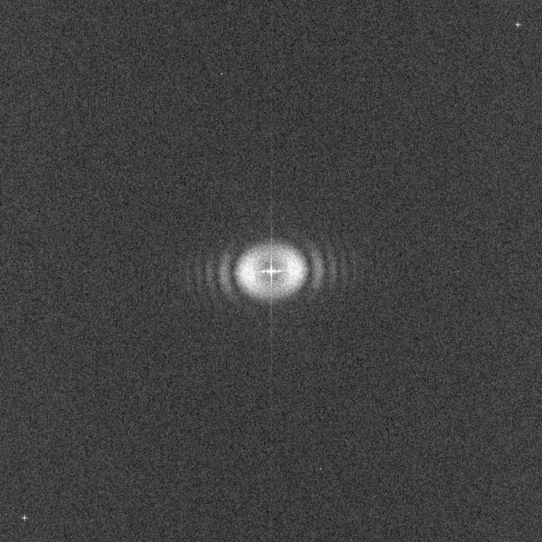
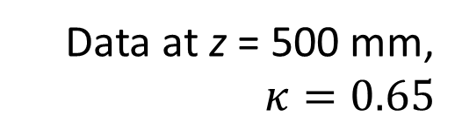

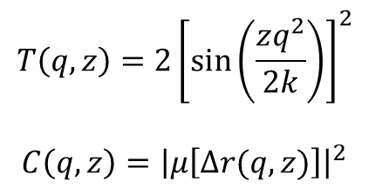
The HNFS technique
Data at z = 500 mm,
$$κ=0.65$$
Introduction to the HNFS method
Issues during Oct. tests
Results of Oct. test
Simulations
Some considerations on signals
900x900 pixels
$$I\left(q,z\right)=T\left(q,z\right)C\left(q,z\right)R\left(q\right)S\left(q\right)+P(q)$$
$$T\left(q,z\right)=2{\left[\sin\left(\frac{zq^{2}}{2k}\right)\right]}^{2}$$
$$C\left(q,z\right)={\left|μ\left[Δr(q,z)\right]\right|}^{2}$$
$$H(q)$$
‘HNFS meeting’ - Siano Mirko - 25/11/2019

Slide 6
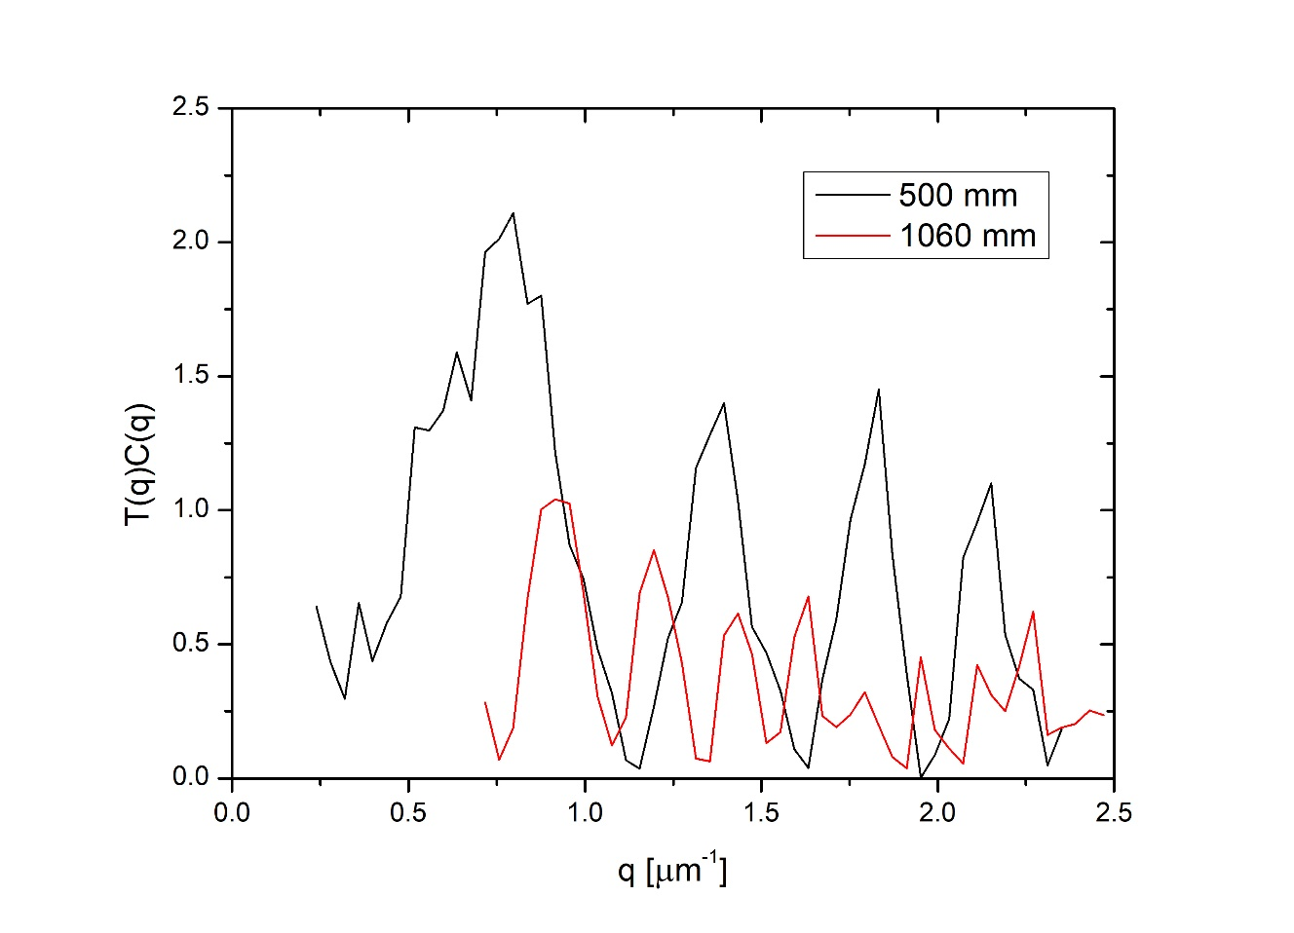
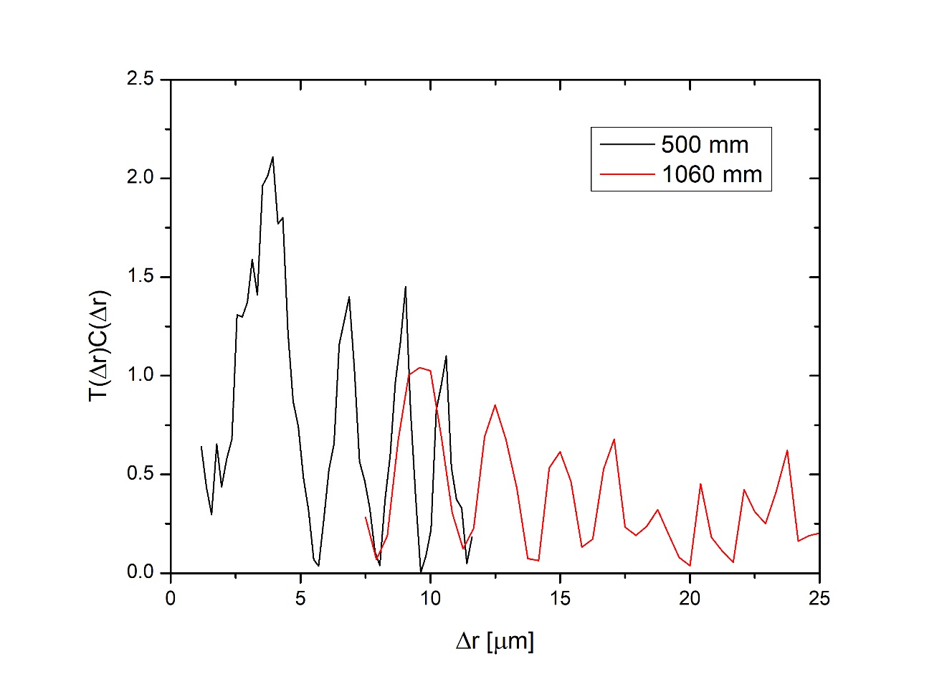
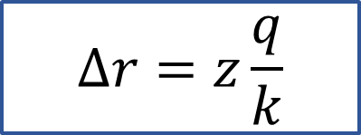
The spatial scaling
Introduction to the HNFS method
Issues during Oct. tests
Results of Oct. test
Simulations
Some considerations on signals
$$Δr=z\frac{q}{k}$$
‘HNFS meeting’ - Siano Mirko - 25/11/2019

Slide 7
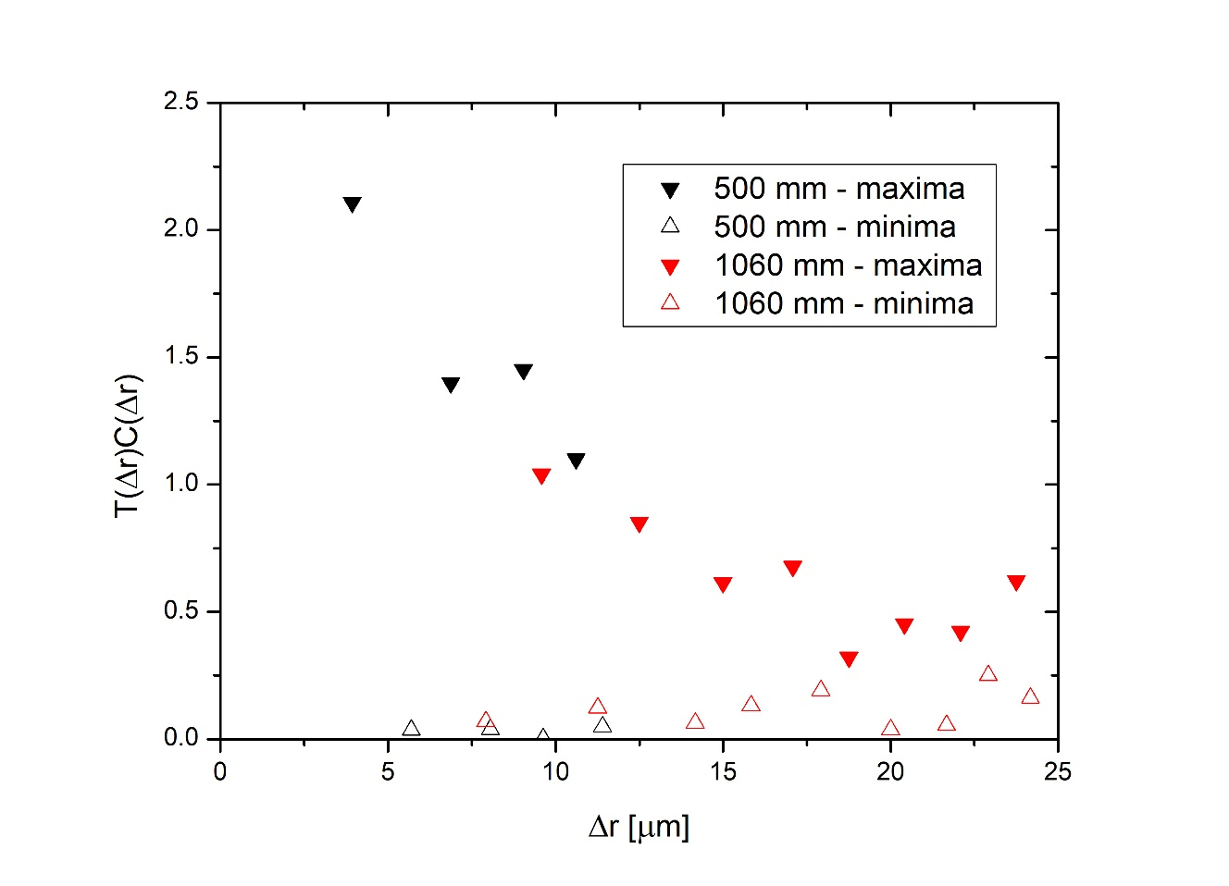
The spatial scaling
Introduction to the HNFS method
Issues during Oct. tests
Results of Oct. test
Simulations
Some considerations on signals
$$Δr=z\frac{q}{k}$$
‘HNFS meeting’ - Siano Mirko - 25/11/2019

Slide 8
Issues during
Oct. tests
‘HNFS meeting’ - Siano Mirko - 25/11/2019

Slide 9
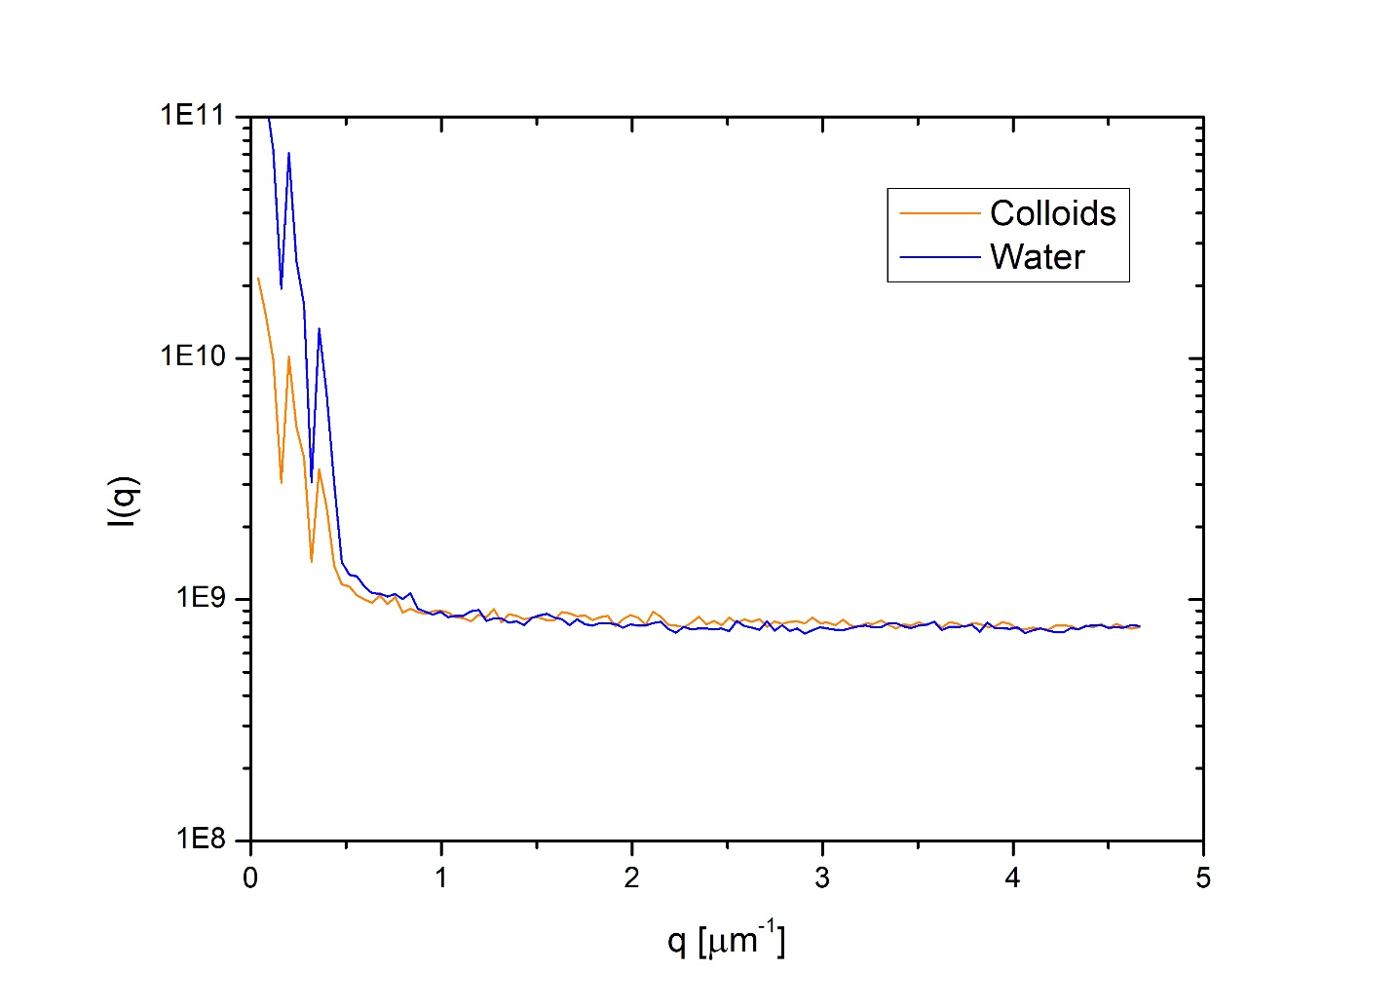
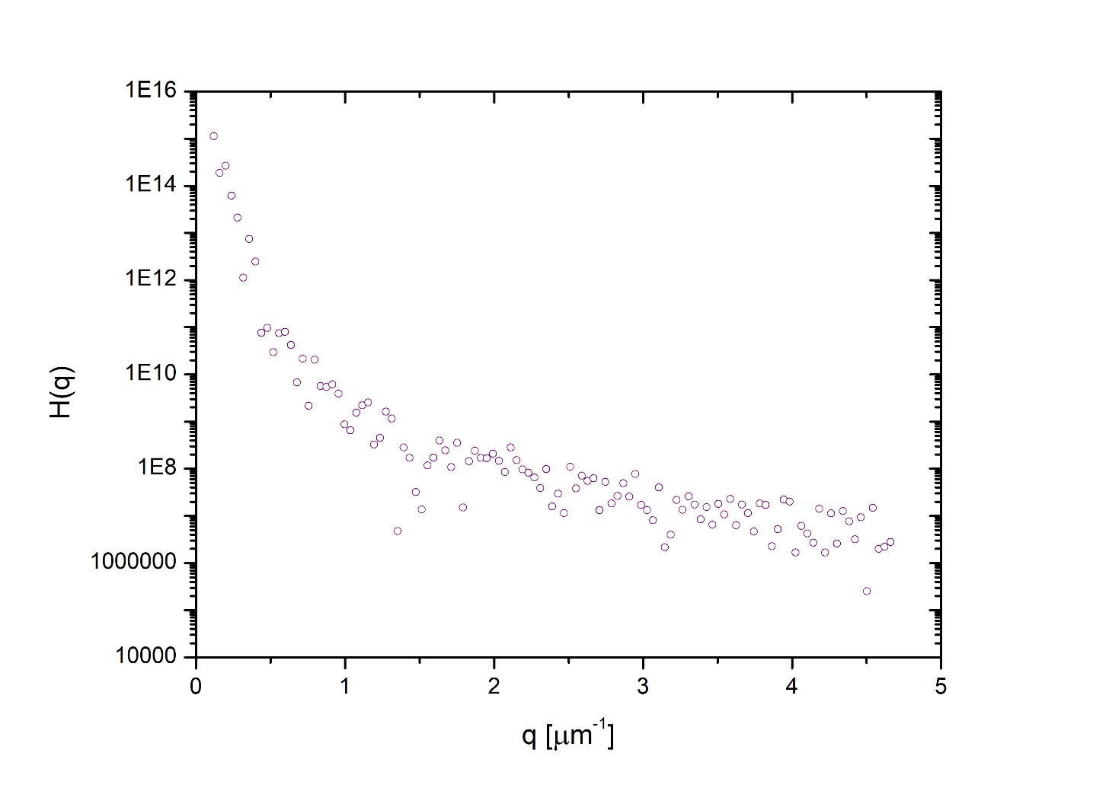
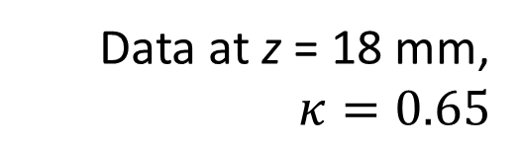
Issues
Introduction to the HNFS method
Issues during Oct. tests
Results of Oct. test
Simulations
Some considerations on signals
Data at z = 18 mm,
$$κ=0.65$$
‘HNFS meeting’ - Siano Mirko - 25/11/2019

Slide 10
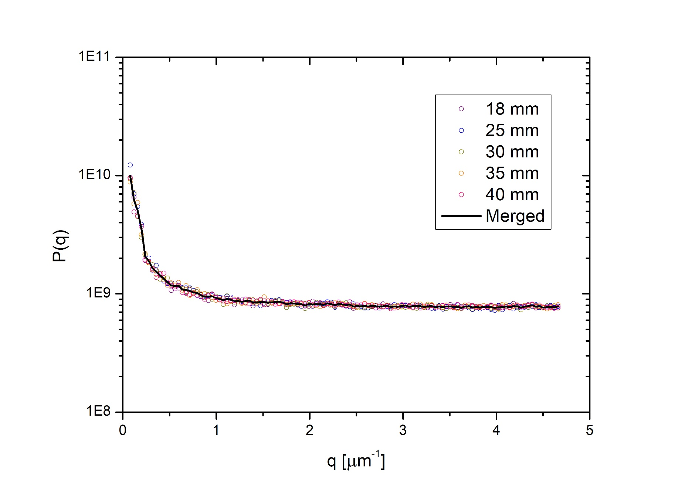
Water signal: strategy
Introduction to the HNFS method
Issues during Oct. tests
Results of Oct. test
Simulations
Some considerations on signals
Minimize fluctuations in water signal by averaging different acquisitions (horizontal profiles)
‘HNFS meeting’ - Siano Mirko - 25/11/2019

Slide 11
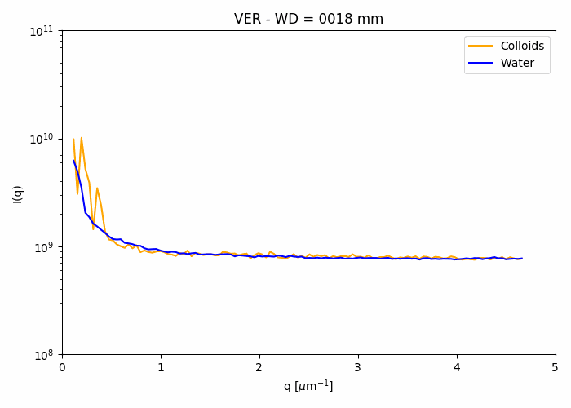
Calibration: strategy
Compute H(q) from data at larger distances (20 mm $→$ 40 mm)
Introduction to the HNFS method
Issues during Oct. tests
Results of Oct. test
Simulations
Some considerations on signals
‘HNFS meeting’ - Siano Mirko - 25/11/2019

Slide 12
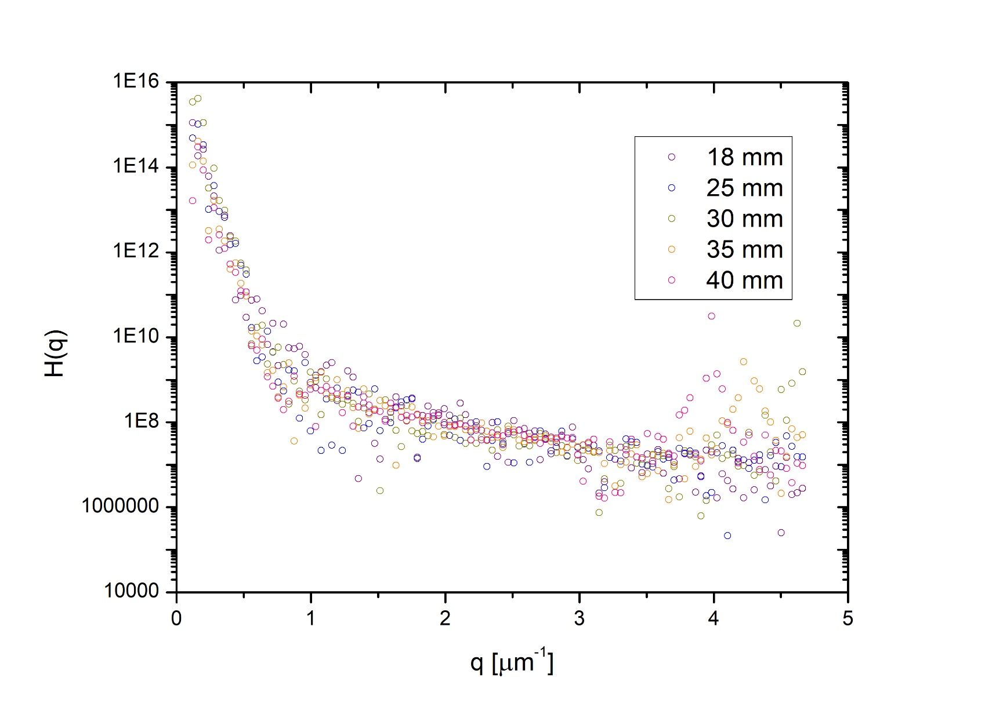
Calibration: strategy
Compute H(q) from data at larger distances (20 mm $→$ 40 mm)
Introduction to the HNFS method
Issues during Oct. tests
Results of Oct. test
Simulations
Some considerations on signals
‘HNFS meeting’ - Siano Mirko - 25/11/2019

Slide 13
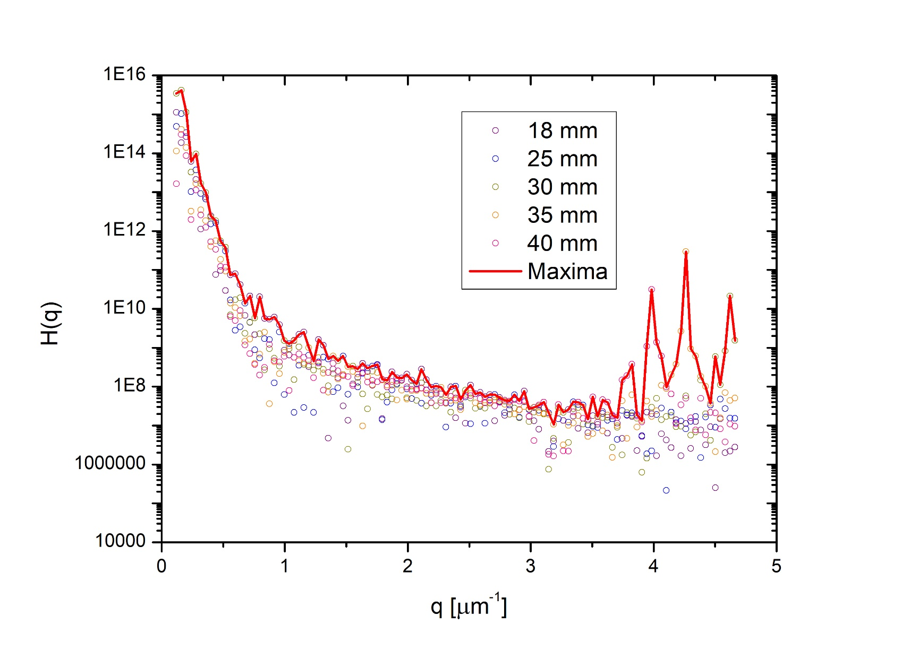
Calibration: strategy
Compute H(q) from data at larger distances (20 mm $→$ 40 mm)
Introduction to the HNFS method
Issues during Oct. tests
Results of Oct. test
Simulations
Some considerations on signals
‘HNFS meeting’ - Siano Mirko - 25/11/2019

Slide 14
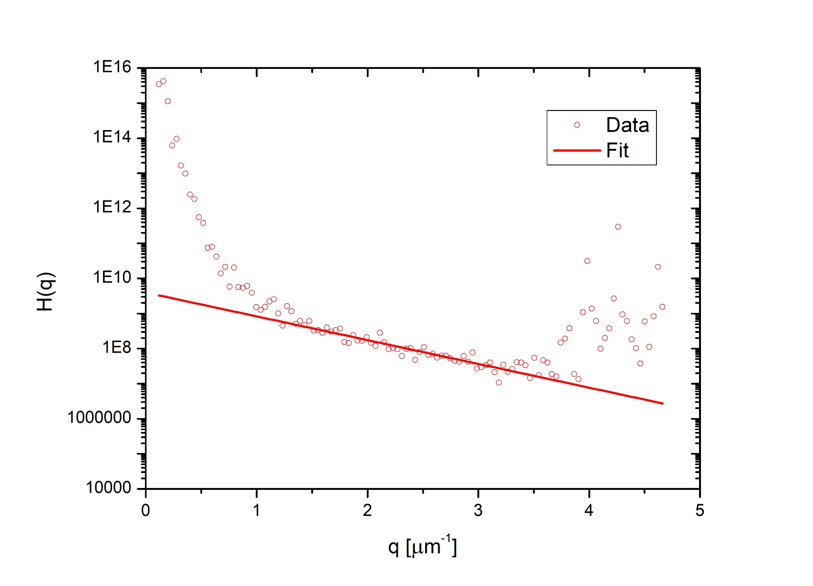

Calibration: strategy
Compute H(q) from data at larger distances (20 mm $→$ 40 mm)
Introduction to the HNFS method
Issues during Oct. tests
Results of Oct. test
Simulations
Some considerations on signals
$$q^{∗}=0.64 μm^{−1}$$
‘HNFS meeting’ - Siano Mirko - 25/11/2019

Slide 15
Results
of Oct. tests
‘HNFS meeting’ - Siano Mirko - 25/11/2019

Slide 16
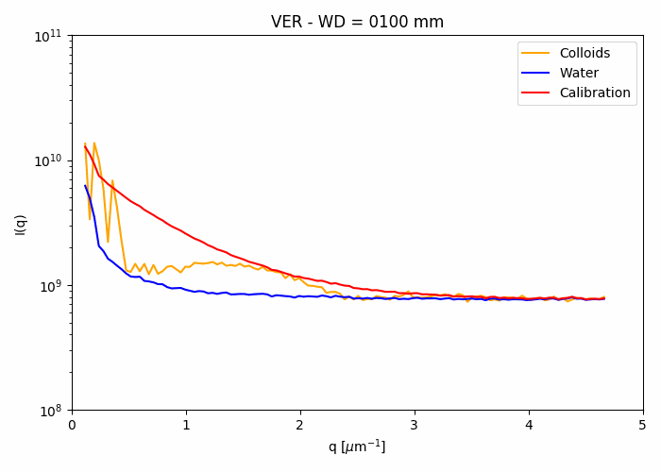
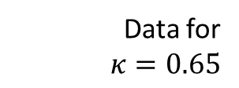
Signal overview
Introduction to the HNFS method
Issues during Oct. tests
Results of Oct. test
Simulations
Some considerations on signals
Data for
$$κ=0.65$$
‘HNFS meeting’ - Siano Mirko - 25/11/2019

Slide 17
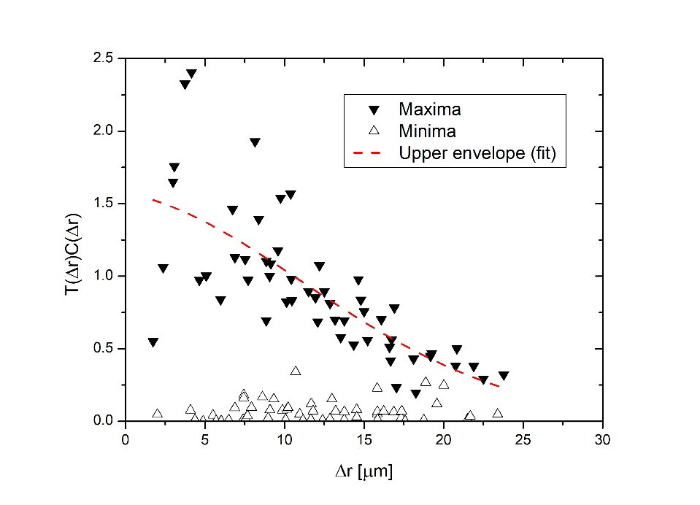
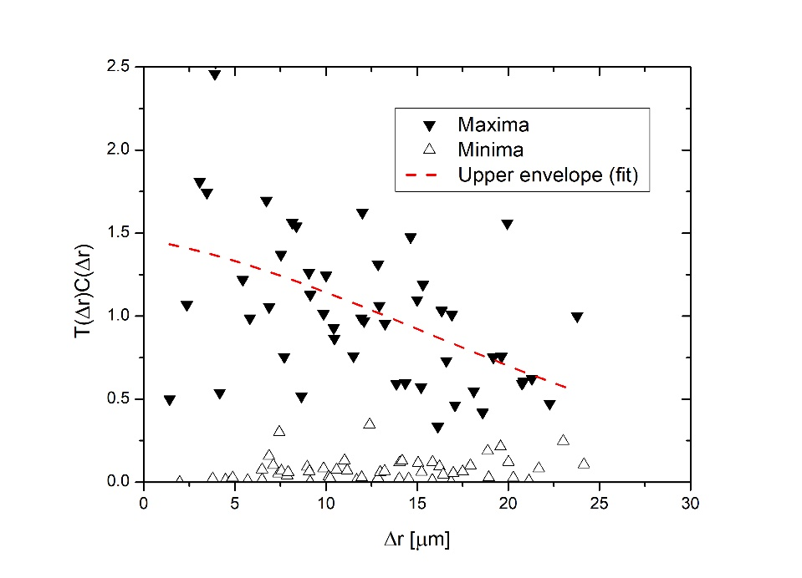
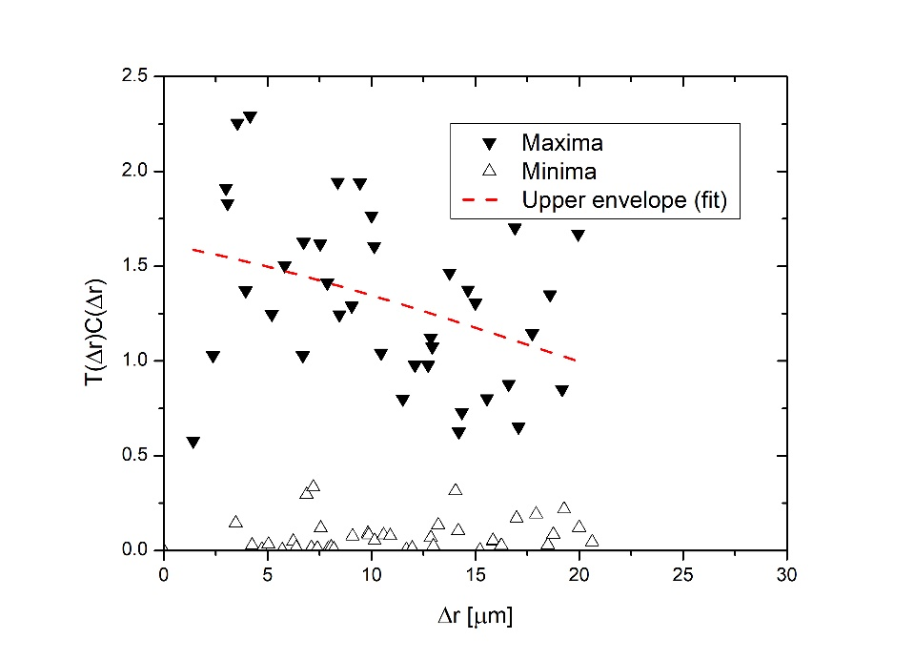







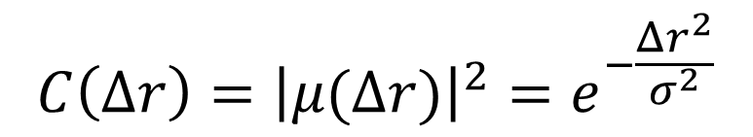
Coupling $κ=0.20$
$$C\left(Δr\right)={\left|μ(Δr)\right|}^{2}=e^{−\frac{Δr^{2}}{σ^{2}}}$$
Introduction to the HNFS method
Issues during Oct. tests
Results of Oct. test
Simulations
Some considerations on signals
$$Δθ=20°$$
$$Δθ=10°$$
$$Δθ=4°$$
$$σ=\left(18.5±1.7\right) μm$$
$$σ=\left(28.7±5.3\right) μm$$
$$σ=\left(39.1±8.9\right) μm$$
‘HNFS meeting’ - Siano Mirko - 25/11/2019

Slide 18
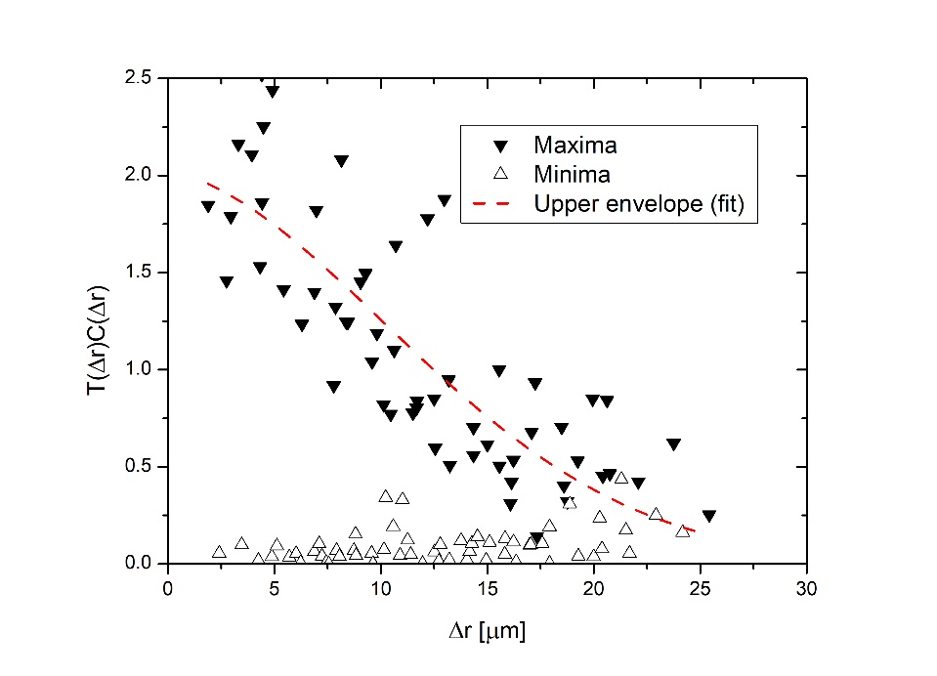
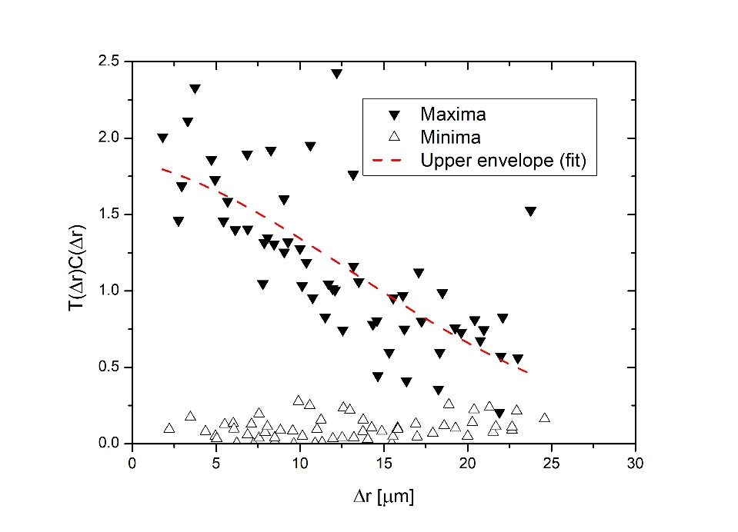
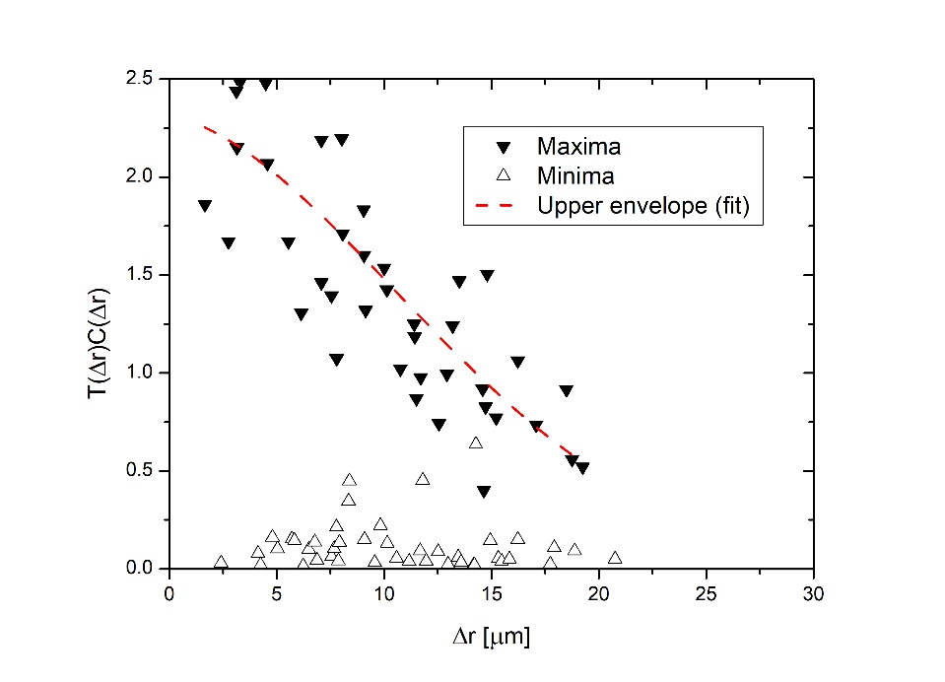




Coupling $κ=0.65$
$$C\left(Δr\right)={\left|μ(Δr)\right|}^{2}=e^{−\frac{Δr^{2}}{σ^{2}}}$$
Introduction to the HNFS method
Issues during Oct. tests
Results of Oct. test
Simulations
Some considerations on signals
$$Δθ=20°$$
$$Δθ=10°$$
$$Δθ=4°$$
$$σ=\left(16.9±1.1\right) μm$$
$$σ=\left(23.4±2.0\right) μm$$
$$σ=\left(17.4±1.6\right) μm$$
‘HNFS meeting’ - Siano Mirko - 25/11/2019

Slide 19
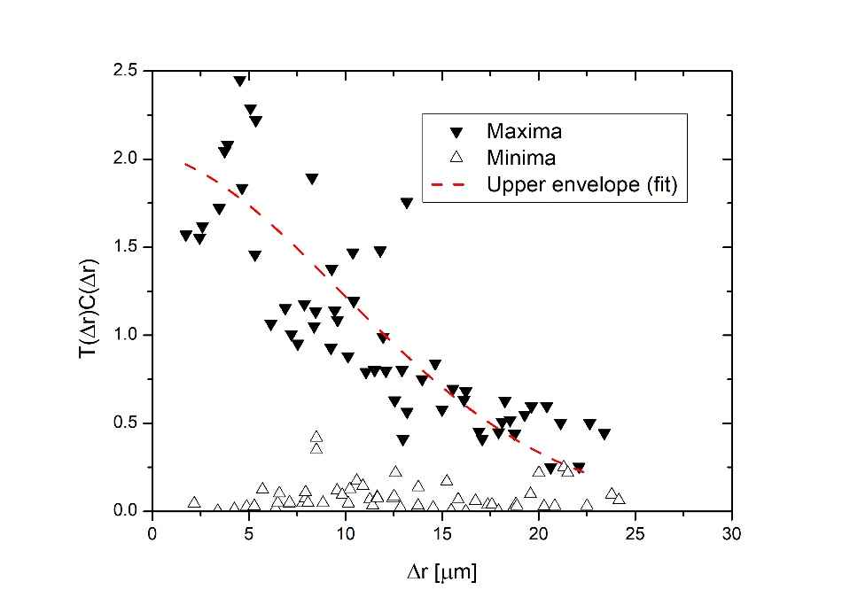
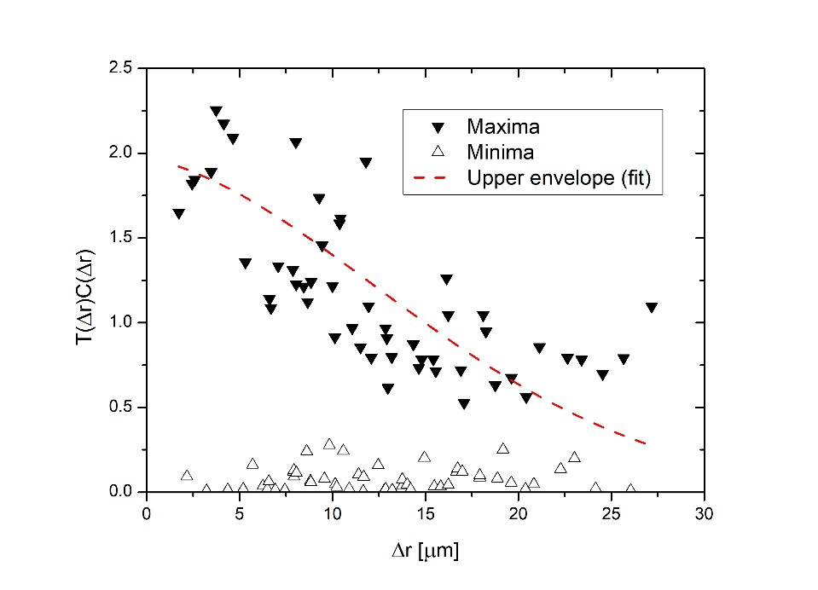
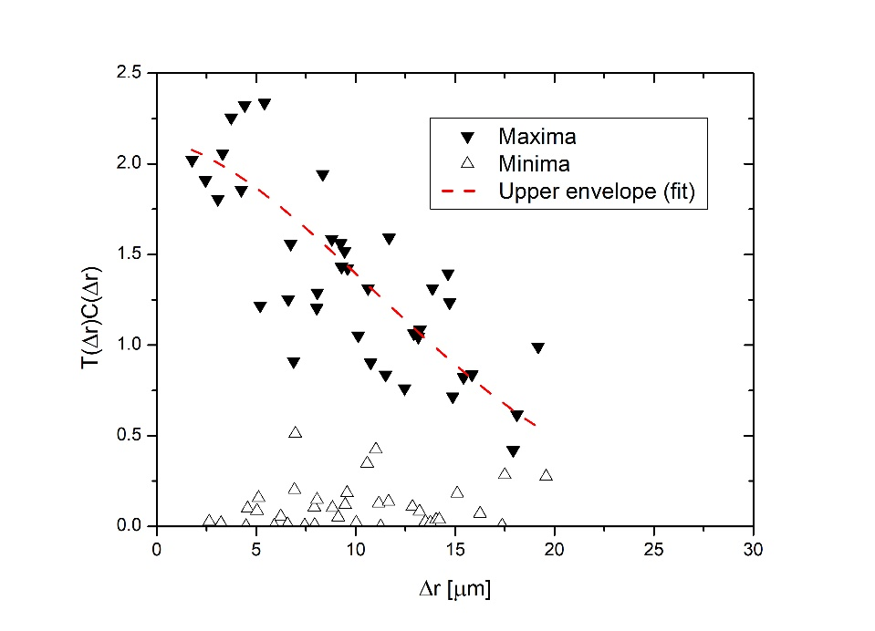




Coupling $κ=0.90$
$$C\left(Δr\right)={\left|μ(Δr)\right|}^{2}=e^{−\frac{Δr^{2}}{σ^{2}}}$$
Introduction to the HNFS method
Issues during Oct. tests
Results of Oct. test
Simulations
Some considerations on signals
$$Δθ=20°$$
$$Δθ=10°$$
$$Δθ=4°$$
$$σ=\left(15.9±1.1\right) μm$$
$$σ=\left(20.9±2.0\right) μm$$
$$σ=\left(18.8±1.7\right) μm$$
‘HNFS meeting’ - Siano Mirko - 25/11/2019

Slide 20
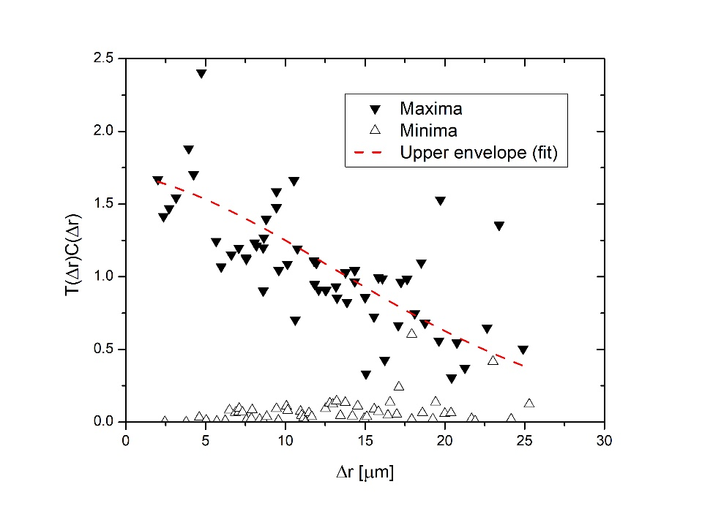
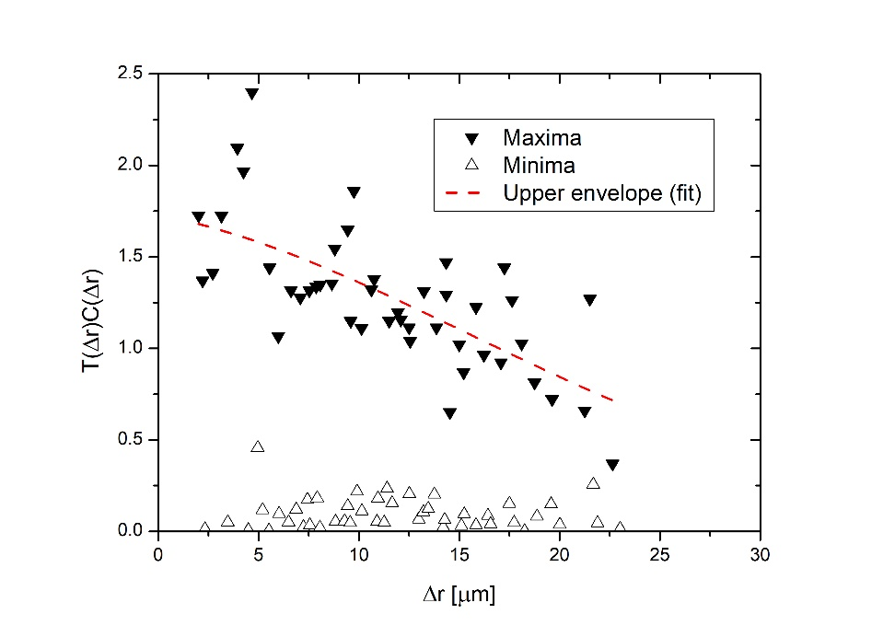
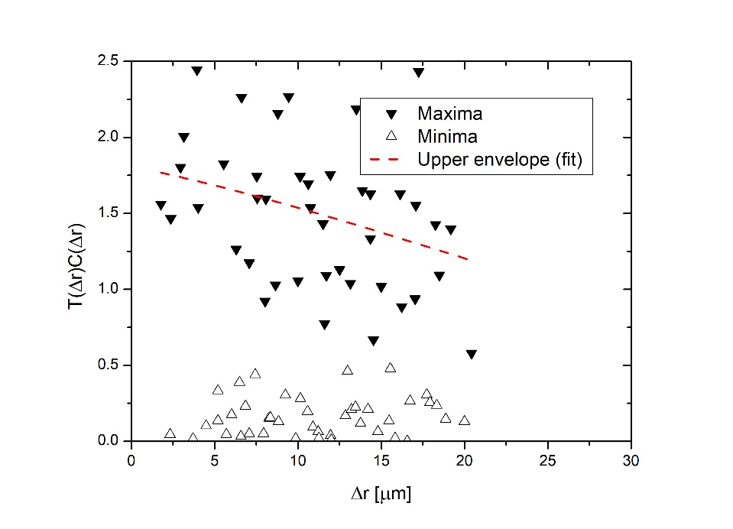




Coupling $κ=1.50$
$$C\left(Δr\right)={\left|μ(Δr)\right|}^{2}=e^{−\frac{Δr^{2}}{σ^{2}}}$$
Introduction to the HNFS method
Issues during Oct. tests
Results of Oct. test
Simulations
Some considerations on signals
$$Δθ=20°$$
$$Δθ=10°$$
$$Δθ=4°$$
$$σ=\left(23.0±2.3\right) μm$$
$$σ=\left(28.4±3.4\right) μm$$
$$σ=\left(39.2±8.5\right) μm$$
‘HNFS meeting’ - Siano Mirko - 25/11/2019

Slide 21

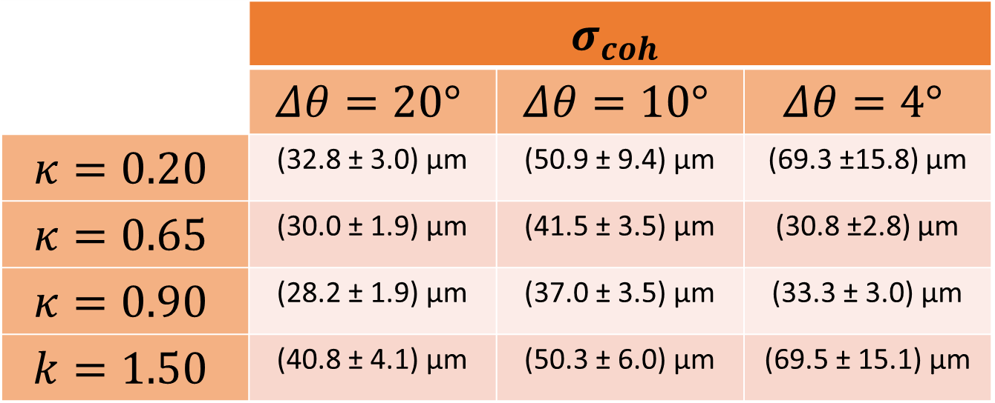
Results
$$C\left(Δr\right)={\left|μ(Δr)\right|}^{2}=e^{−\frac{Δr^{2}}{σ^{2}}}$$
$$σ_{coh}=\sqrt{π}σ$$
Introduction to the HNFS method
Issues during Oct. tests
Results of Oct. test
Simulations
Some considerations on signals
 | $$σ_{coh}$$
 | $$Δθ=20°$$ | $$Δθ=10°$$ | $$Δθ=4°$$
$$κ=0.20$$ | (32.8 ± 3.0) µm | (50.9 ± 9.4) µm | (69.3 ±15.8) µm
$$κ=0.65$$ | (30.0 ± 1.9) µm | (41.5 ± 3.5) µm | (30.8 ±2.8) µm
$$κ=0.90$$ | (28.2 ± 1.9) µm | (37.0 ± 3.5) µm | (33.3 ± 3.0) µm
$$k=1.50$$ | (40.8 ± 4.1) µm | (50.3 ± 6.0) µm | (69.5 ± 15.1) µm
‘HNFS meeting’ - Siano Mirko - 25/11/2019

Slide 22
Simulations
‘HNFS meeting’ - Siano Mirko - 25/11/2019

Slide 23
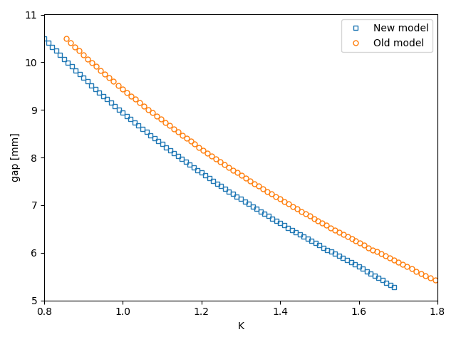
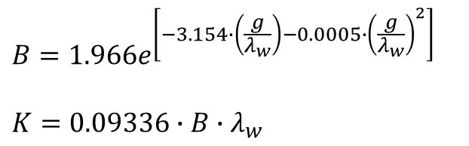
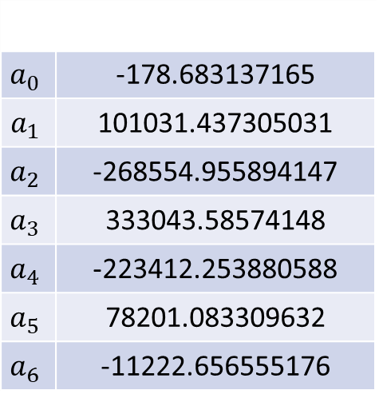
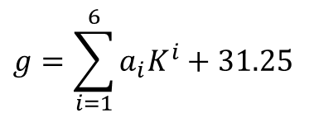
Relation gap-K
$$B=1.966e^{\left[−3.154∙\left(\frac{g}{λ_{w}}\right)−0.0005∙{\left(\frac{g}{λ_{w}}\right)}^{2}\right]}$$
$$K=0.09336∙B∙λ_{w}$$
Old model
Introduction to the HNFS method
Issues during Oct. tests
Results of Oct. test
Simulations
Some considerations on signals
$$g=\sum_{i=1}^{6}{a_{i}K^{i}+31.25}$$
$$a_{0}$$ | -178.683137165
$$a_{1}$$ | 101031.437305031
$$a_{2}$$ | -268554.955894147
$$a_{3}$$ | 333043.58574148
$$a_{4}$$ | -223412.253880588
$$a_{5}$$ | 78201.083309632
$$a_{6}$$ | -11222.656555176
New model
‘HNFS meeting’ - Siano Mirko - 25/11/2019

Slide 24
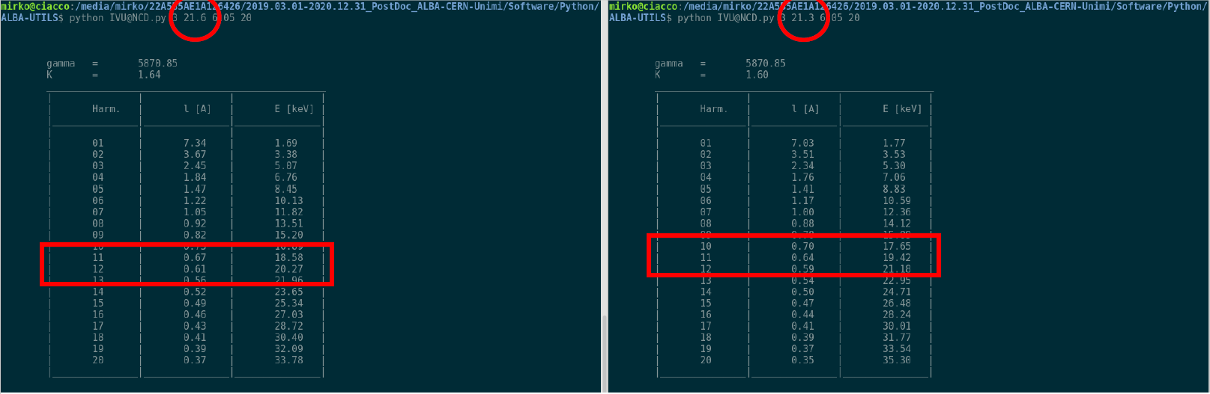

Dependence on $λ_{w}$
Introduction to the HNFS method
Issues during Oct. tests
Results of Oct. test
Simulations
Some considerations on signals
‘HNFS meeting’ - Siano Mirko - 25/11/2019

Slide 25
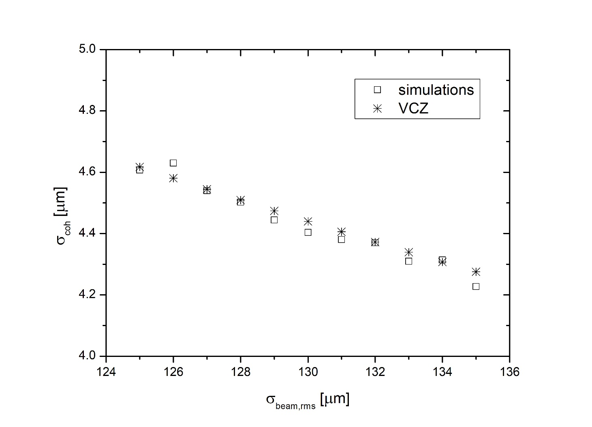
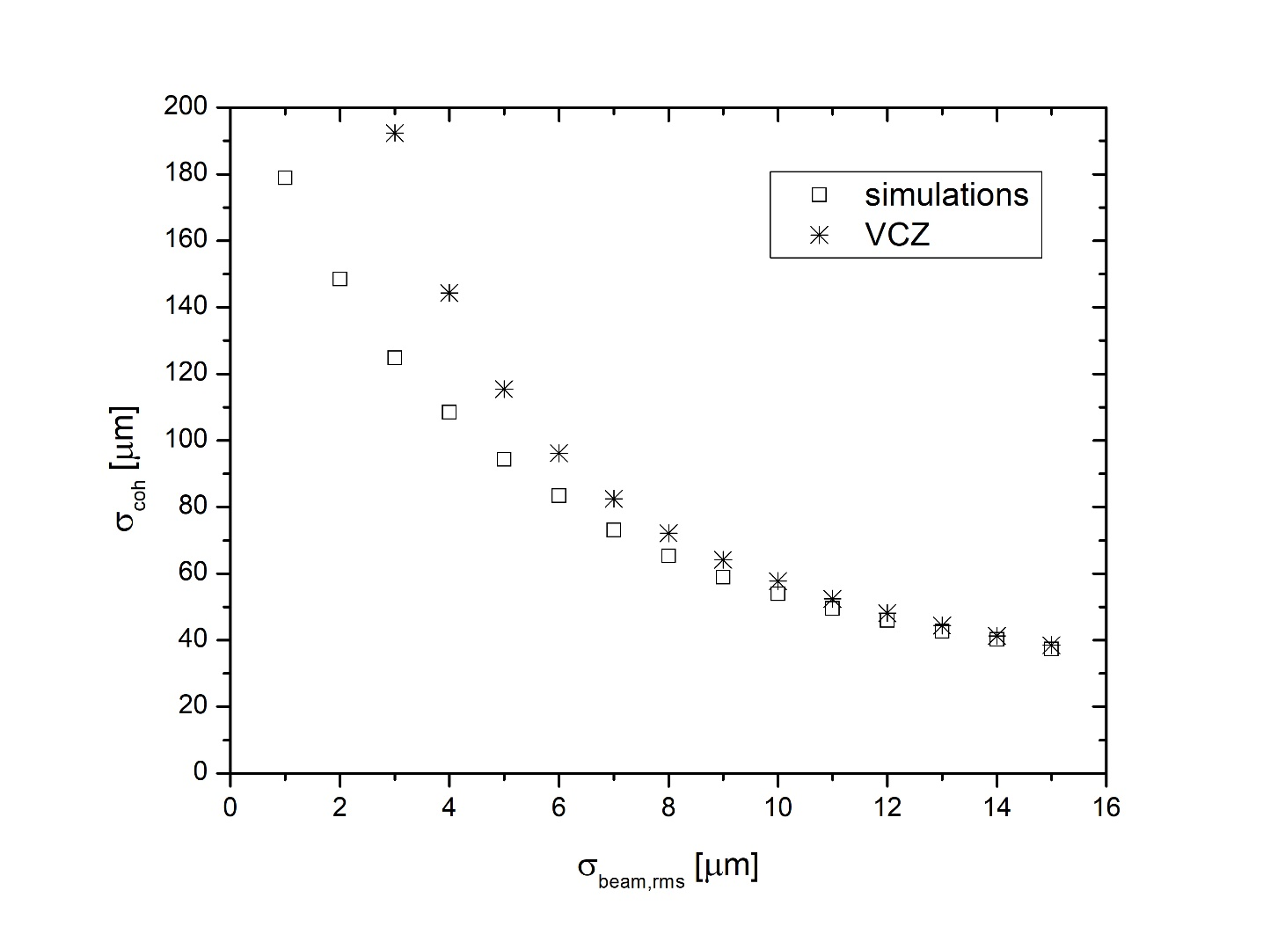
Results of simulations
horizontal
vertical
Introduction to the HNFS method
Issues during Oct. tests
Results of Oct. test
Simulations
Some considerations on signals
‘HNFS meeting’ - Siano Mirko - 25/11/2019

Slide 26
Some considerations
on signals
‘HNFS meeting’ - Siano Mirko - 25/11/2019

Slide 27
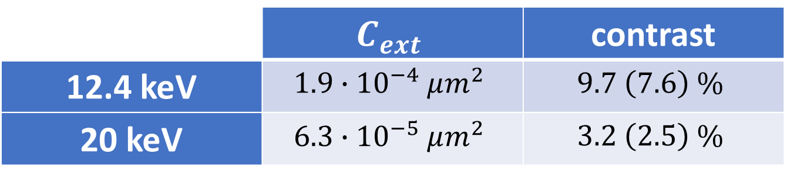






Scattered signal
$$n$$
$$I_{0}$$
$$I(l)$$
$$I\left(l\right)=I_{0}e^{−nC_{ext}l}$$
Introduction to the HNFS method
Issues during Oct. tests
Results of Oct. test
Simulations
Some considerations on signals
contrast of heterodyne speckles
$$nC_{ext}l$$
$$l$$
 | $$C_{ext}$$ | contrast
12.4 keV | $$1.9∙{10}^{−4} μm^{2}$$ | $$9.7 \left(7.6\right) \%$$
20 keV | $$6.3∙{10}^{−5} μm^{2}$$ | $$3.2 \left(2.5\right) \%$$
‘HNFS meeting’ - Siano Mirko - 25/11/2019

Slide 28

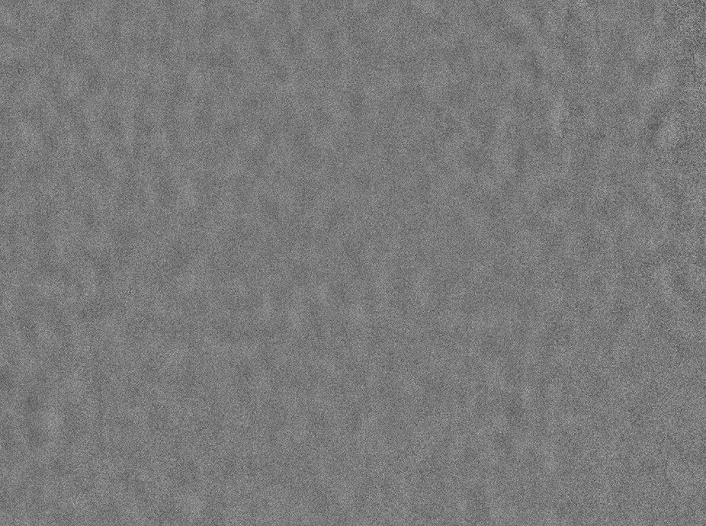
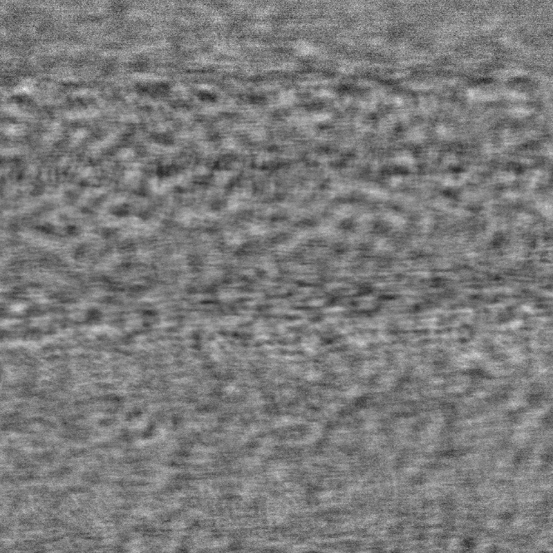
CCD performance
Introduction to the HNFS method
Issues during Oct. tests
Results of Oct. test
Simulations
Some considerations on signals
Basler, 50 ms
20 keV, z = 500 mm
Basler, 50 ms
12.4 keV, z = 500 mm
FReLoN, 5 ms
12.4 keV, z = 500 mm
 | Basler | FReLoN | PCO
Full well capacity | 7000 e⁻ | 320000 e⁻ | 40000 e⁻
Dynamic range | 57.1 dB | >80 dB | 72.0 dB
SNR | 38.2 dB (1.2%) | 54.8 dB (0.18%) | 45.8 dB (0.5%)
‘HNFS meeting’ - Siano Mirko - 25/11/2019

Slide 29
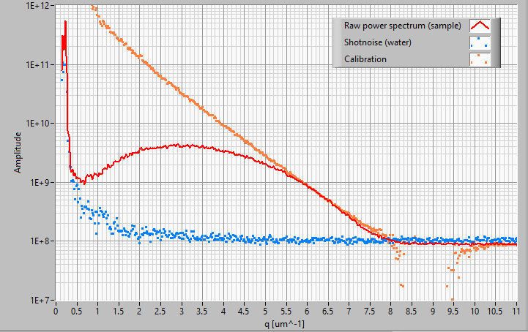
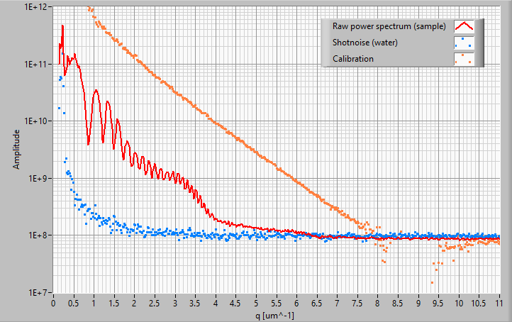
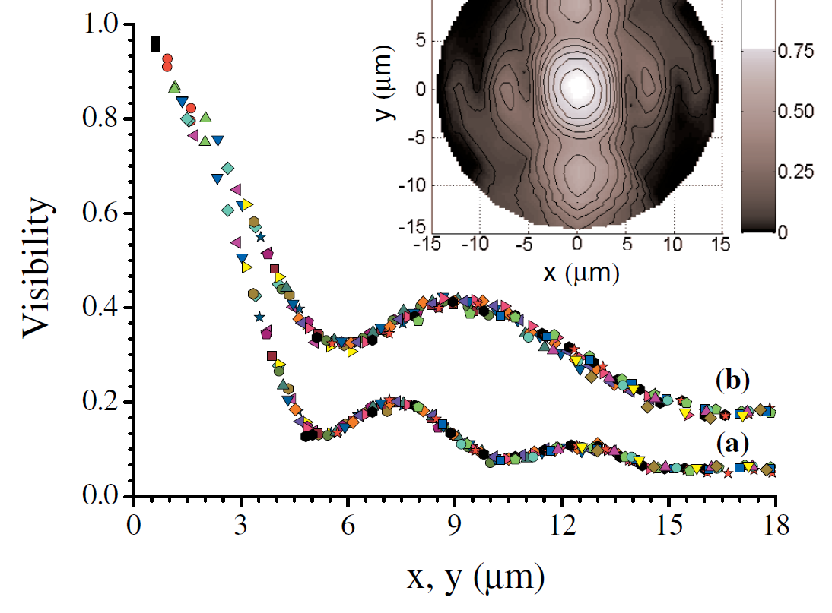
CCD performance
FReLoN,
12.4 keV,
ET = 5 ms,
data at 5 mm
FReLoN,
12.4 keV,
ET = 5 ms,
data at 500 mm
Introduction to the HNFS method
Issues during Oct. tests
Results of Oct. test
Simulations
Some considerations on signals
FReLoN,
12.4 keV,
ET = 5 ms,
coherence measurements
‘HNFS meeting’ - Siano Mirko - 25/11/2019

