Slide 1
ICM activities: LHC, SPS, CPS
G. Pigny, P. Prieto, L. Zygaropoulos, A. Gutierrez, J. De La Gama,
N. Chatzigeorgiou, S. Blanchard, A. Rocha, R. Ferreira, P. Wien
3rd of August 2020

Slide 2
Performed activities
W31 (Pablo, Abel N. & FSU)
LHC Planning and Coordination:
  LS2 Planning Updating and Readjustment: Re-scheduling and status updating of on-going and completed tasks, including new updated Burndown Chart.
  LS2 BV Commissioning Planning Adjustment: Re-scheduling of foreseen beam vacuum commissioning actions in view of the new LHC cooldown-powering schedule.
  BWS Cabling Request Modification: Addition of 1x new cable for the new VPI configuration resulted from the recent BWS sectorizations (LSS4L).
LHC DB (VACCO-3847):
  LSS4R: VGRB and VGIA missing in sector F5R4.B. Solved, both gauges now in 'Use', however unable to change Type for VGRB from DB editor.
  LSS8L: SVCU DP Parameters inverted between blue and red beams valve controllers. Solved, DP parameters re-inverted, now properly configured.
  TI2-TI8: Aesthetics changes, sector names shortening, no need for “vacsec” extension (i.e. 1205, is enough) Solved, new names only include transfer-line's name and sector, (i.e "TI2.1205")
  HL-LS2 Projects: Missing VR_GT objects for recently added TPGs, mainly for new LS2 projects, requiring declaration and proper configuration. Already started for TCLD 11L2, currently on-going.

Slide 3
Planned activities
W32/W33 (Pablo, Abel N. & FSU)
LHC BV Commissioning Phase:
  LSS8R: First contact with field commissioning, teach and review existing procedures. Perform full commissioning of LSS8R (Gauges, Pumps, Valve Chains, Interlocks, NEG, Solenoids, etc.) on W33.
LHC DB (VACCO-3847):
  ITL: Pending interlock corrections, configurations which need rollbacks after BVO’s LS2 interventions (pump and gauges replacements).
  ALICE: VGRB.42.1L2.X will be relocated to the opposite side of the IP2. New position will be identical with the sector valve. No VGRB.42.1R2.X in Layout DB, gauge shall be introduced manually in VacDB.
  TDIS C4R8.X: Wrong itl configuration, using pumps instead of new relay objects. Missing VA_RI objects, which need to be added and VVGS Prev./Next configuration modified.
  BGC C5L4.B/B5L4.B: TPG Channels inversion at DB level, needs to be corrected and gauges properly assigned to their corresponding controller.
  ARC78: to remove the sectorization of the TCLD: 4 x VGPB, 2 x sector valves, 2x VPNNG and 1 x VGRB Following BVO’s request
  LSS7: Additional NEG cart. in LSS7 based on the ref. ECR. Potential need to add them manually
  Other minor issues, listed under the JIRA ticket VACCO-3847.

Slide 4
BV Commissioning Plan
ICM Commissioning Phase Activities
Beam Vacuum Controls Commissioning Activities | Group | Resources Names | Duration | Start | Finish
[LSS1] Point 1 Beam Vacuum Controls Commissioning Activities | ICM-LSS | BVO,Pablo P.,Abel N.,FSU | 10 days | Mon 23/11/20 | Mon 07/12/20
[LSS2] Point 2 Beam Vacuum Controls Commissioning Activities | ICM-LSS | BVO,Pablo P.,Abel N.,FSU | 10 days | Mon 09/11/20 | Mon 23/11/20
[LSS3] Point 3 Beam Vacuum Controls Commissioning Activities | ICM-LSS | BVO,Pablo P.,Abel N.,FSU | 10 days | Mon 26/10/20 | Mon 09/11/20
[LSS4] Point 4 Beam Vacuum Controls Commissioning Activities | ICM-LSS | BVO,Pablo P.,Abel N.,FSU | 10 days | Mon 24/08/20 | Mon 07/09/20
[LSS5] Point 5 Beam Vacuum Controls Commissioning Activities | ICM-LSS | BVO,Pablo P.,Abel N.,FSU | 10 days | Mon 28/09/20 | Mon 12/10/20
[LSS6] Point 6 Beam Vacuum Controls Commissioning Activities | ICM-LSS | BVO,Pablo P.,Abel N.,FSU | 10 days | Mon 12/10/20 | Mon 26/10/20
[LSS7] Point 7 Beam Vacuum Controls Commissioning Activities | ICM-LSS | BVO,Pablo P.,Abel N.,FSU | 10 days | Mon 14/09/20 | Mon 28/09/20
[LSS8] Point 8 Beam Vacuum Controls Commissioning Activities | ICM-LSS | BVO,Pablo P.,Abel N.,FSU | 10 days | Mon 10/08/20 | Mon 24/08/20

Slide 5
Performed activities
W30/31 (Rodrigo)
VELO
Checked and corrected Josef’s modifications of new VELO ACP28 dry pumps (to remove on-board electronics)
Reconfigured the drive in the control crate for proper output for the new motor (170V@80Hz)
Setup is currently installed in B113. We will perform load tests with the new configuration for a few weeks before anything is installed in the VELO pit in LHCb
LHC
Debugged and fixed Profibus mobile related problems
Checked and corrected issue with missing VPP current measurement for some groups after power cut
S7200 Based VPG Problems
Found the conditions to replicate the problem reported by BVO (plus other dangerous situations that might occur)
Currently going over the PLC code to implement fixes for the above problems

Slide 6
Performed activities
W30/31 (Lampros, Alexandre)
Commissioning Sector 12: 70% completed
  Deadlines: w31 for VPGF; w32 for sub-sector gauges, valves and CRYO alarms
  All VPGFs tested
  Piezo gauges calibration P1 right side
  Gauges for IV & BV tested up to 24L2
  Valves tested up to 33R1
Functional tests of VPGFs Sector 23
  All VPGFs of Sector 23 were tested
  Replacement of ACT250R controller at 23R2.M, 24L3 pending
  Installed local crates & started Inner triplets VPGs, P2 right side

Slide 7
Performed activities
W30/31 (Lampros, Alexandre & FSU)
DLM support:
  Inner triplets at Point 5: many issues were found. Fixed and started 3 VPGs.
  15L8 VPG: Stacked VPP. Circuit breaker in the Distribution panel was tripped. Intervention with TS/EL.
  15R7 VPG: ACT250R controller replacement.
  Point 8 Inner triplets: VPGs were swapped at SCADA level. Rodrigo fixed the problem in SCADA and VacDB.
Rack closing/IP2X campaign: 90% completed
  Still missing UA27 (not installed yet) and a final check.
Local Crates production:
  Inspection for non conformities & repairs. FSU prepared 6 pcs in order to finish LHC installation.

Slide 8
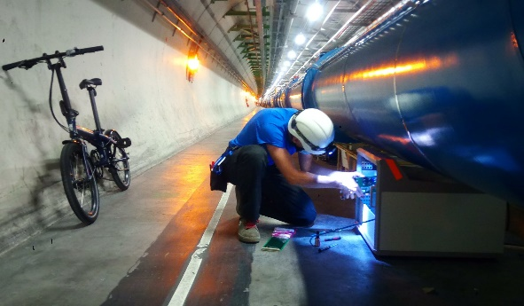
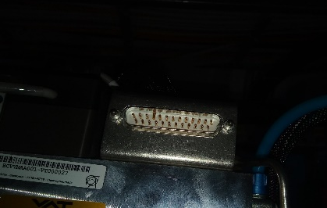
Performed activities
W30/31 (Lampros, Alexandre & FSU)
Damaged connector on multivalve block of 2R5.M
Commissioning Sector 12
8

Slide 9
Planned activities
W32/33 (Lampros, Alexandre & FSU)
Finish Commissioning Sector 12: Gauges, Valves & CRYO Alarms
Start commissioning Sector 78

Slide 10
VPGF, RadTol electronics, Gauge controllers plan
Fixed Pumping Group Controllers / R2E Electronics Replacement Schedule
2019 |  |  |  |  |  |  | 2020
June | July | August | September | October | November | December | January | February | March | April | May | June | July | August
Octant 3
 |  | Start Octant 4
 |  |  | Octant 4
 |  |  |  | Octant 6/7
 |  |  |  |  | Octant 6/7
 |  |  |  |  |  | TESTS
 |  |  |  |  |  |  | Octant 5
 |  |  |  |  |  |  |  | Octant 8
 |  |  |  |  |  |  |  |  | COVID19
 |  |  |  |  |  |  |  |  |  | COVID19
 |  |  |  |  |  |  |  |  |  |  | COVID19
 |  |  |  |  |  |  |  |  |  |  |  | P1 LSS ARC 12
 |  |  |  |  |  |  |  |  |  |  |  |  | P2 LSS L RE22 HW tests
 |  |  |  |  |  |  |  |  |  |  |  |  |  | P2 LSS R RE28 SCADA up HW tests
Finish S12 commissioning
Start S78 commissioning

Slide 11
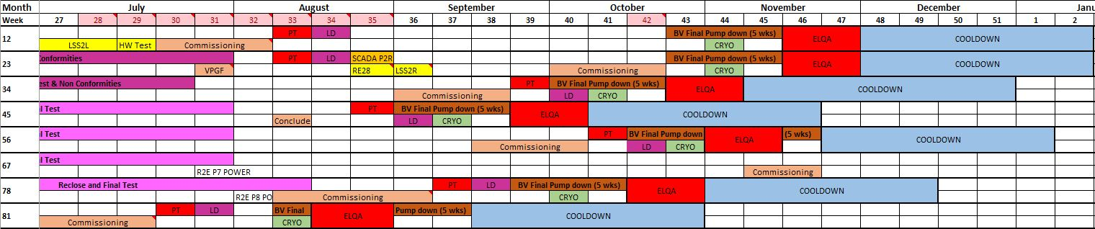
IV Commissioning planning
Commissioning S12
Functional tests VPGF S23
Commissioning S78

Slide 12
LHC Burndown Chart
W30/W31 (Pablo, Lampros, Nikos)
Beam Vacuum, Experiments, Insulation Vacuum, R2E:
\\cern.ch\dfs\Departments\TE\Groups\VSC\ICM\LS2\LHC\-. General Documentation\0. Planning

Slide 13
Performed activities
W30/31 (Abel G.)
SPS-BA2:
  VPIA_20601 in sparking (Fischer connector damaged at rack level)
SPS-LSS2:
  marking all the positions in LSS2 with EN-EL to prepare the cabling campaign
SPS-BA5:
  VPIA_53520 (Sparking in Agilent happening randomly every few hours: solved after replacement of all the local cables)
TI8 (LHC side):
  VPIAL_87005 (high current in ion pumps chain, pump damaged)

Slide 14
Performed activities
W30/31 (Abel G.)
ISOLDE:
  Cabling and testing DUO 11 tri-phase primary pump
REX:
  Consolidation of TRP14 turbo-pump from Alcatel to Pfeiffer (pulling 15m cable from rack to pump with 2 boxes Pfeiffer solution)
MEDICIS:
  Closing of VPP crates following electrical safety consolidation
  RDA3 update for CMW publication (done by Andre)

Slide 15
Performed activities
W30/31 (Abel G.)
PS complex (L3, L4, PS, PSB, TT2, LEAR) and ISOLDE complex (ISOLDE, REX, HIE-ISOLDE, MEDICIS):
  Leave the machines in safe mode and turn all the power outlets off in view to the AUG test. Turn them back on once tests were finished (w/ J. Ferreira)
Fix some issues linked to the AUG tests in PSB:
  2x VVS DP MUX cards broken
  Several TPG300 lost the configuration
  BTP.VGP01 pumping group not reachable

Slide 16
Thank you !

