Slide 1
Report: 28
Activity: SPS
Chiara Pasquino, Anthony Harrison
Meeting 03/08/2020

Slide 2
Activities of the past 2 weeks
BA1:
  TT10 passage pumpdown; Postponed by EN-ACE to September.
  Check of the sector valves in 1- : small CA issues, all working now;
BA2:
  ZS reconfiguration – pumpdown and NEG activation; postponed to september, after cabling campaign;
  MSE exchange – bakeout; leak found on a weld, new tank under preparation at surface: waiting for a window within the cabling campaign where the exchange could be done;
  Pumpdown of 212 & 220;
  Radiation damaged cables for penning gauges endorsed by LS2C;
BA3:
  321 reinstallation;
  800MHz cavities installation;
  RF Cavity 1 – under RF conditioning;
BA4:
  QF_43010 jack exchange: unforeseen but completed, 461 leak tight, ion pumps flashing;

Slide 3
Activities of the past 2 weeks
BA5:
  Material preparation: MDHD modification, BTV acceptance tests, TIDVG5 leak tight, MKDH surface preparation;
  561 pumpdown;
  Marking of the vacuum supports for the new line: few conflicts with existing coffret solved.
BA6:
  QDA_61910 jack exchange: unforseen, activity completed.
TT-60/66 -TI2 – TI8:
  Pumpdown of TI8 line - 1805;
  TI2 Alignement campaign: first vertical measurement of the quadsTT60 – TT66 done, no mechanical disconnection needed;
  TT66 magnet reconnection after jacks replacement;
AWAKE:
  Issue with an interlocking pirani on the plasma cell: to be checked at next access, e-line operation resumed.

Slide 4
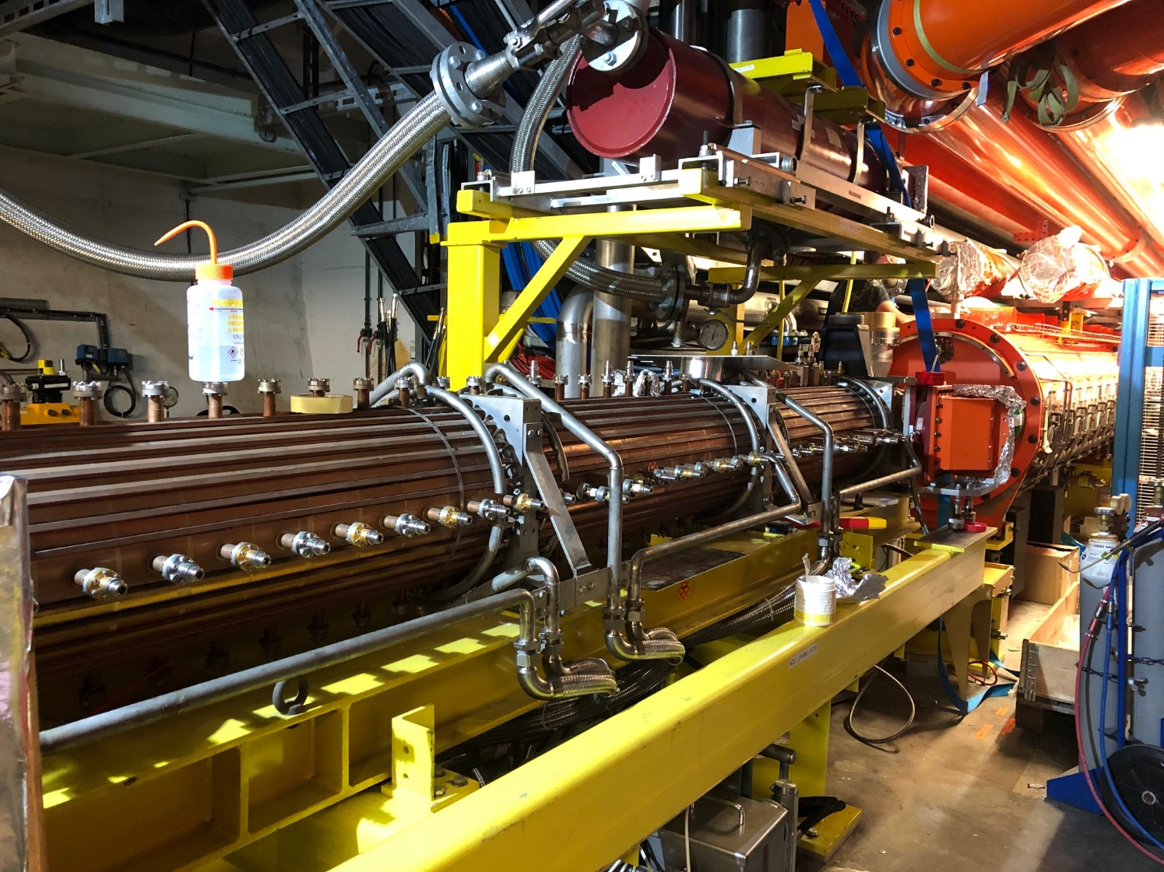
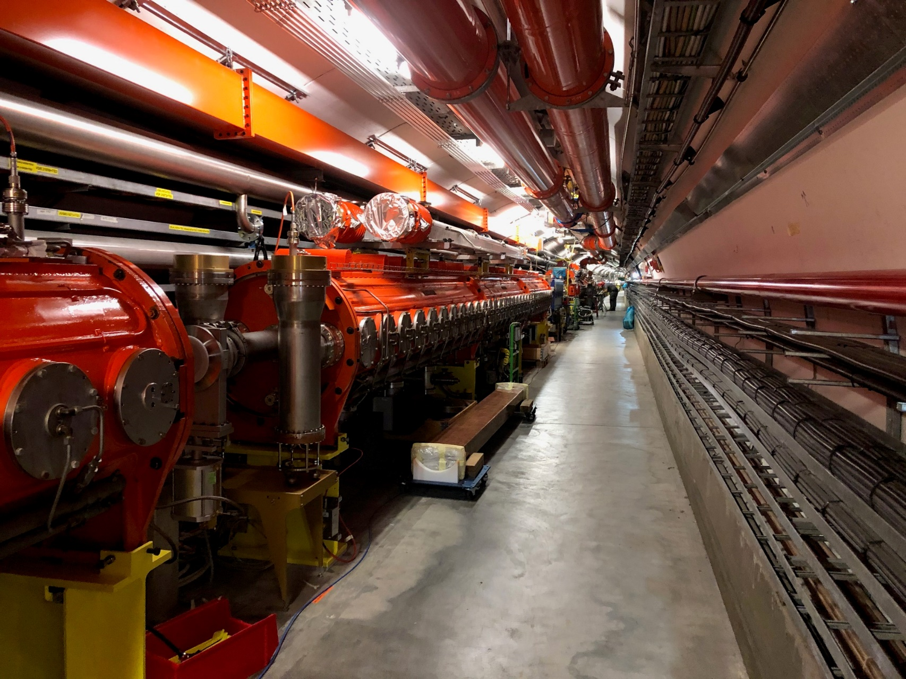
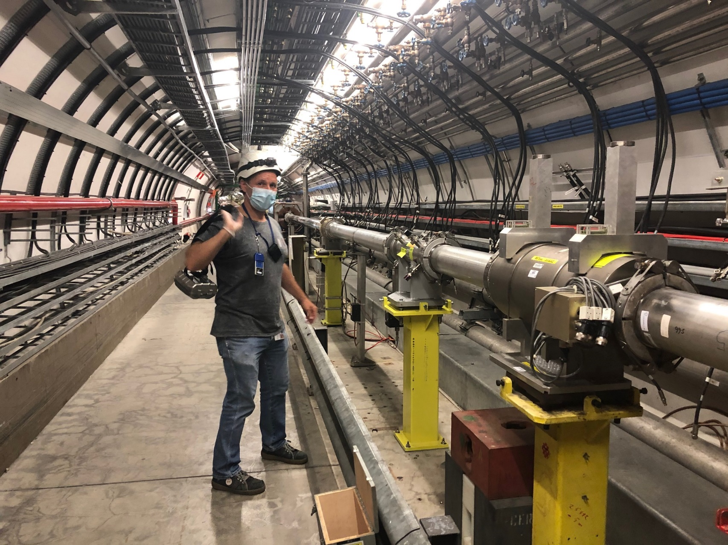
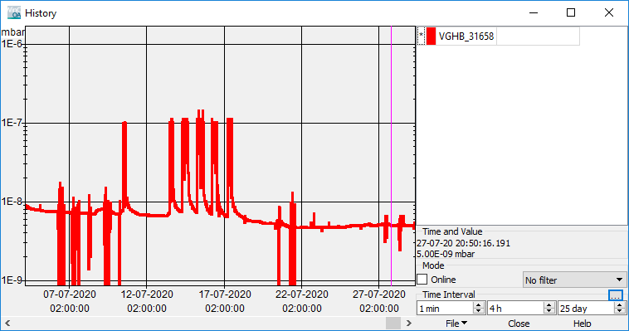
News from LSS3
First RF conditioning
5 cm!!

Slide 5
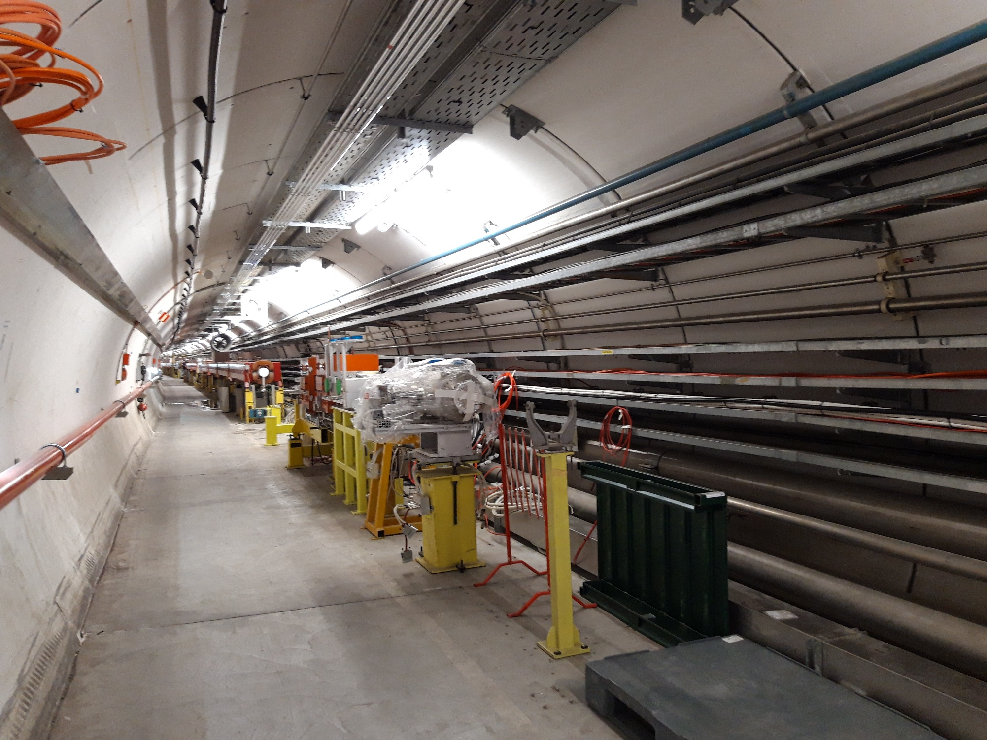
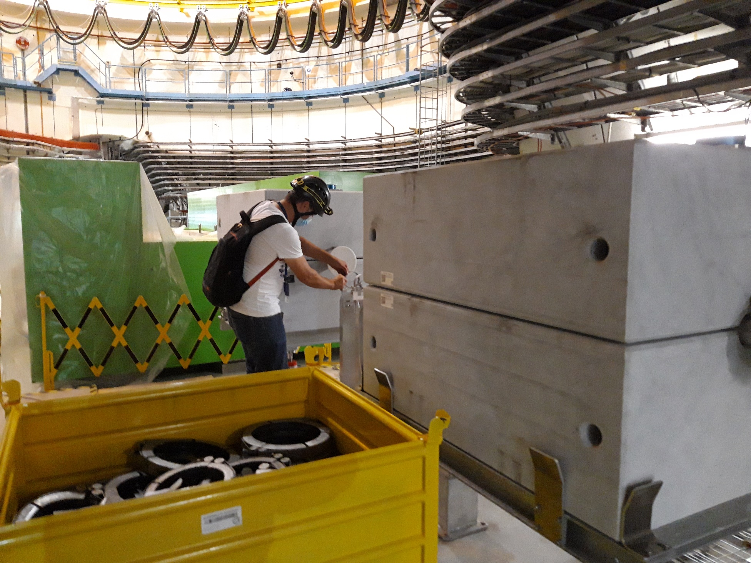
News from LSS5
Equipments and magnet being installed. Few delays expected:
QFA_518 – busbars modifications;
FWS – issue with insulation of the forks cables --> possible delayed installation;
BTV – leak tightness;
5 cm!!

Slide 6
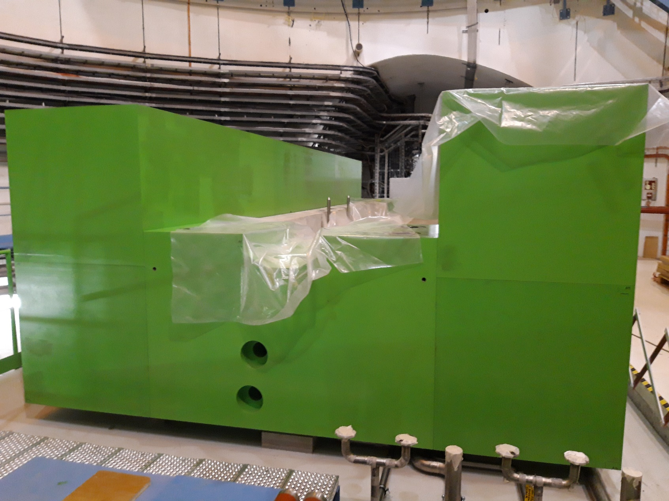
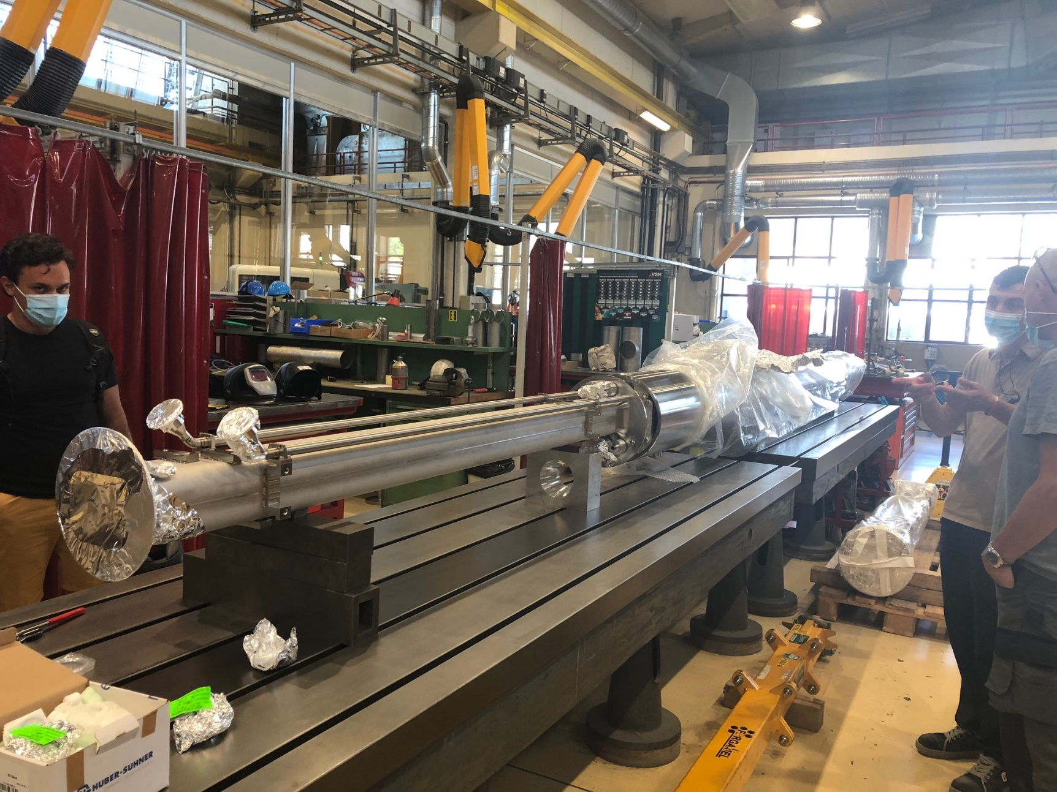
News from LSS5
TIDVG5 readiness:
Shielding installed;
TIDVG5 vacuum chamber fully assembled and leak tight;
Acceptance test + bake out cycle foreseen beginning of September.
5 cm!!

Slide 7
Pressure map
Vacuum sector

Slide 8
PLANNING OVERVIEW

Slide 9
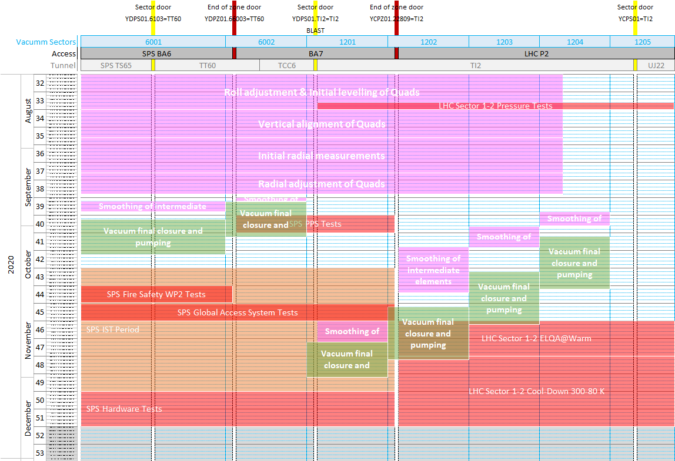
TI2 alignment campaign: approved strategy
Approved at the LS2C: planning to be updated after the alignment measurements are completed (mid September).
Clash for the access to TI2 from BA7 with the PPS tests to be addressed
Clash for the access to TI2 from LHC P2 with the ELQA and cool-down of sector 1-2 to be addressed
Courtesy of J. Coupard

Slide 10
DASHBOARDS - 2020

Slide 11
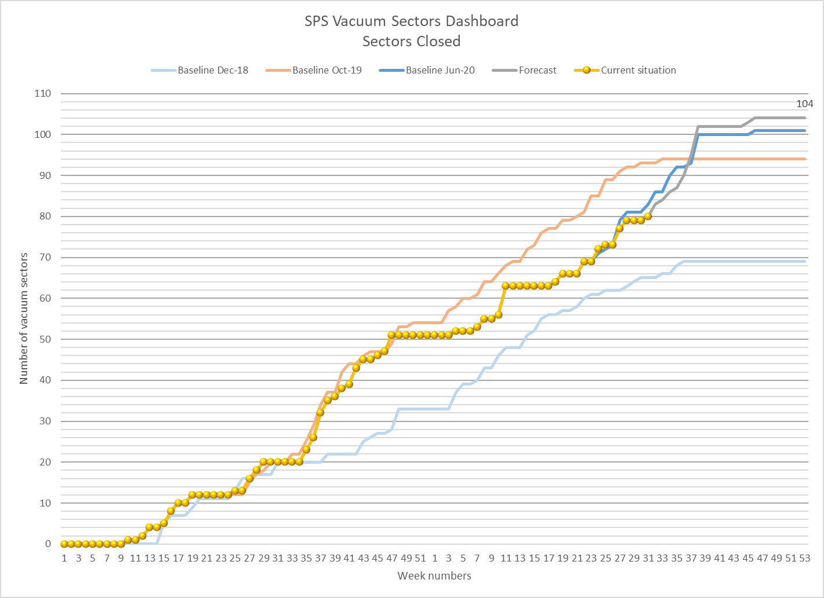
DASHBOARDS - 2020
Steep curve in august – september
Courtesy of
A. Grande Mallavia

Slide 12
Activities of the next 2 weeks
BA2:
  MSE exchange?
BA4:
  Coldex Y chambers reinstallation;
BA3:
  800MHz cavities & pickup installation;
BA5:
  Material preparation;
  LSS5 VSC support drilling;
  Installation of sector valves and chambers;
TT66:
  Magnets reconnection;

Slide 13
Resources distribution
LSS5 reinstallation: Tony
LSS3 reinstallation: Jarmo
Arcs pumpdown and leak detection: Jarmo, Anthony, aC Coating & 40/30;
Acceptance test & lab activities: Tony;
Jobs follow-up & ECR update (Design & Production): Chiara & Tony;
Stock check and purchasing: Chiara & Tony.

Slide 14
Thank you !

Slide 15
Pumpdowns
Lengthy pumpdowns (ion pump flashing) – arcs/DS are behaving all similarly.

Slide 16
Pumpdowns
Lengthy pumpdowns in LS1 too, very similar pumpdown considering we are comparing 1 arc with an half arc (double pumping speed).
For info: 510 – LS1 1 year exposure; 411 – LS2 3 months exposure;
Longer exposure --> difficult flashing.

Slide 17
Pumpdowns – aC coated Vs uncoated sectors
(once on ion pumps)

Slide 18
Pumpdowns - summary
Pumpdown on TMPs is strongly dependent on:
  Exposure time to air:
    Location of the openings, length of the intervention;
    It strongly affects the behaviour of the ion pumps during flashing; → is becoming a limiting factor (all SPS pumping groups are in use at the minute).
    New ion pumps shows a more ‘stable’ behaviour to flashing, but still the process is lenghty in time.
For long exposures (LS1 and LS2), pumpdowns are very similar for coated and uncoated sectors;
Pressure recovery once on ion pumps, is very similar for coated and uncoated sectors, after long exposure.
After LS2 I would test ion pumps performace at different exposures to air/N2/noble gases.

