Slide 1
Report: 28
Activity: LHC Insulation Vacuum
Natalia Koziol, Jaime Pérez Espinós
Meeting 03/08/2020

Slide 2
Performed activities during last 2 weeks
Leak test activities
  Global Leak tests after the pressure test in S8-1
    3 leaks 1.0E-07 - 1.0E-05 mbar l/s
      A1R8.M: Known (from the installation) leak on the CM circuit – no degradation (1.0E-07 reported in 2008)
      A15R8.M: New (LS2) leak in line E ; Phase I @ 10bars: 4.0E-07
      D81.Q: Leak in line D ; compensator on C line exchanged during LS1 and on the D line during LS2 – Phase I @10 bars: 7.5E-07

Slide 3
Performed activities during last 2 weeks
  A19R5.M: new clamshell for M-bellows developed.
    Clamshell tests made on M, N sleeves and M bellows (35 tests) in 5 ICs: QBBI.A20R5, QBBI.B20R5, QBQI.20R5, QQBI.20R5 and QBBI.A21R5 – no outcome
    Accumulation pockets installed on all al the positions + M2N.
    Waiting for TE-CRG availability for the accumulation test (W34)
Closure and preparations for global leak tests
  Pump-down start of 4x volumes in S7-8

Slide 4
Performed activities during last 2 weeks
Closure and preparations for global leak tests
  Resolution of Q6L8 O-ring NCs in s. 7-8
  (In collaboration with ICM and TE-MSC)

Slide 5
Status of pumping group consolidation
TO BE FINISHED AFTER LEAK TESTS

Slide 6
DISMAC – leak test status
READY FOR PRESSURE TEST (W33)
READY FOR PRESSURE TEST (W33)
READY FOR PRESSURE TEST
READY FOR PRESSURE TEST
FINISHED

Slide 7
Planned activities for next 2 weeks
Leak test activities
  A19R5.M: local leak tests by accumulation
  Global LT after the pressure test in S1-2 and S2-3
Closure and preparations for global leak tests
  Replacement of standalone damaged O-ring in Q6L4 (W34)
  Envelope leak test of ~8 vacuum subsectors S7-8
Turbo pumping group consolidation and others
  End of pumping group consolidation in S1-2 (2 positions at B12.Q)

Slide 8
Status of resources
  AL4030: 3 teams + 2 team coordinators (50%, shared with other activities) + % of 1 store keeper (also allocated for mechanical assembly on surface)
    Reduced from today
    1 team coordinator on most of July and August
  CERN: Natalia, Wim, Guillermo (% varies according to his activities in cPS) and Jaime

Slide 9
Thank you !

Slide 10
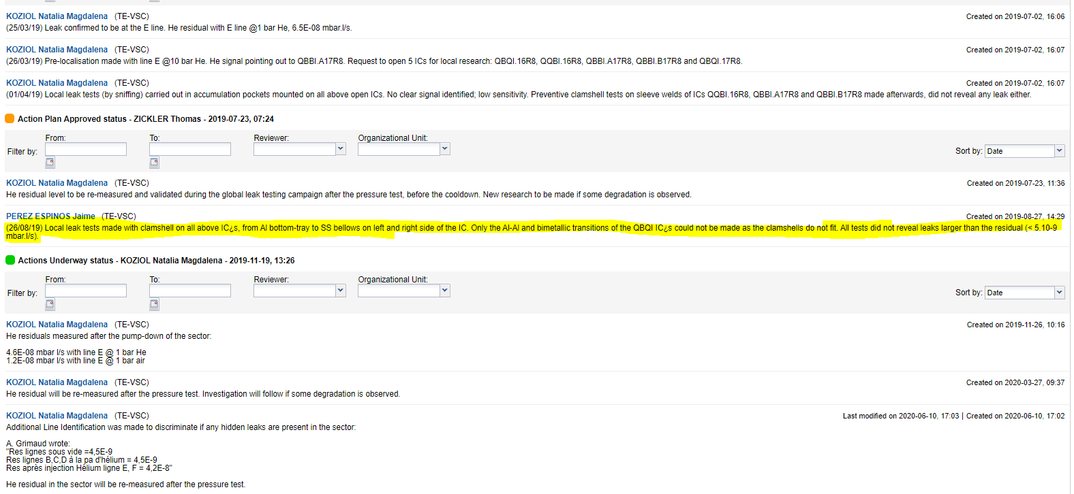
Backup Slides

Slide 11
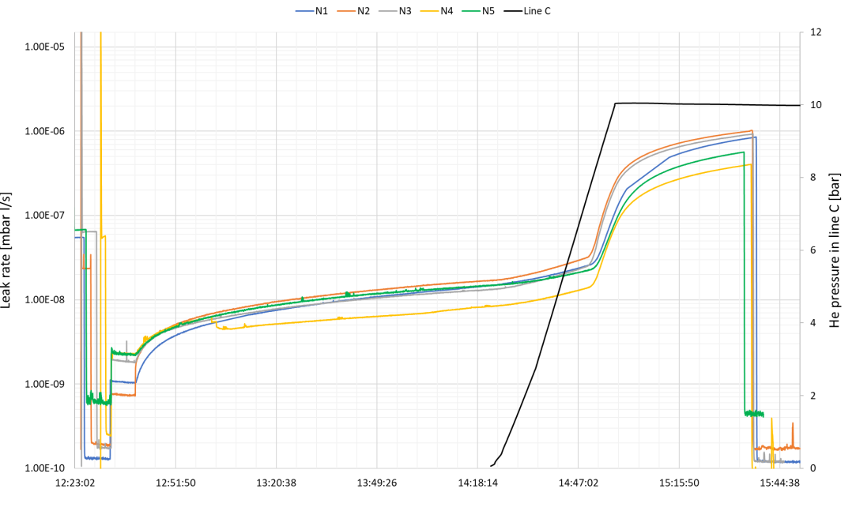
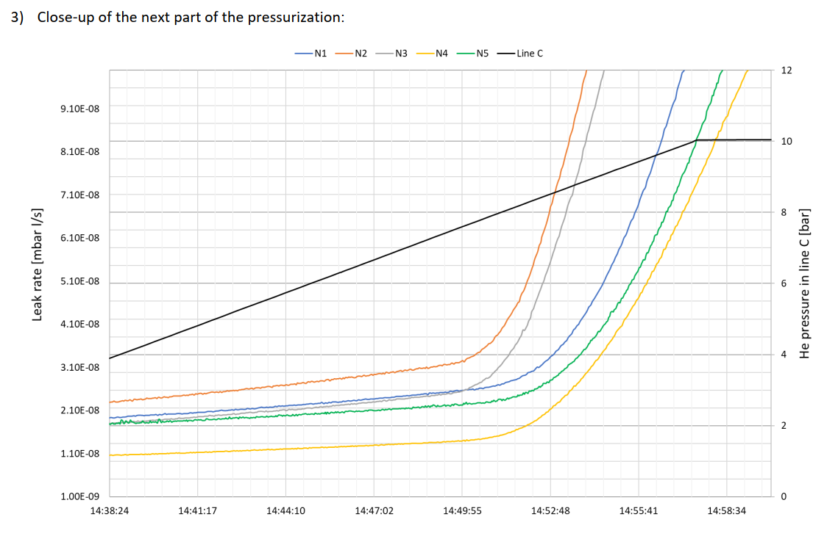
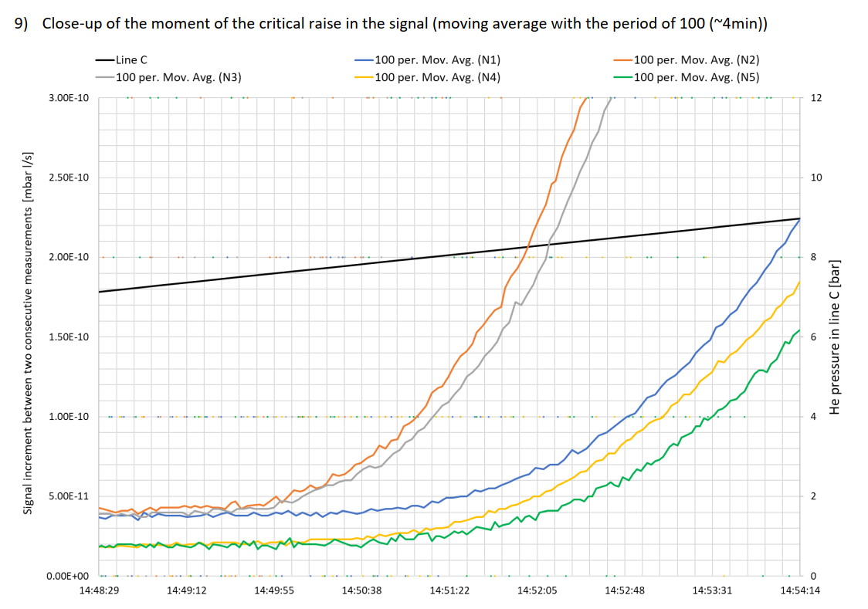
Backup Slides

