Slide 1
Testing the performance of data transfer protocols on long-haul high-bandwidth paths.
Richard Hughes-Jones
GÉANT Association
Tim Rayner, AARNet & Shaun Amy, CSIRO

Slide 2
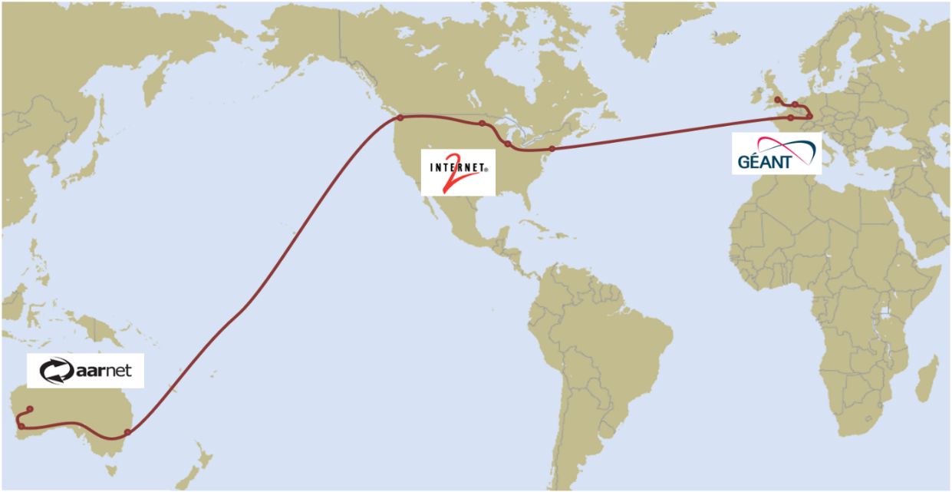
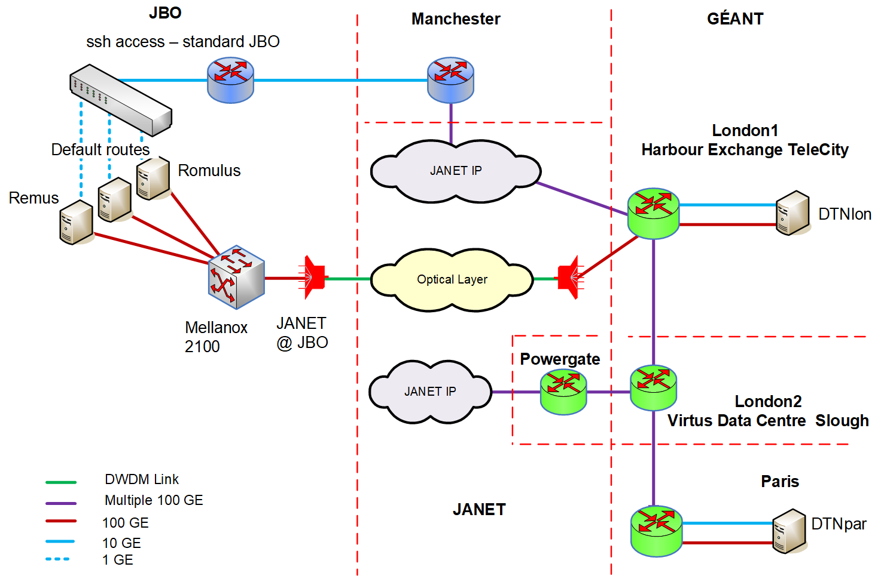
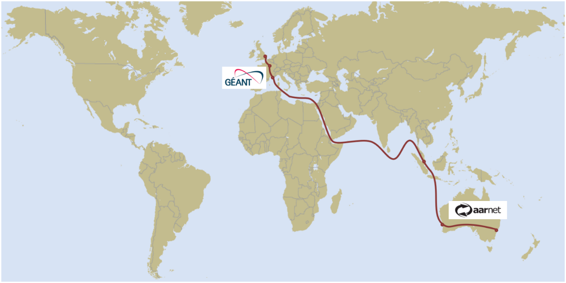
AENEAS Network Topology

Slide 3
Disk to Disk Throughput vs File Size Scan davix:http
davix-get DTNlon-DTNpar
davix-put DTNlon-DTNpar
1 TCP flow
Concern re low transfer speeds
half disk speeds.
Disk - memory
Lon zfs write 30 Gbit/s
Par xfs RAID0 read 25 Gbit/s
Instrument davix and xrdcp
Time measurement better than 1 sec
Set fixed size chunk reads from the network
Measure times for “getChunk” (socket read) & “putChunk” (disk write)
Note TCP performance parameters using tcp_info struct
Record as time series in memory
Option not to write a file (davix-get)
Help from Andy Hanushevsky:
lots of improvements in Xrootd v4.11.0
But Tests done with v 4.8.4 !
Using 1 TCP flow
Did set chunk size
So data should be OK

Slide 4
davix-get: Effect of CPU core. File Size Scan, No File Write
DTNlon-DTNpar A6 good core
DTNlon-DTNpar A1 bad core
Throughput
1 TCP flow
Disk - memory
Lon zfs write 30 Gbit/s
Par xfs RAID0 read 25 Gbit/s
Use of bad core ~5 Gbit/s less
similar to iperf3
Constant read size
Network getChunk times more stable
locked to a CPU
Note variation at start of the transfer
Linked to TCP Slowstart
Shows good performance of Xrootd server – use of sendfile().
getChun, putChunk time series

Slide 5
Protocol Comparaison remus ← DTNpar RTT 14.1 ms
davix-get //http: 1MB buffer
xrdcp //root: 8 MB buffer
Throughput
Disk-to-Disk
74% disk write
~50% disk write
TCP re-transmits
Chunk time series
Net read
Disk write
Notes:
Max 12 Gbit/s files 2 -50 GByte peak at 9.5 Gbit/s for 10 & 20 GB file
Falls to 6.5 Gbit/s > 50 MByte over 7 Gbit/s for files > 2 GByte
getChunk Net 230 - 250 us getChunk baseline ~45 us then 1000 – 2000 us after loss event
putChunk Disk ~450 us putChunk ~5000 us

Slide 6
Protocol Comparaison MRO ← AARNetCanb RTT 56.5 ms
davix-get //http: 1MB buffer
xrdcp //root: 8 MB buffer XRD // CHUNKS=16
Throughput
Disk-to-Disk
50% disk write
~37% disk write
Chunk time series
Net read
Disk write
Stable after slowstart
Notes:
Max 20 Gbit/s files 50 GByte peak at ~15 Gbit/s for 50 GB file
over 10 Gbit/s for files > 2 GByte over 10 Gbit/s for files > 5 GByte
getChunk Net 230 - 250 us getChunk baseline ~45 us then 1000 – 2000 us after loss event
putChunk Disk ~450 us putChunk ~5000 us

Slide 7
Protocol Comparaison DTNlon ← AARNetCanb RTT 259 ms
davix-get //http: 1MB buffer
xrdcp //root: 8 MB buffer XRD // CHUNKS=16
Throughput
Disk-to-Disk
~7.4% disk write
~3% disk write
Chunk
time series
Net read
Disk write
Notes:
Max 2.3 Gbit/s files 20 GByte max 2.6 Gbit/s for 5 GB file
Over 0.8 Gbit/s > 0.5 MByte over 2 Gbit/s for files > 5 GByte
getChunk Net 230 - 250 us getChunk baseline ~45 us then 1000 – 2000 us after loss event
putChunk Disk ~450 us putChunk ~5000 us

Slide 8
What is happening between DTNlon and AARNetCanb?
Look at the “Get Chunk” Network read times
  Large value = delay in reading from the network
Would expect stability after TCP slowstart
Slowstart ends at approx 10 * RTT 259 ms. ≈ 2.6s
Confirmed by the receive buffer size plateau.
Delay Bandwidth Product for 3 Gbit/s ~ 97 MBytes
Every RTT
Read about 100 MBytes then wait 210ms
Why?
  App not providing data to the TCP socket
  TCP auto tuning is working but slower that expected over these RTT – iperf is OK
Investigations continue

Slide 9

What have we learnt?
WebDAV/http(s) and xrd protocols both work well for moving bulk data.
A simple client loop of “Get Chunk” - “Put Chunk” clearly reduces
disk-to-disk throughput.
Use of zero-copy e.g. sendfile() on the server gives a big improvement.
Use of multiple parallel disk accesses is a help
TCP will send what the app gives it – keep the socket full.
TCP auto-tuning works well at medium RTT but may be slower at large RTT.
Next steps
Check out v 4.11.0
Look at multiple TCP flows

