Slide 1
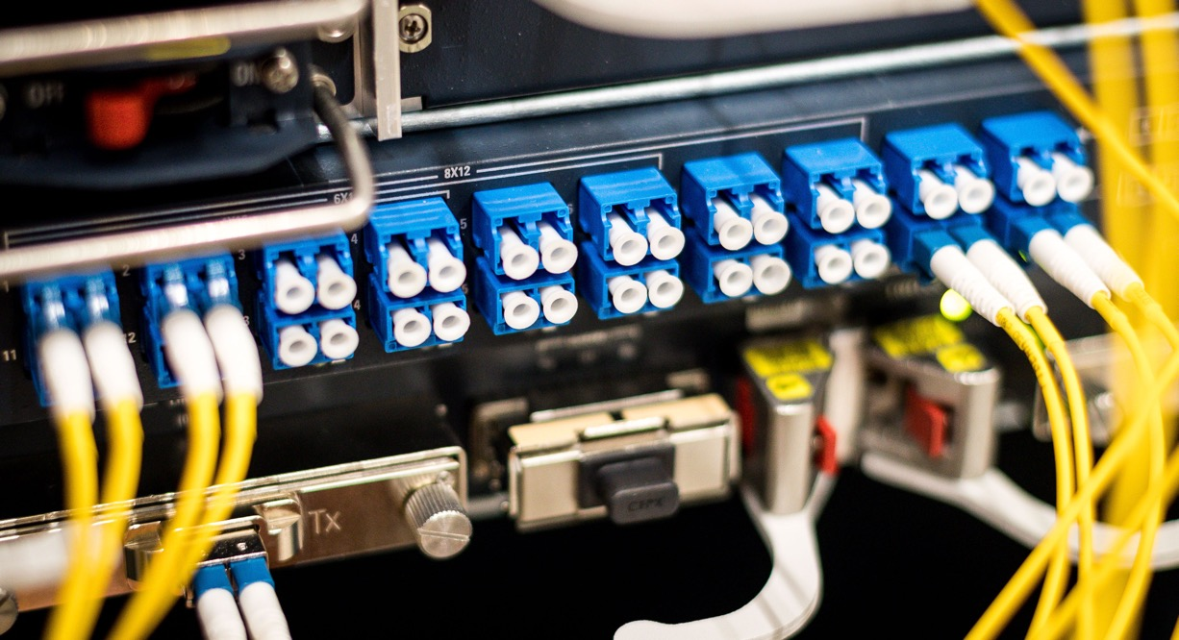
GNA-G AUTOGOLE / SC19-NRE-020
SUPERCOMPUTING 2019
SC’19 – November – Denver, Colorado, USA
John Hess, Tom Lehman, Harvey Newman, John MacAuley, Joe Mambretti, Hans Trompert, Marcos Schwarz,
Gerben van Malenstein and many others

Slide 2
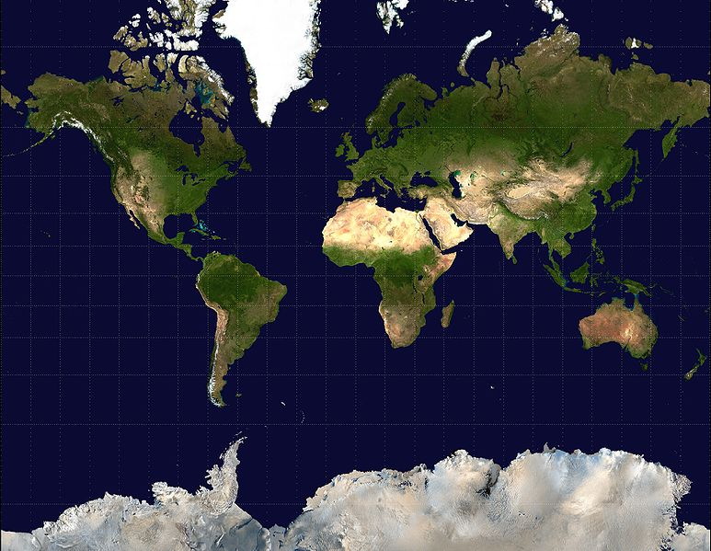
Automated GOLE (AutoGOLE)
GÉANT
NetherLight
StarLight
MOXY
Pionier
KRLight
JGN
KISTI
Pacific Wave
CzechLight
MAN LAN
UvA
ESnet
CERN
Caltech
WIX
KDDI Labs
SINET
AMPATH
AIST
SouthernLight
RNP
Schematic overview of the AutoGOLE

Slide 3

AutoGOLE: multi-domain network services on-demand
User
GUI
NSI
NSI
NSI
Aggregator
Aggregator
Network Service Agent (NSA)
Network Service Agent (NSA)
Network Resource Manager (NRM)
Network Resource Manager (NRM)
3

Slide 4
Themes

Slide 5
Themes
Commercial cloud suppliers already deliver commodity network + compute + storage
    What about the R&E networks and Science Facilities?
From pilot to production
    Moving towards automated provisioning by NOCs
    Implementations, dynamic ANA
Evolving MEICAN
    Features, multi-resource provisioning, …

Slide 6
SURF vision on Automation & Orchestration: mid term, adding optical layer and research on new technical domains
Customer Dashboard & APIs
Business Support Systems
Management
Dashboard
SURF
Automation & Orchestration
Platform
Operational Support Systems
Network Optical Layer
Network Firewall-aaS
Network Service Layer
Compute or Storage Layer
New Technical Domain

Slide 7
Vision on Automation & Orchestration: multidomain interoperability, R&E + Commercial + Scientific Facility
Customer Dashboard & APIs
Customer Dashboard & APIs
Customer Dashboard & APIs
SURF
Automation & Orchestration
Platform
Business Support Systems
SURF
Automation & Orchestration
Platform
Business Support Systems
SURF
Automation & Orchestration
Platform
Business Support Systems
Mgmt
Dashboard
Mgmt
Dashboard
Mgmt
Dashboard
Operational Support Systems
Operational Support Systems
Operational Support Systems
Network Optical Layer
Network Firewall-aaS
Network Service Layer
Compute or Storage Layer
New Technical Domain
Network Optical Layer
Network Firewall-aaS
Network Service Layer
Compute or Storage Layer
New Technical Domain
Network Optical Layer
Network Firewall-aaS
Network Service Layer
Compute or Storage Layer
New Technical Domain
Commercial domain
SURF
Other R&E domain
Customer Dashboard & APIs
SURF
Automation & Orchestration
Platform
Business Support Systems
Mgmt
Dashboard
Operational Support Systems
Network Optical Layer
Network Firewall-aaS
Network Service Layer
Compute or Storage Layer
New Technical Domain
Request/provision interface
e.g. NSI for network resources
Note: standardisation needed!
Scientific Facility

Slide 8
Activities
2019

Slide 9
AutoGOLE activities 2019
Connecting more networks around the globe using NSI
Dynamic ANA planned for this year, expecting scaling up to other regions
    Starting by segment CHI-MON-AMS
MEICAN software development by RNP
Expanding AutoGOLE with connectivity to DTNs through SENSE

Slide 10
SENSE

Slide 11
SENSE
SENSE overview and SENSE-RM slides

Slide 12
SENSE
SENSE overview and SENSE-RM slides

Slide 13
SC19-NRE-020
Demonstration
Lessons learned

Slide 14
SC19-NRE-020 - Overview

Slide 15
SC19-NRE-020 - Lessons learned
Perform first data plane test as early as possible, the devil is in the details
Data plane Los Angeles DTN to CERN DTN was not completed
    OpenNSA does not support NSI Explicit Route Object (ERO)
    implies that the PCE cannot be triggered to choose alternate path
SENSE-Resource Manager (RM) does not run on Ubuntu
    While the CERN DTN does
    Containerize SENSE-RM?
The value of this demonstration is not in the result, but in what we discover and learn

Slide 16
SC19-NRE-020 – Next steps
Towards Persistent Multi-resource Infrastructure
Debugging data plane by improving control plane
    Various approaches: adding ERO to OpenNSA?
    Open-sourcing OpenNSA?
    Adding a specific aggregator temporarily?
    … ?

Slide 17
Directions

Slide 18
AutoGOLE activities 2020
Production
  dynamic ANA
Innovation
towards multi-resource provisioning

Slide 19
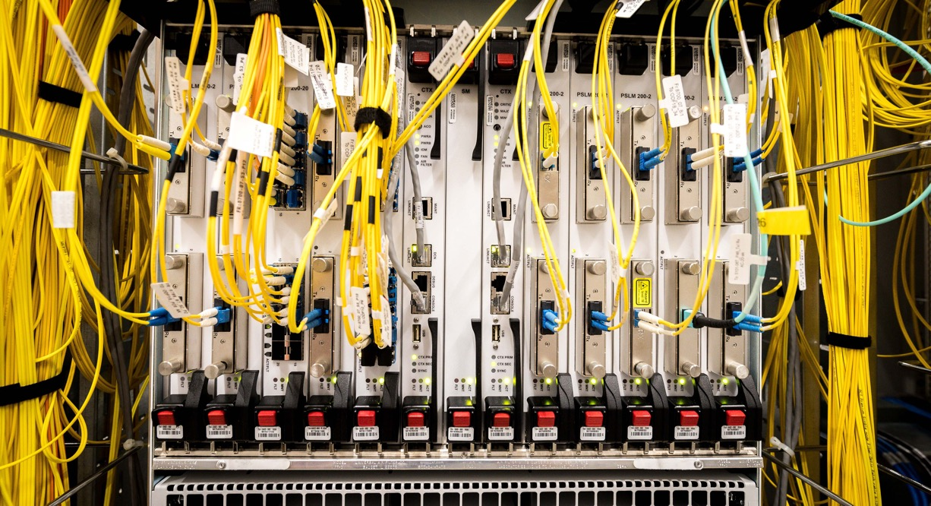
ANY Questions?
Gerben van Malenstein
gerben.vanmalenstein@surfnet.nl
www.surf.nl
linkedin.com/in/vanmalenstein
« DRIVING INNOVATION TOGETHER »

