Slide 1
Run 3 optics
(for the p-p runs)
S. Fartoukh, N. Karastathis
Acknowledgments: all LCR3WG members + LPC
Main outcome of the Run 3 configuration WG
Main Optics changes w.r.t. Run 2
Optics files description for the combined ramp & squeeze
Optics files description for the squeeze (β* levelling)
Chromatic properties
Next steps

Slide 2
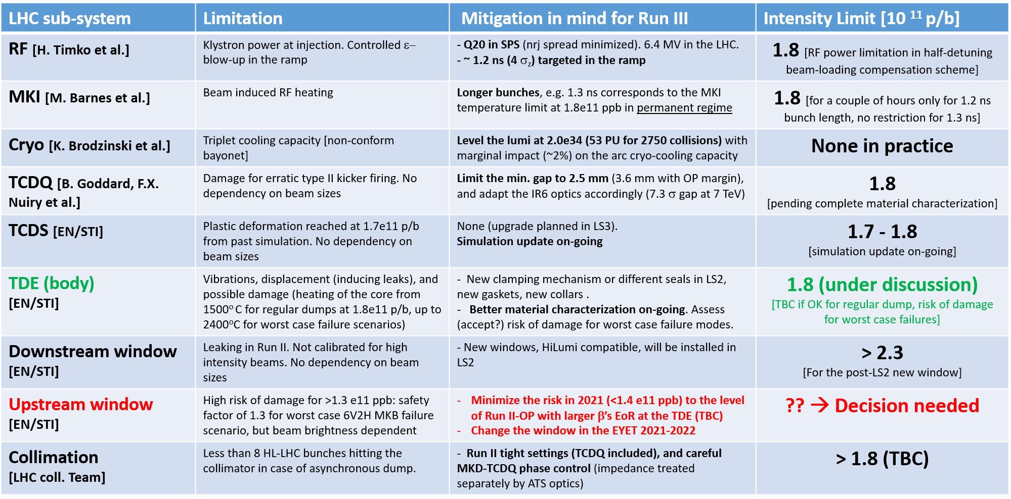
Main outcome of the Run 3 machine configuration WG https://indico.cern.ch/category/10387/
The preparation of the HL-LHC beam will take place in Run III
→ Up to 2.1E11 p/b (γε=1.55 μm for BCMS) at SPS extraction in 2023 (1.3-1.4E11 max in 2021, 1.8E11 in 2022)
→ versus 1.7-1.8E11 p/b acceptable for most of the existing LHC HW (on-going work)
LMC 06.03.2019
“The machine configuration should not limit the performance of the LHC in Run 3” (LMC recommendation)

Slide 3
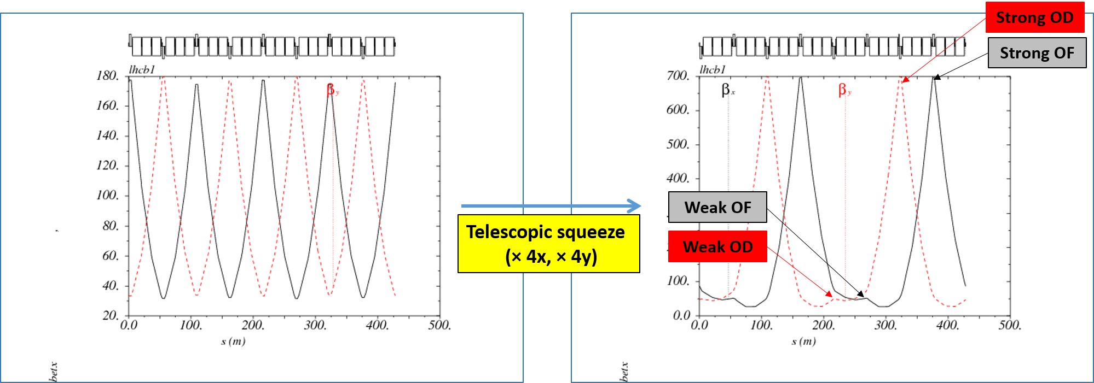
a) First optics constraints: Impedance
→ Telescopic optics are needed to be deployed in the ramp for Landau damping the brighter (and more rigid) Run 3 beam.
→ Two categories of octupoles in s81/12/45/56: the “optically strong” (with increased peak $β^{′}s ∝r_{\text{tele}}∝{1/β}^{∗}$) and the “optically weak” (with decreased peak $β^{′}s ∝β^{∗}$).
Beam 1/2 | “Strong“ OF.b1/OD.b2 | Weak OF.b1/OD.b2 | Strong OD.b1/OF.b2 | Weak OD.b1/OF.b2
Sector 45 (81) | 22.R4(8), 26.R4(8), 30.R4(8), 34.R4(8), 30.L5(1), 26.L5(1), 22.L5(1) | 24.R4(8), 28.R4(8), 32.R4(8), 32.L5(1), 28.L5(1), 24.L5(1) | 25.R4(8), 29.R4(8), 33.R4(8), 31.L5(1) | 31.R4(8), 33.L5(1), 29.L5(1), 25.L5(1)
Sector 56 (12) | 31.R5(1), 33.L6(2), 29.L6(2), 25.L6(2) | 25.R5(1), 29.R5(1), 33.R5(1), 31.L6(2) | 22.R5(1), 26.R5(1), 30.R5(1), 34.R5(1), 30.L6(2), 26.L6(2), 22.L6(2) | 24.R5(1), 28.R5(1), 32.R5(1), 32.L6(2), 28.L6(2), 24.L6(2)
Total | 7+4 = 11 | 6+4 =10 | 4+7 =11 | 4+6=10
→ Anti-telescopic optics (r → 1/r) also works, with the peak β-beating wave shifted by one FODO cell, i.e. the strong octupoles becoming weak, and vice et versa (strictly speaking the direct anharmonicity is reduced by 10%).

Slide 4
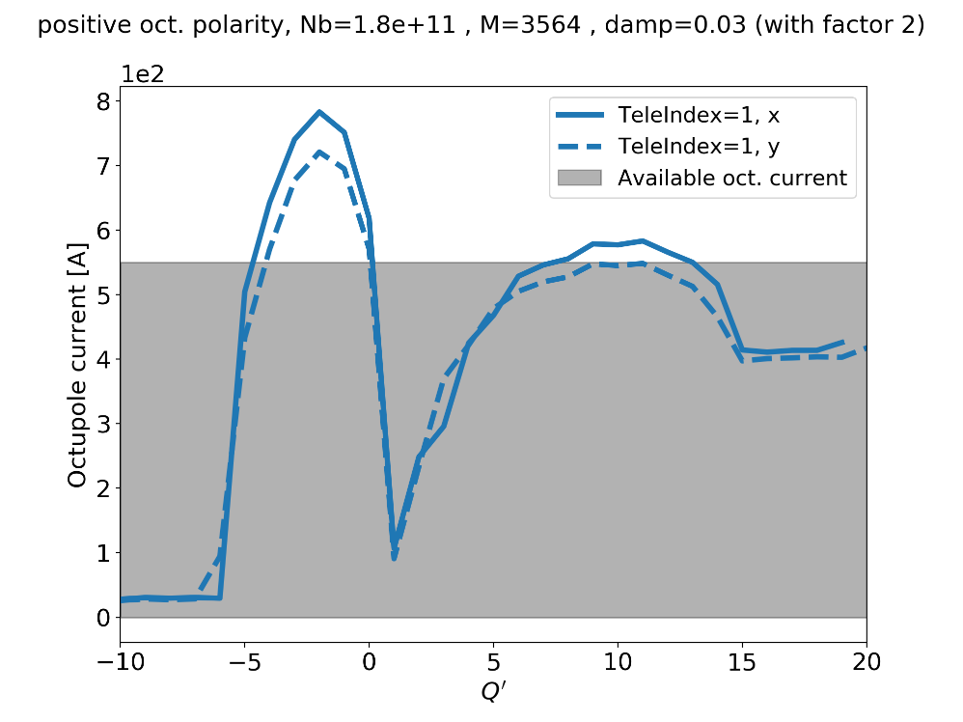
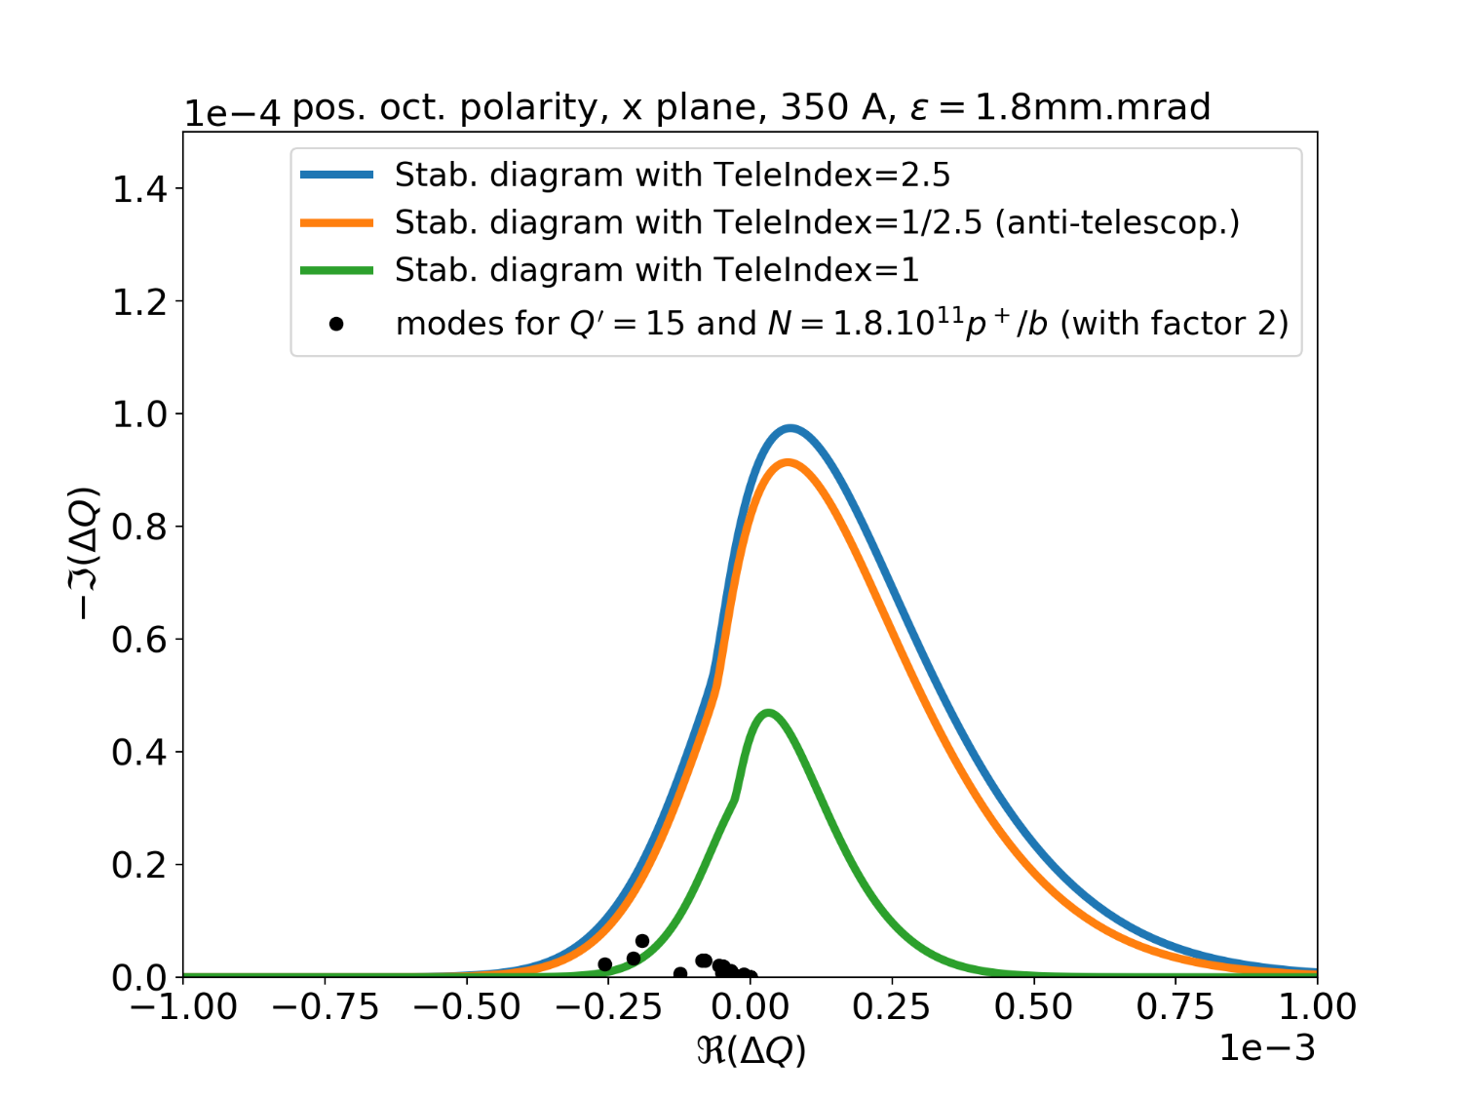
Comparison between telescopic and anti-telescopic optics
in terms of stability diagram
550A (with safety
factor of 2)
Q’=13
Q’=15
[Run II – like collimator settings, new low impedance collimator included]
Coherent modes
still inside (with tele-index)
W/o telescopic (or anti-telescopic) optics, the MO threshold can be (at least) 550 A
in Run 3 (@ Q’=15+/-2, worst case) for a beam brightness of 1 (1.8e11 p/b within 1.8 μm)
N. Mounet

Slide 5
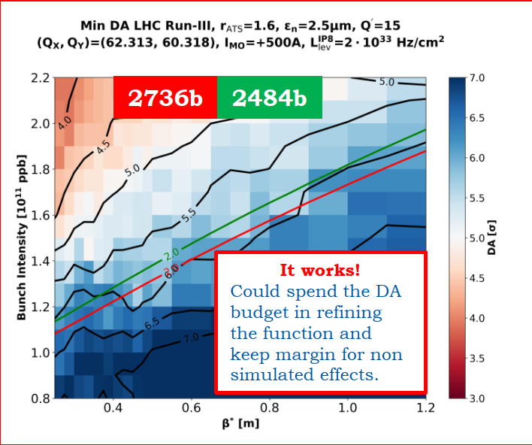
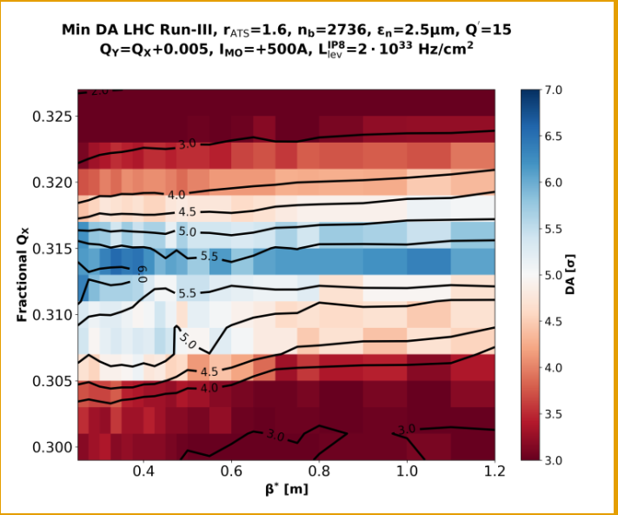
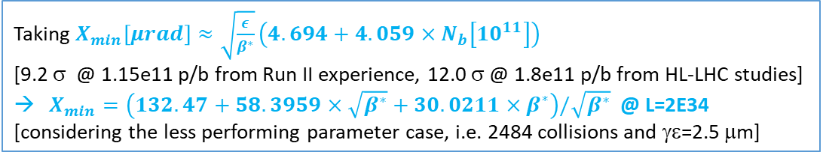
b) 2nd optics constraints: peak Lumi and IT lifetime
L ≤ 2E34 @ 1.8e11 p/b
→ β* dynamic range of up to 500-600% (1-1.5 m→ 25 cm), similar to HL-LHC (vs. 20% in 2018) !
∫ Ldt ≤ 300 fb⁻¹ in total, i.e. “only” ~100-150 fb⁻¹ left for Run III w/o any dedicated measures
→ V-Xing polarity management in ATLAS and operating at minimal X-angle vs. β* (BBLR limit)
Half-crossing angle vs β* in IR1/5[from ~100 μrad up to ~160 μrad]
and corresponding bunch charge evolution @ 2E34
First validation (using preliminary β* levelling optics sequence)
Taking $X_{min}\left[μrad\right]≈\sqrt{\frac{ε}{β^{∗}}}\left(4.694+4.059×N_{b}\left[{10}^{11}\right]\right)$
[9.2 σ @ 1.15e11 p/b from Run II experience, 12.0 σ @ 1.8e11 p/b from HL-LHC studies]
$X_{min}=\left(132.47+58.3959×\sqrt{β^{∗}}+30.0211×β^{∗}\right)/\sqrt{β^{∗}}$ @ L=2E34
[considering the less performing parameter case, i.e. 2484 collisions and γε=2.5 μm]
The WP can even be kept cst over the full
levelling period !

Slide 6
c) Third main optics constraint: Forward physics experiment
β* levelling in telescopic mode is much preferred by the FP experiments (AFP & PPS)
Cst R-matrix from the IP to the Roman Pot’s (within the OMC knobs ..)
In telescopic squeezing mode: “tele-index range” = “β* range”
Considering
(i) a tele-index of 2-2.5 recommended EoR (stability of non-colliding beams for 1.8E11 p/b),
(ii) a β* dynamic range of up to 5-6 in SB (1.8 p/b colliding @ 2E34)
(iii) a typical range of [1/3, 3-4] for the tele-index (optics flexibility/match-ability/correct-ability),
→ The only possible approach is to start β*-levelling from an anti-telescopic optics
Even w/o constraint from impedance (no telescope in the ramp), a β* levelling range of up to 5-6 in telescopic mode would require to start from an anti-telescopic optics at the EoR.
→ β* levelling is the plan A to prepare HL-LHC
Another possibility would be to bet on offset-levelling (with a much smaller β*-levelling fraction in tele-mode, as in 2018), but leading to some difficulty (μ-scan, instabilities may be)
→ Offset levelling is the back-up (unless to fine tune the lumi unbalance between ATLAS and CMS)

Slide 7
.. Betting on the best (1.8e11 p/b within 1.8 μm at Flat top) and investing for HL-LHC (β*-levelling), this is how the ramp and the β*-levelling sequence should look like in Run 3:
EoR Beam and Optics Parameters
EoR = Beginning of SB parameters | 2021 | 2022-2023
Max beam brightness [10¹¹ /μm] | 1.4/1.8 | (up to) 1.8/1.8=1
Full bunch lengh [ns] | 1.2 | 1.2
β* [m] at IP1 & IP5 | 1.0 | 1.5
Half-crossing angle [μrad] | 110.4 [12.1 σ for γε=2.5 μm] | 101.7 [13.6 σ for γε=2.5 μm]
Max Lumi [10³⁴]@ beginning of SB [for γε=1.8 μm and 2736 collisions at IP1/5] | 1.68 | 1.98
EoR pre-squeezed β* [m] (IPQ settings in IR1/5) | 0.6
EoR Tele-index (IPQ settings in IR8/2/4/6) | 0.6/1.0 =0.60 | 0.6/1.5 = 0.40
Single-bunch MO threshold [A] (with margin factor of 2) | 375 | 355

Slide 8
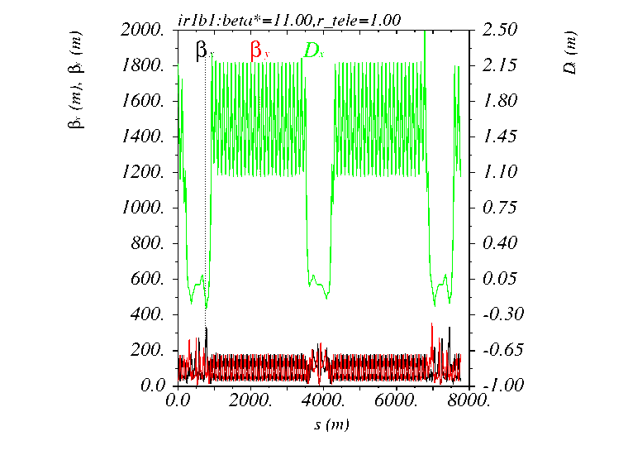
Ramp (2022):
  Pre-squeeze down to β*=1.5/10/1.5/1.5 m at IP1/2/5/8
  Combined Pre-squeeze and anti-tele squeeze at constant β* =1.5 m down to a tele-index of 0.40, i.e β*_{pre-squeeze} = 0.4×1.5=0.6 m
β∗ levelling in Tele mode from 1.5 m to 20 cm (28 cm @ 7 TeV from aperture constraint), i.e. r_{tele} = 0.4 → 3.0
IR8
IR1
IR2

Slide 9
Main optics changes (and similarities) w.r.t. Run 2
Same injection optics as in Run 2 (the impact of BBLR on DA still OK at 1.8E11 p/b)
Pre-squeeze
  New pre-squeeze sequences in IR1 and IR5 from β*=11 m down to 60 cm to maximise the normalised dispersion at the RPs for AFP & PPS (the min. 1.5 mm gap should now be reachable for all RP’s, while sticking to the Run 2 MP rules, TBC)
  “New” IR8 optics transition down to β*= 1.5 m from the 2018 ion cycle (IR2 unchanged w.r.t. Run 2)
Anti-tele and Tele-squeeze of IR2/8/4/6 from r=0.4 (anti-telescope) up to r=3.0 (telescope)
  All new, in particular smoother in IR2 and IR4, at β*=1.5 m in IR8 (vs. 3 m in Run 2), and at constant β’s at the TCDQ in IR6 … BUT big MKD-TCDQ phase advance deviation for the anti-tele-squeeze part (up to 115º vs. 94º nominal)
  Higher leakage from the TCDQ for ASD, but only at high β* > 60 cm (normalised TCT widely open)
  OK from collimation (LHC Collimation Working Group #242) but green light still pending from the LBDS team

Slide 10
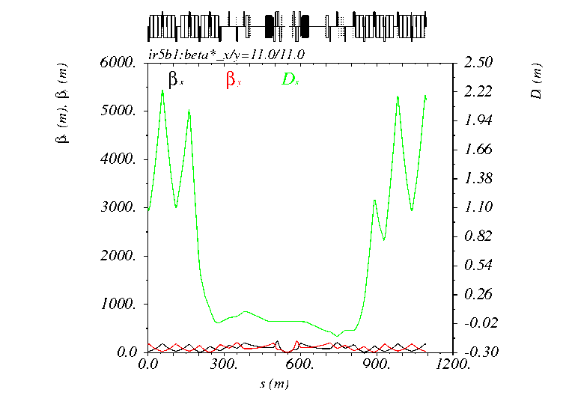
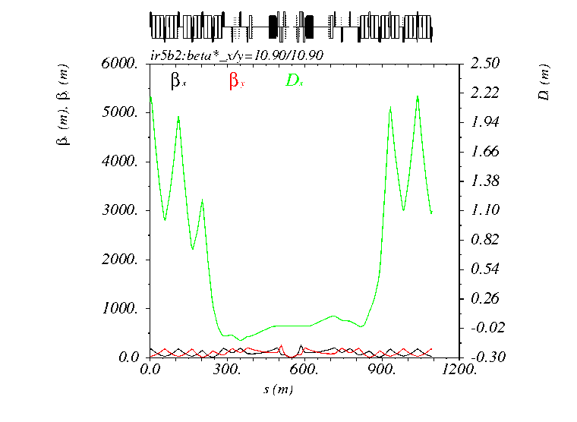
New IR1/5 pre-squeeze from β*=11 m to 60 cm (possible extension down to 40 cm)
Beam 1
Beam 2
Roman Pots: dispersion slightly increased v.s Run 2 (no miracle) but β _{x} sensibly reduced

Slide 11
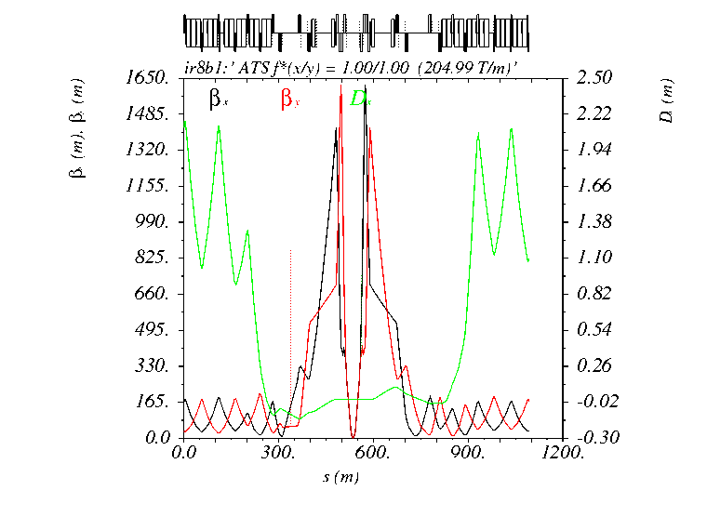
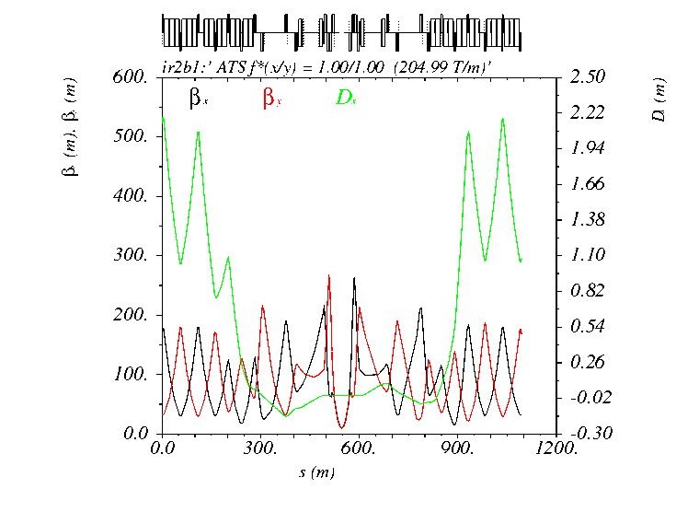
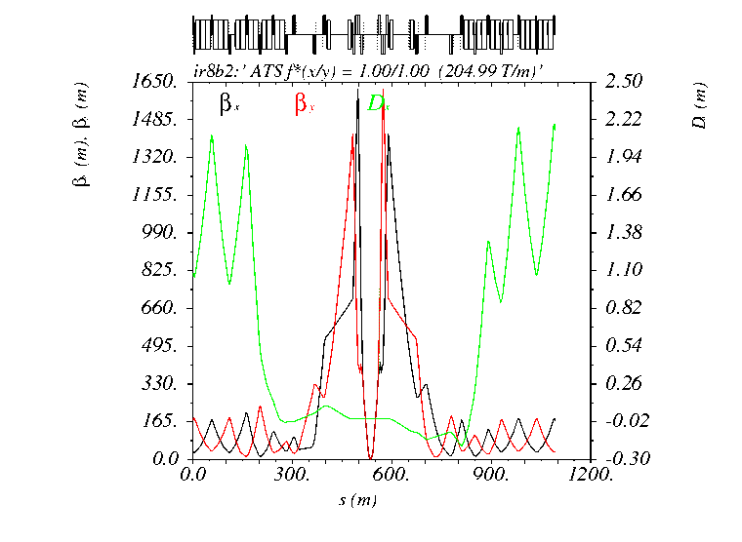
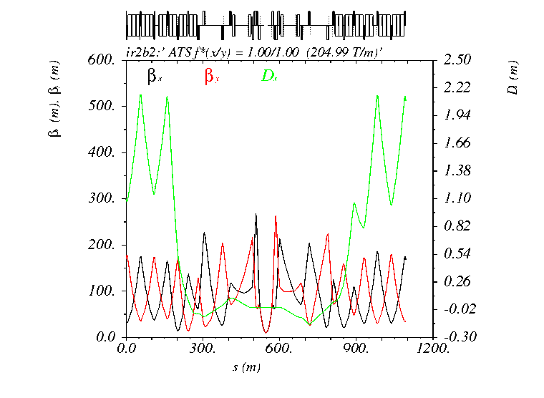
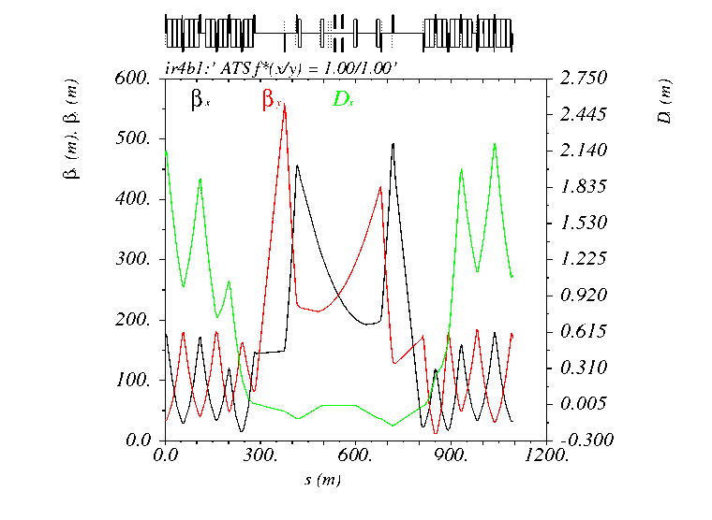
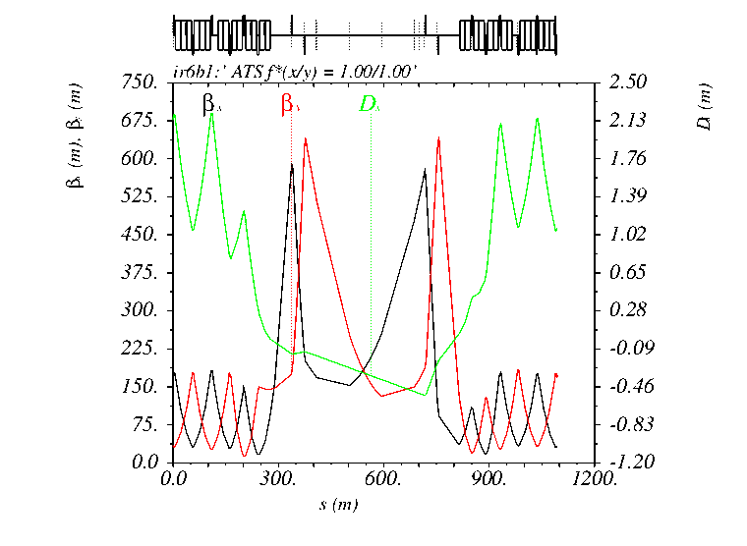
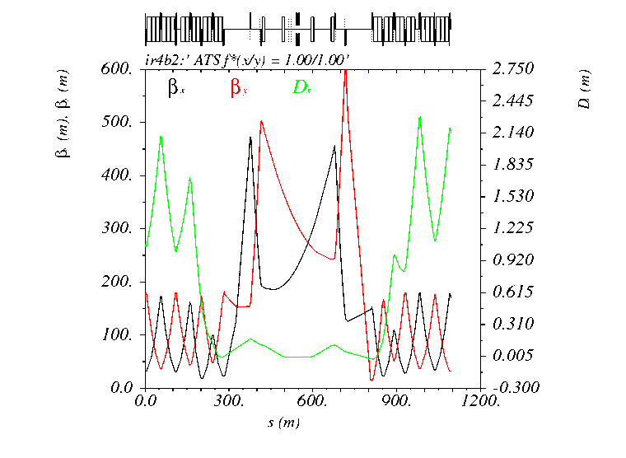
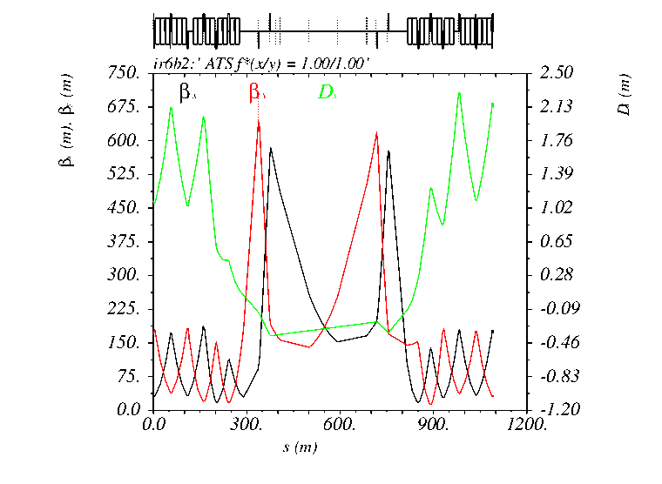
IR2/4/6/8 anti-telescopic squeeze (r=1.0 → 0.4)
Beam 1
Beam 2
IR8
IR2
IR8
IR2
IR4
IR6
IR4
IR6

Slide 12
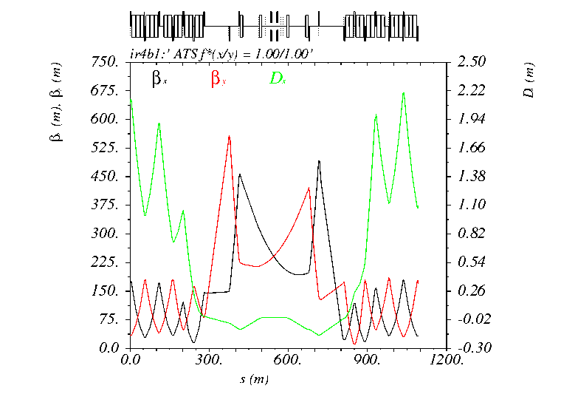
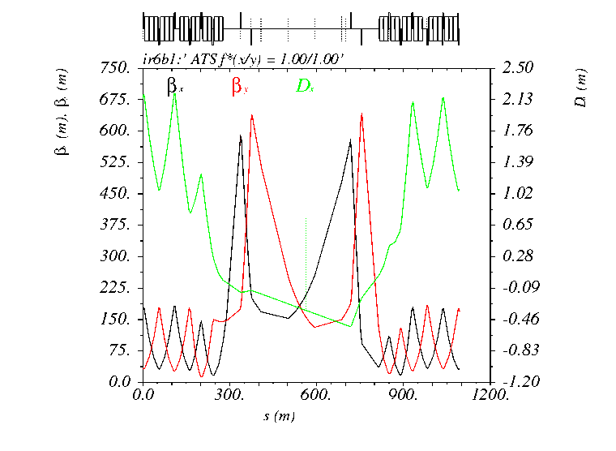
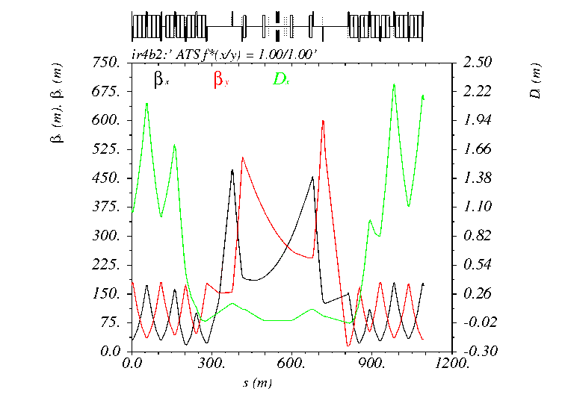
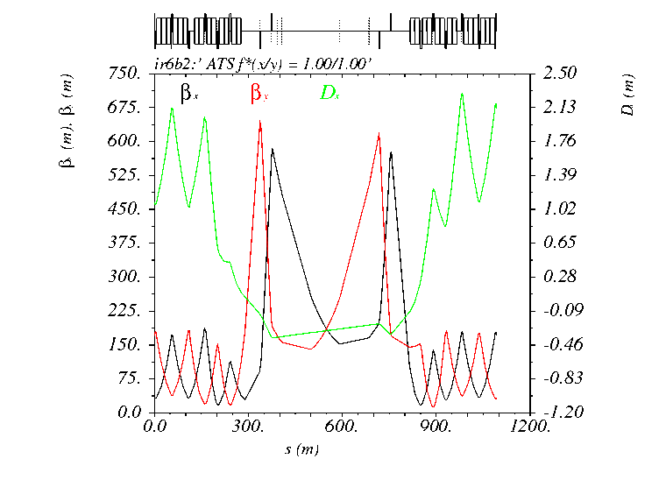
IR2/4/6/8 telescopic squeeze (r=1.0 → 3.0)
Beam 1
Beam 2
IR8
IR2
IR8
IR2
IR4
IR6
IR4
IR6

Slide 13
Ramp & Squeeze in 2021 & 2022-2023
/afs/cern.ch/eng/lhc/optics/runIII/RunIII_dev/2021/PROTON (2021 optics)
/afs/cern.ch/eng/lhc/optics/runIII/RunIII_dev/2022/PROTON (2022-2023 optics)
20 matched points in 2021, and 21 matched points in 2022-2023. The first 18 optics are the same.
Optics file name |  | β* [m] in IR1/2/5/8 |  | Tele-index (& pre-squeezed β* [m] ) |  | Ramp & Squeezing modes
2021 | 2022-2023 | 2021 | 2022-2023 | 2021 | 2022-2023 | 2021 | 2022-2023
Opticsfile.1 |  | 11.000/10.000/11.000/10.000 |  | 1.000 (11.00) |  | Nominal 2018 injection optics
Opticsfile.2 |  | 10.000/10.000/10.000/10.000 |  | 1.000 (10.00) |  | Combined Ramp & Pre-Squeeze at constant tele-index=1 down to β* = 1.5 m at IP1/5/8 (10 m at IP2)
Opticsfile.3 |  | 9.600/10.000/ 9.600/ 9.600 |  | 1.000 (9.60)
Opticsfile.4 |  | 9.100/10.000/ 9.100/ 9.100 |  | 1.000 (9.10)
Opticsfile.5 |  | 8.300/10.000/ 8.300/ 8.300 |  | 1.000 (8.30)
Opticsfile.6 |  | 7.100/10.000/ 7.100/ 7.100 |  | 1.000 (7.10)
Opticsfile.7 |  | 5.900/10.000/ 5.900/ 5.900 |  | 1.000 (5.90)
Opticsfile.8 |  | 4.900/10.000/ 4.900/ 4.900 |  | 1.000 (4.90)
Opticsfile.9 |  | 4.100/10.000/ 4.100/ 4.100 |  | 1.000 (4.10)
Opticsfile.10 |  | 3.300/10.000/ 3.300/ 3.300 |  | 1.000 (3.30)
Opticsfile.11 |  | 2.600/10.000/ 2.600/ 2.600 |  | 1.000 (2.60)
Opticsfile.12 |  | 2.100/10.000/ 2.100/ 2.100 |  | 1.000 (2.10)
Opticsfile.13 |  | 1.700/10.000/ 1.700/ 1.700 |  | 1.000 (1.70)
Opticsfile.14 |  | 1.500/10.000/ 1.500/ 1.500 |  | 1.000 (1.50)
Opticsfile.15 |  | 1.506/10.000/ 1.506/ 1.500 |  | 0.870 (1.31) |  | Ramp and Pre-Squeeze and Anti-Tele-Squeeze at quasi-constant β* ~ 1.5 m at at IP1/5/8 (10 m at IP2)
Opticsfile.16 |  | 1.508/10.000/ 1.508/ 1.500 |  | 0.769 (1.16)
Opticsfile.17 |  | 1.502/10.000/ 1.502/ 1.500 |  | 0.686 (1.03)
Opticsfile.18 |  | 1.500/10.000/ 1.500/ 1.500 |  | 0.600 (0.90)
Opticsfile.19 | Opticsfile.19 | 1.200/10.000/ 1.200/ 1.500 | 1.501/10.000/ 1.501/ 1.500 | 0.600 (0.72) | 0.506 (0.76) | Ramp and Pre-Squeeze at constant tele-index r=1.667 β* = 1.0 m & r = 0.600 EoR |  | Ramp and Pre-Squeeze and Anti-Tele-Squeeze at β* ~ 1.5 m β* = 1.5 m & r = 0.400 EoR
- | Opticsfile.20 | - | 1.501/10.000/ 1.501/ 1.500 | - | 0.440 (0.66)
Opticsfile.20 | Opticsfile.21 | 1.000/10.000/ 1.000/ 1.500 | 1.500/10.000/ 1.500/ 1.500 | 0.600 (0.60) | 0.400 (0.60)

Slide 14
β* levelling in 2021 & 2022-2023
(prepared down to β*=20 cm)
/afs/cern.ch/eng/lhc/optics/runIII/RunIII_dev/2021/PROTON (2021 optics)
/afs/cern.ch/eng/lhc/optics/runIII/RunIII_dev/2022/PROTON (2022-2023 optics)
11 matched points in 2021 (down to 20 cm) and 14 matched points in 2022-2023. The last 11 optics are the same.
Optics file name |  | β* [m] in IR1/2/5/8 |  | Tele-index (& pre-squeezed β* [m] ) |  | Comment
2021 | 2022-2023 | 2021 | 2022-2023 | 2021 | 2022-2023 | 2021 | 2022-2023
- | Opticsfile.21 | - | 1.500/10.000/ 1.500/ 1.500 | - | 0.400 (0.60) | Purely Telescopic Squeeze from β*=1.5 m (1.0 m in 2021) down to 20 cm, i.e. at constant quadrupole settings in IR1 and IR5 (60 cm pre-squeezed β*)
 | Opticsfile.22 |  | 1.330/10.000/ 1.330/ 1.500 |  | 0.451 (0.60)
 | Opticsfile.23 |  | 1.160/10.000/ 1.160/ 1.500 |  | 0.517 (0.60)
Opticsfile.20 | Opticsfile.24 | 1.000/10.000/ 1.000/ 1.500 |  | 0.600 (0.60)
Opticsfile.21 | Opticsfile.25 | 0.840/10.000/ 0.840/ 1.500 |  | 0.714 (0.60)
Opticsfile.22 | Opticsfile.26 | 0.710/10.000/ 0.710/ 1.500 |  | 0.845 (0.60)
Opticsfile.23 | Opticsfile.27 | 0.600/10.000/ 0.600/ 1.500 |  | 1.000 (0.60)
Opticsfile.24 | Opticsfile.28 | 0.510/10.000/ 0.510/ 1.500 |  | 1.176 (0.60)
Opticsfile.25 | Opticsfile.29 | 0.430/10.000/ 0.430/ 1.500 |  | 1.395 (0.60)
Opticsfile.26 | Opticsfile.30 | 0.360/10.000/ 0.360/ 1.500 |  | 1.667 (0.60)
Opticsfile.27 | Opticsfile.31 | 0.300/10.000/ 0.300/ 1.500 |  | 2.000 (0.60)
Opticsfile.28 | Opticsfile.32 | 0.250/10.000/ 0.250/ 1.500 |  | 2.400 (0.60)
Opticsfile.29 | Opticsfile.33 | 0.220/10.000/ 0.220/ 1.500 |  | 2.727 (0.60)
Opticsfile.30 | Opticsfile.34 | 0.200/10.000/ 0.200/ 1.500 |  | 3.000 (0.60)
.. Detailed β*-levelling strategy still to be agreed (e.g. how many β* stops with state-of-the-art optics correction ?)

Slide 15
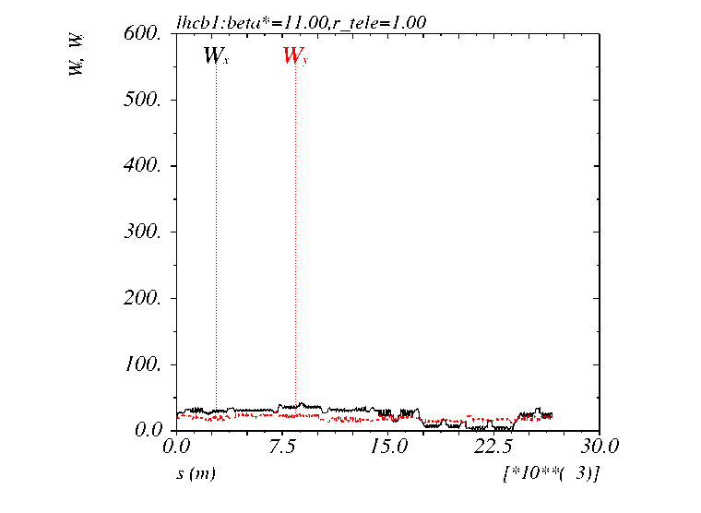
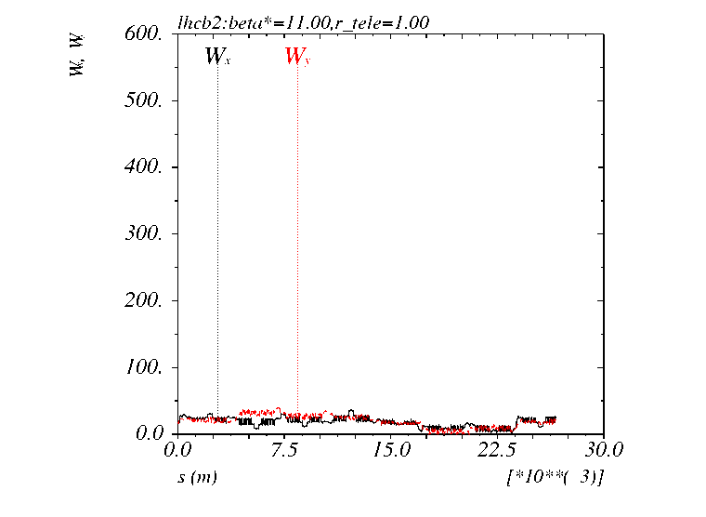

Chromatic properties [2022-2023 cycle]
Fully satisfactory W functions over the cycle (although net impact of IR8)
Beam 1
Beam 2
$$\frac{∆β}{β}=10\% @ δ={10}^{−3}$$
IR5
IR1
IR8

Slide 16
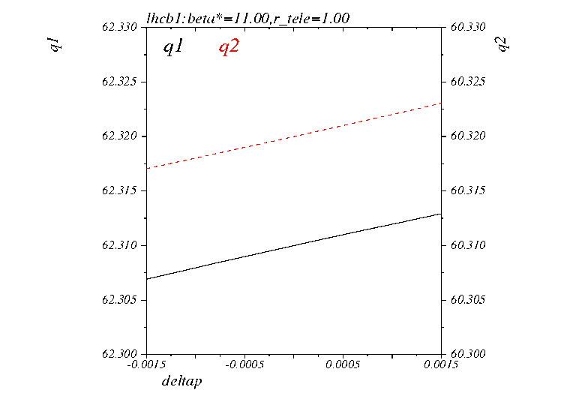
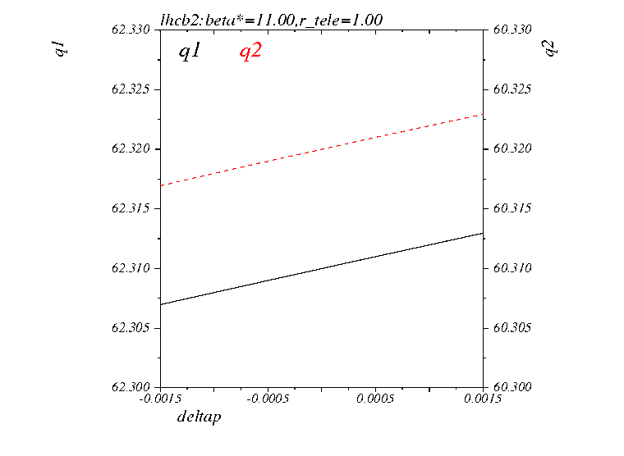
Chromatic properties [2022-2023 cycle]
Non-linear chromaticity from the triplet → well-controlled over the cycle
Beam 1
Beam 2

Slide 17
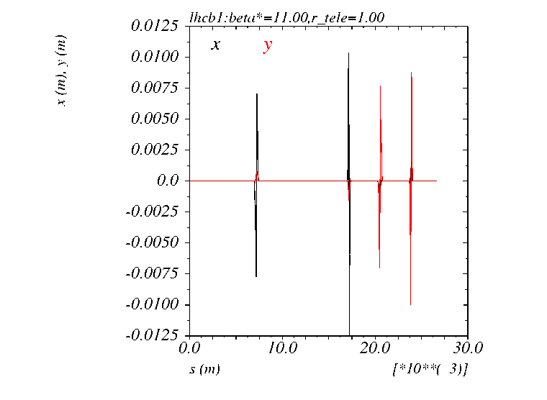
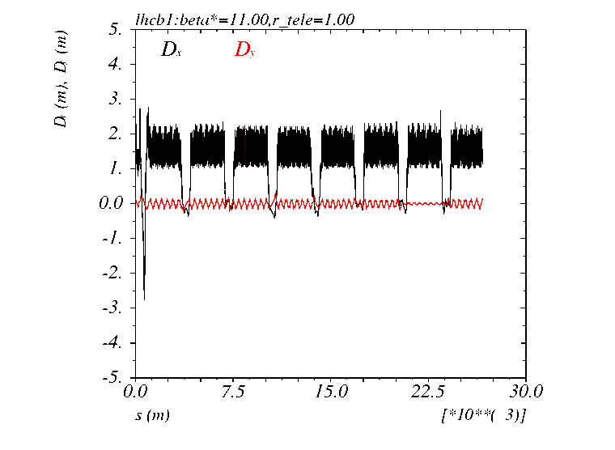
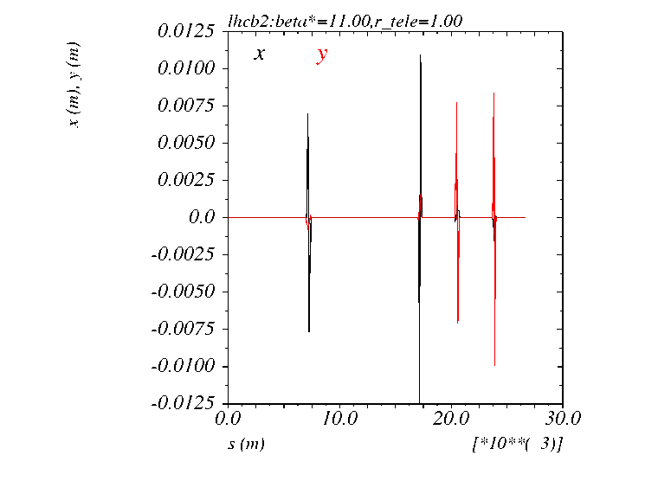
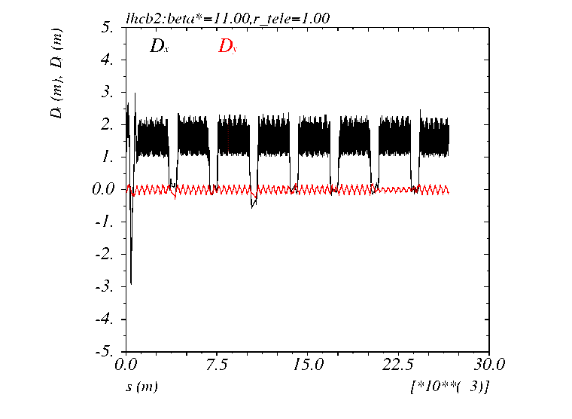
Chromatic properties [2022-2023 cycle]
Spurious dispersion from crossing angle (simplified simulation at constant max. X-angle over the full cycle)
Beam 1
Beam 2
ON_DISP knob
Dispersion (impact of IR8 not corrected)

Slide 18
Next steps
OP (LSA)
Demonstrate the feasibility of the new ramp (within dI/dt and d2I/dt2 PC limits)
Timing table of the squeeze (β* levelling mode)
Collimation
Loss maps & ASD simulations over the cycle
TCT operational scenario, e.g. constant in mm at FT vs β*, maybe fine-tuned to minimize the allowed minimum gap of the Roman Pots (within the MP rules).
Optics & OP (OMC, collimation, LBDS,..)
→ Is that OK for the commissioning teams? Commissioning strategy: how many optics with sate-of-the-art optics corrections, how many with full validation (LM, ASD tests, etc.), β* stop selections, etc ..
Beam-beam (in collision)
DA, tune scan, MO, Q’,… If applicable refine the parametric X-angle functions in β*-levelling mode… but it should work without need of further iteration.
Pacmann effect on orbit, β-beating, etc. at 1.8e11 p/b
Collective effects
Confirm the beam stability over the full cycle (including low-mu Runs), and decide on the octupole polarity
…

Slide 19
Back-up

Slide 20
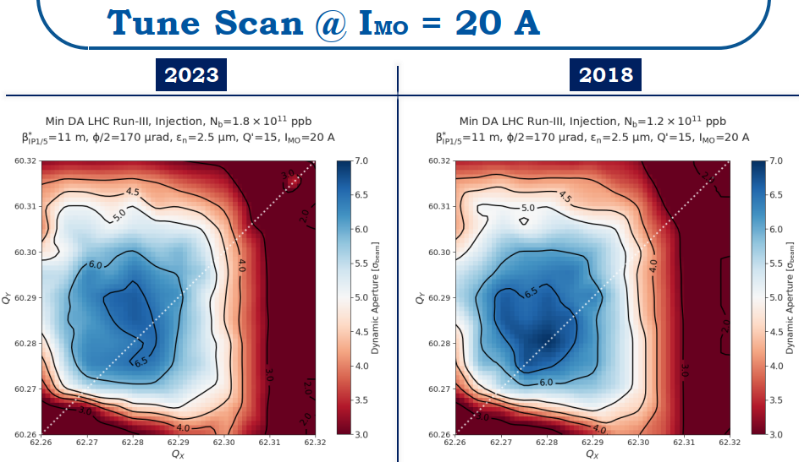
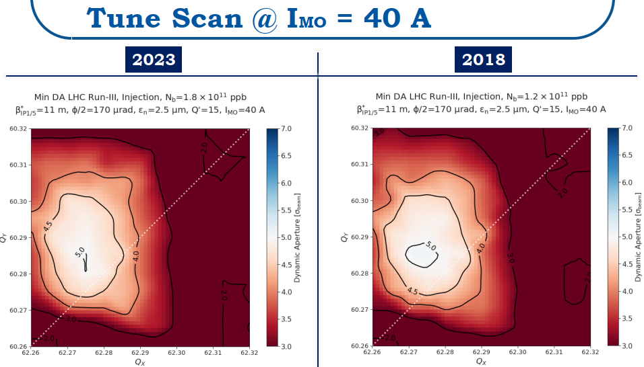
DA at injection for 1.8e11 p/b (keeping the 2017/2018 injection optics)
Even with huge margin taken in emittance (γε=2.5 μm)
the DA killer remains the octupole (at Q’=15), not the BBLR
[in terms of tune spread needed for Landau damping: 40 A @ γε=2.5 μm means 55 A @ γε=1.8 μm at ~cst DA in σ]

Slide 21
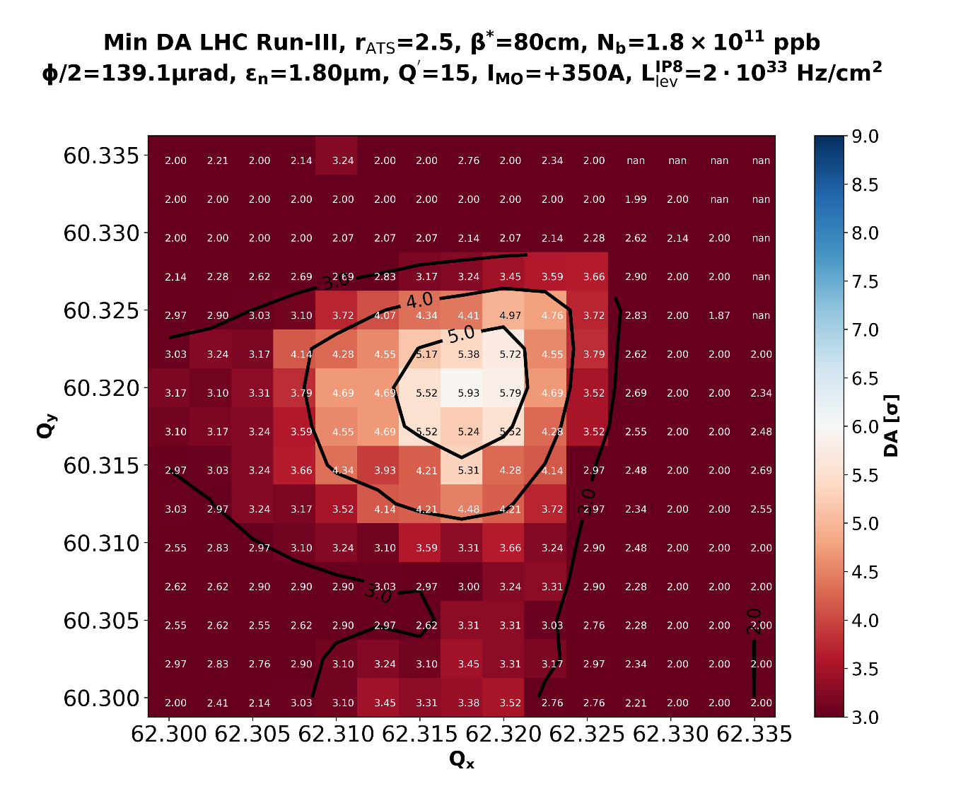
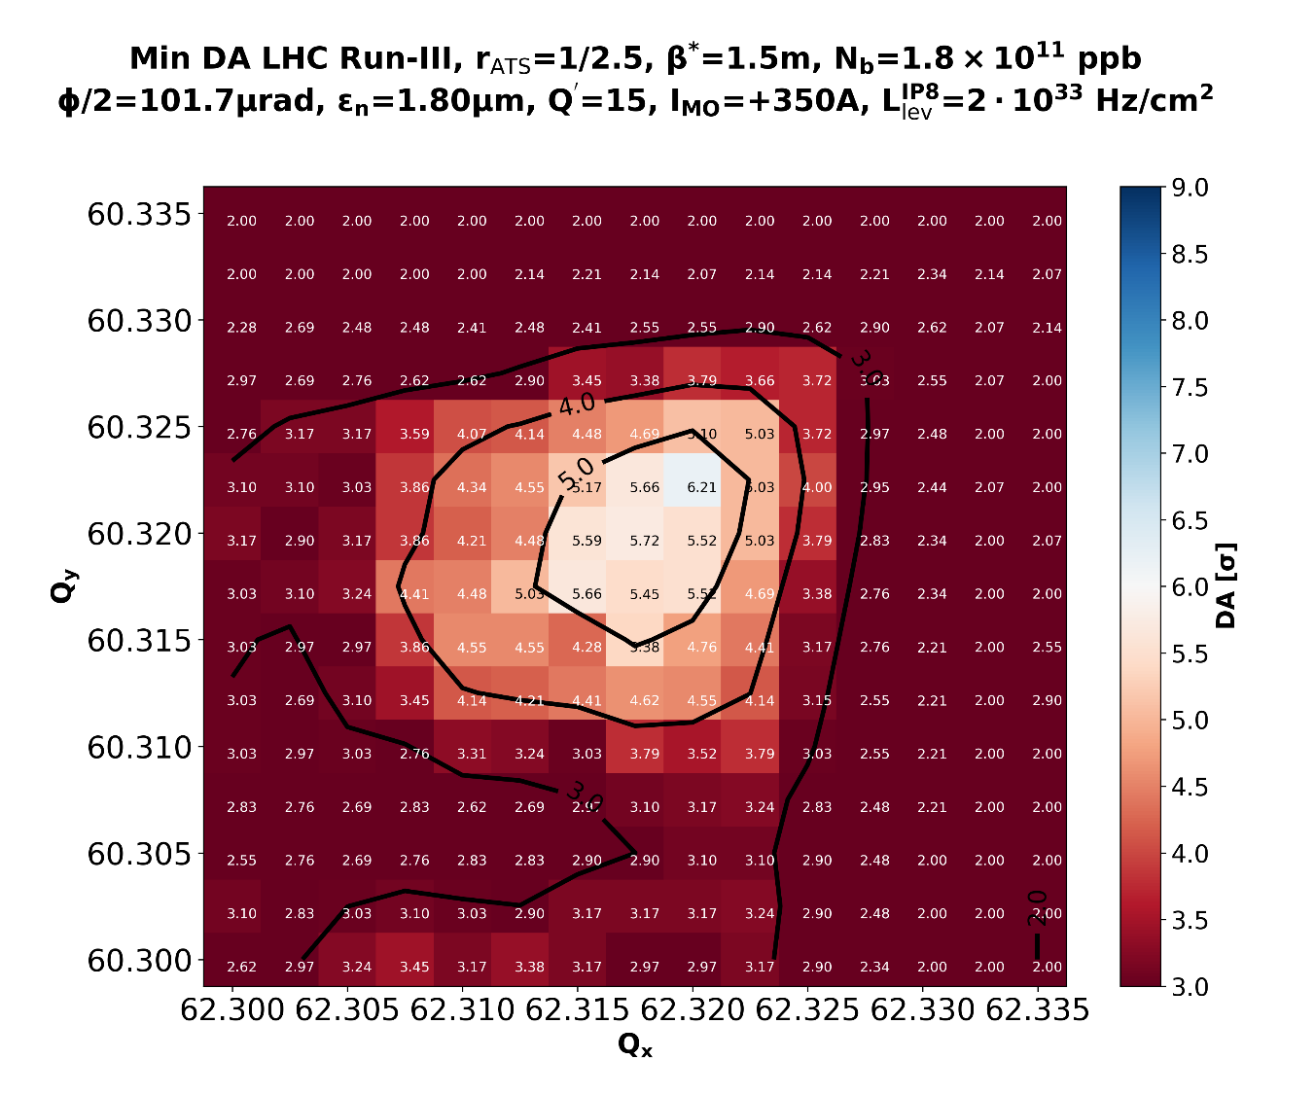
Some pre-checks to compare tele and anti-tele optics (1/3)
Tune scan comparison at “small” emittance (1.8 μm) [different β* but same norm. X-angle]
Telescopic EoR optics with r=2.5
Anti-telescopic EoR optics with r=1/2.5
/afs/cern.ch/eng/lhc/optics/runII/2018/RunIII_DEV/optics_EoR.madx
/afs/cern.ch/eng/lhc/optics/runII/2018/RunIII_DEV/optics_EoR_antitele.madx

Slide 22
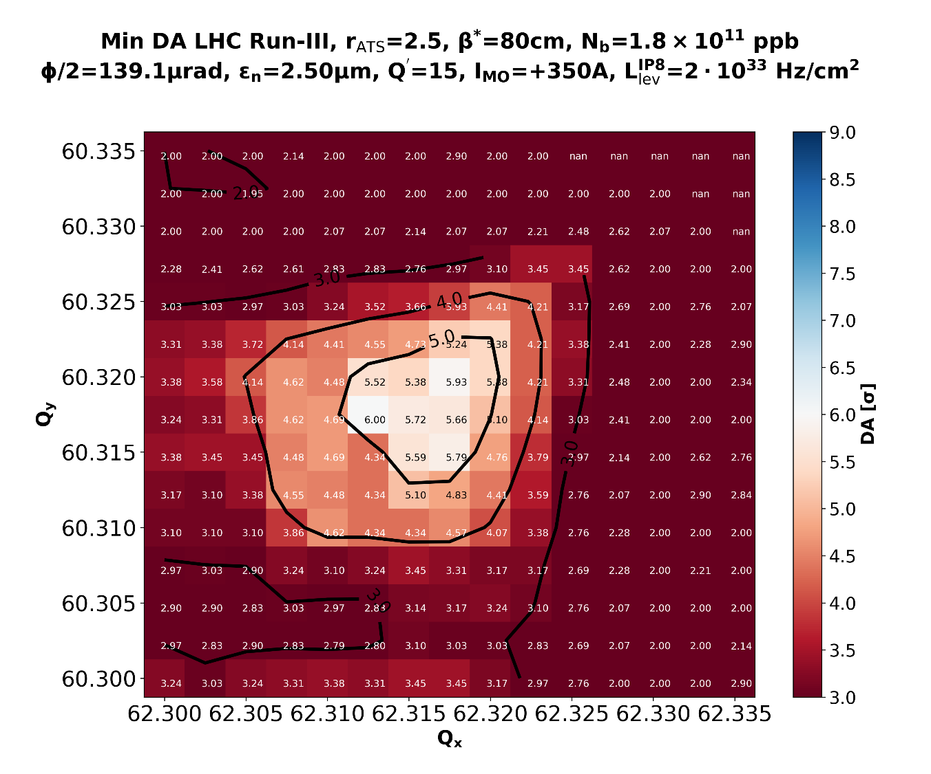
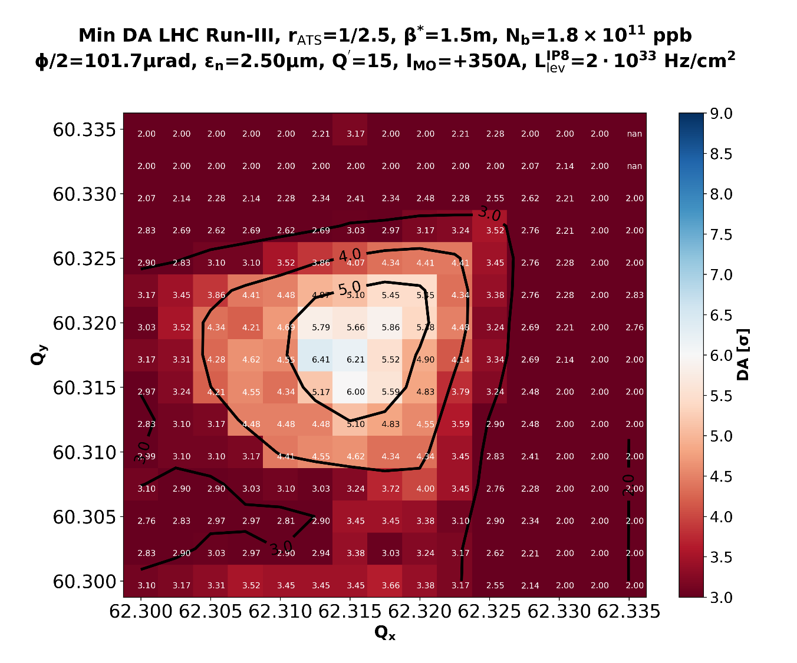
Some pre-checks to compare tele and anti-tele optics (2/3)
Tune scan comparison at “large” emittance (2.5 μm) [different β* but same norm. X-angle]
Telescopic EoR optics with r=2.5
Anti-telescopic EoR optics with r=1/2.5
/afs/cern.ch/eng/lhc/optics/runII/2018/RunIII_DEV/optics_EoR.madx
/afs/cern.ch/eng/lhc/optics/runII/2018/RunIII_DEV/optics_EoR_antitele.madx

Slide 23
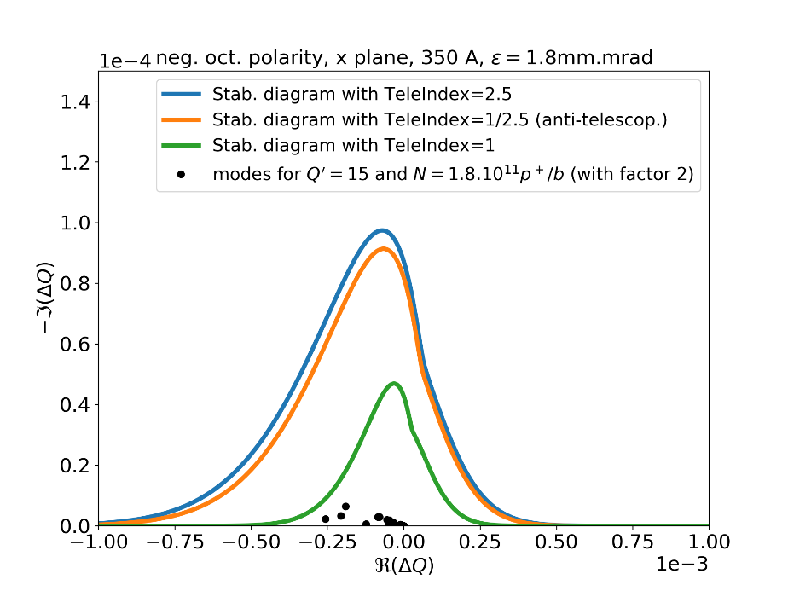
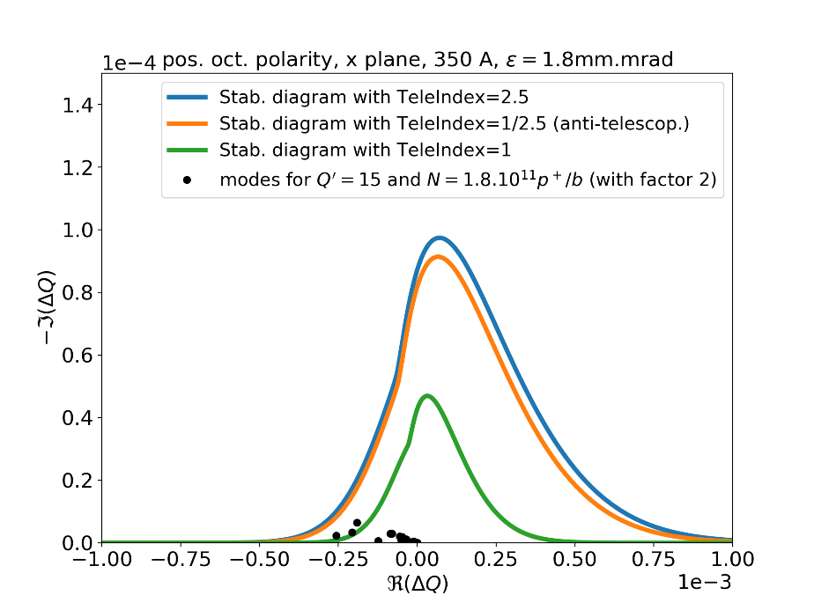
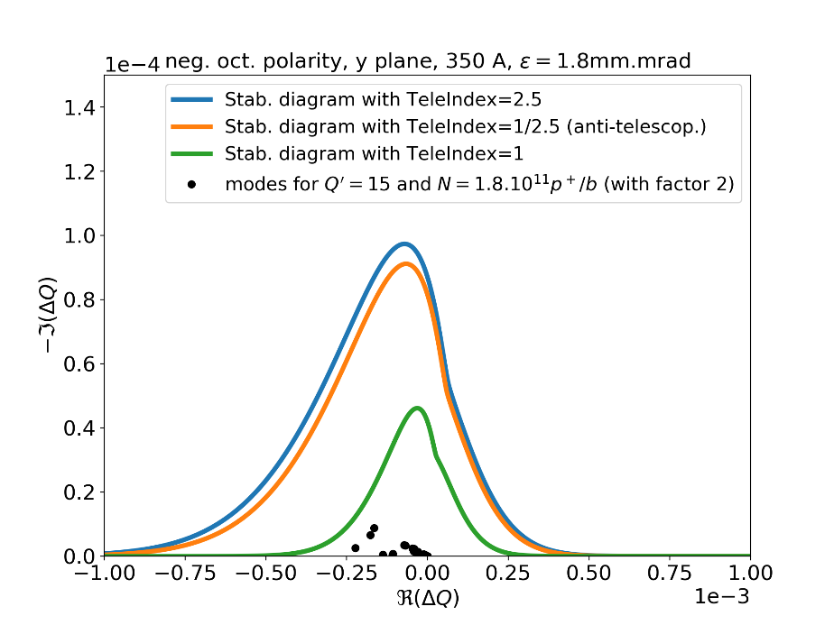

Some pre-checks to compare tele and anti-tele optics (3/3)
Stability diagram comparison (no BBLR), changing r_{tele} into 1/r_{tele}
H-plane
H-plane
Coherent modes
inside (with tele-index)
Coherent modes
well inside
MO<0
(-350 A)
MO >0
(+350 A)
V-plane
V-plane
N. Mounet

Slide 24
Best possible performance reach and IT life time (4/4)
F. Cerutti
10th LCR3 meeting
OPTICS | ROUND | FLAT^{*)} | ROUND + 2024 FLAT^{*)} (+2024 ROUND) | FLAT^{*)} + 2024 FLAT^{*)}
MAGNET | PEAK DOSE [MGy]
Integrated lumi [inc. 190 fb⁻¹ from Run I/II] | after 412 fb⁻¹ | after 419 fb⁻¹ | after 520 (518) fb⁻¹ | after 527 fb⁻¹
Q1 IR1 | 21 | 20.5
Q1 IR5 | 19 | 18
Q2A IR1 | 25.5 | 25 | 32 (32.5) | 31.5
Q2A IR5 | 19.5 | 17
Q2B IR1 | 14 | 17.5
Q2B IR5 | 26.5 | 21.5 | 31 (34) | 26
Q3 IR1 | 12 | 14
Q3 IR5 | 18.5 | 16.5
Round optics in 2021 (V/H crossing in IR1/5) with LHCf good X-angle polarity in ATLAS
→ Then 2 scenarios for 2022/2023
Round (V/H crossing in IR1/5)
X-angle polarity inversion in ATLAS from 2022 to 2023
Flat (H/V crossing in IR1/5)
X-angle polarity inversion in CMS from 2022 to 2023
Finally 2 possible 2024 extensions
Round optics
Flat optics
^{*)} CMS IP shift assumed to be corrected for flat optics (i.e. machine perfectly realigned)
Possible running scenarios exist with 27 MGy with round optics (25 MGy with flat optics) after 420 fb⁻¹, offering a possible extension for a 4th year, preferably with flat optics and 500 ++ fb⁻¹

