Slide 2
LHC Injectors Upgrade days 2020:
LIU Performance Ramping-up Phase
20 – 22 January, 2019
Hotel Royal Plaza, Montreux (CH)

Slide 3
Session overview
Ions:
  Schedule, criticalities to reach the HL-LHC ion target in Nov. 2021
  Risks linked to parallel beam setting–up (other ion species) and mitigations
Protons:
  Intensity ramp-up plans and main milestones 2022-2024, Incl. target to be reached allowing to move to the next step
  Risks and mitigations
    Non-Conformities, spares, CONS…
    Timeline of proposed checkpoints for postponed Hardware related improvements, e.g. Linac source development, SPS aC coating, …
Organisation of activities: lessons learnt, needs

Slide 4
Session overview
Time slot | Talk
Thurs 8:30 – 8:50 (20’) | HL-LHC desiderata during run 3 (protons + ions)
Thurs 8:50 – 9:15 (25’) | PSB/PS (protons + ions)
Thurs 9:15 – 9:45 (30’) | SPS ramp up (protons)
Thurs 9:45 – 10:10 (25’) | Ions in the SPS (ions)
Thurs 10:10 – 10:30 (20’) | Upgrades beyond baseline

Slide 5
Intensity ramp up in Run 3
LIU beam commissioning plan: a gradual intensity ramp up all through Run 3
2020 – 2021
2022
2023 2024
Ramp up to (2.1e11 p/b, 1.9 um) then to HL-LHC values (2.3e11 p/b, 2.1 um) within desired loss budgets for post-LS3 readiness
Intensity/brightness ramp up to (1.8e11 p/b, 1.7 um) within desired loss budgets
Out of LS2: Individual system tests, hardware commissioning, cold check out, commissioning with beam
Recovery of pre-LS2 proton beams with Linac4 and newly installed LIU (and non-LIU) equipment
Commissioning of LIU ion beams for HL-LHC operation in 2021
Covered in Sessions 2 and 3
Also partially covered in previous sessions, but not from the perspective of the beam dynamics challenges

Slide 6
Intensity ramp up in Run 3
LIU beam commissioning plan: a gradual intensity ramp up all through Run 3
LIU/HL-LHC ions in 2021
  Commissioning time from MD time or dedicated? Most probably it will have to be shared between the two
  Need to draft a plan of machine studies leading to the full commissioning: Prerequisites to start studies – do we really need to start all tests in September? – rough steps to be followed, e.g. with single bunches, then shorter trains, maybe with intensity ramp up to disentangle intensity effects, etc.
LIU proton beams throughout Run 3
  Mainly through MDs: Do we have enough MD time; do we need dedicated MD time for some activities (e.g. PS matching at injection); which milestones we need to reach in the different machines over the years; what are the main challenges expected on the path and which actions they may trigger; lessons from past experience of deploying new equipment/new operational scenarios in MDs (e.g. PS broadband cavity, high intensity in SPS)

Slide 7
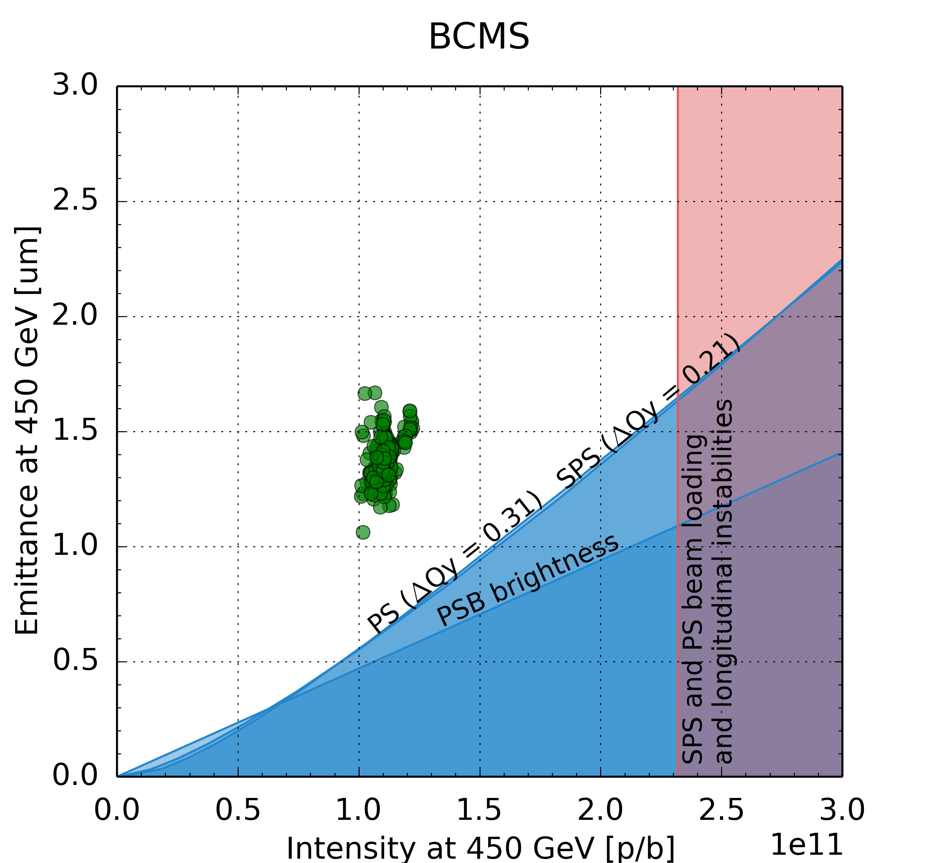
Intensity ramp up in Run 3
In parallel to the intensity ramp up of the LIU beams, also the LHC operational beams will have to follow the LHC requests (Evian 2018)
2020 – 2021
2022
2023 2024
Points from 2018 operation
Intensity/brightness ramp up of BCMS beams to (1.8e11 p/b, 1.3 um) within desired loss budgets
Recovery of pre-LS2 proton beams with Linac4 and newly installed LIU (and non-LIU) equipment
Commissioning of LIU ion beams for HL-LHC operation in 2021

Slide 8
Intensity ramp up in Run 3
In parallel to the intensity ramp up of the LIU beams, also the LHC operational beams will have to follow the LHC requests (Evian 2018)
This will have to be considered beam commissioning for physics and could be done in dedicated mode
  48 bunch trains are in general easier to handle than 72 bunch trains (e-cloud?)
  However preservation of very low emittances could prove difficult
LHC may anyway want to receive higher intensities (than 1.8 p/b) or different LHC beam variants (e.g. 8b4e) before the end of Run 3 for dedicated machine studies with impact on HL-LHC

Slide 9
Session: LIU beam performance ramping up phase
(Giovanni + Heiko)
HL-LHC desiderata during run 3 (protons + ions) – 15’+5’ Rogelio
  Key questions to be answered during Run 3, which could still steer items of HL-LHC?
  Priorities for LHC beam studies in Run 3 in terms of relevance for HL-LHC
  Desiderata for special beams, for which the LIU beam commissioning could help, and timeline to have them available

Slide 10
Session: LIU beam performance ramping up phase
(Giovanni + Heiko)
PSB + PS (protons + ions) – 20’+5’ Alexander
  Plan to ramp up to LIU beam parameters, milestones in PSB and PS
  How to reach the LIU brightness curve in the PSB
  Brightness reach of the PS to reach LIU goals by 2022
    PSB-PS transfer
    Large longitudinal emittance at transfer and PS flat-bottom
    Emittance preservation along the cycle and how to further reduce blow-up
  Higher intensity or smaller longitudinal emittance from the PS
    Impact of the remaining RF upgrades on the PS intensity vs longitudinal emittance reach

Slide 11
Session: LIU beam performance ramping up phase
(Giovanni + Heiko)
SPS ramp up (protons) – 25’+5’ Elena
  Plan to ramp up to LIU beam parameters, milestones
  Reference measurements to validate post-LS2 impedance models (and reduction)
  Losses at PS-SPS transfer, injection and flat-bottom
  Longitudinal stability during the cycle
    Impact of RF upgrade (power, LL) and longitudinal impedance reduction
    Deployment of longitudinal emittance blow-up
    800 MHz voltage programme
  Horizontal instability
    Origin and expected impact with LIU parameters
    Do we have sufficient knobs to suppress it without post-LIU developments?
  Reconditioning for high intensity with respect to e-cloud
    Experience from the past
    Intensity ramp up
    Operational issues that could limit scrubbing efficiency (kicker heating, outgassing, …)

Slide 12
Session: LIU beam performance ramping up phase
(Giovanni + Heiko)
Ions in the SPS (ions) – 20’+5’ Theodoros
  Slip stacking
    Results from simulations, lessons from FNAL experience?
    LLRF readiness, milestones
    Compatibility with new hardware
    Path to full implementation with timeline
  Longitudinal instability
    2018 experience and simulations
    Any improvement to be expected with the upgraded 200 MHz RF system (also concerning FFA and losses at transition)?
    Expectations with and without slip stacking, possible roadmap to stabilization (longitudinal emittance blow up, 800 MHz)
  Potential transverse instability
    Transverse impedance issues with displaced beams?

Slide 13
Session: LIU beam performance ramping up phase
(Giovanni + Heiko)
Upgrade beyond baseline: LIU2 – 15’+5’ Hannes
  Decision trees for post-LIU upgrade options and associated cost estimates
    To correct “failure scenarios” or nonconformities causing underperformance or low reliability?
    Include Linac4 (e.g. source developments for higher current, RFQ strategy, reliability improving upgrades?)
    Include the benefit from other items dropped from LIU (or downsized), like the PSB orbit correctors, PS RF upgrades (amplifiers for 40/80 MHz cavities, additional ferrite tuner)
  Strategy during Run 3 to follow-up the need for additional upgrades during ramp up phase (and beyond) – assess necessity, endorse, finance, execute
    How much MD time needed in Run 3 for the ramp up and to identify showstoppers (Thursday long parallel Md slots and impact on the possible reduction wrt 2018)

