Slide 2
LHC Injectors Upgrade Workshop
Montreux, 20-22 January 2020

Slide 3
LIU beam performance ramping up phase:
PSB and PS
A. Huschauer with input from
S. Albright, F. Antoniou, F. Asvesta, H. Bartosik, C. Bracco, H. Damerau, G.P. Di Giovanni, M. Fraser, K. Hanke,
A. Lasheen, B. Mikulec, H. Rafique, E. Renner, G. Rumolo, E. Shaposhnikova, F. Tecker

Slide 4
Outline
Beam performance ramp-up for proton beams during Run 3
The standard beam
  Intensity ramp-up
  Brightness ramp-up
The BCMS beam as operational beam during Run 3
Conclusions

Slide 5
Beam performance ramp-up for proton beams during Run 3
Two different beams have to be distinguished during Run 3
  Standard beam with 72 bunches (HL-LHC baseline)
    gradual performance increase to be carried out in parallel MDs
      allocate a permanent parallel “LIU commissioning” slot in the PSB and the PS super cycle?
  BCMS with 48 bunches
    considered to be the operational beam during Run 3
    performance increase as the work on the standard beam progresses
Two main aspects of the LIU beam performance ramp-up of the standard beam
  Intensity ramp-up → mainly occurring in the SPS
  Brightness ramp-up → determined by the PSB and PS performance

Slide 6
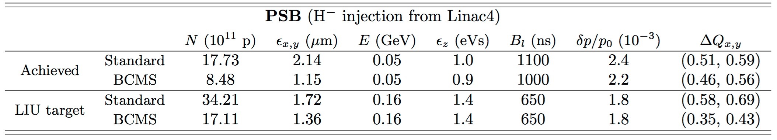
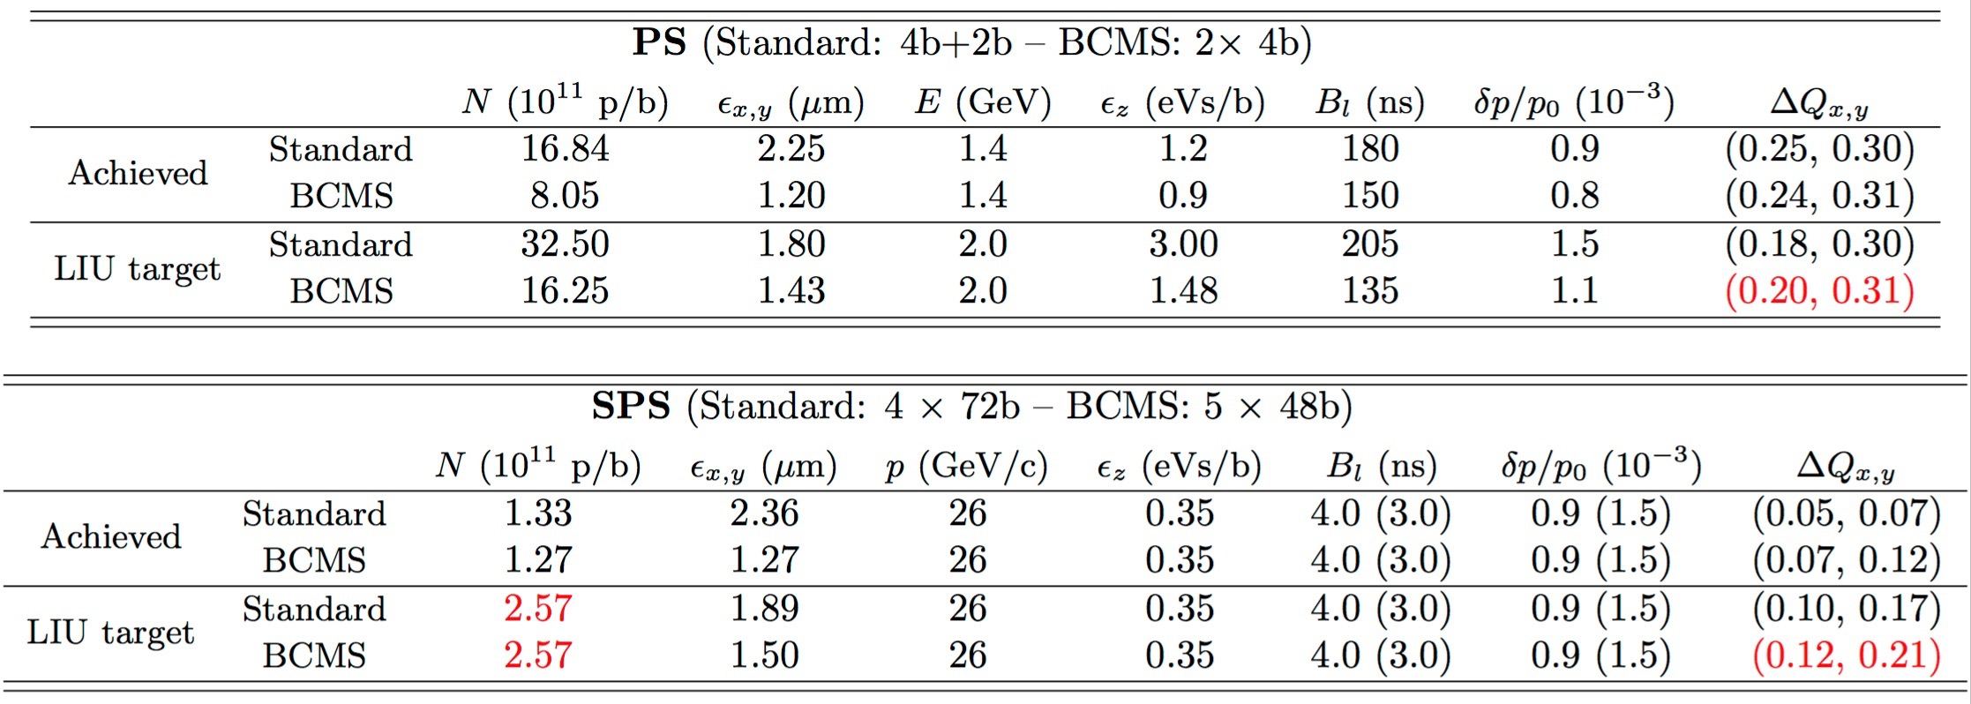
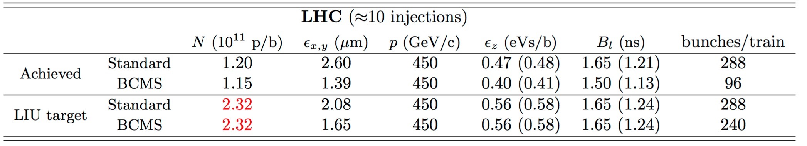
Beam performance ramp-up for proton beams during Run 3
LIU target beam parameters at injection of the respective accelerator (from EDMS1296306)

Slide 7
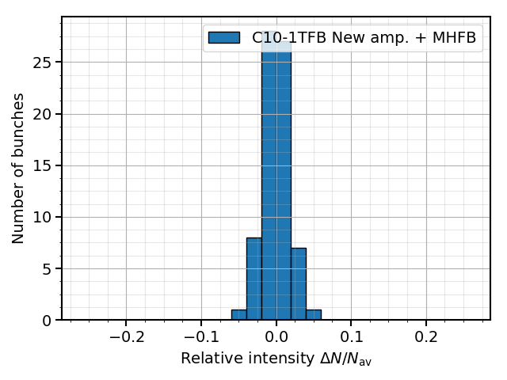
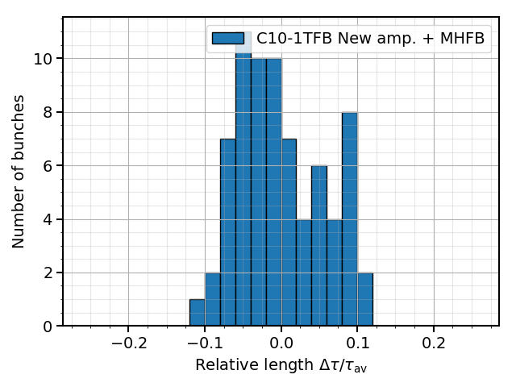
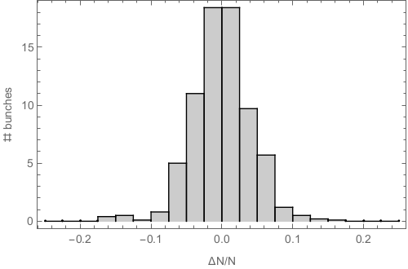
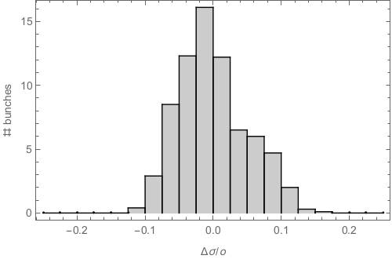
Intensity ramp-up of the standard beam
Intensity reach demonstrated at PS extraction pre-LS2
  Remaining upgrades of the PS RF systems will further improve the reproducibility and reduce the bunch-by-bunch variability
    New 10 MHz feedback amplifiers to reduce the impedance and deliver more robust performance
    Improved reliability of the Finemet cavity
    No major modifications to the high-frequency cavities (multi-harmonic feedbacks already in place pre-LS2)
Simulation results confirm improved beam quality after LS2
  Pre-LS2 measurements: bunch-by-bunch variation ≈ ±10%
  Assuming completely independent triple and double
  splittings in simulations
  significantly reduced intensity spread achievable
  at LIU intensity
  Further optimization possible to improve bunch
  length spread at the expense of increased intensity
  spread
  Further simulations indicate degradation of the triple
  splitting in the presence of the Finemet impedance
  → studies with beam required during Run 3
Intensity spread
Bunch length spread
measurement
measurement
simulation
simulation

Slide 8
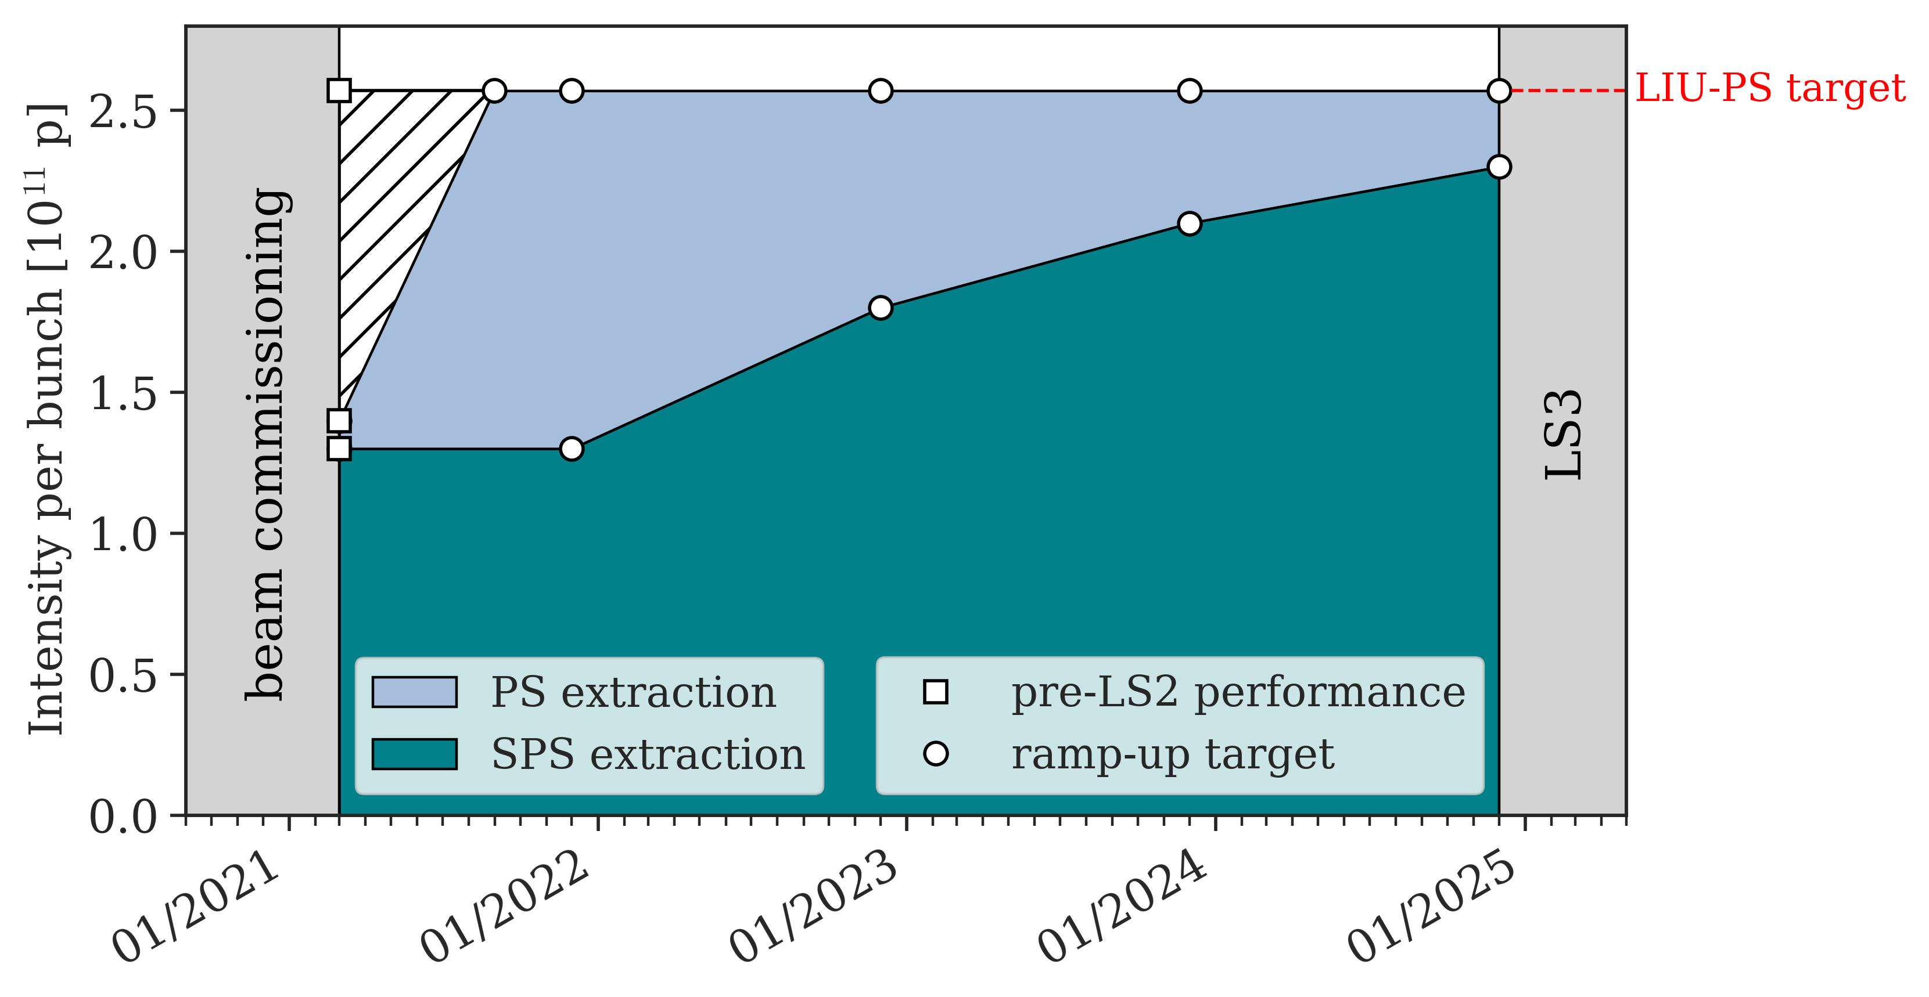
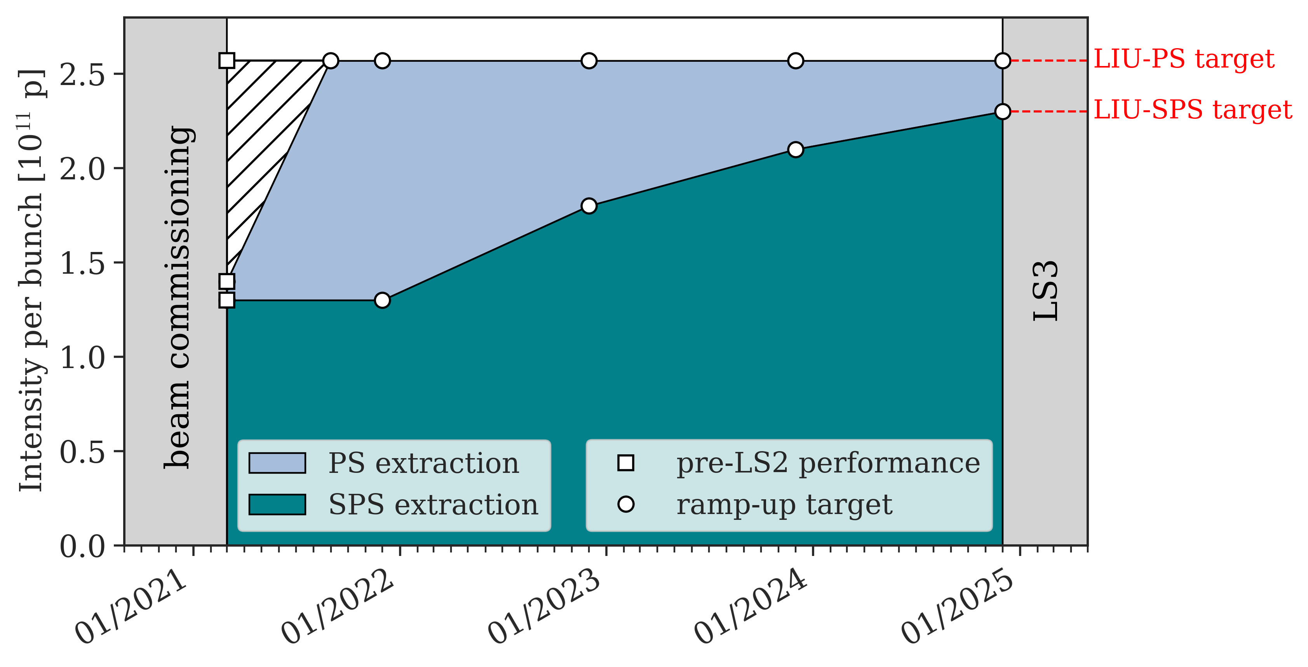
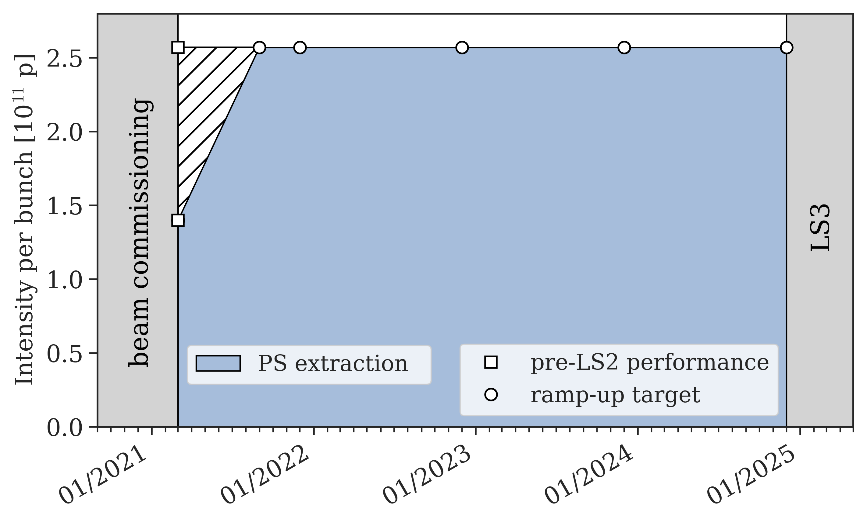
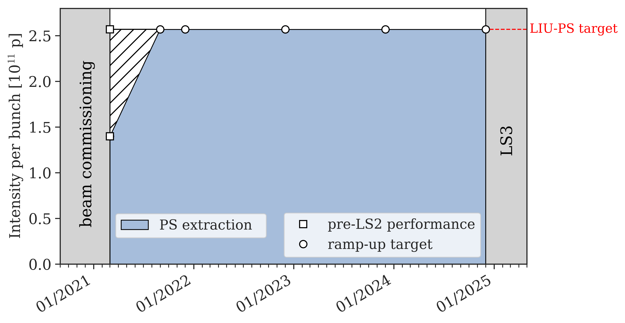
Intensity ramp-up of the standard beam
Intensity reach demonstrated at PS extraction pre-LS2
  Recovery of high-intensity beams
  expected by end of summer 2021
Gradual intensity ramp-up in the SPS
  Ramp-up planned to start from 2022
  due to LHC Pb-ion run at the end of 2021
  LIU-SPS intensity target planned to be reached at the end of 2024

Slide 9
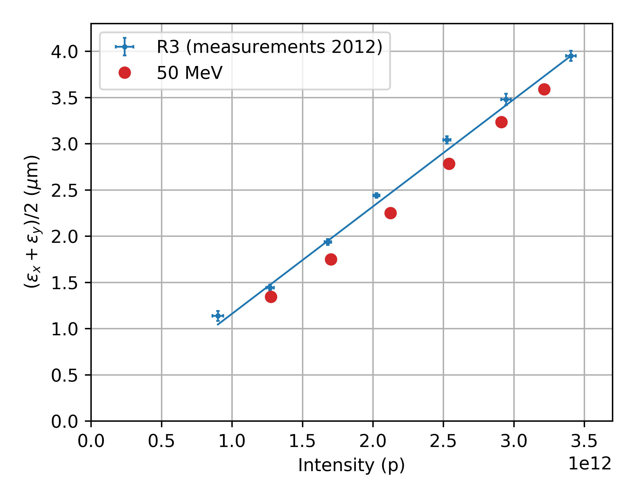
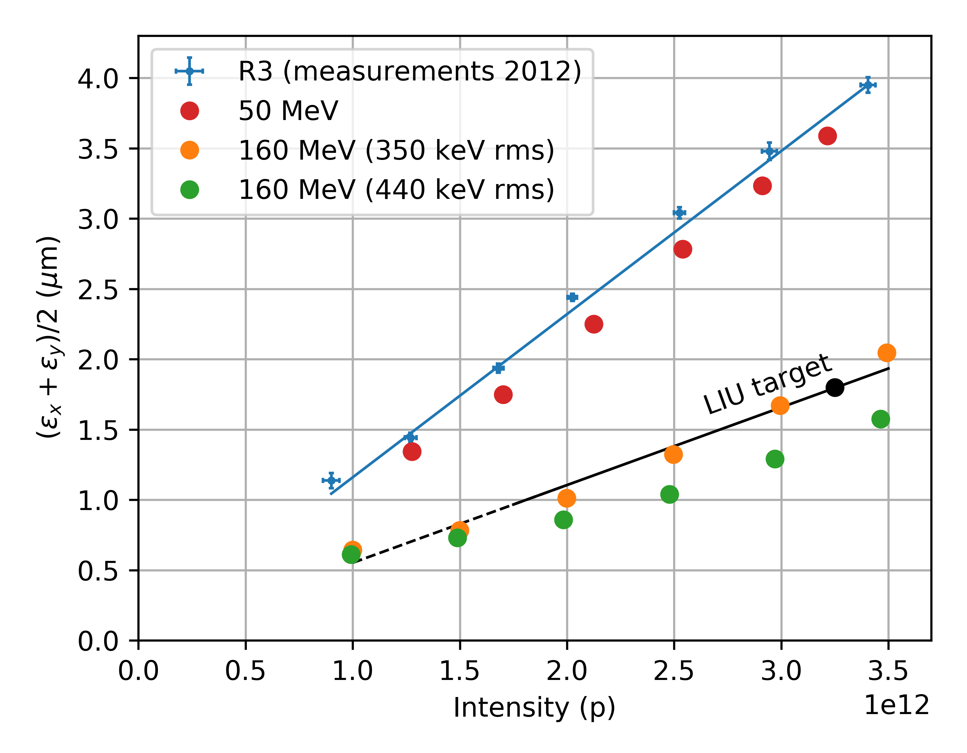
Brightness ramp-up of the standard beam
Achievable PSB brightness limited by the injection scheme and acceleration at low energy
PSB space charge simulation studies were performed to reproduce pre-LS2 and investigate LIU performance
  Simulations at 50 MeV (beam from Linac2)
    capture of coasting beam (1e-3 dp/p rms) with operational
    voltage program
    capture losses of about 15% (as observed in measurements)
    single turn injection on the ramp (no multi-turn stacking)
    1 µm transverse emittance at injection
    Q_{x} / Q_{y} = 4.40 / 4.45
    5% beta-beating included
  Simulations at 160 MeV (beam from Linac4)
    25 mA at PSB injection
    350 keV rms energy spread with chopping factor 0.6
    440 keV rms energy spread with chopping factor 0.7
    “flat1” cycle and voltage program provided by S. Albright
    injection on flat bottom, with injection chicane and foil
    0.4 µm transverse emittance at injection
    Q_{x} / Q_{y} = 4.40 / 4.45
    15% beta-beating included
minimum PSB emittance (foil hits)
➔ large energy spread (~440 keV rms) from Linac4 required

Slide 10
Brightness ramp-up of the standard beam
Achievable brightness along the chain will be limited by space charge effects on the PS flat bottom
  LIU baseline: beams with large longitudinal emittance at PS injection to overcome this limitation
  Brightness ramp-up therefore determined by the evolution of the longitudinal emittance at PS injection
Longitudinal emittance at PS injection will be gradually increased during Run 3
  Brightness ramp-up is foreseen to take place until the end of 2023
  Limited experience with large longitudinal emittance beams and their impact on transverse emittances
    Standard procedure from an RF point-of-view
  Transverse emittance preservation at PS injection and on the flat bottom is expected to be the most critical aspect
  Emittance preservation along the ramp might also become critical and work is ongoing to improve the control of the PFW
  Foresee sufficient commissioning time to gain experience

Slide 11
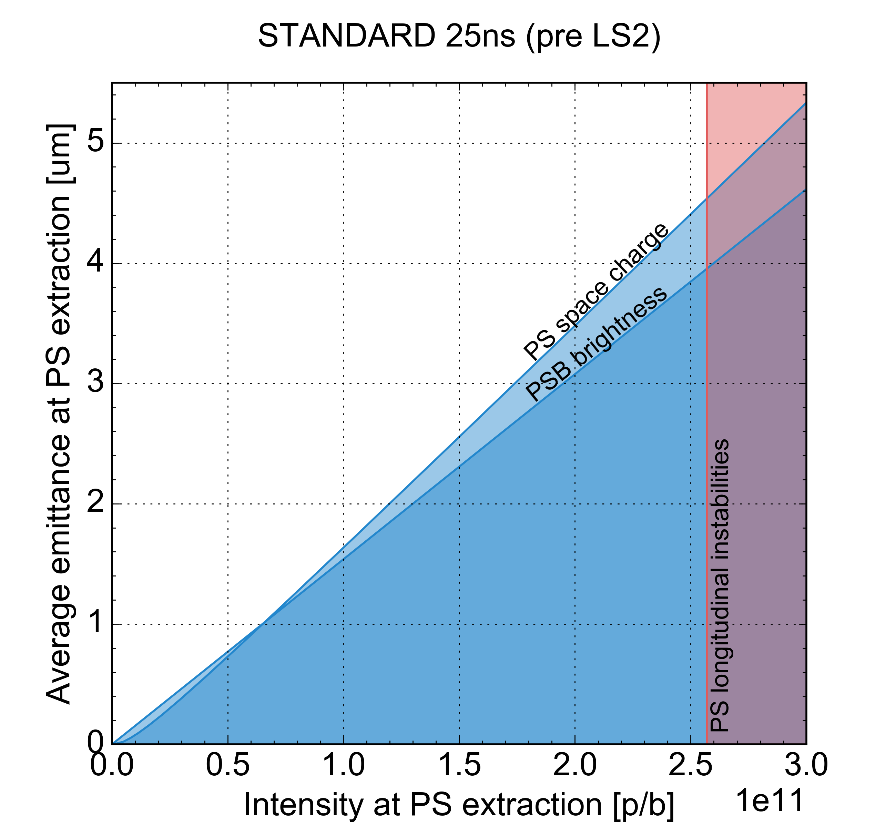
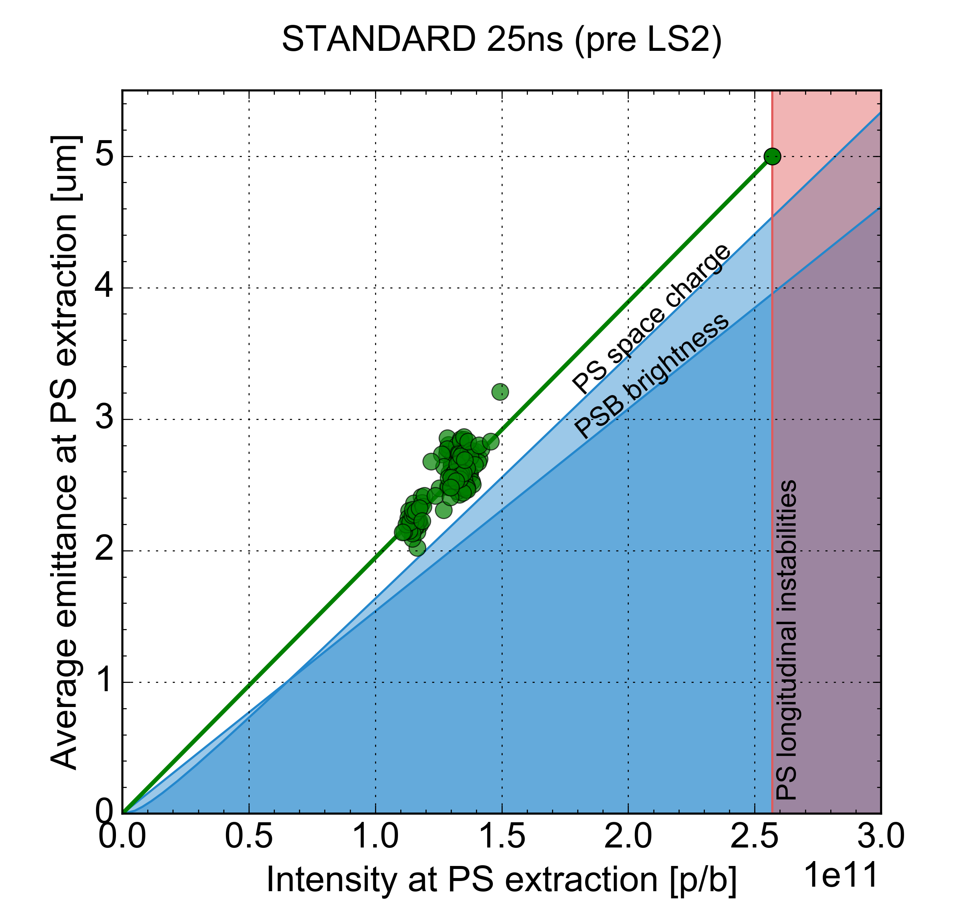
Pre-LS2 performance of the standard beam
Experience with the standard beam
  Operational experience limited to 2016
  LIU intensity target achieved in MDs in 2018
    Reliable beam production at high-intensity achieved after transverse optimization
Performance at different intensities followed constant brightness
HI performance
Operational performance in 2016

Slide 12
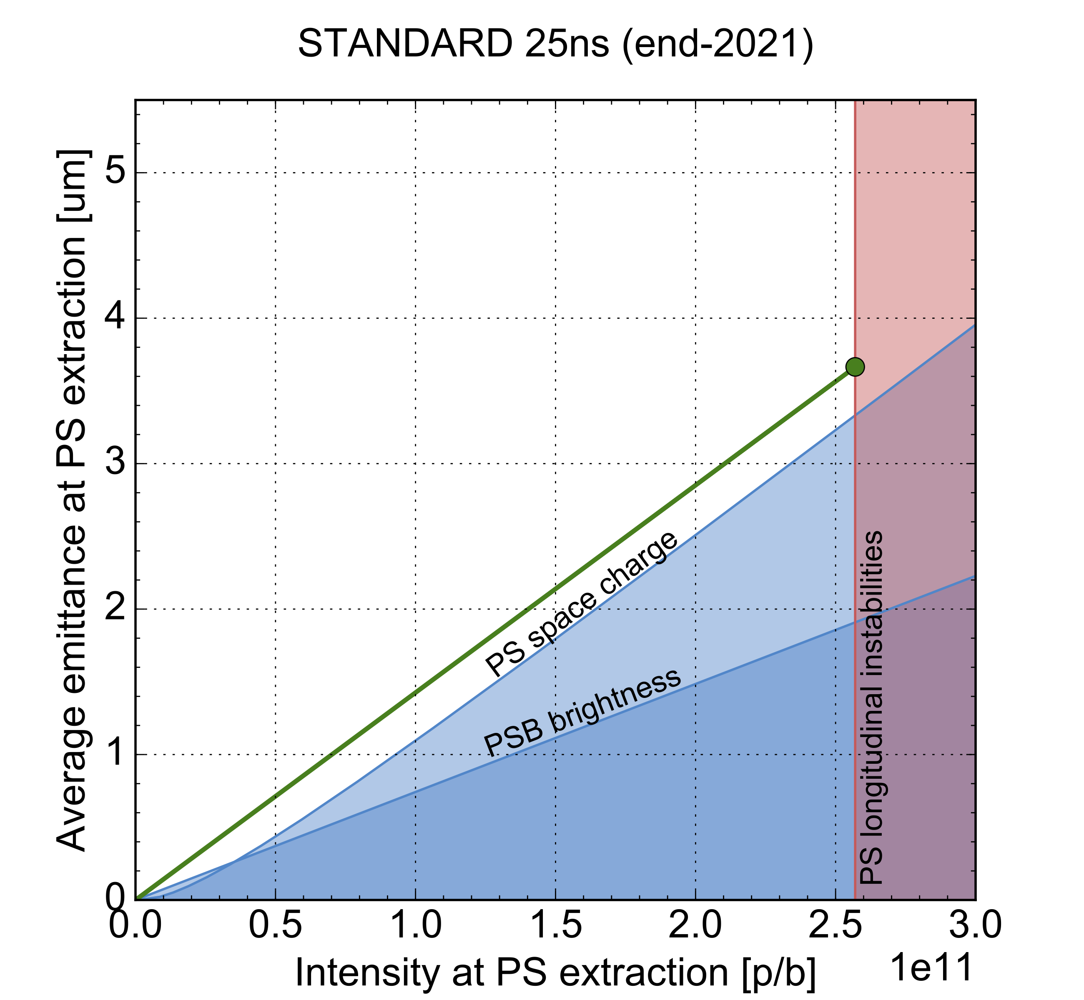
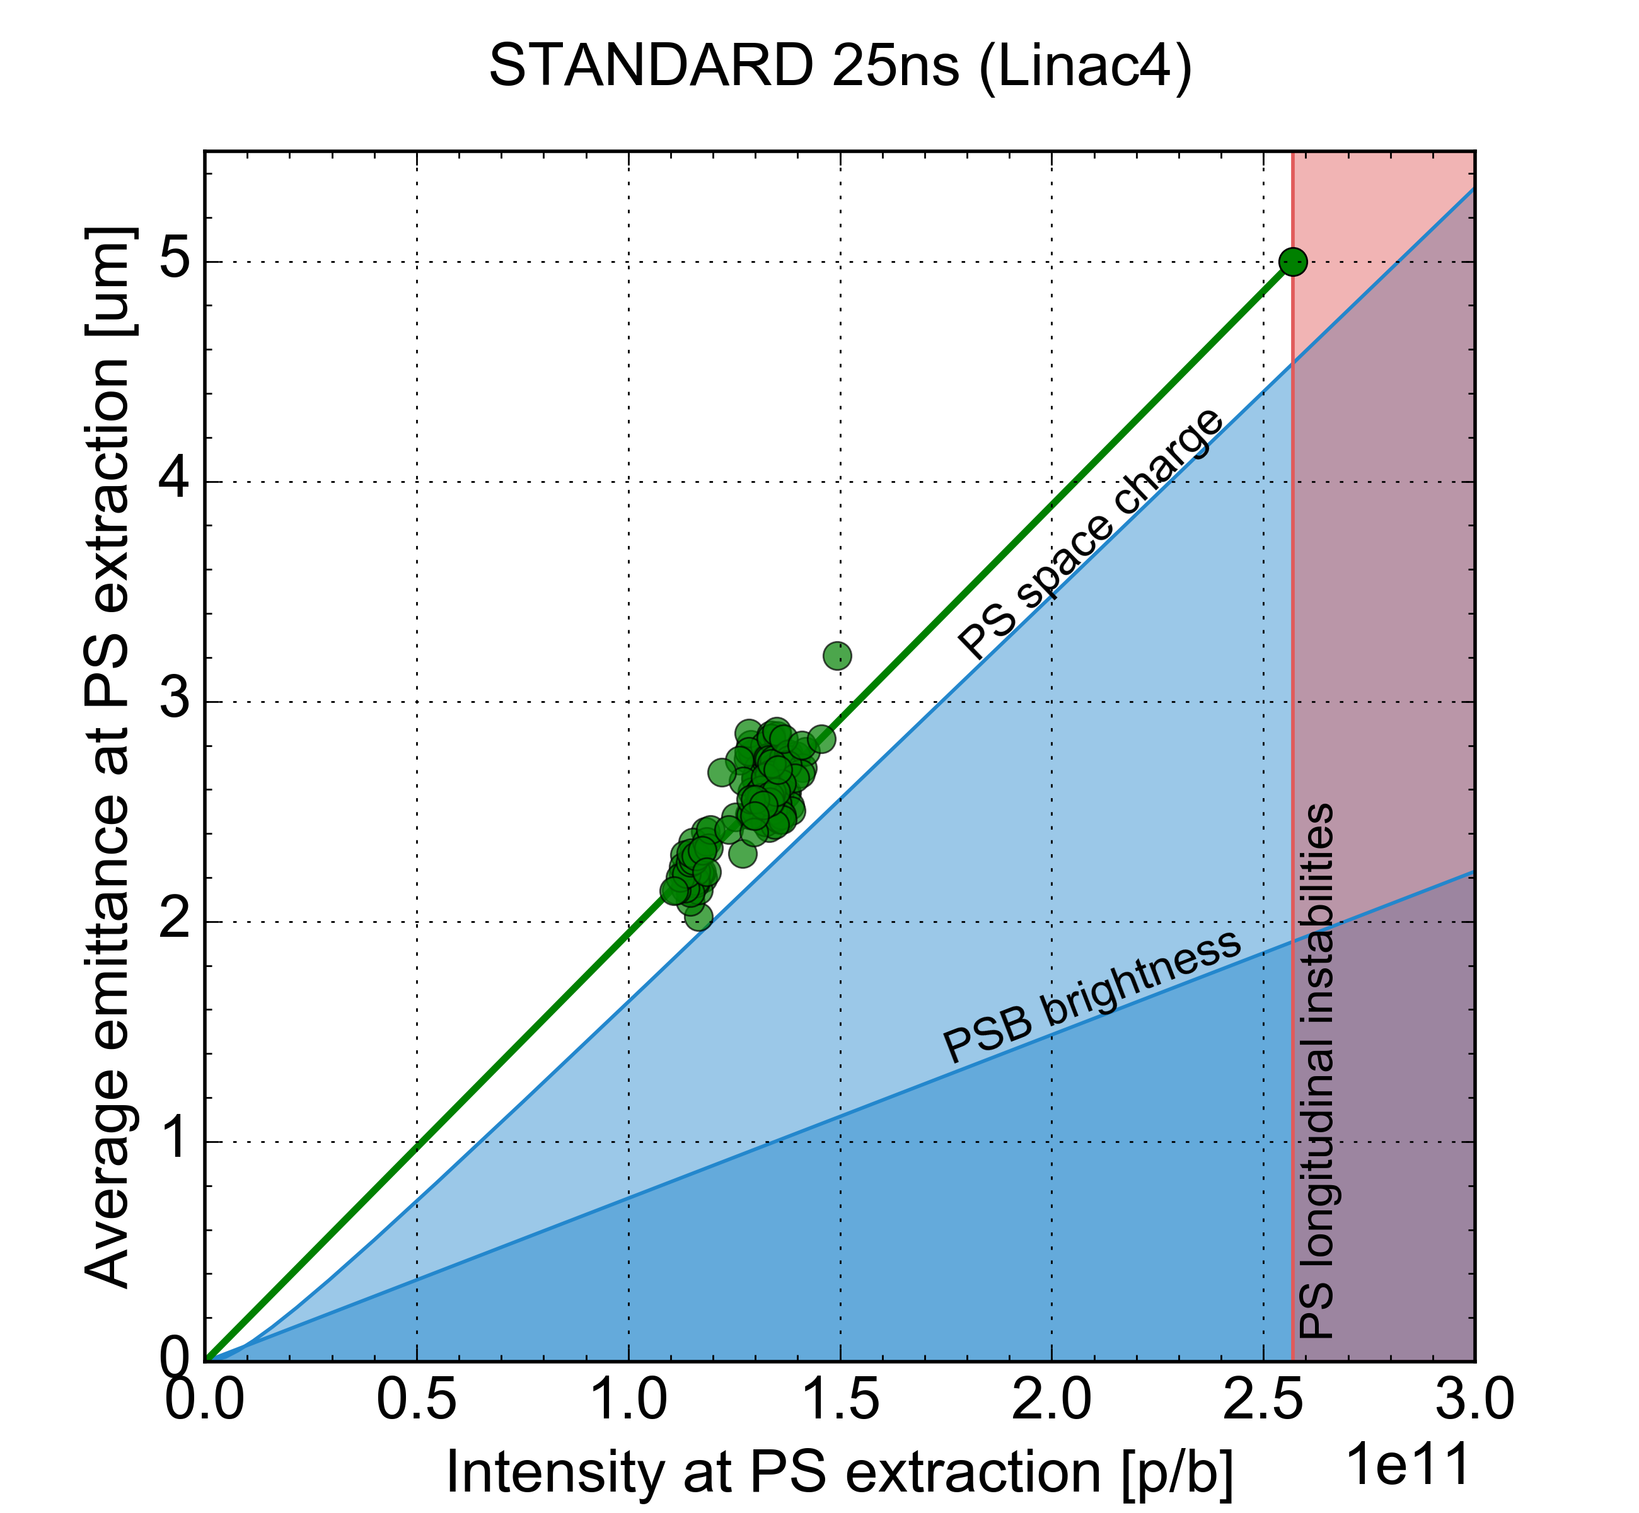
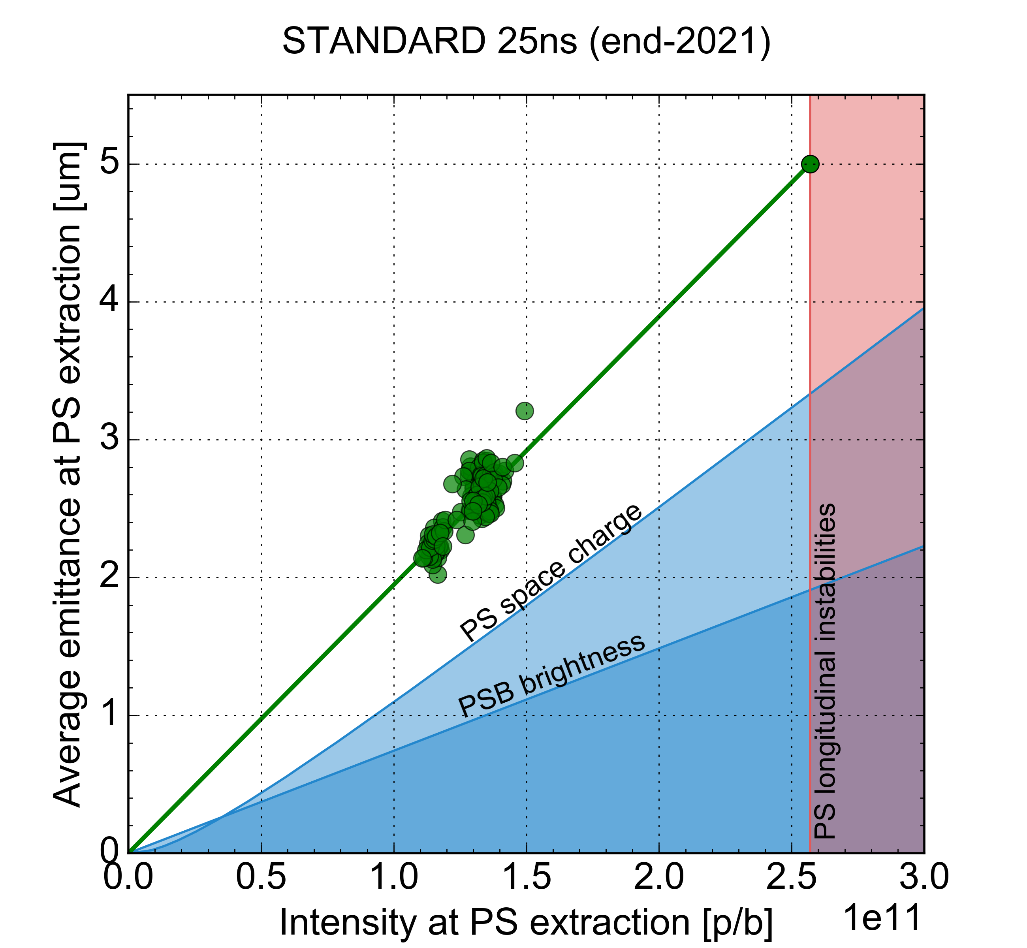
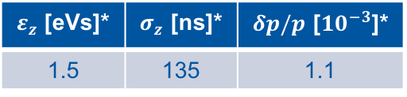
Target performance of the standard beam at the end of 2021
PSB will deliver beams of significantly increased brightness already in 2021
Longitudinal parameter target at PS injection in 2021
  will require longitudinal blow-up at the end of the PS flat bottom
Achievable brightness will be limited by space charge effects on the PS flat bottom
First important brightness increase expected to be achieved at the end of 2021
  Including a 10% margin on the transverse emittances with respect to the maximum achievable performance
HI performance
Operational performance in 2016
$ε_{z}$ [eVs]* | $σ_{z}$ [ns]* | $δp/p$ [${10}^{−3}$]*
1.5 | 135 | 1.1
* parameter conventions according to EDMS1296306
2021 target brightness

Slide 13
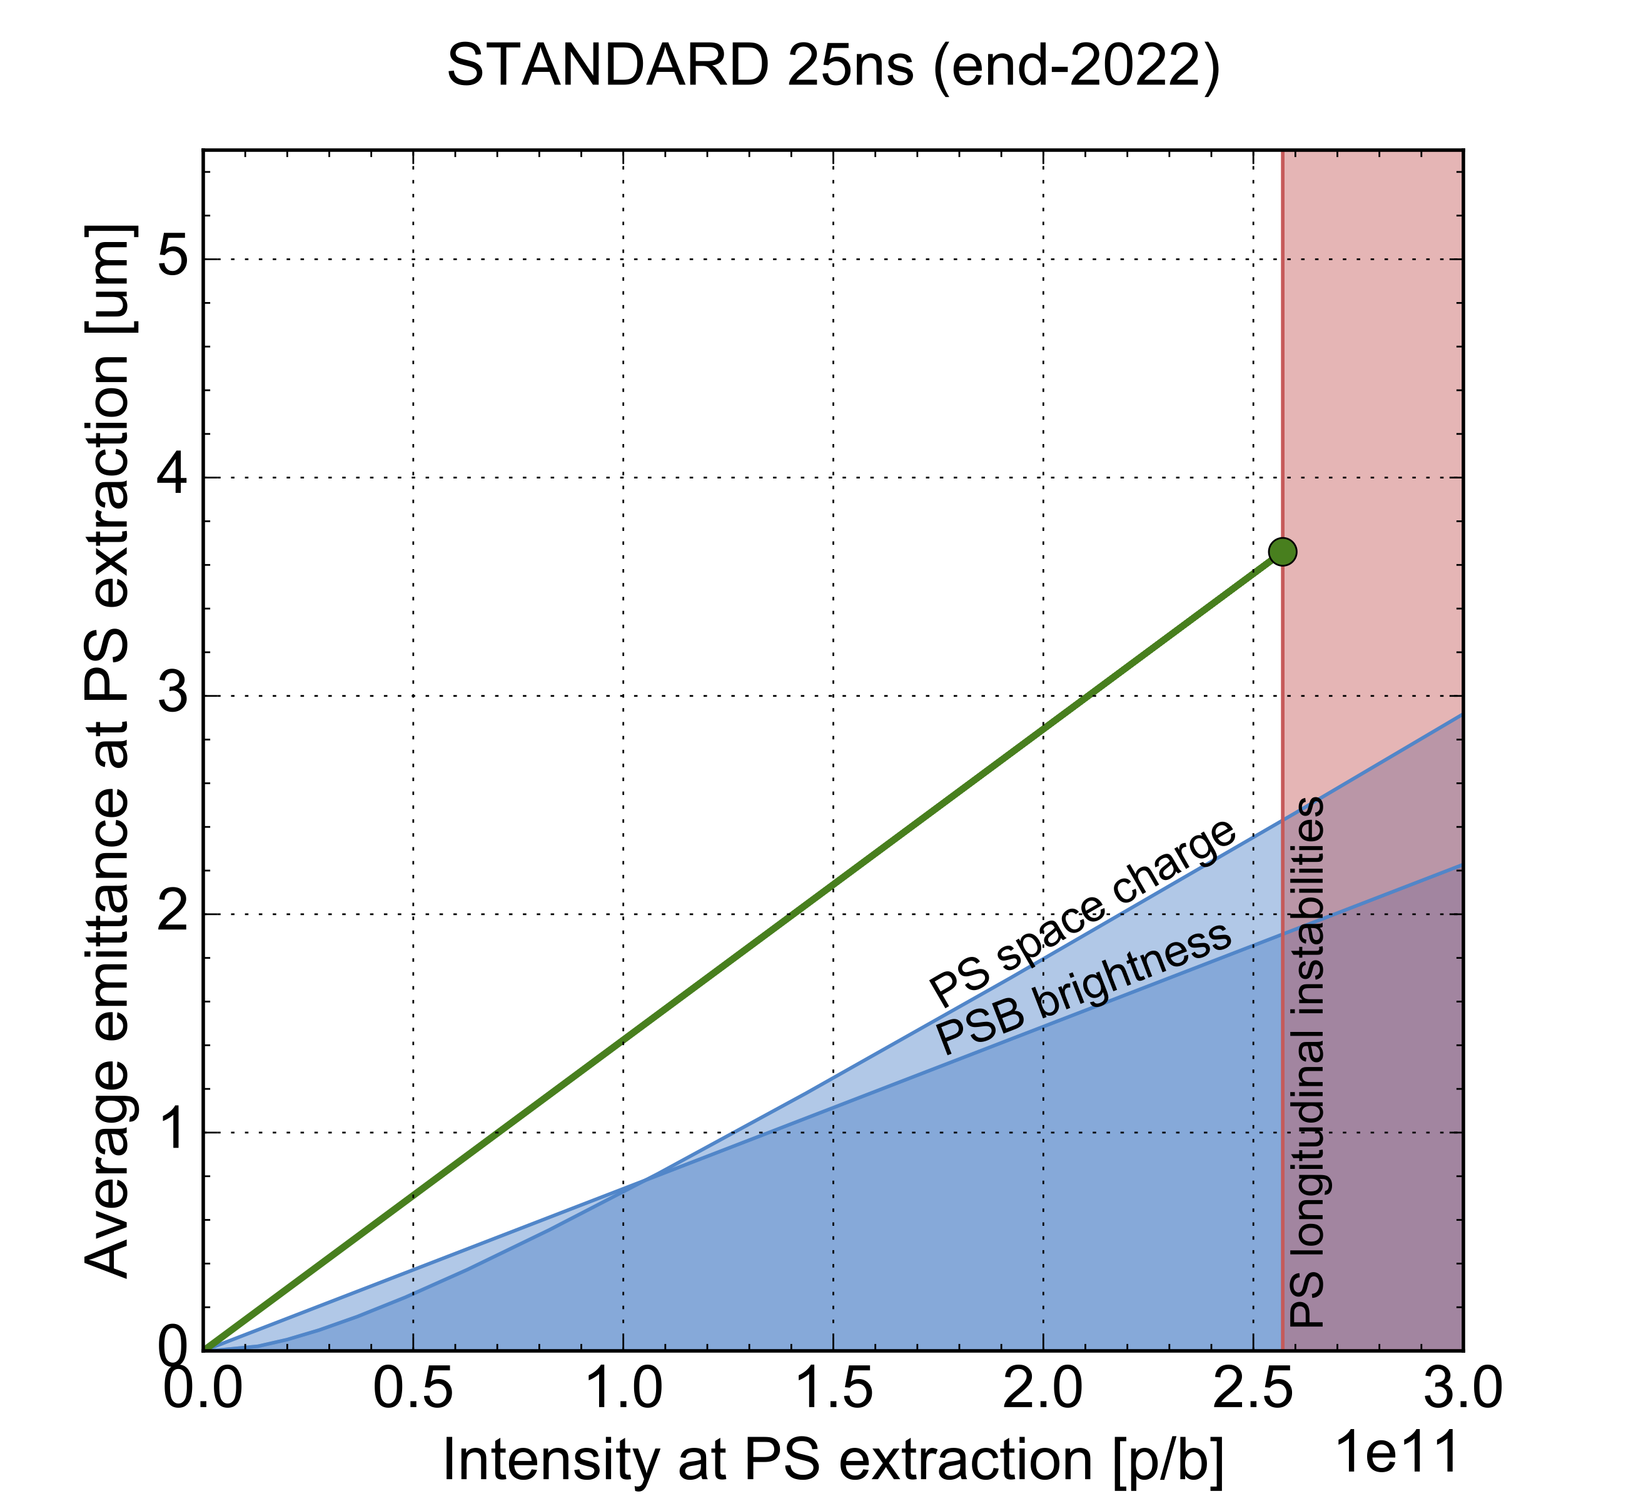

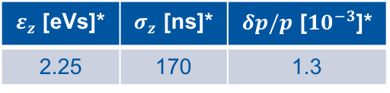
Target performance of the standard beam at the end of 2022
Further brightness increase by increasing the longitudinal emittance at PS injection
  Longitudinal parameter target at PS injection in 2022
Achievable brightness will still be limited by space charge effects on the PS flat bottom
$ε_{z}$ [eVs]* | $σ_{z}$ [ns]* | $δp/p$ [${10}^{−3}$]*
2.25 | 170 | 1.3
2021 target brightness
* parameter conventions according to EDMS1296306
2022 target brightness

Slide 14
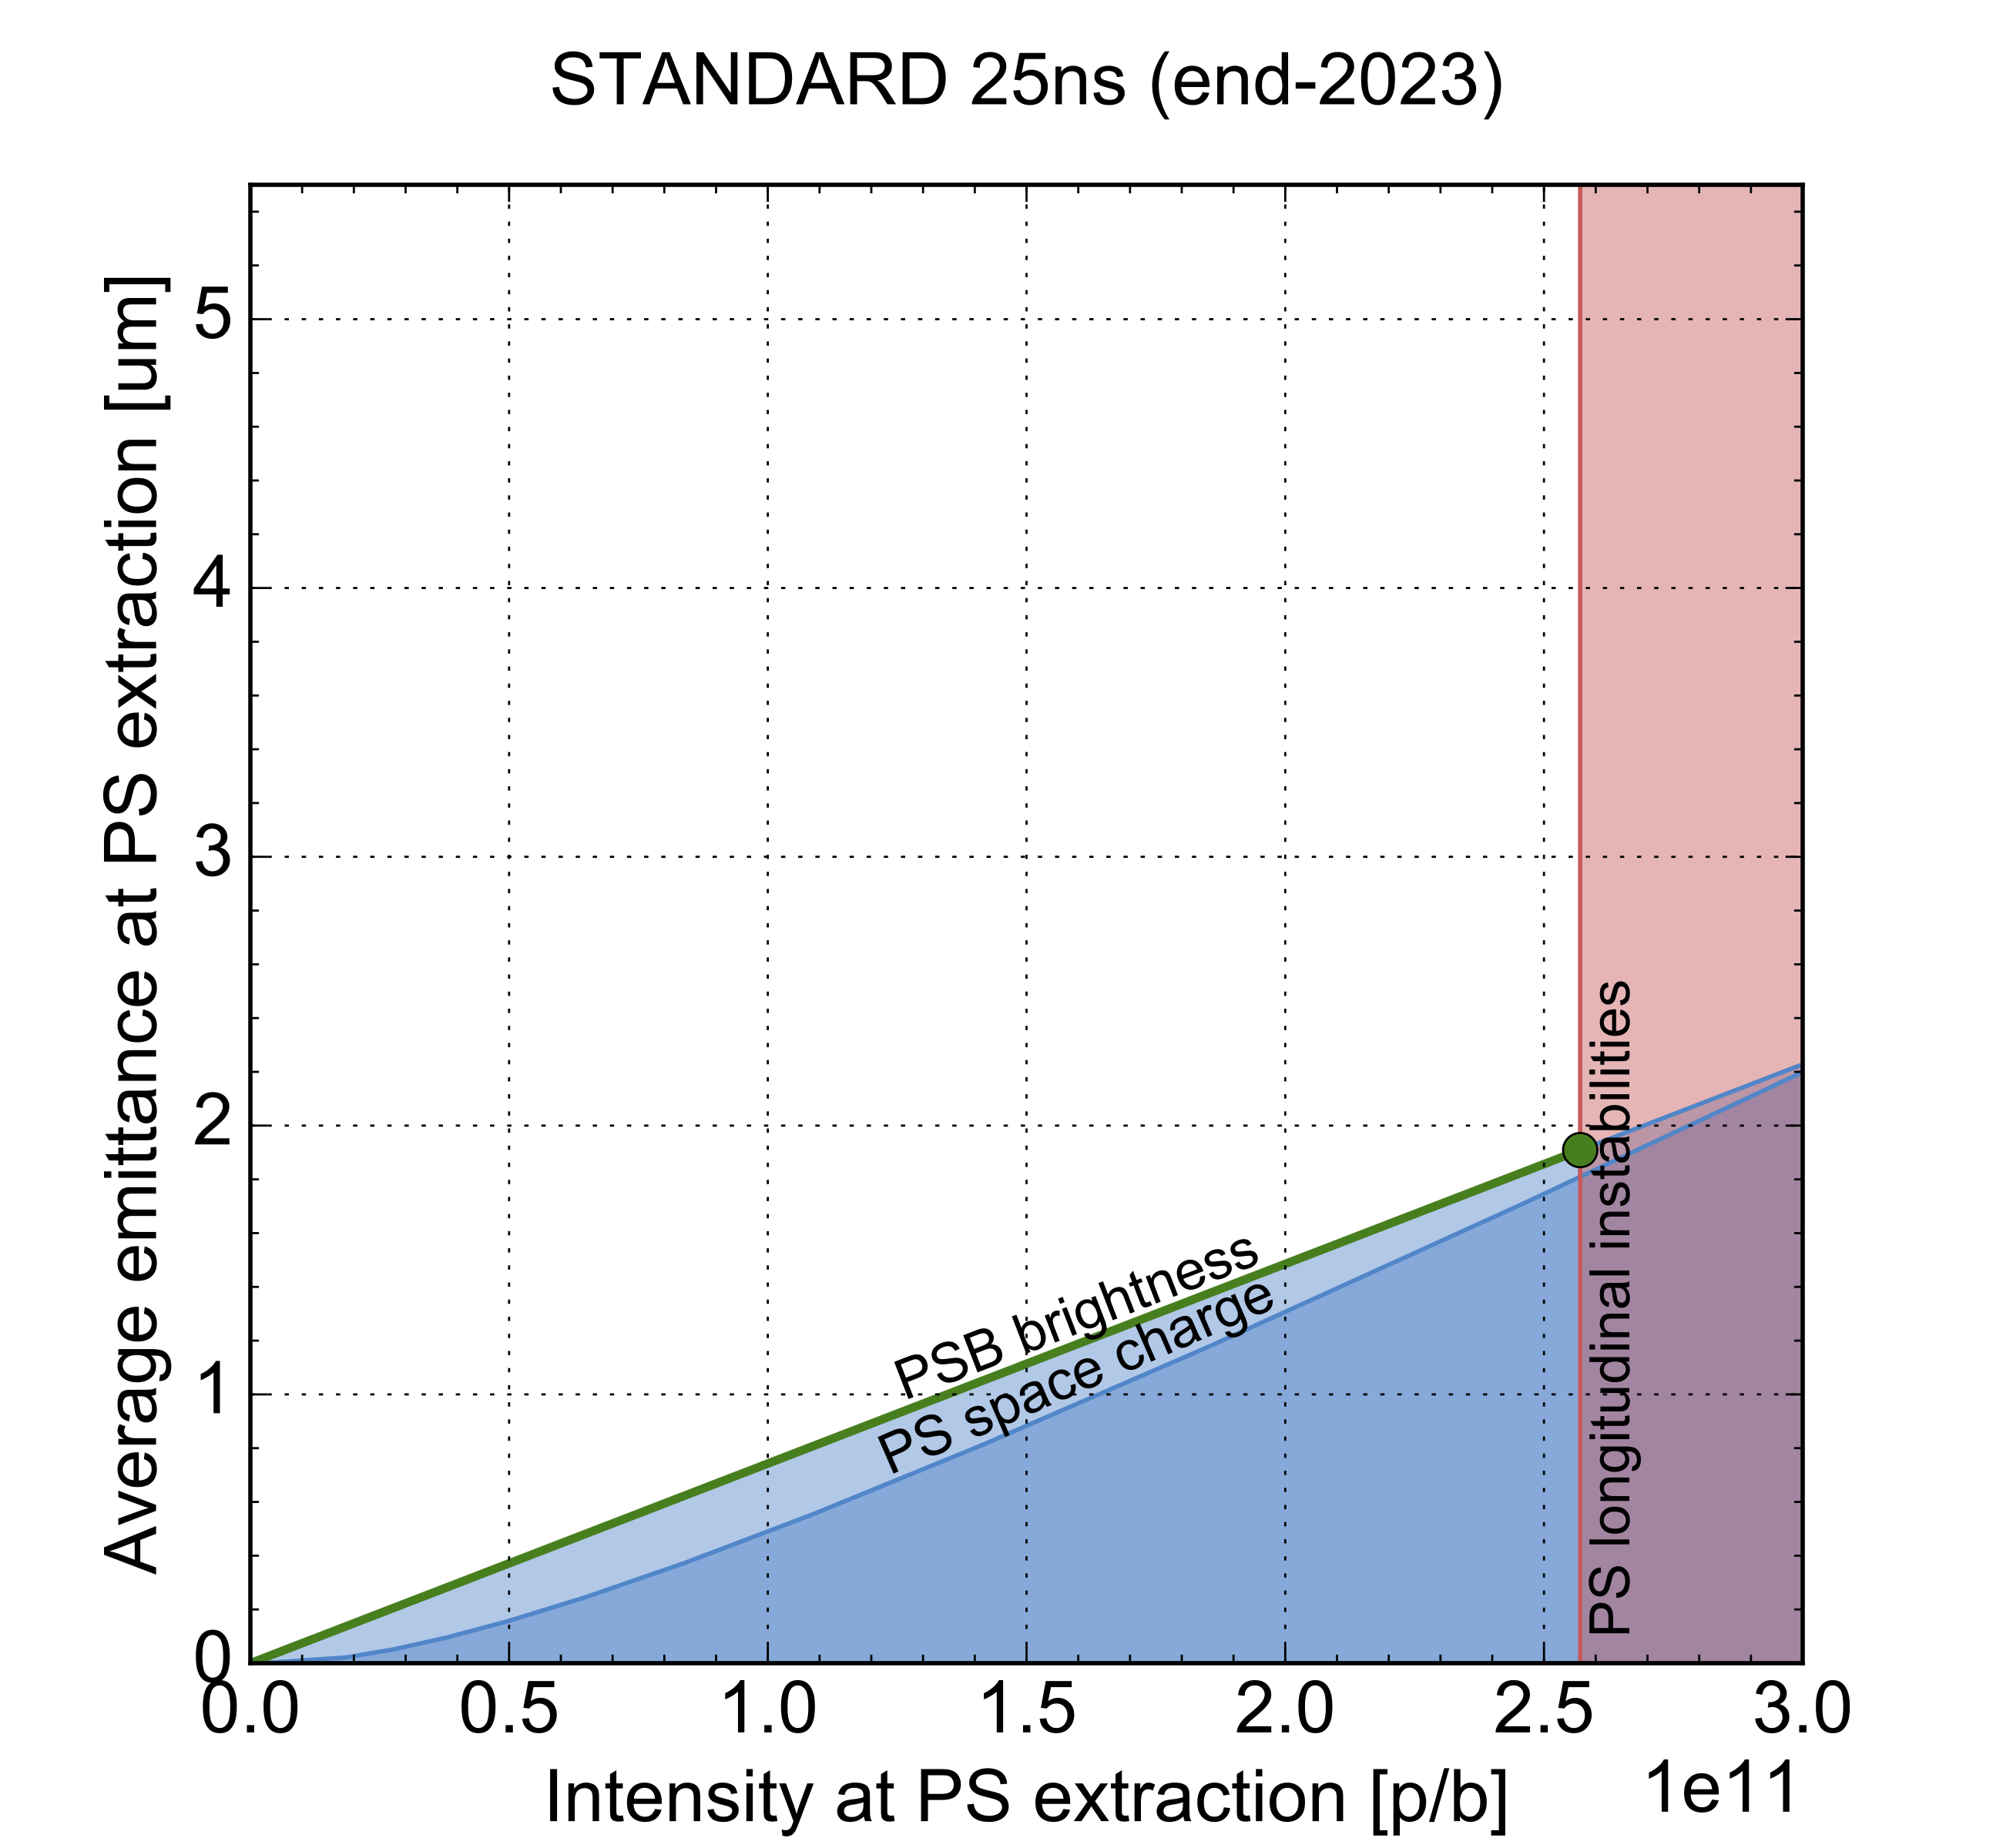
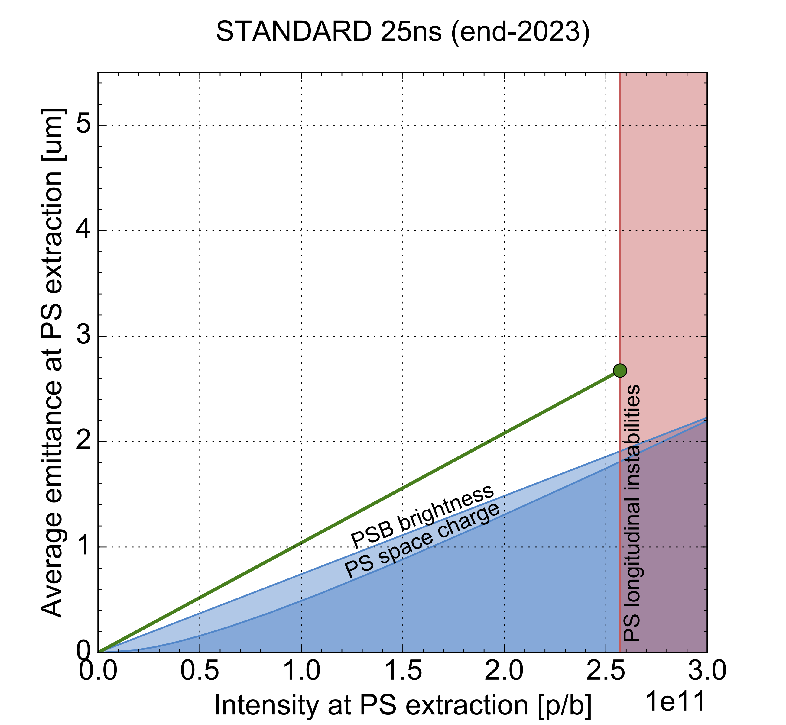
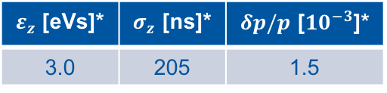
Target performance of the standard beam at the end of 2023
Final step in longitudinal emittance foreseen in 2023
  Longitudinal parameter target at PS injection in 2023
  (= LIU parameters)
LIU performance at PS extraction planned to be reached at the end of 2023
$ε_{z}$ [eVs]* | $σ_{z}$ [ns]* | $δp/p$ [${10}^{−3}$]*
3.0 | 205 | 1.5
LIU performance at PS extraction
* parameter conventions according to EDMS1296306
2022 target brightness

Slide 15
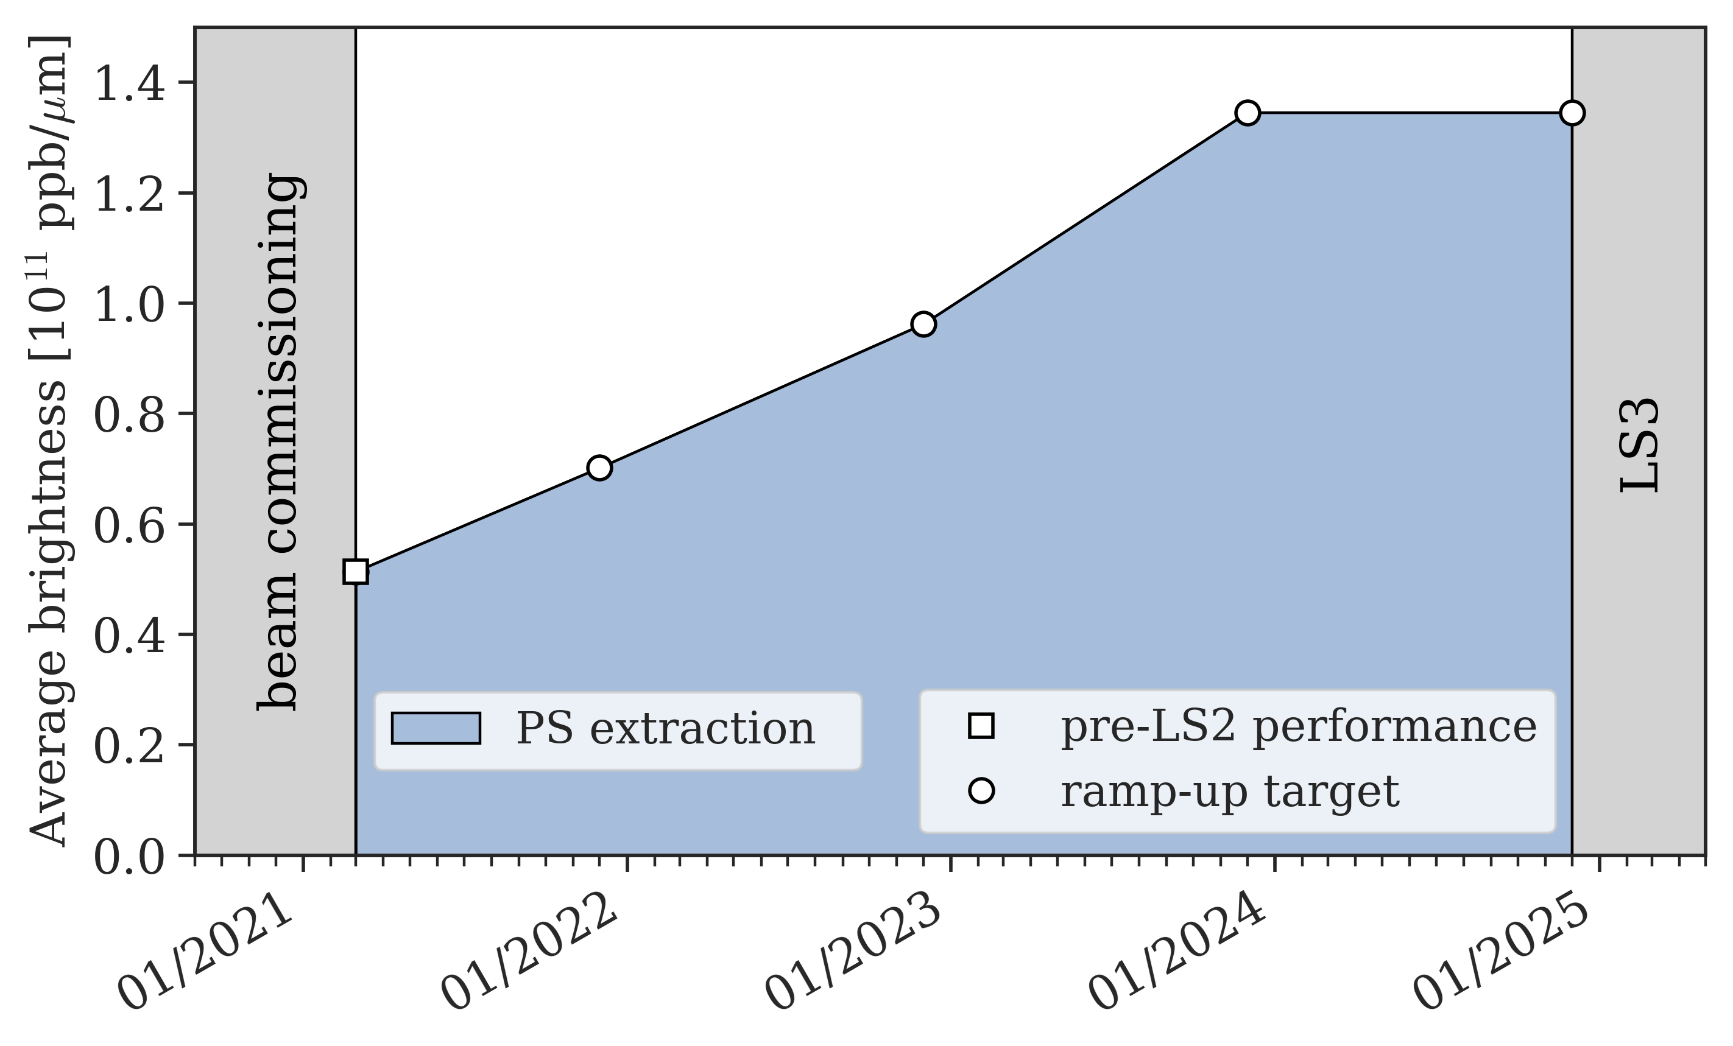
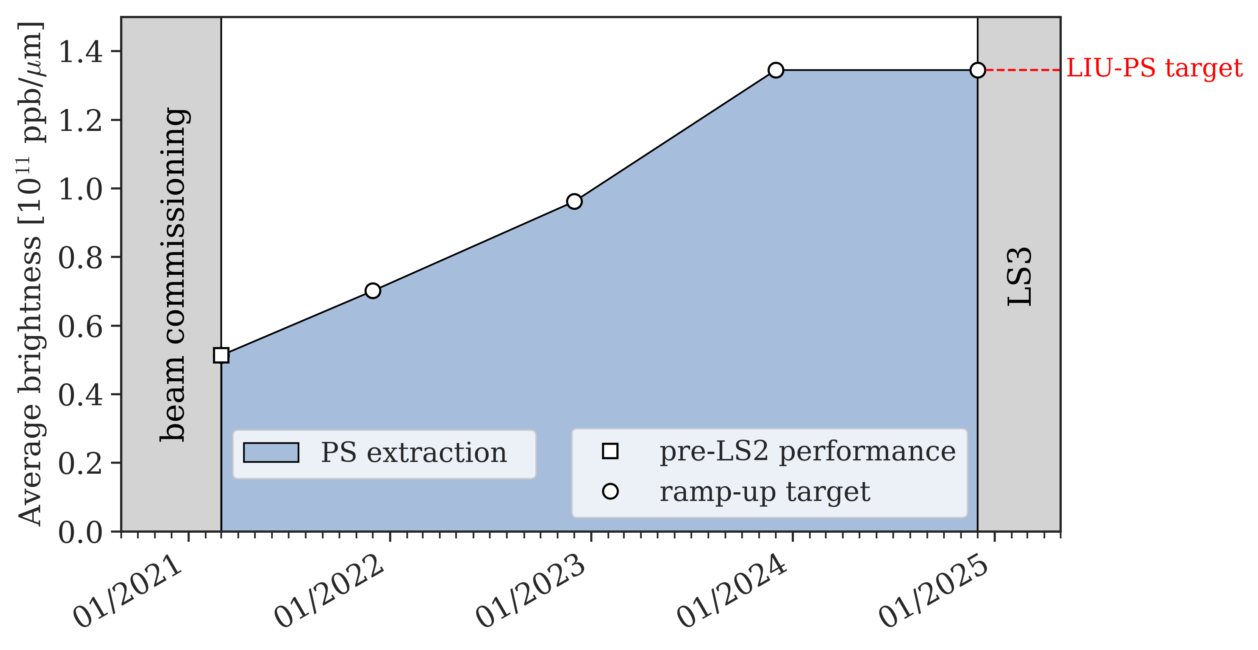
Summary of the brightness ramp-up of the standard beam during Run 3
Brightness ramp-up determined by the evolution of longitudinal parameters at PS injection
  Ramp-up foreseen to gradually occur
  until the end of 2023
LIU beam performance expected to be available at PS extraction at the end of 2023
  SPS performance ramp-up will continue throughout 2024 (see Elena’s talk)

Slide 16
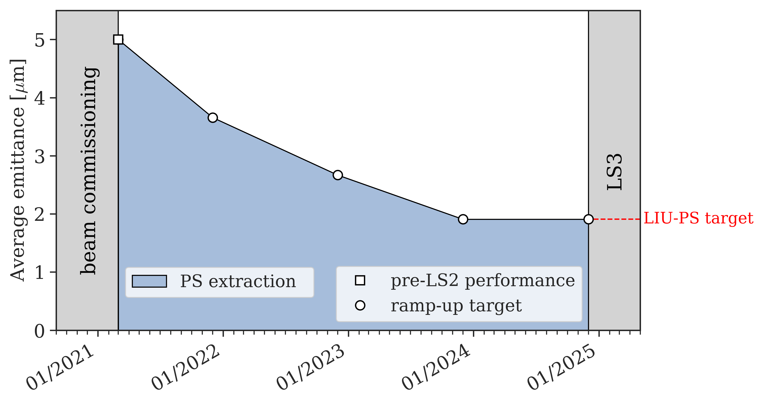
Emittance evolution of the standard beam during Run 3
Transverse emittances will gradually
decrease during the brightness ramp-up
Figure shows the emittance evolution at
PS extraction considering the LIU
intensity target of 2.57 x 10¹¹ ppb

Slide 17
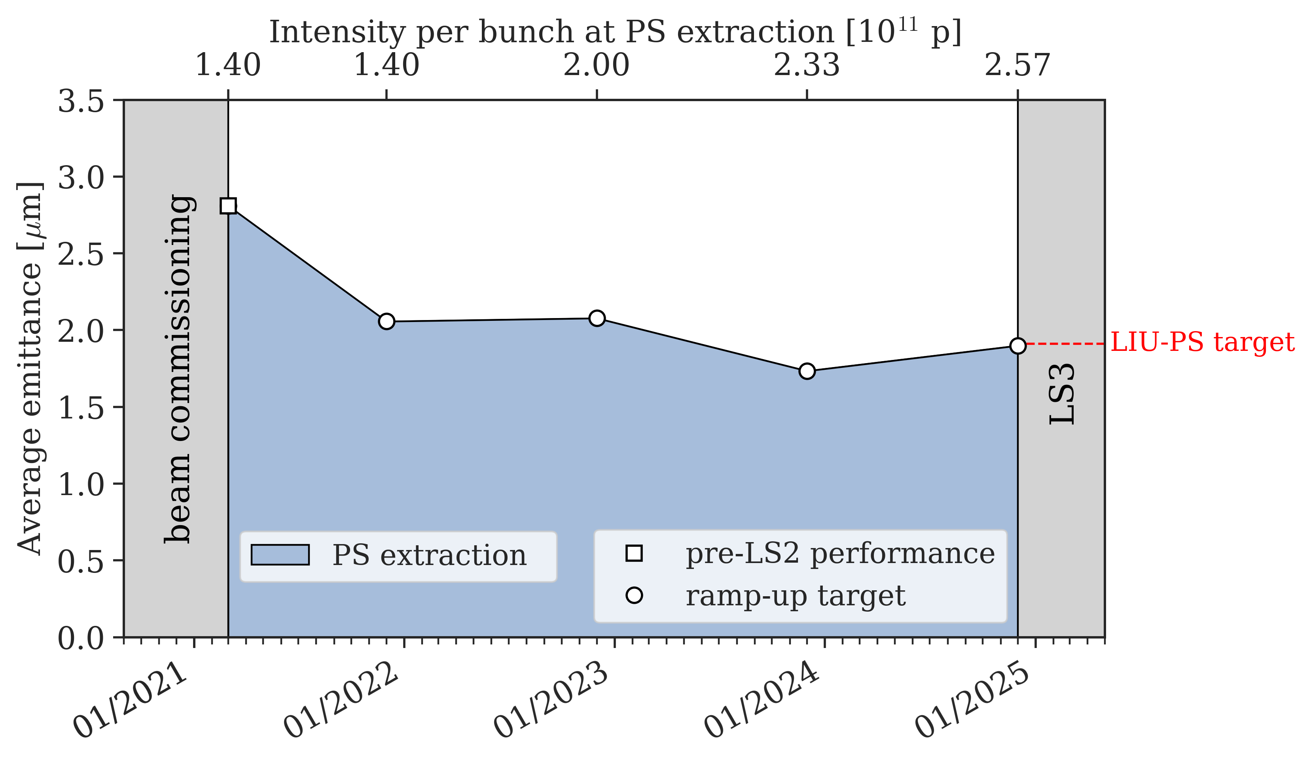
Emittance evolution of the standard beam during Run 3
Transverse emittances will gradually
decrease during the brightness ramp-up
Figure shows the emittance evolution at
PS extraction following the projected
intensity ramp-up of the SPS
The emittance during 2024 is expected
to increase as the last step of the
intensity ramp-up occurs at constant
brightness

Slide 18
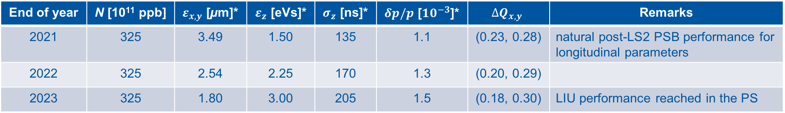
Summary of the projected beam parameter evolution at PS injection during Run 3
Brightness ramp-up of the standard beam during Run 3 determined by the gradual increase of the longitudinal emittance at PS injection
Beams expected to be operationally available according to the table below
  LIU performance at PS extraction planned to be reached at the end of 2023
End of year | N [10¹¹ ppb] | $ε_{x,y}$ [µm]* | $ε_{z}$ [eVs]* | $σ_{z}$ [ns]* | $δp/p$ [${10}^{−3}$]* | $$∆Q_{x,y}$$ | Remarks
2021 | 325 | 3.49 | 1.50 | 135 | 1.1 | (0.23, 0.28) | natural post-LS2 PSB performance for longitudinal parameters
2022 | 325 | 2.54 | 2.25 | 170 | 1.3 | (0.20, 0.29)
2023 | 325 | 1.80 | 3.00 | 205 | 1.5 | (0.18, 0.30) | LIU performance reached in the PS
* parameter conventions according to EDMS1296306

Slide 19
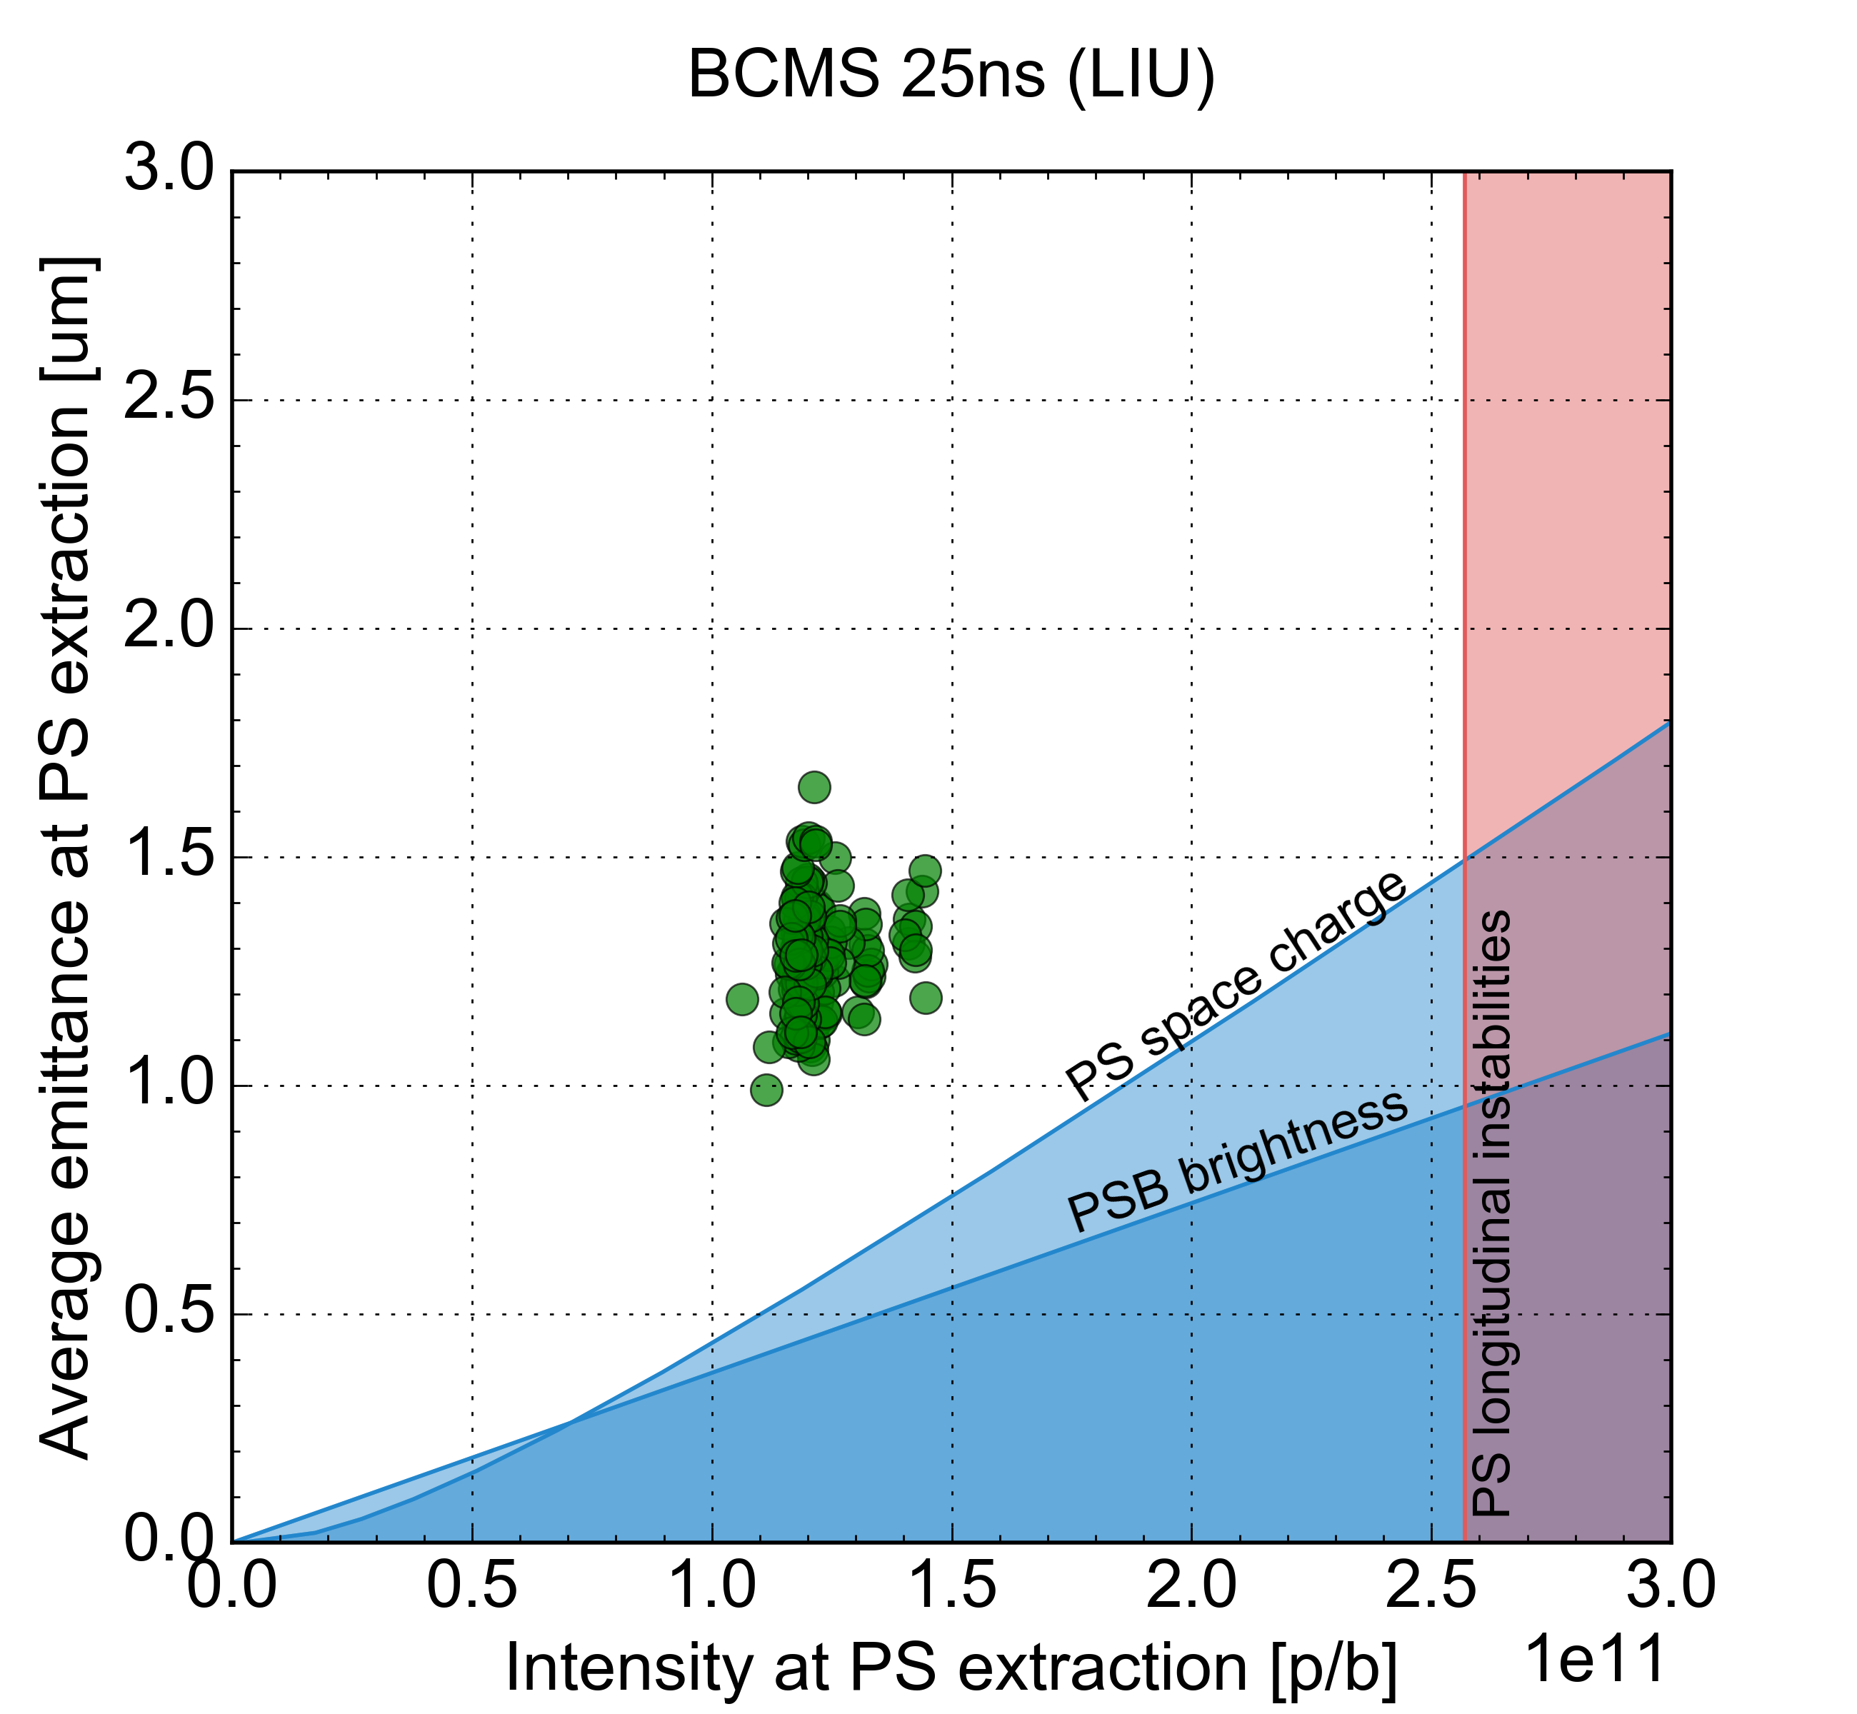
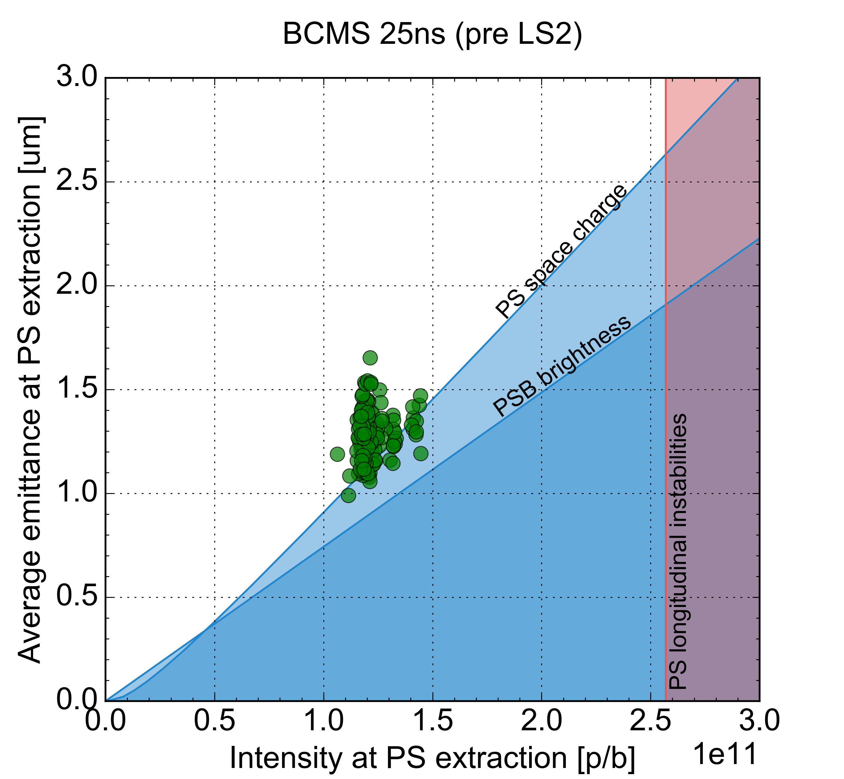
The BCMS beam as operational beam during Run 3
BCMS beam considered as operational LHC beam during Run3
  Based on the report from the Run 3 configuration working group at the 2019 Evian Workshop
BCMS beam production expected to be less critical than the standard beam in the PS
LHC will benefit from increased performance as PS brightness and SPS intensity are ramped up
Operational performance in 2018
minimum PSB emittance (foil hits)

Slide 20
To be included?
  Choice of future injection energy
  Choice of future intermediate plateau energy
  Microwave instabillity at transition for low-emittance ion beams

Slide 21
Conclusions
Two main aspects of the LIU beam performance ramp-up for the standard beam during Run 3
  Intensity ramp-up
  Brightness ramp-up
Brightness ramp-up determined by the evolution of longitudinal parameters at PS injection
LIU beam performance expected to be reached at PS extraction at the end of 2023
  One additional year required to achieve LIU performance at SPS extraction
BCMS beam considered as operational LHC beam during Run 3
  BCMS performance will gradually improve as the performance ramp-up progresses

Slide 22
Backup slides

Slide 23
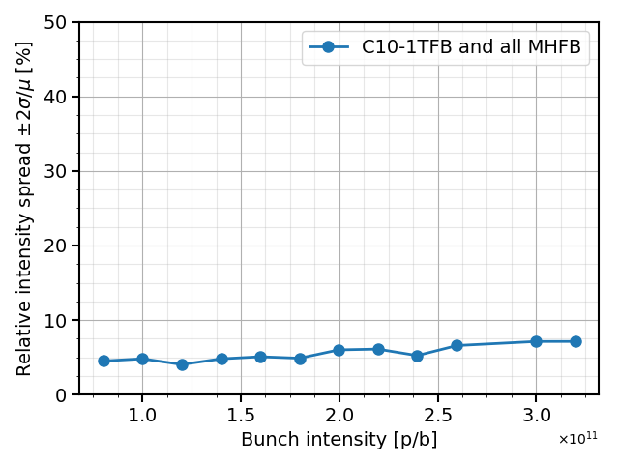
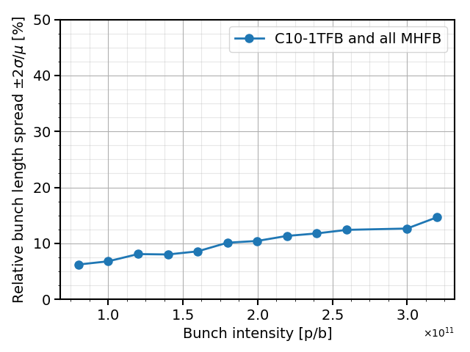
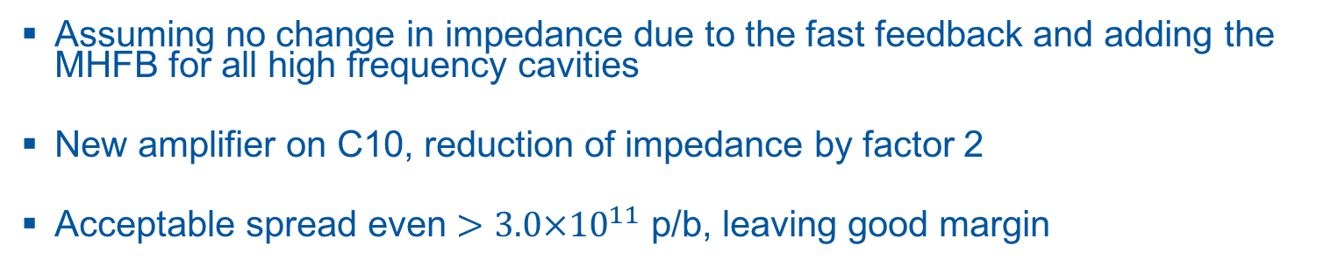
Best achievable double splitting after LS2
Intensity spread
Bunch length spread
Assuming no change in impedance due to the fast feedback and adding the MHFB for all high frequency cavities
New amplifier on C10, reduction of impedance by factor 2
Acceptable spread even $>3.0×{10}^{11}$ p/b, leaving good margin
A. Huschauer

Slide 24
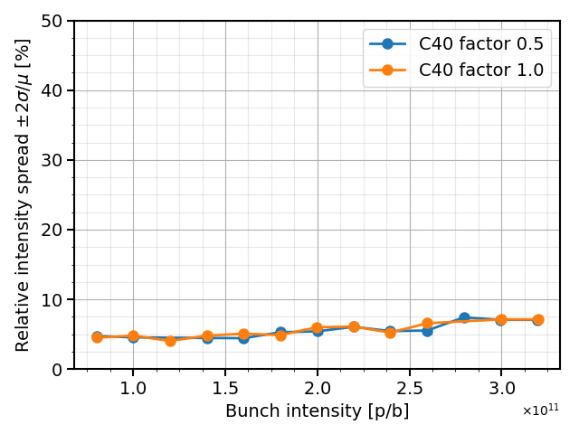
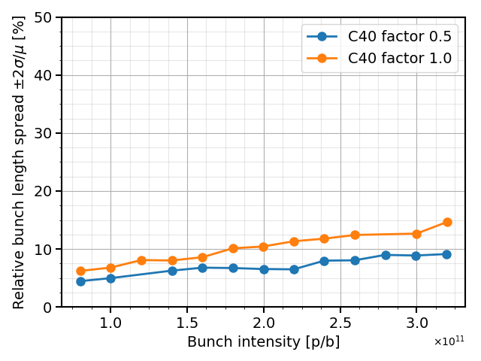
Benefits of improved fast feedback on C40
Intensity spread
Bunch length spread
Improving the fast feedback for the 40 MHz has little influence on the bunch intensity spread but gradually improves the bunch length spread
The optimal phase setting for bunch length and intensity spread is different, further impedance reduction would allow to reduce the need to find a compromise between intensity/length optimization
A. Huschauer

Slide 25
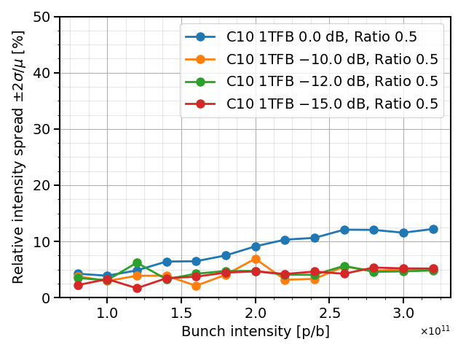
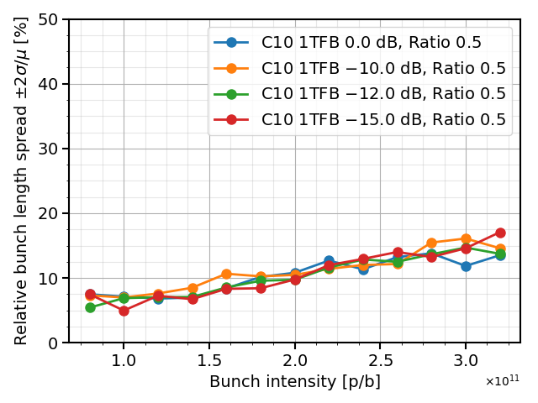
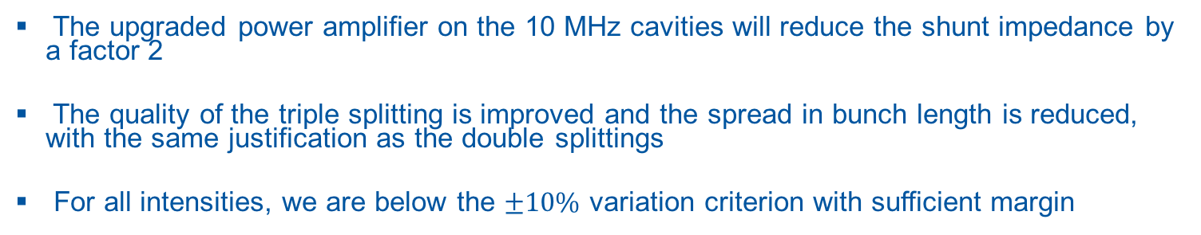
Best achievable triple splitting after LS2
Intensity spread
Bunch length spread
The upgraded power amplifier on the 10 MHz cavities will reduce the shunt impedance by a factor 2
The quality of the triple splitting is improved and the spread in bunch length is reduced, with the same justification as the double splittings
For all intensities, we are below the $±10\%$ variation criterion with sufficient margin
A. Huschauer

Slide 26
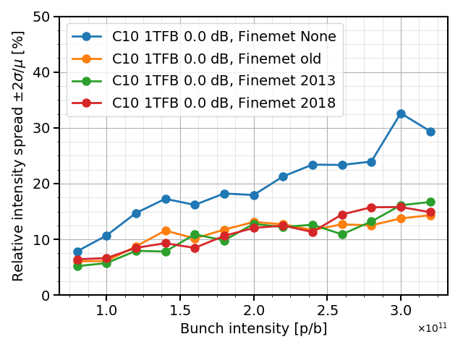
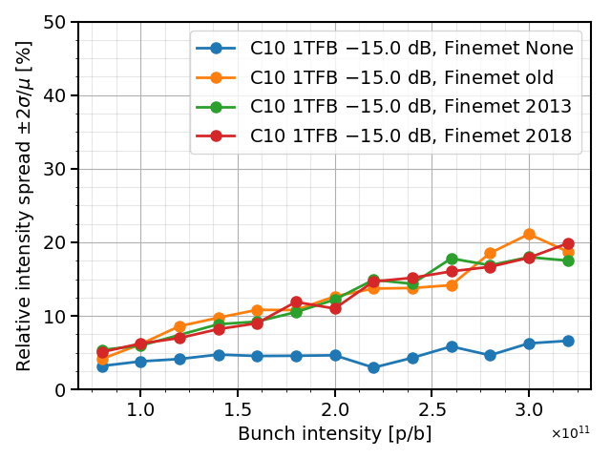
Influence of Finemet model on splittings
Intensity spread, without 1TFB
Intensity spread, with 1 TFB
The different fitting results for the Finemet impedance were included in simulations
The different models for the Finemet impedance have the same influence on the triple splitting
There is something more fundamental than the fitting quality or impedance flatness of the Finemet cavity that affects the triple splitting
NB: simulations done for pre-LS2 C10 impedance
A. Huschauer

Slide 27
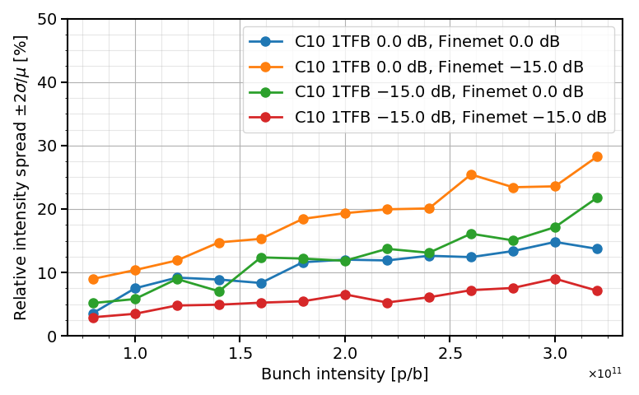
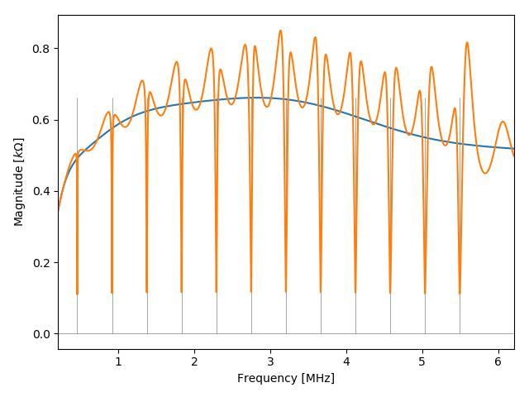
Adding a “MHFB” on the Finemet cavity
Finemet impedance with “MHFB” (resonator filters)
The parameters for the “Multi-Harmonic Feedback” model on the Finemet cavity are based on results from 2014 tests:
  -15 dB impedance reduction
  Bandwidth of 8 kHZ at +3 dB from minimum
  Notches on h=1 to h=12
Enabling both 1TFB on C10 cavities and MHFB on Finemet cavity greatly improves the quality of the triple splitting
A. Huschauer

Slide 28
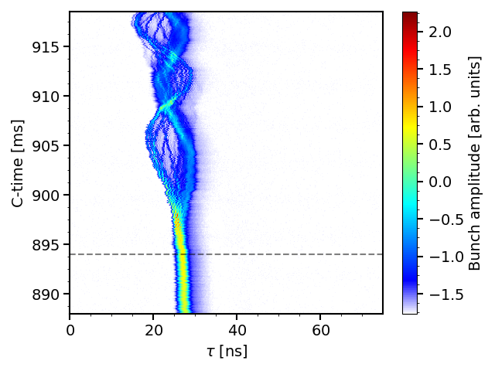
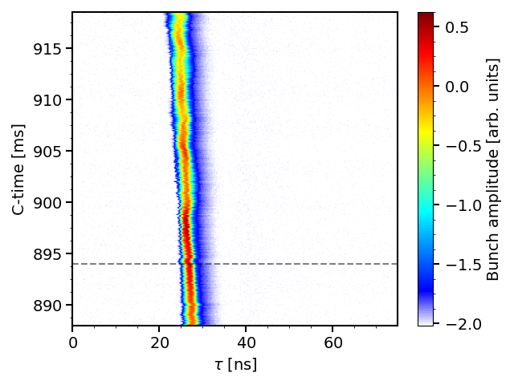
Microwave instability at transition crossing for ion beams
BUP 0x3kV
BUP 3x3kV
Transition timing
Microwave instability right after transition is responsible for uncontrolled emittance blow-up and generation of tails -> more intensity in satellite bunches
Occurs with the higher bunch intensity with the 3 bunches beam (same total intensity as the 4 bunches beam), cured with controlled emittance blow-up (BUP) (also measured with Xenon https://indico.cern.ch/event/710562/)
Study useful for impedance source identification and general benchmark of transition crossing simulations (also beneficial for p+ beams)
A. Huschauer

Slide 29
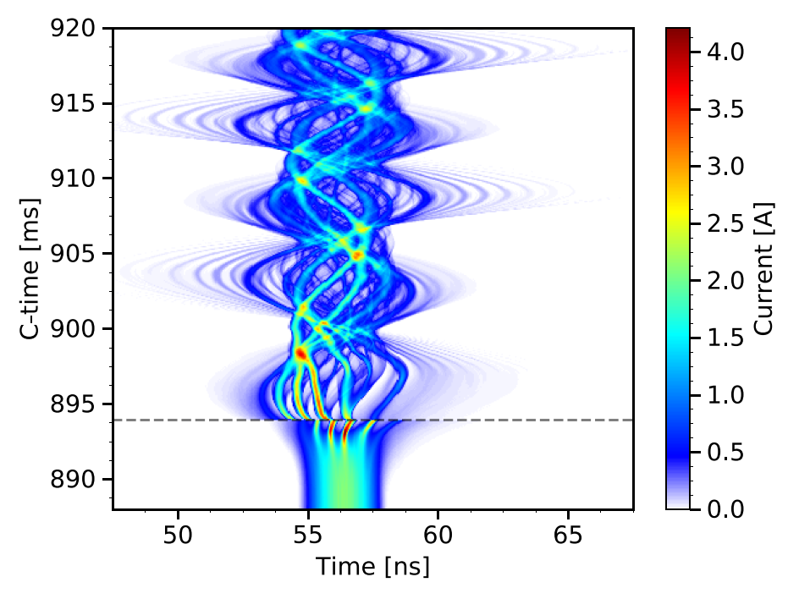
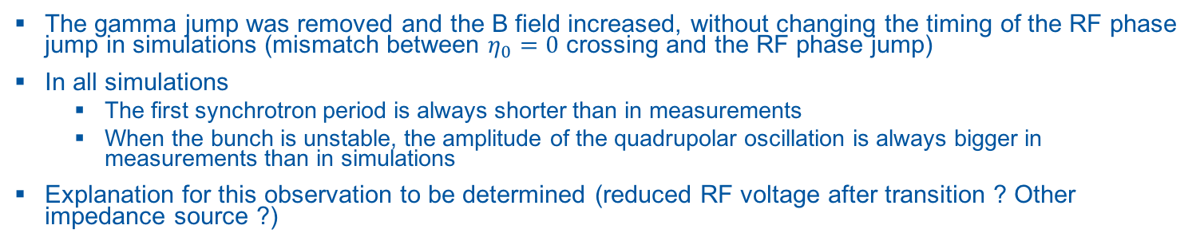
Microwave instability at transition crossing - simulation studies
Simulation
Measurement
The gamma jump was removed and the B field increased, without changing the timing of the RF phase jump in simulations (mismatch between $η_{0}=0$ crossing and the RF phase jump)
In all simulations
  The first synchrotron period is always shorter than in measurements
  When the bunch is unstable, the amplitude of the quadrupolar oscillation is always bigger in measurements than in simulations
Explanation for this observation to be determined (reduced RF voltage after transition ? Other impedance source ?)
A. Huschauer

