Slide 1
EXSO Meeting
6th February 2020
O. Beltramello

Slide 2
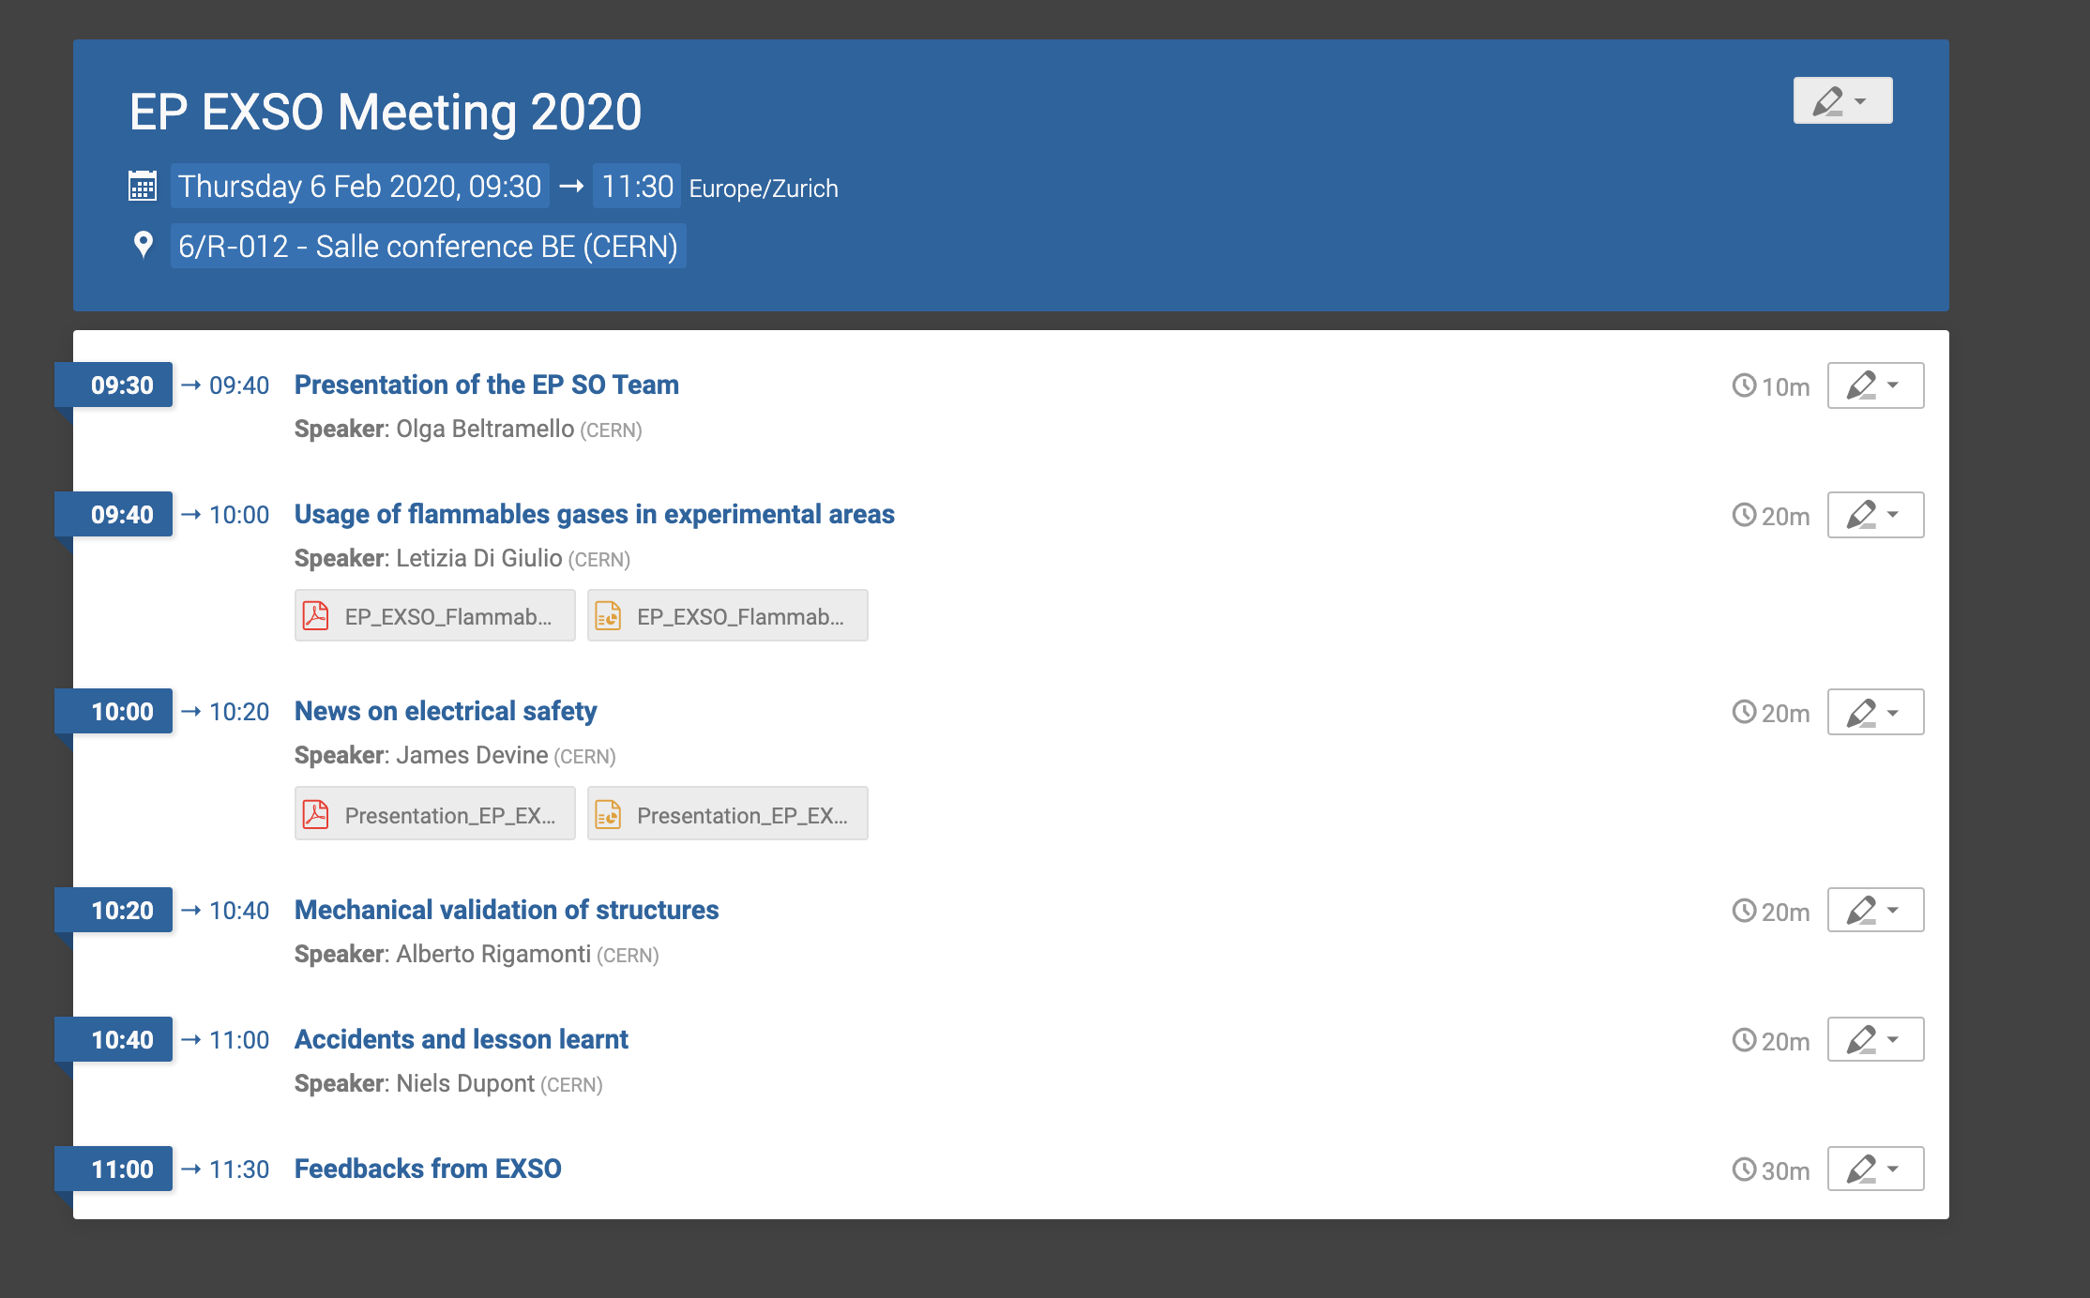
Agenda
We try to give the essential news
… but also we need your feedback, this is essential for us (now and all year long)

Slide 3






The EP SO team … some new arrivals
Evelyne Dho Niels Dupont Letizia di Giulio
(Buildings, TSOs, ADSO COMPASS, (DDSO, Accidents) (FGSO, Accidents, ISOLDE,
Cloud, NA62, CAST) ADSO ISOLDE, EHN1, Neutrino Platform)
Alberto Rigamonti James Devine Serge Ferry
(Mechanics, ADSO COMPASS, (ESO) (EP-DT Safety link person)
AD Hall, TSO 107)
Olga Beltramello
(DSO, Mechanics)

Slide 4
THANK YOU !
For your motivation
For your help to keep our experiments safe and our personnel safe
For your assistance and for your feedback …
We should be informed of all safety matters in your experiment
Don’t hesitate to contact us for all safety matters, we are here to help you,

