Slide 2


Structural safety guidelines EP-HSE approach
EP EXSO meeting
A.Rigamonti, O.Beltramello, M. Andreini

Slide 3
Why a guideline for structures ?
At the moment, there is no CERN specific safety guideline for structural analysis of detectors components and equipment.
Need to uniform the required documentation and clarify requirements (norms, regulations, standards…).
Provide a guideline on the structural modelling and analysis methods.
The guideline is aimed to any structure and/or structural component for equipment and detectors to be installed in EP Experiments.
Based on the technical note for structures and structural components agreed between CERN and Fermilab for DUNE/LBNF (EDMS 2172998).

Slide 4
Three main documents
Preliminary Structural Design Report
Structural Design Calculation Notes
Structural Safety File

Slide 5
Preliminary Structural Design Report (PSDR)
Name of the author/s and qualifications
Scope and objective
List of the design and fabrication/ assembly regulation, norms and standards
Identification of the load cases that occur during the transportation, installation, and operation.
Design and execution assumptions (e.g class of consequences, execution class, etc.)
Analysis methods for the individual models considering its integration into the global models.
Serviceability requirements
List and brief description of structural tests (if necessary) to validate the structural safety file (SSF)
Approval by EP SO, with assistance of HSE

Slide 6
Structural design calculation notes
Standards and regulations (consistent with the PSDR)
Mass budget
  Level of confidence on the estimation and the contingency applied on the mass.
  Configuration assumptions
Load cases and combinations
  Self-weights, dead loads, thermal loads, live loads, moving loads, environmental loads, imposed loads, construction loads, seismic loads, etc.
  For all phases of the lifetime
  Partial safety factors for each load and load combination.

Slide 7


(Seismic loads)

Slide 8
Structural design calculation notes
Materials
  Properties
  Partial safety factors
  Referenced to drawings
Structural modelling
  Complex models needs to be performed through Finite Element Methods
  Material models (linear, non-linear, partial safety factors…)
  Finite element discretization (Element type, sizing, etc.)
  Internal constraints and external restraints
  Load conditions (Type, position, magnitude, partial safety factors, direction, etc.)
  Description of the joint connections

Slide 9
Structural design calculation notes
Structural analyses shall be presented for all the considered load cases along the structure lifetime.
  The type of analysis (linear or non-linear, with or without imperfections, transient or static) shall be mentioned and justified.
  For all the considered load cases.
  Diagrams and/or maps of the internal forces/moments, stresses, deformations and detailed numerical values where necessary.

Slide 10
Structural design calculation notes
Safety verifications
  Verification of the structural members (for example beams and shells)
  Joint-connections verifications
  Base connections’ assessment
  Distribution of stresses, reaction forces and moments, deflections shall be used to mark out the critical points
  Summarize the minimum safety margins for the most critical elements, joint connections and lifting/handling points.
Serviceability verifications

Slide 11
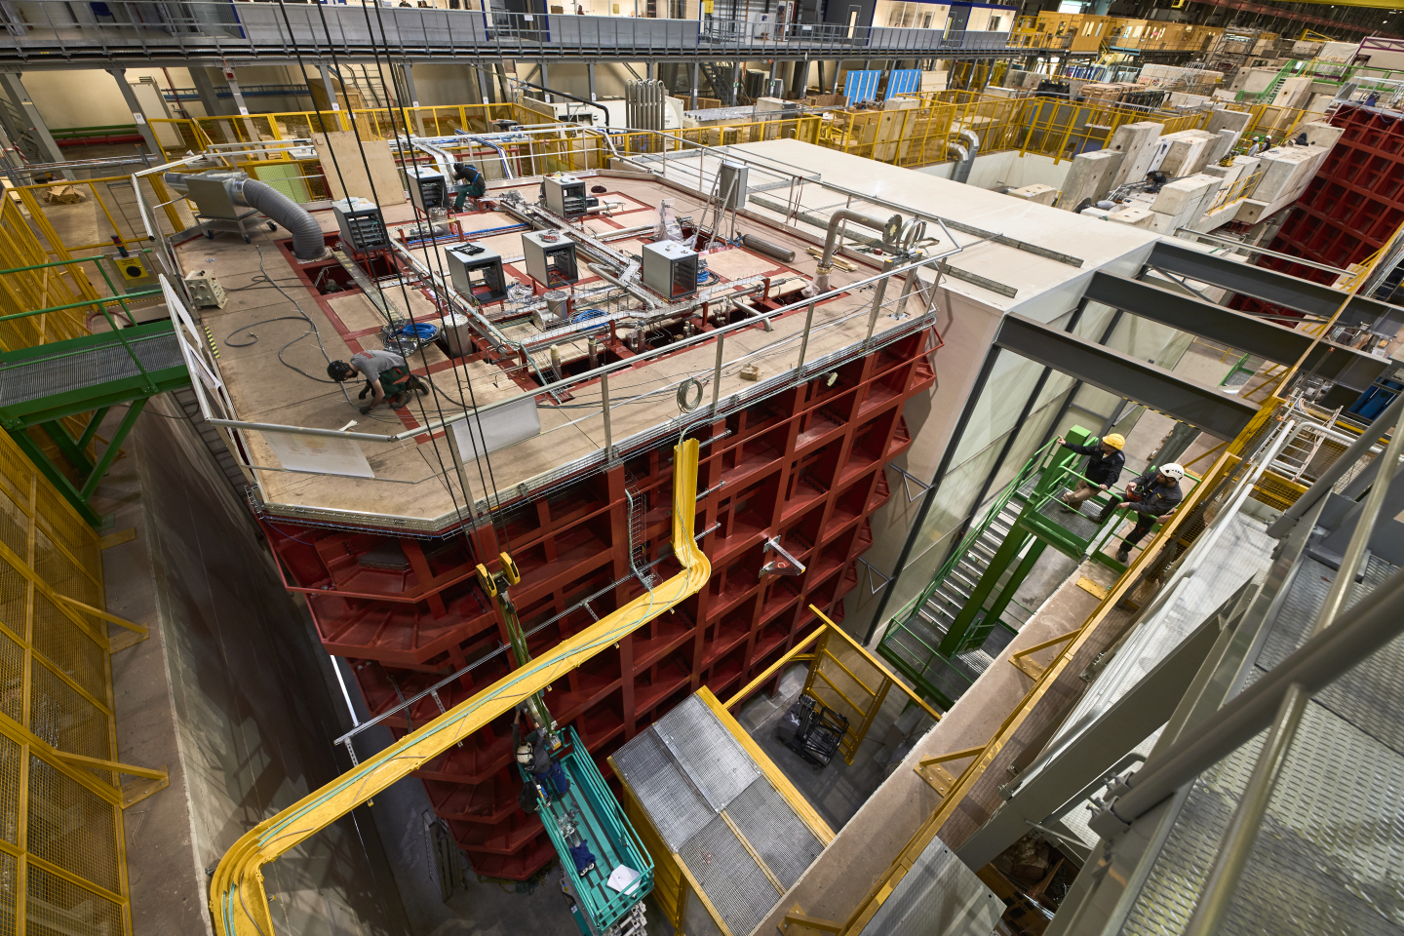
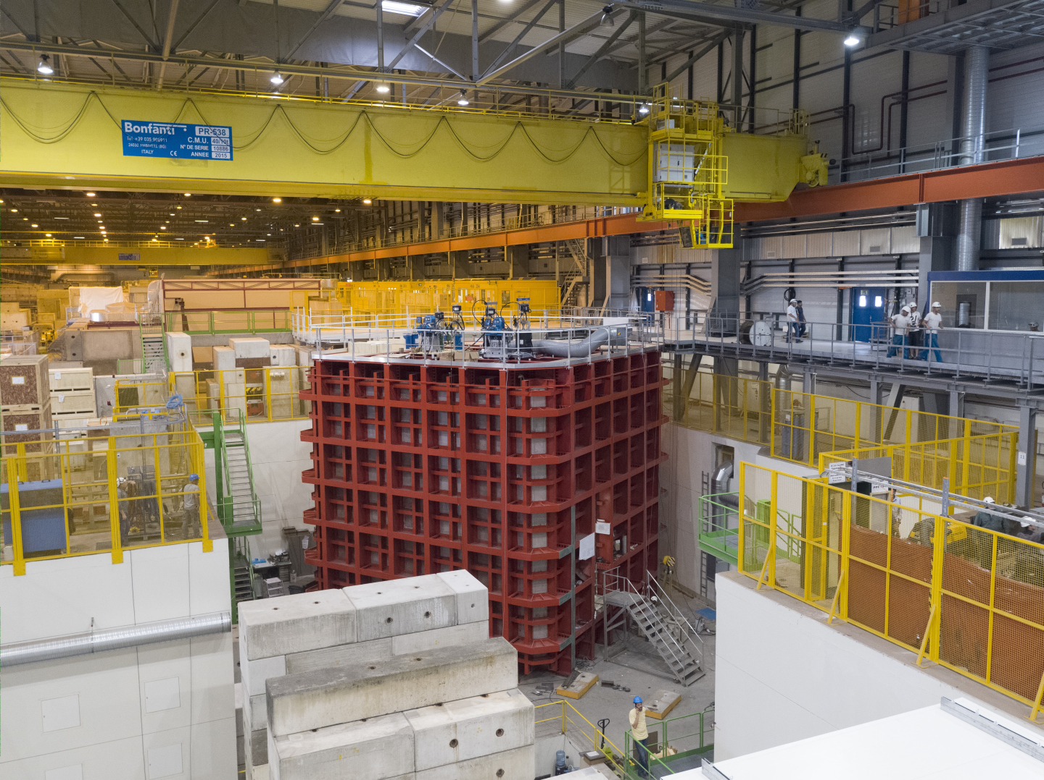
Example (static) : Neutrino platform

Slide 12
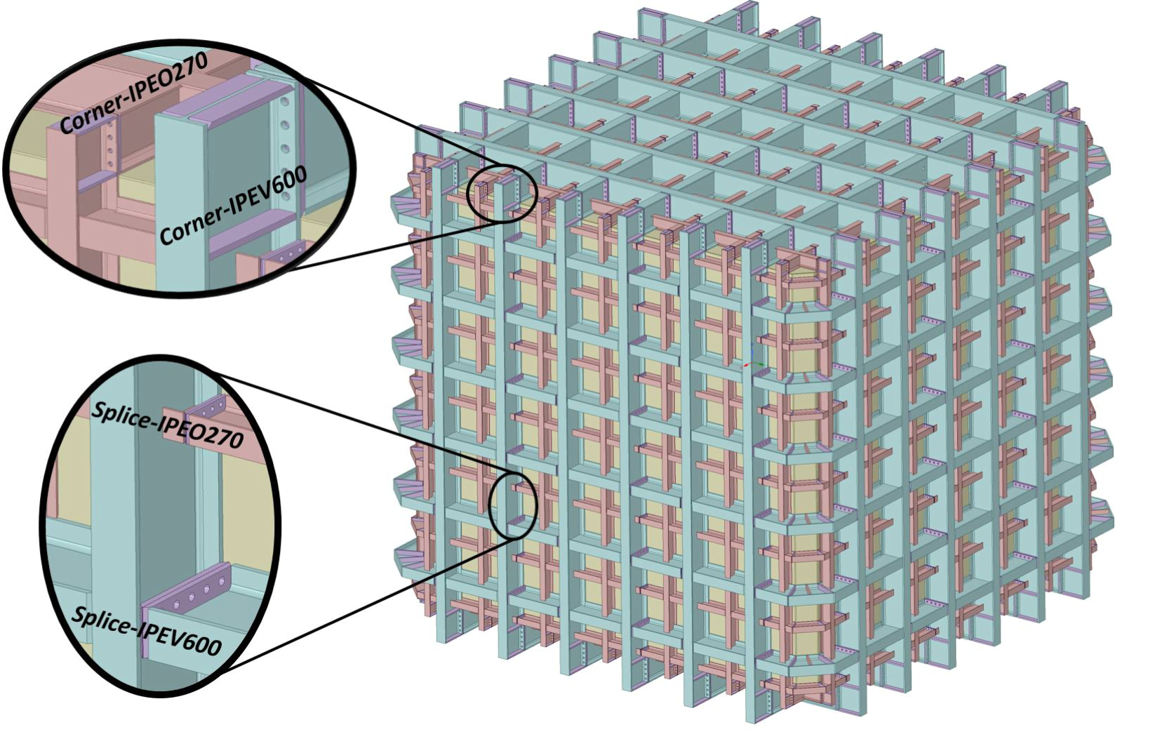
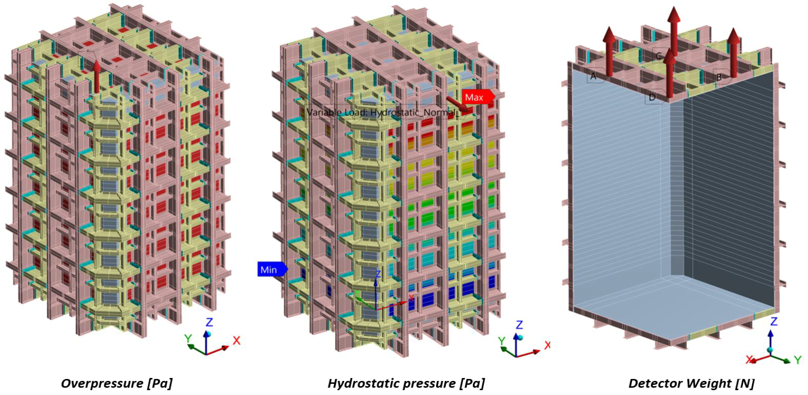
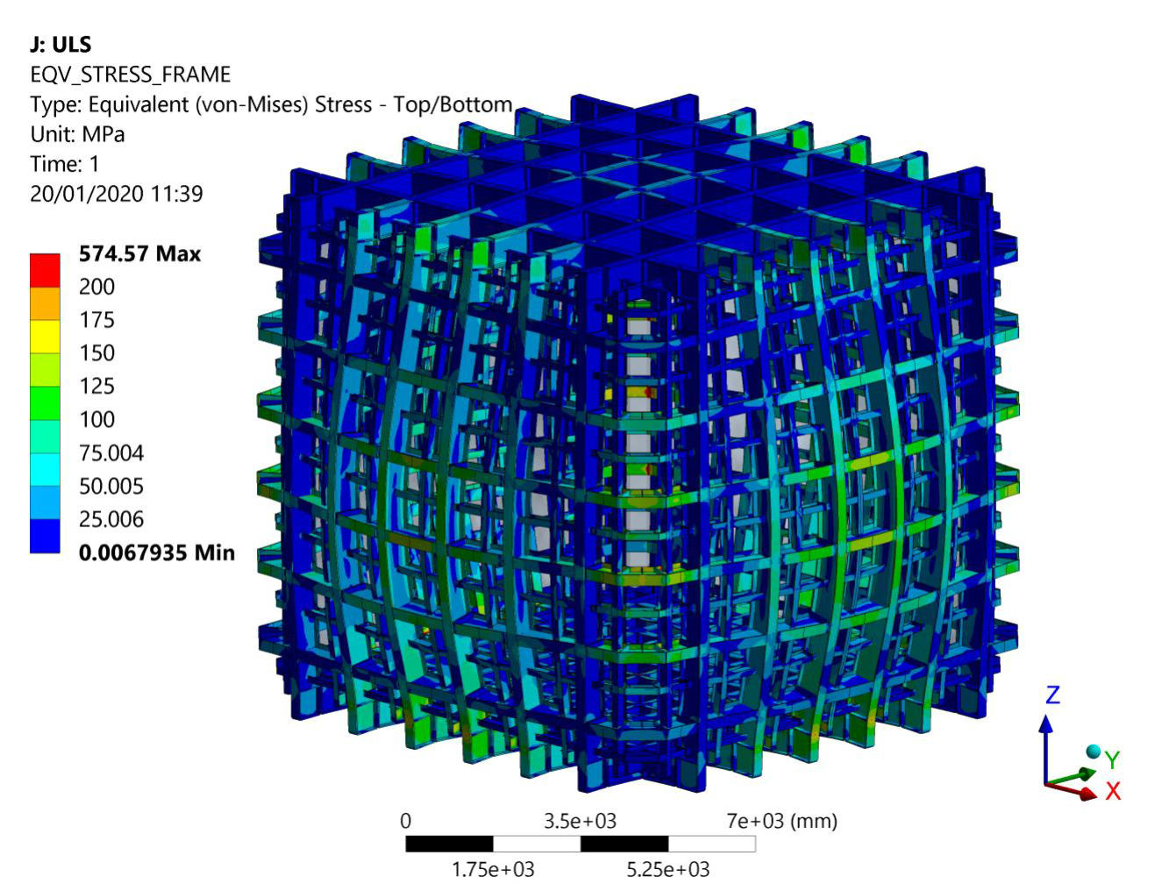
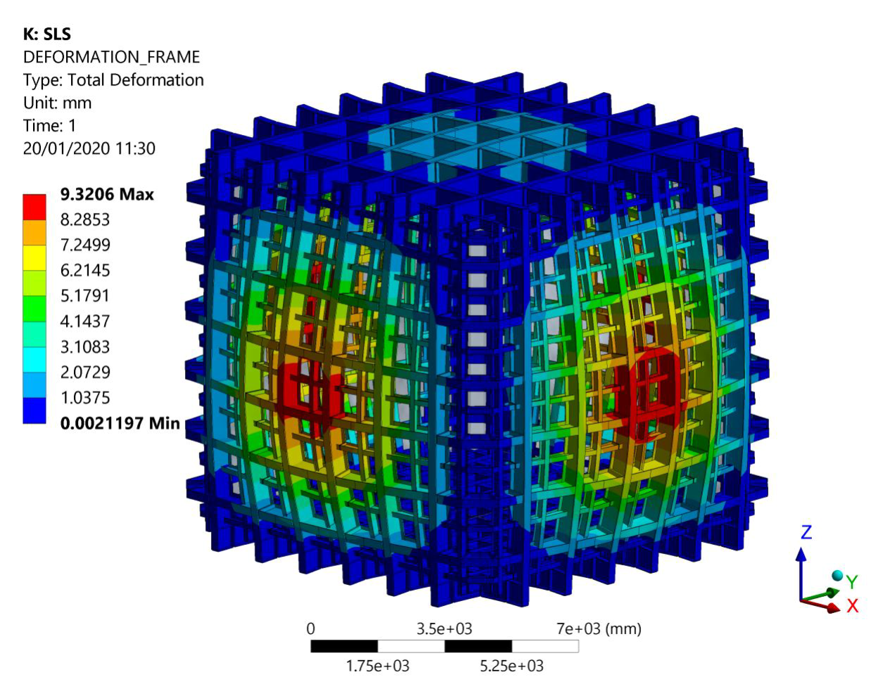
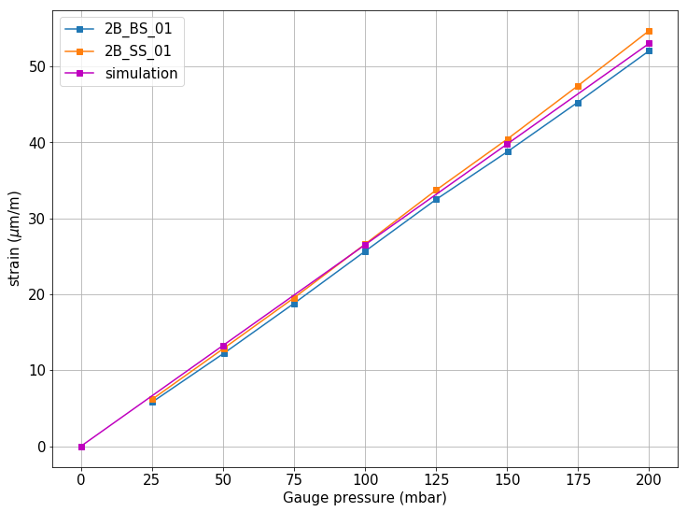
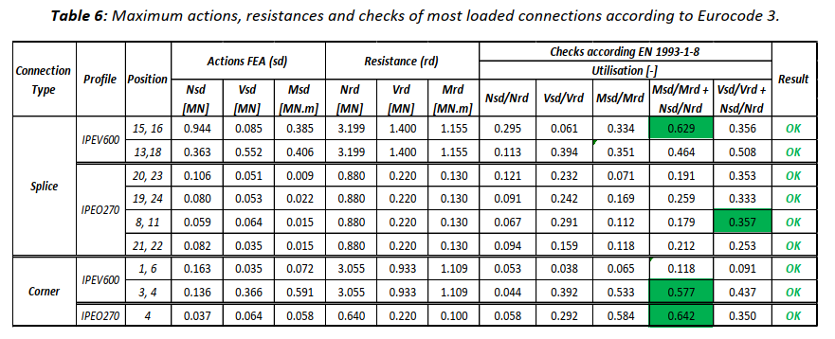
Example (Static) : Neutrino platform
EN 1993 Eurocode 3 – Design of steel structures
EN 1993-1-8 Eurocode 3 – Design of steel structures – Design of joints
EN 1993-1-4 Eurocode 3 – Design of steel structures – Part 1-4: General rules-Supplementary rules for stainless steel
…

Slide 13
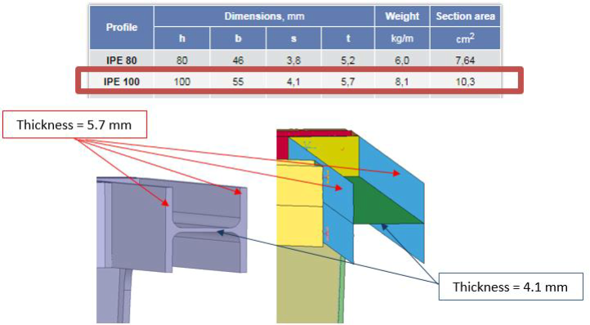
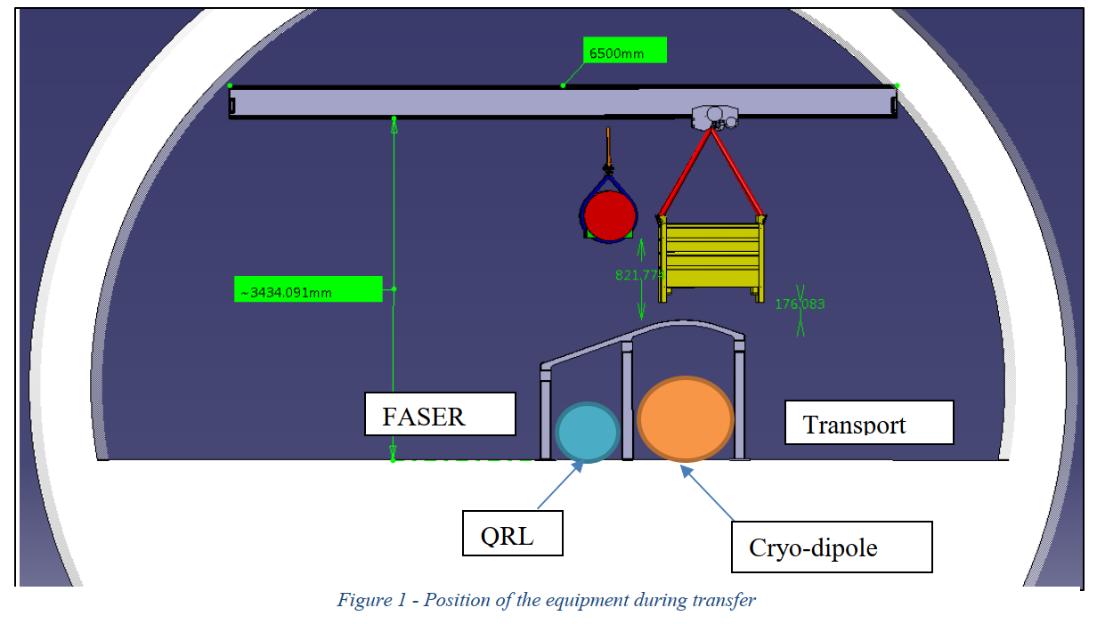
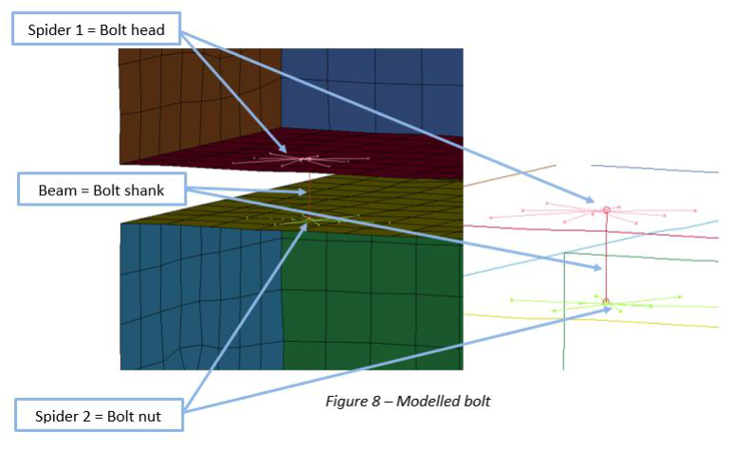
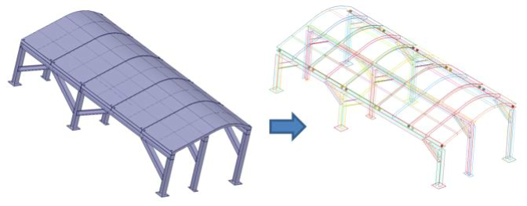
Example (Dynamic) : QRL protection

Slide 14
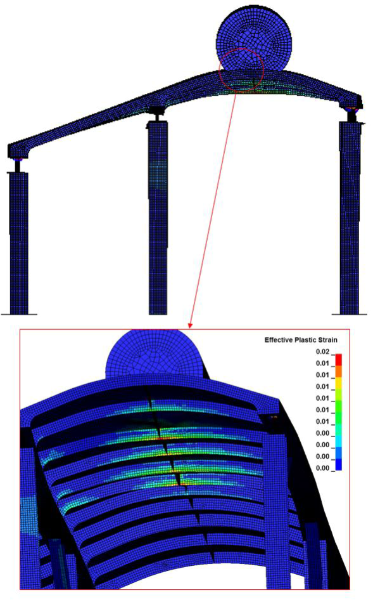
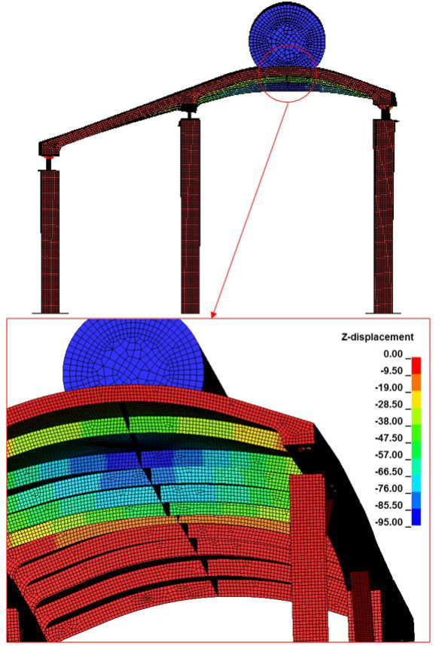
Example (Dynamic) : QRL protection
EN 1993-1-8: Eurocode 3: design of steel structures – Design of joints.
EN 10025-2: Hot rolled products of structural steels.

Slide 15
Structural safety file
The PSDR
The technical 2D drawings and geometrical 3D models
The transportation, the installation and the operation technical specifications.
The structural design calculation notes (SDCN)
The required QA/QC documentation
The eventual testing documentation on structures and structural components of the equipment.
The records of final in situ equipment inspections before commissioning or operation.
All recommendations from the safety reviews related to the equipment together with the follow up actions.
All the documentation related to the acceptance or recommendations from the EP safety office and HSE unit (e.g HSE safety validation forms etc.)
Any PE-licensed engineer signed-off documents for the experiment components required by external authorities

Slide 16
Structural safety file
For any information or question about structures (and mechanical safety in general), please contact:
Me – Alberto Rigamonti
DSO – Olga Beltramello
The EP Safety Office
HSE Unit Expert – Marco Andreini
Thank you! Questions?

